Slide 1
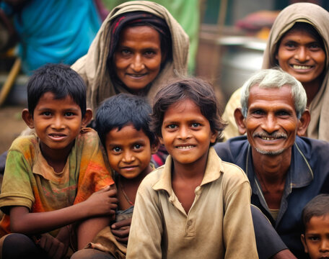
Community Work Course
CODE: FCFO0301
Esha Tandon (2023UEE3631) (EE-2)

Slide 2
Helpless Women in India The Plight of Helpless Women in India
Violence and Abuse:
30% of Indian women aged 15-49 have experienced domestic violence (NFHS-5, 2019-2021).
Widows:
Over 42 million widows in India (Census 2011), many facing abandonment and financial insecurity.
Trafficking:
Women constitute 40% of all trafficking victims in India (NHRC Report).
Unemployment:
Only 19.2% of Indian women participated in the labor force in 2021 (World Bank).
Key Challenges:
Lack of education and awareness.
Limited access to healthcare and financial independence.
Deep-rooted gender inequality and societal stigma.
Call to Action:
Promote education, strengthen laws, and create support systems for economic and social empowerment of women.

Slide 3
Helpless Children in India The Challenges Faced by Helpless Children in India
Child Labor:
10.1 million children engaged in labor (Census 2011).
Orphans:
An estimated 30 million orphans in India, many facing neglect and lack of basic needs (UNICEF).
Malnutrition:
35.5% of children under five are stunted (NFHS-5, 2019-2021).
Street Children:
Around 11 million children live on the streets, vulnerable to abuse and exploitation.
Key Challenges:
Lack of access to education and healthcare.
Exploitation in child labor and trafficking.
Psychological trauma from abandonment and abuse.
Call to Action:
Strengthen child welfare programs, ensure education for all, and provide a nurturing environment to build their future.

Slide 4

Freedom Welfare Foundation CIN: U74999UP2017NPL093083
Founded by Mr. Rohit Saxena after the tragic loss of his wife, the Freedom Welfare Foundation is dedicated to empowering women, uplifting children, and supporting families. Operating from Canada, Mr. Saxena ensures the foundation remains a beacon of hope.
Key Focus Areas:
-->Women Empowerment
-->Child Welfare
-->Family Services
-->Empowered 5,000+ women with skills and financial aid.
-->Reached 10,000+ children with joy and resources.
-->Supported 2,000 families to rebuild relationships and access resources.
Vision:
-->To create a safer, more equitable society where women, children, and
families thrive together.

Slide 5
How Did We Volunteer?
Direct Engagement:
Met homeless children, distressed women, and single mothers in vulnerable areas, building trust through personal visits.
Supporting Single Mothers:
Guided them on acquiring modern skills and finding employment opportunities.
Resource Distribution:
Provided food to over 150 women and children.
Distributed pamphlets on government schemes for education, healthcare, and housing.
Child Welfare Activities:
Organized play sessions and joy events to uplift underprivileged children emotionally and mentally.
Overcoming Challenges:
Built trust despite initial hesitance.
Addressed emotional and resource-related challenges with teamwork and collaboration.
Impact: Empowered individuals with tools, knowledge, and hope for a better future.

