Slide 1
STOCK MARKET DATABASE
Name: Harsh Parmar
SAP ID: 45207210056
ROLL No. : A034

Slide 2
01
Entity-Realtionship Diagram
An entity–relationship model describes interrelated things of interest in a specific domain of knowledge.
02
Schema
It is a collection of database objects associated with a database.
Database Diagram
03
A schema diagram is a diagram which contains entities and the attributes that will define that schema.
04
SQL Tables using DDL
Data Definition Language is a syntax for creating and modifying database objects such as tables, indices, and users.
05
Database
A structured set of data held in a computer, especially one that is accessible in various ways.

Slide 3
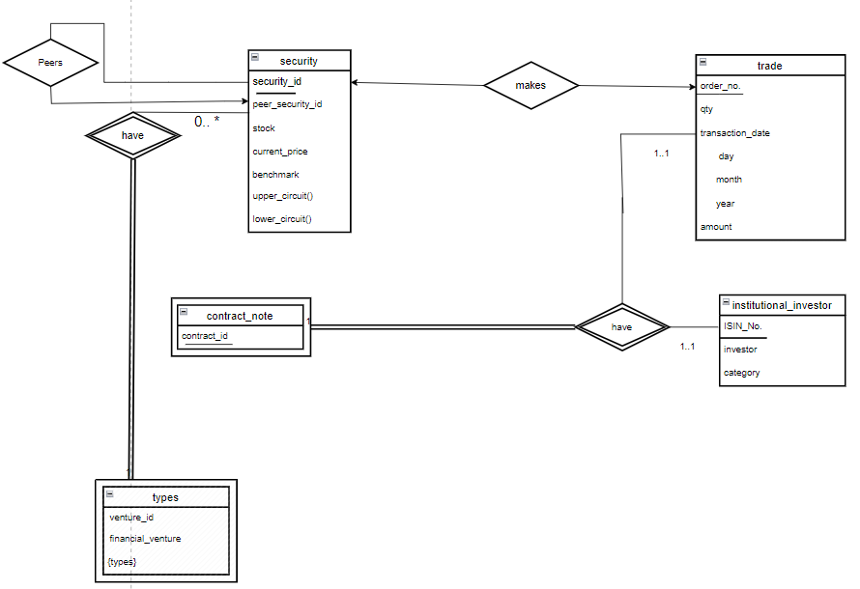
Entity-Relationship Diagram

Slide 4
Schema
security(security_id, peer_security_id, stock, current_price, benchmark)
institutional_investor(ISIN_No, investor,category)
trade(order_no, security_id, qty, transaction_date, amount) types(venture_id,security_id, financial_venture, types) contract_note(contract_id, order_no, ISIN_No)

Slide 5
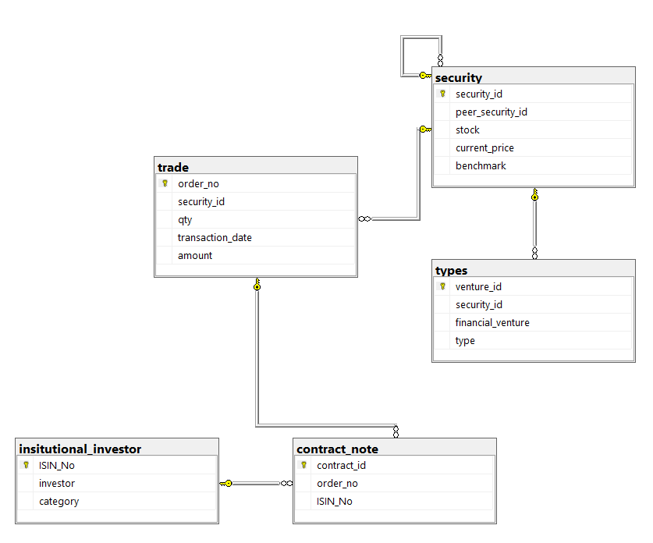
Database Diagram

Slide 6
SQL Tables using DDL
create database miniproject;
create table security(
security_id int,
peer_security_id int,
stock varchar(40) NOT NULL,
unique(stock),
current_price numeric(10,2),
check(current_price != 0),
benchmark varchar(30),
primary key(security_id),
foreign key (peer_security_id) references security(security_id));
create table insitutional_investor(
ISIN_No int,
unique(ISIN_NO),
investor varchar(40) NOT NULL,
category char(4),
primary key(ISIN_No));

Slide 7
create table trade(
order_no numeric(5,0),
security_id int,
qty int,
transaction_date date,
amount numeric(10,2),
check(amount > 0),
primary key (order_no),
foreign key(security_id) references security);
create table contract_note(
contract_id varchar(15),
order_no numeric(5,0),
ISIN_No int,
primary key (contract_id),
foreign key (order_no) references trade,
foreign key (ISIN_No) references insitutional_investor);

Slide 8
create table types(
venture_id int,
security_id int,
financial_venture varchar(60),
type varchar(10),
primary key (venture_id),
foreign key(security_id) references security);

Slide 9
Database
THE SECURITY TABLE
security_id | peer_security_id | stock | current_price | benchmark
500112 | 500209 | State Bank of India | 540.67 | BANKNIFTY
500209 | 500790 | Infosys Ltd | 1621.56 | CNXIT
500325 | 500112 | Reliance Industries Ltd | 2546.45 | NIFTY50
500570 | NULL | Tata Motors Ltd | 469.25 | NIFTYJR
500790 | NULL | Nestle India Ltd | 19827.7 | CNXFMCG
532450 | 500570 | Eicher Motors Ltd | 2354 | NIFTYAUTO
532500 | 532450 | Maruti Suzuki India Ltd | 1621.56 | NIFTY50

Slide 10
THE INSTITUTIONAL INVESTOR TABLE
THE CONTRACT_NOTE
ISIN_No | investor | category
1153 | Star Health Insurance | DII
4823 | Invesco | FII
5640 | Life Insurance Corporation Of India | DII
6721 | BlackStone | FII
9080 | Morgan Stanley | FII
contract_id | order_no | ISIN_No
45B21 | 4377 | 4823
672J1 | 5657 | 5640
89HJ1 | 1150 | 1153
9001S | 2340 | 9080
9DR34 | 6500 | 9080
I2333 | 7865 | 6721
M7K21 | 9087 | 4823
VB646 | 2311 | 1153

Slide 11
THE TYPES TABLE
venture_id | security_d | financial_venture | type
1111 | 532450 | FOUR SQUARE CAPITAL | Cyclical
1231 | 500112 | ACCEL PARTNERS | Defensive
1261 | 500790 | BLUME VENTURES | Cyclical
1333 | 532500 | CHIRATAE VENTURES | Value
1354 | 500325 | NEXUS VENTURE PARTNERS | Growth
1441 | 500209 | SEQUOIA CAPITAL | Growth
1900 | 500570 | KALAARI CAPITAL | Dividend
1932 | 532450 | MORGAN STANLEY | Growth
2025 | 500325 | GOLDMAN SACHS | Aggressive
THE TRADE TABLE
order_no | security_id | qty | transaction_date | amount
1150 | 500209 | 45 | 12-09-2021 | 72970.2
2311 | 500112 | 789 | 12-06-2020 | 426588.6
2340 | 500570 | 78 | 28-10-2020 | 36601.5
4377 | 532500 | 56 | 16-05-2020 | 90807.36
5657 | 500570 | 230 | 14-03-2022 | 107927.5
6500 | 500325 | 980 | 29-08-2021 | 2495521
7865 | 532500 | 90 | 05-02-2022 | 145940.4
9087 | 500790 | 114 | 19-04-2019 | 2260358

Slide 12
Thankyou

