Slide 1
Cartify - E-Commerce Platform
A Full-Stack Java Spring Boot Application
Harshvardhan L S
43731054
Department of Computer Science
Sathyabama

Slide 2
Abstract
Cartify is an e-commerce platform built using Java Spring Boot
Implements complete online shopping functionality with premium user experience
Features modern full-stack architecture with MySQL database integration
Designed with minimalist aesthetics using Black, Gold, Silver, and White color palette
Provides seamless shopping experience from product browsing to order completion
Key Highlights:
🛒 Complete shopping cart functionality
💎 Luxury UI/UX design
🚀 Spring Boot MVC architecture
📱 Fully responsive design

Slide 3
Existing System & Limitations
Traditional E-commerce Platforms:
Generic design lacking aesthetic appeal
Complex navigation and cluttered interfaces
Limited focus on premium user experience
Often built with PHP or older technologies
Identified Gaps:
❌ No mInimalist e-commerce solutions
❌ Inconsistent user experience across devices
❌ Limited customization options
❌ Poor performance with large catalogs
❌ Outdated technology stacks

Slide 4

Proposed System - Cartify
Innovative Solutions:
Core Features:
✅ Minimalist Design - Premium black and gold theme
Product catalog with high-quality images
✅ Modern Tech Stack - Java Spring Boot with Thymeleaf
Shopping cart with real-time updates
✅ Responsive Architecture - Works seamlessly on all devices
Order management system
✅ Scalable Database - MySQL with optimized relationships
Secure checkout process
✅ User-Centric Flow - Intuitive shopping experience
Admin product management

Slide 5
Advantages of Cartify
Technical Advantages:
User Experience Advantages:
Business Advantages:
🚀 High Performance - Optimized Spring Boot architecture
👑 Min Design - Premium visual appeal
💰 Cost Effective - Open-source technologies
📱 Mobile Responsive - Works on all devices
🔒 Security - Built-in Spring Security features
🔧 Easy Maintenance - Well-structured codebase
⚡ Fast Loading - Optimized assets and code
📊 Scalability - Modular design for easy expansion
🌐 Deployment Ready - Cloud deployment prepared
🎯 Intuitive Navigation - Easy to use interface
💾 Data Integrity - Proper database relationships

Slide 6

Limitations
Technical Limitations:
Future Scope for Improvement:
⚠️ Learning Curve - Requires Java/Spring Boot knowledge
⚠️ Resource Intensive - Higher memory requirements than PHP
Add user registration and login
⚠️ Deployment Complexity - More setup required than static sites
Functional Limitations:
Integrate payment gateways
⚠️ No User Authentication in current version
⚠️ No Payment Gateway Integration
⚠️ Limited Admin Features
Implement admin dashboard
⚠️ No Inventory Management System
Add product search and filters

Slide 7
Hardware Requirements
Development Environment:
Production/Server Requirements:
Client-Side Requirements:
💻 Processor: Intel i5 or higher
🖥️ Processor: 2-core CPU or higher
📱 Devices: Desktop, Tablet, Mobile
🎯 RAM: 8GB minimum, 16GB recommended
🎯 RAM: 8GB minimum
🌐 Browser: Chrome, Firefox, Safari, Edge
💾 Storage: 1GB SSD storage
💾 Storage: 1GB free space
🌐 Network: Stable internet connection
📶 Internet: Broadband connection
🖥️ Display: 1920×1080 resolution or higher

Slide 8
Software Requirements
Backend Technologies:
Frontend Technologies:
☕ Java: JDK 21
🌐 Thymeleaf: Template engine
🚀 Spring Boot: 3.5.7 version
🎨 HTML5 & CSS3: Markup and styling
🗄️ MySQL: 8.0 database
⚡ JavaScript: Client-side interactions
📦 Maven: Dependency management
🎯 Bootstrap: Responsive framework (implicit)
Development Tools:
🔧 IDE: IntelliJ IDEA, Eclipse, or VS Code
🗄️ MySQL Workbench: Database management
🌐 Browser Dev Tools: Debugging
📝 Postman: API testing (if APIs added)

Slide 9
System Modules
Product Management Module
Shopping Cart Module
Order Management Module
Add/remove items
Product catalog display
Quantity management
Order creation and processing
Product details and pricing
Real-time price calculation
Order history
Image management
Status tracking
User Interface Module
Database Management Module
Responsive design
Data persistence
Minimalist theme implementation
Relationship management
Navigation and layout
Query optimization

Slide 10
Module Description
Product Management Module:
Order Management Module:
Displays products with high-quality images
Customer information collection
Manages product information and pricing in INR
Order confirmation system
Handles stock quantity and availability
Purchase history tracking
Provides product search and categorization
Order status updates
Shopping Cart Module:
Database Module:
Session-based cart management
MySQL relational database
Real-time total calculation
Proper table relationships
Item quantity updates
Optimized queries for performance
Persistent cart data across sessions
Data integrity maintenance

Slide 11
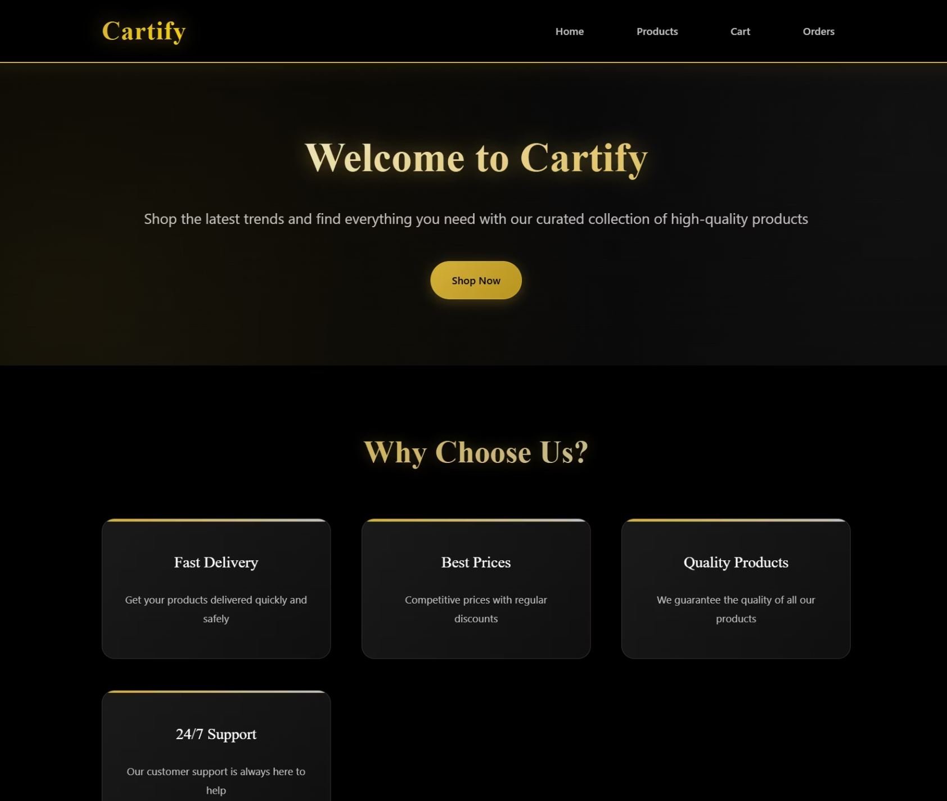
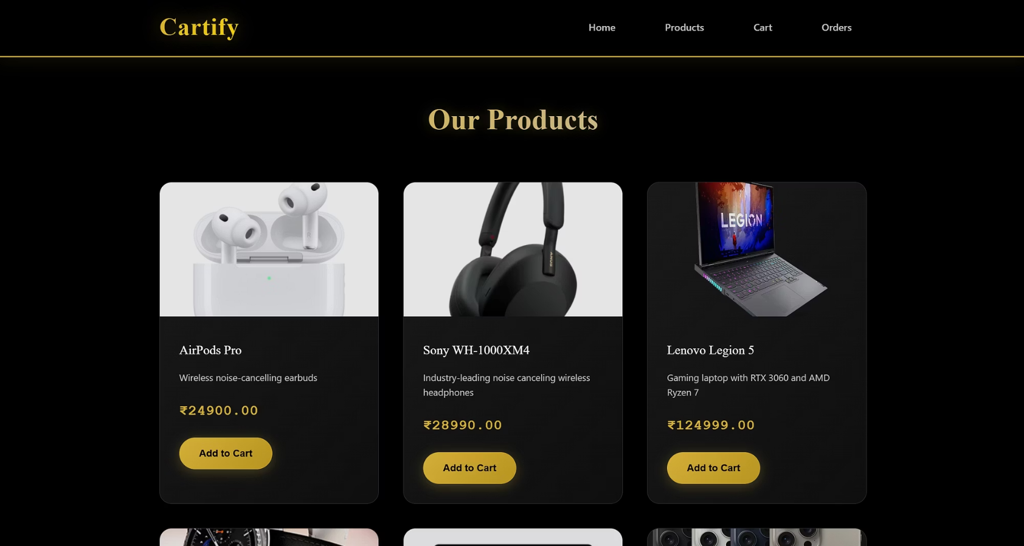
Home & Products page
Product Catalogue
Home Page

Slide 12
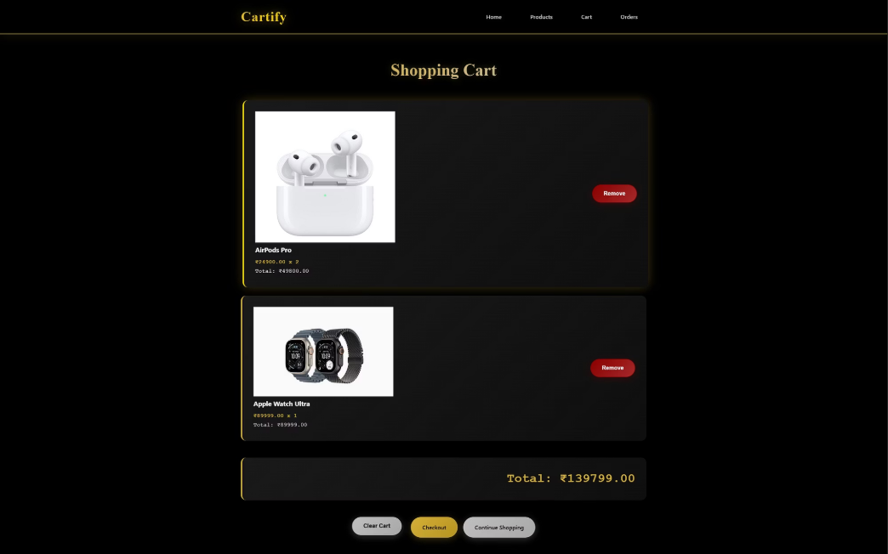
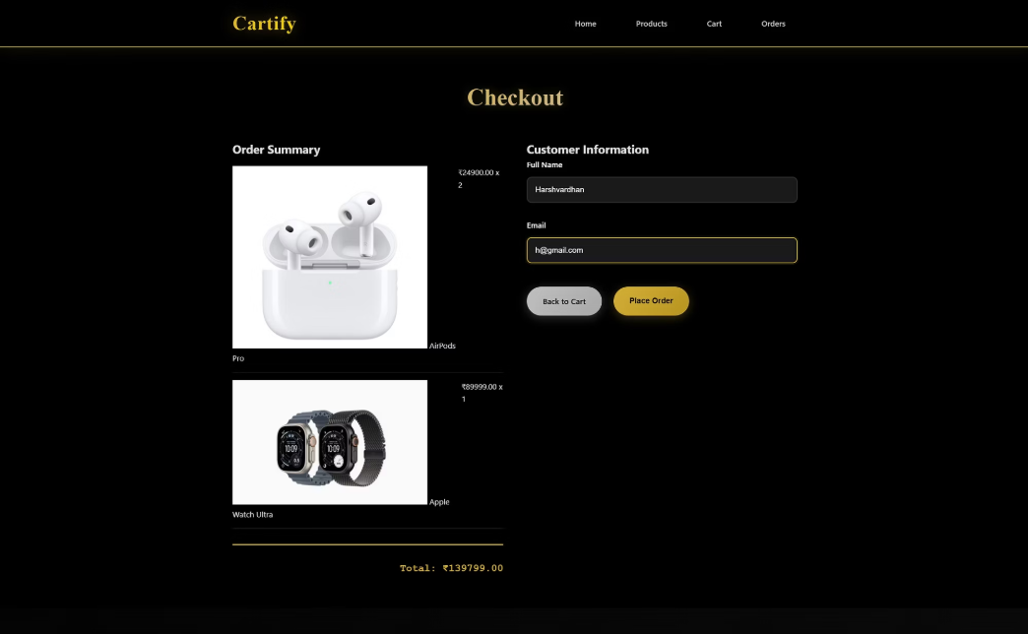
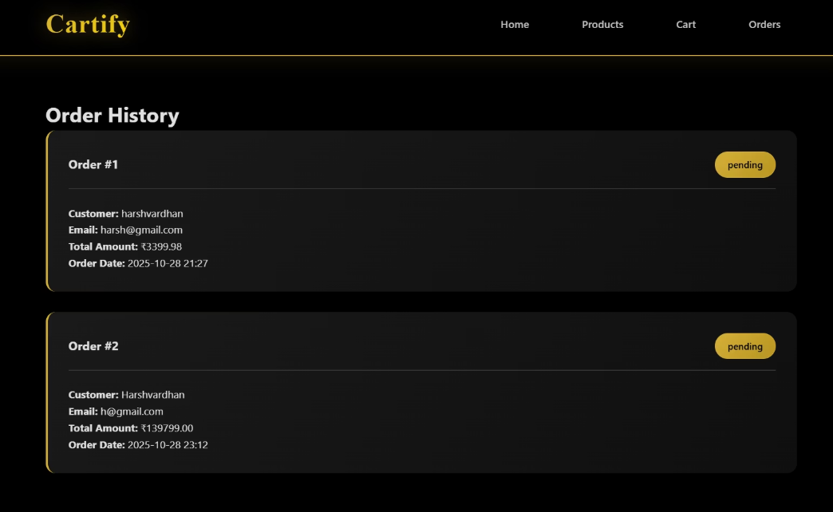
Cart
Cart
Check Out
Order history & Tracking

Slide 13
Conclusion
Project Achievements:
Future Enhancements:
✅ Successfully developed a full-stack e-commerce platform
🔮 User authentication system
✅ Implemented modern Java Spring Boot architecture
🔮 Payment gateway integration
✅ Created premium user experience with luxury design
🔮 Advanced admin features
✅ Built complete shopping functionality
🔮 Inventory management
✅ Ensured responsive design across all devices
🔮 Product reviews and rating

