Slide 1

Team Name : Supply Chain Forge
Team Leader Name : Harsh Patel
Team Size : 1
Problem Statement : Supply Chain Ontology and Governed Conversational Analytics

Slide 2

Problem brief: four systems, four versions of the truth
The business problem
Supply chain data sits in four systems (ERP, WMS, TMS, SRM) that name and date things their own way. Ask “What is our on-time delivery rate?” and each team gets a different answer.
Leadership asks: “What is our on-time delivery rate?”
Planning says
Who it is for
68.2%
Production planners, procurement leads (buyers) and logistics coordinators, plus the leaders who need one number they can act on.
using the ERP order date
Pain today → with Supply Chain Forge
Logistics says
Teams reconcile spreadsheets and argue about whose number is right. Now every metric is defined once in a Snowflake semantic view, and people, dashboards and the AI agent all read that one definition.
87.5%
using the carrier’s promised date
Industry context
Same shipments, 19.3 points apart.
Supply Chain Forge makes 87.5% the one governed answer, for every team.
Manufacturing and distribution: 12 plants in APAC, EMEA and AMER, 150 suppliers, 1,200 parts, ~725K orders and ~780K shipments over 10 years, with SAP-style source tables and real-world defects.

Slide 3
Architecture: one governed layer, built and run in Snowflake
DATA SOURCES
CLEANED
GOVERNED
ONTOLOGY
CONSUMERS
ERP
orders, customers, FX
CONFORMED
10 incremental dynamic tables
dedupe, code maps, FX to USD, test and orphan removal, dq_flags
GOVERNED
9 business-named views
masking policies per role, sensitivity tags, persona procedures
SUPPLY_CHAIN_SV
semantic view
10 entities, 12 relationships, 4 canonical + 15 metrics, 14 verified queries
Cortex Agent
Analyst + data_health tool
WMS
inventory, usage
Streamlit app
router: instant (~1 s) or agent
TMS
shipments, carriers
3 personas
same number, different masking
SRM
suppliers, parts, contracts
77 Data Metric Functions + SP_DATA_HEALTH check every layer for freshness and defects
Input: plain-English questions (unstructured)
Structured tables, SAP-style names, 19 kinds of defects
BUILT WITH COCO CLI SKILLS, EACH OWNING ONE LAYER
sql-author
schemas, DDL
dynamic-tables
CONFORMED
data-governance
masking, tags
agent-studio
semantic view, agent
data-quality
DMFs, health
lineage
validation

Slide 4
Impact: one trusted number, answered in seconds
0.000000
19.3 pts
~1 s
28 / 30
difference between Planner, Buyer and Logistics on all 4 metrics (6 decimal places)
of cross-team disagreement on on-time delivery removed (68.2% vs 87.5%)
instant governed answers with no LLM call; agent answers ~12 s at p50
agent evaluation questions correct, incl. multi-part, Hindi and refusals
Measurable outcomes
Scalability
Beyond the demo
• One definition per metric replaces per-team SQL and spreadsheet reconciliation
• 93/93 data-quality self-checks pass; 77 DMFs watch every load
• Masking enforced by Snowflake policies, not by the app
• Incremental dynamic tables and an XS warehouse handle ~6M source rows
• Rebuilt from the repo into a new account with no hand fix, data byte-identical
• A nightly task appends each new business day automatically
• Swap the generator for real SAP and WMS connectors; layers stay the same
• Add a metric or synonym to the semantic view: the agent and app pick it up
• Same pattern fits finance, sales or HR data that disagree across systems

Slide 5
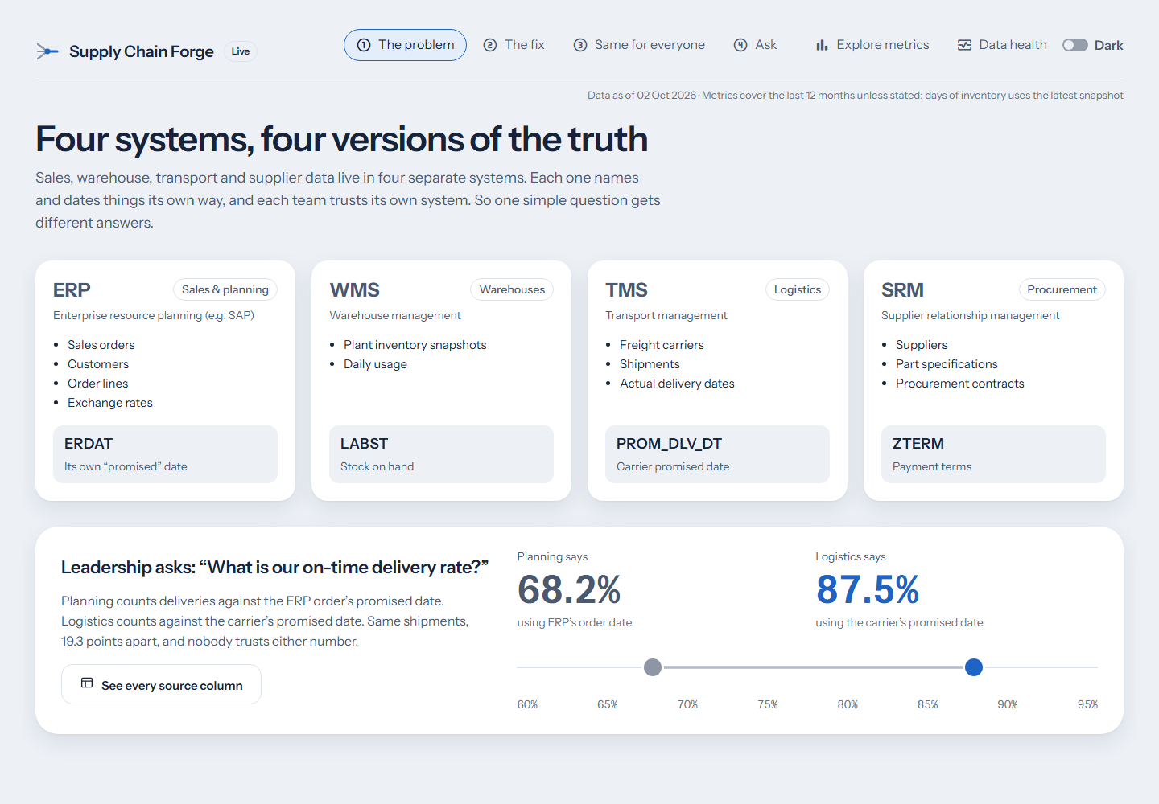
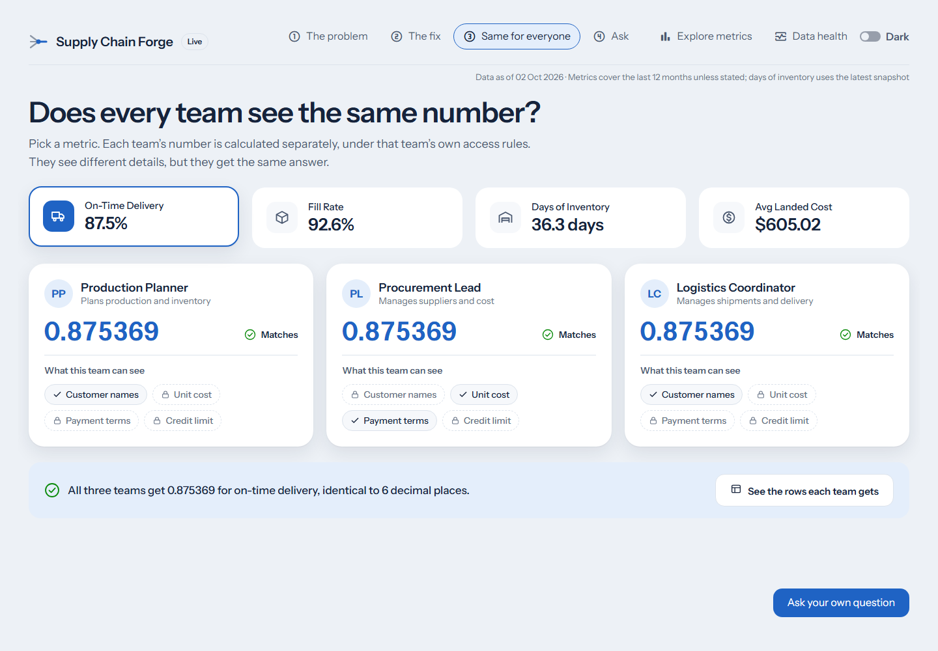
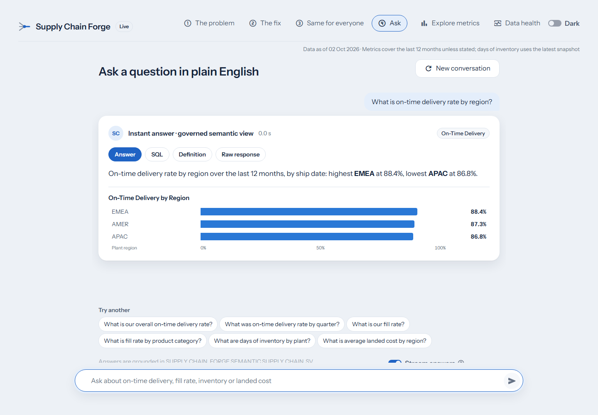
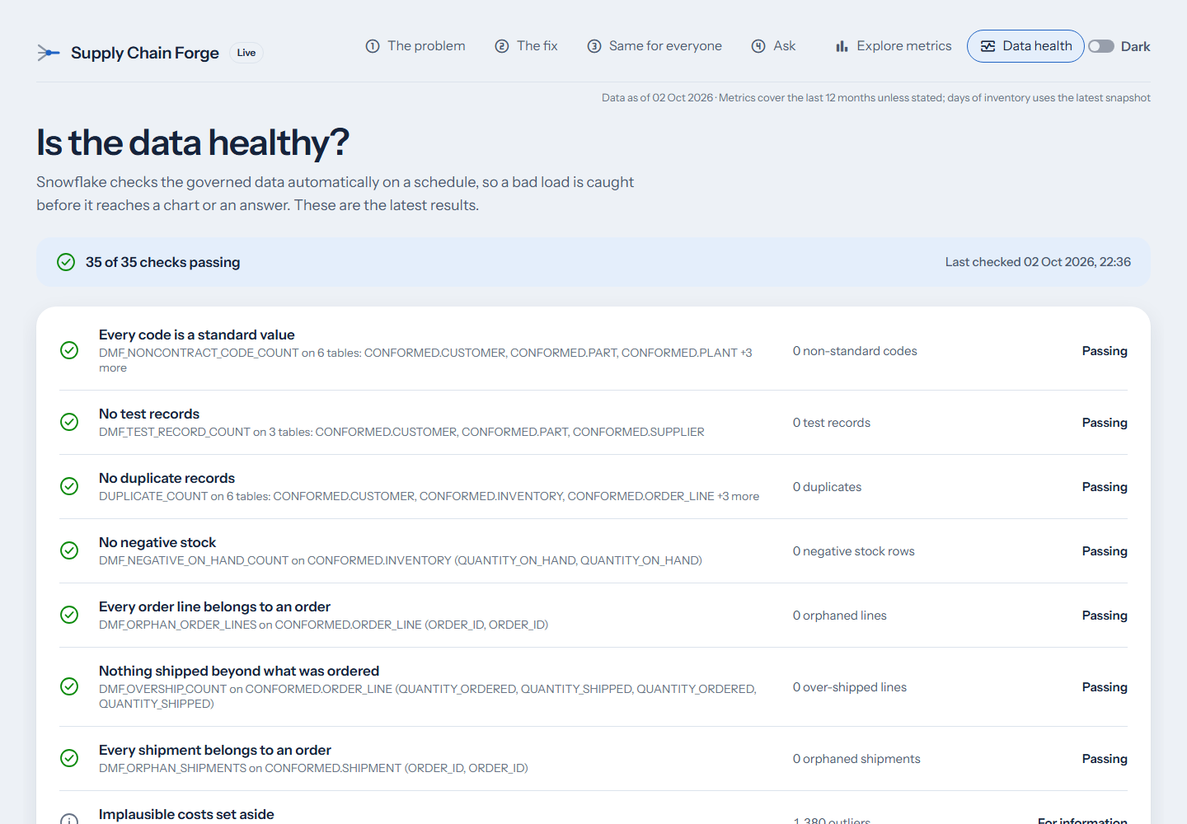
The working prototype: live on Snowflake
Input
A plain-English question, e.g. “What is on-time delivery by region?”
Processing
The router runs governed semantic-view SQL or asks the Cortex Agent; masking applies per role
Output
A governed answer with its chart, SQL, metric definition and the path that answered
1 The problem: two numbers
2 Same for everyone
3 Ask: instant governed answer
4 Data health: 35/35 passing
Try it: supply-chain-forge.streamlit.app · Code and docs: github.com/Harsh2292/snowflake-forge
Public link on Streamlit Community Cloud, reading Snowflake live through a key-pair service user with a read-only role, rate limits and a Cortex budget.

Slide 6
How it was built: CoCo CLI plus a frozen contract
1
Contract first
docs/CONTRACT.md fixes every object name, metric, valid pairing and masking rule
What CoCo CLI delivered
✓ 4 source schemas, ~6M rows of messy data
✓ 10 dynamic tables that clean it incrementally
✓ 9 governed views, masking policies for 3 roles
✓ 1 semantic view: 19 metrics, 14 verified queries
✓ 1 Cortex Agent with a custom data_health tool
✓ 77 Data Metric Functions, alerts and cost caps
✓ Full replay into a new account with no hand fix
2
CoCo builds Snowflake
Schemas, CONFORMED dynamic tables, masking, semantic view, Cortex Agent, DMFs, cost caps
3
Handoff lock
Generator, quality and eval SQL written outside Snowflake; CoCo runs it and records each run
4
Proof captured
Real Snowflake output saved as artifacts; ~1,000 tests replay it in CI
Two AI agents, one frozen contract: CoCo CLI built and ran everything in Snowflake; Claude Code built the app, tests and docs; a human coordinated both.

Slide 7

supply-chain-forge.streamlit.app · github.com/Harsh2292/snowflake-forge

