Slide 1

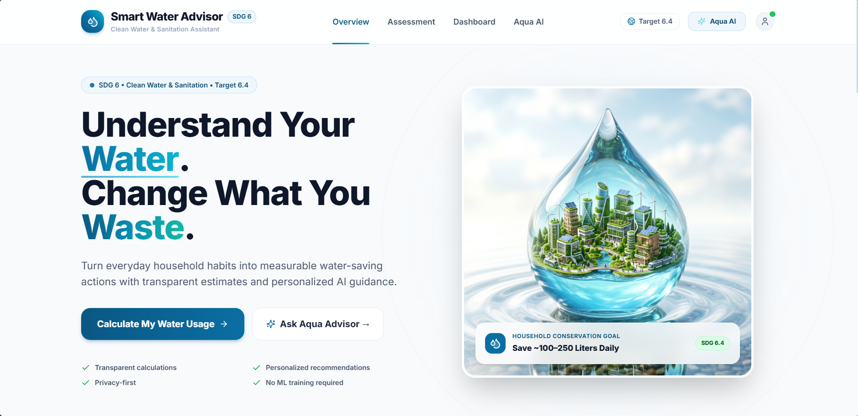
UN SDG 6 · TARGET 6.4 · WATER-USE EFFICIENCY
Smart Water Usage Advisor
AI-Powered Household Water Conservation & Water-Use Efficiency Platform
SWUA landing page
Presented by Harsh Singh
Jabalpur Engineering College (JEC)
B.Tech – Information Technology
Notes:
Hello, I am Harsh Singh from Jabalpur Engineering College, B.Tech Information Technology. Our project is Smart Water Usage Advisor, a web-based platform designed to improve household water-use efficiency in alignment with UN SDG 6, particularly Target 6.4.
Pitch (60 seconds): People use water every day but often don't know where it is consumed or wasted. Our system lets users enter daily habits and generates a transparent consumption estimate, category-wise breakdown and major wastage areas. The hybrid architecture is the difference: a deterministic engine does the calculations, while Aqua Advisor uses RAG-grounded AI for personalised guidance. A local fallback keeps guidance available if the external AI service is down. Our goal is to turn water consumption from an invisible habit into understandable, actionable information.

Slide 2

01 PROBLEM & SOLUTION
Invisible Water, Visible Waste
Our solution: SWUA
The problem
A full-stack web app where users enter daily water-use habits and receive an estimate, breakdown and advice.
Households use a lot of water every day, but have little visibility into where it goes or where it is wasted.
1
User inputs
Long showers
Excessive flushing
Running taps
Household size, showers, toilet, kitchen, laundry, leaks
Inefficient dishwashing
Excess laundry
Water leakage
2
Consumption calculation
Deterministic engine using empirical flow rates
Gardening / cleaning waste
3
Usage breakdown
Category-wise litres per day and share
THE CORE QUESTION
Wastage detection
How can we help households understand their water behaviour, find their wastage points, and get practical guidance to improve efficiency?
4
Top opportunities to reduce water use
5
AI / RAG advice
Aqua Advisor gives personalised recommendations
Smart Water Usage Advisor | SDG 6.4
2 / 9
Notes:
Problem: households consume significant water daily but lack clear visibility. Small inefficiencies (long showers, excessive flushing, running taps, leakage) add up to substantial daily and monthly wastage.
Solution flow: User Inputs -> Water Consumption Calculation -> Usage Breakdown -> Wastage Detection -> AI/RAG-Based Advice. The calculation engine is deterministic; AI is mainly for conversational guidance.

Slide 3





02 SDG ALIGNMENT & USERS
Built for UN SDG 6.4
Who it is for
CLEAN WATER AND SANITATION
6.4
Households
Individuals
Families who want to understand and reduce daily water use
People monitoring their personal water-use habits
Water-Use Efficiency
SWUA helps households:
Understand their consumption
Identify unnecessary usage
Eco-conscious users
Communities
Detect potential wastage
Users cutting their footprint and utility costs
Groups promoting water-conservation awareness
Learn conservation techniques
Make better daily decisions
Scope: household demand-side conservation, not municipal or agricultural water management.
Smart Water Usage Advisor | SDG 6.4
3 / 9
Notes:
SDG 6.4 focuses on improving water-use efficiency and reducing water stress. SWUA contributes at the household level. Target users: urban/suburban households, individuals, environmentally conscious users and communities.
Q10 - How does this contribute to SDG 6.4? It promotes household-level water-use efficiency by helping users understand consumption, identify wastage and adopt conservation practices.

Slide 4





03 AI SOLUTION & ARCHITECTURE
Deterministic Core + AI Layer
Deterministic layer
AI layer: Aqua Advisor
Predefined empirical flow rates plus user-provided habits. Transparent and reproducible, with no AI in the maths.
Understands the user’s questions
Uses the calculated water profile
Retrieves relevant conservation knowledge (RAG)
Generates personalised, natural-language advice
Persons × Shower duration × Flow rate
e.g. 3 people × 10 min × 9.5 L/min = 285 L per shower cycle
FRONTEND
BACKEND
AI PROVIDERS
React 18 · Vite 5 · Tailwind CSS · Lucide React · Framer Motion
Python 3.13 · FastAPI · Uvicorn · Pydantic V2
OpenAI-, Gemini-compatible and Groq LLMs, with a Smart Local Heuristic Engine fallback
Smart Water Usage Advisor | SDG 6.4
4 / 9
Notes:
Key point: AI does NOT perform the core water-consumption mathematics. Deterministic layer = transparent, reproducible calculation. AI layer = Aqua Advisor for conversation and personalised recommendations.
Q1 Why AI? The calculation itself does not need AI; AI translates the water profile and retrieved knowledge into understandable advice.
Q2 Why not fully rule-based? Calculation and diagnosis are rule-based, but users ask questions in many ways, which benefits from an AI layer.
Q5 Does AI calculate consumption? No, the deterministic engine does.

Slide 5









04 RAG WORKFLOW
Grounded Advice, Lightweight Retrieval
User question
Tokenise
Match & score
Top 3 entries
Add profile
Grounded answer
Asked in the Aqua Advisor chat
Query processing and stop-word removal
Phrase, keyword, synonym and token-similarity scoring over the JSON knowledge base
Most relevant knowledge entries selected
User’s water profile + retrieved knowledge form the AI context
Personalised advice with sources shown
No vector database
Why RAG here
If the AI API fails
Lightweight local retrieval: tokenisation and relevance scoring over a curated JSON knowledge base.
Answers are tied to a defined knowledge source, not an unrestricted chatbot. Retrieved sources are surfaced.
The Smart Local Heuristic Engine still gives profile-aware answers from the local knowledge base.
Smart Water Usage Advisor | SDG 6.4
5 / 9
Notes:
Pipeline: User Question -> Query Processing -> Tokenization & Stop-word Removal -> Knowledge Base Matching -> Relevance Scoring -> Top 3 Entries -> User Water Profile + Retrieved Knowledge -> Aqua Advisor -> Grounded Response -> Sources.
Q3 How does RAG work? Query is processed, relevant terms extracted, local knowledge base entries scored, the most relevant retrieved and given as context to the advisor.
Q4 Vector DB? No, a lightweight local mechanism with tokenisation and relevance scoring over a curated JSON file.
Q6 If the AI API fails? The Smart Local Heuristic Engine responds using the local knowledge base.

Slide 6
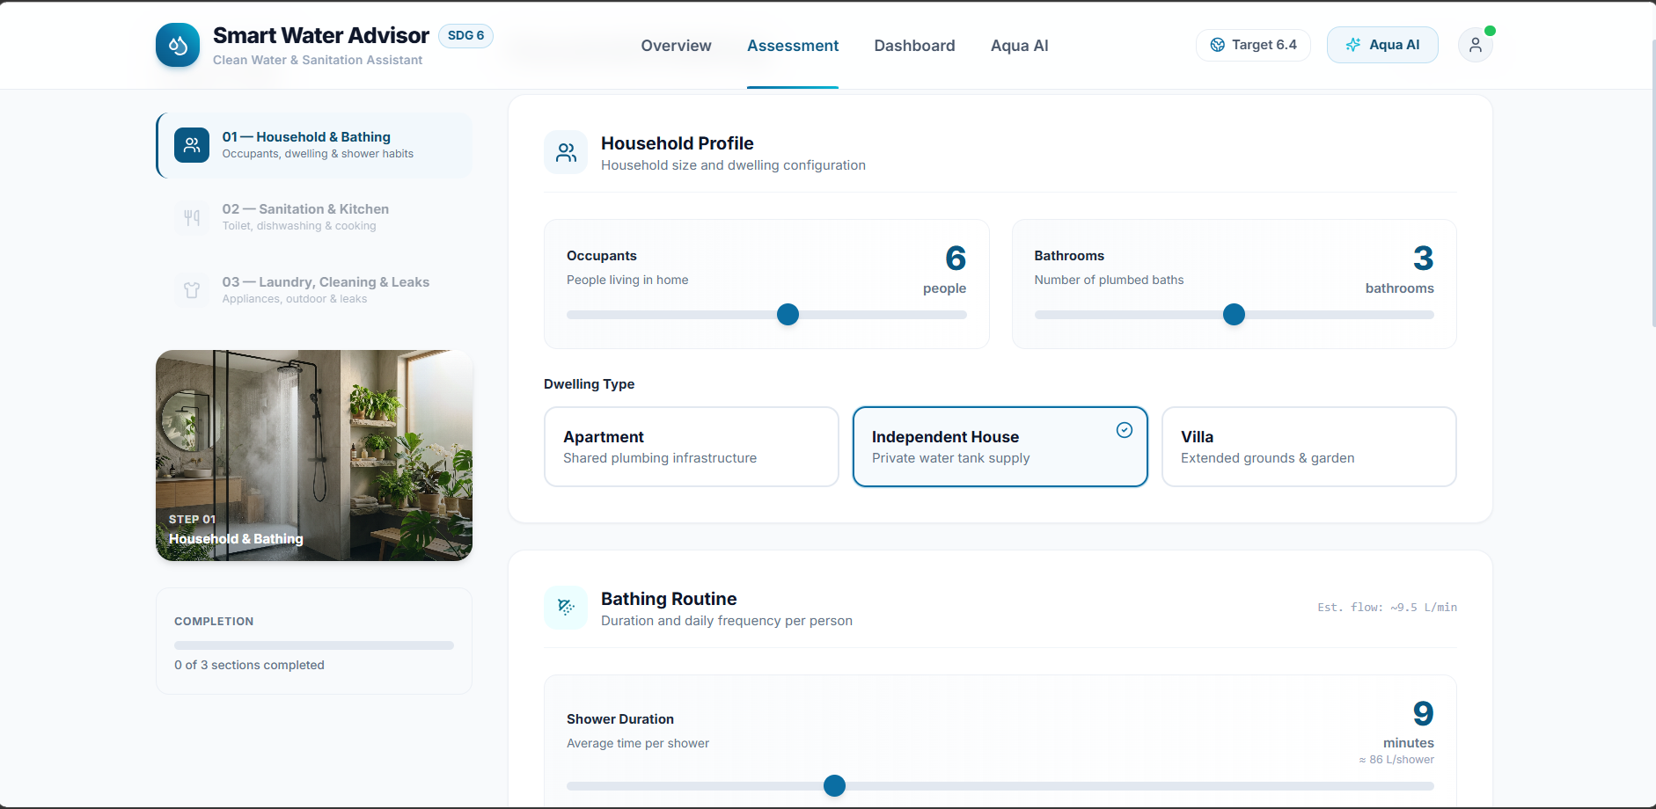
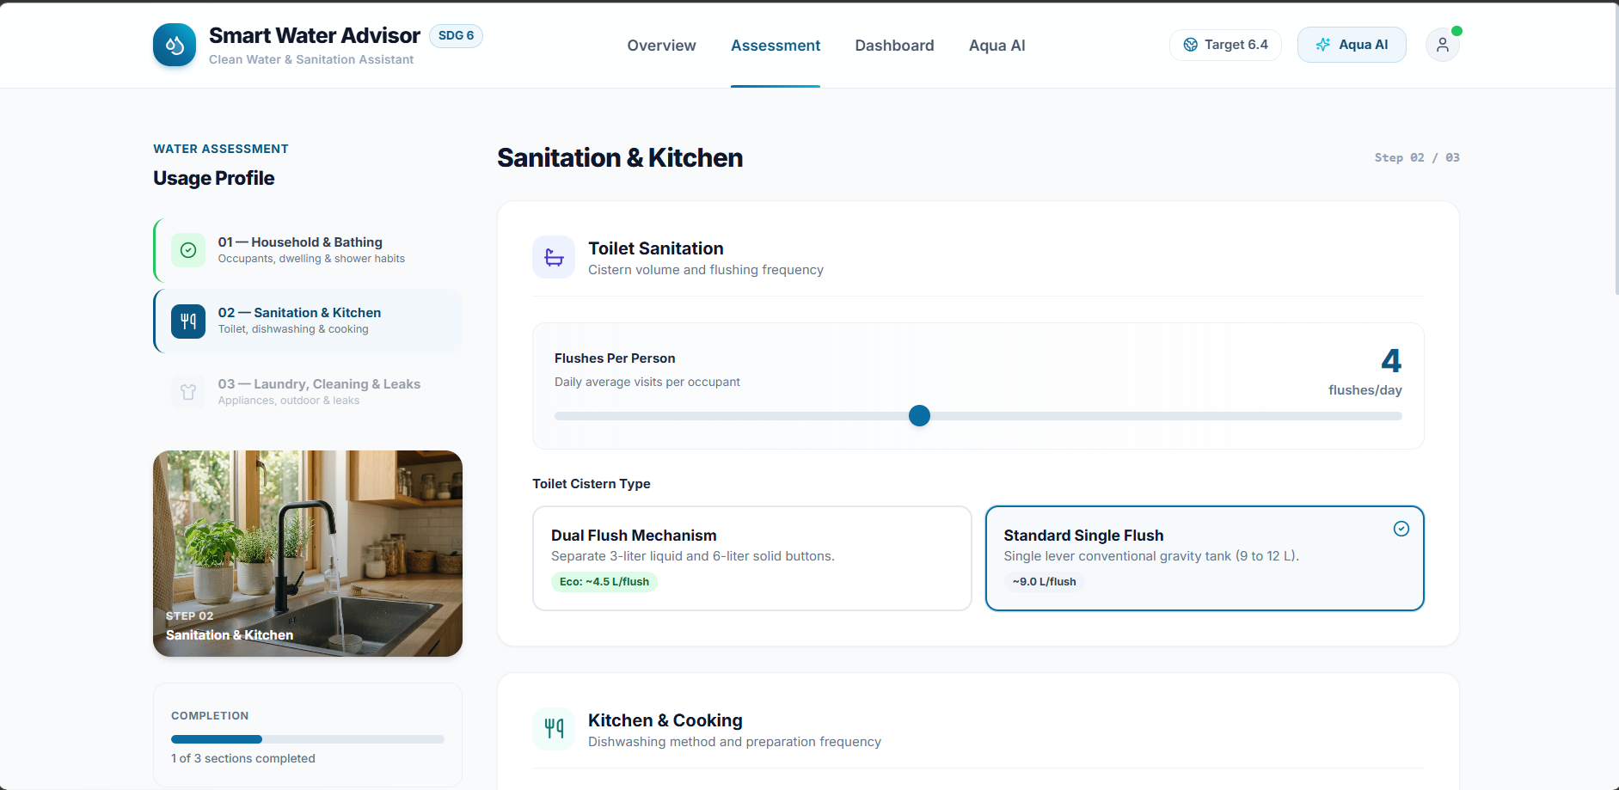

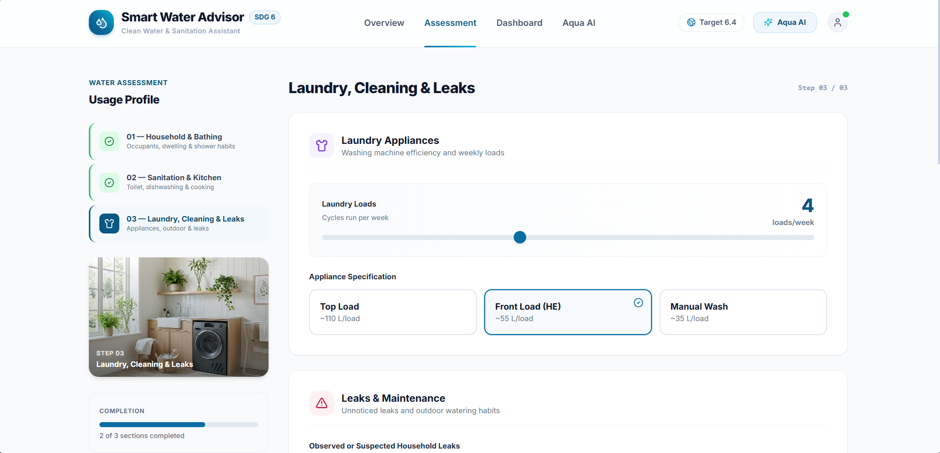
05 PROTOTYPE · ASSESSMENT
A Guided 3-Step Assessment
2 Sanitation & Kitchen
Flushes per person, cistern type, kitchen habits.
1 Household & Bathing
Occupants, bathrooms, dwelling type and shower duration (est. flow ≈ 9.5 L/min).
Sample input: 6 people · 3 bathrooms · independent house · 9-min showers
3 Laundry, Cleaning & Leaks
Loads per week, appliance type, leaks, watering.
Smart Water Usage Advisor | SDG 6.4
6 / 9
Notes:
Demo steps 1-3: Start from the landing page, click Start Assessment, enter a realistic example (household size, shower duration, flushing, kitchen habits, laundry, possible leak) and submit.
'The frontend sends these inputs to our FastAPI backend, where the deterministic calculation engine estimates water consumption using predefined empirical flow rates.'

Slide 7
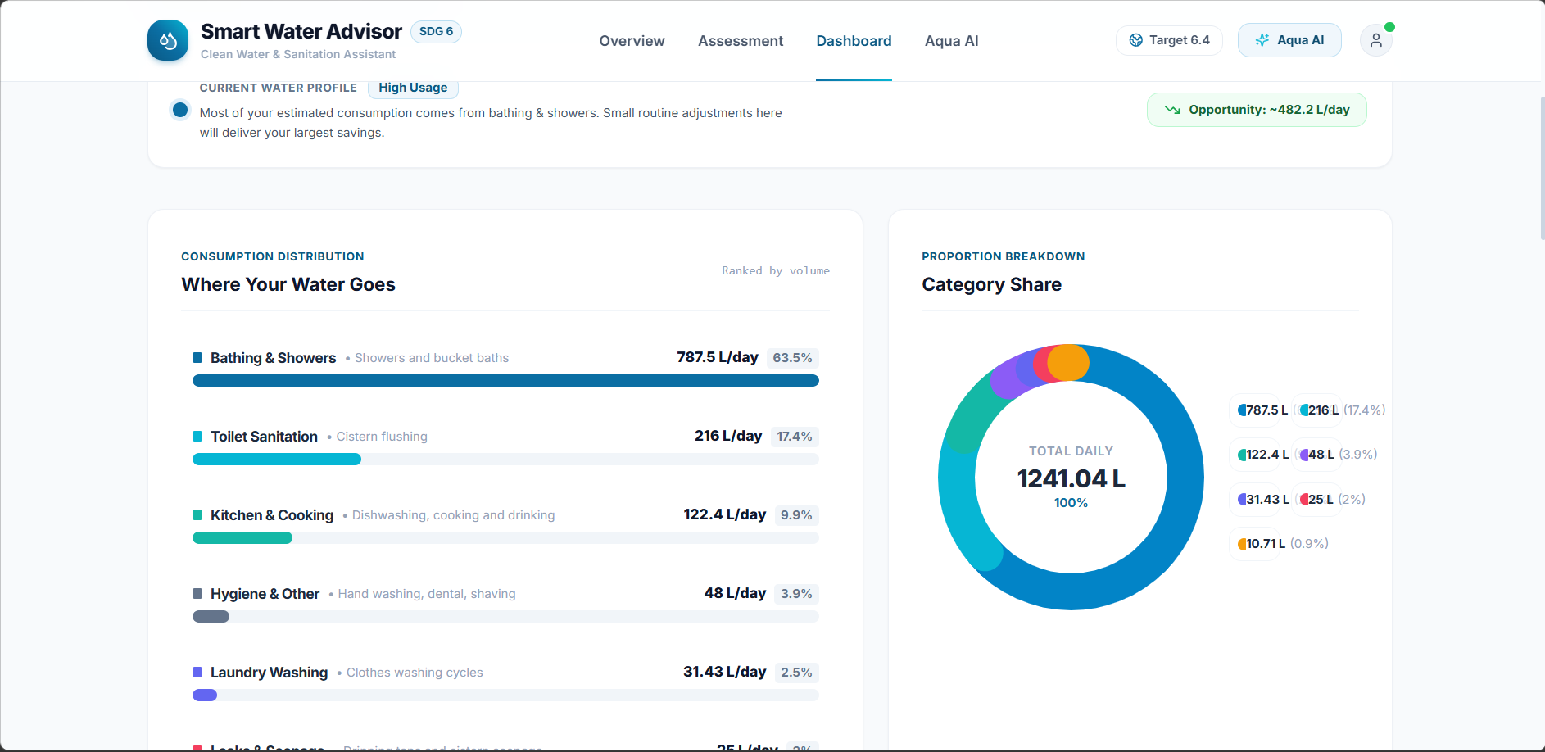
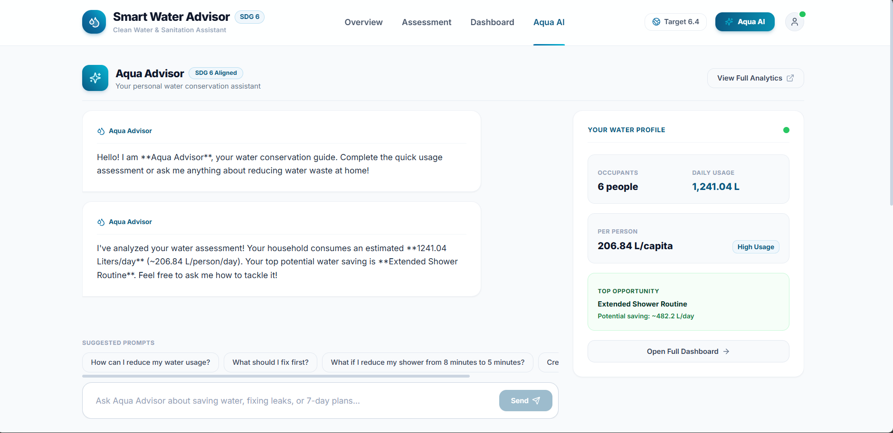
06 PROTOTYPE · RESULTS & ADVISOR
From Numbers to Guidance
1,241 L
63.5%
~482 L
Reads the household’s own profile: 206.84 L/person/day
total daily use
from bathing
top saving / day
Suggested prompts help users start the conversation
The dashboard shows where water goes, ranked by volume, not just one final number.
Advice grounded in the local knowledge base
Smart Water Usage Advisor | SDG 6.4
7 / 9
Notes:
Dashboard: highlight total water consumption, category breakdown, donut chart, bar chart and top wastage areas. 'Instead of only one final number, the system tells the user where water is consumed and which areas have the highest potential wastage.'
Aqua Advisor: ask 'How can I fix the leak and save water?'. The assistant uses the user's profile and relevant knowledge-base information. Then show the Verified Sources section: the response is grounded in our local water-conservation knowledge base, not an unrestricted chatbot.

Slide 8




07 RESPONSIBLE AI & IMPACT
Trustworthy by Design
Transparency
What makes SWUA different
Figures are behavioural estimates, not meter readings; the UI carries a disclaimer.
TYPICAL WATER CALCULATOR
Explainability
“You consume X litres/day.”
Calculated data is deterministic; advice comes from AI/RAG. The two stay separate.
Non-judgmental
SWUA
Encouraging, supportive recommendations that never blame users.
X litres/day → major consumption areas → potential wastage points → contextual guidance on how to reduce them
Grounded
Answers draw on a curated water-conservation knowledge base.
Central innovation: deterministic calculations + wastage analysis + RAG + conversational AI + local fallback
Privacy
Stateless architecture; assessment data is not permanently stored.
Smart Water Usage Advisor | SDG 6.4
8 / 9
Notes:
Impact: before SWUA, households see only a water bill. With SWUA: daily habits -> consumption estimate -> category breakdown -> wastage detection -> personalised advice -> behavioural change -> improved water-use efficiency.
Q7 Real-time monitoring? No, it is a behavioural estimator and does not read meters or IoT sensors.
Q8 Accuracy? Behavioural estimates that depend on user inputs and standard empirical flow rates.
Q9 Privacy? Stateless; assessment data is not permanently stored.

Slide 9

08 LIMITATIONS & FUTURE SCOPE
Honest Limits, Clear Next Steps
Limitations
Future scope (not yet built)
Estimate quality depends on how accurately users report habits
No physical meter or IoT flow measurement
Based on standard empirical flow rates, not live telemetry
Household focus only: not municipal, agricultural or industrial
IoT water-flow sensors
Real-time monitoring
Mobile application
Historical tracking
Personalised goals
Smart leak detection
Location-specific tips
Smart-home integration
Community analytics
Thank you
Turning water consumption from an invisible habit into understandable, actionable information.
Harsh Singh · Jabalpur Engineering College · B.Tech IT
Smart Water Usage Advisor | SDG 6.4
9 / 9
Notes:
Do not hide limitations: user-input dependency, no physical meter, behavioural estimation, household-only scope. Future scope items should be presented as future, not as implemented features.

