Slide 1
Spring Framework
Mentor : Rahul Dixit

Slide 2

Terminology
Terminology:-Dependency Injection, IOC, Auto wiring, Auto configuration, Starter Projects.
Application :- Web app, REST API, Full Stack
Variety of other framework, tool and platform integrations: Maven, Spring Data, JPA, Hibernate, Docker and Cloud

Slide 3
Getting Started with Spring Framework - Why?
You can build a variety of applications using Java, Spring and Spring Boot:
Web
REST API
Full Stack
Microservices
Irrespective of the app you are building:
Spring framework provides all the core features
Understanding Spring helps you learn Spring Boot easily
Helps in debugging problems quickly

Slide 4

Why is Coupling Important?
Coupling: How much work is involved in changing something?
Coupling is important everywhere:
An engine is tightly coupled to a Car
A wheel is loosely coupled to a Car
You can take a laptop anywhere you go A computer, on the other hand, is a little bit more difficult to move
Coupling is even more important in building great software Only thing constant in technology is change
Business requirements change
Frameworks change
Code changes
We want Loose Coupling as much as possible
We want to make functional changes with as less code changes as possible
Let's explore how Java Interfaces and Spring Framework help with Loose Coupling!

Slide 5
Getting Started with Spring Framework
Design DrawingApp to draw (Circle, Rectangle, Square etc) in an iterative approach:
Iteration 1: Tightly Coupled Java Code
Drawing class
Draw method
Game classes: Circle, Rectangle, Square etc
Iteration 2: Loose Coupling - Interfaces
Drawing class Shape interface
Shape classes: Circle, Rectangle, Square etc
Iteration 3: Loose Coupling - Spring Level 1
Spring Beans
Spring framework will manage objects and wiring
Iteration 4: Loose Coupling - Spring Level 2
Spring Annotations
Spring framework will create, manage & auto-wire objects

Slide 6
Getting Started with Spring Framework - Goals
Goal: Understand core features of Spring Framework
Approach: Build a Loose Coupled Hello World Drawing App with Modern Spring Approach
Get Hands-on with Spring and understand:
Why Spring?
Terminology
Tight Coupling and Loose Coupling
IOC Container
Application Context
Component Scan
Dependency Injection
Spring Beans
Auto Wiring

Slide 7
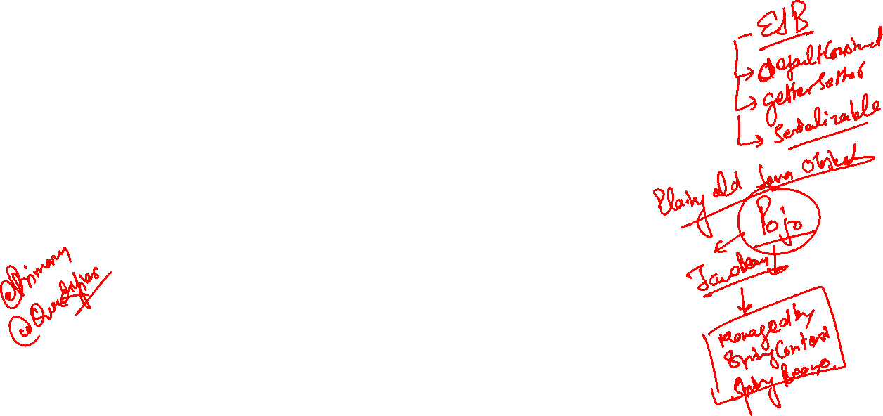
Spring Questions You Might Be Thinking About
Question 1: Spring Container vs Spring Context vs IOC Container vs Application Context
Question 2: Java Bean vs Spring Bean
Question 3: How can I list all beans managed by Spring Framework?
Question 4: What if multiple matching beans are available?
Question 5: Spring is managing objects and performing auto-wiring.
BUT aren't we writing the code to create objects?
How do we get Spring to create objects for us?
Question 6: Is Spring really making things easy?

Slide 8
What is Spring Container?
Spring Container: Manages Spring beans & their lifecycle
1: Bean Factory: Basic Spring Container
2: Application Context: Advanced Spring Container with enterprise-specific features
Easy to use in web applications
Easy internationalization
Easy integration with Spring AOP
Which one to use?: Most enterprise applications use Application Context
Recommended for web applications, web services - REST API and microservices

Slide 9
Exploring Spring Dependency Injection
Constructor Injection : - Dependencies are set by Creating the bean using its constructor
Setter Injection :- Dependencies are set by calling setter methods on your beans
Field :- No setter or constructor .Dependency Injected using reflection.
Q Which is better to inject Dependencies
Spring Team Recommends Constructor based Injection. Because all Initialization Done By Only One Method i.e. Constructor

Slide 10

Field Injection
@Component
class BussinesLogic{
@Autowired
Dependency1 dependency1;
@Autowired
Dependency2 dependency2;
@Override
public String toString() {
return "BussinesLogic [dependency1=" + dependency1 + ", dependency2=" + dependency2 + "]";
}
@Component
class Dependency1{}
@Component
class Dependency2{}

Slide 11

Setter Injection
@Autowired
public void setDependency2(Dependency2 dependency2) {
System.out.println("Setter of Dependency 2");
this.dependency2 = dependency2;
}
@Override
public String toString() {
return "BussinesLogic [dependency1=" + dependency1 + ", dependency2=" + dependency2 + "]";
}
}
@Component
class BussinesLogic{
Dependency1 dependency1;
Dependency2 dependency2;
@Autowired
public void setDependency1(Dependency1 dependency1) {
System.out.println("Setter of Dependency 1");
this.dependency1 = dependency1;
}

Slide 12

Constructor Injection :- Executed with @Autowired Managed By Spring
@Component
class BussinesLogic{
Dependency1 dependency1;
Dependency2 dependency2;
@Autowired
public BussinesLogic(Dependency1 dependency1, Dependency2 dependency2) {
System.out.println("Constructor Injection");
this.dependency1 = dependency1;
this.dependency2 = dependency2;
}
@Override
public String toString() {
return "BussinesLogic [dependency1=" + dependency1 + ", dependency2=" + dependency2 + "]";
}
}

Slide 13
Exploring auto-wiring in depth
When a dependency needs to be @Autowired, IOC container looks for matches/candidates (by name and/or type)
If no match is found Result: Exception is thrown
One match is found Result: Autowiring is successful
Multiple candidates Result: Exception is thrown
You need to help Spring Framework choose between the candidates
@Primary & @Qualifier Comes Into a Picture

Slide 14
@Primary vs @Qualifier - Which one to use?
@Primary - A bean should be given preference when multiple candidates are qualified
@Qualifier - A specific bean should be auto-wired (name of the bean can be used as qualifier)
Just @Autowired: Give me (preferred Bean)
@Autowired + @Qualifier
@Qualifier has higher priority then @Primary

Slide 15
Inversion Of Control
In Our Initial Program We Explicitly create an Object and Inject It Explicitly. But Here everything is managed by Spring Called IoC (Inversion Of Control)

Slide 16

Spring Framework - Important Terminology
@Component (..): An instance of class will be managed by Spring framework
Dependency: Drawing needs
Shape impl! Shape Impl (Ex: Circle) is a dependency of Drawing
Component Scan: How does Spring Framework find component classes?
It scans packages! (@ComponentScan(“packageName"))
Dependency Injection: Identify beans, their dependencies and wire them together (provides IOC - Inversion of Control)
Spring Beans: An object managed by Spring Framework
IoC container: Manages the lifecycle of beans and dependencies Types: ApplicationContext (complex), BeanFactory (simpler features - rarely used)
Autowiring: Process of wiring in dependencies for a Spring Bean

Slide 17
Why do we have a lot of Dependencies?
In Drawing Hello World App, we have very few classes
BUT RealWorld applications are much more complex:
Multiple Layers (Web, Business, Data etc)
Each layer is dependent on the layer below it!
Example: Business Layer class talks to a data layer class
Data Layer class is a dependency of Business Layer class
There are thousands of such dependencies in every application!
With Spring Framework:
INSTEAD of FOCUSING on objects, their dependencies and wiring
You can focus on the business logic of your application!
Spring Framework manages the lifecycle of objects:
Mark components using annotations: @Component (and others..)
Mark dependencies using @Autowired
Allow Spring Framework to do its magic!
Ex: BusinessCalculationService

Slide 18
E.g.
@Configuration
@ComponentScan
public class RealWorldExampleContextLauncher {
public static void main(String[] args) {
try(var context = new AnnotationConfigApplicationContext(RealWorldExampleContextLauncher.class))
{
Arrays.stream(context.getBeanDefinitionNames()).forEach(System.out::println);
System.out.println(context.getBean(BussinessService.class).findMax());
public interface DataService {
public int [] retrieveData();
}
=======================

Slide 19
@Component
public class BussinessService {
private DataService dataService;
@Autowired
public BussinessService(DataService dataService) {
super();
this.dataService = dataService;
}
public int findMax() {
return Arrays.stream(dataService.retrieveData()).max().orElse(0);}}

Slide 20
@Component
public class MongoDbDataService implements DataService {
public int[] retrieveData() {
return new int [] {1,2,3,4,5,6,7,8,9};
}
}
@Component
@Primary
public class MySqlDataService implements DataService {
public int[] retrieveData() {
return new int [] {11,22,33,44,55,66,77,88,99};
}
}

Slide 21
Exploring Lazy Initialization of Spring Beans
Default initialization for Spring Beans:
Eager initialization is recommended:
Errors in the configuration are discovered immediately at application startup
However, you can configure beans to be lazily initialized using Lazy annotation:
NOT recommended (AND) Not frequently used
Lazy annotation:
Can be used almost everywhere @Component and @Bean are used
Lazy-resolution proxy will be injected instead of actual dependency
Can be used on Configuration (@Configuration) class:
All @Bean methods within the @Configuration will be lazily initialized

Slide 22
Comparing Lazy Initialization vs Eager Initialization
Heading | Lazy Initialization | Eager Initialization
Initialization time | Bean initialized when it is first made use of in the application | Bean initialized at startup of the application
Default | NOT Default | Default
Code Snippet | @Lazy OR @Lazy(value=true) | @Lazy(value=false) OR (Absence of @Lazy)
What happens if there are errors in initializing? | Errors will result in runtime exceptions | Errors will prevent application from starting up
Usage | Rarely used | Very frequently used
Memory Consumption | Less (until bean is initialized) | All beans are initialized at startup
Recommended Scenario | Beans very rarely used in your app | Most of your beans

Slide 23
E.g. @Lazy
@Configuration
@ComponentScan
public class LazyInitializationExample {
public static void main(String[] args) {
try(var context = new AnnotationConfigApplicationContext(LazyInitializationExample.class))
{
Arrays.stream(context.getBeanDefinitionNames()).forEach(System.out::println);
System.out.println("All set for Lazy Initialization");
context.getBean(B.class);}}}
@Component
class A{}
@Component
@Lazy
class B{
A a;
B(A a)
{
System.out.println("Dependency Injected");
this.a=a;}
}

Slide 24
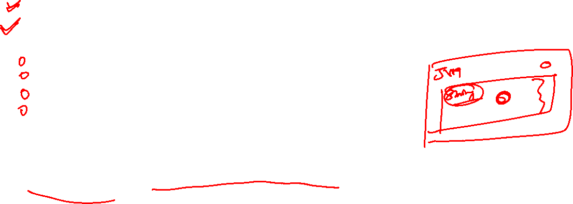
Spring Bean Scopes
Spring Beans are defined to be used in a specific scope:
Singleton - One object instance per Spring IoC container
Prototype - Possibly many object instances per Spring IoC container
Scopes applicable ONLY for web-aware Spring ApplicationContext
Request - One object instance per single HTTP request
Session - One object instance per user HTTP Session
Application - One object instance per web application runtime
Websocket - One object instance per WebSocket instance
Java Singleton vs Spring Singleton
Spring Singleton: One object instance per Spring IoC container
Java Singleton : One object instance per JVM

Slide 25
E.g.
@Component
class NormalClass{}
@Component
@Scope(value = ConfigurableBeanFactory.SCOPE_PROTOTYPE)
class PrototypeClass{}
@Configuration
@ComponentScan
public class SimpleSpringContextLauncher {
public static void main(String[] args) {
try(var context = new AnnotationConfigApplicationContext(SimpleSpringContextLauncher.class)){
System.out.println(context.getBean(NormalClass.class));
System.out.println(context.getBean(NormalClass.class));
System.out.println(context.getBean(NormalClass.class));
System.out.println(context.getBean(PrototypeClass.class));
System.out.println(context.getBean(PrototypeClass.class));
System.out.println(context.getBean(PrototypeClass.class));
System.out.println(context.getBean(PrototypeClass.class));}}}

Slide 26
Prototype vs Singleton Bean Scope
Heading | Prototype | Singleton
Instances | Possibly Many per Spring IOC Container | One per Spring IOC Container
Beans | New bean instance created every time the bean is referred to | Same bean instance reused
Default | NOT Default | Default
Code Snippet | @Scope(value= ConfigurableBeanFactory.SCOPE_PROTOTYPE) | @Scope(value= ConfigurableBeanFactory.SCOPE_SINGLETON OR Default
Usage | Rarely used | Very frequently used
Recommended Scenario | Stateful beans | Stateless beans

Slide 27
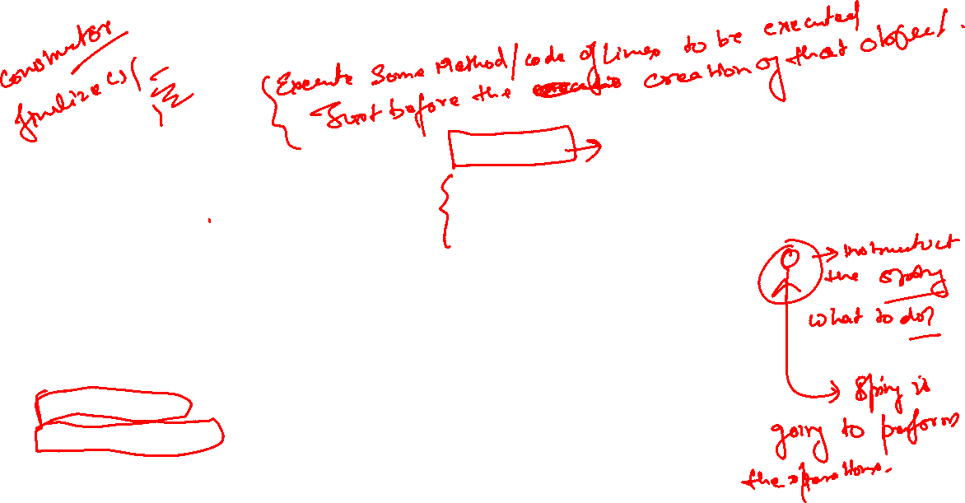
@PostConstruct & @PreDestroy
@Component
class SomeClass{
SomeDependency someDependency;
public SomeClass(SomeDependency someDependency) {
super();
this.someDependency = someDependency;
System.out.println("All Dependencies are Ready");
}
@PostConstruct
void initialize(){
someDependency.getReady();}
@PreDestroy
void cleanUp() {
System.out.println("CleanUp Activity is Done");
}}
@Component
class SomeDependency{
public void getReady() {
System.out.println("All Initialization is done");
}}

Slide 28
Jakarta Contexts & Dependency Injection (CDI)
Spring Framework V1 was released in 2004
CDI specification introduced into Java EE 6 platform in December 2009
Now called Jakarta Contexts and Dependency Injection (CDI)
CDI is a specification (interface)
Spring Framework implements CDI
Important Inject API Annotations:
Inject (~Autowired in Spring)
Named (~Component in Spring)
Qualifier
Scope
Singleton
To Add Jakarta Annotation:-
Add Libraries By Simply Adding Dependencies in pom.xml
<!-- https://mvnrepository.com/artifact/jakarta.inject/jakarta.inject-api -->
<dependency>
<groupId>jakarta.inject</groupId>
<artifactId>jakarta.inject-api</artifactId>
<version>2.0.1</version>
</dependency>

Slide 29
Spring Stereotype Annotations - @Component & more..
@Component - Generic annotation applicable for any class
Base for all Spring Stereotype Annotations
Specializations of @Component:
@Service - Indicates that an annotated class has business logic
@Controller - Indicates that an annotated class is a "Controller" (e.g. a web controller) Used to define controllers in your web applications and REST API
@Repository - Indicates that an annotated class is used to retrieve and/or manipulate data in a database
What should you use?
Use the most specific annotation possible
Why?
By using a specific annotation, you are giving more information to the framework about your intentions.
You can use AOP at a later point to add additional behavior
Example: For @Repository, Spring automatically wires in JDBC Exception translation features

Slide 30
Quick Review of Important Spring Annotations
@Configuration:- Indicates that a class declares one or more @Bean methods and may be processed by the Spring container to generate bean definitions
@ComponentScan :- Define specific packages to scan for components. If specific packages are not defined, scanning will occur from the package of the class that declares this annotation
@Bean:- Indicates that a method produces a bean to be managed by the Spring container.
@Component:- Indicates that an annotated class is a "component“
@Service:- Specialization of @Component indicating that an annotated class has business logic
@Controller:- Specialization of @Component indicating that an annotated class is a "Controller" (e.g. a web controller). Used to define controllers in your web applications and REST API @Repository Specialization of
@Repository:- indicating that an annotated class is used to retrieve and/or manipulate data in a database.
@Primary :- Indicates that a bean should be given preference when multiple candidates are qualified to autowire a single valued dependency.

Slide 31
@Qualifier:- Used on a field or parameter as a qualifier for candidate beans when autowiring.
@Lazy :- Indicates that a bean has to be lazily initialized. Absence of @Lazy annotation will lead to eager initialization.
@Scope :- (value = ConfigurableBeanFactory.SCOPE_PROTOTYPE) Defines a bean to be a prototype - a new instance will be created every time you refer to the bean. Default scope is singleton - one instance per IOC container.
@PostConstruct :- Identifies the method that will be executed after dependency injection is done to perform any initialization.
@PreDestroy :- Identifies the method that will receive the callback notification to signal that the instance is in the process of being removed by the container. Typically used to release resources that it has been holding.
@Named :- Jakarta Contexts & Dependency Injection (CDI) Annotation similar to Component.
@Inject :- Jakarta Contexts & Dependency Injection (CDI) Annotation similar to Autowired

Slide 32
Quick Review of Important Spring Concepts
Dependency Injection :- Identify beans, their dependencies and wire them together (provides IOC - Inversion of Control).
Constr. injection :- Dependencies are set by creating the Bean using its Constructor.
Setter injection :- Dependencies are set by calling setter methods on your beans.
Field injection :- No setter or constructor. Dependency is injected using reflection.
IOC Container :- Spring IOC Context that manages Spring beans & their lifecycle.
Bean Factory :- Basic Spring IOC Container.
Application Context :- Advanced Spring IOC Container with enterprise-specific features - Easy to use in web applications with internationalization features and good integration with Spring AOP.
Spring Beans :- Objects managed by Spring

Slide 33
Framework, Modules and Projects
Spring Core : IOC Container, Dependency Injection, Auto Wiring, ..
These are the fundamental building blocks to:
Building web applications
Creating REST API
Implementing authentication and authorization
Talking to a database
Integrating with other systems
Writing great unit tests
Let's now get a Spring:
Spring Framework
Spring Modules
Spring Projects

Slide 34
Framework and Modules
Spring Framework contains multiple Spring Modules:
Fundamental Features: Core (IOC Container, Dependency Injection, Auto Wiring, ..)
Web: Spring MVC etc (Web applications, REST API)
Web Reactive: Spring WebFlux etc
Data Access: JDBC, JPA etc
Integration: JMS (Java Message Services) etc
Testing: Mock Objects, Spring MVC Test etc
Why is Spring Framework divided into Modules?
Each application can choose modules they want to make use of
They do not need to make use of everything in Spring framework!

Slide 35
Spring Projects
Application architectures evolve continuously
Web > REST API > Microservices > Cloud > ...
Spring evolves through Spring Projects:
First Project: Spring Framework
Spring Security: Secure your web application or REST API or microservice
Spring Data: Integrate the same way with different types of databases : NoSQL and Relational
Spring Integration: Address challenges with integration with other applications
Spring Boot: Popular framework to build microservices
Spring Cloud: Build cloud native applications

Slide 36
Framework, Modules and Projects
Hierarchy: Spring Projects > Spring Framework > Spring Modules
Why is Spring Eco system popular?
Loose Coupling: Spring manages creation and wiring of beans and dependencies
Makes it easy to build loosely coupled applications
Make writing unit tests easy! (Spring Unit Testing)
Reduced Boilerplate Code: Focus on Business Logic Example: No need for exception handling in each method! All Checked Exceptions are converted to Runtime or Unchecked Exceptions
Architectural Flexibility: Spring Modules and Projects You can pick and choose which ones to use (You DON'T need to use all of them!)
Evolution with Time: Microservices and Cloud Spring Boot, Spring Cloud etc!

Slide 37
Thanks

