Slide 1
Harry Potter and the Chamber of Secrets
Auto-generated deck

Slide 2
Agenda
Dursley's visit and Harry's confinement
Encounter with Dobby the house elf
Dobby's warning against Hogwarts
Harry's acceptance of home

Slide 3

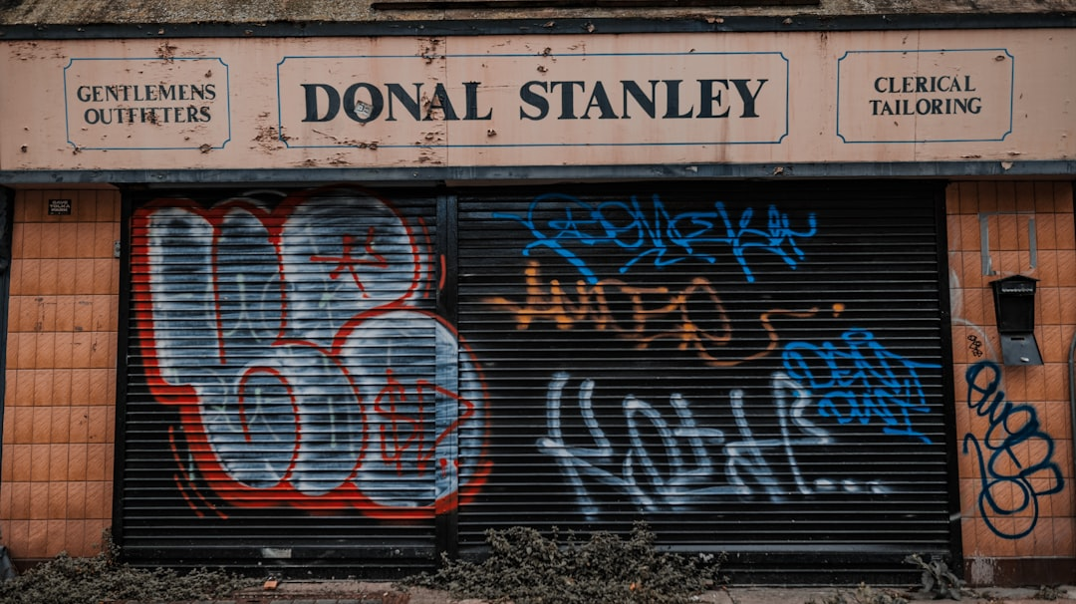
The Dursleys' Cruel Plan
Uncle Vernon's important client
Harry's confinement to his room
Isolation and anticipation
The oppressive Dursley household

Slide 4
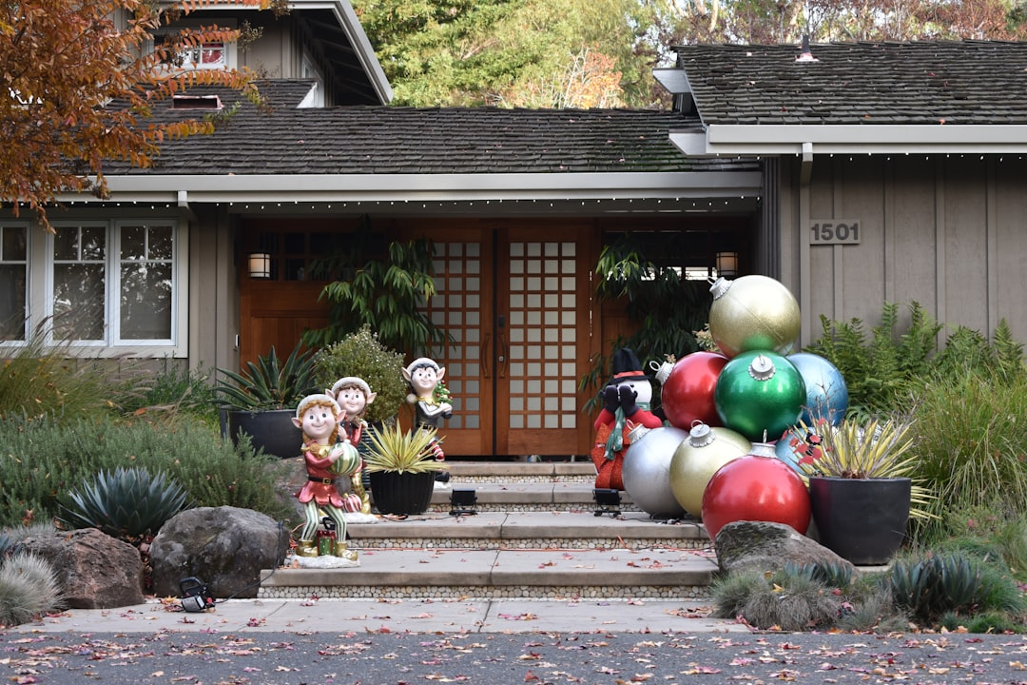
Dobby's Intervention
Dobby's unexpected appearance
The warning about Hogwarts
Dobby's magical abilities
The elf's desperate plea

Slide 5

The Weight of the Prophecy
The mystery surrounding Hogwarts
The potential dangers awaiting Harry
Dobby's desperate attempt to prevent Harry from returning
The looming threat

Slide 6
Conclusion
Harry's initial resistance to the warning
The eventual acceptance of home
A newfound sense of belonging
Looking forward to the next chapter

