Slide 1
Harry Potter and the Chamber of Secrets
Auto-generated deck

Slide 2
Agenda
Dursley's visit and Harry's confinement
Encounter with Dobby the house elf
Dobby's warning against Hogwarts
Harry's changing perspective on home

Slide 3

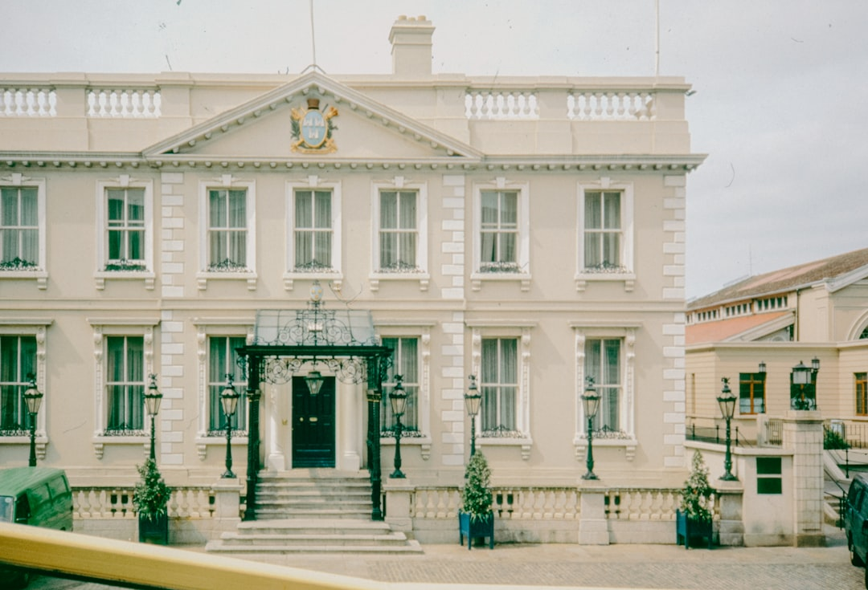
The Dursleys' Harsh Treatment
Uncle Vernon's client visit
Harry's confinement to his room
The Dursleys' cruelty and neglect
Harry's isolation and loneliness

Slide 4
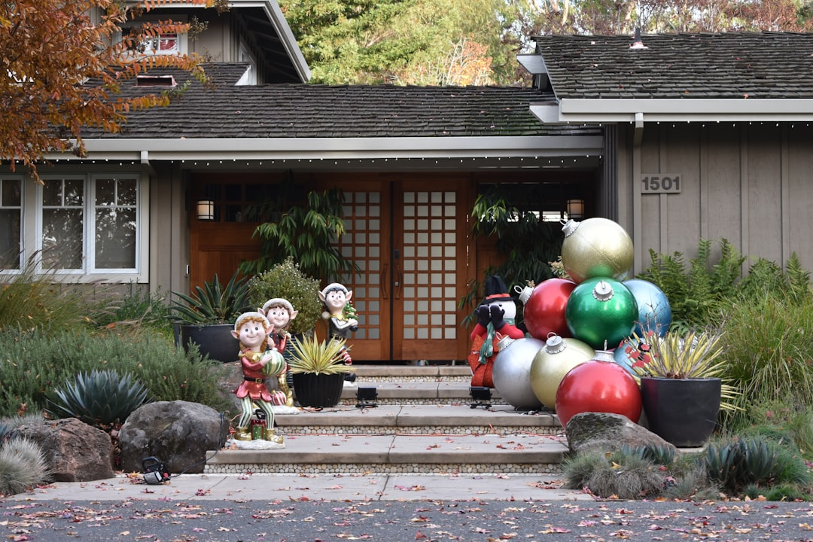
Dobby's Intervention
Dobby's unexpected appearance
Dobby's warning about Hogwarts
Dobby's attempts to prevent Harry's return
Dobby's magical abilities

Slide 5
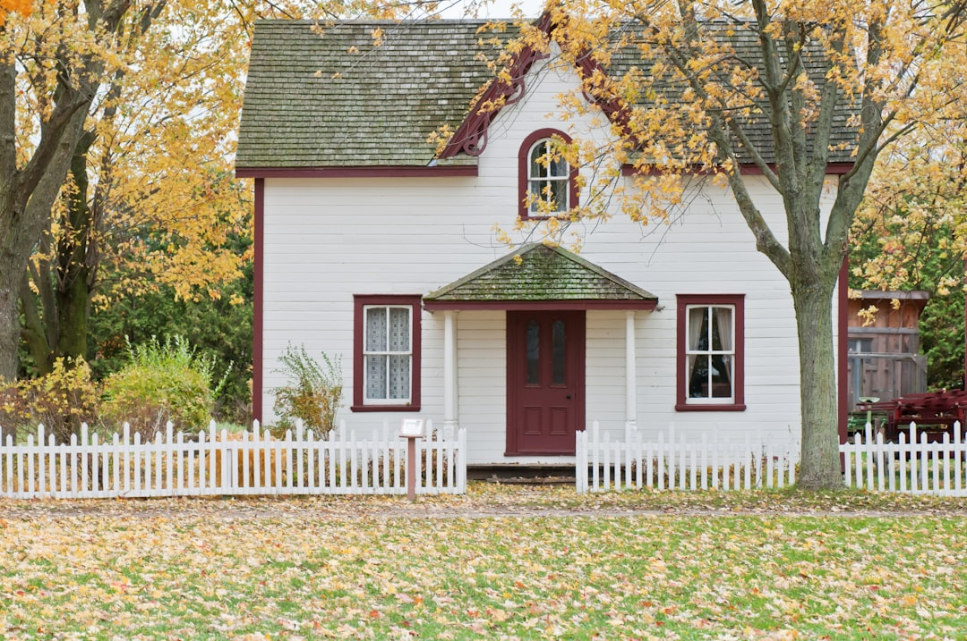
Shifting Perceptions of Home
Harry's initial feelings of discomfort
The gradual change in his perspective
The realization that home is more than just a place
Harry's emotional growth and resilience

Slide 6
Conclusion
The significance of home and belonging
Overcoming adversity and finding strength
The development of Harry's character
The foreshadowing of future events

