Slide 1
Harry Potter and the Chamber of Secrets
Auto-generated deck

Slide 2
Agenda
Dursley's visit and Harry's confinement
Encounter with Dobby the house elf
Dobby's warning against Hogwarts
Harry's changing perspective on home

Slide 3
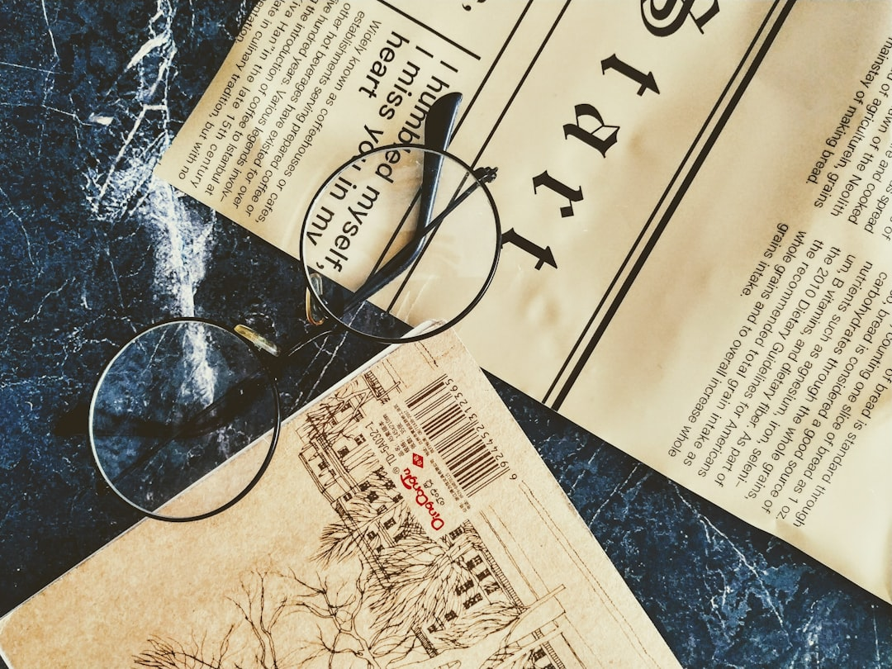
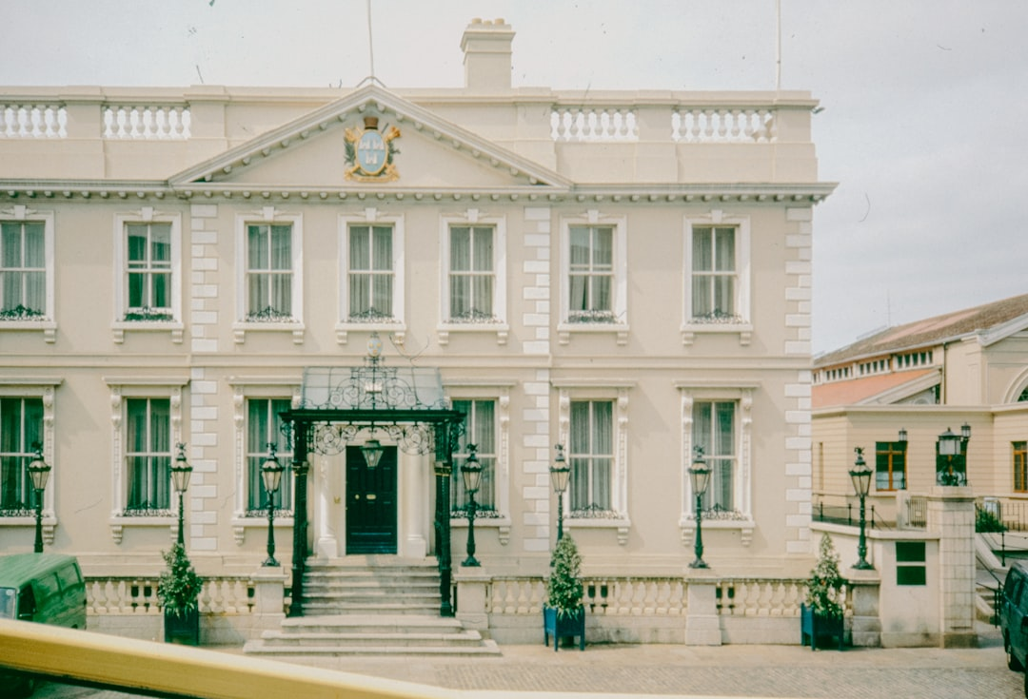
The Dursleys' Harsh Treatment
Uncle Vernon's client visit
Harry's confinement to his room
The Dursleys' cruelty and neglect
Building tension and anticipation

Slide 4
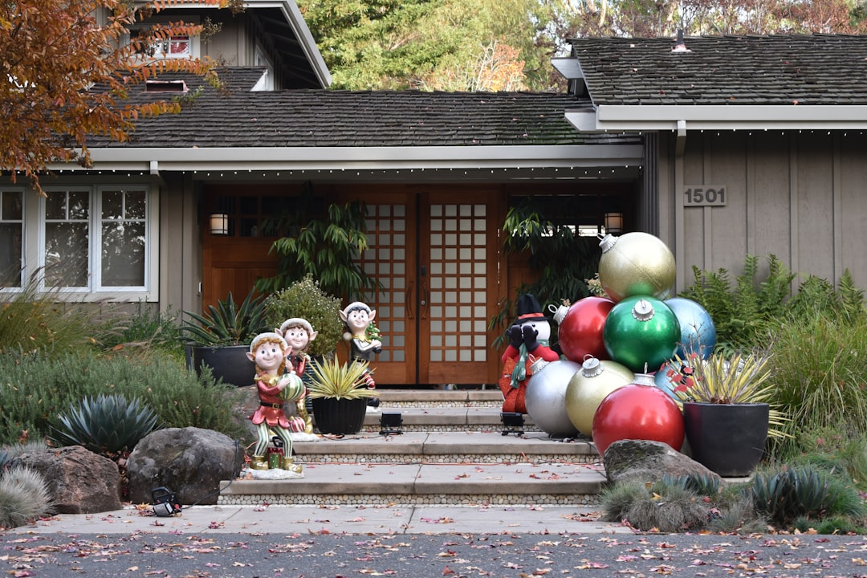
Meeting Dobby
Dobby's appearance and mannerisms
The elf's warning about Hogwarts
Dobby's attempts to prevent Harry's return
Introduction of magical conflict

Slide 5
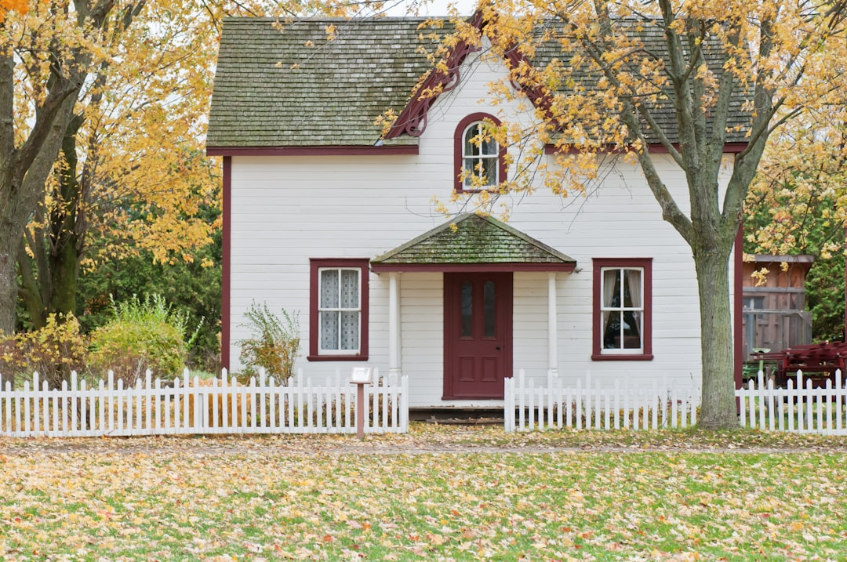
Harry's evolving understanding of home
Shift in Harry's perspective
The significance of home and belonging
Contrast between the Dursleys' house and Hogwarts
Emotional growth and maturity

Slide 6
Conclusion
The resolution of the conflict
Harry's acceptance of his true home
Themes of family, belonging, and acceptance
Anticipation for future adventures

