Slide 1
Deep Boltzmann Machine:
A Basic Understanding
Presented By: Harshit Singh 226511

Slide 2
CONTENTS
*
*
*
*
*
*
Types of BM
Energy Function of DBMs
Limitations of BM
Learning in DBMs
Architecture of DBM
Application of DBMs

Slide 3
Types Of Boltzmann Machines
Restricted Boltzmann Machine (RBM):
An RBM is a two-layer neural network used for dimensionality reduction and feature learning by modeling the probability distribution of input data.
Deep Boltzmann Machine (DBM):
A DBM is an extension of RBM with multiple hidden layers, capable of capturing complex hierarchical features and used for tasks like image generation.
Deep Belief Network (DBN):
A Deep Belief Network is a type of generative neural network composed of stacked (RBMs), enabling hierarchical feature learning and representation in data.

Slide 4
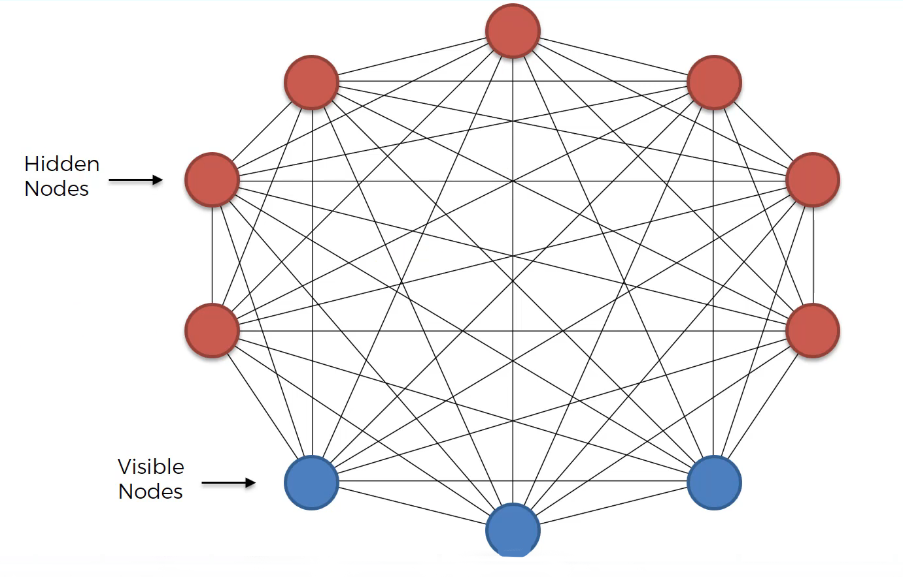
Boltzmann Machine

Slide 5
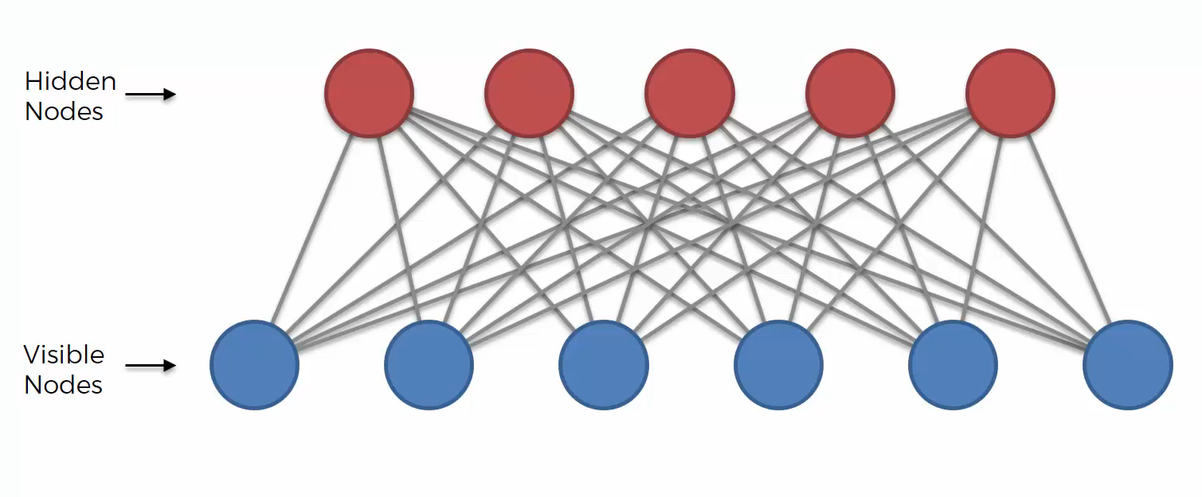
RESTRICTED BOLTZMANN MACHINE

Slide 6

Merit/Demerits of Boltzmann Machines
Mode collapse can occur in BMs, limiting output variety.
Traditional Boltzmann Machines (BMs) lack depth for capturing complex patterns.
BMs struggle with training difficulty and vanishing gradients.
Deep Boltzmann Machines (DBMs) mitigate these issues with layered architecture.
DBMs better handle inference and sampling challenges and DBMs offer scalability for complex data.
DBMs potentially enhance generalization by capturing higher-level abstractions.

Slide 7
What is Deep Boltzmann Machine ?
Enhanced Depth: DBMs feature multiple hidden layers for capturing complicated hierarchical patterns in data.
Training Challenges: DBMs diminish issues like vanishing gradients and mode collapse through their layered architecture.
Inference and Sampling: DBMs facilitate more efficient approximations for inference and sampling tasks.
Generalization: By capturing higher-level abstractions, DBMs potentially improve generalization to diverse tasks.
Scalability: DBMs offer scalability for complex, high-dimensional datasets, making them suitable for various applications.

Slide 8
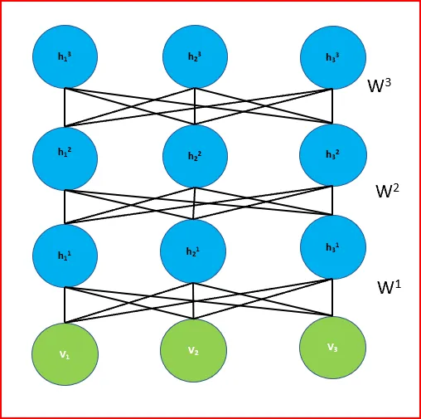
Architecture Of DBMs
Hidden Layers
Visible Layers

Slide 9
Energy Function in DBMs
The energy function E for a Deep Boltzmann Machine is defined as:
E(v, h^(1), h^(2), ..., h^(L)) = -∑(i) a_i^(v) v_i - ∑(j=1)^L ∑(k) a_k^(h^(j)) h_k^(j) - ∑(j=1)^L-1 ∑(k) ∑(l) h_k^(j) W_kl^(j, j+1) h_l^(j+1)
Where:
v is the vector of visible units' states.
h^(j) is the vector of hidden units' states in layer j.
a_i^(v) and a_k^(h^(j)) are biases for visible and hidden units, respectively.
W_kl^(j, j+1) is the weight between the k-th hidden unit in layer j and the l-th hidden unit in layer j+1.
L is the number of hidden layers.

Slide 10
Learning in Deep Boltzmann Machines
Layer-wise Pretraining: RBMs in each layer are pretrained unsupervised to initialize the network's weights and biases.
Gibbs Sampling: Gibbs sampling is employed for inference and learning in DBMs, enabling the network to iteratively adjust unit states.
Contrastive Divergence (CD): CD is a common learning algorithm for DBMs, approximating the gradients needed for weight updates during training.
Fine-tuning: After pretraining, the DBM is fine-tuned using supervised or unsupervised learning techniques to optimize for specific tasks.
Regularization: DBMs can be prone to overfitting due to their complexity; regularization techniques help prevent this by constraining model complexity.
Challenges: Training DBMs can be computationally expensive, and the architecture's depth might lead to vanishing gradients during learning.
Applications: DBMs find use in various domains, such as feature learning, generative modeling, and pattern recognition.

Slide 11
Applications of Deep Boltzmann Machines
Collaborative Filtering
Dimensionality Reduction
DBMs excel in recommendation systems by capturing intricate user-item interactions for personalized suggestions.
Leverage hierarchical structure to uncover latent preferences and improve recommendation accuracy.
DBMs can learn compact representations of high-dimensional data, aiding in reducing data complexity.
Useful for tasks like visualization, compression, and efficient storage.
Image Generation
Feature Learning
DBMs can model complex image distributions, making them effective in generating realistic images.
Learn hierarchical features to capture intricate visual patterns in generated content.
DBMs learn robust features from raw data without manual feature engineering.
Extract informative representations for downstream tasks like classification, clustering, and regression.

Slide 12
“No one knows what the right algorithm is, but it gives us hope that if we can discover some crude approximation of whatever this algorithm is and implement it on a computer, that can help us make a lot of progress.”
—Andrew Ng

Slide 13
THANK YOU!

Slide 14
Fonts & colors used
This presentation has been made using the following fonts:
Kantumruy Pro
(https://fonts.google.com/specimen/Kantumruy+Pro)
#263165
#f4eef4
#f3f4ee
#ffffff

