Slide 1

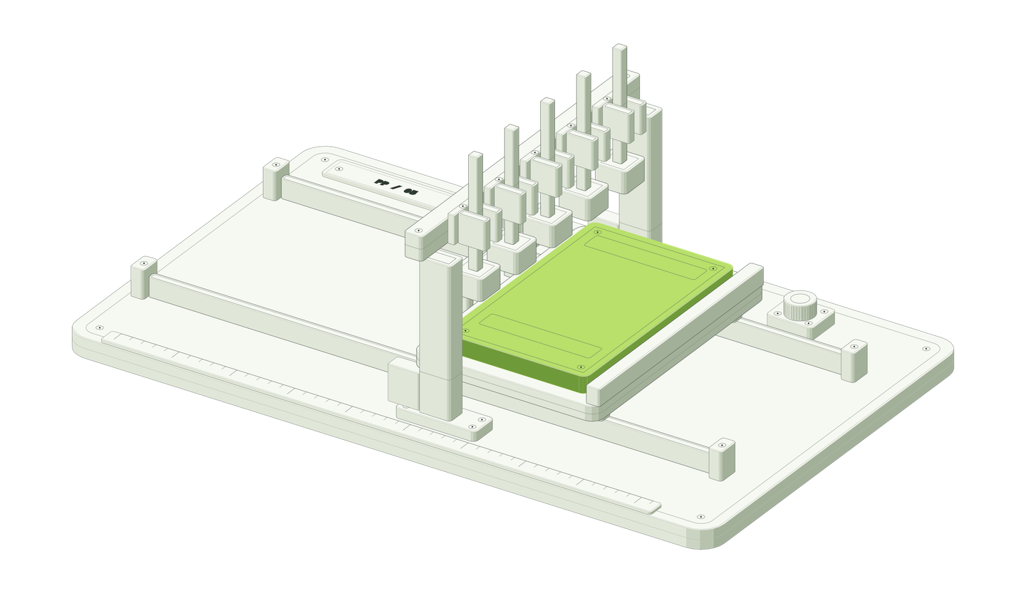


ProofPatch
eSaral Tech Team
Supply Chain
Remediation
DevSec
Notes:
10 seconds. ProofPatch turns a security advisory into a proposed fix with evidence a reviewer can replay. For this hackathon we start where Japanese SMEs actually hear about vulnerabilities: JPCERT/CC and JVN advisories. The machine on the right is our verification interlock: the patch only moves forward when all five checks retract. Today's frontend outcomes are simulated; one prepared PHP repair PR and its CI run are real.
1

Slide 2
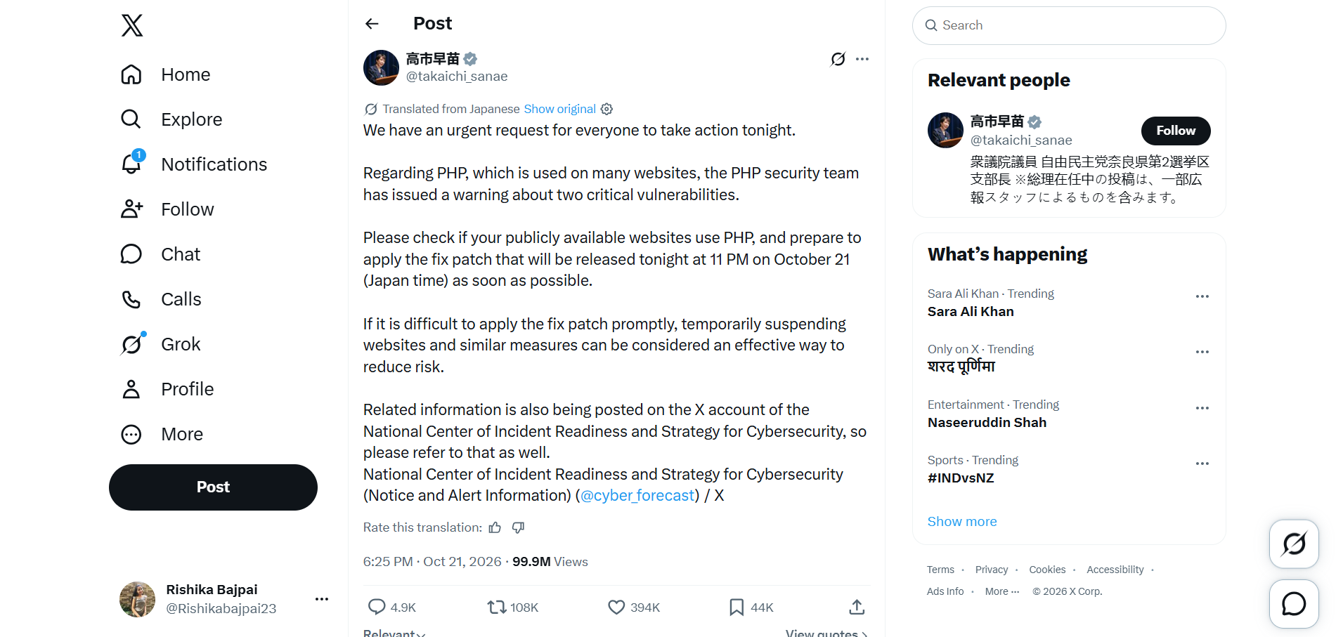
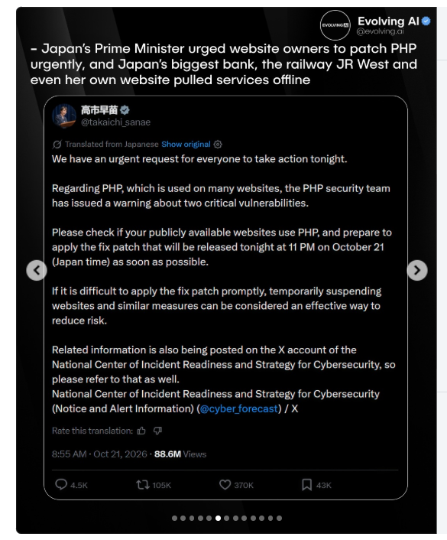
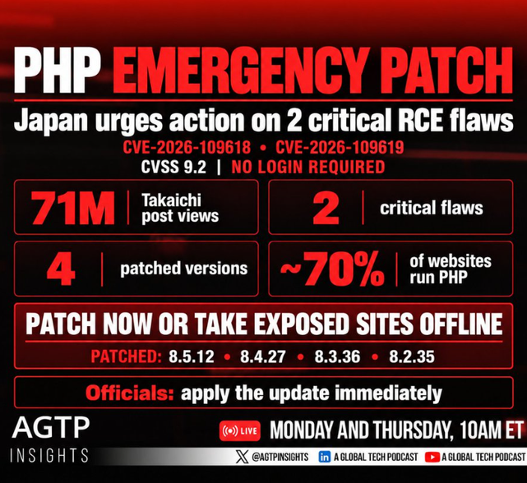

Slide 3



ProofPatch
Three security failures in six weeks
eMudhra
PHP2Shell
Gyazo
Oct 17, 2026 | Certificate authority
Oct 21, 2026 | Web runtime flaw
Sep 11, 2026 | Japanese image SaaS
-20%
9.2
23.6M
share price in a single session
CVSS: unauthenticated remote code execution
user records stolen
Private keys for 8 intermediate certificates were trivially guessable. Missed for about 18 months, across two audits. Mozilla and Google moved to distrust.
Two critical flaws affecting PHP 5.4 onward. PHP runs roughly 70% of sites with a known server language. Japan's JPCERT/CC and IPA issued alerts.
One flaw in the upload server let attackers run commands. 490M image metadata records were also accessed and image delivery was paused.
Different industries, same root cause: a flaw that slipped past review.
Notes:
45 seconds. Three recent incidents show why verified fixes matter to the business.
eMudhra (17 Oct 2026): the private keys behind eight intermediate certificates could be worked out by anyone; one key was literally the number 4. eMudhra traced it to a script error at an April 2025 key ceremony and says no systems were breached and no data lost. It went unnoticed for about 18 months, through two audit cycles. Mozilla removed the root, Chrome removal is scheduled, MeitY set up a probe, and shares fell 20% to the lower circuit.
PHP2Shell (21 Oct 2026): CVE-2026-109618 and CVE-2026-109619, both CVSS 9.2, allow unauthenticated remote code execution. Fixed in 8.2.35, 8.3.36, 8.4.27 and 8.5.12. JPCERT/CC (JPCERT-AT-2026-0033), IPA and JVN (JVNVU#99905564) published Japanese advisories. Active exploitation had not been reported at disclosure, so this is a critical flaw rather than a confirmed breach.
Gyazo, run by Kyoto-based Helpfeel (11 Sep 2026): attackers exploited a vulnerability in the image upload server to run arbitrary commands, taking about 23.62 million user records and about 490 million image metadata records.
Sources:
https://theprint.in/tech/meity-sets-up-team-to-probe-emudhra-certificate-breach-says-digital-signature-services-unaffected/3078125/
https://inc42.com/buzz/emudhras-security-key-flaw-what-went-wrong-and-why-google-mozilla-stepped-in/
https://www.kaspersky.com/blog/cve-2026-109618-109619-php-vulnerabilities/56583/
https://www.jpcert.or.jp/at/2026/at260033.html
https://bleepingcomputer.com/news/security/gyazo-server-flaw-exploited-to-steal-236-million-user-records
3

Slide 4
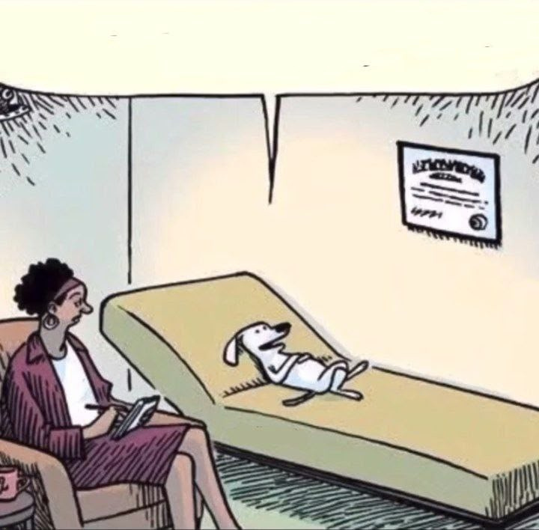
the worst i feel is when im not even at fault and the team asks me to fix it.
.
.
ProofPatch
Senior dev
Notes:
5 seconds. Let the room laugh, then move on: every one of the next three companies was vulnerable. The question is who can fix it fast, and prove the fix.
2

Slide 5
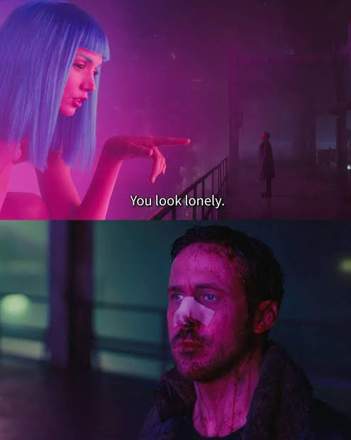
vulnerable
can fix you
ProofPatch
Notes:
5 seconds. Let the room laugh, then move on: every one of the next three companies was vulnerable. The question is who can fix it fast, and prove the fix.
2

Slide 6
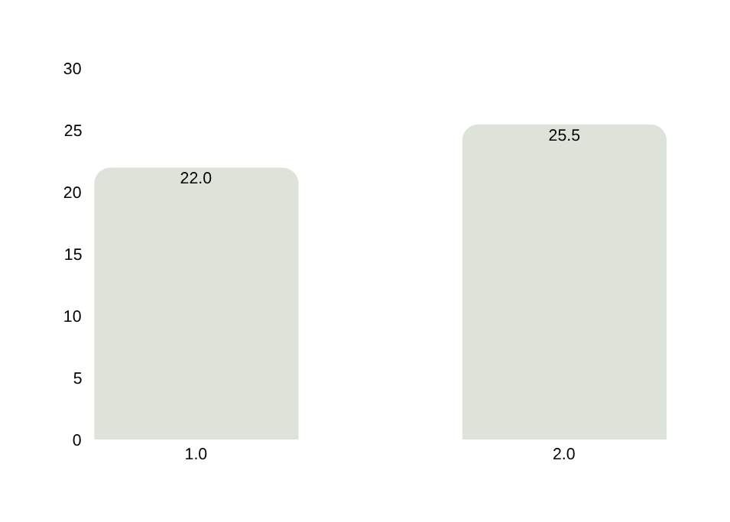
A breach is a balance-sheet event
ProofPatch
Average cost of one breach in India
31%
₹ crore, up 15.9% in a year
of breaches now begin with an exploited vulnerability, the number one way in
39,500
records exposed in an average Indian breach, up from 38,200
₹2.47 cr
average saved by organisations that test offensively, the top cost reducer
IBM Cost of a Data Breach 2026 (India, Mar 2025 to Feb 2026 breaches). Verizon 2026 DBIR (22,000+ confirmed breaches).
4
Notes:
30 seconds. IBM's 2026 report puts the average breach in India at a record ₹25.5 crore, up 15.9% from ₹22 crore. Verizon's 2026 DBIR found vulnerability exploitation is now the top way in at 31% of breaches. IBM also found offensive testing was the biggest cost reducer, saving ₹2.47 crore on average. Industry context, not proof of demand in our segment.
Sources:
https://in.newsroom.ibm.com/India-Records-its-Highest-Average-Cost-of-a-Data-Breach-2026
https://www.techrepublic.com/article/news-verizon-dbir-vulnerability-exploitation-2026/
4

Slide 7





ProofPatch
Every alert turns into unplanned engineering work
01
02
03
04
Triage
Reproduce
Repair
Review
Does this affect our app?
Can we show the failure?
Will the fix break normal use?
What evidence can we trust?
The business pays twice
Developer hours on every alert that turns out to be noise, and breach cost on the one that slips through.
Workflow pain is a hypothesis that still needs customer validation.
6
Notes:
30 seconds. Every advisory starts the same four steps: triage, reproduce, repair, review. Each pulls a developer off roadmap work. We hypothesise that reproduction and trustworthy review evidence take the most time, and that skipping them is how flaws get through. This needs customer validation.
6

Slide 8





ProofPatch
Three agents, each allowed to do one thing
Agent 1
Agent 3
Agent 2
Supply Chain Agent
DevSec Agent
Remediation Agent
Finds the upstream risk
Freezes and runs the checks
Proposes the repair
Reads JPCERT/JVN feeds and repo inventory, writes a bilingual risk brief
Records the baseline, runs isolated tests, verifies the candidate
Writes a scoped candidate branch with rationale and rollback
Cannot edit code
Cannot write the fix
Cannot touch the tests or merge
Controller: plain code, not a fourth agent
A human owns the merge
Scope, budgets, retries, and who may promote a fix
Notes:
30 seconds. Supply Chain reads approved Japanese and vendor feeds plus the repository inventory, and writes a source-backed risk brief in Japanese and English. It cannot edit code. DevSec records the affected baseline and freezes the checks before any fix is written, then verifies the candidate. It cannot write the fix. Remediation writes a scoped candidate branch. It cannot touch the frozen tests or merge. The controller is deterministic infrastructure that routes work and enforces budgets. A human always owns the merge. Planned models: Groq gpt-oss-20b for Supply Chain, gpt-oss-120b for Remediation and DevSec review; not live yet.
7

Slide 9
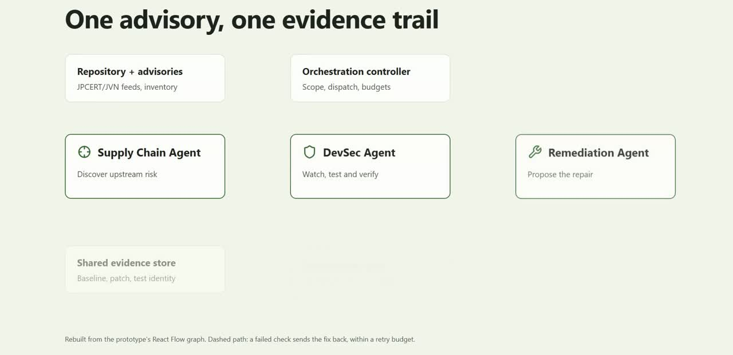
ProofPatch

Slide 10
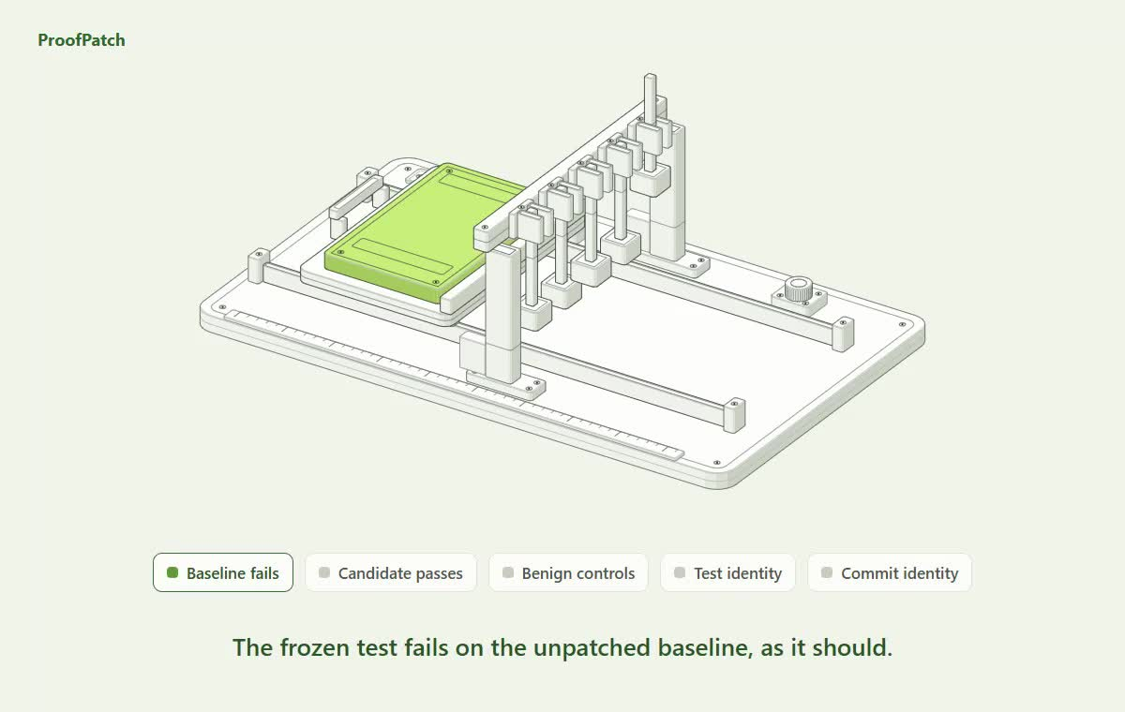
ProofPatch

Slide 11


ProofPatch
SakuraShop: a real draft fix, tested in CI
15 / 15
business checks passed in the candidate CI run
Draft PR #1
arigato-php-demo
Japanese UTF-8 product names survive
PHP 8.3.35
8.3.36
Two matcha sets total exactly ¥4,800
Only 3 files changed
Tokyo customer can read own order
Dockerfile
Another customer cannot read it
composer.json
config/security.ini
Anonymous and invalid tokens are denied
Verifier frozen: SHA-256 1273fbfe...0f30, unchanged by the fix
影響あり
要確認
人によるレビュー待ち
Affected
Config follow-up
Awaiting human review
Fictional merchant. Prepared fixture repair, not a live model run. Checks prove application behaviour, not that the RCE is unexploitable.
11
Notes:
45 seconds. This part is real. SakuraShop is a fictional Japanese merchant running PHP 8.3.35. Draft PR #1 on Harsh5840/arigato-php-demo moves it to 8.3.36 and changes only three files: Dockerfile, composer.json and config/security.ini. CI guards reject any other path, verifier change or extra Docker instruction. The candidate CI run observed PHP 8.3.36 and passed all 15 frozen business checks: Japanese UTF-8 text, integer-yen totals, own-order access, and denial of other customers and anonymous requests. The PR stays draft: the configuration follow-up is open and a human still decides. Base 78d4958, candidate 04f1399. It was prepared by hand as a fixture, not generated by a live Groq run.
Links:
https://github.com/Harsh5840/arigato-php-demo/pull/1
https://github.com/Harsh5840/arigato-php-demo/actions/runs/40111416786
11

Slide 12
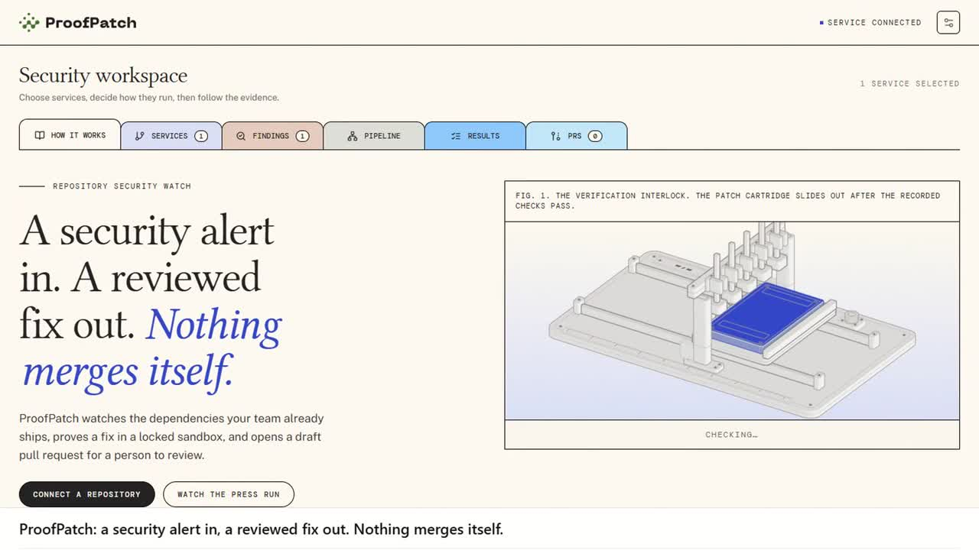

Slide 13
ProofPatch
A global market, with Japan as the first beachhead
Market size, global
Where we compete
Same engine, any feed: JPCERT / JVN first, then CERT-In, NVD, GitHub
TAM
$14.8B
ProofPatch (target)
Global application-security spend, 2026; 13.6% a year to 2031
Aikido
GitHub Autofix
Proof a fix is safe to ship →
SAM
$5.8B
Snyk Agent Fix
The ~39% spent by small and mid-sized firms, the fastest-growing segment
Local manual audits
Dependabot
SOM
$1.1M ARR
Starts from local advisories, in the team’s language →
600 workspaces by year 3: Japan 150, India 150, US / Europe 300
Entry price GitHub Code Security $30 per committer · Snyk Team from $25 · Aikido Basic $350 for 10 users · ProofPatch from ₹4,999 per workspace
TAM and SME share: Mordor Intelligence (2026). SOM: our bottom-up target, assumptions in notes. Map is a positioning hypothesis, not a benchmark.
14

Slide 14
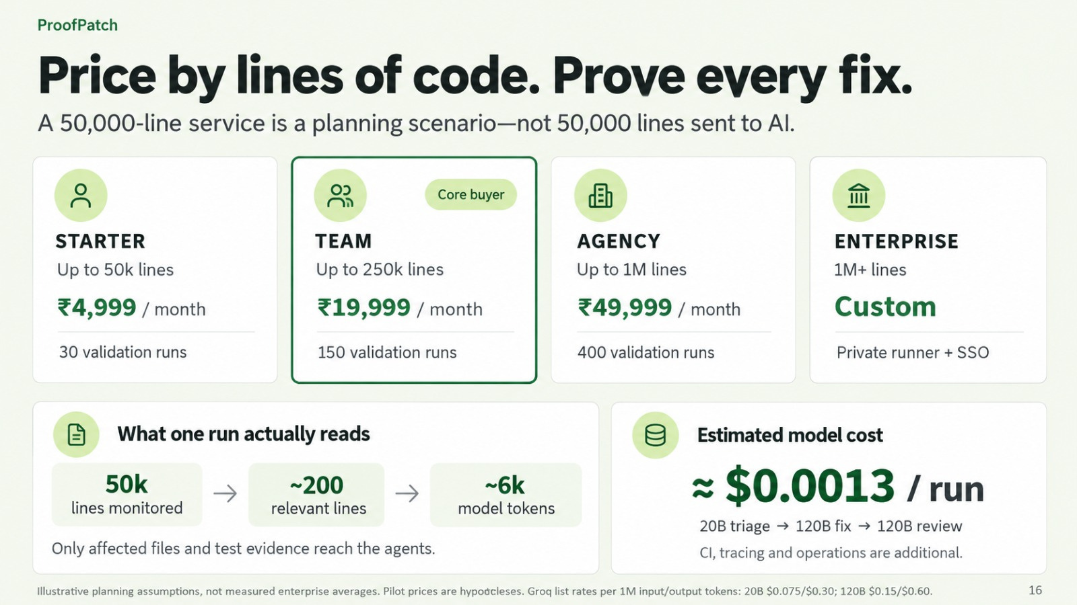
ProofPatch

Slide 15




ProofPatch
Land in through dev partners, then go global
First customer Japanese dev partners maintaining 5–50 PHP or Node sites for SME clients, with no security engineer
Buying moments a JPCERT / JVN alert · a client security questionnaire · an ISMS or P-mark audit
Months 0–3
Months 3–9
Months 9–18
Founder-led
Product-led
Partner-led
· 10 interviews via Japan–India startup programmes and Tokyo / Osaka dev meetups
· 3 design partners on owned fixtures
· Live demo: JPCERT alert to draft PR
· Free alert matcher: JPCERT / JVN against your repos, 5 runs a month
· GitHub Marketplace app; Japanese guides on Qiita and Zenn
· Each client evidence packet carries our name
· Reseller programme: 20% revenue share for dev partners
· Hosting providers, MSPs and ISMS consultants refer
· Then India, US and Europe: add a feed and a language
Target: 2 paid commitments
Target: 5% free to paid
Target: 60 workspaces, payback < 6 months
North star advisories closed with a tested draft PR, per workspace, per month
Plan and targets, not results. Japan is the beachhead; the engine is feed-agnostic. No partnerships, listings or resellers exist yet.
17

