Slide 1
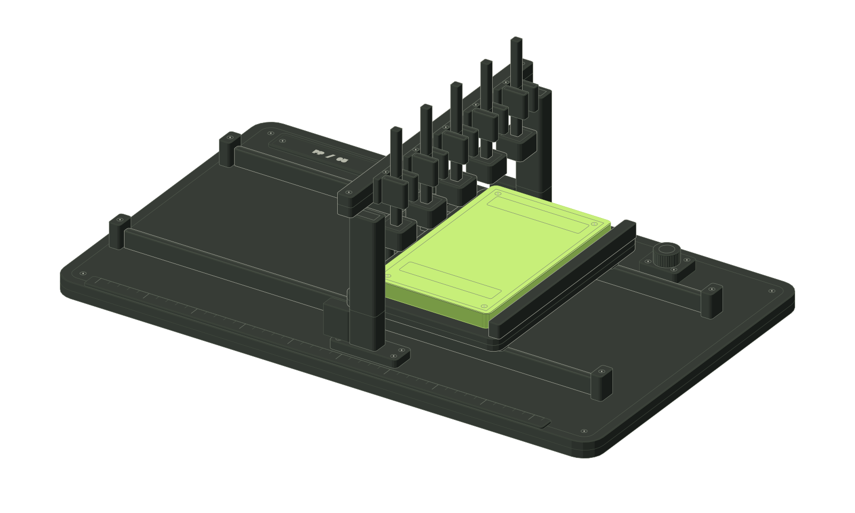
ProofPatch
The fix.
And the proof.
Security remediation that a
reviewer can actually verify.
Supply Chain
Remediation
DevSec
Hackathon / Checkpoint 1
01
Notes:
10 seconds. ProofPatch helps a reviewer check a proposed security fix. Our four-person team is testing this concept for small TypeScript SaaS teams. Today’s prototype uses synthetic data.

Slide 2
ProofPatch
An alert starts the work.
Triage
Does this affect our app?
31%
Reproduce
Can we show the failure?
Repair
Will it break normal behavior?
Review
What evidence can we trust?
of breaches began with
vulnerability exploitation
Verizon 2026 DBIR, using 2025 incident data. Workflow pain still needs customer validation.
02
Notes:
50 seconds. An alert starts a sequence of triage, reproduction, repair and review. We hypothesize that realistic reproduction and trustworthy review evidence consume valuable developer time. Verizon reports 31% of breaches started with vulnerability exploitation in the 2026 DBIR, based on 2025 incident data. That is industry context, not proof of demand in our target segment.
Sources:
https://www.verizon.com/about/news/breach-industry-wide-dbir-finds

Slide 3
ProofPatch
A small team. A real review problem.
5–30
GET /invoices/inv_1042
developers
Signed in as Tenant B
200
Tenant A’s invoice is returned.
TypeScript / Node SaaS
CTO buys. Developer uses.
No dedicated AppSec engineer.
The reviewer needs to prove the boundary holds.
Synthetic example. Initial customer segment and pain are hypotheses, not interview findings.
03
Notes:
45 seconds. Our initial customer hypothesis is a SaaS team of 5–30 developers without dedicated AppSec staff. The CTO buys and a developer uses the product. In this synthetic invoice fixture, Tenant B receives Tenant A’s invoice. The reviewer must establish the tenant boundary without breaking the legitimate owner’s access. We have not conducted customer interviews yet.

Slide 4
ProofPatch
Three roles. One evidence gate.
1
Supply Chain
3
DevSec
2
Remediation
Inventory + advisory risk
Baseline + frozen checks
Updates + code repairs
Candidate returns to DevSec for independent replay.
Baseline fails
Candidate passes
Benign controls pass
Test IDs match
Commit IDs match
DevSec freezes baseline checks before repair. Controller routes work; gate holds unresolved follow-up. Human merges.
04
Notes:
30 seconds. Supply Chain matches inventory to upstream advisories and compromise signals. Remediation proposes supported updates and scoped repairs. Development Security monitors local changes, records the baseline before candidate writes, freezes checks and verifies repairs. The controller routes jobs; a deterministic gate enforces checks and outstanding incident/configuration review. Remediation cannot edit frozen tests. A human owns the merge. PHP runtime and compromised Composer releases require different responses. Sources: https://www.php.net/archive/2026.php and https://github.com/intercom/intercom-php/security/advisories/GHSA-gr3r-crp5-qrrm

Slide 5
ProofPatch
Block the attack. Preserve the customer.
Security replay
Benign regression
Tenant B → Tenant A invoice
Invoice owner → own invoice
200
404
200
200
Unauthorized request denied
Legitimate access preserved
If either check fails, hold the patch.
Illustrative fixture results. This demonstrates a regression workflow, not comprehensive pentesting.
05
Notes:
30 seconds. The cross-tenant request changes from 200 to 404, while the owner still receives 200. Security replay passing is insufficient if benign behavior fails. In the demo, choose Regression fails to hold the interlock, then retry with all checks passing. These results are simulated; this is a bounded regression workflow, not comprehensive pentesting.

Slide 6
ProofPatch
Focus on the last mile of security review.
Existing product | Documented capability
Dependabot | Dependency security-update PRs
GitHub Agentic Autofix | Code fixes, CodeQL rerun, draft PR
Snyk Agent Fix | Agentic remediation for code findings
Aikido Infinite | Continuous testing, AutoFix, retesting
Our proposed focus
Portable tenant-boundary tests + customer-owned execution
Official vendor descriptions; full source links in notes. Product advantage remains unproven.
06
Notes:
30 seconds. Existing vendors already cover automated fixes and verification. The listed capabilities are vendor-documented claims, not independent benchmarks. Our proposed focus is portable tenant-boundary regression packs, customer-owned execution and low-friction onboarding for small teams. We must compare that proposition with existing tools before claiming an advantage.
Sources:
https://docs.github.com/en/code-security/concepts/supply-chain-security/dependabot-security-updates
https://github.blog/changelog/2026-10-15-agentic-autofix-for-code-scanning-alerts-general-availability/
https://docs.snyk.io/scan-fix-and-prevent/scan-with-snyk/snyk-code/manage-code-vulnerabilities/fix-code-vulnerabilities-automatically
https://www.aikido.dev/blog/introducing-aikido-infinite

Slide 7
ProofPatch
Price the outcome. Bound the compute.
₹4,999
Monthly assumption | Base case | Cost stress
Run cost | ₹25 | ₹100
Total variable cost | ₹1,250 | ₹3,500
Contribution | 75% | 30%
per workspace / month
3 repositories
30 bounded validation runs
30 runs + ₹500 infrastructure
Pricing hypothesis
Illustrative economics; excludes support, salaries, tax, payment fees and sales.
07
Notes:
25 seconds. Pricing hypothesis: ₹4,999 per workspace per month, including three repositories and 30 bounded runs. At an assumed ₹25 per run plus ₹500 infrastructure, monthly variable cost is ₹1,250 and contribution is approximately 75%. At ₹100 per run, cost rises to ₹3,500 and contribution falls to 30%. These assumptions exclude support, salaries, tax, payment fees and sales. Willingness to pay and actual costs are unmeasured.

Slide 8
ProofPatch
Earn three pilots before expanding.
10
5
3
2
Interviews
Observations
Scoped pilots
Paid commitments
Understand the last alert
Watch the real work
Use owned fixtures
Test willingness to pay
Start with incubators and SaaS communities.
Proposed validation targets. No interviews, pilots, paid commitments or partnerships have been obtained.
08
Notes:
25 seconds. Before expanding, target ten interviews, five observed remediation workflows, three scoped pilots and two paid commitments. Start with incubators and SaaS communities, then publish a reproducible demo. These are proposed validation targets, not achieved traction or existing partnerships.

Slide 9
ProofPatch
Measure the work a developer gets back.
30%
Trust before scale
No bad-patch promotion on the controlled benchmark
less active remediation time
Evidence a reviewer can replay
Costs measured with retries included
Target on matched pilot tasks.
Benchmark against the current workflow.
Targets, not results. Scenario: 100 workspaces × ₹4,999 × 12 = ₹59.988 lakh annual revenue; not market size.
09
Notes:
25 seconds. Target 30% less active developer remediation time on matched pilot tasks compared with the current workflow. Track invalid patch promotion, review usefulness, onboarding and compute costs including retries. No savings have been demonstrated. A revenue scenario of 100 workspaces at ₹4,999 for 12 months equals ₹59.988 lakh; this is not market size, traction or a forecast.

Slide 10
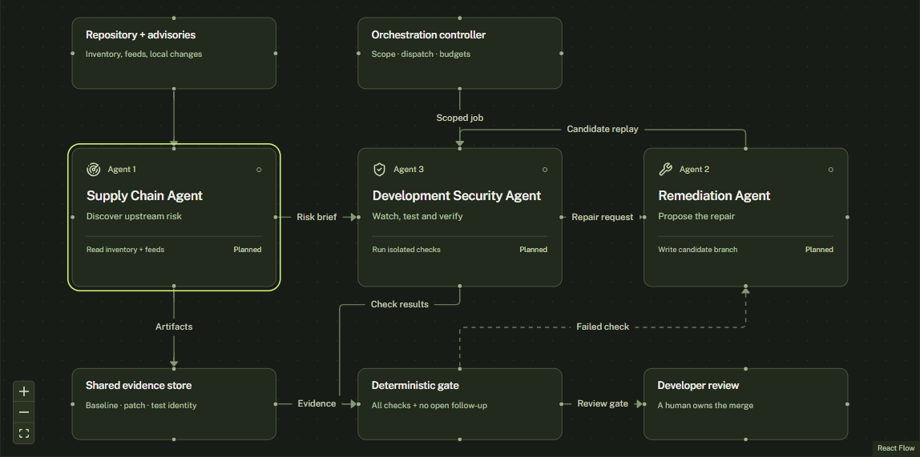
ProofPatch
The workflow is ready to demonstrate.
Built for Checkpoint 1
React Flow agent diagram
Blocked regression path
Review + trace export
Next: one real loop
Scanner → isolated fixture
→ tested patch → draft PR
Four-member team. Current outcomes are synthetic. The 48-hour MVP window remains provisional.
10
Notes:
30 seconds including a short demo. Show Run demo, the patch, evidence and the failed-regression gate. The Next.js frontend, Anatomy interlock, Bklit gauge, local draft preview and JSON export are implemented with synthetic data. Real scanners, agent execution, isolated tests and GitHub integration are next. Four members own frontend, scan ingestion, testing/fixing, and orchestration/research respectively. The 48-hour window is provisional. Ask for three design partners.

Slide 11
ProofPatch
Keep execution inside a bounded runner.
Reviewer
Orchestrator
Runner
Next.js UI
Hono + bounded jobs
Customer-owned fixture
Pinned commits
Frozen test identity
Scoped tokens
Run budgets
Human merge review
Postgres records + scrubbed evidence artifacts
Planned architecture. Only the reviewer frontend is implemented today.
11
Notes:
Backup. Proposed architecture: Next.js reviewer UI; Hono orchestration and a bounded queue; customer-owned isolated runner; Postgres records and scrubbed evidence artifacts. Pin commits and test identity, scope tokens, enforce budgets and require human merge review. Only the frontend is implemented today. OSV supplies dependency intelligence. ZAP baseline is passive scanning, not a pentest.
Sources:
https://google.github.io/osv-scanner/
https://www.zaproxy.org/docs/docker/baseline-scan/

Slide 12
ProofPatch
Evidence behind the idea.
Verizon 2026 DBIR
Breach context, based on 2025 data
GitHub Dependabot + Agentic Autofix
Security updates, code fixes and verification
Snyk Agent Fix
Agentic remediation documentation
Aikido Infinite
Continuous testing, fixes and retesting
OSV-Scanner + ZAP baseline
Tool options and passive-scan limits
Synthetic prototype. Real customer validation comes next.
Full URLs in speaker notes and PRD. Prices, savings and adoption targets are hypotheses.
12
Notes:
Backup. Sources were checked on 24 October 2026. Vendor capabilities have not been independently benchmarked. The prototype is synthetic. Pricing, demand, differentiation, adoption and savings remain hypotheses. Full links follow.
Sources:
https://www.verizon.com/about/news/breach-industry-wide-dbir-finds
https://github.blog/changelog/2026-10-15-agentic-autofix-for-code-scanning-alerts-general-availability/
https://docs.github.com/en/code-security/concepts/supply-chain-security/dependabot-security-updates
https://docs.snyk.io/scan-fix-and-prevent/scan-with-snyk/snyk-code/manage-code-vulnerabilities/fix-code-vulnerabilities-automatically
https://www.aikido.dev/blog/introducing-aikido-infinite
https://google.github.io/osv-scanner/
https://www.zaproxy.org/docs/docker/baseline-scan/

