Slide 1
ProofPatch
Ship the fix.
Keep the proof.
Three agents. One reviewable security workflow.
For small SaaS teams protecting customer data
without a dedicated AppSec engineer.
ProofPatch / Checkpoint 1
01
Notes:
10 seconds. Working name, not trademark-cleared. Introduce the user: small TypeScript SaaS teams. This is a Checkpoint 1 concept and simulated prototype. Four-member team. No customer traction claimed.

Slide 2
The gap between finding and fixing matters.
31%
01
Find the relevant risk
02
Reproduce it in our app
of breaches began with
vulnerability exploitation
03
Patch without breaking behavior
04
Give the reviewer usable evidence
Verizon 2026 DBIR
Based on 2025 incident data
Source: Verizon 2026 DBIR announcement. Industry context does not establish demand for ProofPatch.
ProofPatch / Checkpoint 1
02
Notes:
50 seconds. Industry context only, not target-customer prevalence. Verizon 2026 DBIR uses 2025 incident data. The workflow pain is a hypothesis to validate, not a result from interviews. Source: https://www.verizon.com/about/news/breach-industry-wide-dbir-finds

Slide 3
Start with a specific developer workflow.
Initial customer hypothesis
“Can I merge this fix
without breaking a customer?”
5–30 developers
TypeScript / Node SaaS
Tenant-scoped customer data
Alert context is incomplete.
Reproduction needs real application setup.
Review evidence is scattered.
CTO buys. Developer uses.
No dedicated AppSec engineer.
Validation needed: observe five real workflows and identify the largest source of active developer effort.
ProofPatch / Checkpoint 1
03
Notes:
45 seconds. Customer profile and pain remain hypotheses. No interviews completed. We will ask for a walkthrough of actual recent remediation work and artifacts instead of hypothetical enthusiasm.

Slide 4
Three roles. A gate no agent can override.
01
02
03
Scout
Challenger
Fixer
Map dependencies and code signals. Prioritize with context.
Reproduce the failure. Freeze the security test and benign controls.
Propose a scoped patch. Explain compatibility and tradeoffs.
REPLAY + POLICY GATE
Baseline fails. Candidate passes. Normal behavior survives.
Matching test and commit identities. Human review owns the merge.
ProofPatch / Checkpoint 1
04
Notes:
30 seconds. Scout reads approved signals. Challenger runs bounded checks. Fixer proposes a minimal change. Challenger reruns frozen tests. Separate agents alone do not prove independence. Deterministic evidence requirements and permission boundaries matter more than agent count.

Slide 5
One failure a judge can understand.
Tenant B requests Tenant A’s invoice.
Before
After proposed fix
200
404
Unauthorized data access
Access denied; owner still gets 200
If legitimate access breaks, the patch is blocked. All outcomes here are simulated.
ProofPatch / Checkpoint 1
05
Notes:
30 seconds. This example is synthetic. Tenant B must not read Tenant A invoice. After the tenant-scoped query, cross-tenant access returns 404 while the owner still gets 200. A failed legitimate-use test blocks promotion. This is a regression demonstration, not a claim of comprehensive pentesting.

Slide 6
The competition already fixes and verifies.
Alternative | Documented capability
Dependabot | Dependency security-update pull requests
GitHub Agentic Autofix | Code fixes, CodeQL rerun, draft PR for review
Snyk Agent Fix | Agentic remediation for Snyk Code findings
Aikido Infinite | Continuous testing, AutoFix and retesting
Our proposed focus
Portable tenant-boundary regression packs, customer-owned execution,
and bounded onboarding for small teams.
ProofPatch / Checkpoint 1
06
Notes:
30 seconds. No false novelty claims. All capability descriptions are official vendor claims, not independent benchmarks. GitHub GA on October 15 2026. Proposed focus needs validation against these products. Sources: github: https://github.blog/changelog/2026-10-15-agentic-autofix-for-code-scanning-alerts-general-availability/
dependabot: https://docs.github.com/en/code-security/concepts/supply-chain-security/dependabot-security-updates
snyk: https://docs.snyk.io/scan-fix-and-prevent/scan-with-snyk/snyk-code/manage-code-vulnerabilities/fix-code-vulnerabilities-automatically
aikido: https://www.aikido.dev/blog/introducing-aikido-infinite

Slide 7
A pilot offer with measurable economics.
₹4,999
Illustrative monthly cost
Model + compute
₹750
per workspace / month
Infrastructure
₹500
Total variable cost
₹1,250
3 repositories
30 bounded validation runs
CTO or engineering lead buys
Contribution
₹3,749 / 75%
Hypotheses, not results. At ₹100/run, contribution falls to 30%. Excludes support, salaries, tax and sales.
ProofPatch / Checkpoint 1
07
Notes:
25 seconds. Pricing is a hypothesis. ₹4,999/workspace/month for three repos and 30 bounded runs. Base illustrative cost is 30 × ₹25 plus ₹500 infrastructure = ₹1,250. Contribution ₹3,749, about 75%. At ₹100/run contribution drops to ₹1,499, about 30%. Excludes salaries, support, tax, payment fees and sales. No measured costs or willingness to pay.

Slide 8
Earn three pilots before building a platform.
10
5
3
2
interviews
observations
scoped pilots
paid commitments
Understand recent work
Watch real alert resolution
Use owned staging fixtures
Test willingness to pay
Distribution hypothesis: incubators, SaaS communities, then a reproducible GitHub demo.
Two-week validation targets. No interviews, pilots, paid commitments or partnerships are claimed today.
ProofPatch / Checkpoint 1
08
Notes:
25 seconds. No existing customers or partnerships. Proposed channels: incubators, founder and developer communities, public reproducible demo. Recruit five prospects, prioritize three pilots. The validation targets are ten interviews, five workflow observations, three pilots, two paid commitments.

Slide 9
Measure value. Keep the business claims honest.
Outcome to test
Trust to earn
30% less active remediation time on matched pilot tasks. A target, not an achieved result.
No bad-patch promotion on the controlled benchmark. Publish failures and coverage limits.
₹59.988 lakh
100 paying workspaces × ₹4,999 × 12
Illustrative annual revenue scenario.
Not market size, traction or a forecast.
ProofPatch / Checkpoint 1
09
Notes:
25 seconds. Target at least 30% lower median active developer remediation time, on matched tasks versus current tools, without increased invalid fixes. Track costs including retries. The revenue scenario is 100 × 4,999 × 12 = ₹5,998,800 = ₹59.988 lakh, not TAM or forecast. If evidence does not improve review or onboarding is too expensive, narrow the product or stop.

Slide 10
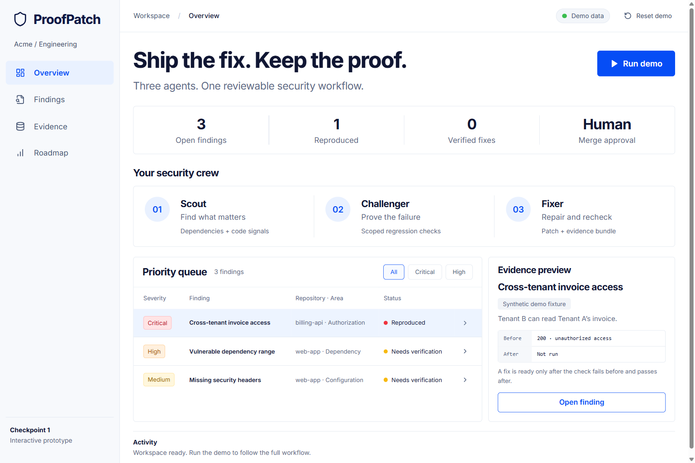
Checkpoint 1: show the workflow, state the limits.
Built
Interactive prototype
Local workflow + failure gate
Synthetic evidence export
Next: working MVP
Real scanner + isolated fixture
Before/after test execution
Draft PR with evidence
Four-member team. Provisional 48-hour MVP plan. Ask: three design partners and feedback on trust and onboarding.
ProofPatch / Checkpoint 1
10
Notes:
30 seconds including short demo. Open http://127.0.0.1:3000 and Run demo. Frontend, state, filters, failure gate and export are built. Agents, live scans, sandbox and GitHub integration are planned. Four-member provisional 48-hour plan: A frontend/demo, B scan ingestion, C tests/fixer, D orchestration/research/pitch. Request three design partners.

Slide 11
Architecture: evidence crosses every boundary.
Reviewer UI
Orchestrator
Execution
Next.js
Hono + bounded queue
Customer-owned runner
Scout
Challenger + Fixer
Evidence gate
Advisory / code signals
Baseline / patch / replay
Deterministic rules
Postgres records + scrubbed artifact store
Pinned commits and frozen tests. Scoped tokens. Allowlisted staging.
Run budgets. Human review. No autonomous production merge.
ProofPatch / Checkpoint 1
11
Notes:
Backup slide. Proposed architecture, not deployed infrastructure. Next.js frontend only is implemented. Hono API orchestrates bounded jobs. Customer-owned ephemeral runners execute tests. Postgres stores entities and jobs, object storage stores scrubbed evidence. No production exploitation or automatic merging. OSV for dependency intelligence. ZAP baseline is passive, not a pentest. Sources: https://google.github.io/osv-scanner/
https://www.zaproxy.org/docs/docker/baseline-scan/

Slide 12
Sources and status
Verizon 2026 DBIR
Industry breach context
GitHub Dependabot + Agentic Autofix
Security-update PRs and code remediation
Snyk Agent Fix
Agentic remediation documentation
Aikido Infinite
Continuous testing, fixes and retesting
OSV-Scanner + ZAP baseline
Tool options and passive-scan limits
Checked 24 Oct 2026. Full URLs in speaker notes and PRD. Prototype results, pricing and pilot targets are not production evidence.
ProofPatch / Checkpoint 1
12
Notes:
Backup sources. All checked 24 October 2026. Vendor claims not independently benchmarked. Full URLs: verizon: https://www.verizon.com/about/news/breach-industry-wide-dbir-finds
github: https://github.blog/changelog/2026-10-15-agentic-autofix-for-code-scanning-alerts-general-availability/
dependabot: https://docs.github.com/en/code-security/concepts/supply-chain-security/dependabot-security-updates
snyk: https://docs.snyk.io/scan-fix-and-prevent/scan-with-snyk/snyk-code/manage-code-vulnerabilities/fix-code-vulnerabilities-automatically
aikido: https://www.aikido.dev/blog/introducing-aikido-infinite
osv: https://google.github.io/osv-scanner/
zap: https://www.zaproxy.org/docs/docker/baseline-scan/
All prices, adoption targets, differentiation and time savings are hypotheses. The prototype is synthetic.

