Slide 1
Testing and Analysis of Open Clinic Software
Harshkumar Gohil(2862904)
Nikita Kondapalli(2837105)

Slide 2

ABOUT
Healthcare management software project system designed to simplify clinic operations.
The project aims to provide a comprehensive platform for managing patient records, appointments, prescriptions, and billing.
Primary goal is to improve the efficiency and effectiveness of healthcare delivery.
Open source
The project is still in the development phase, with several features yet to be implemented.

Slide 3
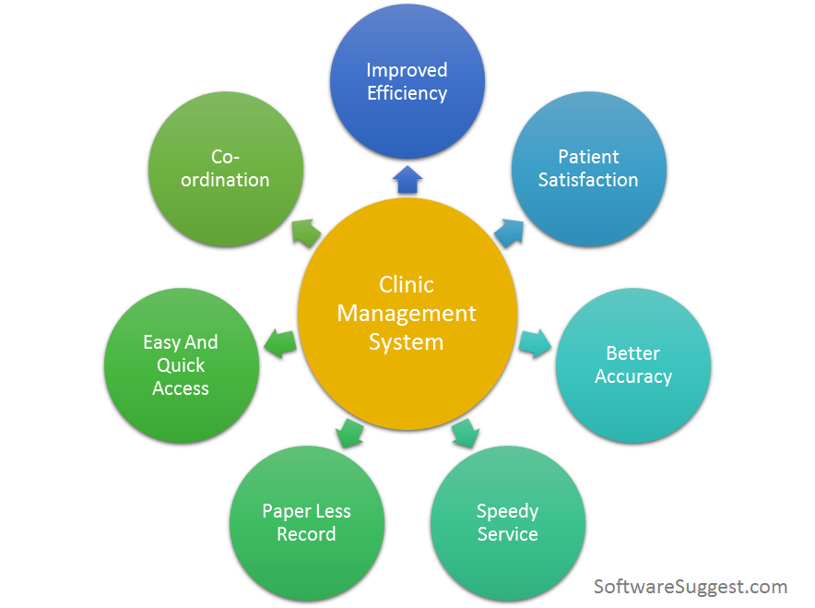
Purpose of the Open Clinic Software Project
• Develop a software application that streamlines the process of managing patient information and appointments for healthcare professionals.
• The software aims to simplify administrative tasks
• Improve patient experiences
• Digitilizing the patient records
• By centralizing patient information,
• Improve the healthcare experience for both patients and healthcare professionals

Slide 4
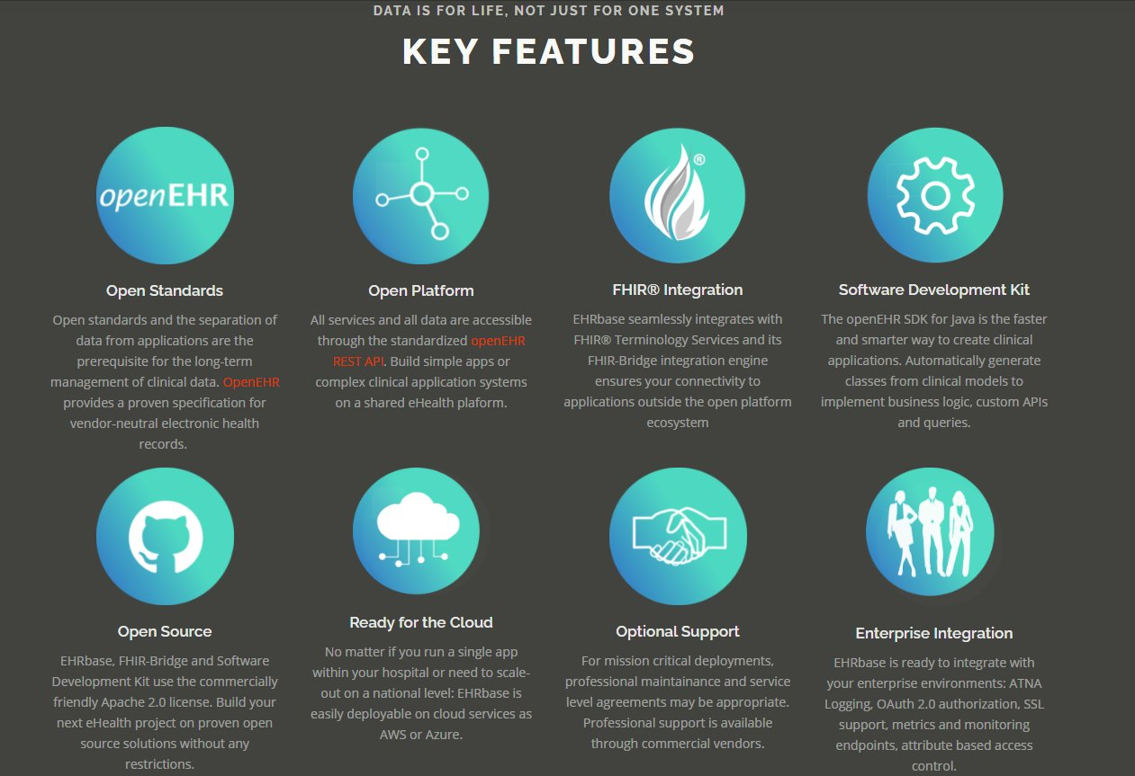
Features of the Open Clinic Software Project

Slide 5

Target Audience
• Healthcare professionals and staff
• Patients seeking medical care
• Features that meet the needs of the target audience
• Easy-to-use interface for healthcare professionals
• Online scheduling and appointment management for patients
• Electronic medical records management

Slide 6
TEST CASES
Functional Tests
User Interface Tests
Integration Tests
Performance Tests

Slide 7

Defect Reports
Bug Reports
Enhancement Requests

Slide 8
Conclusions
• Summary of the overall testing process for the Open Clinic software project
• Identifies the strengths and weaknesses of the testing approach that was used
• Discusses the lessons learned during the testing process
• Outlines the future directions for testing and development of the software
• Provides final recommendations for the Open Clinic software project

Slide 9
Thank You

