Slide 1


Campus Placement Recruitment System
Presented By: Tirth Patel (23MCA147)
Harsh Prajapati (23MCA161)
Tejas Prajapati (23MCA164)
Project Guide:
Ms. Kritika Pandy

Slide 2
Presentation Contents
Existing System
Proposed System
Diagrams
Use Case Diagram
Activity Diagram
Class Diagrams
Data Dictionary
Screen Layouts
Future Enhancement
Bibliography/References

Slide 3
Project Profile
Project Name: Campus Placement Recruitment System
Type of Application: Web Application
Project Description: This Project is aimed at developing an web application for the training and Placement Department of the College. The system is a web application that can be accessed with proper login provide.
Team Size:3 PEOPLE
Front End: HTML,CSS,JAVASCRIPT
Back End: DJANGO
Database: SQLITE 3
Tools used: VISUAL STUDIO CODE

Slide 4
Existing System
The existing manual placement management system is inefficient and error-prone, requiring significant time and effort to collect and maintain student data, which leads to inaccuracies, confidentiality risks, and difficulties in tracking progress, ultimately hindering effective placements for students and employers.

Slide 5
Proposed System
Web-Based System: The proposed system is an online placement management System designed to streamline the collection and organization of student data, reducing the time and manpower required for manual processes.
User-Friendly Access: The application supports multiple user roles—such as placement officers, Coordinator, and students—allowing each user to manage and upload information securely through personalized accounts.
Primary Objective : The primary objective of CPRS is to provide a one-stop solution for managing the entire placement process, from registration to job offers.

Slide 6
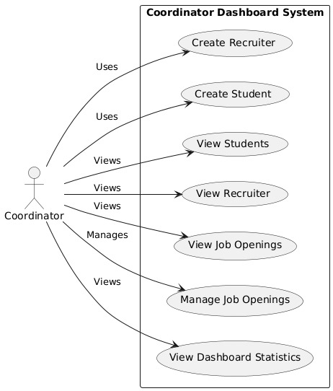
Use Case Diagram Coordinator

Slide 7
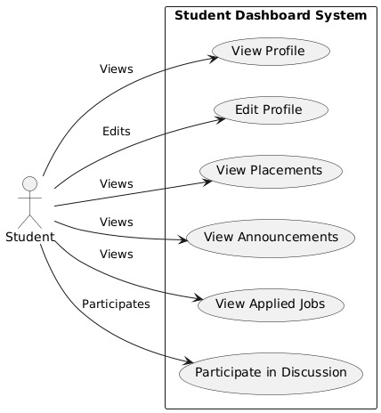
Use Case Diagram Student

Slide 8
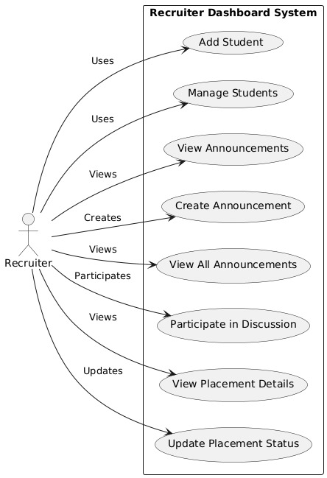
Use Case Diagram Recruiter

Slide 9
Activity Diagram Coordinator
View Diagram

Slide 10
Activity Diagram Recruiter
View Diagram

Slide 11
Activity Diagram Student
View Diagram

Slide 12
SCREEN LAYOUT

Slide 13
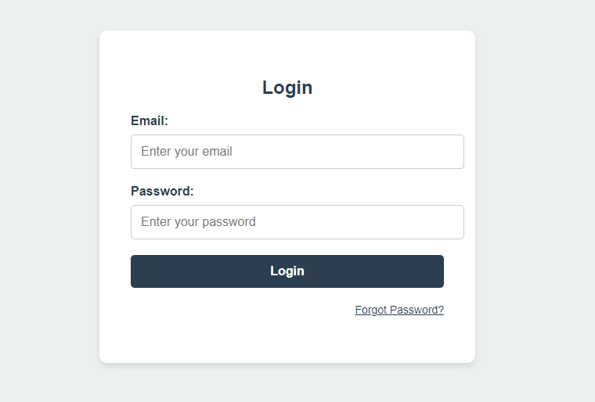
Login Form

Slide 14
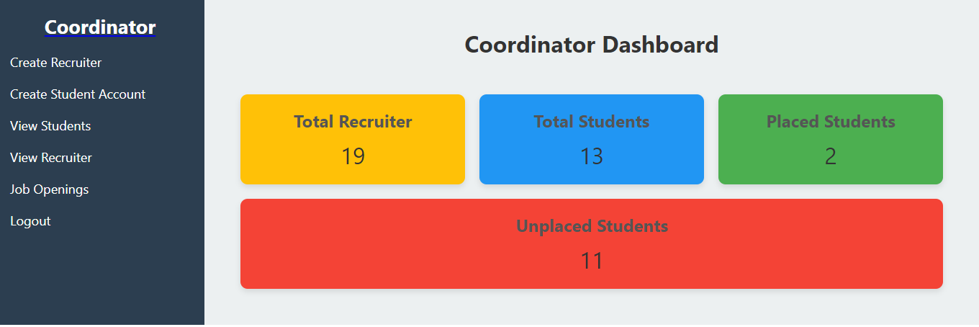
Coordinator Dashboard

Slide 15
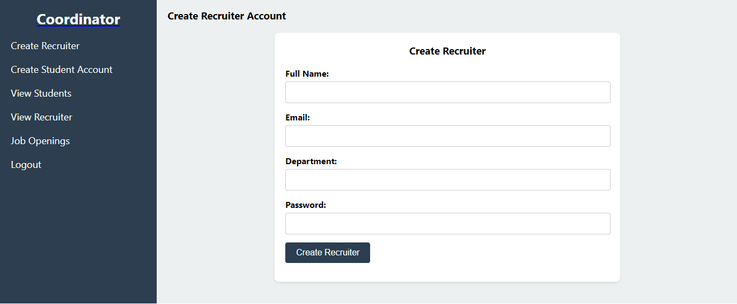
Recruiter Creation

Slide 16
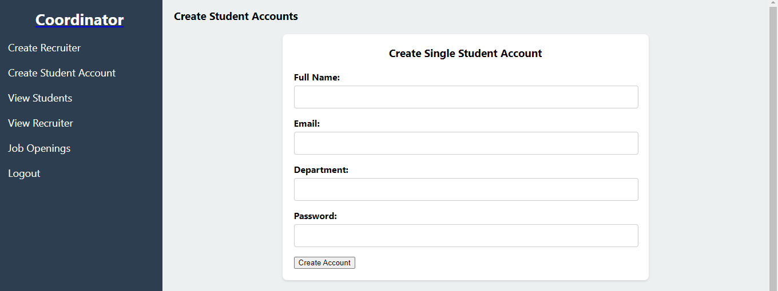
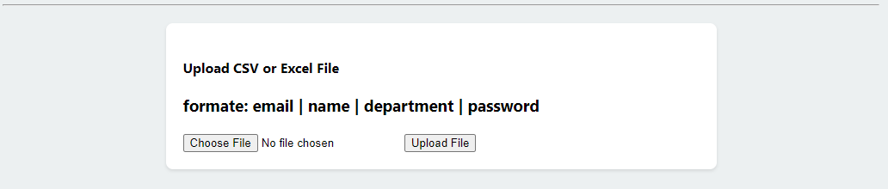
Create Student Account

Slide 17
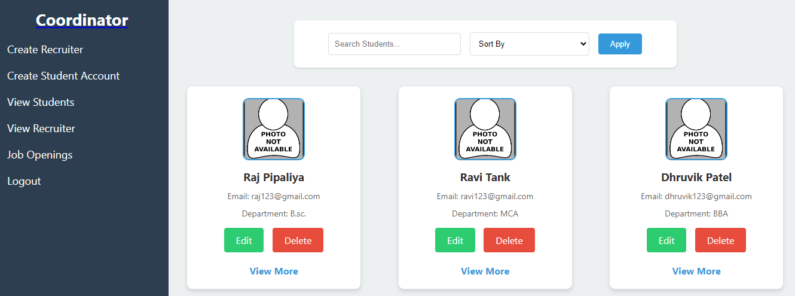
View Student

Slide 18
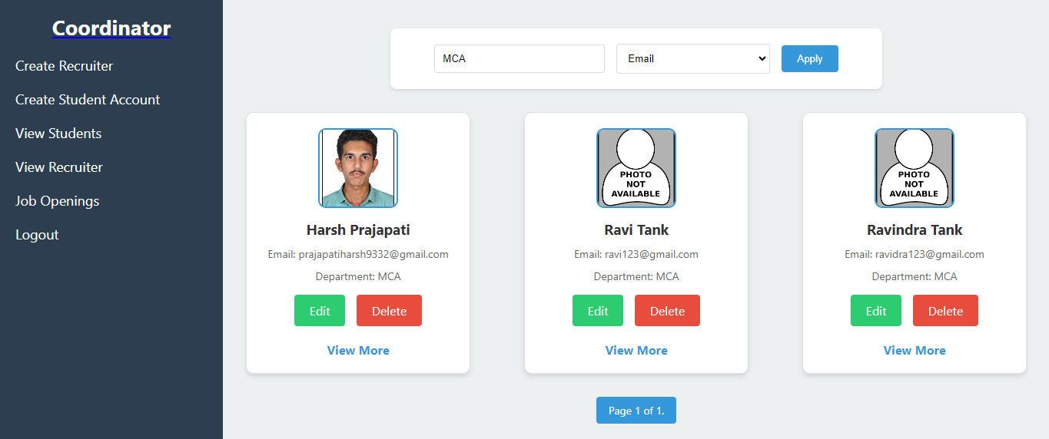
Search By Course

Slide 19
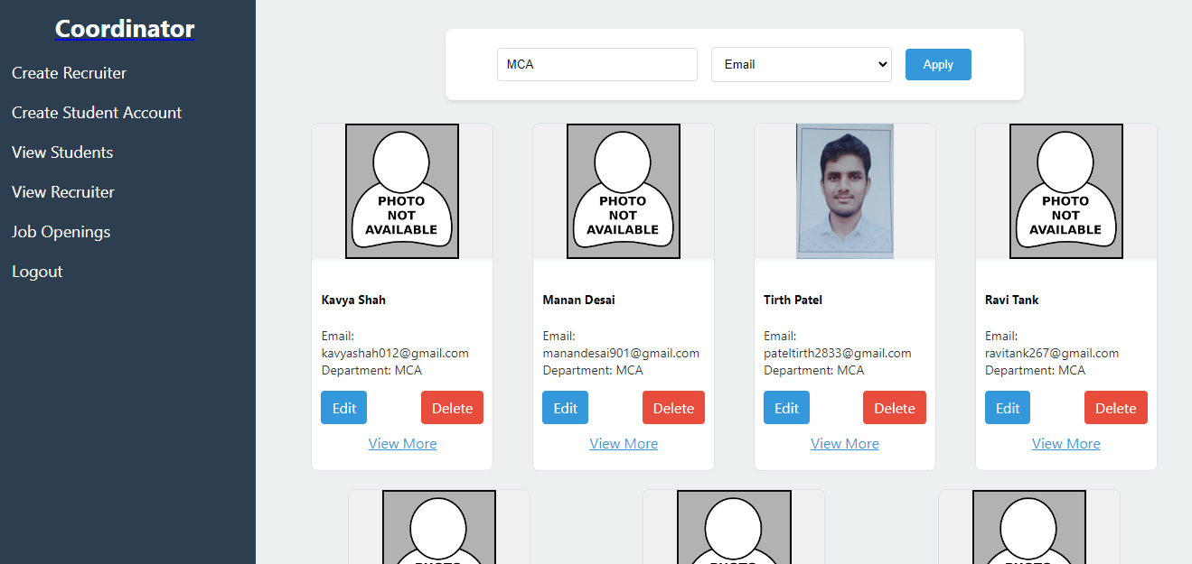
Recruiter View

Slide 20
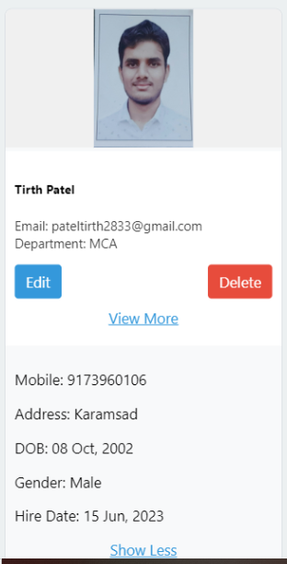
More View Recruiter

Slide 21
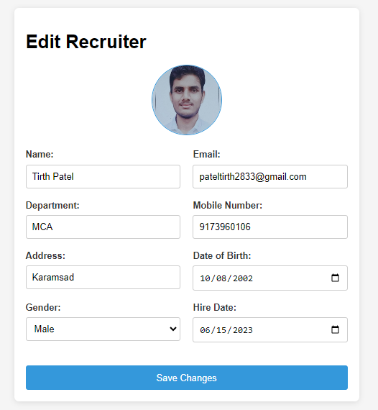
Edit Recruiter

Slide 22
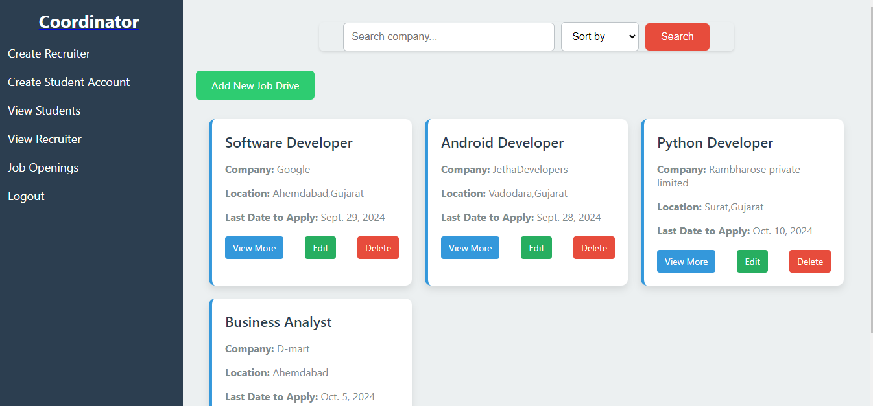
Job Openings

Slide 23
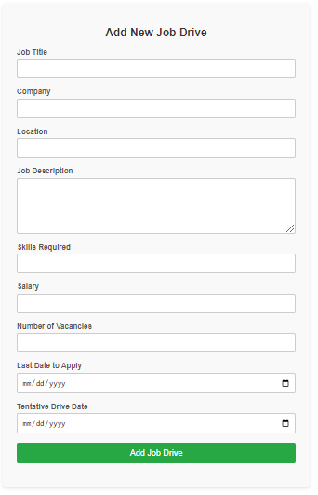
Add New Job

Slide 24
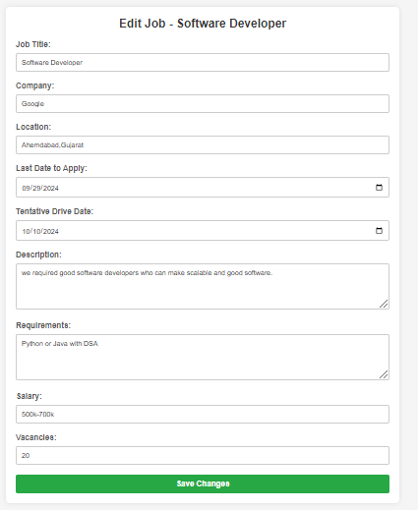
Edit Job

Slide 25
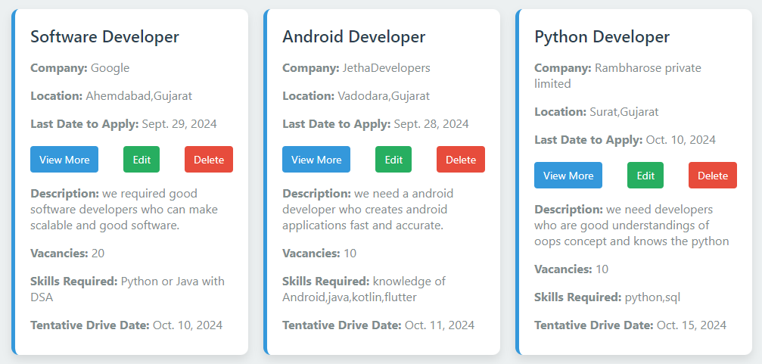
More View

Slide 26
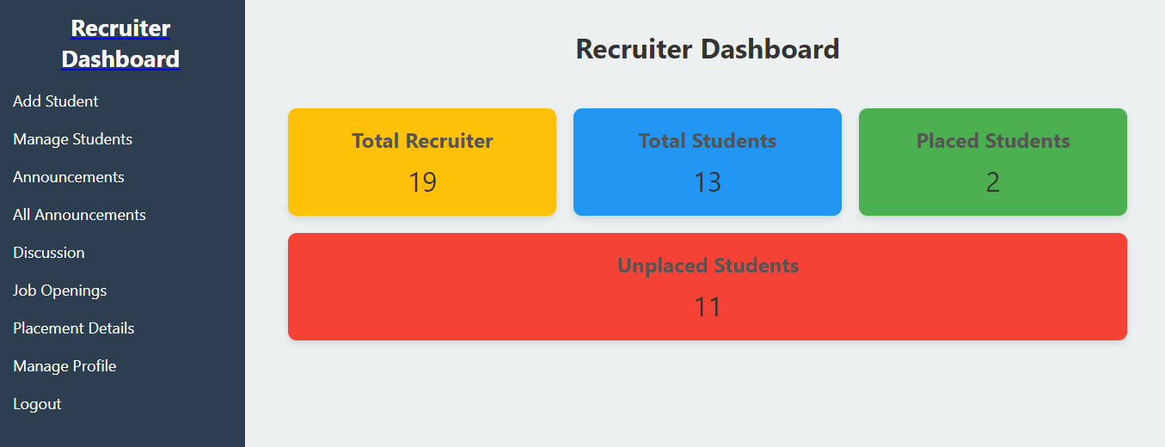
Recruiter Dashboard

Slide 27
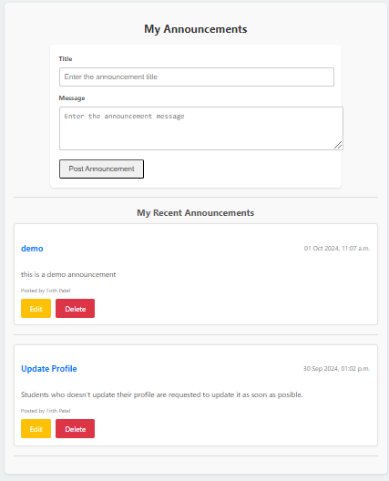
Announcements

Slide 28
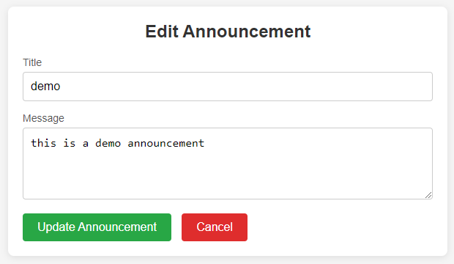
Edit Announcements

Slide 29
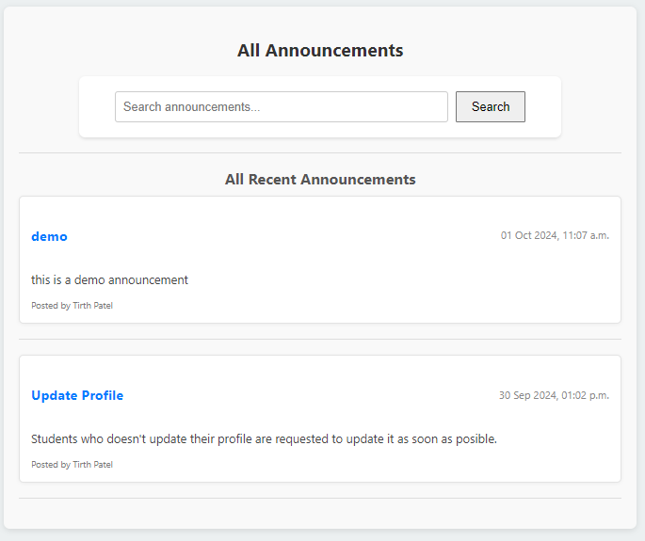
All Announcements

Slide 30
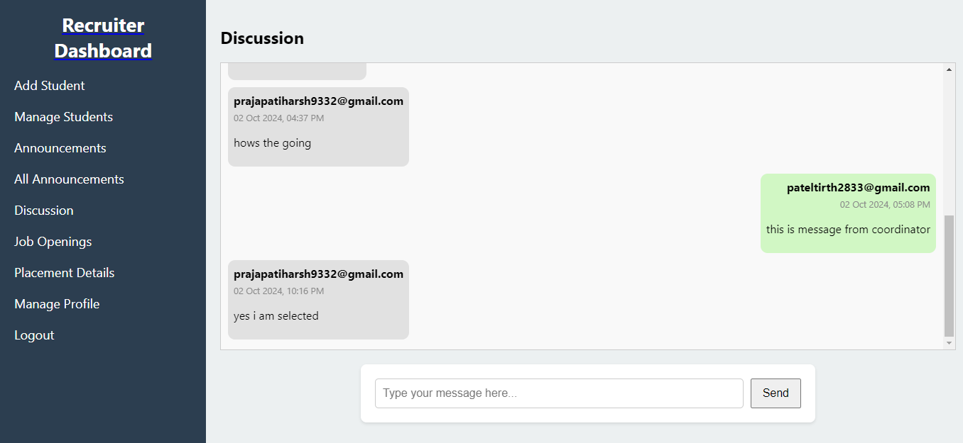
Discussion

Slide 31
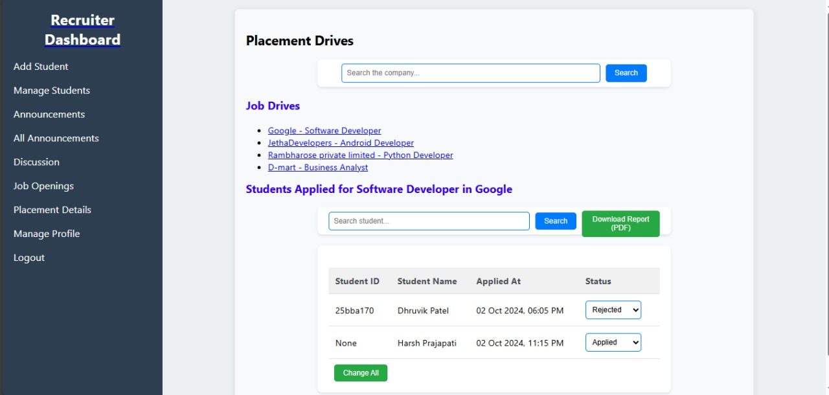
Placement Drive

Slide 32
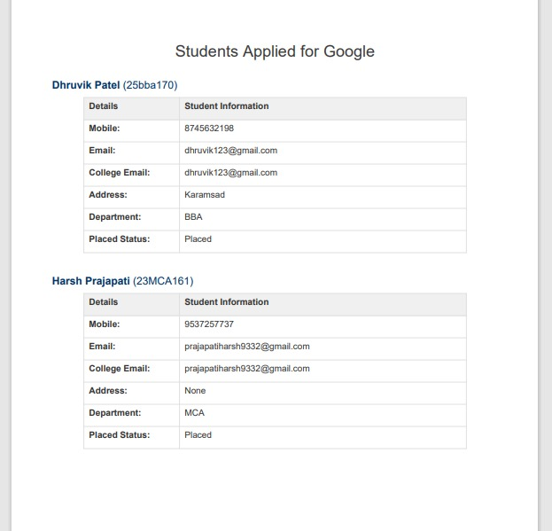
Placement Report

Slide 33
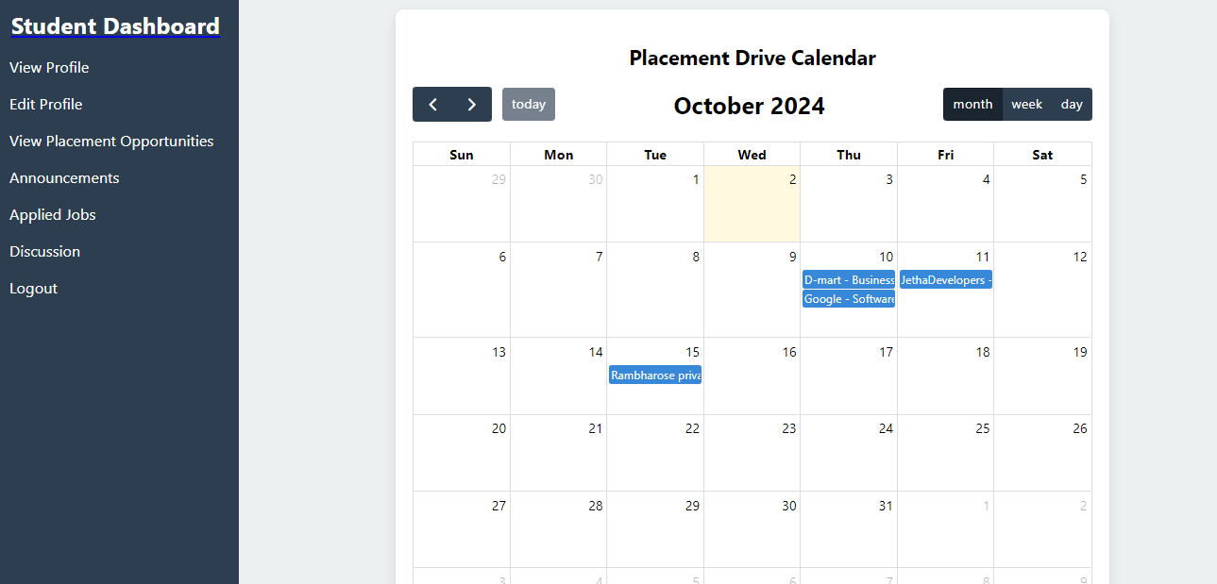
Student Dashboard

Slide 34
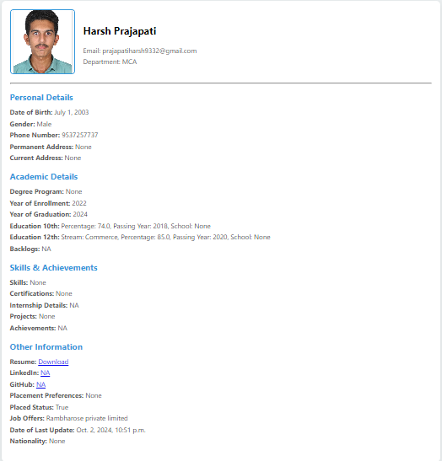
View Profile

Slide 35
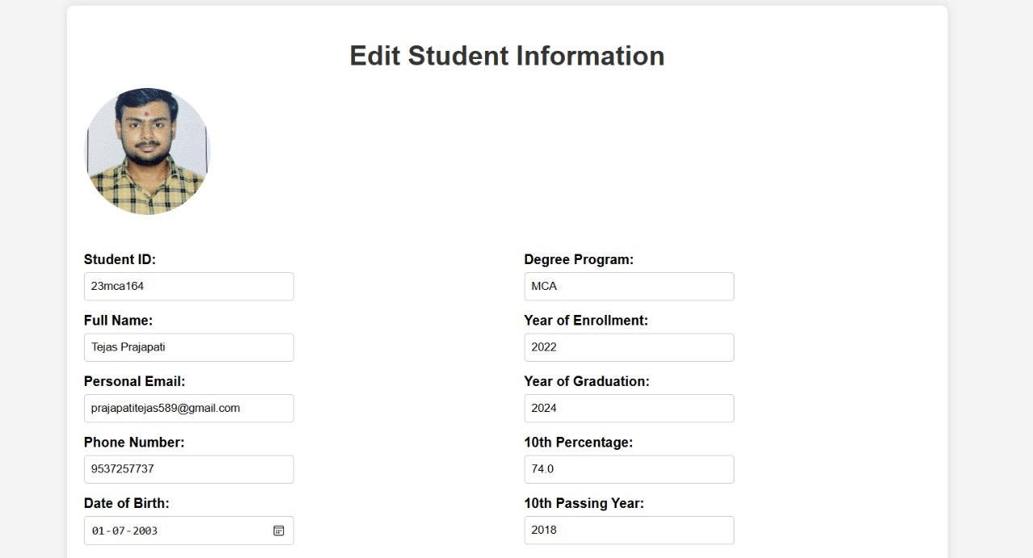
Edit Profile

Slide 36
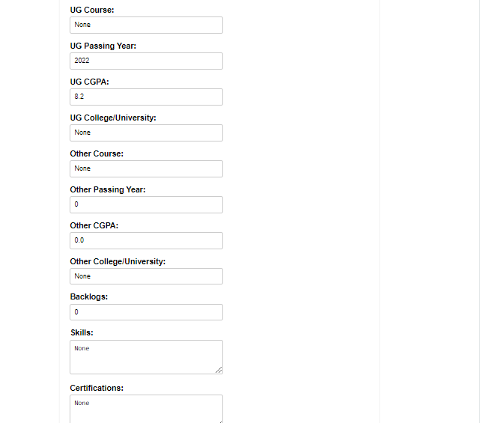

Slide 38
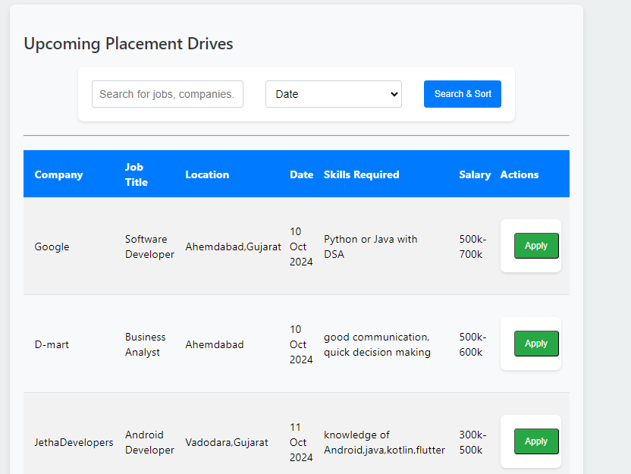
View Opportunities

Slide 39
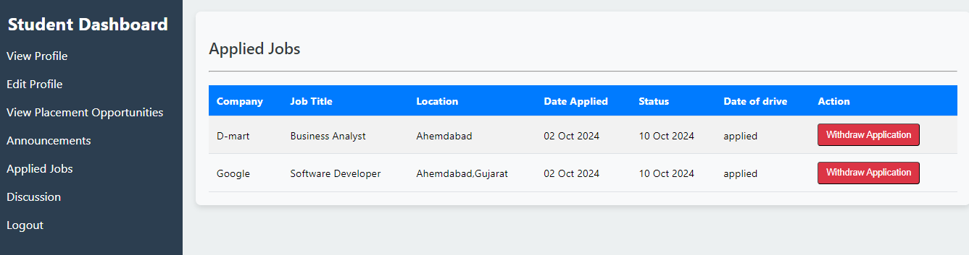
Applied Jobs

Slide 40
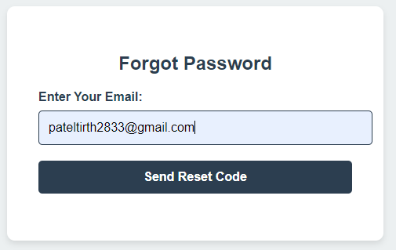
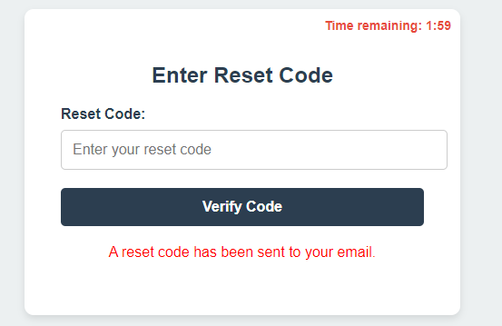
Forgot Password

Slide 41
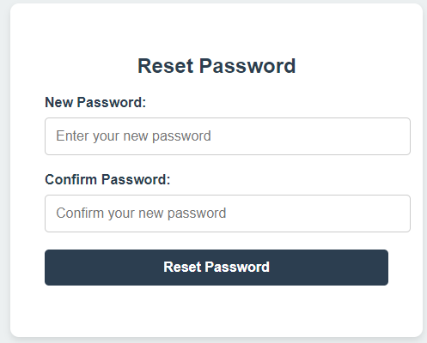
Reset Password

Slide 42
Future Enhancements
AI-Powered Candidate Matching: Leverages AI algorithms to connect students with job opportunities based on their skills and interests, providing tailored recommendations for both students and recruiters.
Mobile Application: Offers a mobile-friendly interface for students and recruiters to access the system anytime, receive real-time updates on job postings, and track recruitment activities.
Social Media Integration: Integrates with LinkedIn for students to showcase their profiles and enables companies to share content, enhancing employer branding and helping students understand company culture.

Slide 43
Referances
Python Resources:
Python Documentation (Official)
W3Schools Python Tutorial
Django Resources:
Django Documentation (Official)
MDN Web Docs Django Tutorial
GeeksforGeeks Django Tutorial
HTML, CSS, and JavaScript Resources:
W3Schools CSS Tutorial
W3Schools JavaScript Tutorial
W3Schools HTML Tutorial

Slide 44
Thank You

