Slide 1



walmart-sales-analysis-report-v1
View in Power BI

Slide 2
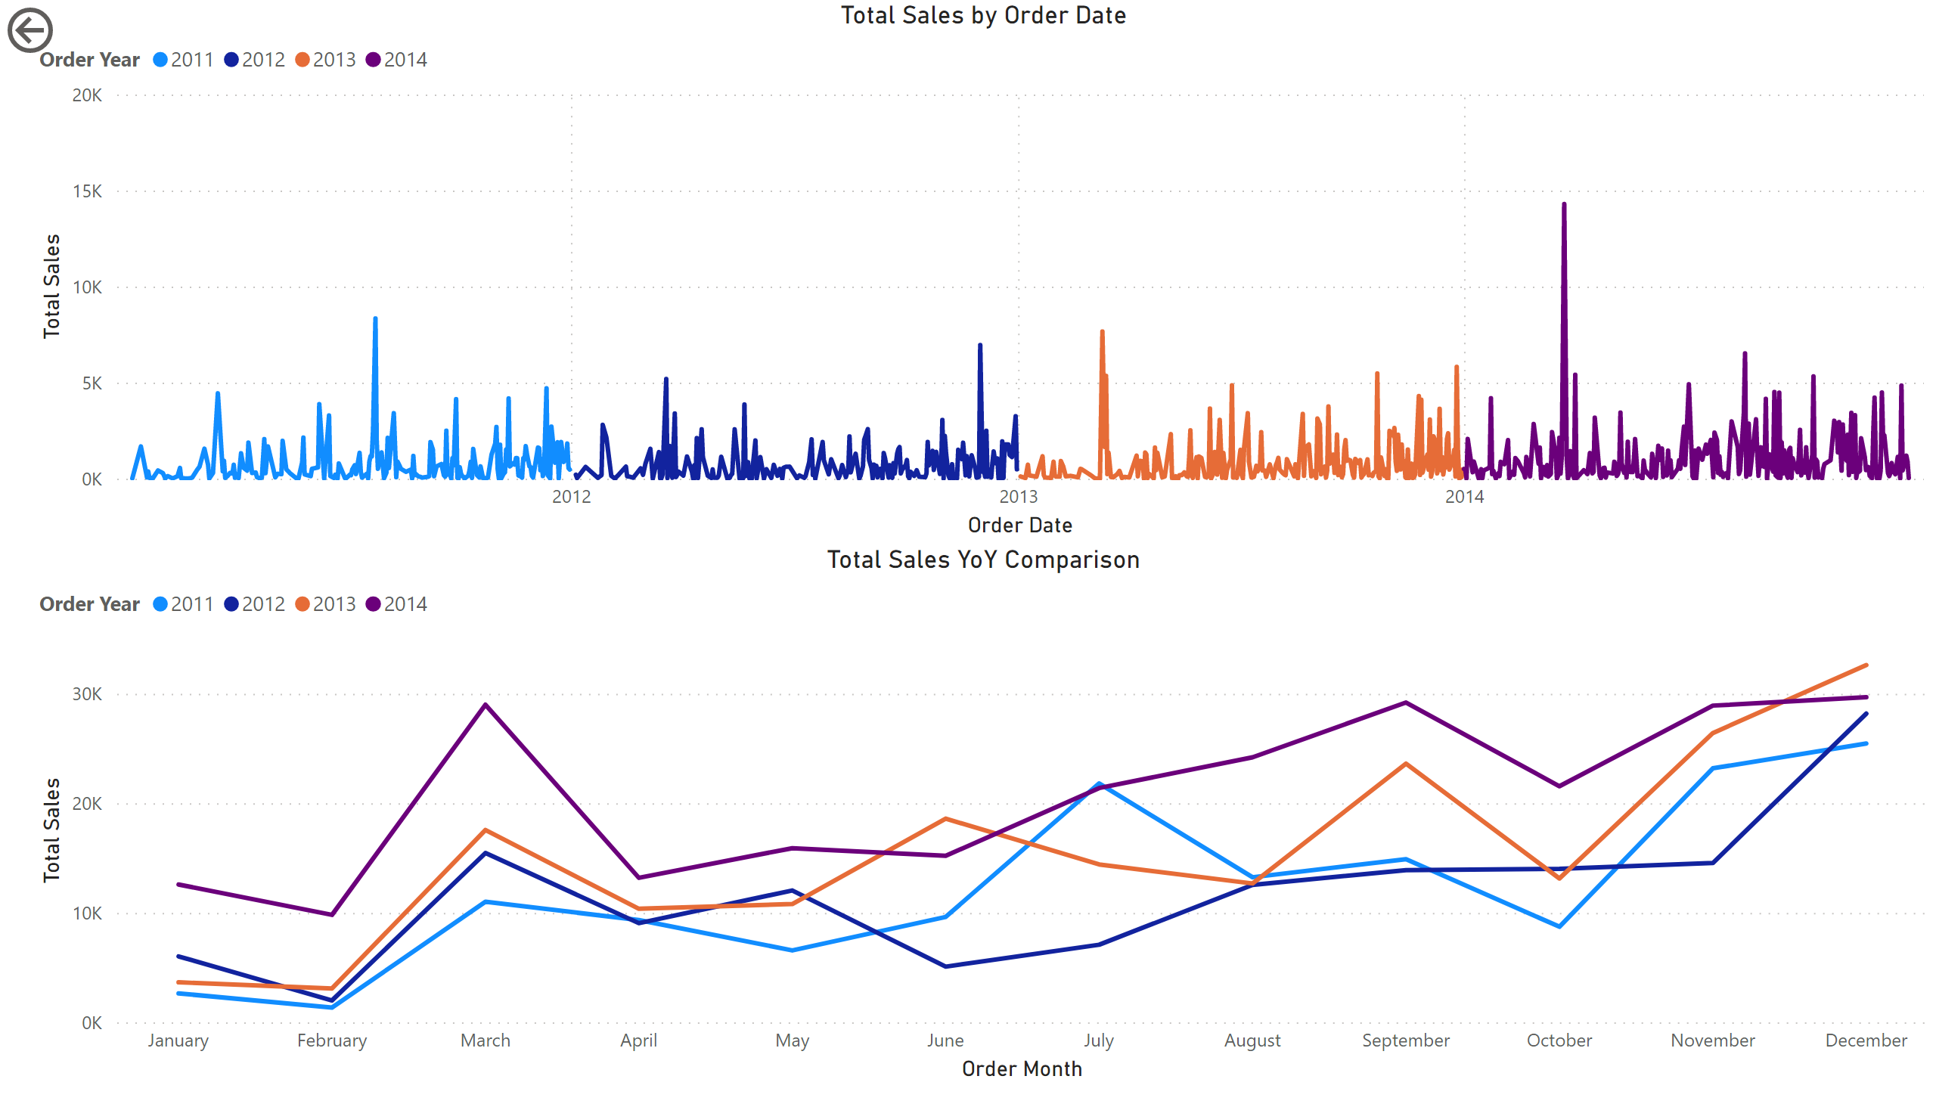
Sales1
Notes:
Total Sales YoY Comparison
No alt text provided
Total Sales by Order Date
No alt text provided
actionButton
No alt text provided

Slide 3
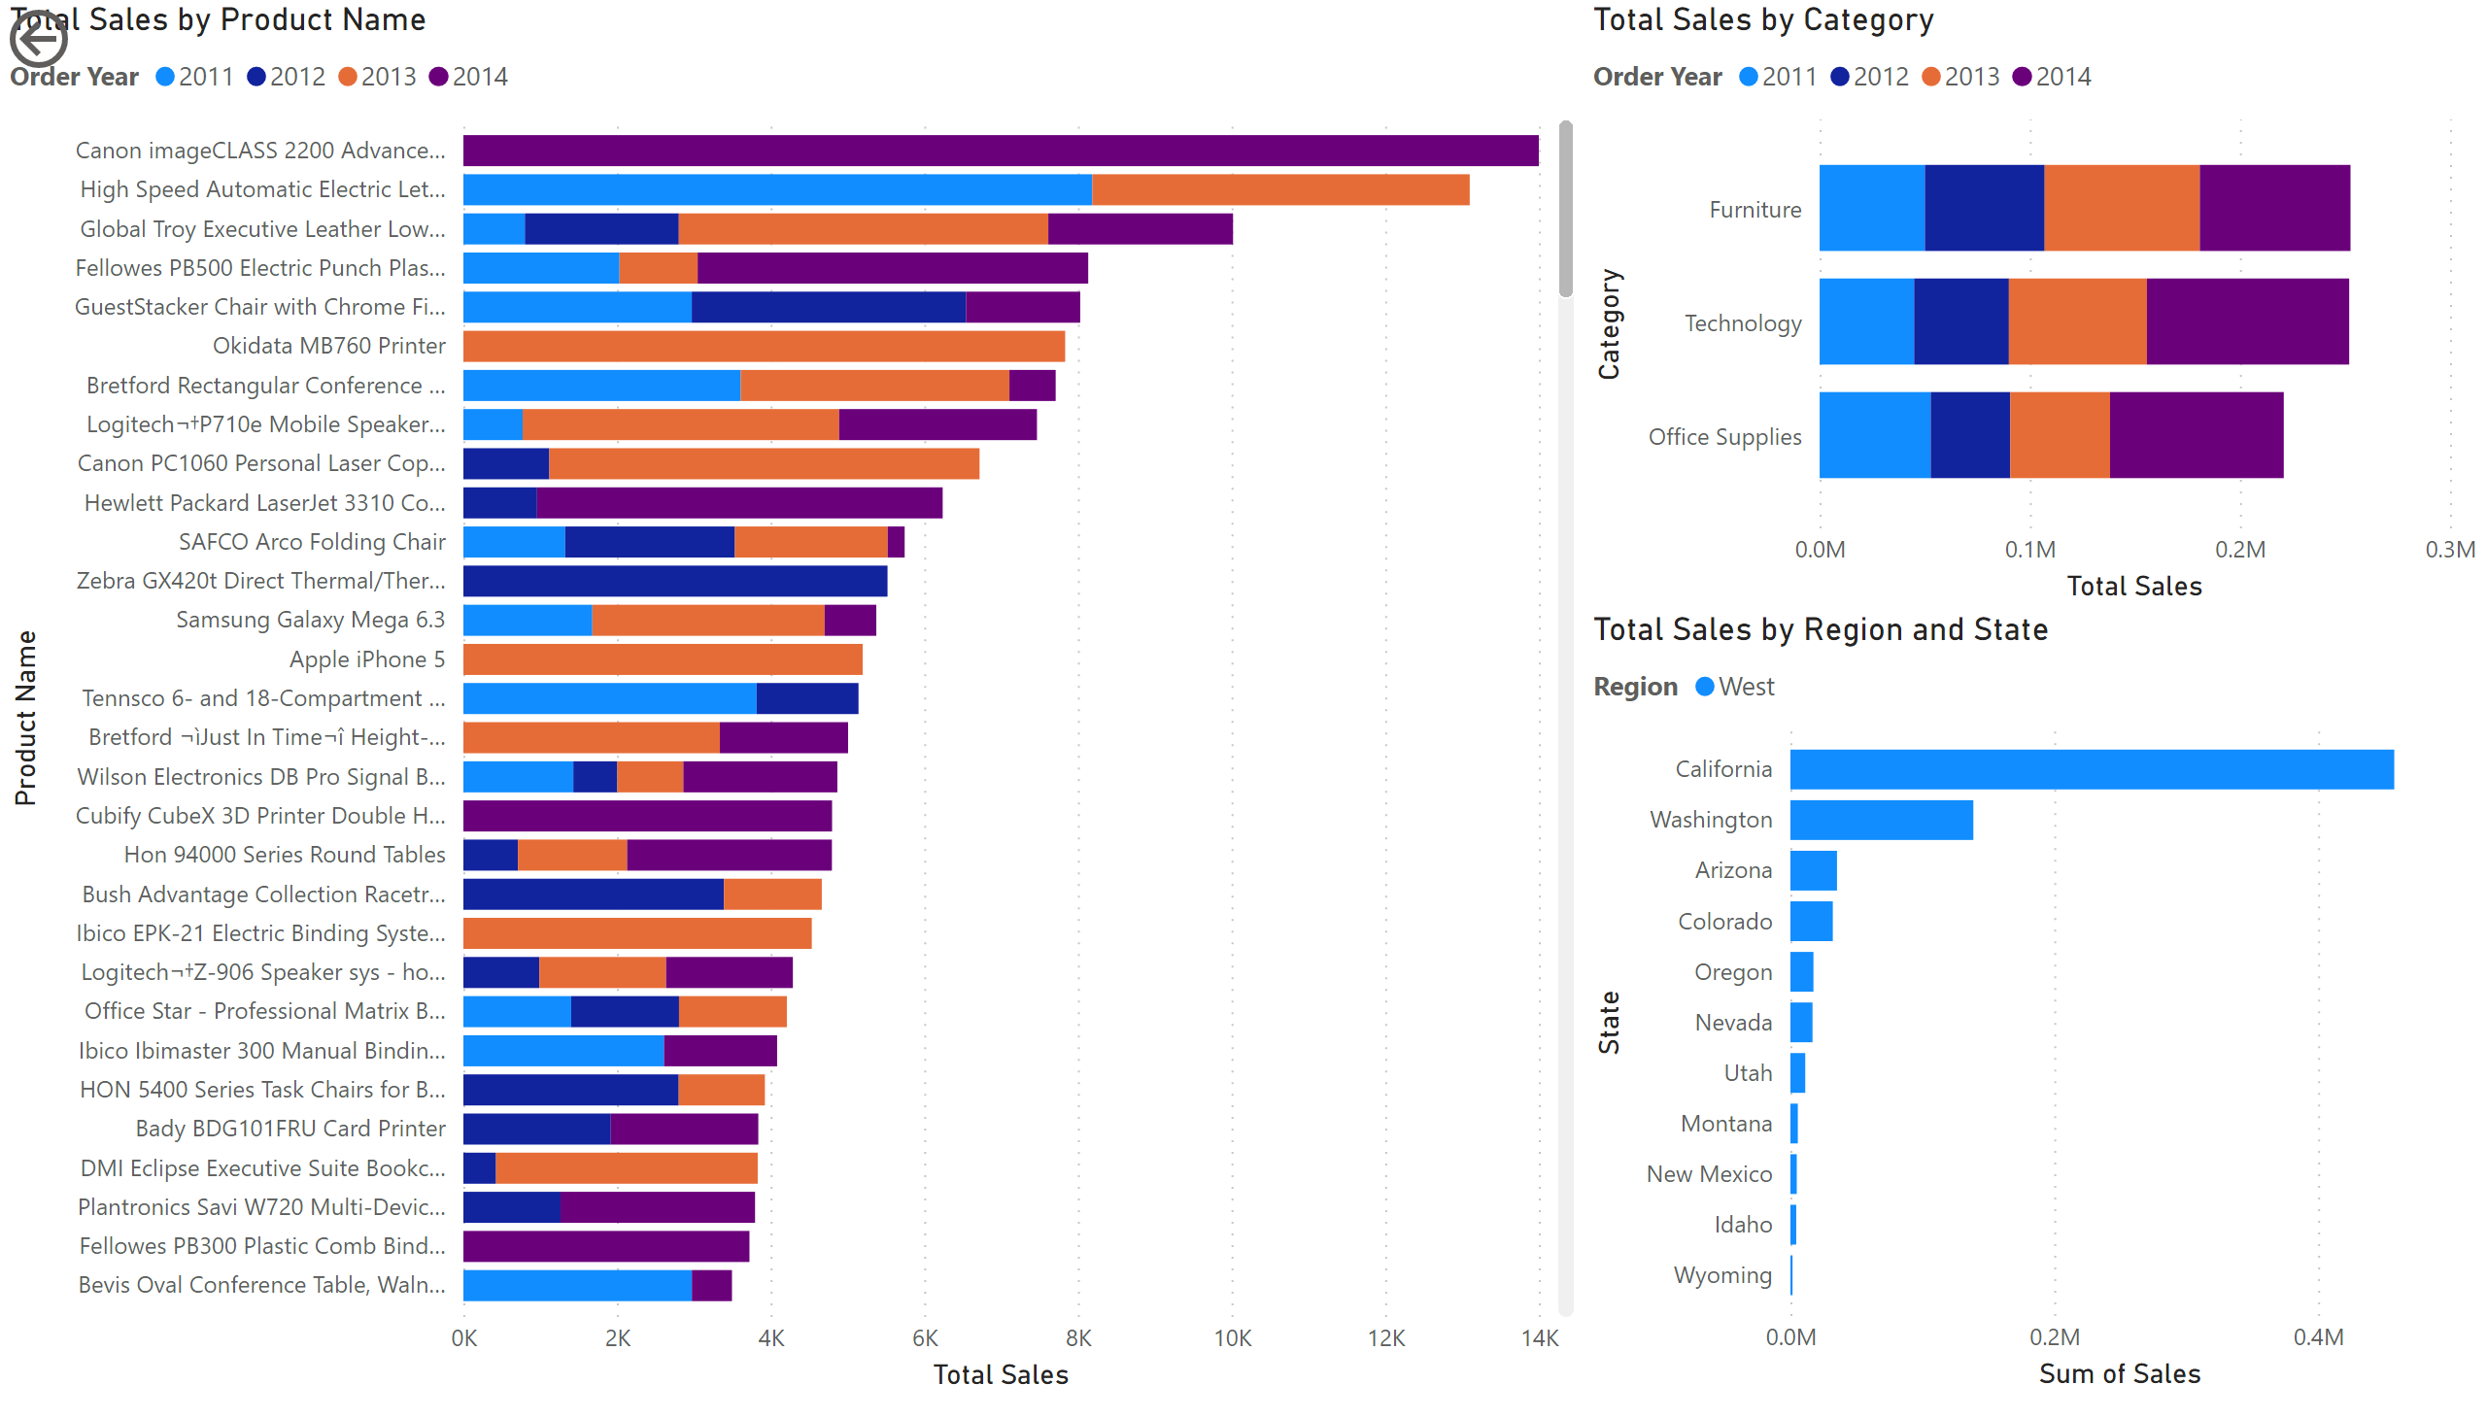
Sales2
Notes:
Total Sales by Category
No alt text provided
Total Sales by Product Name
No alt text provided
Total Sales by Region and State
No alt text provided
actionButton
No alt text provided

Slide 4
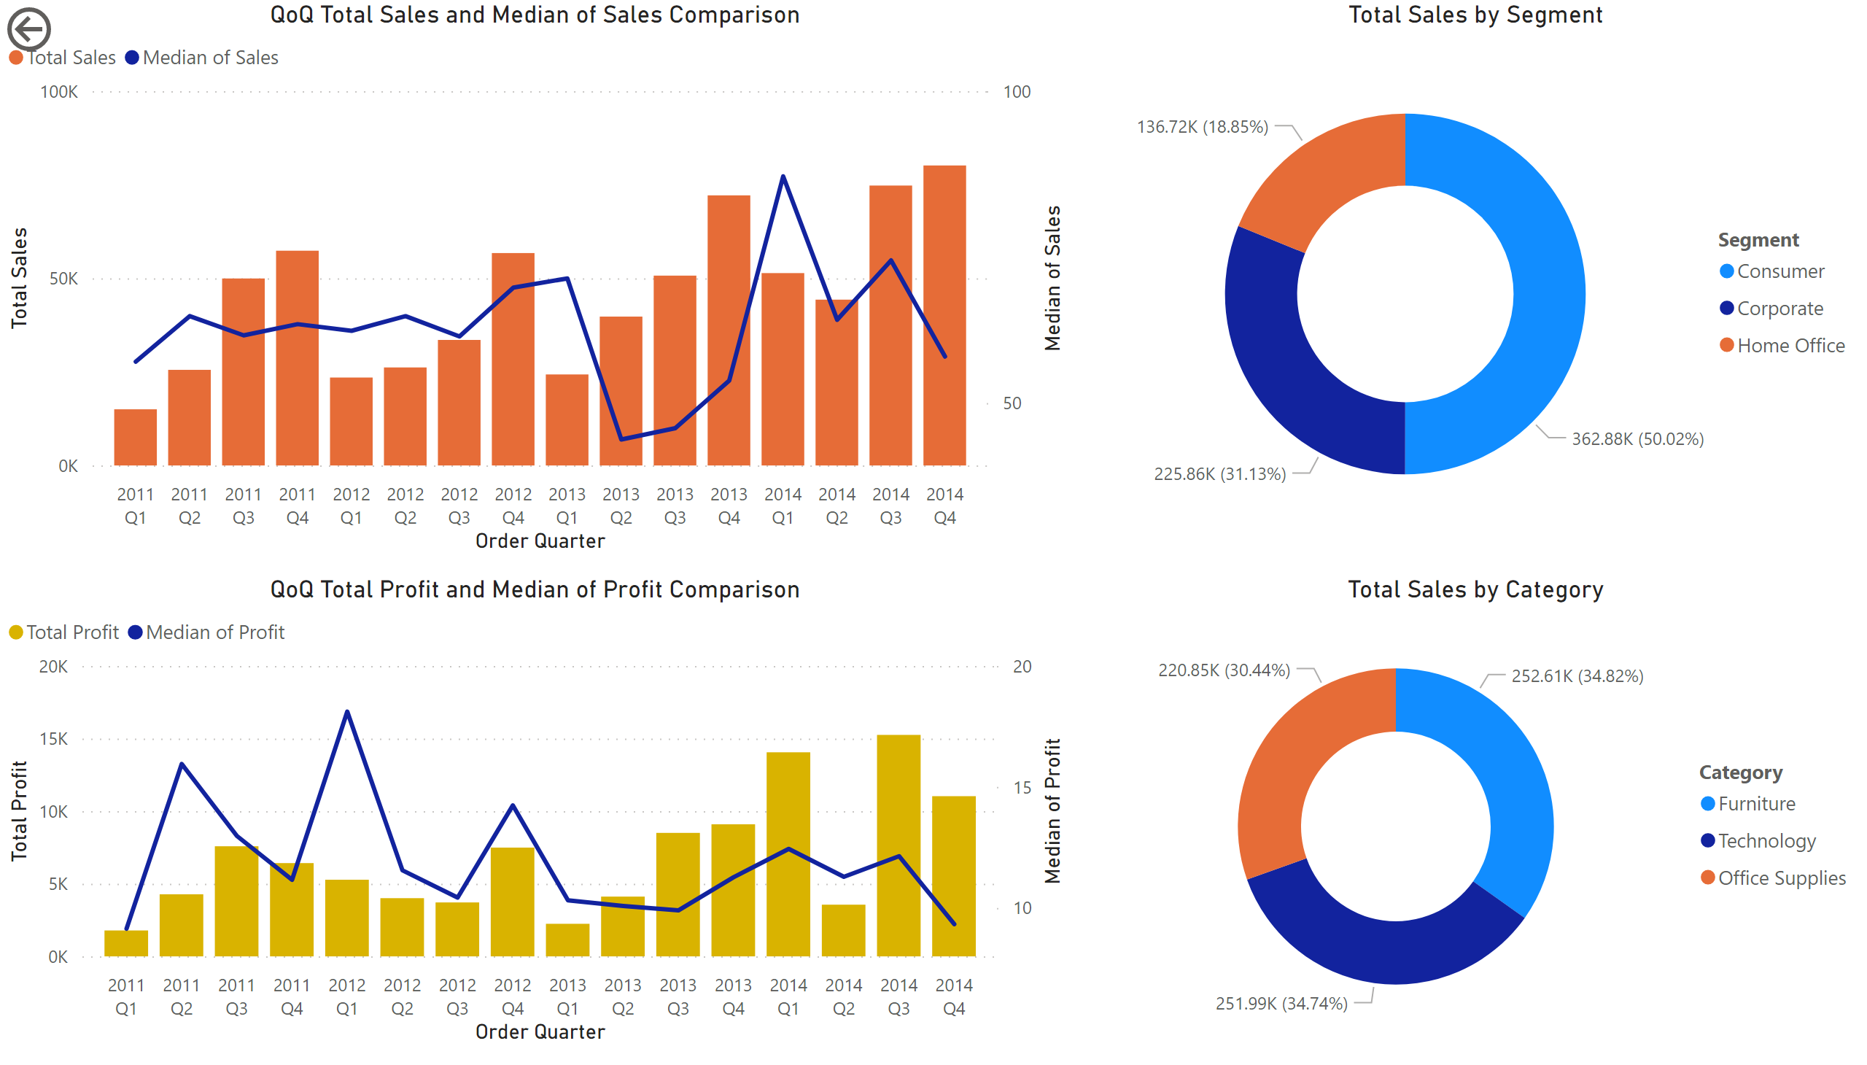
Sales3
Notes:
actionButton
No alt text provided
donutChart
No alt text provided
Total Sales by Segment
No alt text provided
QoQ Total Profit and Median of Profit Comparison
No alt text provided
QoQ Total Sales and Median of Sales Comparison
No alt text provided

Slide 5
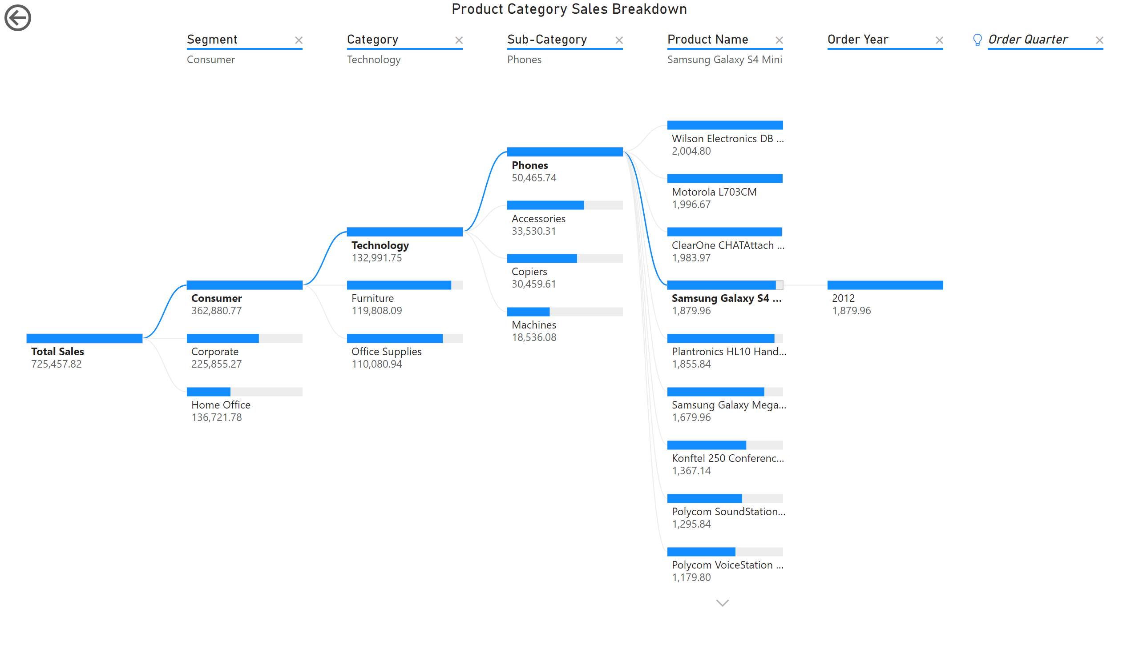
Sales4
Notes:
actionButton
No alt text provided
Product Category Sales Breakdown
No alt text provided

Slide 6
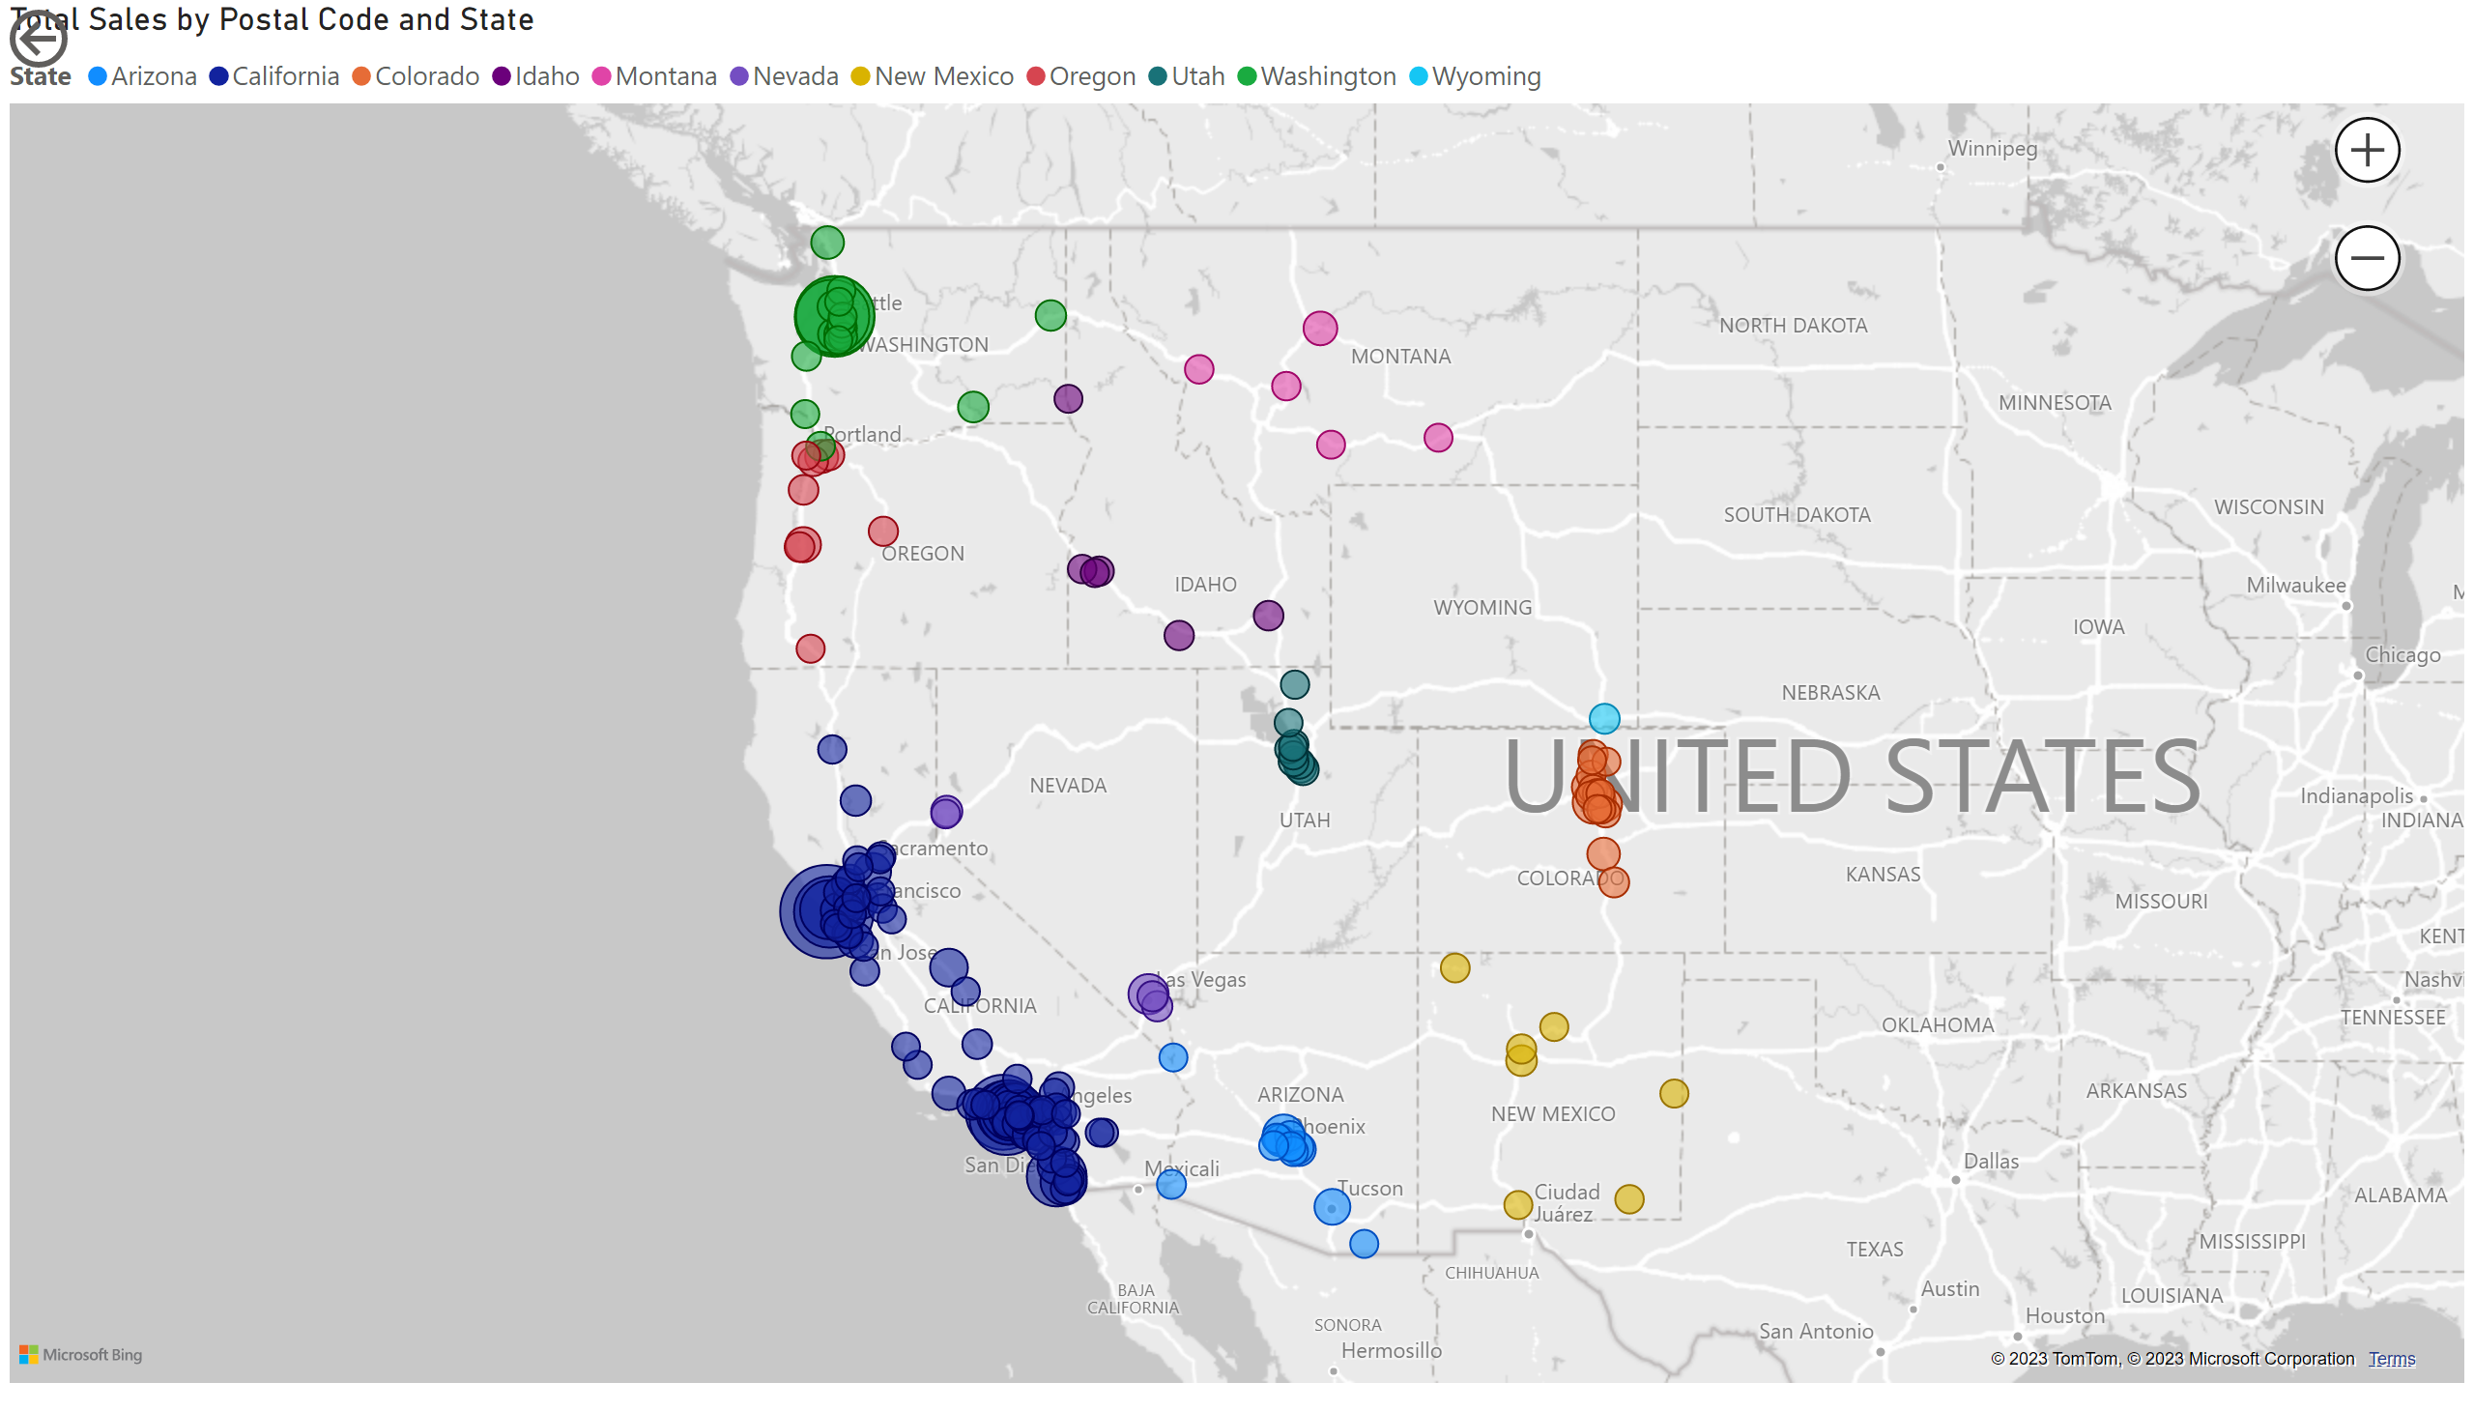
Sales5
Notes:
map
No alt text provided
actionButton
No alt text provided

Slide 7
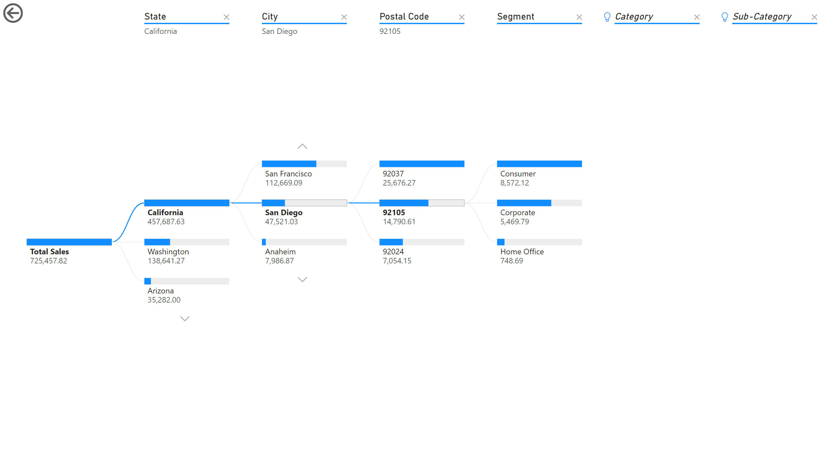
Sales6
Notes:
actionButton
No alt text provided
decompositionTreeVisual
No alt text provided

Slide 8
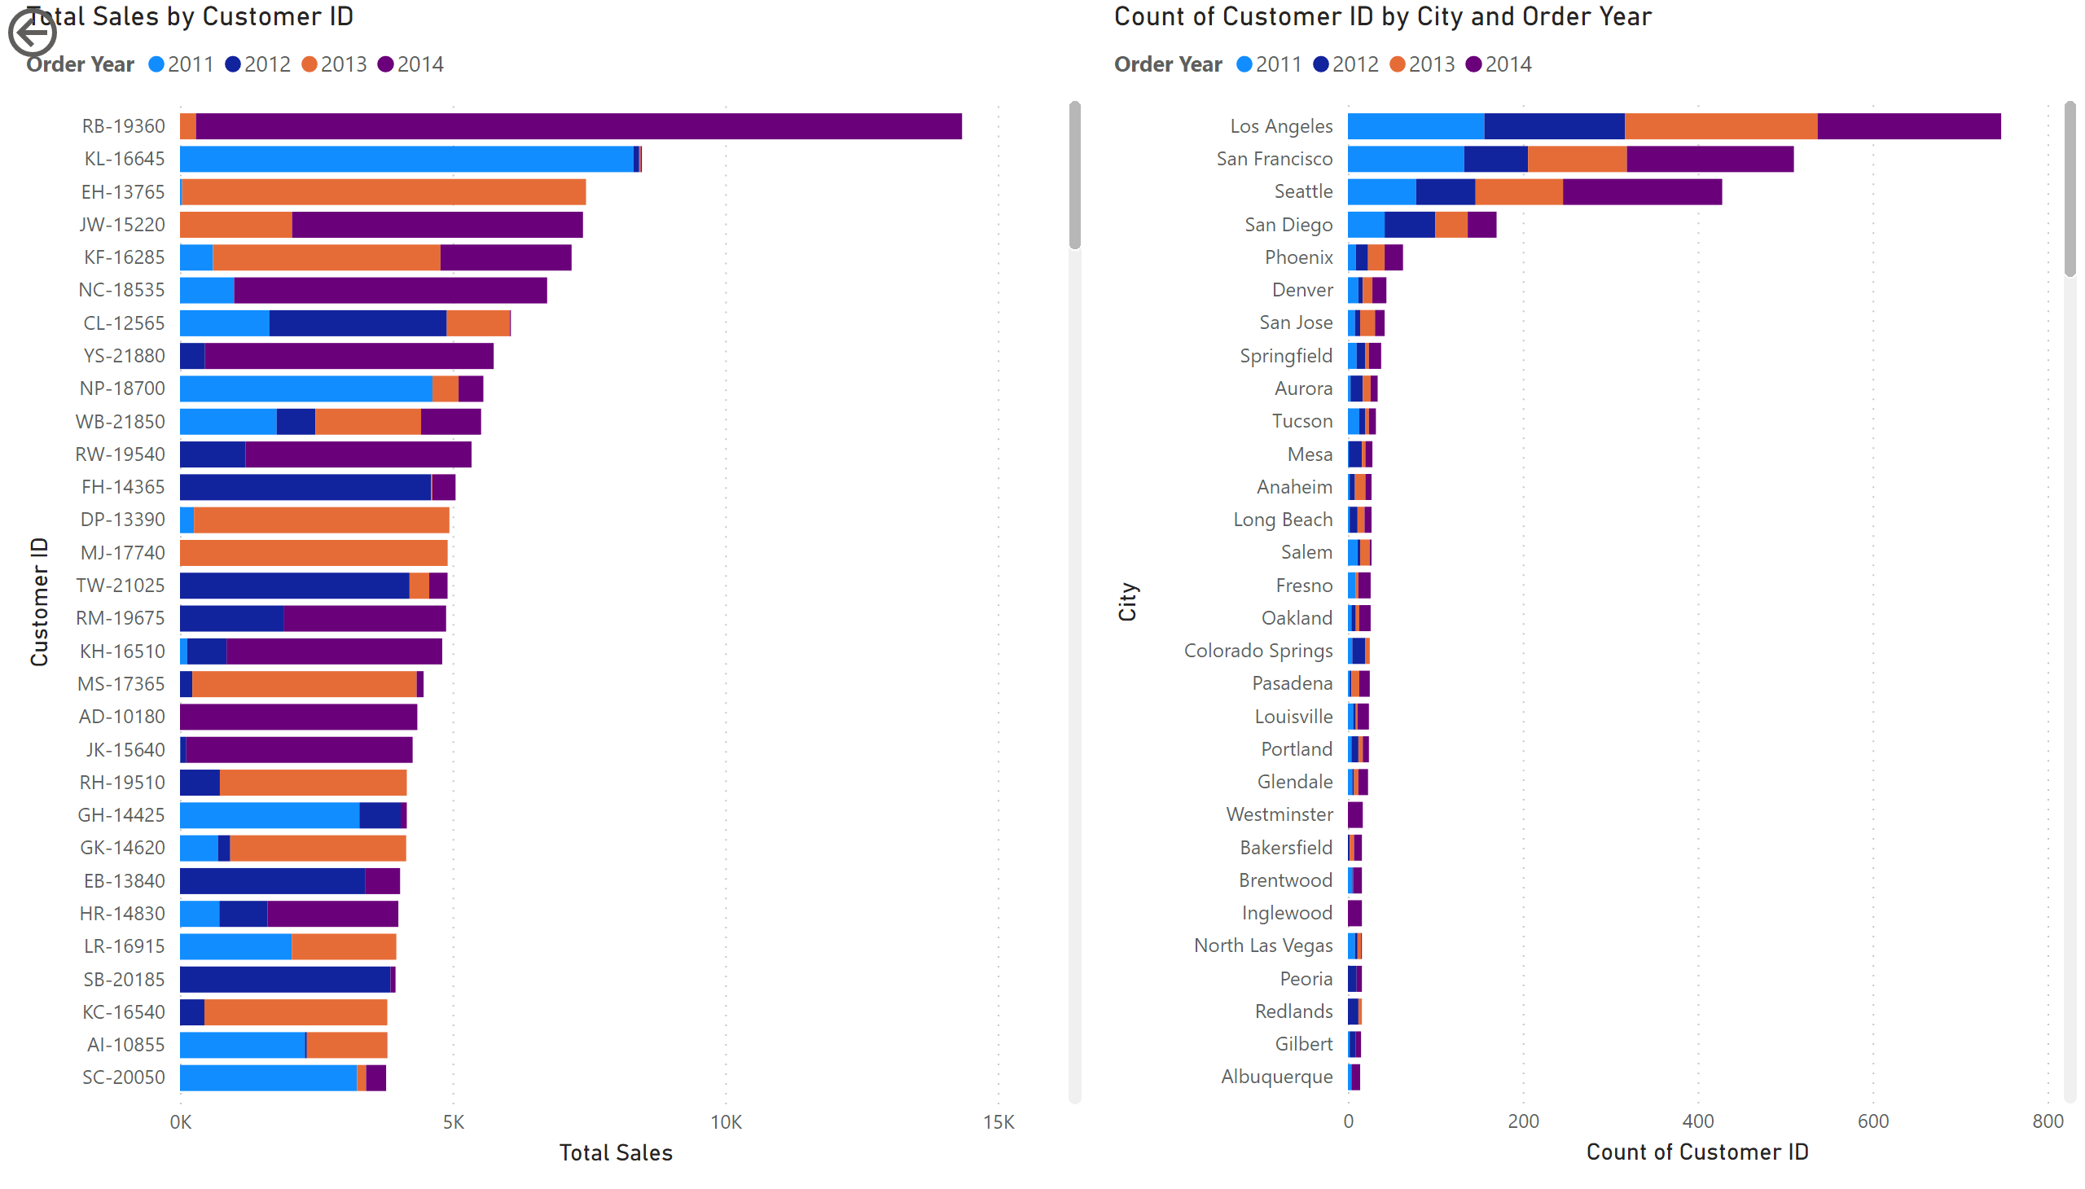
Customer1
Notes:
Total Sales by Customer ID
No alt text provided
actionButton
No alt text provided
barChart
No alt text provided

