Slide 1

COFFEE SALES DATA ANALYSIS

Slide 2
Introduction to Problem Statement (1/3)
Coffee sales have increased due to growing demand. This analysis focuses on:-
- Identifying top-performing coffee products
- Analyzing sales patterns across time
- Gaining actionable insights to improve revenue
Objective: Optimize sales strategies using data-driven insights.

Slide 3
Introduction to Problem Statement (2/3)
Dataset Includes:-
- Coffee types (Espresso, Latte, Cappuccino, etc.)
- Sales revenue and time-based trends
- Monthly, daily, and hourly sales patterns
Goal: Use data to understand sales performance.

Slide 4
Introduction to Problem Statement (3/3)
Key Questions:-
- Which coffee products generate the most revenue?
- How do sales vary by time (day, week, month)?
- What are the seasonal sales trends?

Slide 5
Techniques Used to Solve the Problem (1/3)
Techniques Used:-
1. Data Preprocessing:
- Cleaning and organizing data
- Handling missing and duplicate values
- Addressing outliers

Slide 6
Techniques Used to Solve the Problem (2/3)
2. Exploratory Data Analysis:
- Visualized data trends using charts
- Aggregated sales data by time
- Explored patterns to identify key drivers of revenue

Slide 7
Techniques Used to Solve the Problem (3/3)
3. Insights Extraction:
- Identified top revenue-generating products
- Explored time-based sales patterns
- Derived actionable insights for inventory and marketing

Slide 8
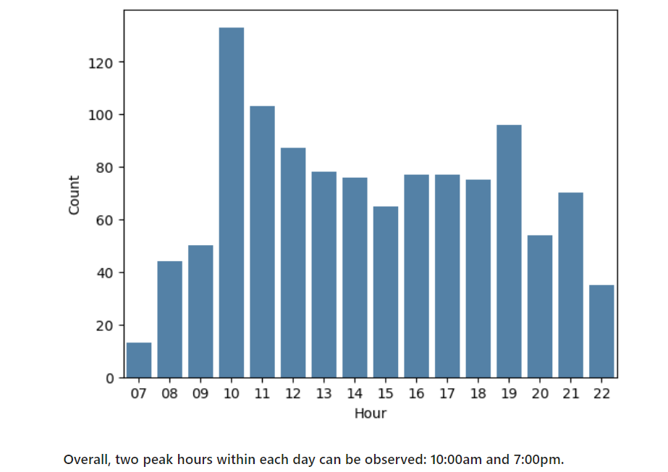
Output and Results (1/5)
The plots below illustrate the shopping traffic for each product throughout the day.

Slide 9
Output and Results (2/5)
Notably, all products experience a peak in traffic
around 10:00 AM, with this trend being particularly
pronounced for Latte. Additionally, Cappuccino,
Cocoa, and Hot Chocolate tend to be more popular
during the evening hours, specifically between
6:00pm and 8:00pm.

Slide 10
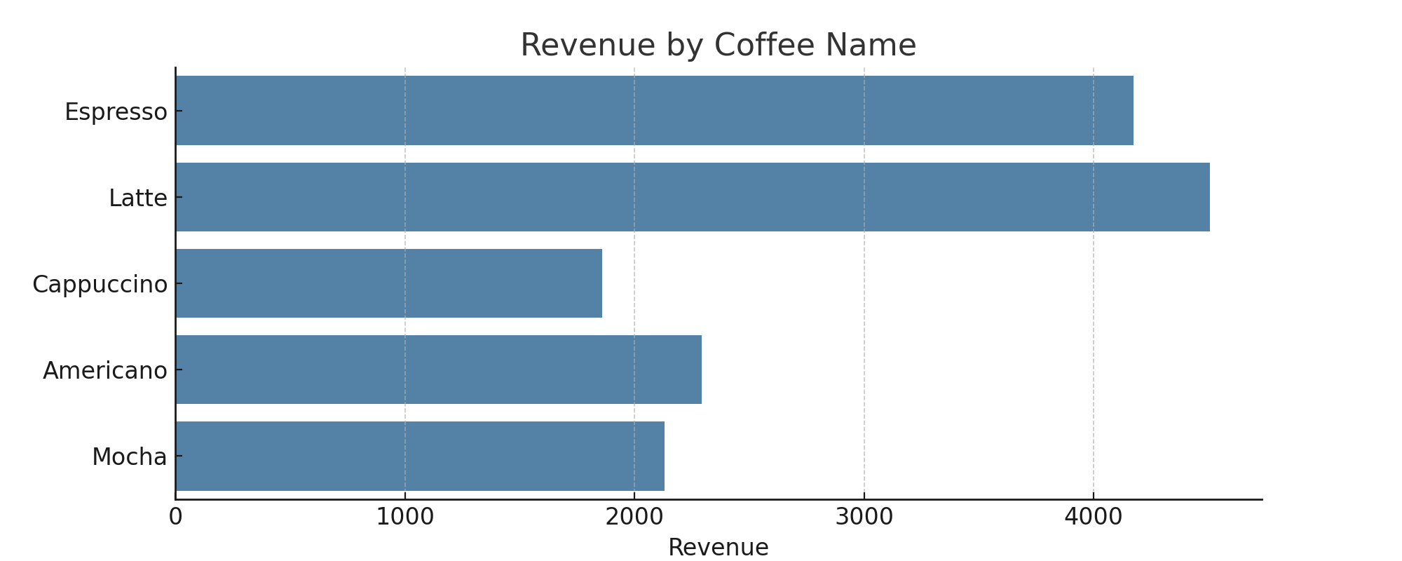
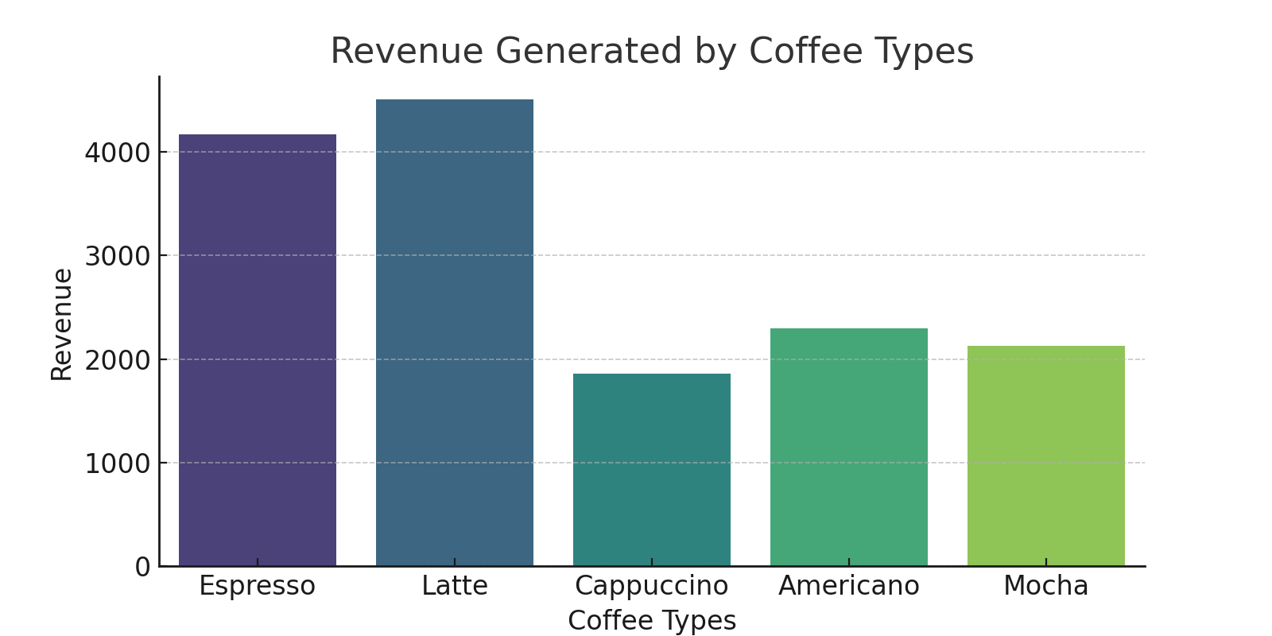
Output and Results (3/5)
Revenue Generated by each Coffee :-

Slide 11
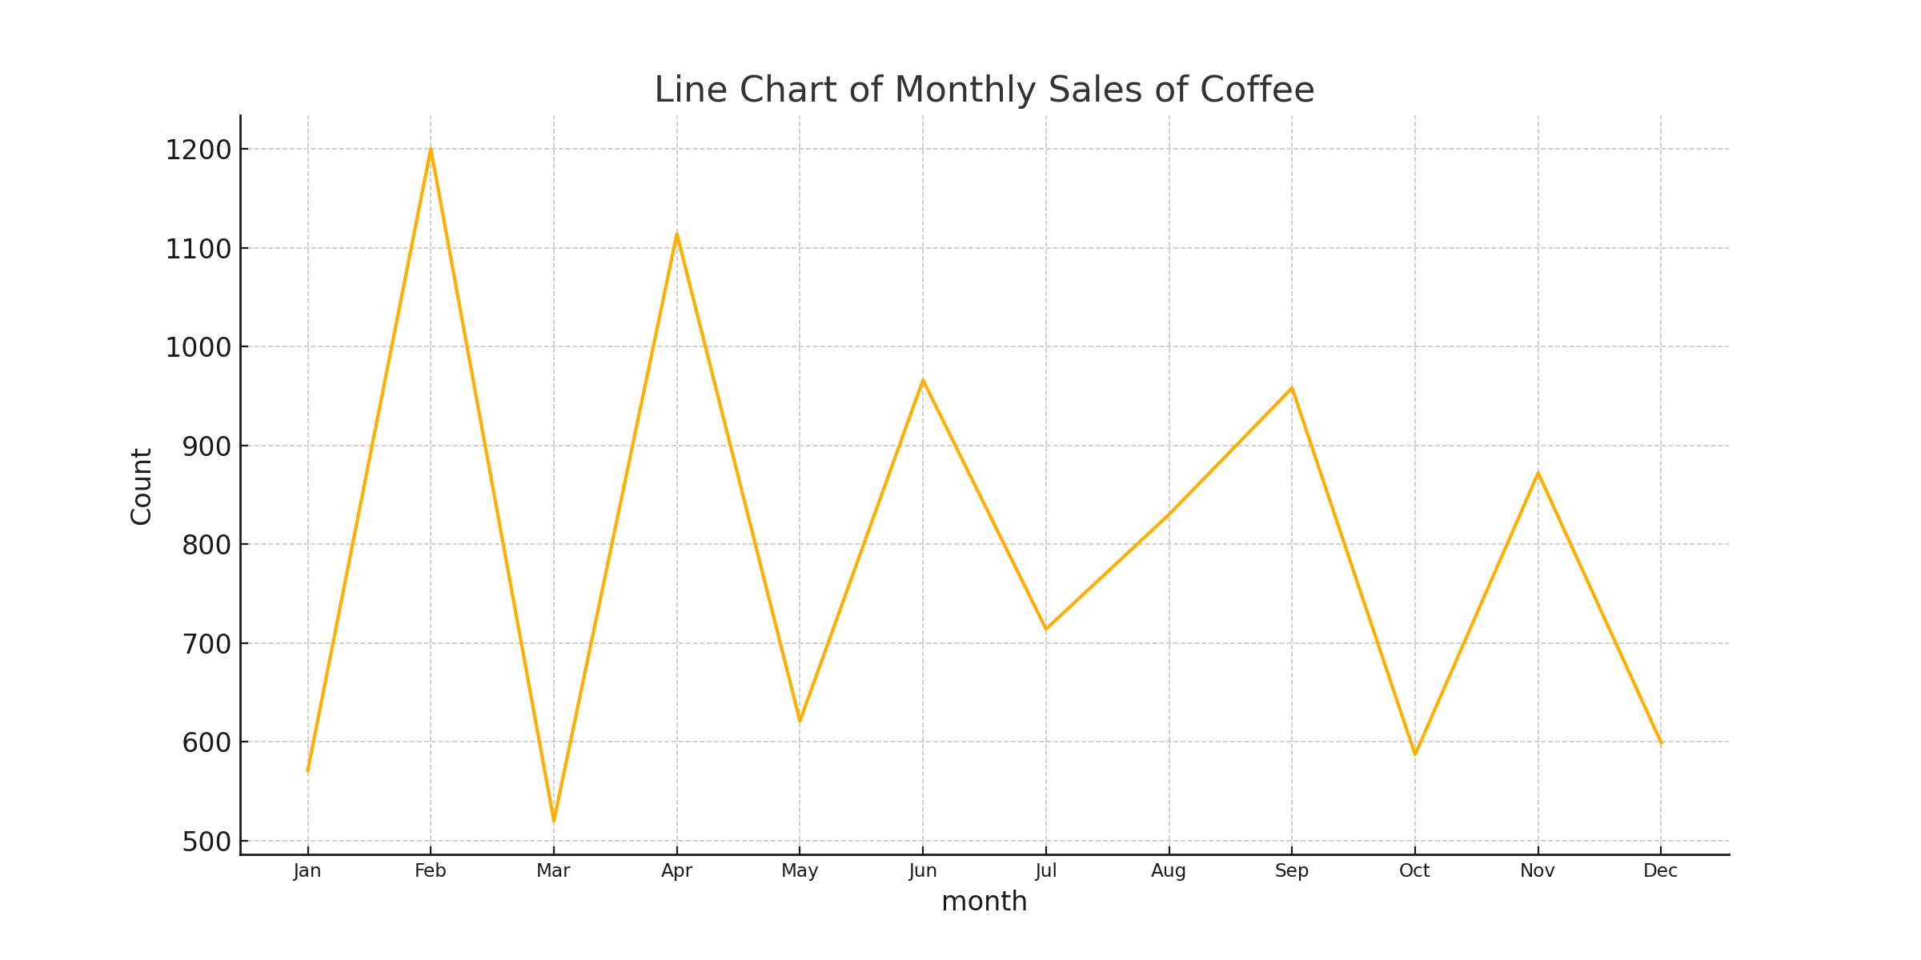
Output and Results (4/5)
Line Chart of Monthly Sales of Coffee:-

Slide 12
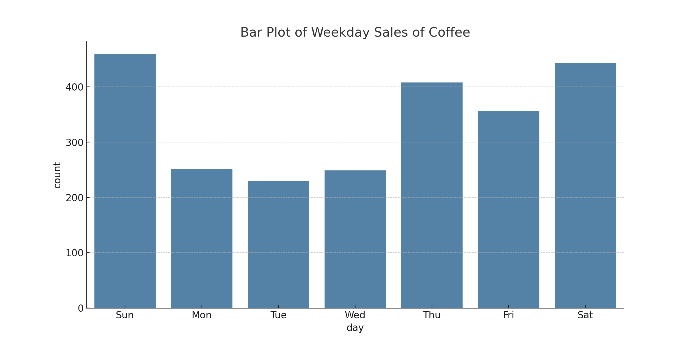
Output and Results (5/5)
Bar Plot of Weekday Sales of Coffee:-

