Slide 1

World Population Analysis
Problem Statement, Techniques, and Results:-

Slide 2
Problem Statement :-
Slide 1
Understanding the dynamics of global population distribution.
The dataset includes demographic, geographic, and population-related features.

Slide 3
Slide 2
Problem Statement :-
Key questions:
- What factors influence population growth?
- Can we predict population trends using machine learning?

Slide 4
Techniques Used:-
Slide 1
- Data Preprocessing
- Handling missing values
- Feature selection and scaling

Slide 5
Techniques Used:-
Slide 2
- Visualization
- Pie Charts, Multiple Bar plots, and Bar
Plots

Slide 6
Techniques Used:-
Slide 3
- Machine Learning
- Linear Regression
- Evaluation using MSE and R2 Score

Slide 7
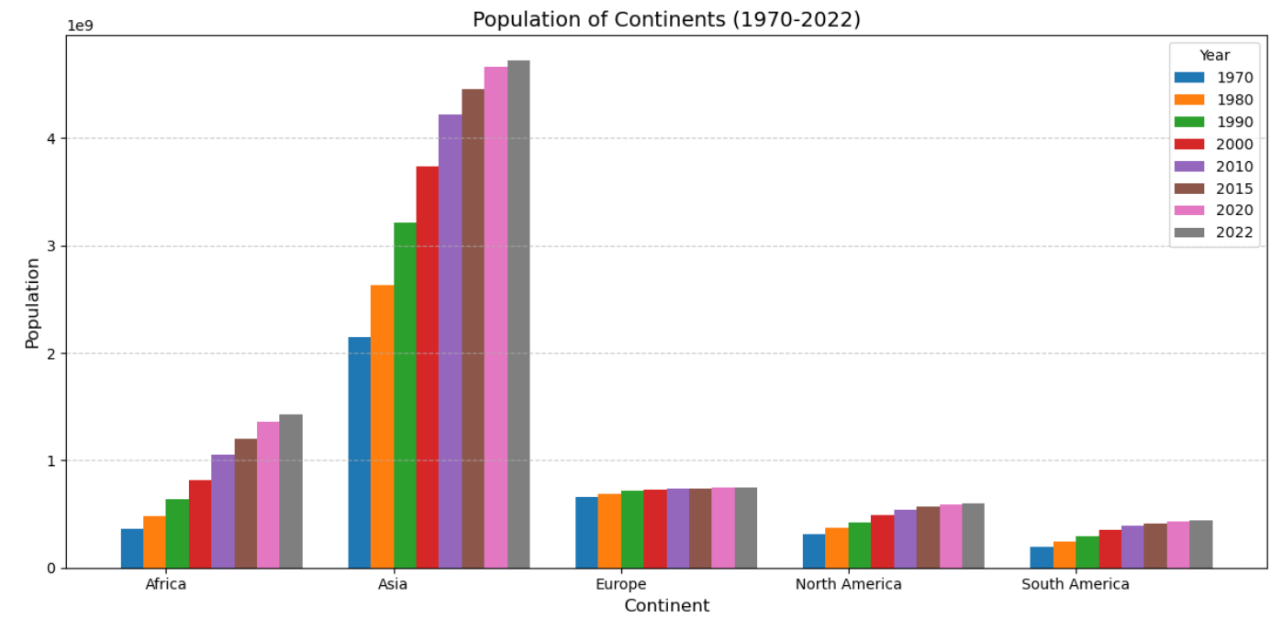
Visual representation of population data and model results.
Refer to the generated visualizations for insights:-
Chart 1

Slide 8
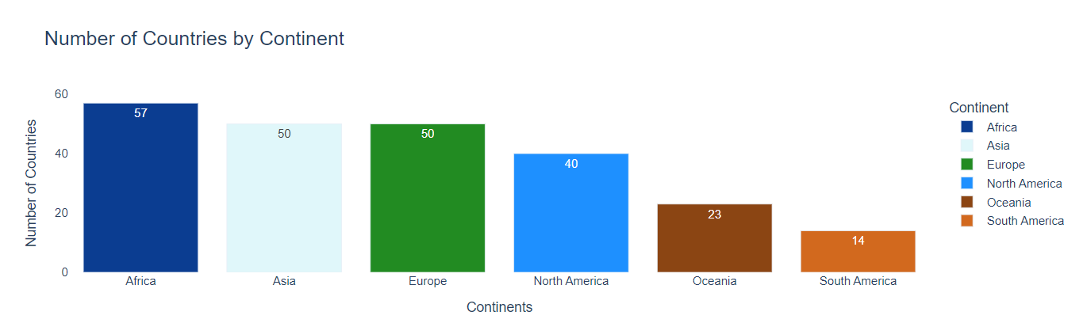
Plotting number of countries of respective Continents:-
Chart 2

Slide 9
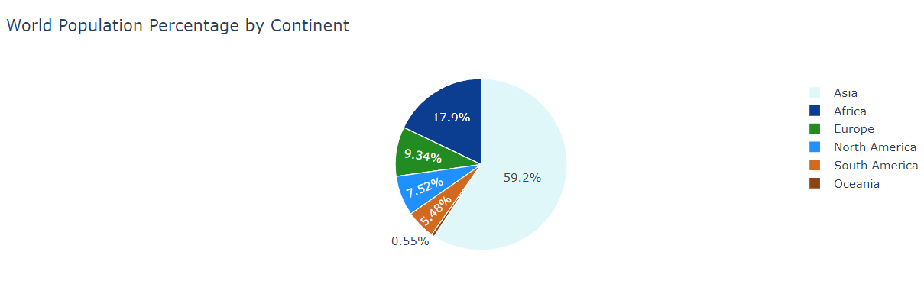
Plotting World Population Percentage by Continent with Pie Chart:-
Chart 3

Slide 10
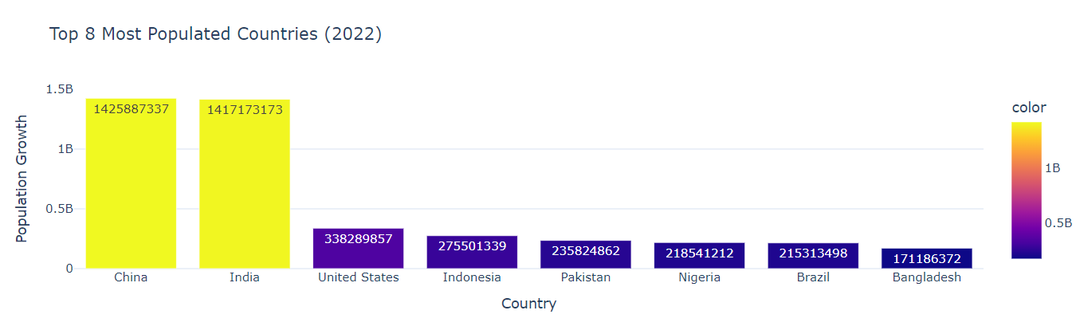
Plotting Top 8 most Populated Countries in the year 2022:-
Chart 4

Slide 11
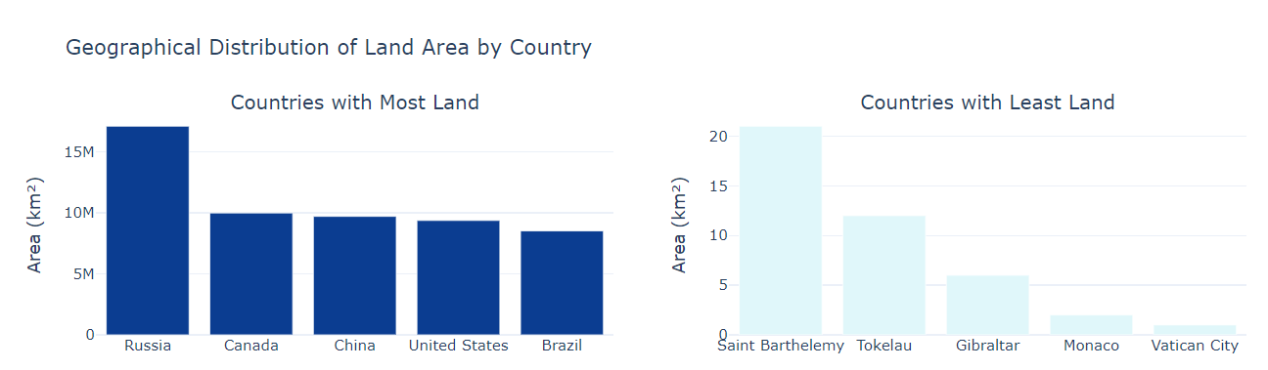
Plotting Geographical Distribution of Land Area by Country:-
Chart 5

Slide 12
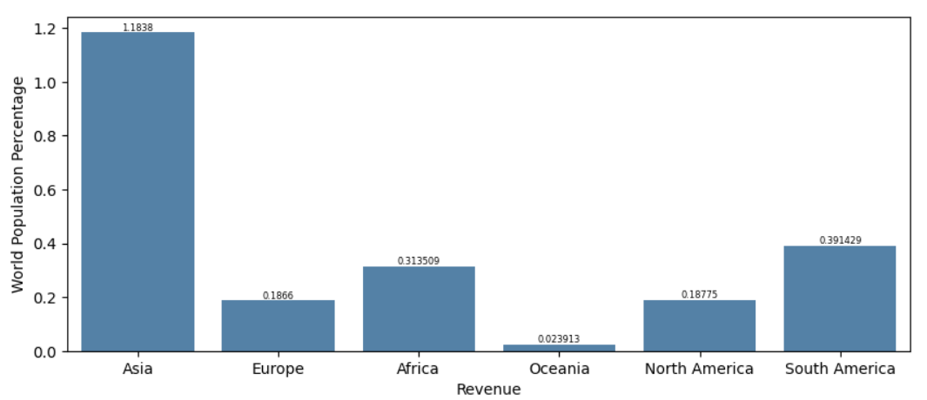
Plotting Bar Chart between World Population Percentage and Revenue generated by the Continents:-
Chart 6

