Slide 1
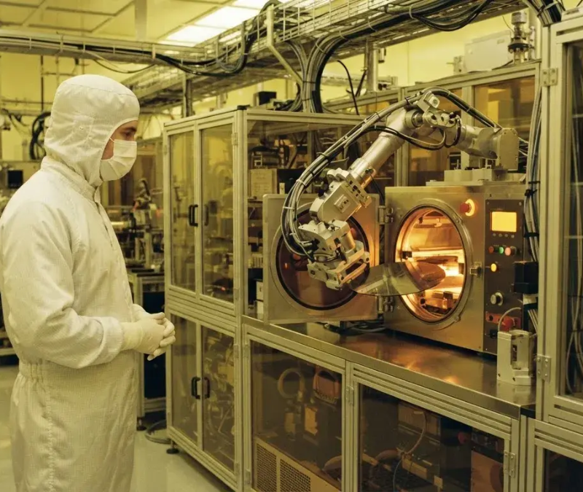
WafGuard AI
WafGuard AI —
Semiconductor Yield
Prediction & Root-Cause
Analysis Platform
Predict. Diagnose. Prevent.
Improve Yield.
WafGuard AI Team · AI Track

Slide 2

The High Cost of
Yield Failure
Addressing the multi-million dollar impact of
yield drops in advanced chip nodes
01
02
03
04
The Cost of Failure
High-Dimensional
Target Audience
Why Current Methods
At 3nm/5nm nodes, a 1% yield drop
Complexity
Designed for Semiconductor Process
Fail
costs tens of millions of dollars per
Root causes are hidden across
Engineers, Yield Enhancement
Manual diagnostics take weeks, and
month in scrapped wafers and lost
thousands of sensors, process drifts,
Engineers, and Fab Operations Leads.
existing tools alert engineers only
revenue.
and spatial die patterns.
after wafers fail electrical testing.

Slide 3
WafGuard AI: An Intelligent Decision-
Support Platform
Unifying telemetry, spatial maps, and equipment health into a single control room
Predictive Yield & Risk
Scoring
Wafer Defect Pattern CNN
WafGuard AI
Multi-Signal SHAP Root
Cause Ranking
Pre-Run What-If Simulator
& Copilot

Slide 4
Multi-Tier Decoupled Architecture
Telemetry
FastAPI
ML
MongoDB
Dashboard
and Wafer
Preprocessor
Inference
Storage
and Alerts
Grids
Data processing via
Execution of models
Persistence of
Visualization on
Raw data collection
Python 3.13 and
using XGBoost,
processed data into
React dashboard
from sensor
FastAPI.
PyTorch, scikit-
MongoDB.
and delivery of Slack
telemetry and wafer
learn, SHAP, and
alerts.
grids.
IBM watsonx.ai
SDK.

Slide 5
Incident Investigation: LOT_10901
Predicted yield: 76.2%
Engineering
Action
Grad-CAM
Defect
SHAP Root
Heatmap
Cause
Automated
Candidate
Risk
Detection

Slide 6
Leveraging watsonx.ai and
IBM Cloud
IBM watsonx.ai
Strict Guardrails
IBM Cloud
Synthesizes multi-modal evidence (yield
Operates purely on evidence-grounded facts
Designed for microservice deployment,
loss, SHAP, visual patterns) into natural-
(FACT, MODEL_OUTPUT) to prevent LLM
containerized FastAPI endpoints, and
language engineering reports.
hallucinations.
scalable MongoDB storage.

Slide 7
Measured Impact & Model
Performance
0.96 ROC-
89.6%
Minutes vs.
AUC
Accuracy
Weeks
Lot Yield Classifier
Wafer Defect Pattern
Investigation Cycle Time
Lot Yield Classifier performance for low-
Wafer Defect Pattern CNN across 9 failure
Reduction in root-cause investigation cycle
yield detection.
classes.
time.
Quantifying the accuracy and business value of the WafGuard AI
platform

Slide 8
The WafGuard AI Team
Het Baraiya
Harsh Bhalodiya
Team Lead, Architecture, Backend API, & MongoDB.
Lead AI/ML Engineer, XGBoost, SHAP, & watsonx.ai.
Tirth Gambhava
Ujjain Dhanani
Computer Vision Engineer, PyTorch CNN, & Grad-CAM.
Full Stack Developer, React Dashboard, & What-If Simulator.

