Slide 1
Cloud Computing SCE
Deploying a website using Amazon Web Services.

Slide 2
Flow of the presentation
01
What is Amazon Amplify?
02
What is GraphQL?
03
What is Amazon DynamoDB
04
Hosting the website

Slide 3

What is Amazon Amplify?
AWS Amplify is a complete solution that lets frontend web and mobile developers easily build, ship, and host full-stack applications on AWS, with the flexibility to leverage the breadth of AWS services as use cases evolve. No cloud expertise needed.
AWS is a full-stack platform designed to assist web and mobile developers in developing full-stack and scalable applications that are hosted by AWS. The platform includes a plethora of tools and services that enable users to easily configure backends, connect apps, deploy static web apps instantly, and manage content outside of the AWS console.

Slide 4
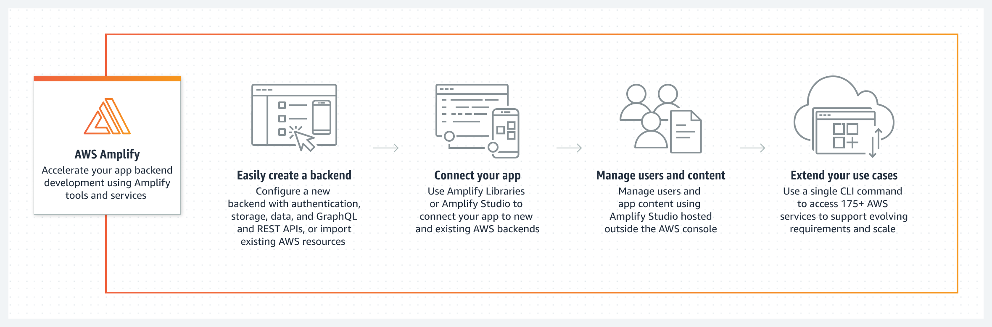
Create an App backend
Create a cross-platform backend for your iOS, Android, Flutter, web, or React Native app with real-time and offline functionality in just a few clicks.

Slide 5
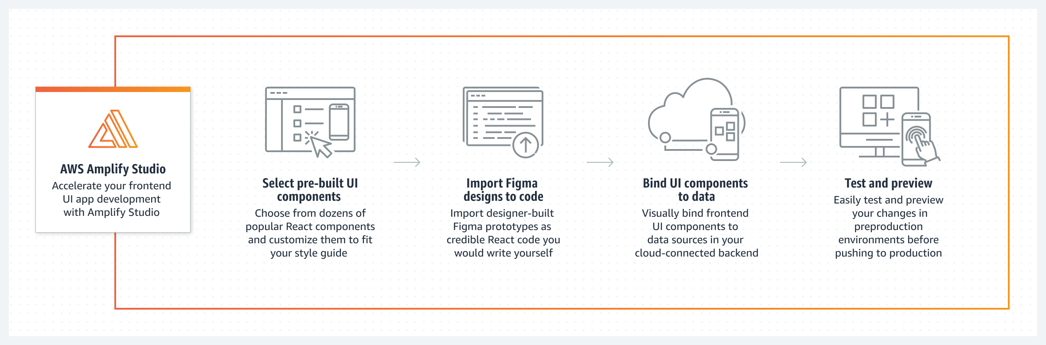
Build a Frontend UI
Visually build a pixel-perfect UI and connect your frontend UI to a cloud backend in clicks. AWS Amplify saves you from writing thousands of lines of code.

Slide 6
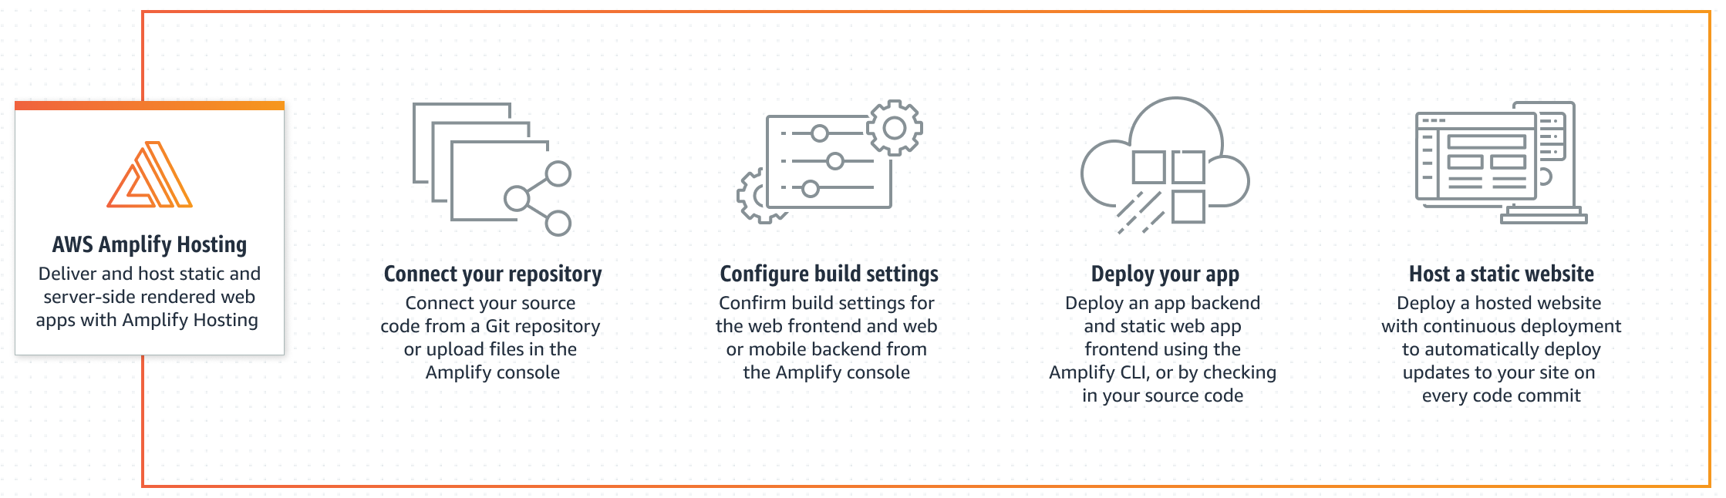
Host a web app
Easily deploy your web app or website to the fast, secure, and reliable AWS content delivery network (CDN), with hundreds of points of presence globally.

Slide 7
Features and Services of Amplify
Amplify Studio (Visual Interface):Point-and-click environment to build and deploy a full-stack app quickly, including frontend UI and backend.
Amplify CLI (Command Line Interface):Local toolchain to configure and manage an app backend with just a few commands.
Amplify Libraries (Open-Source Client Libraries):Open-source client libraries to build cloud powered mobile and web apps.
Amplify UI Components (Open-Source Design System):Open-source design system with cloud-connected components for building feature-rich apps fast.
Amplify Web Hosting (Managed CI/CD and Hosting):Fully managed CI/CD and hosting for fast, secure, and reliable static and server-side rendered apps.

Slide 8
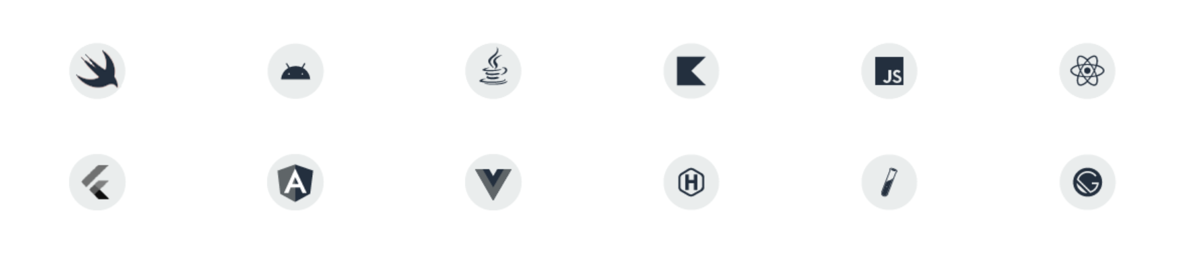
Tools that work with Amplify

Slide 9
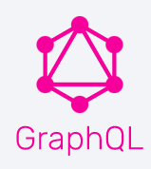
GraphQL is a query language and server-side runtime for application programming interfaces (APIs)that prioritizes giving clients exactly the data they request and no extra data. GraphQL is designed to make APIs fast, flexible, and developer-friendly. Developed By Facebook in 2015 , GraphQL became open-source hosted by The Linux Foundation in 2018.
What is GraphQL ?

Slide 10
QL terms How does GraphQL Work ?
API developers use GraphQL to create a schema to describe all the possible data that clients can query through that service.
A GraphQL schema is made up of object types, which define which kind of object you can request and what fields it has.
As queries come in, GraphQL validates the queries against the schema. GraphQL then executes the validated queries.
The API developer attaches each field in a schema to a function called a resolver. During execution, the resolver is called to produce the value.

Slide 11
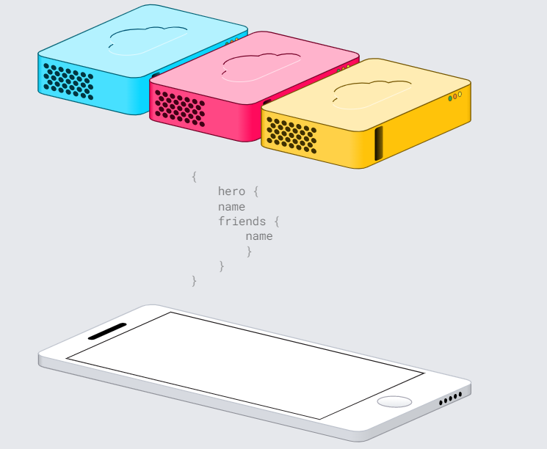
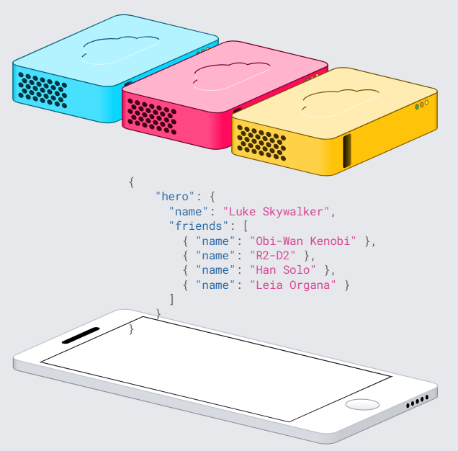

Slide 12
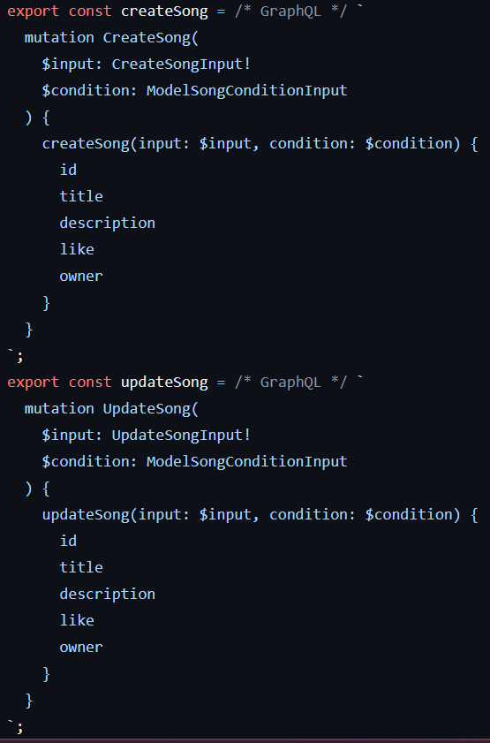
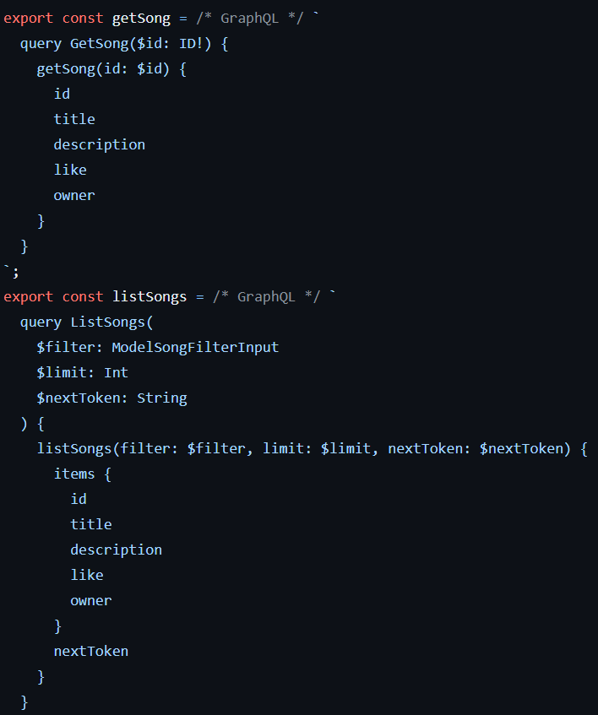
Queries and Mutations

Slide 13
Dynamo DB
Amazon DynamoDB is a cloud-native NoSQL primarily key-value database.
While we cannot describe exactly what DynamoDB is, we can describe how you interact with it. When you set up DynamoDB on AWS, you do not provision specific servers or allocate set amounts of disk. Instead, you provision throughput — you define the database based on provisioned capacity — how many transactions and how many kilobytes of traffic you wish to support per second. Users specify a service level of read capacity units (RCUs) and write capacity units (WCUs). As stated above, users generally do not directly make DynamoDB API calls. Instead, they will integrate an AWS SDK into their application, which will handle the back-end communications with the server. DynamoDB data modeling needs to be denormalized. For developers used to working with both SQL and NoSQL databases

Slide 14
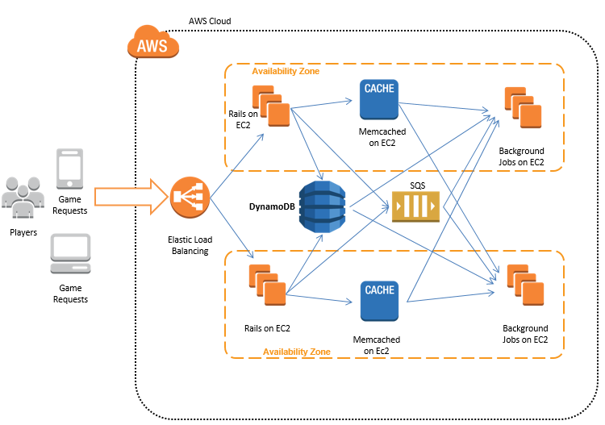
Working of DynamoDB

Slide 15
Schemas, resolvers, and other common Gr
Advantages Disadvantages
Scalability
Cost Effective
Data Replication
Serverless
Easy to administer
Schemaless DB, Ideal for IoT, Mobile, Gaming
Security
Provisioned throughput and batch jobs don't work well together.
DynamoDB can be scaled – until it’s not simple.
Limited Storage
Can’t Redesign Applications
Time Consuming

Slide 16
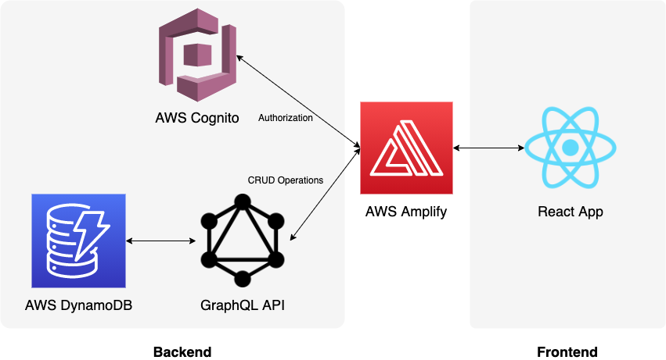
Cloud Architecture

Slide 17

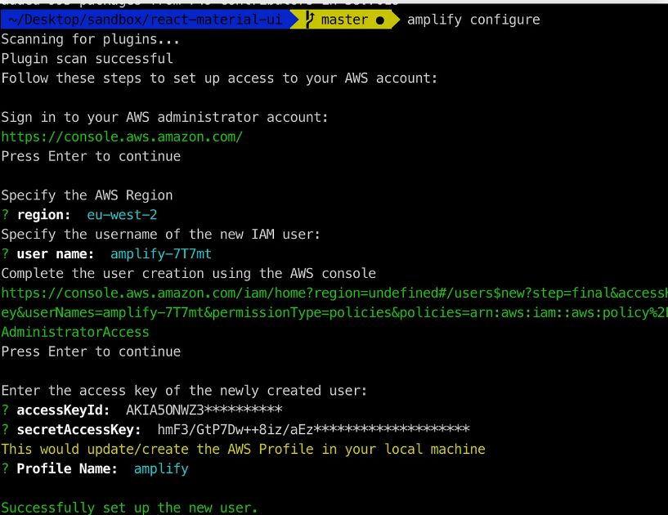

Let us see the Implementation!
1. Setup Amplify
The Amplify Command Line Interface (CLI) is a unified toolchain to create, integrate, and manage the AWS cloud services for your app.
After that run the configuration script:

Slide 18
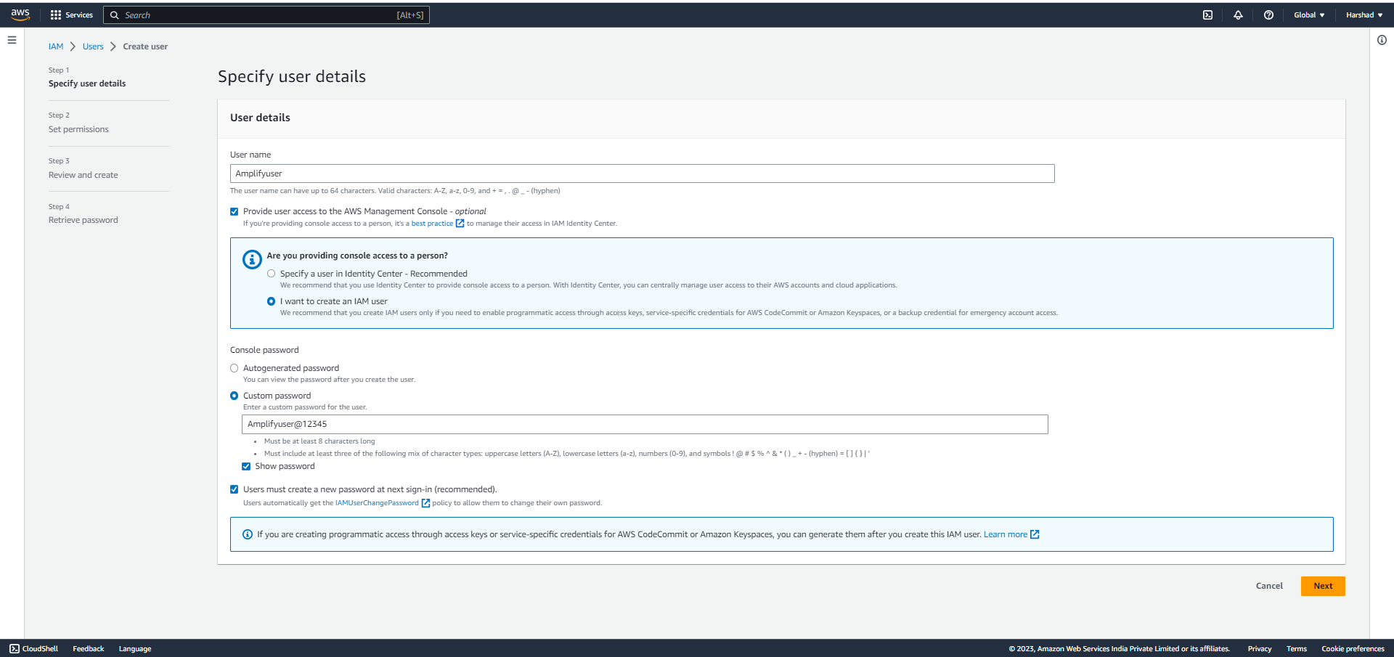
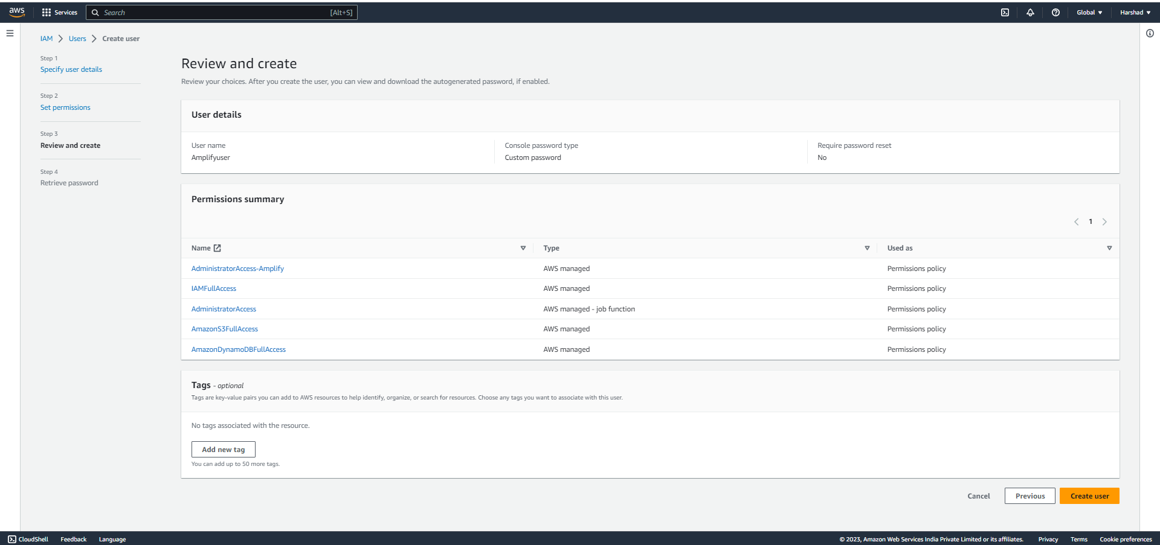

Slide 19


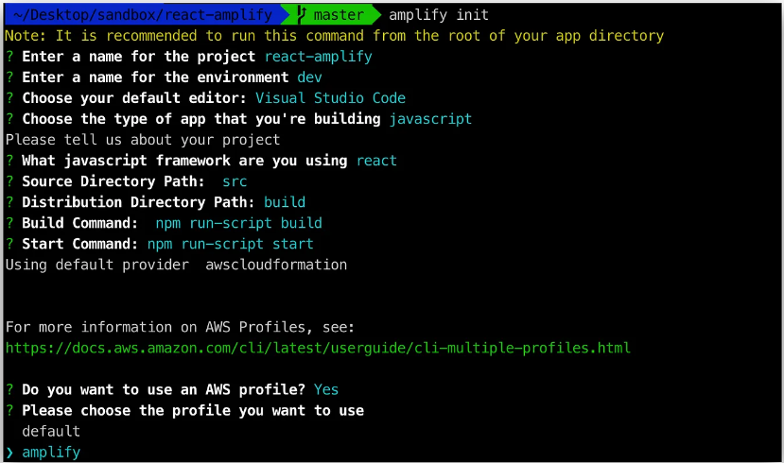
2. Create our app
Create our React app:
This will create a new React app in the react-amplify directory. Now, from the root directory, we can initialize the backend using amplify:

Slide 20

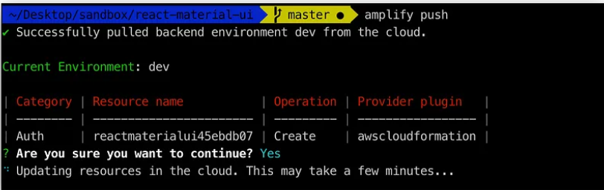
Now push the configuration to the cloud:
This will create and deploy the necessary changes to our AWS account.
A configuration file called aws-exports.js will be copied to our configured source directory.

Slide 21

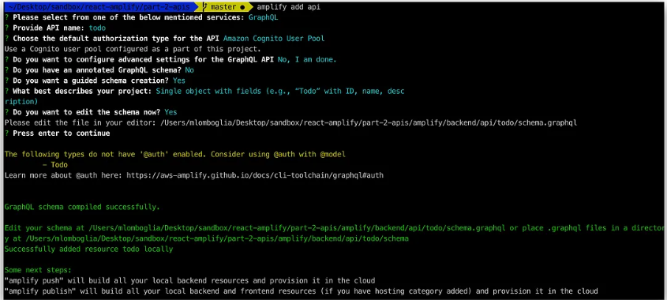
3. Adding a GraphQL API and Database
GraphQL – A query language and server-side API implementation based on a typed representation of your application. This API representation is declared using a schema based on the GraphQL type system.
To add an API it is as simple as running the following command in the root directory of your project.

Slide 22
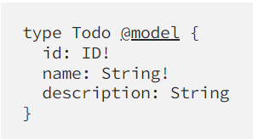
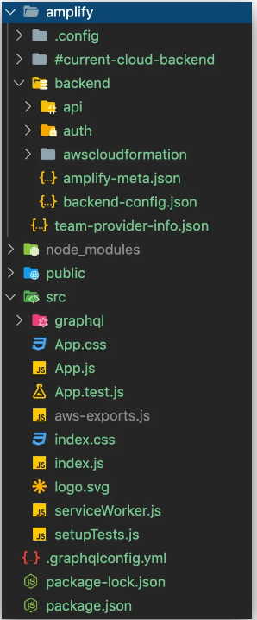

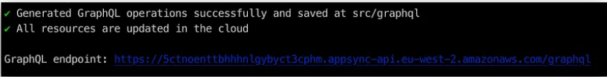
We will use single object with fields by AWS Amplify.
The graphql.schema file will automatically be created on the following path:
Now, push the schema to AWS

Slide 23
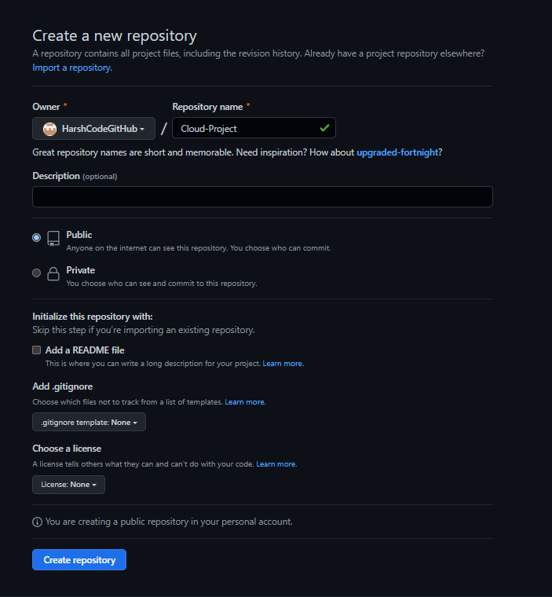
4. Writing the frontend code to interact with API & Deploy it using GitHub
After we have written code we need to commit our code to github repository.

Slide 24
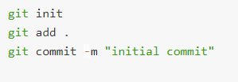

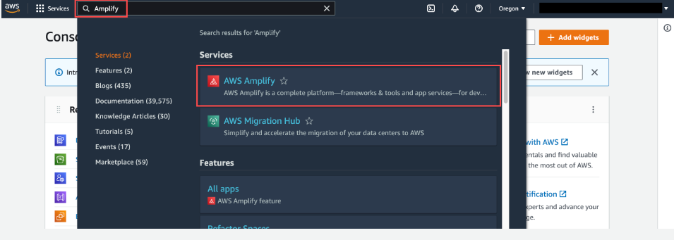
Deploy app using AWS Amplify

Slide 25
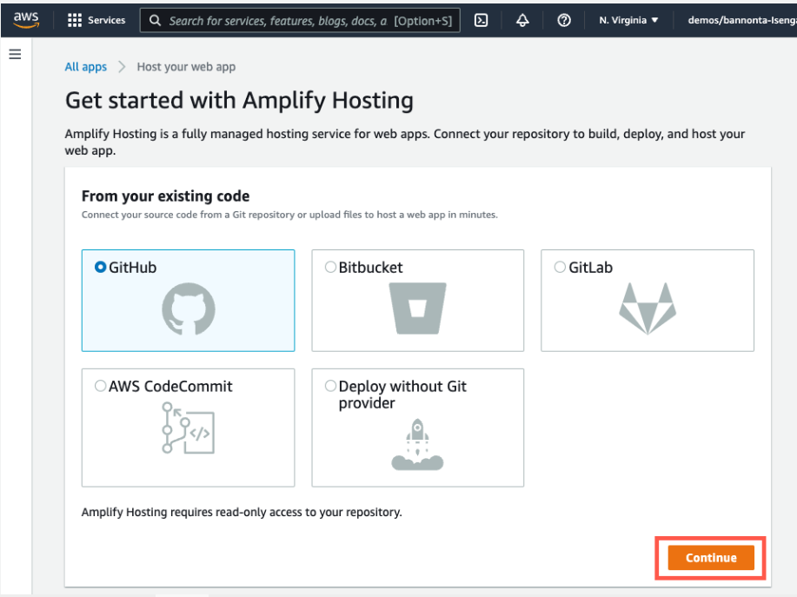
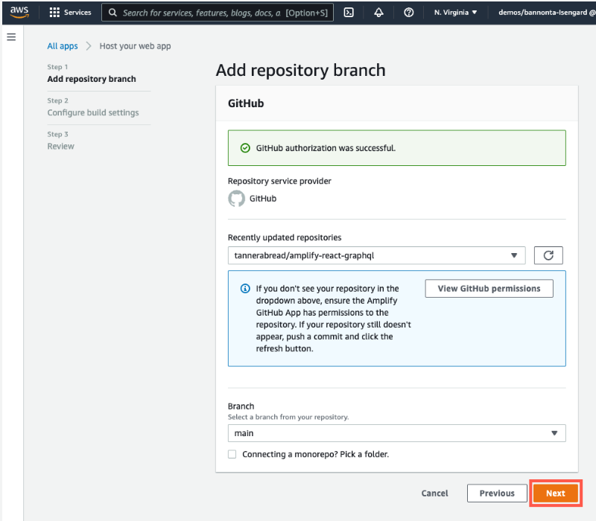

Slide 26
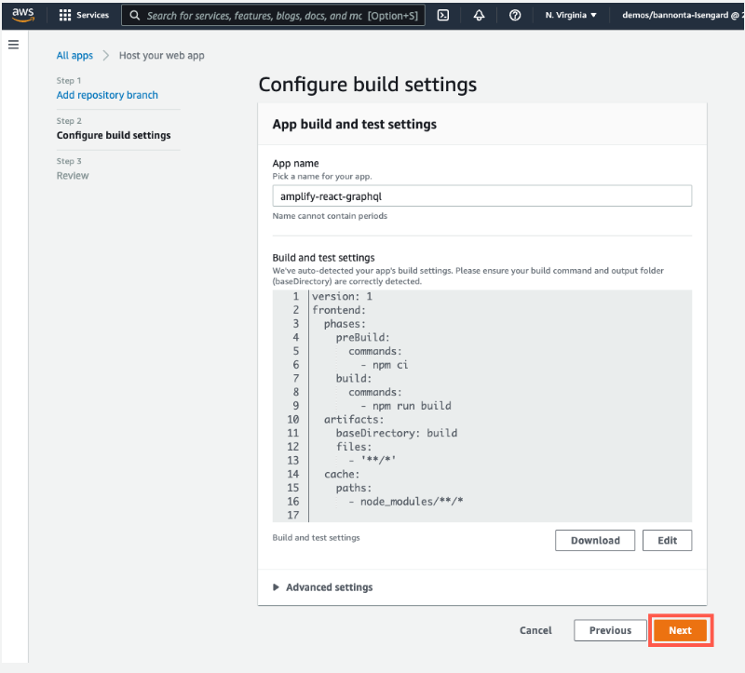
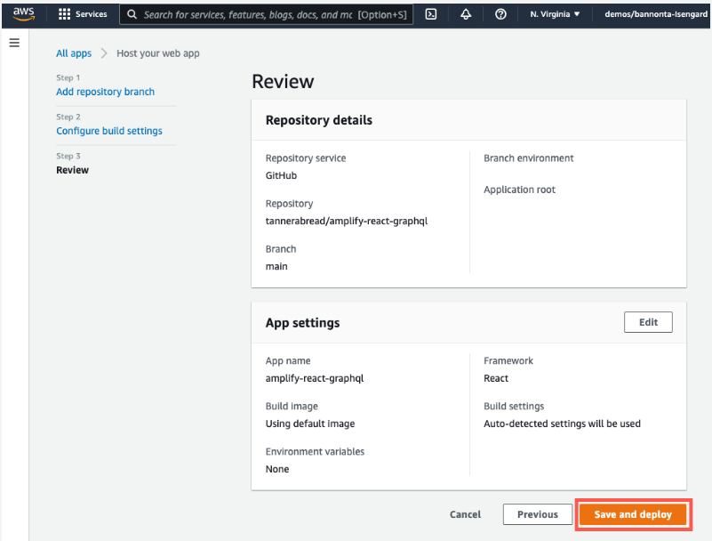

Slide 27
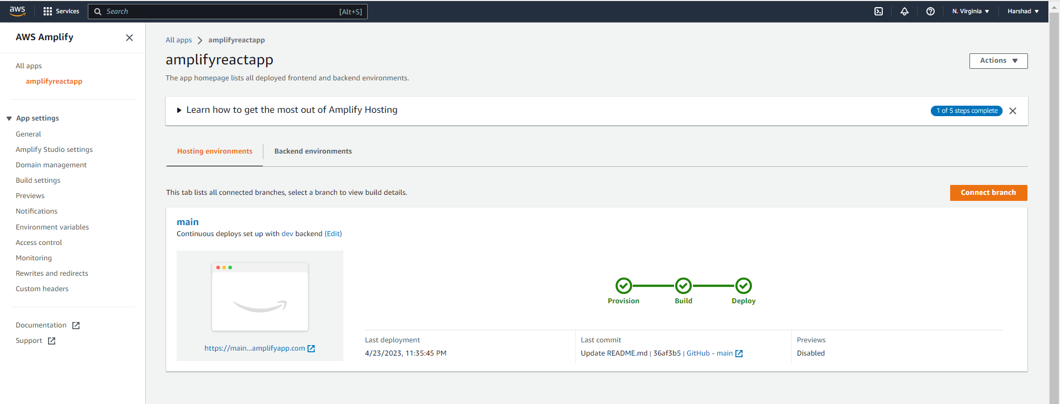
https://main.devz7ogw94bel.amplifyapp.com/

Slide 28
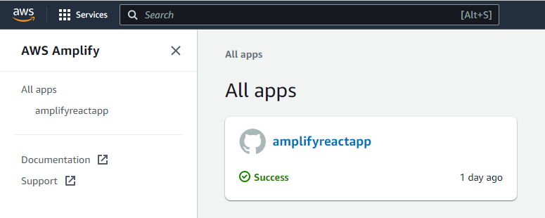
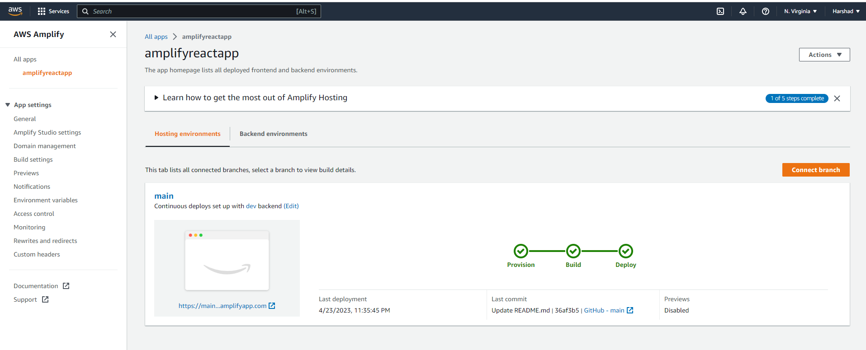

Slide 29
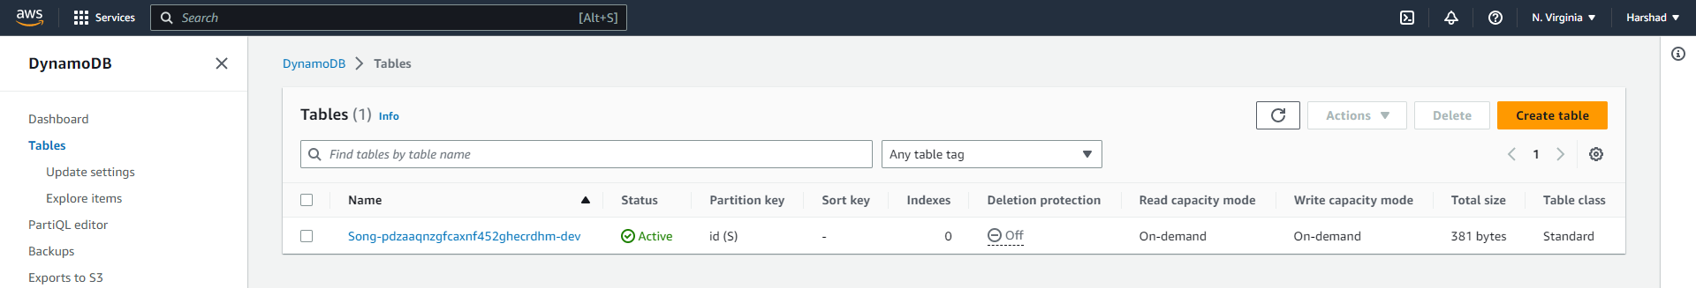
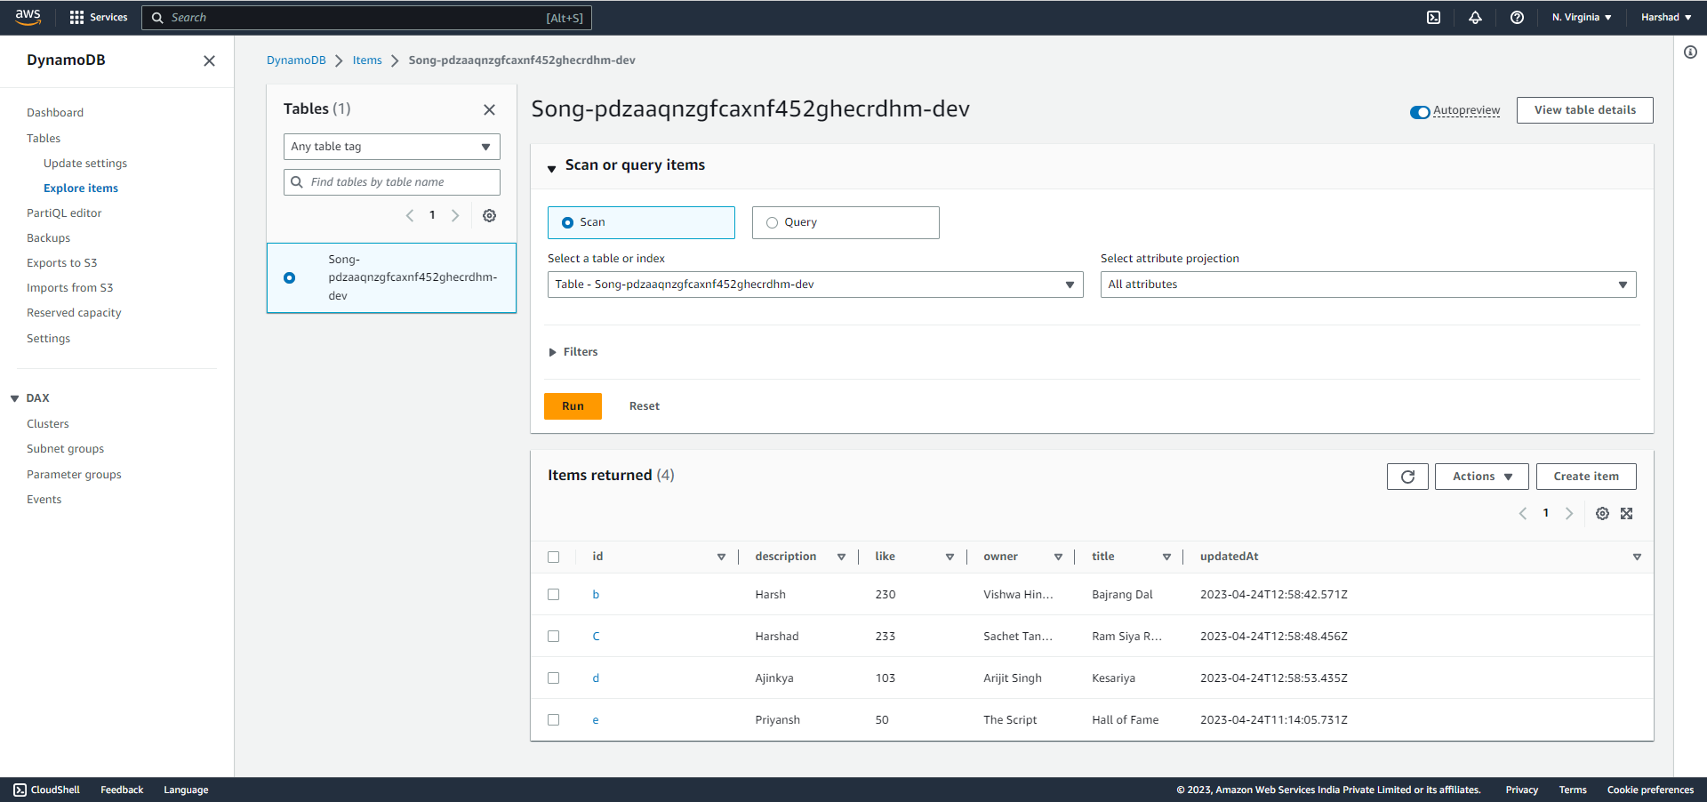

Slide 30
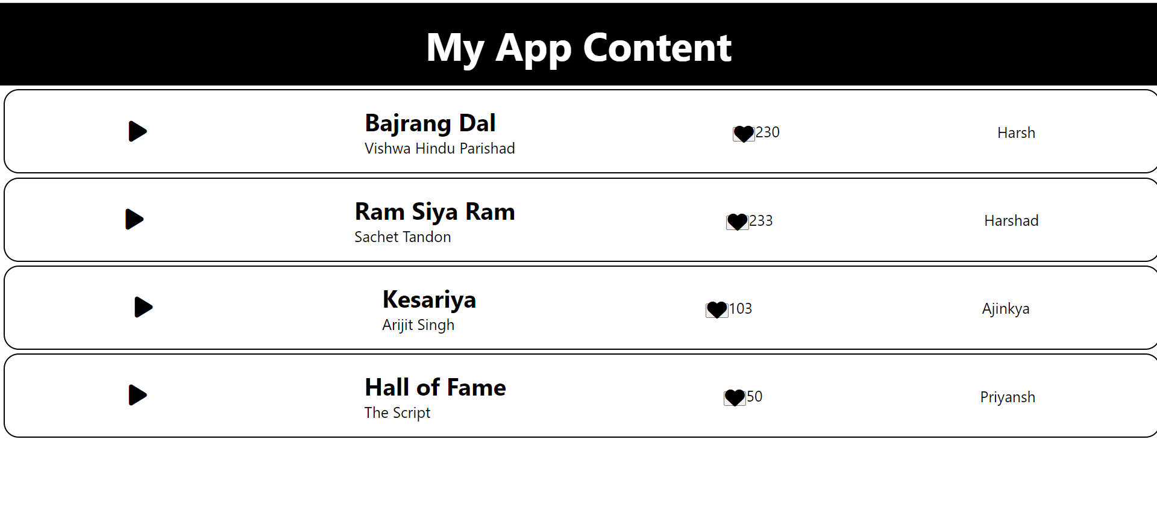

Slide 31
References:
https://aws.amazon.com/getting-started/hands-on/build-react-app-amplify-graphql/module-one/
https://docs.amplify.aws/cli/
https://docs.aws.amazon.com/amplify/latest/userguide/getting-started.html
https://graphql.org/
https://www.dynamodbguide.com/what-is-dynamo-db/

Slide 32
THANK YOU
Now you can deploy your website using Amazon Amplify!

