Slide 1



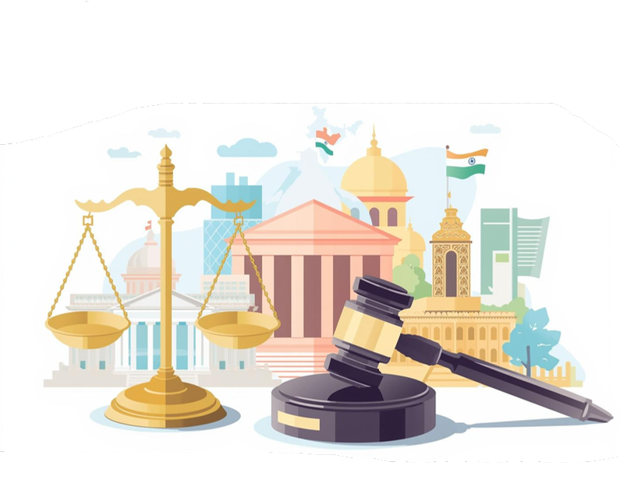
AI-Legis
Intelligent Legal Case Analysis & Inconsistency Detection System

Slide 2


Current Challenges
Addressing inefficiencies in the Indian legal system today
The Indian legal landscape faces significant challenges, including manual tracking of cases through physical "Black Diaries," leading to inefficiencies.
Lawyers manage 20–30+ active cases, resulting in information asymmetry where clients lack real- time visibility. This fragmentation causes missed deadlines and heightened cognitive load for legal professionals.

Slide 3

Problem Statement
Addressing Inefficiencies and Promoting Transparency in Legal Practices
The Indian legal system is plagued by inefficiencies due to reliance on outdated practices. The reliance on physical documentation and fragmented communication leads to information asymmetry, leaving both lawyers and clients in the dark. A digital transformation is essential to enhance transparency and streamline legal processes for all stakeholders.

Slide 4

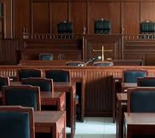


Target Users
Lawyers
Clients
Clerks/Interns
Independent practitioners needing efficient case management
Litigants seeking better case updates and access
Administrative staff managing files and research tasks

Slide 5

Our Proposed Solution
Transforming the Indian legal system through an AI-powered platform
Automated Case Tracker: Scrapes e-Courts data for instant status updates.
Semantic Search & OCR: Transforms scans/PDFs into searchable legal data with context-aware indexing.
Inconsistency Tracking: AI engine detects logical contradictions across evidence and witness statements.
AI-Legal Assistant: Summarizes complex court orders into simple, layperson English.

Slide 6
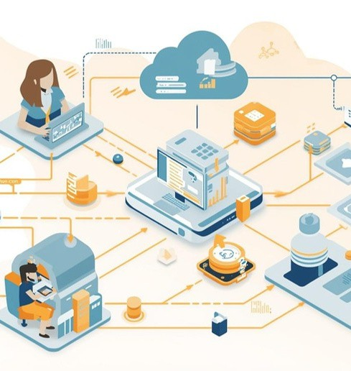
Technology
Architecture Overview
Frontend:
Flutter / React Native for cross-platform mobile accessibility.
Backend:
Python (FastAPI) for high-performance request handling.
Database:
MongoDB Atlas (Cloud) for secure, scalable case file storage.
Intelligence:
OpenAI API and LangChain for Natural Language Processing (NLP) and semantic research.

Slide 7
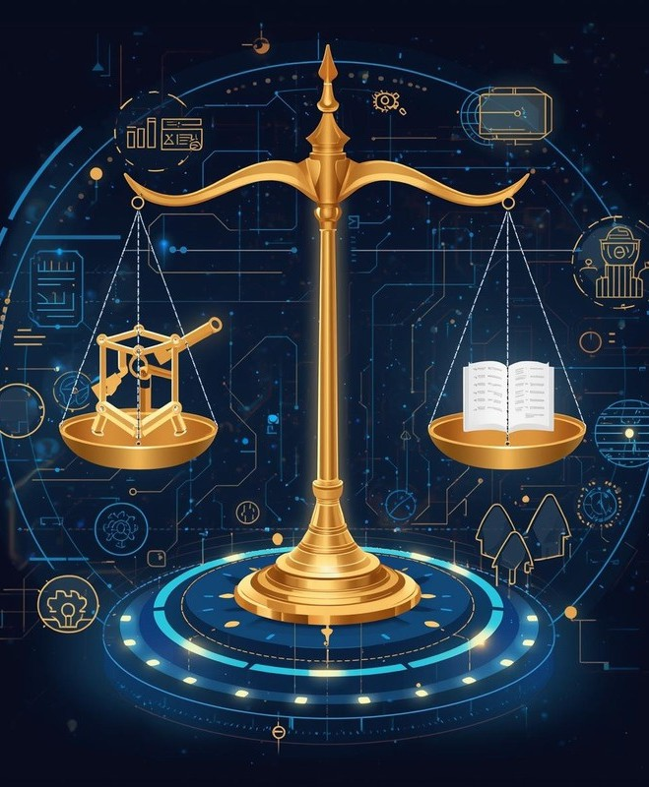
Towards a Smarter Justice System
AI-Legis bridges the gap between archaic legal practices and modern digital standards by consolidating fragmented workflows into an intelligent, high-precision workspace that addresses lawyer burnout and client anxiety.
By leveraging semantic search and automated inconsistency detection, we aim to eliminate data silos and accelerate the judicial process, transforming case management from a reactive struggle into a proactive, transparent experience.

Slide 8
Thank You!!
Our Team:
Kabir Jain |ADT24SOCB0524 Yash Patil |ADT24SOCB1425 Harsh Datar |ADT24SOCB0432 Pratik Ingole|ADT24SOCB0832
Faculty Guide:
Dr. Nagesh Jadhav
Group:
SY16-07

