Slide 1

Software Measurement(SOEN6611)
Submitted to: Dr. Rodrigo Morales Submitted By: Team 10

Slide 2
Outline
Investigating the practicality of implementing suite of object oriented design metrics (C&K).
Measuring the metrics as predictors to find defects in the classes and determining to use them earlier.
Three different releases of three large-sized tools named Ant, Mockito and Wildfly are used.
SciTool’s Understand is used to calculate the metrics value and to identify bad smells.
Quantitative analysis is done to find out the advantages and drawbacks.

Slide 3
Introduction
Architecture becomes complex with evolvement inducing bugs.
Changes made after the software delivery takes up to 90% of total cost.
Using the metrics at early stages and at every stage increases the efficiency of development process.
Our goal is to investigate correlation between C&K metrics and design defects.
We used publicly available datasets like Ant, Mockito and Wildfly.
We focused on the empirical validation of the software.
Tools used: Scitools Understand, Designite Java and Jupyter Notebook.
Metrics used: WMC, DIT, NOC, CBO, RFC, LCOM

Slide 4
Related Studies
Satwinder Singh [1], used Analyst4J tool for detecting metrics, code smells and defective classes.
‘Software bug prediction using object-oriented metrics’[2] used Ckjm tool for C&K metrics collection
Victor R. Basili[5], used a manual approach on codes written in C++ language. GEN++ tools was used to collect C&K metrics.
All the studies used different collection method but same Logistic regression model.

Slide 5
Research Questions
Is the CK metric suites useful in identifying design-defects?
How accurately they are able to predict the design-defects?
Which CK metrics are more likely to predict design-defects?

Slide 6
Research methods
Selected projects are based on JAVA with more than 300K lines of code
WMC, DIT, NOC, CBO, RFC and LCOM are taken as independent variables.
C&K metric suite has been implemented to analyse design-defect.

Slide 7
Data collection
Different softwares were used to collect the data as data from single software would be clean.
Custom code was written to combine the data sets which introduces imbalance in data sets.
Imbalanced data is dealt first as the accuracy of model would be greater than 90%, means over-fitting.

Slide 8
INTERNAL METRICS IMPLEMENTATION[3][4]
Metrics | Purpose
Weighted Method per Class (WMC) | WMC is the sum of complexity of the methods of the class.
Depth of Inheritance Tree (DIT) | It is the maximum length of a path from class node to root node in the tree hierarchy
Coupling between Objects (CBO) | Two classes are said to be coupled if methods/instance variables declared or defined in one class are used by the other class.
Response for Class (RFC) | It is the set of methods that can be executed in response to a message received by an object of that class.

Slide 9
INTERNAL METRICS IMPLEMENTATION
Metrics | Purpose
McCabe’s Cyclomatic Complexity | It is a software metric used to measure the complexity of a program.
Lack of Cohesion of Methods (LCOM) | It measures the cohesiveness of the class. Low cohesion indicates high complexity and more fault-proneness.
Number of Children (NOC) | It measures the number of immediate sub-classes derived from the base class.

Slide 10
External METRICS IMPLEMENTATION
Number of bugs
Count of bugs
0 (Absence) | 232434
1(Presrent) | 11074

Slide 11
Data Analysis
All the analysis is performed on the raw data set.
Statistical tests are used for binary variables. Thus, we use Logistic Regression
Variables executing correlation > 45% are considered and repetitive data is eliminated.
Heatmaps for MOCKITO and Wildfly are shown in next slide:

Slide 12
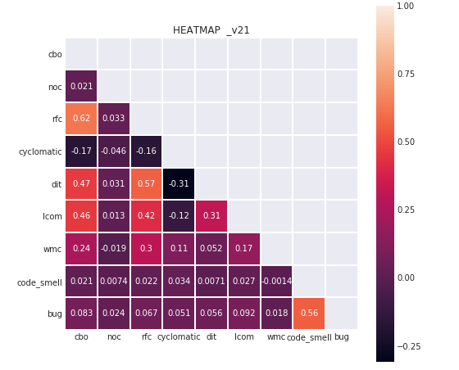
Data Analysis
Mockito
CBO vs RFC (62%)
CBO vs DIT (47%)
CBO vs LCOM (46%)
RFC vs DIT (57%)

Slide 13
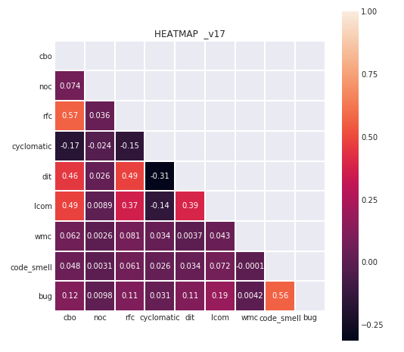
Data Analysis
Wildfly
CBO vs RFC (57%)
CBO vs DIT (46%)
CBO vs LCOM (49%)
RFC vs DIT (49%)

Slide 14
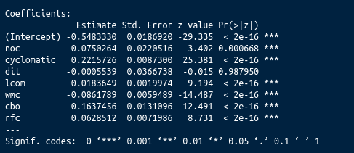
Data Analysis
For regression with independent variables we use P-values to make the conclusions.
The code displays the level of significance.
The threshold value for alpha is set at 0.5.
P- value between 0 and alpha is accepted as significant with higher significance as it goes closer to 0.
DIT was discarded.

Slide 15
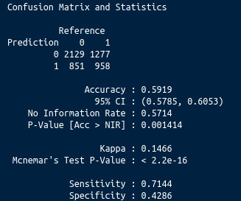
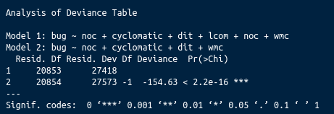
Data Analysis
Null Hypothesis: C&K metrics has no correlation with code smells.
Alternate Hypothesis: C&K metrics is correlated with bugs/code smells.

Slide 16
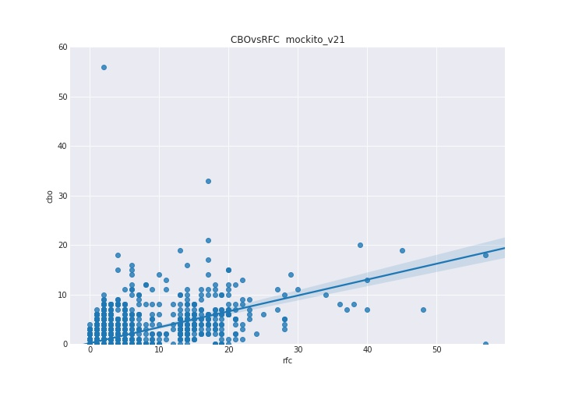
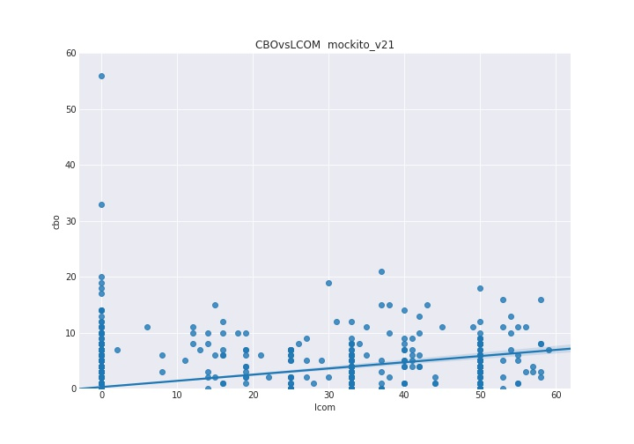
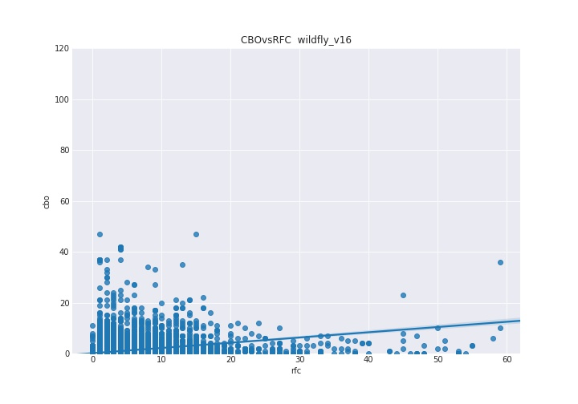
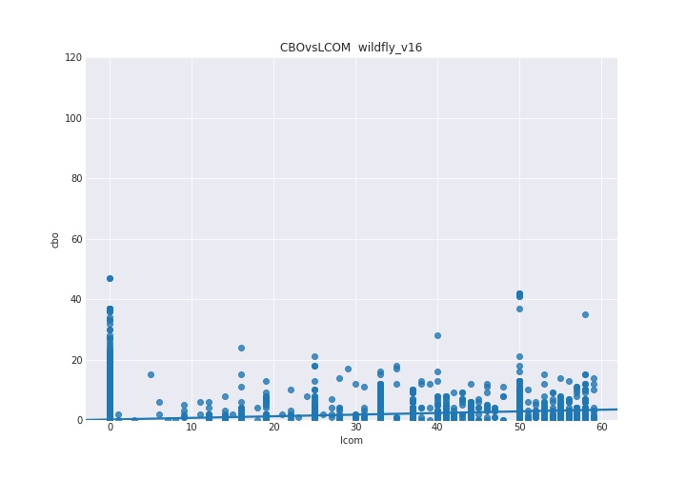
Data Analysis

Slide 17
Challenges Faced
Extra clarity is required on the data as Scitool’s Understand as it not only provide data on classes but also on the files and directory.
Otherwise this could result in incorrect analysis.
Lower RAM memories led to multiple crashes.
Selecting criteria for each type of code smell was also a time consuming discussion because of our limited knowledge.
Data cleaning and preparation was a major challenge as the output of Designite java separates the Packages, Methods and Types of classes then detects code smells.

Slide 18
Discussion
Basic model without hyper-parameter tuning has 60% prediction accuracy.
This model shows 42% specificity and 71% sensitivity means the model is not overfitted.
After eliminating insignificant variables, we see model 2 is significant.
Null hypothesis was rejected.
Model 2

Slide 19
Conclusion and future research
Null-hypothesis is negated.
There is a correlation between CK metric and design defect prediction model.
We also concluded that external and internal factors affects the proneness of design defect.
All metrics except DIT, have lower P-values.
C&K metric resulted to be better Design defect predictor than ‘traditional’ metric suite.

Slide 20
Conclusion and future research
For future research, we can use this prediction model on small and less complex projects.
Model could be used for different versions to check defects with evolution.
Different properties and type of defects will be considered into account.
Adding design defect severity to check the abilities of our prediction model.

Slide 21
Summary
We investigated the practicality of implementing C&K (Chidamber & Kemerer) metrics suite.
We used 3 professionally built projects to measure the metrics as predictors.
Relationship between object-oriented metrics and defect prediction was studied in terms of bug by, computing the accuracy of the proposed model on different datasets using logistic regression.
We have negated the 'null-hypothesis', which signifies that there is considerable correlation between the response and the predictor variables.
We concluded, there is a correlation between CK metric and design defect prediction model
Also our results show that we can use our prediction model to predict the design defects in large projects

Slide 22
References
[1] Heena Kapila & Satwinder Singh, Analysis of CK Metrics to predict Software Fault-Proneness using Bayesian Inference, International Journal of Computer Applications (0975 – 8887)
[2] Software bug prediction using object-oriented metrics DHARMENDRA LAL GUPTA 1,2, * and KAVITA SAXENA 2
[3] ] “A Critical Suggestive Evaluation of CK Metric”, Pacific Asia Conference on Information Systems, PACIS 2005, Bangkok, Thailand, July 7-10, 2005.
[4] ] “Analysis of Various Software Metrics Used to Detect Bad Smells”, Sukhdeep Kaur, Dr. Raman Maini, The International Journal of Engineering and Science (IJES), Volume 5, Issue 6, Pages PP -14-20 2016 ISSN (e) : 2319 – 1813 ISSN (p) : 2319 – 1805.
[5] A Validation of Object-Oriented Design Metrics as Quality Indicators, Victor R. Basili, 1996

