Slide 1
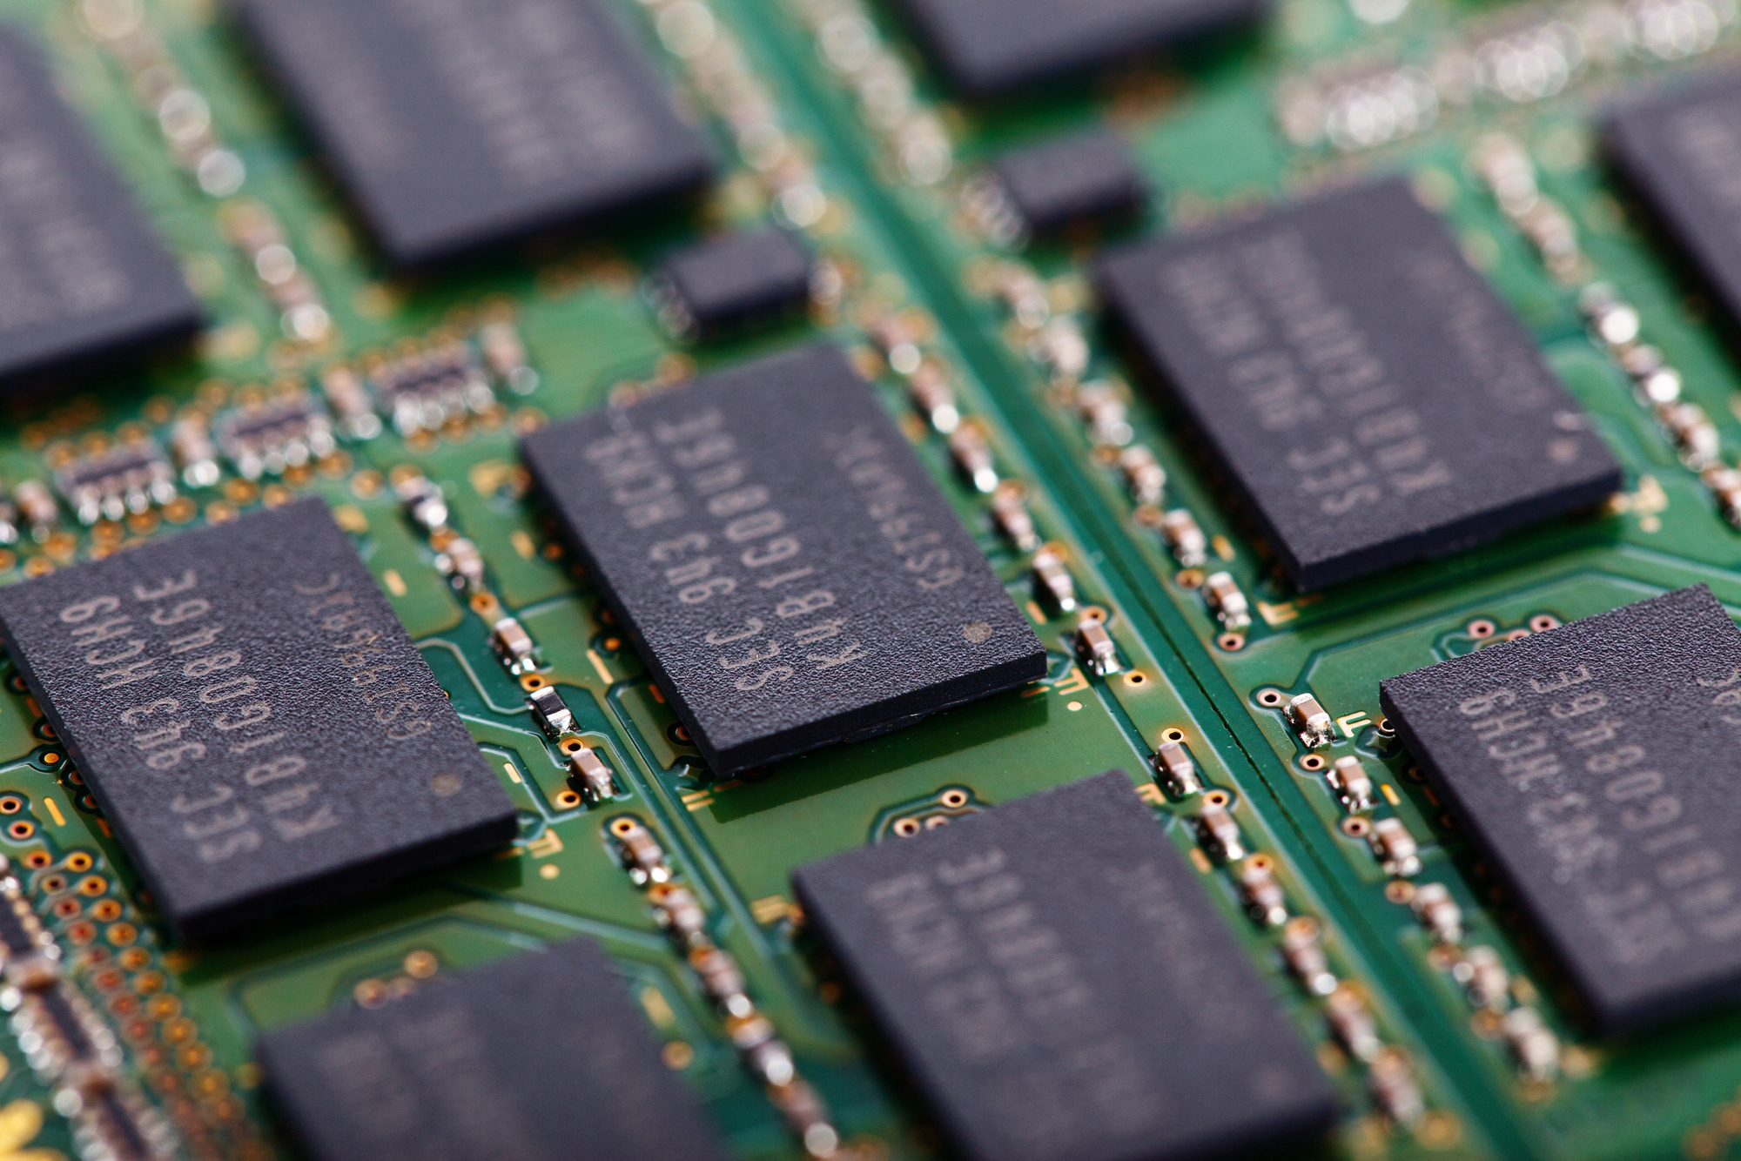


DATE:11 JULY 2024
ASIC MANUFACTURING PROCESS
FROM DESIGN TO FABRICATION
Group 4
Tirth Chauhan
Nandini Vajani
Shahid Chopda
Hani prajapati
Harsh Kapadiya

Slide 2



DATE:11 JULY 2024
INTRODUCTION TO ASIC
01
Applications of ASICs
ASICs find applications in various industries, each leveraging the technology for unique purposes. Here are some prominent sectors in which ASICs play a pivotal role
Consumer electronics
Telecommunications
Automotive industry
healthcare
ASIC, short for application-specific integrated circuit, is a specialized type of integrated circuit meticulously designed to perform a specific function or set of functions within an electronic system. Unlike general-purpose microprocessors in everyday electronic devices like your microwave or TV box, ASICs are tailor-made for a particular application, offering unparalleled efficiency and performance.
02
Advantages of ASICs
Presented by Tirth Chauhan and Nandani Vajani
Performance Optimization
Power Efficiency
Space Optimization
Cost effective in Volume
Product Cost Reduction

Slide 3
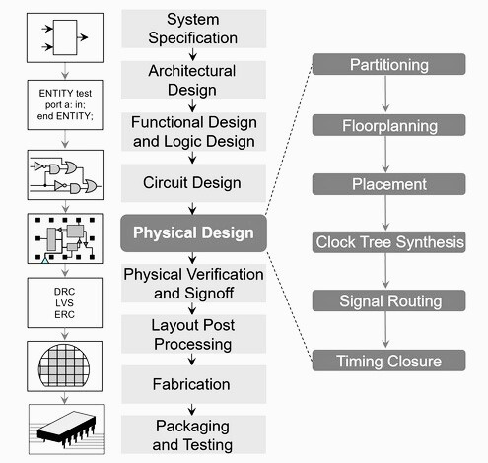
OVERVIEW OF ASIC DESIGN FLOW
Specification:
Define functionality and constraints
Set performance and physical requirements
Design
Architectural Design: Outline structure
RTL Design: Develop RTL code
Synthesis: Convert RTL to gate-level netlist
Verification
Functional Verification
Timing Analysis: Validate timing requirements
Formal Verification: Prove design correctness
Fabrication
Prepare GDSII files for manufacturing
Silicon wafer production at foundry
Testing
Wafer testing for functionality
Chip-level performance validation
Packaging
Encapsulate in protective package
Attach system integration connections

Slide 4


ASIC WAFER FABRICATION TECHNOLOGIES
Types Of ASIC Wafer Fabrication Technologies:
CMOS(Complementary Metal-Oxide-Semiconductor)
BiCMOS (Bipolar CMOS)
GaAs (Gallium Arsenide)
SOI (Silicon on Insulator)
FinFET (Fin Field-Effect Transistor)
SiGe (Silicon-Germanium)
High-K Metal Gate (HKMG)
ASIC (Application-Specific Integrated Circuit) fabrication technologies are processes used to create custom-designed silicon chips tailored for specific applications. These technologies encompass a variety of semiconductor processes that convert raw silicon wafers into highly functional integrated circuits. The choice of technology impacts the performance, power consumption, cost, and application suitability of the final product.

Slide 5
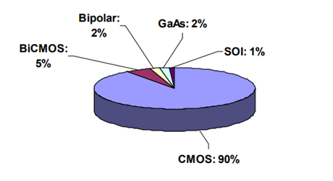
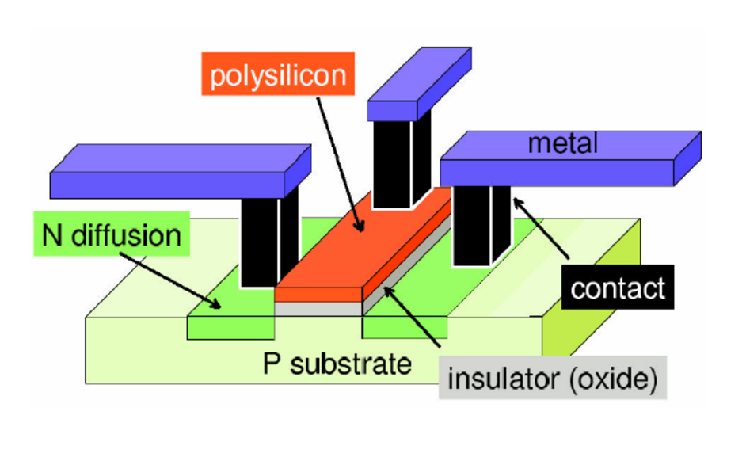
CMOS (COMPLEMENTARY METAL-OXIDE-SEMICONDUCTOR) TECHNOLOGY
Although a number of processing technologies are available, the majority of the production is done with traditional CMOS. Other processes are limited to areas where CMOS is not very suitable (like high speed RF applications)
The semiconductor surface is subjected to various processing steps in which impurities and other materials are added with specific geometrical patterns .
The fabrication steps are sequenced to form three dimensional regions that act as transistors and interconnects that form the network
An Integrated Circuit (IC) is an electronic network fabricated in a single piece of a semiconductor material
Fabrication process sequence
Silicon manifacture
Wafer processing - Lithography - Oxide growth and removal - Diffusion and ion implantation - Annealing - Silicon deposition - Metallization
Testing
Assembly and packaging

Slide 6
Processes Of VLSI Wafer Fabrication:
Wafer Preparation:
Crystal Growth: As described earlier, single crystal silicon ingots are grown using methods like the Czochralski (CZ) or Float-Zone (FZ) method.
Wafer Slicing: The silicon ingot is sliced into thin wafers using a diamond saw.
Wafer Polishing: The sliced wafers are polished to achieve a smooth, mirror-like surface.
Oxidation
Thermal Oxidation: The silicon wafer is exposed to oxygen or water vapor at high temperatures, forming a thin layer of silicon dioxide (SiO₂) on the surface.
Purpose: The oxide layer serves as an insulator, a mask for ion implantation, or a gate dielectric in MOSFETs.
Photolithography
Photoresist Application: A light-sensitive photoresist material is applied to the wafer.
Mask Alignment and Exposure: A photomask with the desired pattern is aligned with the wafer, and UV light is used to transfer the pattern onto the photoresist.
Developing: The exposed photoresist is developed, leaving behind a patterned photoresist on the wafer.
Etching
Dry Etching: Plasma or reactive ion etching (RIE) is used to remove the exposed areas of silicon dioxide or other materials, leaving the desired pattern.
Wet Etching: Chemical solutions are used to etch away unprotected areas.
Doping
Ion Implantation: Ions of dopant materials (e.g., boron, phosphorus) are accelerated and implanted into specific regions of the wafer.
Diffusion: The wafer is heated to drive the dopants into the silicon and activate them.

Slide 7
Deposition
Chemical Vapor Deposition (CVD): Gaseous reactants are used to deposit thin films of materials like silicon dioxide, silicon nitride, or polysilicon onto the wafer.
Physical Vapor Deposition (PVD): Techniques like sputtering or evaporation are used to deposit metal films, such as aluminum or copper, for interconnects.
Planarization
Chemical Mechanical Planarization (CMP): The wafer surface is polished to ensure a flat and even surface, which is crucial for subsequent photolithography steps.
Interconnect Formation
Metal Deposition: Metals (e.g., aluminum, copper) are deposited to form the wiring that connects different parts of the circuit.
Damascene Process: Trenches and vias are etched into the dielectric, filled with metal, and then planarized.
Passivation
Passivation Layer: A protective layer of silicon nitride or silicon dioxide is deposited over the entire wafer to protect the circuits from contamination and damage.
Testing and Packaging
Wafer Testing: Electrical tests are performed on each die (individual circuit) on the wafer to identify functional and non-functional dies.
Dicing: The wafer is cut into individual dies.
Packaging: Functional dies are mounted into packages, connected to external leads, and encapsulated for protection.
Final Testing:Packaged ICsundergo final testing to ensure they meet specifications.

Slide 8
FOUNDARIES
"Foundries" in the context of technology and manufacturing refer to companies that produce semiconductors, integrated circuits (ICs), and other microelectronics. These foundries specialize in the fabrication of silicon wafers, which are used to create chips that power a wide range of electronic devices, from smartphones to servers.
The term "semiconductor foundry" is commonly used to describe these companies, and they typically operate on a contract manufacturing model. This means they manufacture ICs based on the designs provided by their customers, who may be fabless semiconductor companies (companies that design ICs but do not have their own manufacturing facilities) or integrated device manufacturers (IDMs) that design and manufacture their own ICs but may outsource some production.
Some well-known semiconductor foundries include:
TSMC (Taiwan Semiconductor Manufacturing Company)
Global Foundries
Samsung Foundry
UMC (United Microelectronics Corporation)
SMIC (Semiconductor Manufacturing International Corporation)

Slide 9
Testing and Verification of ASIC:
Testing of ASIC (Application-Specific Integrated Circuit) manufacturing before packaging is crucial to ensure the functionality and reliability of the chips. Here are the key steps involved in this process:
Wafer Testing (Wafer Probe Test):
Objective: To identify defective chips before the costly packaging process.
- Process:
- A probe card is used to make temporary electrical contact with the pads or bumps on each die (individual chip) on the
wafer.
- Automated test equipment (ATE) runs a series of tests to check the electrical characteristics and functionality of each die.
- Defective dies are marked with an ink dot or recorded in a map for later reference.
Parametric Testing:
- Objective: To ensure the electrical parameters of the ICs are within specified limits.
- Process:
- Tests include checking for parameters like voltage, current, frequency, and timing.
- Helps in identifying process variations and ensures that the devices meet the design specifications.
Burn-in Testing:
- Objective: To identify early failures and ensure reliability.
- Process:
- The wafers or individual dies are subjected to elevated temperatures and voltages for an extended period.
- This process accelerates potential failure mechanisms and identifies weak dies.

Slide 10
Testing and Verification of ASIC:
Functional Testing:
- Objective: To verify that the ASIC performs its intended functions correctly.
- Process:
- Functional tests simulate real-world operating conditions.
- Complex patterns and scenarios are applied to check the functionality.
Yield Analysis:
- Objective: To assess the overall yield of the manufacturing process.
- Process:
- Analyzing the results from wafer testing to determine the percentage of good dies.
- Helps in identifying patterns of defects and areas for process improvement.
Defect Analysis:
- Objective: To understand the root causes of failures.
- Process:
- Failed dies are analyzed using techniques like scanning electron microscopy (SEM), focused ion beam (FIB), and others.
- Identifying the defects helps in improving the manufacturing process.
Wafer Sorting:
- Objective: To separate good dies from defective ones.
- Process:
- Good dies are picked from the wafer and prepared for packaging.
- Defective dies are discarded or used for further analysis.

Slide 11
Why need of packaging?
However, many high-performance VLSI chip scan fail stringent test specifications after packaging if chip designers have not included various effects of packaging constraints and parasitics in their design. The numbers of ground planes and power planes and the bonding pads greatly affect the behaviours of the on-chip power and ground buses. Also the length of the bonding wire between the chip and the package and the lead length in the package determine the inductive voltage drop in the output circuit. An equally important consideration is thermal problems. Good packages should provide low thermal resistance and, hence, limited temperature increase beyond the ambient temperature due to power dissipation. Since the choice of proper packaging technology is critical to the success of the chip development, chip designers should work closely with package designers from the start of the project, especially for full custom designs. Also, since the final cost of the packaged chip depends largely on the package cost itself, for low-cost chip development, designers must ensure enough design margins that the chips can function properly in low-cost packages with more parasitic effects and less thermal conductivity. Some of the important packaging concerns are * Hermetic seals to prevent the penetration of moisture
Thermal conductivity
Thermal expansion coefficient
Pin density
Parasitic inductance and capacitance
alpha-particle protection

Slide 12
Types of package
Various types of packages are available for integrated circuit chips. Integrated circuit packages are generally classified by the method which is used to solder the package on the printed circuit board (PCB). The package pins can be introduced in holes drilled in the (PCB); this method is called pin-through-hole (PTH)
Plastic Dual In-line Package (PDIP)Features: A rectangular housing with two parallel rows of pins.
Applications: Used for simpler, low-pin-count ASICs in cost-sensitive applications.
2. Plastic Leaded Chip Carrier (PLCC)Features: A square or rectangular package with leads on all four sides. Applications: Often used in moderate pin-count applications with a need for more robust mechanical performance compared to PDIP
3. Small Outline Integrated Circuit (SOIC)Features: A smaller, thinner version of PDIP with gull-wing leads. Applications: Suitable for surface-mount technology (SMT) with moderate pin count.
4. Quad Flat Package (QFP)Features: A flat, square or rectangular package with leads extending from all four sides. Applications: Commonly used in applications requiring a high pin count, such as consumer electronics and telecommunications.
5. Ball Grid Array (BGA)Features: A package with an array of solder balls on the underside for connection to the PCB. Applications: Ideal for high-density, high-performance applications. Variants include: Plastic BGA (PBGA)MicroBGA (µBGA)Fine-Pitch BGA (FBGA)

Slide 13
FINAL TESTABILITY and ASSURANCE OF ASIC:
The task of determining whether fabricated chips are fully functional is highly complex and can be very time-consuming. However, when faulty chips pass an improperly designed test, they can cause system failures and enormous difficulty in system debugging. As the number of transistors integrated into a single chip increases, the task of chip testing to ensure correct functionality becomes increasingly more difficult
Final testing and assurance of Application-Specific Integrated Circuits (ASICs) are critical stages in ensuring their functionality and reliability before deployment. Here are some key steps typically involved in this process
Visual Inspection
Objective : To identify any physical defects on the packaged ASIC.
2. Electrical Testing
Objective : To verify the electrical functionality and performance of the ASIC.
3. Thermal Testing
Objective : To ensure the ASIC can operate reliably within its specified temperature range.
4. Reliability Testing
Objective : To assess the long-term reliability and robustness of the ASIC.
5. Environmental Testing
Objective : To evaluate the ASIC’s performance under various environmental conditions.

Slide 14
Conclusion:
In conclusion, the manufacturing process of Application-Specific Integrated Circuits (ASICs) is a meticulous and highly specialized endeavor that demands rigorous testing and quality assurance at every stage. From the initial design and wafer fabrication to the pre-packaging and post-packaging tests, each step is crucial to ensuring the final product meets the stringent requirements of functionality, reliability, and performance.
The integration of advanced testing methodologies, including wafer-level testing, parametric verification, and functional tests, ensures that only the highest quality dies proceed to the packaging phase. Post-packaging tests further validate the ASICs, confirming their robustness under various environmental and operational stresses.
This comprehensive approach not only guarantees the production of reliable and efficient ASICs but also enhances customer satisfaction by delivering products that meet or exceed expectations. As technology continues to evolve, so too will the methods and processes involved in ASIC manufacturing, paving the way for even more sophisticated and high-performance integrated circuits in the future.

Slide 15
References:
1.https://en.wikipedia.org/wiki/Application-specific_integrated_circuit
2.https://www.ansys.com/en-in/simulation-topics/what-is-asic-design
3.https://teamvlsi.com/2020/05/asic-design-flow-overview-v1.html
4.https://semiconductorclub.com/the-future-of-asics-innovations-and-emerging-trends/
5.http://www-micro.deis.unibo.it/~masetti/Dida01/tecCMOS
6.http://csg.csail.mit.edu/6.375/6_375_2006_www/handouts/lectures/L05-Synthesis-Placement-
Routing
7.C-MOSkang

