Slide 1


Zomato IPO Valuation & Strategy Analysis
Harsh Garg | July 2025

Slide 2
Executive Summary
• IPO valued at 30.1× EV/Revenue vs peer median 13.4× -> overvalued.
• Peer‑implied market cap ≈ ₹31k Cr, ~50% below IPO cap.
• 38× oversubscription and 51% listing gain due to demand.
• Stock corrected –25% within a year, aligning with fundamentals.

Slide 3
Company Snapshot
• Food delivery & restaurant discovery platform (founded 2010).
• IPO Date: 23 Jul 2021 | Issue Size: ₹9,375 Cr.
• Price Band: ₹72‑76 | Final Price: ₹76.
• Listing Market Cap: ₹64,365 Cr | Enterprise Value: ₹59,933 Cr.

Slide 4
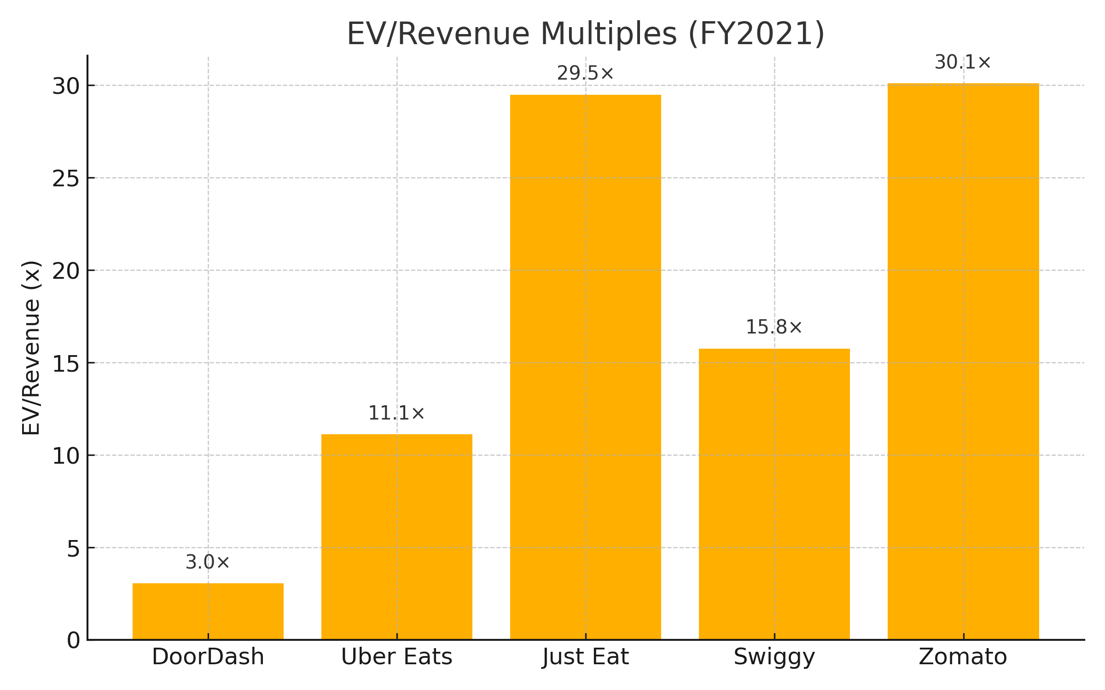
Comparable Company EV/Revenue

Slide 5
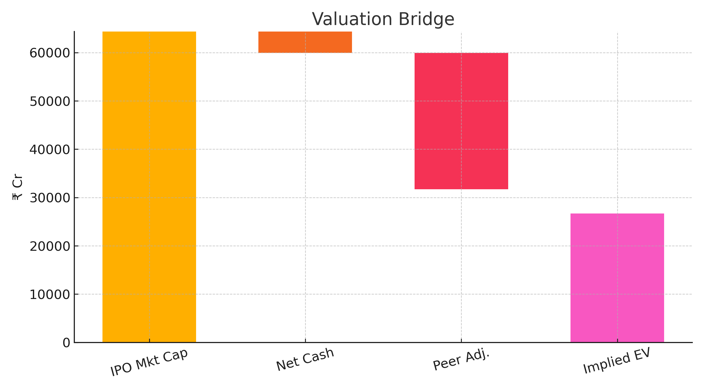
Valuation Bridge

Slide 6
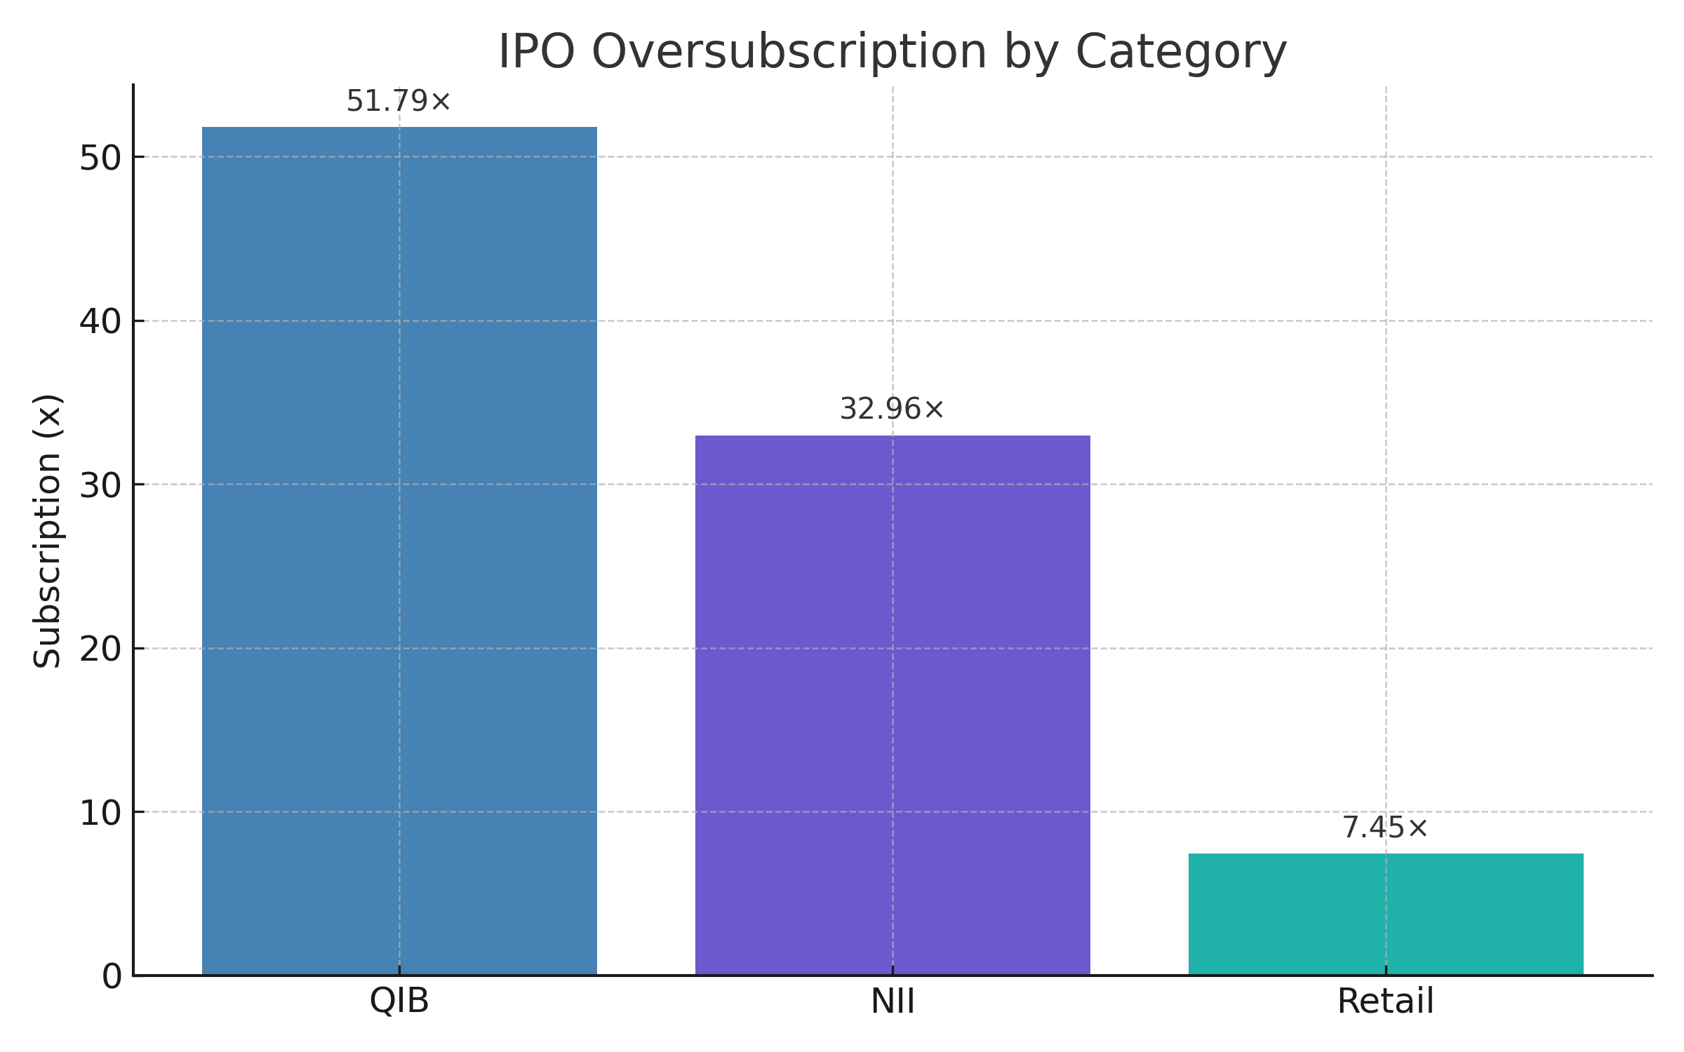
Oversubscription by Investor Type

Slide 7
Strategic Takeaways
• Aggressive pricing succeeded via anchor & book‑building strategy.
• Market corrected valuation within 12 months.
• Case study in demand-driven tech IPO pricing.

Slide 8
Thank You
Harsh Garg | LinkedIn

