Slide 1
VIT-IND-03 • SMART MANUFACTURING
Acoustic AI-Based Metal Parts
Quality Inspection & Predictive Maintenance
Thrust Area: Smart Manufacturing | Domain: Metal Parts & Industrial Quality Inspection
PROJECT TEAM
Pradnyan Dongre – 33
Yogen Gharge – 48
Harsh Ghotkar – 50
Om Hiwarkar - 65
Industry 4.0 Predictive Quality Inspection Platform
01

Slide 2
INTRODUCTION
An AI Platform That Listens to Machines
CORE CAPABILITIES
CONCEPT
An AI-powered Acoustic Predictive Quality Inspection Platform designed for Industry 4.0 environments.
1
Real-Time Machine Health Monitoring
Continuous acoustic + vibration tracking of running equipment.
HOW IT WORKS
The system actively “listens” to industrial equipment — CNC machines, lathes, and production lines — using IoT acoustic and vibration sensors to perform Non-Destructive Testing (NDT).
2
Acoustic Defect Detection
Identifies structural cracks and material fatigue from sound signatures.
3
Predictive Maintenance Scheduling
Estimates failure probability to plan maintenance before breakdown.
Industry 4.0 Predictive Quality Inspection Platform
02

Slide 3
MOTIVATION
The Core Problem
LIMITATIONS OF TRADITIONAL INSPECTION
Manufacturers rely heavily on visual inspection — internal cracks in metal components remain completely invisible.
WHY IT MATTERS
Invisible
Micro-fractures develop deep inside metal parts long before total failure occurs.
Internal cracks: undetectable by eye
Manual inspection is highly time-consuming and prone to human error.
Reactive
Maintenance today = after failure
THE COST OF INACTION
Unexpected machine breakdowns cause massive production loss. Traditional sensors often miss early-stage defects, pushing plants into reactive — and expensive — maintenance instead of predictive maintenance.
Costly
Unplanned downtime drains output
Industry 4.0 Predictive Quality Inspection Platform
03

Slide 4
LITERATURE SURVEY
From Detection to Diagnosis: Where the Field Stands
VISUAL vs. ACOUSTIC INSPECTION
EVOLUTION OF AI IN MANUFACTURING
Computer vision is heavily researched for surface defects, but recent literature emphasizes acoustic/vibration signals for detecting sub-surface anomalies (e.g., internal bearing wear).
Traditional: Rule-based Digital Signal Processing (DSP)
Current Trend: CNNs analyzing Mel-Spectrograms (Koizumi et al., MIMII dataset)
IDENTIFIED GAP IN LITERATURE
Existing models can detect that an anomaly exists — but struggle to explain what the defect is, or predict when it will fail.
OUR BRIDGE
This project bridges that gap by combining CNNs for defect detection with clustering and predictive algorithms for Remaining Useful Life (RUL) estimation.
Industry 4.0 Predictive Quality Inspection Platform
04

Slide 5
OBJECTIVES & EXPECTED OUTCOMES
What We Are Building, and What It Delivers
PRIMARY OBJECTIVES — PLATFORM FEATURES F01–F07
EXPECTED KPIs
F01
Develop a Crack Prediction Engine and Acoustic Defect Detector.
Downtime ↓
Reduce machine downtime hours
F04
Build a Predictive Maintenance Scheduler with AI-based failure alerts.
Accuracy ↑
High detection accuracy for early-stage defects
F07
Create a Digital Maintenance History and Industrial Dashboard.
Cost ↓ / RUL ↑
Lower maintenance cost, extend Remaining Useful Life
Industry 4.0 Predictive Quality Inspection Platform
05

Slide 6
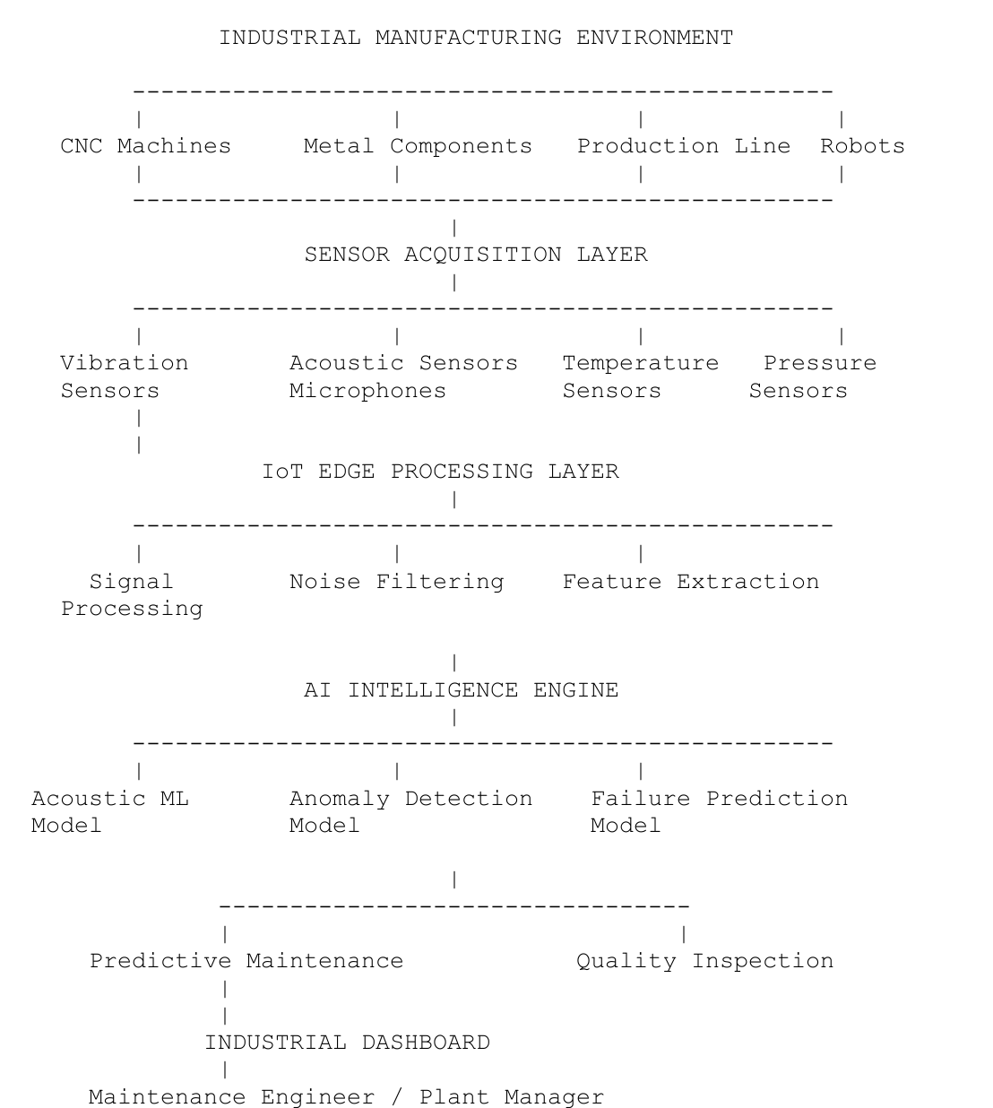
PROJECT FLOW DIAGRAM
System Architecture
AI INTELLIGENCE
ENGINE
Acoustic ML Model
Detects abnormal sound patterns
CNN Model
Classifies specific defect signatures
Predictive Analytics
Estimates component life (RUL)
Industry 4.0 Predictive Quality Inspection Platform
06

Slide 7
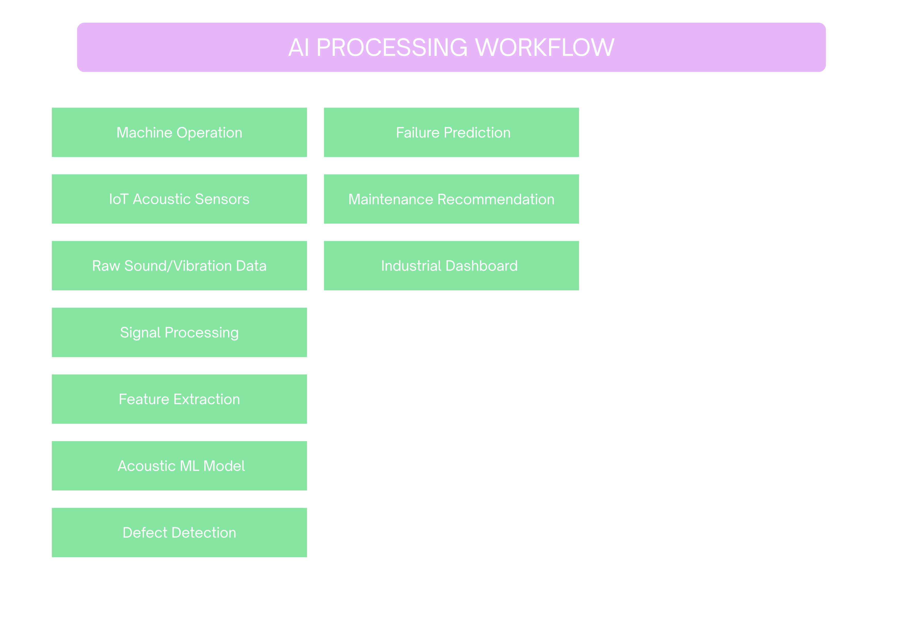
Industry 4.0 Predictive Quality Inspection Platform
06

Slide 8
ALGORITHM & TECHNOLOGY STACK
How the Intelligence Is Built
DATA & SIGNAL PROCESSING LAYER
Librosa and SciPy convert raw .wav sound/vibration data into 2D Mel-Spectrograms and extract feature vectors (MFCCs, Spectral Energy).
AI LAYER — TensorFlow / Scikit-Learn
CNN
Algorithm 1 — Supervised CNN
K
Algorithm 2 — Unsupervised K-Means
Extracts spatial features from spectrogram images for binary anomaly detection: Defective vs. Healthy.
Maps defective feature vectors into mathematical clusters to classify the physical fault type — Micro Crack, Material Fatigue, Leak.
EDGE & COMMUNICATION LAYER
Flask-based real-time processing simulating Raspberry Pi edge environments, using WebSockets (future MQTT) for device messaging.
Industry 4.0 Predictive Quality Inspection Platform
07

Slide 9
CURRENT STATUS
Coding Complete: 40%
40% COMPLETE
✓
Signal Processing Engine
✓
AI Models Trained & Integrated
Automated pipeline applies 100Hz–5000Hz bandpass filters and generates spectrograms dynamically.
CNN Anomaly Detector and Diagnostic Clustering models successfully deployed in backend app.py.
✓
Live Simulation Thread
✓
Interactive Dashboard
System samples from the dataset every 5 seconds, processes audio, and performs live inference.
Displays real-time Digital Twins, dynamic RUL calculations, unique part tagging (e.g., VLV-ERR-A9F2), and a live Acoustic Intelligence Engine log.
Industry 4.0 Predictive Quality Inspection Platform
08

Slide 10
RESULT AND DISCUSSION
From Detection to Predictive Maintenance
LIVE INFERENCE RESULTS
DIAGNOSTIC VALIDATION (PCA)
The system successfully identifies malfunctioning audio signatures in milliseconds, proving the viability of Edge AI deployment.
Clustering was validated using Principal Component Analysis. The scatter plot confirmed 3 distinct, mathematically separated families of machine defects — with no human labeling.
RUL VARIES BY DEFECT SIGNATURE
2 hours
400 hours
Remaining Useful Life assigned to “Micro Cracks”
Remaining Useful Life assigned to “Material Fatigue”
Discussion: by calculating RUL dynamically per defect signature, the platform moves beyond simple anomaly detection to true Predictive Maintenance.
Industry 4.0 Predictive Quality Inspection Platform
09

Slide 11
CONCLUSION & SDG ALIGNMENT
A Predictive Quality Inspection Platform for Industry 4.0
We have successfully developed the core architecture of an Industry 4.0 Predictive Quality Inspection Platform. It effectively solves the problem of invisible internal defects by utilizing AI-powered acoustic analysis — reducing reliance on slow visual/manual inspections.
SDG ALIGNMENT
SDG 9
Industry, Innovation & Infrastructure
SDG 12
Responsible Consumption & Production
Building resilient and smart industrial infrastructure.
Ensuring efficient resource utilization by extending equipment life and reducing scrap metal.
Industry 4.0 Predictive Quality Inspection Platform
10

Slide 12
FUTURE SCOPE
Roadmap to 100% Completion
As we move toward 100% completion — aligning with the VIT-IND-03 architecture — our roadmap includes:
01
02
03
04
05
Hardware & Sensor Integration
Advanced Time-Series AI (LSTM)
Industrial Database Implementation
IoT Communication Protocol
Deployment (Kubernetes)
Deploy onto a physical Raspberry Pi (Edge AI); integrate Vibration, Temperature, and Pressure sensors to fuse with acoustic data.
Implement LSTM neural networks to analyze historical degradation trends for pinpoint-accurate failure dating.
Transition to scalable PostgreSQL/MongoDB storing TBL_SENSOR_READING_LOG, TBL_MACHINE_MASTER, TBL_DEFECT_CATEGORY_MASTER.
Replace WebSockets with standard MQTT for robust, low-bandwidth device-to-device messaging on the factory floor.
Containerize the application for industrial-scale deployment on a Kubernetes cluster.
Industry 4.0 Predictive Quality Inspection Platform
11

Slide 13
REFERENCES
References
[1]
VIT-IND-03 PRD — Smart Manufacturing: Acoustic AI-Based Metal Parts Quality Inspection.
[2]
Koizumi, Y., et al. (2019). MIMII Dataset: Sound Dataset for Malfunctioning Industrial Machine Investigation and Inspection. Workshop on Detection and Classification of Acoustic Scenes and Events.
[3]
McFee, B., et al. (2015). librosa: Audio and Music Signal Analysis in Python.
[4]
TensorFlow Core documentation & Scikit-Learn Machine Learning in Python guidelines.
Industry 4.0 Predictive Quality Inspection Platform
12

