Slide 1
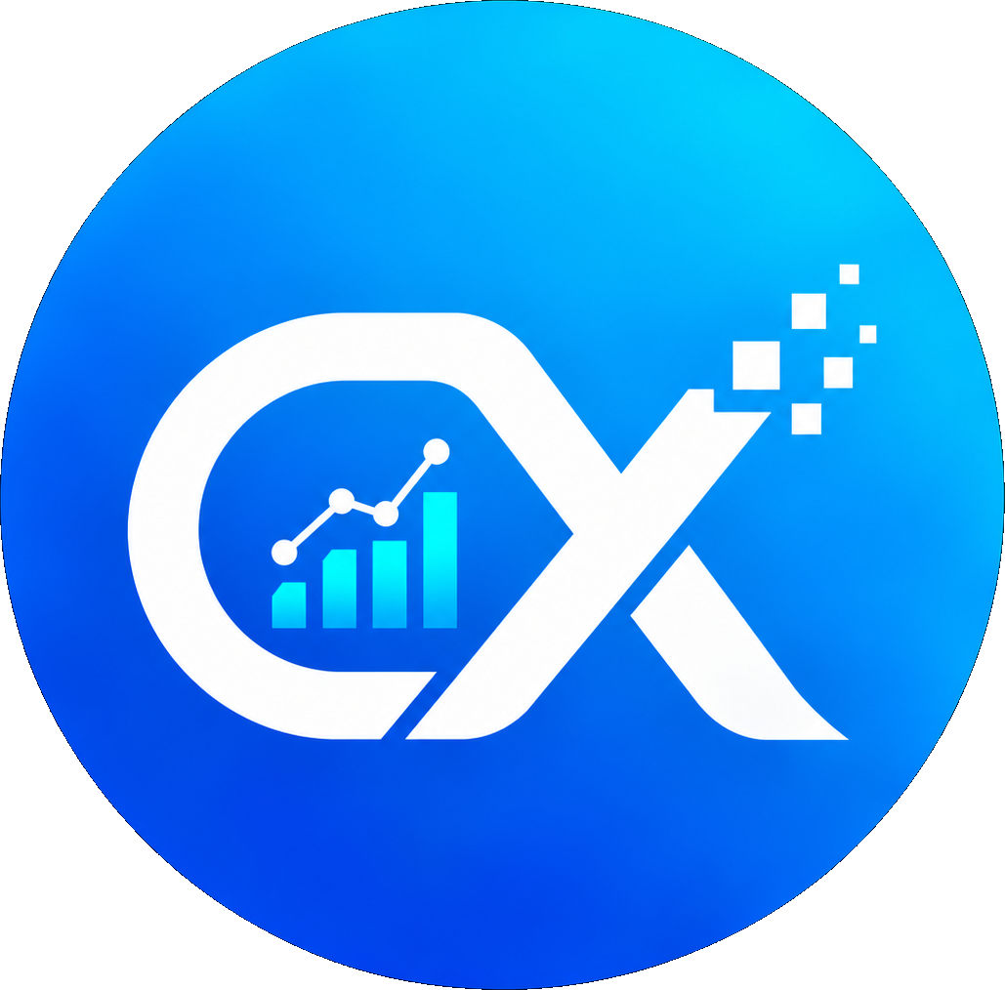
CampusX
Platform Highlights
AI-Powered Academic Intelligence Platform
6
Prediction Systems
SGPA, Attendance, Marks, Risk, Performance, Career
Smarter Education. Brighter Futures.
3
Role-Based Portals
Student, Faculty, Admin dashboards
Team Name:
GenAI
Copilot
Institution:
Natural language academic assistant
Members:
52
Backend Services
Guide:
Enterprise-grade FastAPI microservices
30+
Pages
Comprehensive platform coverage
21+
Database Tables
Structured PostgreSQL schema
1
Notes:
Welcome to CampusX. This presentation covers 6 prediction systems, 3 role-based portals, a GenAI copilot, and a full production tech stack. Built for smarter education and brighter futures.

Slide 2
PROBLEM STATEMENT
The Challenges We Solve
01
02
03
Scattered Academic Data
No Early Risk Warning
Subject Performance Uncertainty
Students juggle multiple spreadsheets, portals, and paper records. No single source of truth for grades, attendance, or progress.
By the time poor performance is noticed, it's too late. There's no predictive system to alert students or faculty before failures occur.
Students don't know which subjects they'll struggle with next semester. No data-driven prediction of future marks.
04
05
06
Generic Career Guidance
Faculty Lack Analytics
No 24/7 Academic Assistant
Career advice is one-size-fits-all. No personalized recommendations based on actual academic performance and skills.
Teachers have no dashboards showing class performance trends, at-risk students, or workload distribution.
Students can't get instant answers to academic questions outside office hours. No AI-powered support.
2
Notes:
Six real problems CampusX solves: scattered academic data, no early risk warning, subject performance uncertainty, generic career guidance, faculty lacking analytics, and no 24/7 academic assistant.

Slide 3
SOLUTION OVERVIEW
How CampusX Solves It
Students
Faculty
Admins
CampusX Platform
Unified Data Ingestion → ML Predictions → GenAI Copilot → Role-Based Portals
ML Predictions
Dashboards
GenAI Copilot
Career Guidance
6 trained models
3 role-based portals
24/7 AI assistant
Personalized paths
3
Notes:
CampusX centralizes scattered data, runs ML predictions, and delivers personalized insights to three user roles: Students, Faculty, and Admins through dedicated portals.

Slide 4
PLATFORM OVERVIEW
By The Numbers
6
3
30+
Prediction Systems
Role-Based Portals
Pages
ML models serving real-time predictions
Student, Faculty, Admin dashboards
Comprehensive platform coverage
52
21+
15+
Backend Services
Database Tables
Chatbot Tools
Enterprise-grade FastAPI endpoints
Structured PostgreSQL schema
GenAI copilot tool registry
4
Notes:
Bird's eye view of CampusX: 6 prediction systems, 3 role-based portals, 30+ pages, 52 backend services, 21+ database tables, and 15+ chatbot tools.

Slide 5
STUDENT PORTAL
Student Dashboard
Overview Dashboard
Key Metrics Card
Academic Analytics
SGPA Tracker
Report Card
Attendance %
Subject Performance
Backlog Status
Attendance Tracker
Credits Earned
Timetable Viewer
Health Score
ML Predictions
Priority Tasks
Career Guidance
Goal Setting
Notifications
[Screenshot: Student Dashboard]
5
Notes:
Student portal is the most feature-rich. ML insights predict SGPA, attendance risk, and career fit. What-if simulator lets students model scenarios before making decisions.

Slide 6
FACULTY PORTAL
Faculty Dashboard
Class Overview
Analytics Capabilities
Student Performance Analytics
• Class Performance Trends
Attendance Analytics
• At-Risk Student Alerts
• Subject Difficulty Analysis
Marks Entry
• Attendance Pattern Mining
Attendance Entry
• Marks Distribution
Workload Dashboard
• Workload Distribution
At-Risk Students
• Comparative Analytics
Subject Comparison
• Export & Reporting
Export Reports
Notifications
[Screenshot: Faculty Dashboard]
6
Notes:
Faculty portal: performance/attendance analytics, workload tracking, marks and attendance entry. Faculty can identify at-risk students early.

Slide 7
ADMIN PORTAL
Admin Dashboard
Institution Overview
Intelligence Dashboard
Risk Donut Chart
• Institution-Wide Risk Analysis
ML System Monitor
• ML Model Performance
• Prediction Accuracy Metrics
Student Management
• System Health Monitoring
Faculty Management
• User Activity Analytics
Course Management
• Data Pipeline Status
Analytics Dashboard
• Capacity Planning
System Health
• Compliance Reporting
Bulk Operations
Audit Logs
[Screenshot: Admin Dashboard]
7
Notes:
Admin portal: institution-wide analytics, risk donut visualization, ML intelligence monitoring. Full system health and compliance reporting.

Slide 8
AI / ML SYSTEMS
Core Differentiator: 6 Prediction Systems
M1 V3
M2-TP
M3 V2
SGPA Predictor
Attendance Risk
Marks Predictor
Algorithm: Linear Regression
Algorithm: Gradient Boosting
Algorithm: Decision Tree
Predicts next-semester SGPA from historical marks
Flags students likely to fall below 75% attendance
Predicts per-subject marks with early warning
Trained ML
Trained ML
Trained ML
M3 V3
M4
M5
Early Warning
Performance Engine
Career Fit
Algorithm: Random Forest
Algorithm: Rule-Based Logic
Algorithm: Cosine Similarity
Multi-risk assessment with confidence scores
Fallback scoring when ML models unavailable
Maps skills and grades to career pathways
Trained ML
NOT ML - Rule-Based
Trained ML
8
Notes:
Core differentiator: 6 ML prediction systems. M4 is NOT ML - it's a rule-based fallback engine. All ML models use scikit-learn 1.9.0 pinned. Trained on real student data.

Slide 9
PROBLEM → SOLUTION
Every Problem Has a CampusX Solution
Problem: No Early Warning
Problem: Scattered Data
Problem: Generic Guidance
Students fail without notice
Multiple portals, no unified view
One-size-fits-all career advice
CampusX Solution:
CampusX Solution:
CampusX Solution:
M3 V3 Early Warning
Unified Dashboard
M5 Career Fit
Predicts risk 4 weeks before failure
Single source of truth for all data
Personalized pathways from real data
Problem: No Predictions
Problem: Faculty Blind Spots
Problem: No AI Support
Students guess their performance
No class-level analytics
No instant academic answers
CampusX Solution:
CampusX Solution:
CampusX Solution:
M1 V3 SGPA Predictor
Faculty Analytics
GenAI Copilot
Predicted SGPA with confidence
At-risk alerts and trends
24/7 role-aware assistant
9
Notes:
Each pair is a concrete implemented capability. M3 V3 early warning predicts risk before exams. M1 V3 gives predicted SGPA. M5 maps to career paths. Copilot answers 24/7.

Slide 10
TECH STACK
Production-Grade Technology Stack
Frontend
Next.js 15, React 19, TypeScript, Tailwind CSS, shadcn/ui
BFF pattern, Server Components
Backend
FastAPI (Python 3.11), Pydantic v2, asyncpg, Celery
Async-first, auto-generated OpenAPI
Database
PostgreSQL 15, SQLAlchemy 2.0, Alembic
21+ tables, parameterized queries
ML / AI
scikit-learn 1.9.0, pandas, joblib, numpy
6 models, joblib cached singletons
GenAI
OpenAI GPT-4o-mini, Tool Registry, System Prompts
Intent routing, verified context
Security
HMAC-SHA256 JWT, bcrypt, HttpOnly, RBAC
Rate limiting, token revocation
DevOps
Docker, Docker Compose, Health Checks
One-command deployment, auto-restart
10
Notes:
Production stack: BFF pattern for security. asyncpg for database. scikit-learn 1.9.0 pinned for reproducibility. Docker with health checks.

Slide 11
ARCHITECTURE
System Architecture
Students
Faculty
Admins
Next.js 15 Frontend (Server Components + BFF)
BFF fetch
FastAPI Backend (52 Services, JWT Auth, Rate Limiting)
Security Layer
PostgreSQL (21+ Tables)
ML Pipeline (6 Models, joblib cache)
GenAI Layer (OpenAI GPT-4o-mini, Tool Registry, Intent Router)
11
Notes:
BFF pattern: Server components fetch from FastAPI. No client-side API keys. JWT auth at every layer. ML pipeline runs server-side with joblib cached models.

Slide 12
DATA FLOW
ML Inference Data Flow
Data
Collection
Feature
Engineering
ML
Inference
Result
Validation
Dashboard
Display
1. Student requests SGPA prediction
6. ML model loaded from joblib cache
2. Frontend sends BFF request (server-side)
7. Prediction generated with confidence
3. Backend validates JWT & RBAC permissions
8. Result validated against business rules
4. Feature extraction from PostgreSQL
9. Response returned to Next.js server
5. Data shaped to 38-feature contract
10. Dashboard renders predicted SGPA
12
Notes:
ML inference happens server-side. Joblib cached singletons for fast loading. Real DB data feeds into 38-feature contract. Results validated before display.

Slide 13
AI COPILOT
GenAI Academic Copilot
User
Query
Intent
Router
Tool
Registry
Verified
Context
GenAI
Provider
Response
Student Tools
Security Invariants
• SGPA Prediction
• Attendance Check
1. No API keys exposed to client (BFF pattern)
• Subject Analysis
• Career Guidance
2. All tool calls verified against RBAC permissions
3. Verified context only - no raw DB access
Faculty Tools
• Class Analytics
• At-Risk Alerts
4. Rate limiting on all Copilot endpoints
• Marks Entry
• Workload View
5. JWT validation on every request
6. Tool registry is role-gated
Admin Tools
7. No data leakage across tenants
• Institution Overview
• ML Monitor
8. Audit logging for all AI interactions
• Risk Analysis
• System Health
13
Notes:
Not a ChatGPT wrapper. Intent Router → Tool Registry → Verified Context → LLM. All tool calls verified against RBAC. No API keys exposed to client.

Slide 14
UI SCREENS
Live Platform Screenshots
Screenshot:
Screenshot:
Screenshot:
Screenshot:
Student Dashboard
Academic Analytics
ML Predictions
Report Card
Screenshot:
Screenshot:
Screenshot:
Screenshot:
Faculty Dashboard
Attendance Analytics
Admin Overview
GenAI Copilot
14
Notes:
Live screenshots, not mockups. SplashCursor animation on hero. shadcn/ui components. Dark theme consistent across all portals.

Slide 15
SECURITY
Enterprise-Grade Security
HMAC-SHA256 JWT Signing
Docker Deployment
HttpOnly Cookies (No XSS)
Docker Container
bcrypt Password Hashing
Role-Based Access Control
Docker Compose
Rate Limiting (Per Endpoint)
Token Revocation & Expiry
Next.js
Data Isolation (Tenant-Safe)
FastAPI
Audit Logging (All Actions)
PostgreSQL
CORS & Security Headers
15
Notes:
Security from day one. HMAC-SHA256 JWT signing. HttpOnly cookies prevent XSS. bcrypt for passwords. RBAC at every endpoint. Docker one-command deployment.

Slide 16
IMPACT
Measurable Impact
Area
Without CampusX
With CampusX
Data Access
Multiple portals, spreadsheets
Single unified dashboard
Performance Risk
Detected after failure
Predicted 4 weeks early
Career Guidance
Generic, one-size-fits-all
Personalized, ML-driven
Faculty Analytics
Manual tracking, spreadsheets
Real-time dashboards
Student Support
Office hours only
24/7 GenAI Copilot
Academic Prediction
No prediction capability
6 ML prediction systems
Institution Oversight
Reactive reporting
Proactive risk monitoring
16
Notes:
Reactive to proactive. M3 predicts before exams. M1 gives predicted marks. 24/7 copilot replaces office-hours-only support. Single dashboard replaces scattered data.

Slide 17
CONCLUSION
What We Built & What's Next
What We Built
Future Scope
✓ 6 production ML prediction systems (scikit-learn 1.9.0)
📱 Mobile App (React Native)
✓ 3 role-based portals (Student, Faculty, Admin)
👨‍👩‍👧 Parent Portal with alerts
✓ GenAI Academic Copilot with tool registry
☁️ Cloud deployment (AWS/GCP)
✓ 52 backend services on FastAPI
🔄 Automated model retraining
✓ 21+ database tables with PostgreSQL
📊 Advanced analytics (cohort analysis)
✓ Enterprise security: JWT, RBAC, rate limiting
🤝 LMS integration (Moodle, Canvas)
CampusX — Smarter Education. Brighter Futures. | Thank You!
17
Notes:
Working platform: 6 prediction systems, 3 portals, GenAI copilot. Future: mobile app, parent portal, cloud deployment, automated retraining, LMS integration.

