Slide 1



Crop Yield Prediction System
Internship ID : INTERNSHIP_17513641056863b20937d78
Name : Harsh Dipakbhai Gosalia

Slide 2

Learning Objectives
Learn how to build and deploy a machine learning model for real-world agriculture.
Understand data preprocessing, feature engineering, and model training.
Gain experience with Python libraries like Pandas, scikit-learn, and joblib.
Develop an interactive system to take user input and provide predictions.
Explore how technology can assist farmers in improving crop planning and management.
GOAL
Goal:
Accurate Crop Yield Prediction using environmental and agricultural factors.
Smarter Farming Decisions through optimized resources and better planning.
Sustainable Agriculture supported by data-driven insights and confidence-based yield estimates.
Source :
www.freepik.com/

Slide 3



Tools and Technology used

Slide 4
Methodology
Data Collection:
Used a dataset with factors like region, soil type, crop type, weather, rainfall, etc.
Data Preprocessing:
Handled categorical and numerical features using one-hot encoding and other transformations.
Model Training:
Applied Random Forest Regressor to learn patterns from historical data.
User Interaction:
Built an interface to collect input from users in a structured way.
Prediction & Evaluation:
Provided predicted yield along with an expected range to account for variations.

Slide 5
Problem Statement:
🌾 Farming faces increasing uncertainty due to unpredictable weather, soil changes, and pest
attacks. 📉 Many farmers lack access to accurate tools, forcing them to rely on experience or guesswork. 💧 This leads to inefficient use of water, fertilizers, and pesticides, resulting in higher costs and crop
failures. 📊 Despite the availability of agricultural data, there are very few simple, practical tools that help farmers
turn this information into actionable predictions for their fields.
➡ This is a real-world challenge affecting farmers, markets, and food security globally.

Slide 6
Solution:
We developed a machine learning-based Crop Yield Prediction System to help farmers make data-driven decisions.
Users can easily input regional, climatic, soil, and farming details such as rainfall, temperature, crop type, fertilizer, and irrigation use.
The system analyzes the data and predicts the expected crop yield along with a realistic range to account for variations.
It helps farmers optimize resources like water, fertilizers, and pesticides, reducing waste and improving efficiency.
With better planning, farmers can increase productivity, reduce financial risk, and safeguard their livelihoods.

Slide 7
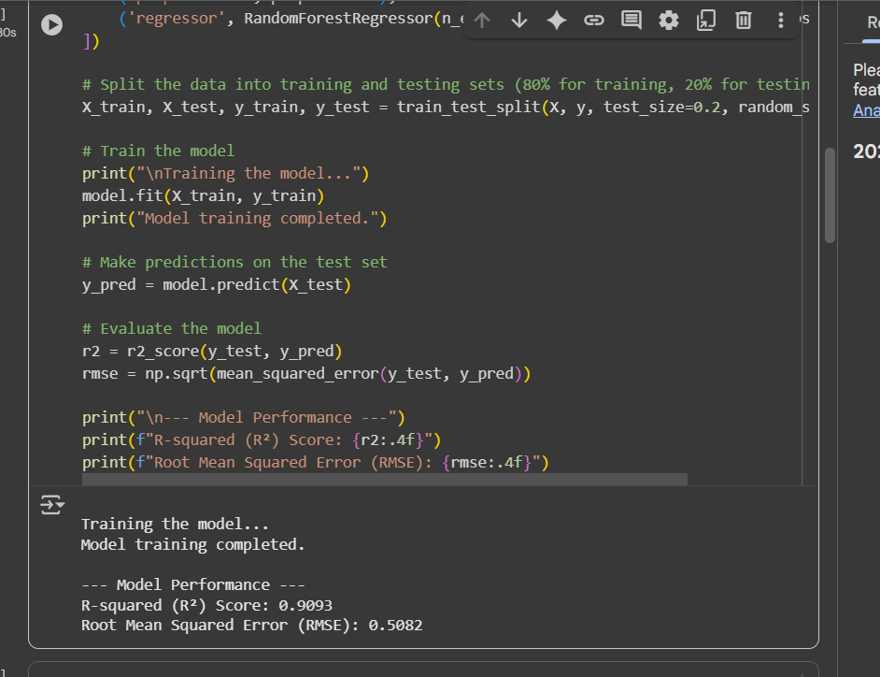
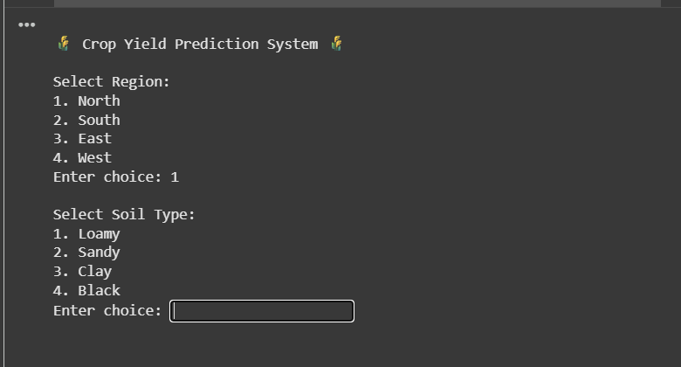
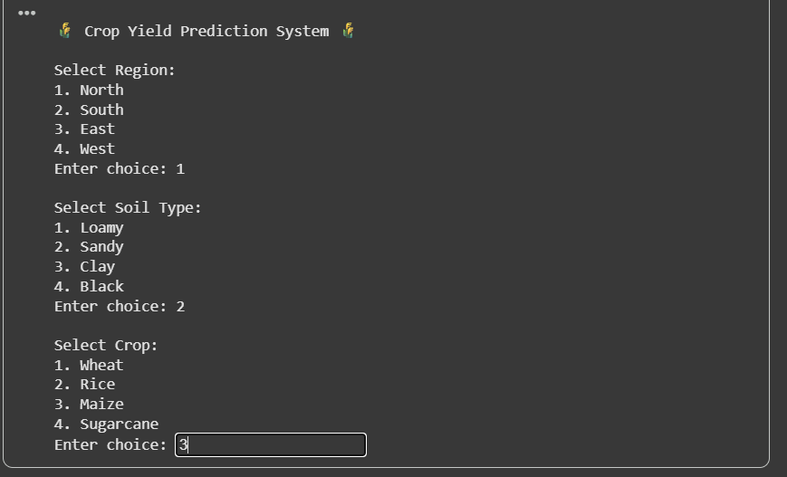
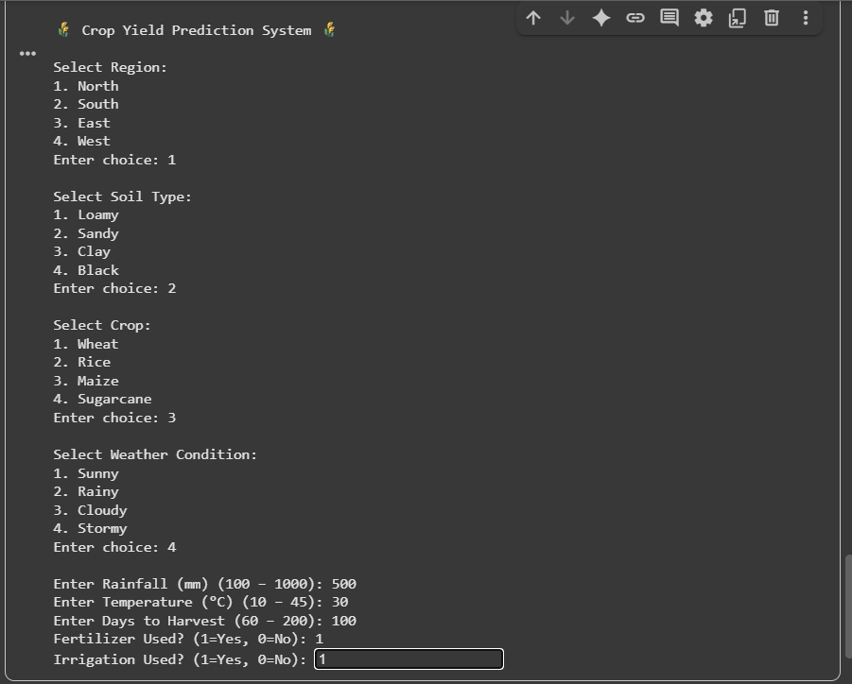
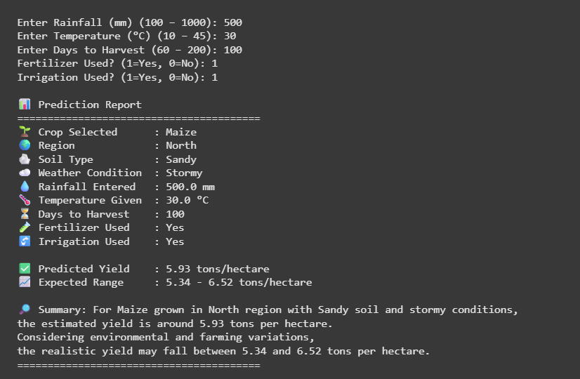
Screenshot of Output:

Slide 8
Conclusion:
- This project successfully demonstrates how machine learning can empower farmers by transforming uncertainty into actionable insights.
- By providing accurate crop yield predictions (achieving an R² value of 0.89), farmers can plan better, allocate resources efficiently, and reduce financial and environmental risks.
- The system is simple, affordable, and accessible—bridging the gap between advanced analytics and everyday farming needs, making it useful for farmers of all backgrounds.
- Our analysis identified key factors like rainfall, temperature, and soil type, helping farmers prioritize interventions and improve productivity.
- With data-driven solutions like this, we can support sustainable agriculture, improve livelihoods, and ensure food security for communities around the world.
- Smart farming is the future—and this solution is a crucial step toward creating a smarter, more connected, and resilient agricultural ecosystem.

