Slide 1
MOVIE RECOMMENDER
Team Name/No: 15
Harshit Mani Tripathi 2210990389
Harsh Guleri 22100990379
Gurpreet Singh 2210990348
Hardik Garg 2210990355

Slide 2
Index
Objective
Introduction
Methodology, Approach & Techniques
Algorithm
Flow Chart
Conclusion
Reference

Slide 3
Objective
.
The primary objective of this project is to develop a movie recommendation system using machine learning techniques. Specific objectives include:
Exploratory data analysis of movie data.
Preprocessing the data to handle missing values and encode categorical variables.
Training and evaluating machine learning models for movie recommendation.
Saving the trained model for future use.

Slide 4
Introduction
Movie recommendation systems are algorithms designed to suggest movies to users based on their preferences, viewing history, and behavior. These systems aim to personalize the viewing experience by presenting users with relevant content that matches their interests
The goal of Movie Recommender is to develop a mobile application that provides personalized movie recommendations to users based on their preferences and viewing history. With the increasing availability of digital streaming platforms and vast libraries of movies, users often face the challenge of finding content that aligns with their interests. Movie Recommender aims to address this issue by leveraging recommendation algorithms to offer tailored suggestions, enhancing the user experience and satisfaction.

Slide 5
Methodology , Approach & Techniques
The methodology for fake news detection encompasses data collection, preprocessing, and feature extraction to prepare the data for analysis. Machine learning models are trained and evaluated using labeled datasets, with techniques like ensemble methods and cross-validation enhancing their accuracy. Human-in-the-loop approaches, user behaviour analysis, and real-time monitoring are employed for ongoing refinement and adaptation to combat evolving misinformation.
Approach :
Fake news detection programs utilize diverse approaches, including content and source analysis, user engagement scrutiny, and machine learning. These methods aim to discern misinformation by examining text, source credibility, and user interactions, thereby enhancing accuracy. Integration of cross-referencing, semantic analysis, and network evaluation further bolsters these programs' efficacy in identifying and mitigating fake news dissemination.
Techniques :
Fake news detection programs utilize content, source, and user engagement analysis alongside machine learning to discern misinformation. Cross-referencing and semantic analysis verify claims, while network analysis identifies influential nodes in misinformation dissemination. These techniques collectively bolster the efficacy of fake news detection systems in combat.
Data Exploration: We start by importing necessary libraries such as Matplotlib, Seaborn, and pandas for data visualization and manipulation. The dataset, “tmdb_5000_movies," is loaded into a pandas Data Frame for analysis. Initial exploration includes examining the shape of the data, visualizing the distribution of movie names, and exploring key numerical features through histograms and violin plots.
2. Data Cleaning: Data preprocessing steps include handling missing values, encoding categorical variables, merging datasets, drop unwanted columns, extract information from dates and splitting the dataset into training and testing sets.
3. Data Preprocessing and Splitting: The dataset is divided into features (X) and target labels (y). Then, the data is split into training and testing sets using the train_test_split function.

Slide 6
METHODOLOGY
4. Model Training and Evaluation: We employ four different machine learning algorithms for weather prediction:
K-Nearest Neighbors (KNN)
Support Vector Machine (SVM)
Gradient Boosting Classifier (GBC)
XGBoost Classifier (XGB)
Each model is trained on the training set and evaluated for accuracy on the testing set.
5. Prediction: Finally, we demonstrate the model's predictive capability by inputting sample data and predicting the corresponding movie names.
6. Model Saving: The trained XGBoost Classifier model is saved using pickle for future use.

Slide 7
Algorithm
Data Loading and Exploration:
Import necessary libraries.
Read the CSV file (“tmdb_5000_movies") into a pandas Data Frame.
Display the first few rows of the dataset to understand its structure.
Explore the shape of the dataset.
Data Visualization:
Visualize the gerne distribution, cast popularity and relation of Budget vs Vote average by scatter plot and print the results by recommending Movies.
The data includes various data and information about the movies like their Overview, Genres, Budget, Rating, Cast and Crew.
Data Cleaning:
Data preprocessing steps include handling missing values, encoding categorical variables, merging datasets, drop unwanted columns, extract information from dates and splitting the dataset into training and testing sets.

Slide 8
4. Feature Encoding:
Use Label Encoder to encode the ‘movie' column (categorical) into numerical values.
5. Data Preprocessing and Splitting:
Separate features (X) and target labels (y) from the dataset.
Split the data into training and testing sets using train-test-split function.
6. Model Training and Evaluation:
Train and evaluate four different machine learning models:
K-Nearest Neighbors (KNN)
Support Vector Machine (SVM)
Gradient Boosting Classifier (GBC)
Print the accuracy of each model on the testing set.
7. Prediction:
Demonstrate the model's predictive capability by providing sample input data and predicting the corresponding movie name
8. Model Saving:
Save the trained Classifier model using pickle for future use.

Slide 9
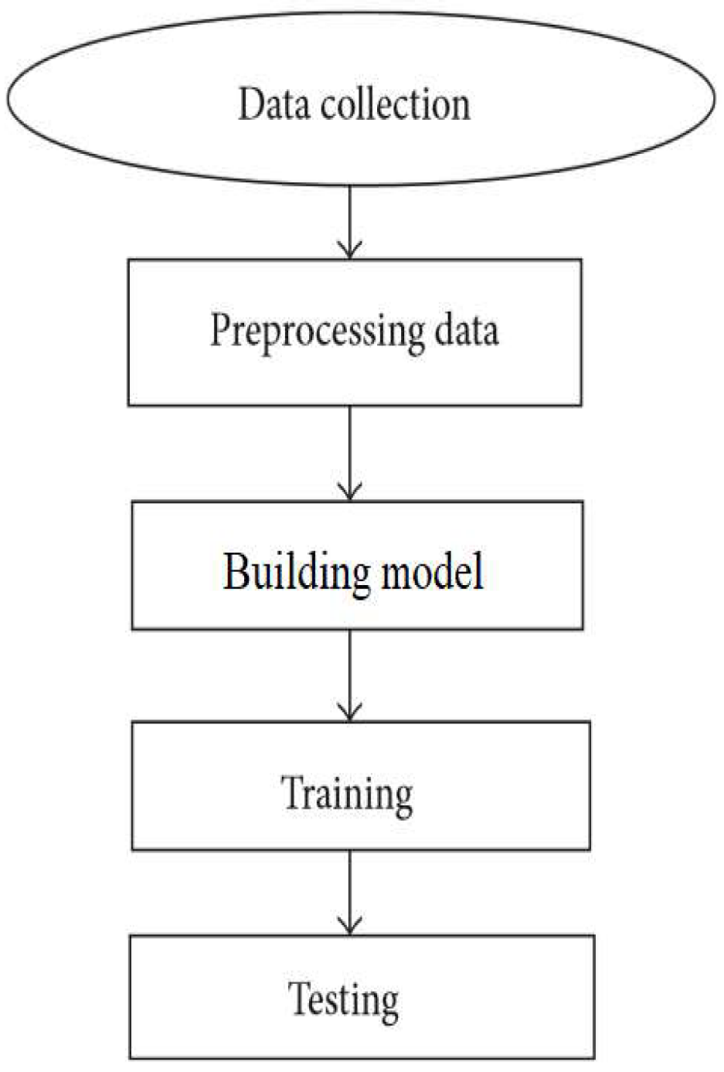
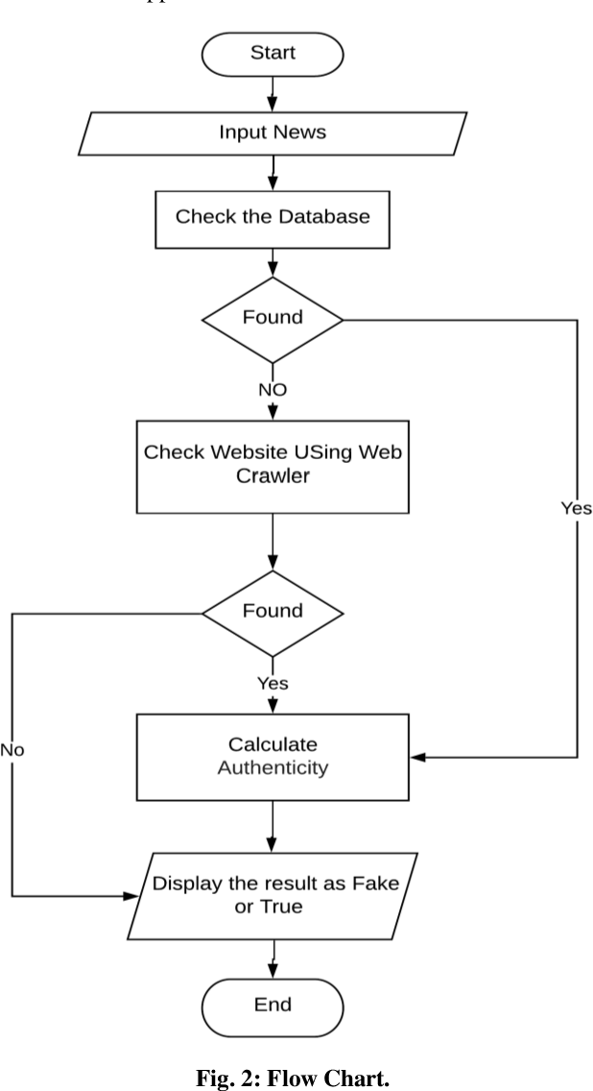
Flowchart

Slide 10
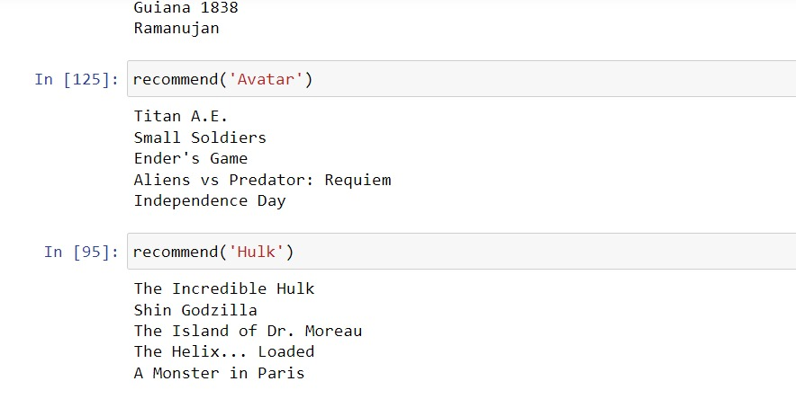
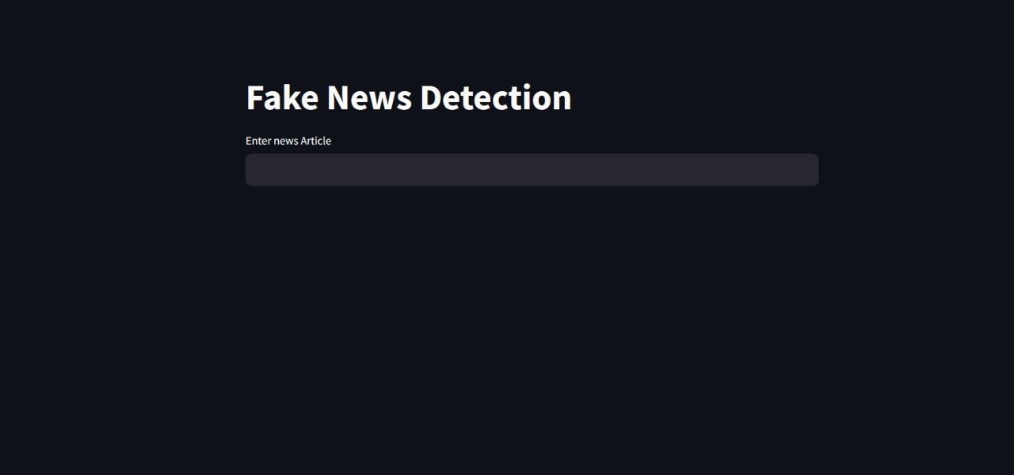
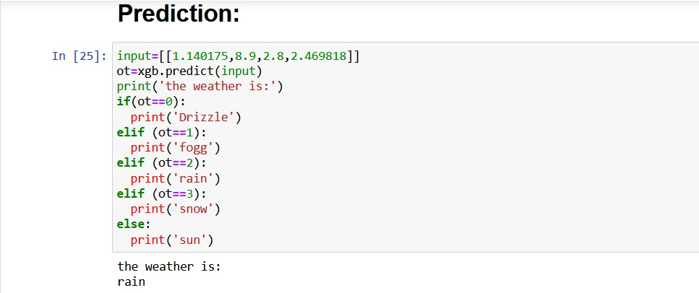
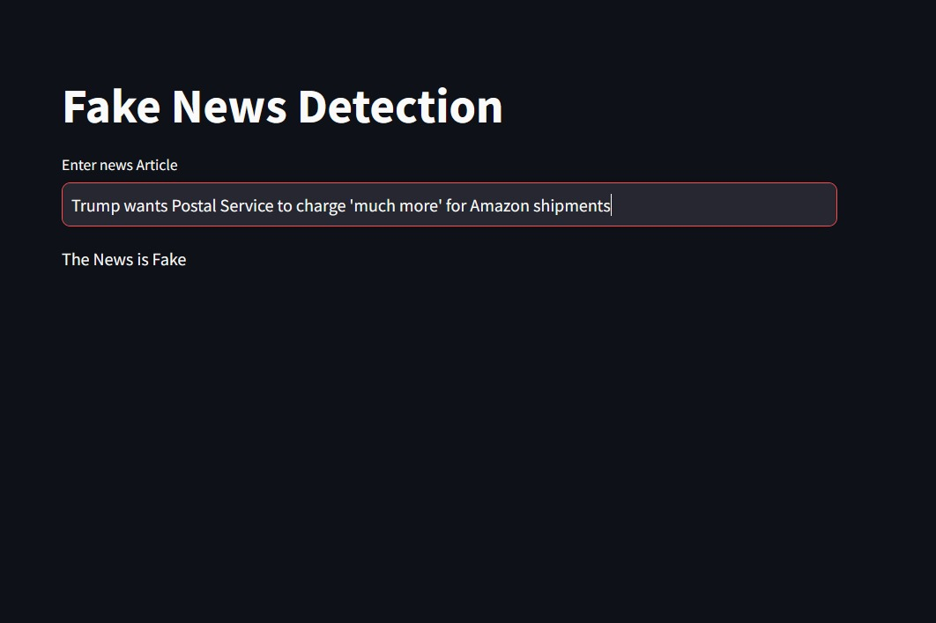
Result

Slide 11
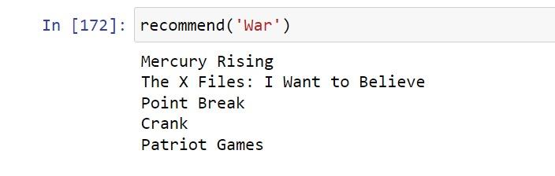
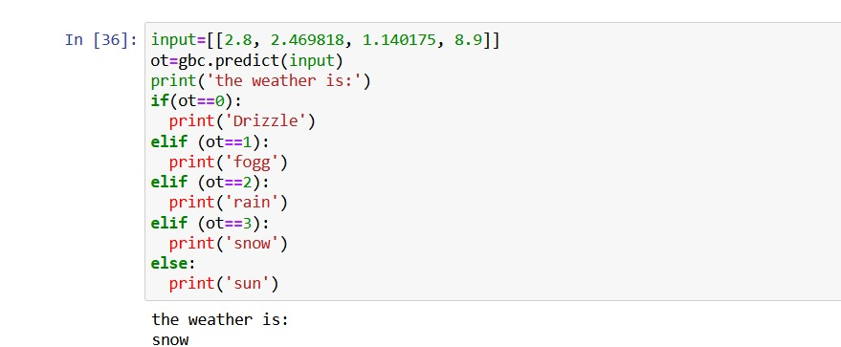
Result
22CS016

Slide 12
Conclusion
Conclusion
The project successfully develops a Movie recommendation system using machine learning techniques. The trained model demonstrates good accuracy in predicting movie names based on there reviews. The project highlights the importance of data preprocessing, feature engineering, and model selection in improving prediction performance.

Slide 13
The End
Thank you

