Slide 1
Lecture 3
(Activity)

Slide 2
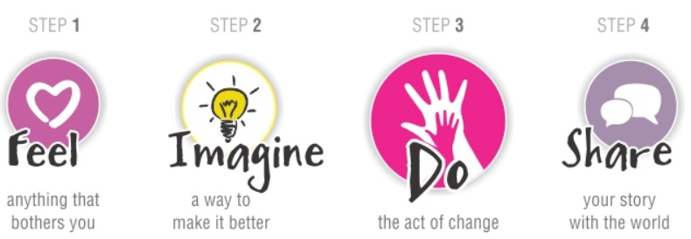

Slide 3
Dig Deeper – Interview your partner for 5 minutes each
Understand Choices
Allows us to identify needs
Understanding Experience
Allows us to innovate

Slide 4
360 tool
FACT
Preferences
Physical/ material/ color/ cost/ weight/ brand
FORM
Preferences
Shapes/ size/ texture/ pockets/ patterns
FUNCTION
What is the main use?
Where/ when do they use it?
Where is it stored when not in use? How is it carried?
RELATIONSHIPS
What does you partner have in their bag that you don’t? What would he/ she hate to loose?
What gets removed/ added in the bag daily?
How is the bag personalized?
Is the bag a reflection of their personality?

Slide 5
Using the insights gained from interview
REDESIGN/ ILLUSTRATE
the wallet that you would gift your partner

Slide 6
CREATE
The prototype with the material in front of you

Slide 7
Share your designs

Slide 8
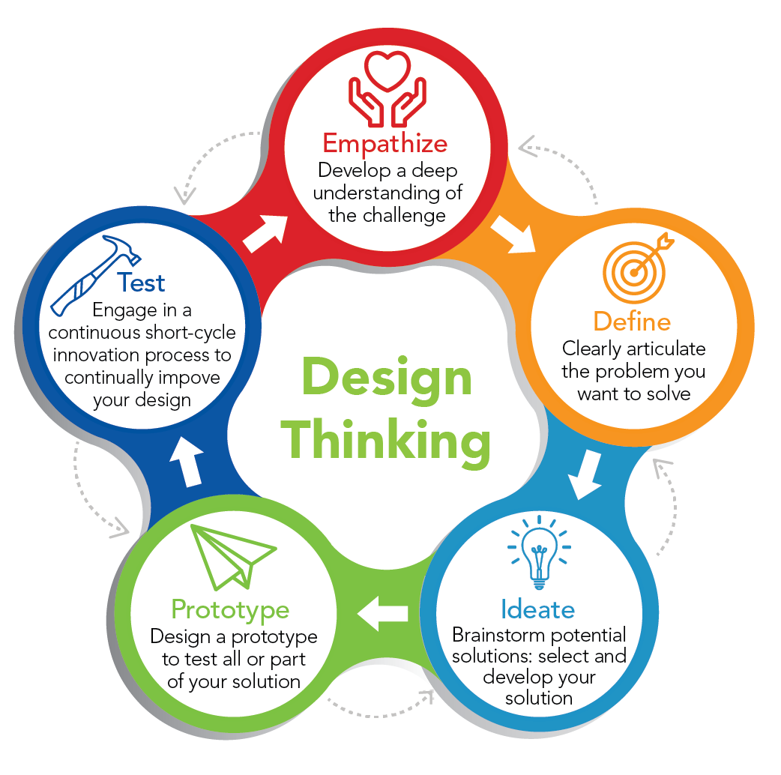

Slide 9
Who are users/ stakeholders? - Who do we design for?
Not as obvious as you think:
those who interact directly with the product
those who manage direct users
those who receive output from the product
those who make the purchasing decision
those who use competitor’s products
Three categories of user (Eason, 1987):
primary: frequent hands-on
secondary: occasional or via someone else
tertiary: affected by its introduction, or will influence its purchase

Slide 10
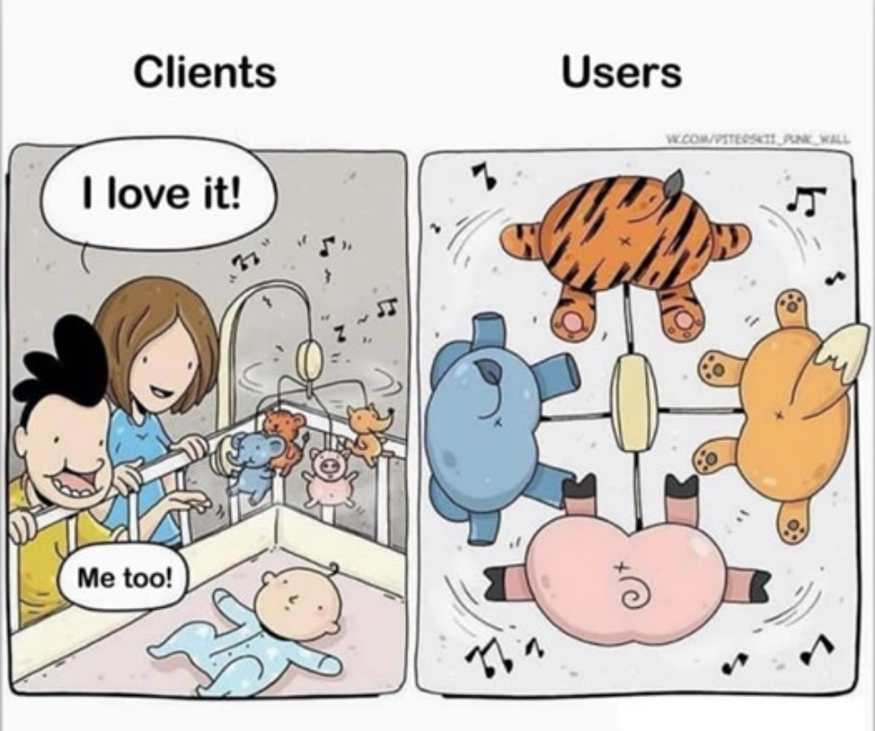

Slide 11
User have different capabilities and abilities.
For example, individual differences:
size of hands may affect the size and positioning of input buttons
motor abilities may affect the suitability of certain input and output devices
height if designing a physical kiosk
strength - a child’s toy requires little strength to operate, but greater strength to change batteries
disabilities (e.g. sight, hearing, dexterity)
abilities also vary according to context

Slide 12
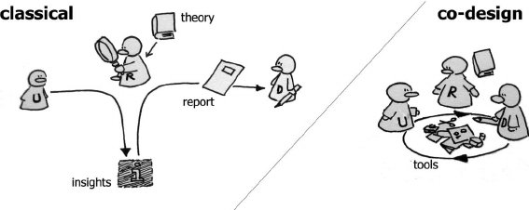
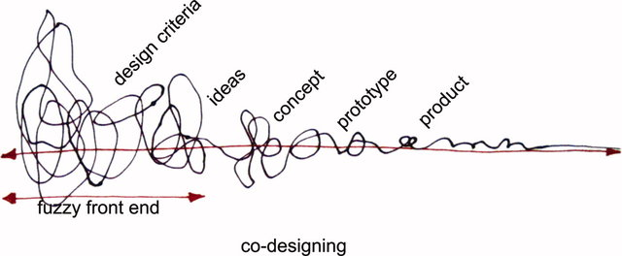
What are needs?
Users rarely know what is possible
Users can’t tell you what they ‘need’ to help them achieve their goals
Instead, look at existing tasks:
their context
what information do they require?
who collaborates to achieve the task?
why is the task achieved the way it is?
Envisioned tasks:
can be rooted in existing behaviour
can be described as future scenarios

Slide 13
Capturing User Needs
Interviews
Contextual Inquiries
Questionnaires
Observations
Mixed-methodology
Practices you might engage in during this course…perhaps!

Slide 14
Top UX Research Methods
Discover | • Field study • Diary study • User interview • Stakeholder interview • Requirements & constraints gathering
Explore | • Competitive analysis • Design review • Persona building • Task analysis • Journey mapping • Prototype feedback & testing (clickable or paper prototypes) • Write user stories • Card sorting
Test | • Qualitative usability testing (in-person or remote) • Benchmark testing • Accessibility evaluation
Listen | • Survey • Analytics review • Search-log analysis • Usability-bug review • Frequently-asked-questions (FAQ) review
Source: https://www.nngroup.com/

Slide 15
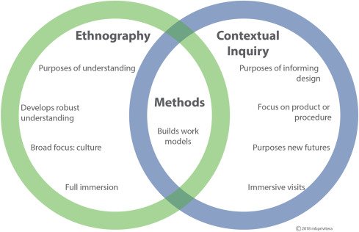
Source: The Internet

