Slide 1
Lecture 4

Slide 2
Design (Research)
Defining the term Research

Slide 3
Research is a systematic inquiry, the goal of which is knowledge.
- Bruce Archer

Slide 4
“Research is generally defined as a systematic investigation that establishes novel facts, solves new or existing problems, proves new ideas, or develops new theories. It is primarily associated with the search for knowledge, especially in the sciences and technological fields.”

Slide 5
Scientific research is a systematic process of inquiry aimed at discovering and explaining new knowledge, involving observation, experimentation, and the application of scientific methods to understand the natural world.

Slide 6
Research is a systematic inquiry, the goal of which is knowledge.
- Bruce Archer

Slide 7
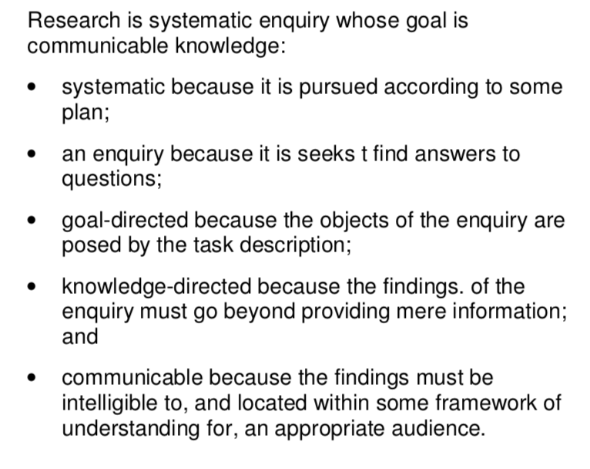

Slide 8
Research is:
Purposive – based on identification of an issue or problem worthy and capable of investigation
Inquisitive – seeking to acquire new knowledge
Informed - Conducted from an awareness of previous related research
Methodical – planned and carried out in a disciplined manner
Communicable - generating and reporting results which are testable and accessible by others.

Slide 9
Types of Research in Science Tradition
Fundamental
Strategic
Applied
Action
Option
Bruce Archer, 1995
Notes:
1. Fundamental (Basic) Research:
Fundamental research focuses on gaining new insights and understanding without immediate application.
Example:
Studying quantum mechanics principles.
Investigating how human memory processes information.
Exploring the genetic structure of a newly discovered species.
2. Strategic Research:
This type of research is aimed at addressing long-term goals and informing strategic decisions and policies.
Example:
Research conducted to understand climate change trends for policy formulation.
Analysis of demographic changes to shape national education policy.
Researching renewable energy technologies to guide future energy policies.
3. Applied Research:
Applied research aims at solving practical problems or developing new applications from scientific knowledge.
Example:
Developing a vaccine for a newly emerged virus.
Research to improve battery performance in electric vehicles.
Creating new farming techniques to enhance crop yield in drought-affected regions.
4. Action Research:
Action research is usually conducted by practitioners themselves to improve their own practices through reflective and iterative methods.
Example:
A teacher implementing and evaluating new classroom management techniques.
A community worker collaborating with residents to identify and solve local environmental issues.
Nurses collaboratively researching methods to improve patient care and reduce hospital infections.
5. Option Research:
Option research explores multiple potential options and evaluates them to identify the most feasible or optimal solutions.
Example:
Evaluating different technologies for waste management in urban planning.
Analyzing various marketing strategies to select the best approach for a product launch.
Assessing different infrastructure projects based on cost-benefit analyses to inform governmental investment decisions.

Slide 10
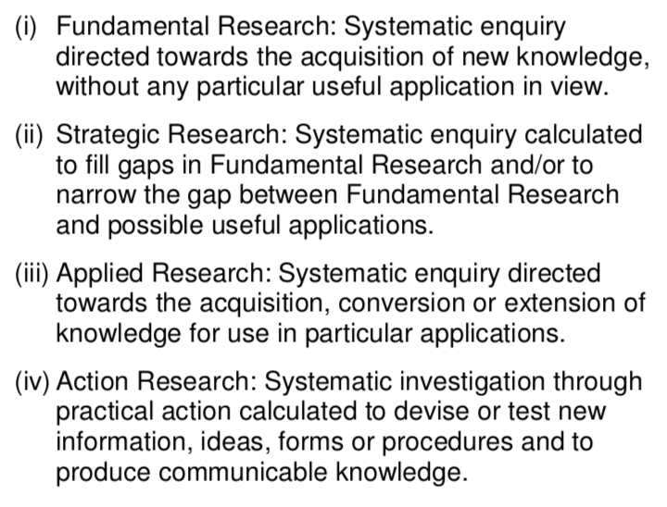
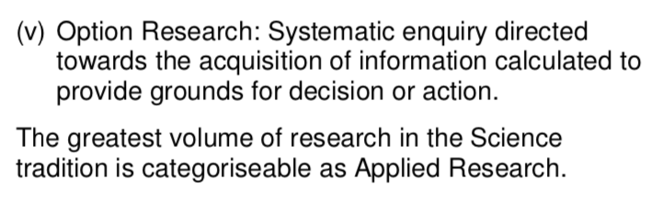
Notes:
1. Fundamental (Basic) Research:
Fundamental research focuses on gaining new insights and understanding without immediate application.
Example:
Studying quantum mechanics principles.
Investigating how human memory processes information.
Exploring the genetic structure of a newly discovered species.
2. Strategic Research:
This type of research is aimed at addressing long-term goals and informing strategic decisions and policies.
Example:
Research conducted to understand climate change trends for policy formulation.
Analysis of demographic changes to shape national education policy.
Researching renewable energy technologies to guide future energy policies.
3. Applied Research:
Applied research aims at solving practical problems or developing new applications from scientific knowledge.
Example:
Developing a vaccine for a newly emerged virus.
Research to improve battery performance in electric vehicles.
Creating new farming techniques to enhance crop yield in drought-affected regions.
4. Action Research:
Action research is usually conducted by practitioners themselves to improve their own practices through reflective and iterative methods.
Example:
A teacher implementing and evaluating new classroom management techniques.
A community worker collaborating with residents to identify and solve local environmental issues.
Nurses collaboratively researching methods to improve patient care and reduce hospital infections.
5. Option Research:
Option research explores multiple potential options and evaluates them to identify the most feasible or optimal solutions.
Example:
Evaluating different technologies for waste management in urban planning.
Analyzing various marketing strategies to select the best approach for a product launch.
Assessing different infrastructure projects based on cost-benefit analyses to inform governmental investment decisions.

Slide 11
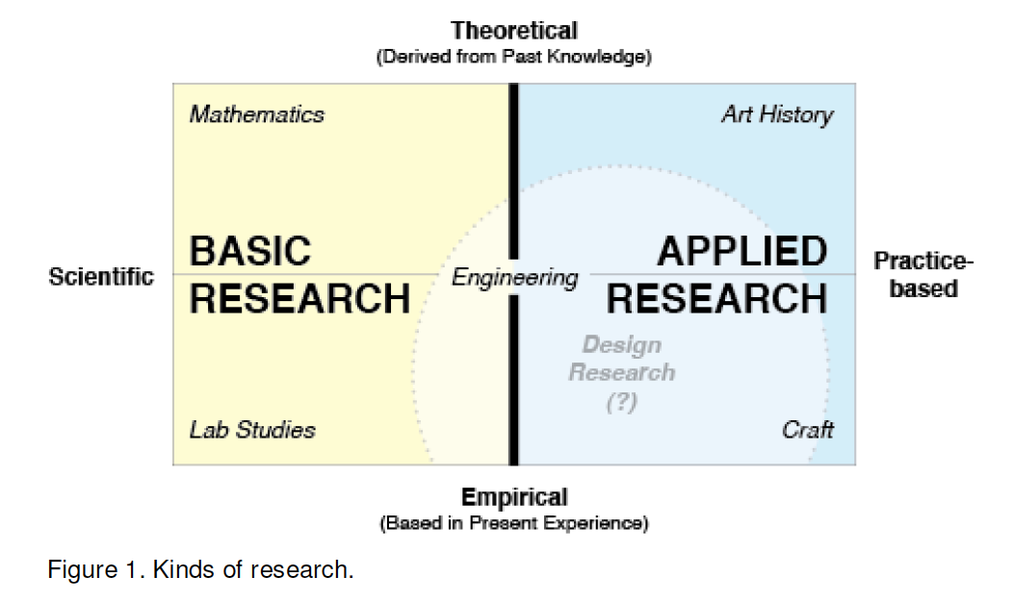

Slide 12
Empirical
Descriptive
Analytical
Applied
Fundamental
Quantitative
Qualitative
______ research follows a pattern of identification of problem/ research question, study design involving several decision points and interpreting data and drawing conclusions as part of the findings of the research.
Source: Wohlin, Claes, and Aybüke Aurum (2015)

Slide 13
The textbook explanation of the scientific method is “Collect the facts or data. … Formulate a hypothesis. … Plan and do additional experiments to test the hypothesis. … Modify the hypothesis.” And, an experimenter should consider a hypothesis to be a “tentative explanation of certain facts” and must remember that a “well-established hypothesis is called a theory or a model” (Hein and Arena, 2000)

Slide 14
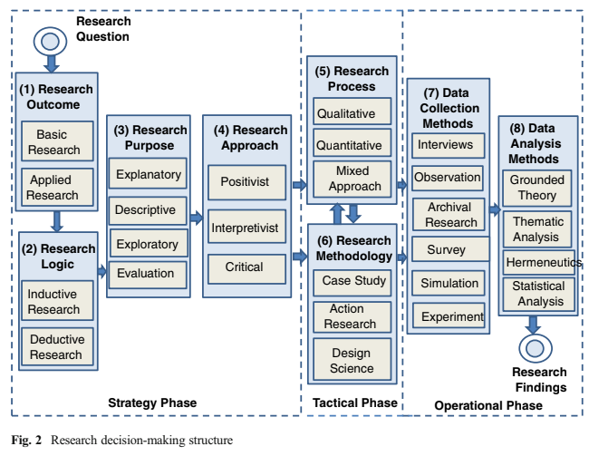
Source: Wohlin, Claes, and Aybüke Aurum (2015)

Slide 15
The strategy phase involves a plan that gives direction to the researcher for the tactical and operational phase of the research. This phase enables the researcher to conduct his/her
research systematically, and to position the research in relation to different general approaches to research.
The research strategy involves decisions on research outcome, research logic, research purpose, and research approach. The strategy phase sets the stage for the research.

Slide 16

Inductive approach (Bottom-Up Approach)
In an inductive approach to research, a researcher begins by collecting data that is relevant to his or her topic of interest. Once a substantial amount of data have been collected, the researcher will then take a breather from data collection, stepping back to get a bird’s eye view of her data. At this stage, the researcher looks for patterns in the data, working to develop a theory that could explain those patterns. Thus when researchers take an inductive approach, they start with a set of observations and then they move from those particular experiences to a more general set of propositions about those experiences.

Slide 17
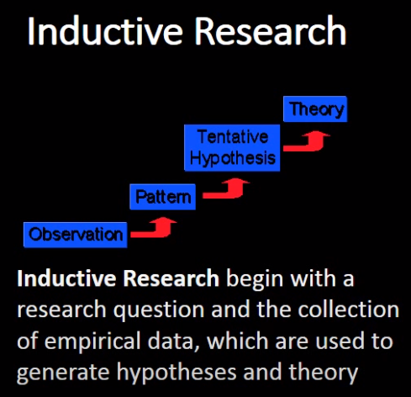

Slide 18
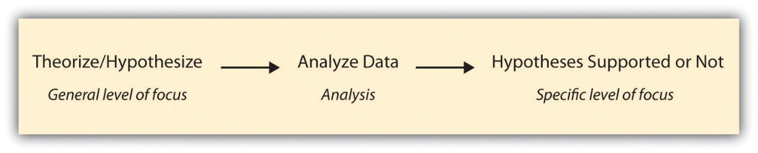
Deductive approach (Top-Down Approach)
Researchers taking a deductive approach take the steps described earlier for inductive research and reverse their order. They start with a social theory that they find compelling and then test its implications with data. That is, they move from a more general level to a more specific one. A deductive approach to research is the one that people typically associate with scientific investigation. The researcher studies what others have done, reads existing theories of whatever phenomenon he or she is studying, and then tests hypotheses that emerge from those theories.

Slide 19
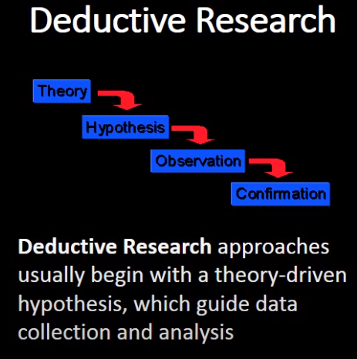

Slide 20
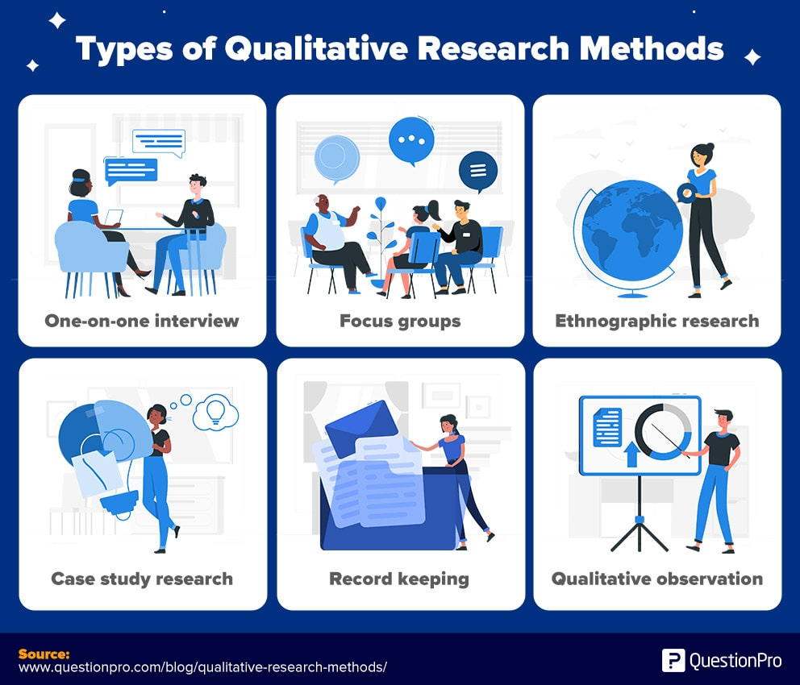
Types of Research Approach
Qualitative research is an approach for exploring and understanding the meaning individuals or groups ascribe to a social or human problem. The process of research involves emerging questions and procedures, data typically collected in the participant’s setting, data analysis inductively building from particulars to general themes, and the researcher making interpretations of the meaning of the data.
Notes:
The final written report has a flexible structure. Those who engage in this form of inquiry support a way of looking at research that honors an inductive style, a focus on individual meaning, and the importance of reporting the complexity of a situation.

Slide 21
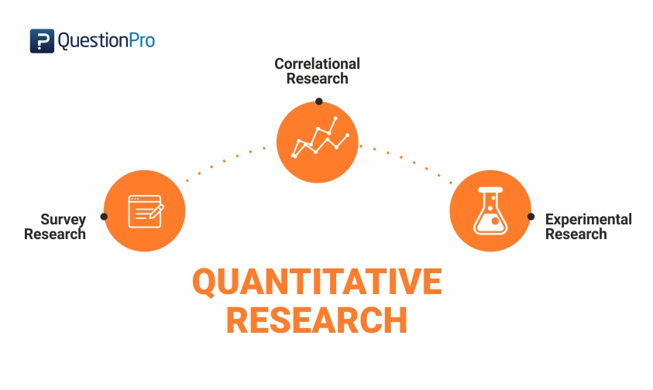
Types of Research Approach
Quantitative research is an approach for testing objective theories by examining the relationship among variables. These variables, in turn, can be measured, typically on instruments, so that numbered data can be analyzed using statistical procedures.
Notes:
The final written report has a set structure consisting of introduction, literature and theory, methods, results, and discussion. Like qualitative researchers, those who engage in this form of inquiry have assumptions about testing theories deductively, building in protections against bias, controlling for alternative or counterfactual explanations, and being able to generalize and replicate the findings.

Slide 22
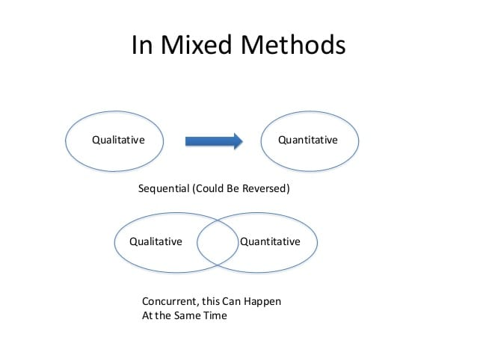
Types of Research Approach
Mixed methods research is an approach to inquiry involving collecting both quantitative and qualitative data, integrating the two forms of data, and using distinct designs that may involve philosophical assumptions and theoretical frameworks. The core assumption of this form of inquiry is that the integration of qualitative and quantitative data yields additional insight beyond the information provided by either the quantitative or qualitative data alone.

Slide 23
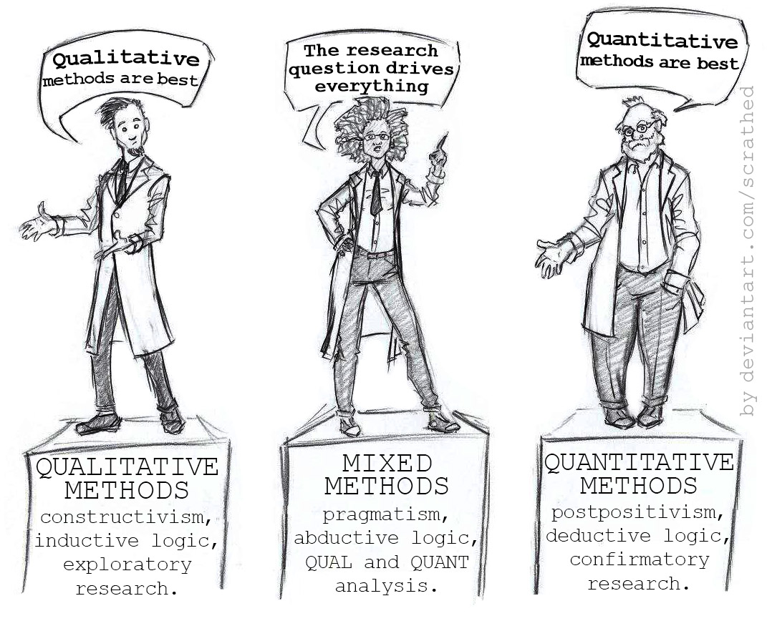

Slide 24
Quantitative Research
Quantitative research is an approach for testing objective theories by examining the relationship among variables. These variables, in turn, can be measured, typically on instruments, so that numbered data can be analyzed using statistical procedures.

Slide 25
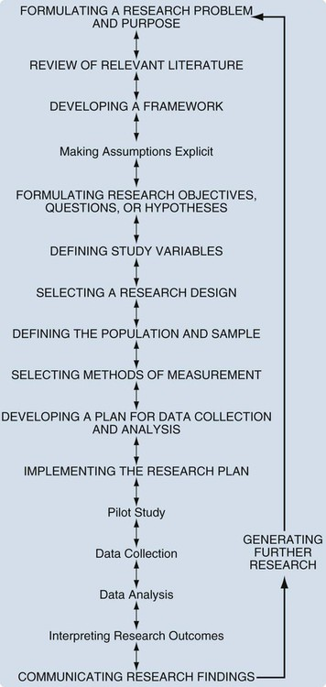
Source: https://nursekey.com/introduction-to-quantitative-research-2/

Slide 26
Research Questions
Hypothesis
Descriptive: describes what currently exists
Relational: addresses a relationship between two or more variables
Causal: allows the researcher to draw a causal inference
An operational definition of a predicted answer to the research question.
Matches a concept, such as intelligence, with a measurement method or tool such as a survey or scale.
Operationalizing your concepts make your hypothesis testable.
Notes:
Descriptive: “How much?”, “How regularly?”, “What percentage?”, “What time?”, “What is?” Primarily, a descriptive research question will be used to quantify a single variable, but there's nothing stopping you covering multiple variables within a single question.
Relational research questions. These types of questions seek to assess the relationship between two or more variables or groups. This type of question could be phrased as: Does the leadership style of ice cream shop employers predict job satisfaction of ice cream shop employees?
Cause and Effect Questions Designed to determine whether one or more variables causes or affects one or more outcome variables. What is affect of exercise on heart rate? What is the effect hand fatigue on reaction time? What are the most potent vectors for disease transmission?

Slide 27
Descriptive: “How much?”, “How regularly?”, “What percentage?”, “What time?”, “What is?” Primarily, a descriptive research question will be used to quantify a single variable, but there's nothing stopping you covering multiple variables within a single question.
Relational research questions. These types of questions seek to assess the relationship between two or more variables or groups. This type of question could be phrased as: Does the leadership style of ice cream shop employers predict job satisfaction of ice cream shop employees?
Cause and Effect Questions Designed to determine whether one or more variables causes or affects one or more outcome variables. What is affect of exercise on heart rate? What is the effect hand fatigue on reaction time? What are the most potent vectors for disease transmission?

Slide 28
Descriptive: “How much?”, “How regularly?”, “What percentage?”, “What time?”, “What is?” Primarily, a descriptive research question will be used to quantify a single variable, but there's nothing stopping you covering multiple variables within a single question.
What are the most common navigation patterns used by users on a specific website?
What are the demographics of users who frequently use a specific feature of an application?
How do users typically interact with a particular type of interface element (e.g., buttons, sliders)?
What are the common error messages users encounter when using a software application?

Slide 29
Relational research questions: These types of questions seek to assess the relationship between two or more variables or groups. This type of question could be phrased as: Does the leadership style of ice cream shop employers predict job satisfaction of ice cream shop employees?
How does the usability of a mobile app compare between users with and without prior experience using similar apps?
Does implementing a gamified reward system increase user engagement in a learning application?
Does the use of a touch-screen interface lead to faster task completion times compared to a keyboard and mouse interface?

Slide 30
Cause and Effect Questions: Designed to determine whether one or more variables causes or affects one or more outcome variables. What is affect of exercise on heart rate? What is the effect hand fatigue on reaction time? What are the most potent vectors for disease transmission?
What are the effects of a specific design element or feature on user performance or efficiency?
Examples:
Does a new navigation system improve task completion time?
Does a particular feedback mechanism reduce errors?
Does a change in layout affect user satisfaction?

Slide 31
Research Question
A research question is 'a question that a research project sets out to answer‘
Formation of the research question is largely determined by, and likewise influences, where and what kind of information will be sought.
The research question must be accurately and clearly defined.

Slide 32
The investigator must first identify the type of study (qualitative, quantitative, or mixed) before the research question is developed.
Forming the research question may become an iterative process when parameters of the research process, such as field of study or methodology, do not fit the original question.

Slide 33
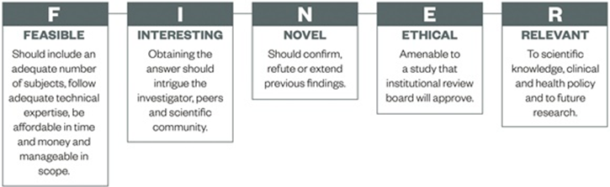
FINER method for formulating research question
The FINER method prompts researchers to determine whether one has the means and interest to conduct the study. It also asks one to consider the ethical ramifications, as well as the relevancy of the research.

Slide 34
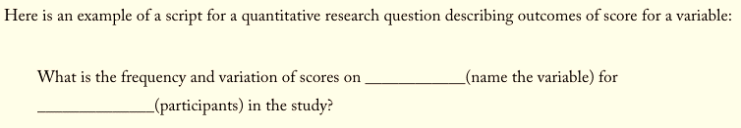
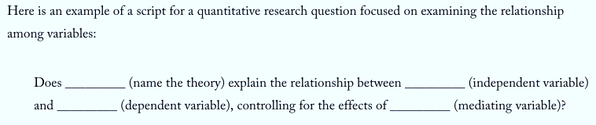
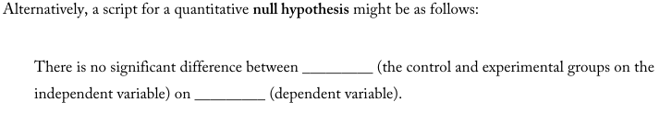

Slide 35
Variables
Variables are measurable characteristics or properties of people or things that can take on different values. In contrast, characteristics that do not vary are constants.
A hypothesis states a presumed relationship between two variables in a way that can be tested with empirical data. It may take the form of a cause-effect statement, or an "if x,...then y" statement.
The cause is called the independent variable; and the effect is called the dependent variable.

Slide 36
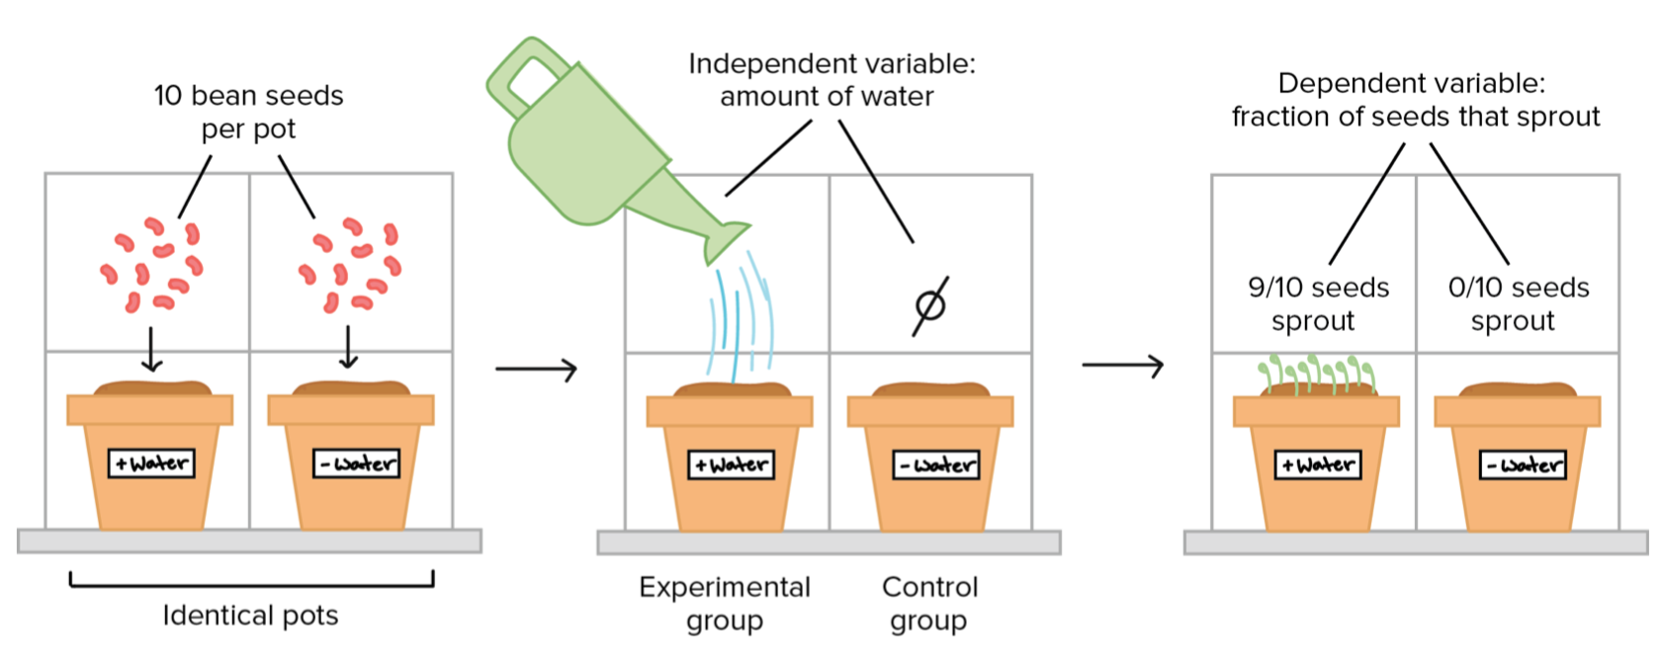

Slide 37
Relationships can be of several forms: linear, or non-linear. Linear relationships can be either direct (positive) or inverse (negative).
In a direct or positive relationship, the values of both variables increase together or decrease together. That is, if one increases in value, so does the other; if one decreases in value, so does the other.
In an inverse or negative relationship, the values of the variables change in opposite directions. That is, if the independent variable increases in value, the dependent variable decreases; if the independent variable decreases in value, the dependent variable increases.

Slide 38
In a non-linear relationship, there is no easy way to describe how the values of the dependent variable are affected by changes in the values of the independent variable.
If there is no discernable relationship between two variables, they are said to be unrelated, or to have a null relationship. Changes in the values of the variables are due to random events, not the influence of one upon the other.

Slide 39
Hypothesis
A hypothesis (plural hypotheses) is a proposed explanation for a phenomenon. For a hypothesis to be a scientific hypothesis, the scientific method requires that one can test it.
If hypotheses are used, there are two forms: (a) null and (b) alternative. A null hypothesis represents the
traditional approach: It makes a prediction that in the general population, no relationship or no
significant difference exists between groups on a variable. The wording is, “There is no difference (or
relationship)” between the groups.
The alternative hypothesis is a position that states something is happening, a new theory is preferred instead of an old one (null hypothesis)

Slide 40
Example: A Null Hypothesis
An investigator might examine three types of reinforcement for children with autism: (a) verbal cues, (b) a reward, and (c) no reinforcement. The investigator collects behavioral measures assessing social interaction of the children with their siblings. A null hypothesis might read as follows:
There is no significant difference between the effects of verbal cues, rewards, and no reinforcement in terms of social interaction for children with autism and their siblings.

Slide 41

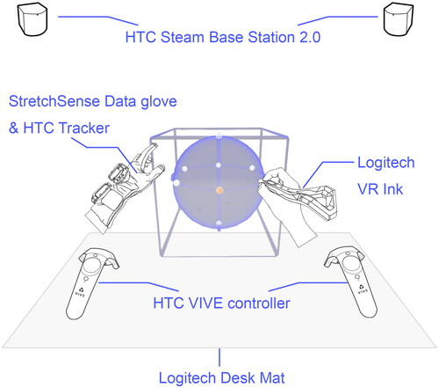
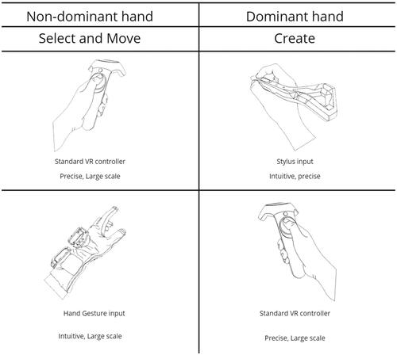
Our work mainly investigates two research questions: (1) How can the stylus and gesture be integrated into asymmetric interaction for fast and precise sketching in VR? (2) What are the benefits of integrating the stylus and gesture in asymmetric interaction for VR sketching tasks?
H1: The integration of gesture input and stylus capabilities in asymmetric interaction can contribute to immersive and efficient VR sketching experiences.
H2: The advanced asymmetrical approach, combining stylus and hand gestures, outperforms standard symmetric methods. It excels especially in complex, fast, and precise virtual reality sketching tasks, leveraging the combined input for optimal performance.

Slide 42

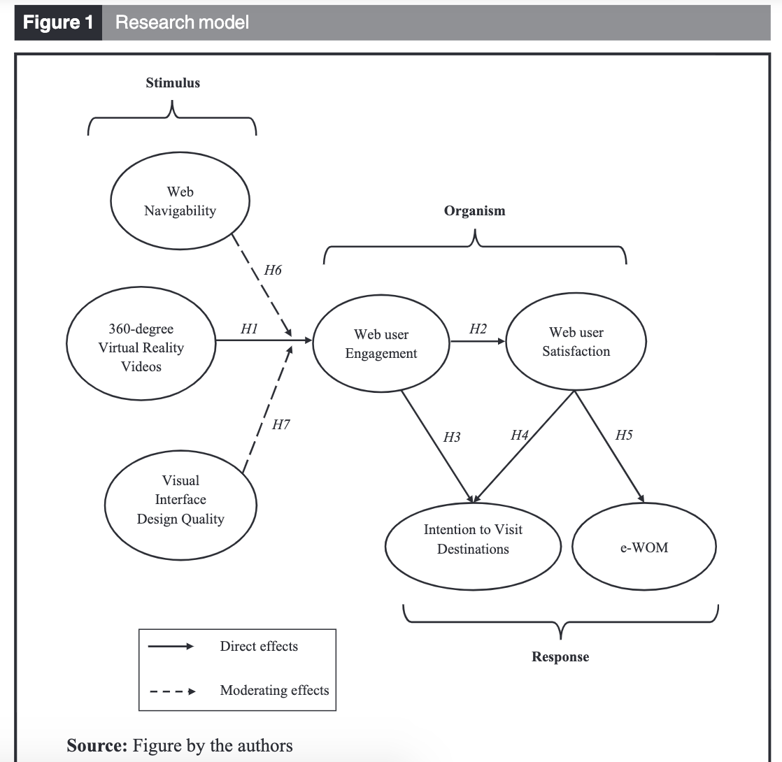
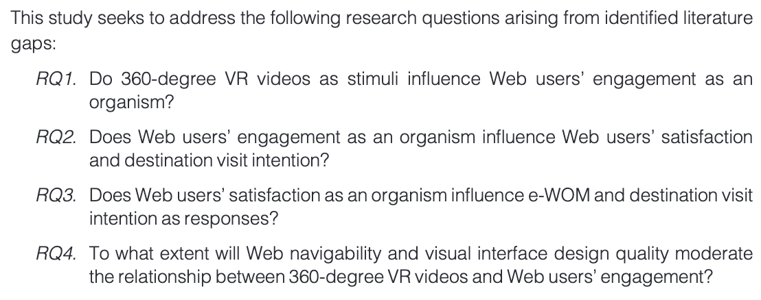


Slide 43

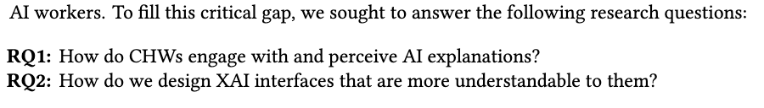
This paper examines how CHWs in rural India engage with and perceive AI explanations and how we might design explainable AI (XAI) interfaces that are more understandable to them. We conducted semi-structured interviews with CHWs who interacted with a design
probe to predict neonatal jaundice in which AI recommendations are accompanied by explanations. We (1) identify how CHWs interpreted AI predictions and the associated explanations, (2) unpack the benefits and pitfalls they perceived of the explanations, and (3) detail how different design elements of the explanations impacted their AI understanding.
To answer these questions, we conducted semi-structured interviews with 35 CHWs who interacted with a design probe that predicts neonatal jaundice and provides explanations on how it arrived at a prediction.

