Slide 1
Lecture 1

Slide 2
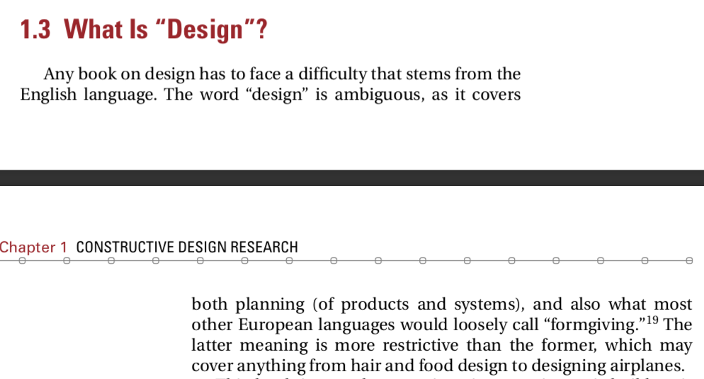
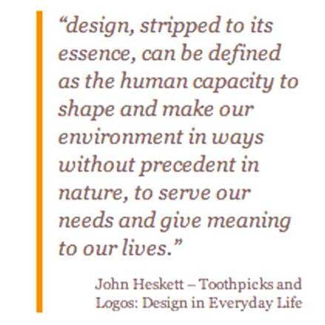

Slide 3
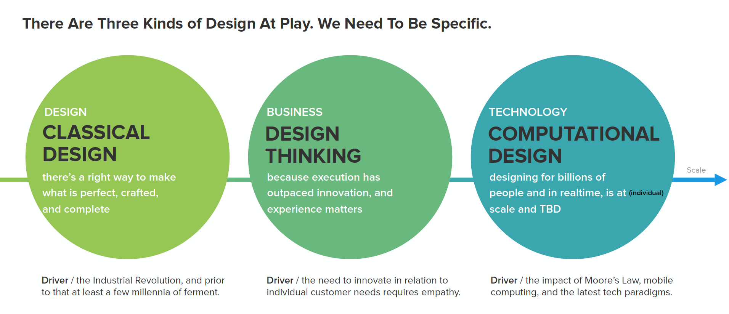
Image Source: Design in Tech Report, 2016

Slide 4
﻿In the English language the word ‘design’ takes on a variety of verb and noun meanings.

Slide 5
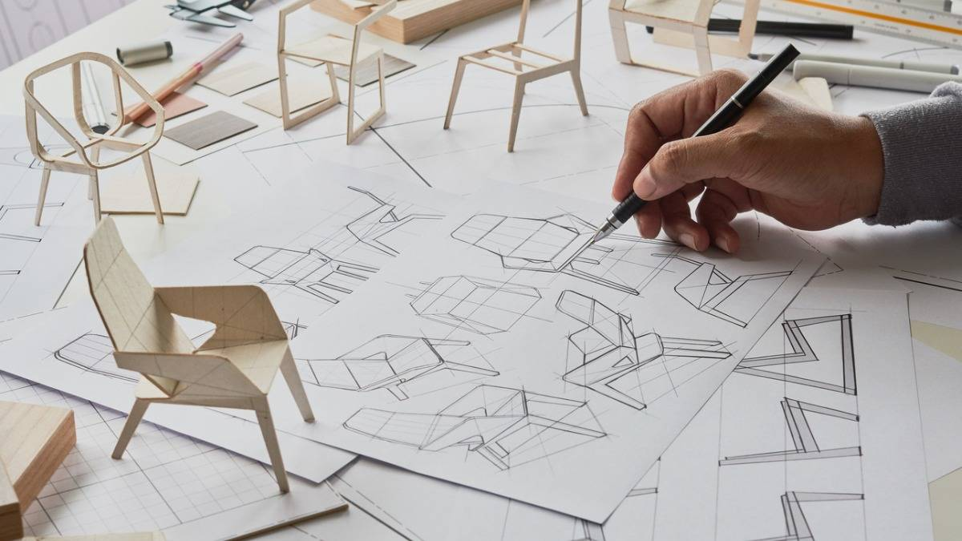
In its verb form, standard dictionaries suggest elements of definition involving representing an artefact, system or society, or the fixing of its look, function or purpose.

Slide 6
Design as a Verb
Architecture: The iterative process of sketching, modeling, and refining a building concept.
Industrial Design: Prototyping and testing new forms for ergonomic efficiency.
UI/UX Design: Conducting user research, wireframing, and usability testing.
Fashion Design: Draping fabric, sketching patterns, and iterating based on material behaviour.
Graphic Design: Brainstorming, ideating layouts, and refining branding elements.

Slide 7
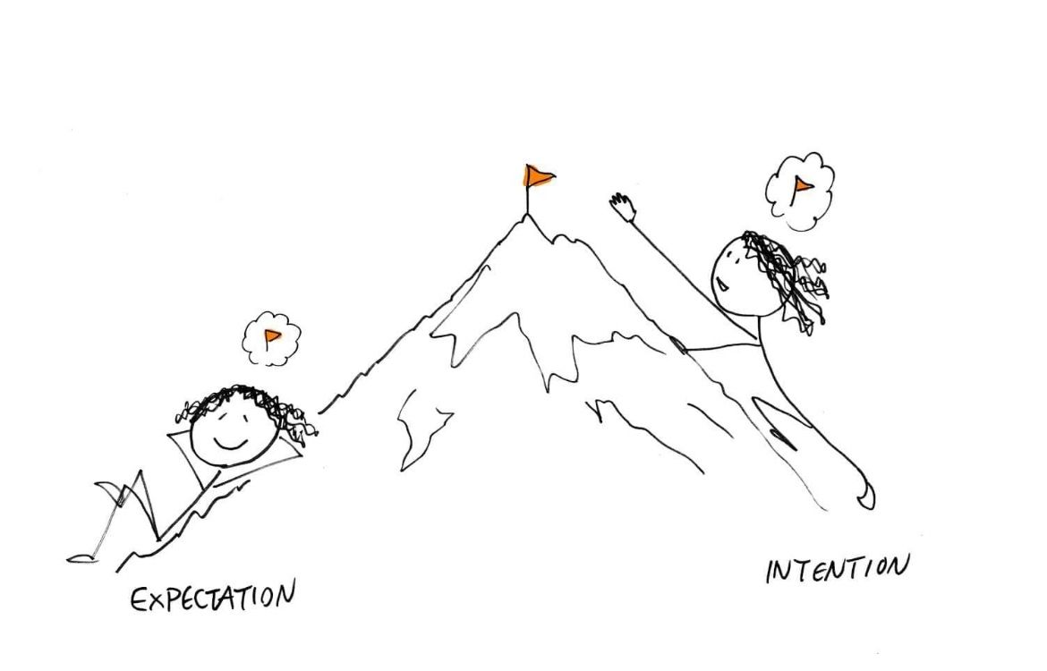
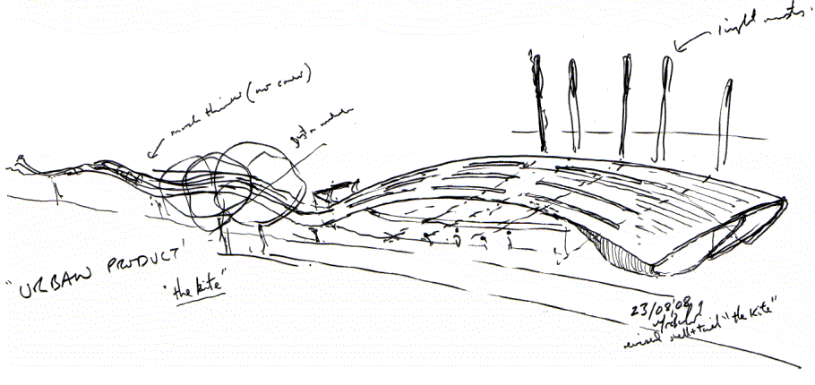
In its noun form, same dictionaries suggest concepts of sketch, drawing, plan, pattern, intention or purpose, or the art of producing them.

Slide 8
Design as a Noun
Architecture: The final blueprint or completed building.
Industrial Design: The finished physical product (e.g., a chair, phone, or medical device).
UI/UX Design: The deployed website or app interface.
Fashion Design: The completed garment, ready for production or runway.
Graphic Design: A published book cover, corporate logo, or digital poster.

Slide 9
The word ‘Design’ therefore has meanings ranging from the abstract conception of something to the actual plans and processes required to achieve it.
Process
Design
Outcome
(action)
(an artifact)
Dual nature of “Design”

Slide 10
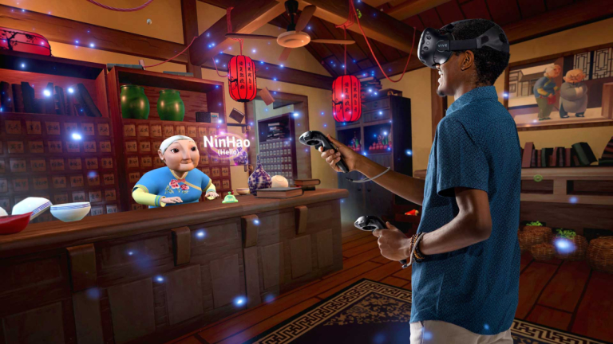
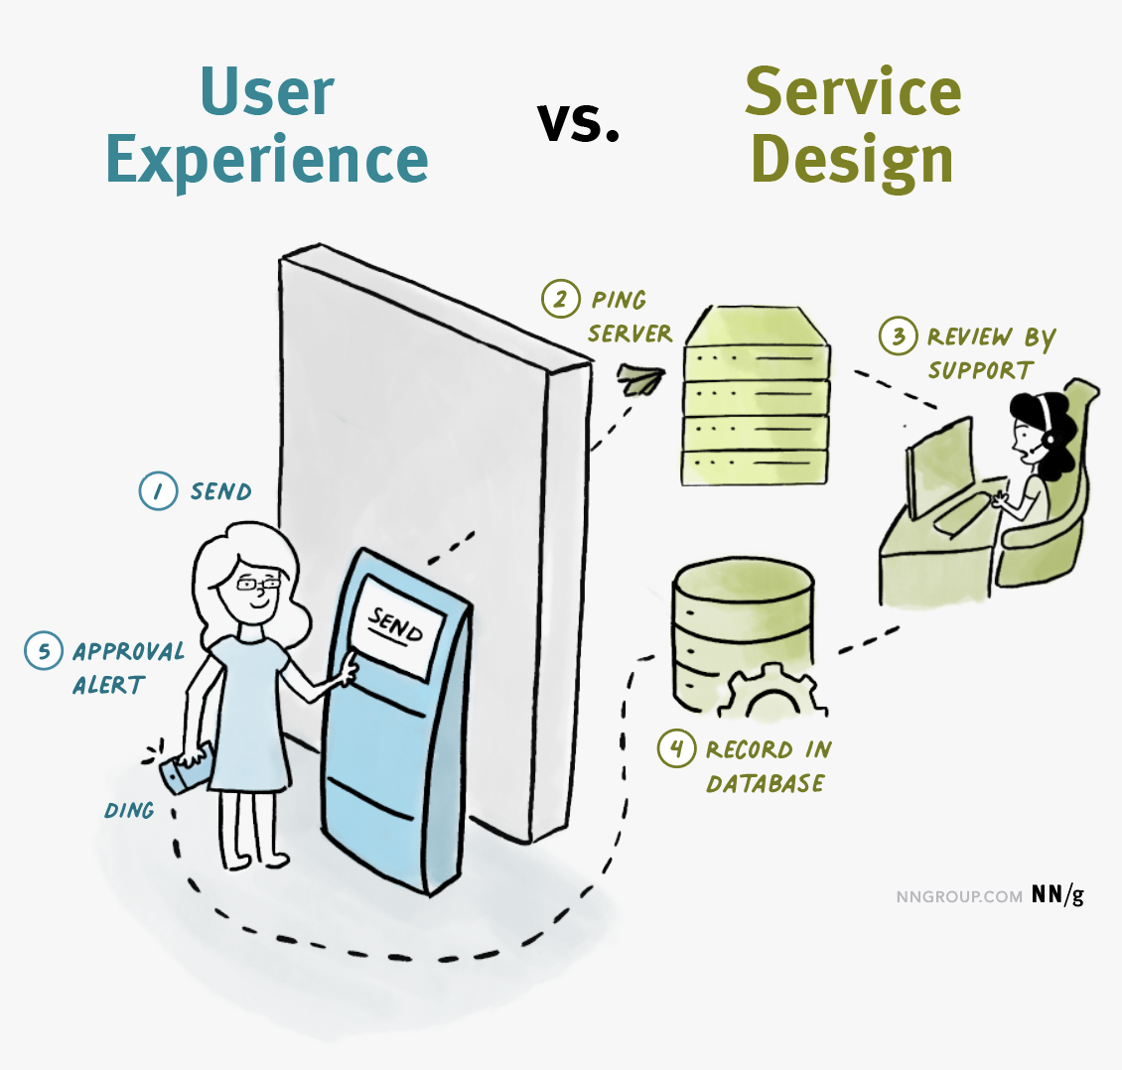

Interplay Between the Two
Game Design:
Verb: The process of developing mechanics, playtesting, and balancing difficulty.
Noun: The final game with defined rules, characters, and levels.
Service Design:
Verb: Mapping user journeys, testing service touchpoints, and iterating customer experience.
Noun: The structured framework of a customer service system.
Education Design:
Verb: Developing curricula, testing pedagogical methods, and refining lesson plans.
Noun: The final syllabus, a learning framework, or an instructional guide.

Slide 11
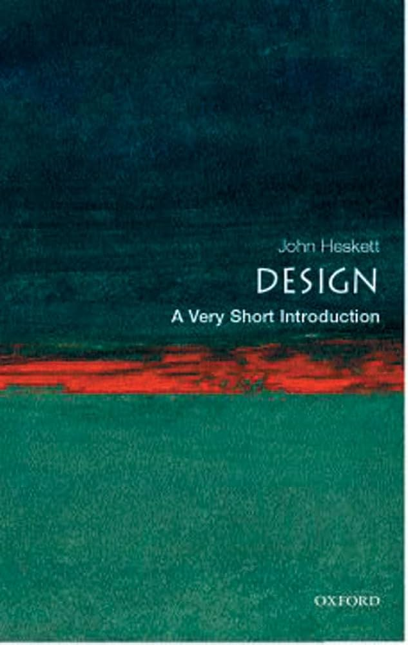
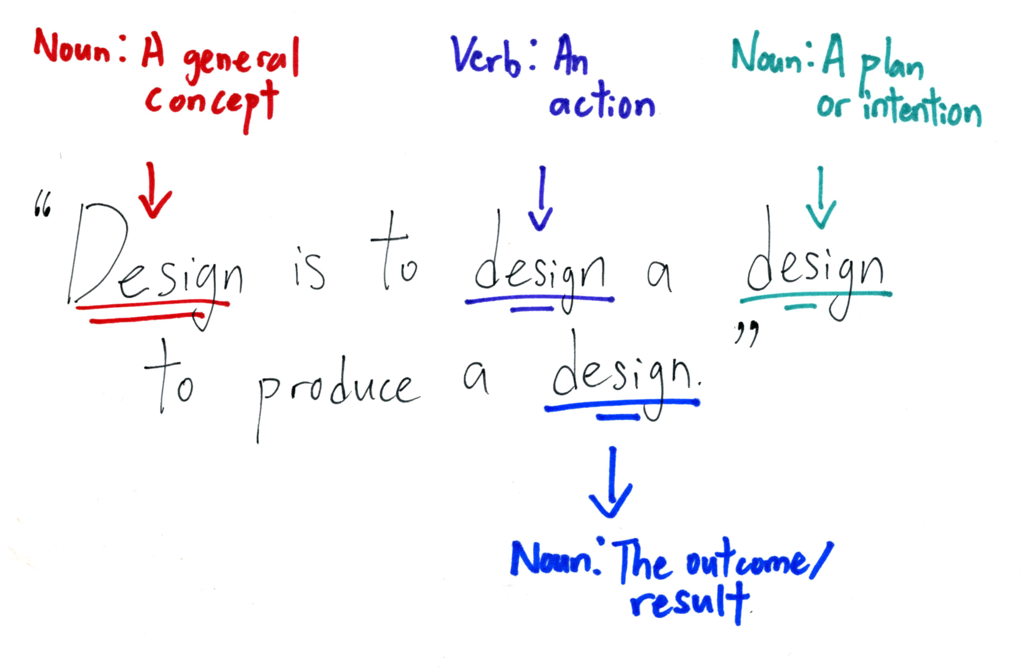

Slide 12
Design is a complex, multifaceted phenomenon, involving: people, a developing product, a process involving a multitude of activities and procedures; a wide variety of knowledge, tools and methods; an organisation; as well as a micro-economic and macro-economic context.
Blessing, L. T., & Chakrabarti, A. (2009)

Slide 13

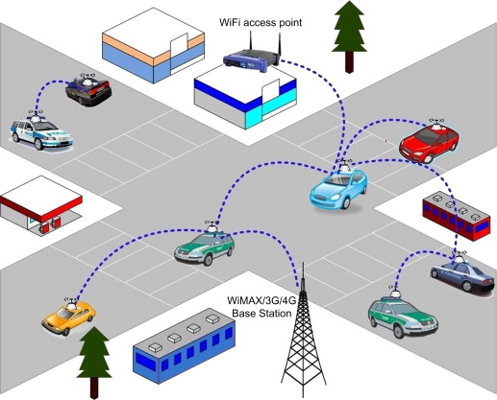
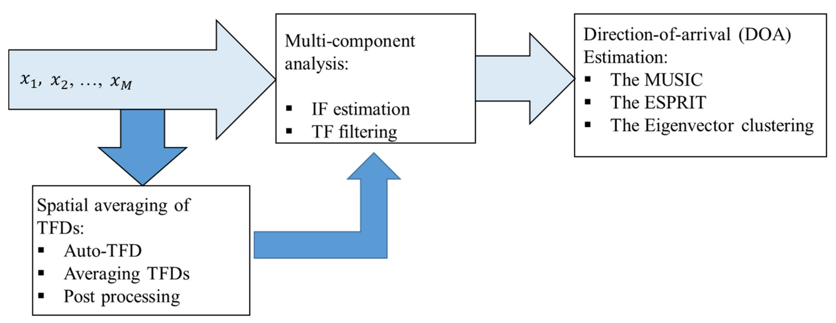
The Object of Study of Design
Notes:
In the Direction of Arrival (DOA) project, algorithms for estimating the DOA of a satellite TV signal were tested. Each of the tested algorithms is an artifact, the context for each of them is an IT infrastructure for watching TV in the backseat of the car.

Slide 14
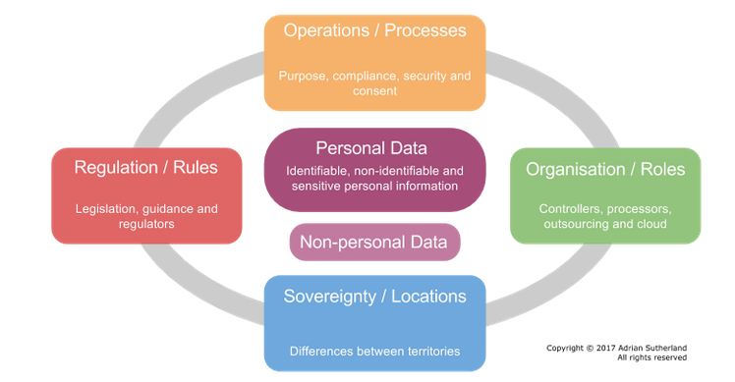
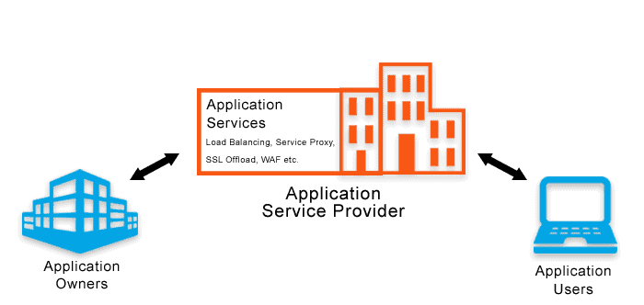
The Object of Study of Design
Method
Notes:
In the data location compliance (DLC) project, a method was developed that allows cloud service providers to show compliance of the European data location regulations. The method is an artifact, and the context consists of cloud service providers who want to offer their services on European market.

Slide 15
Software components/ system,
Hardware components/ system,
Organization,
Business process,
Service,
Method,
Technique,
Conceptual Structure
Software,
Hardware,
People,
Organizations, Business processes,
Service, Method,
Technique,
Conceptual Structures,
Values, Desires, Fears,
Goals, Norms,
Budgets
Interaction
Artifact
Context

