Slide 1

MANTHAN:
AI Medical Diagnosis Assistant Chatbot
2024
PG-Diploma in Artificial Intelligence
Guided By :
Mr. Prakash Sinha
Submitted By:
Harsh Jain (240840128018)
Dhananjay Gaikwad (240840128012)
Abhishek Mali (240840128003)
Siddhi Shintre (240840128033)
Page
01

Slide 2
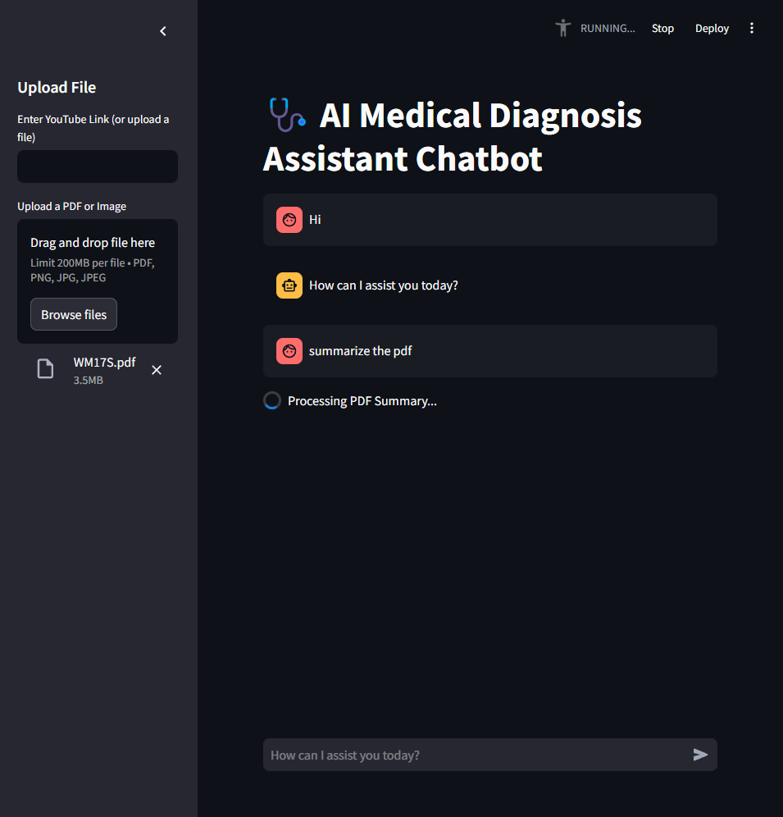

OBJECTIVE
To develop an AI-powered medical assistant capable of diagnosing diseases like breast cancer and malaria efficiently.
Simplify complex medical data analysis using deep learning and natural language processing (NLP).
Provide quick, accurate, and user-friendly health insights for both medical professionals and general users.
Page
02

Slide 3



2024
TECHNOLOGIES USED
Python: Core programming language for backend development.
TensorFlow & Keras: Deep learning frameworks for building disease detection models.
Streamlit: For creating an intuitive and interactive web-based user interface.
Ollama (LLM): Utilized for natural language processing and summarizing medical documents.
PDFPlumber: To extract and process text from PDF files efficiently.
Page
03

Slide 4
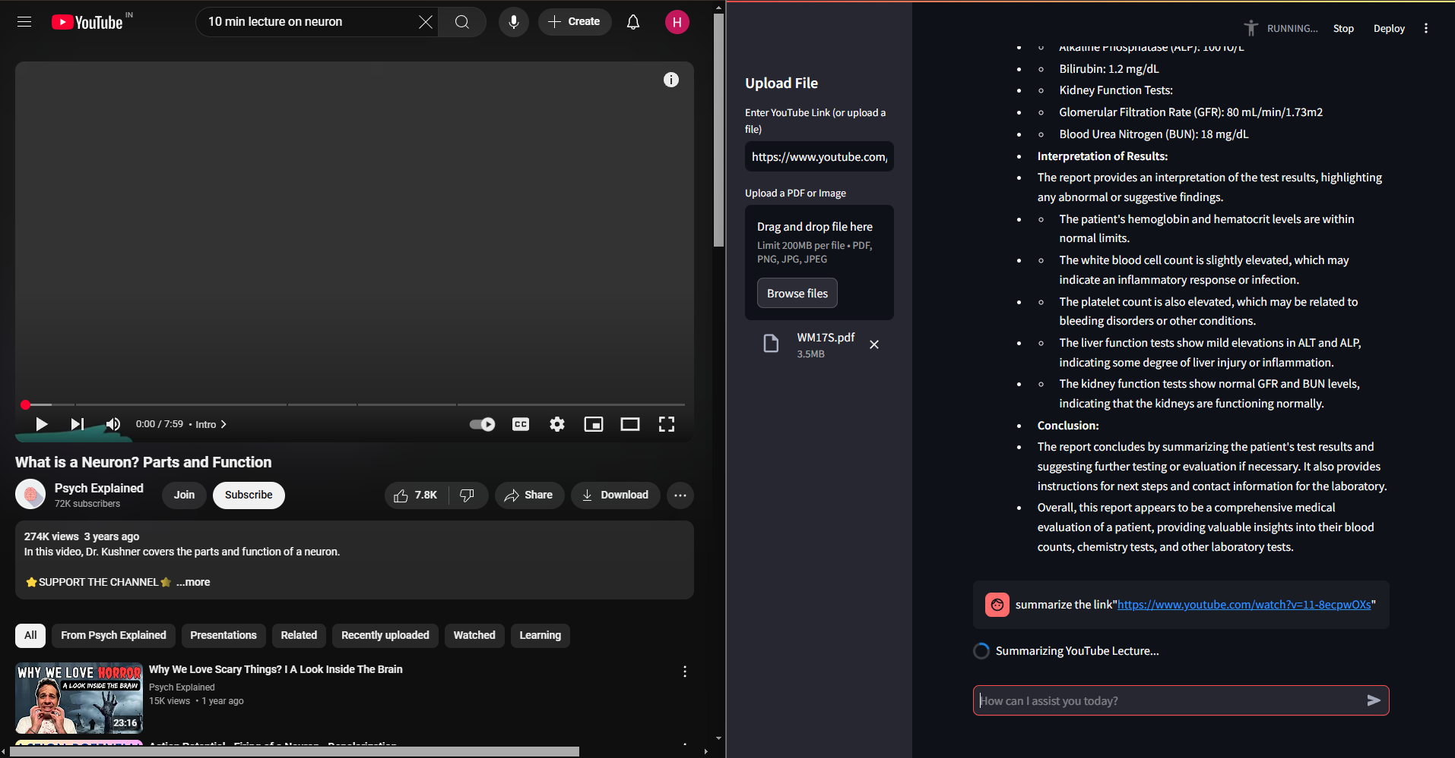

Slide 5

2024
FLOW OF DATA
User Input
File Type Detection
Processing Module:
Result Generation
Output Presentation
Uploads an image, PDF, or provides a YouTube link via the web interface.
The system automatically identifies the type of input (Image, PDF, or Video).
Image Input: Deep learning models analyze medical images (e.g., mammograms) to detect diseases.
PDF Input: NLP models process and summarize the extracted text from PDFs.
Displays user-friendly, concise results on the dashboard for easy interpretation.
Analyzes and interprets the data.
Page
04

Slide 6
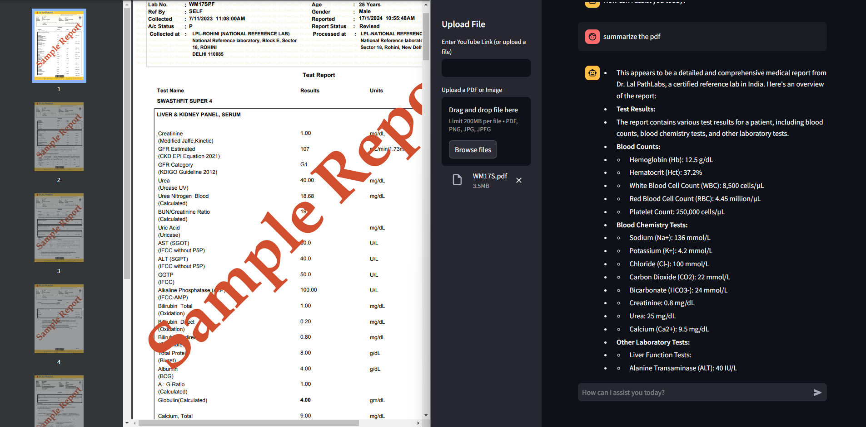
2024
IMPLEMENTATION RESULTS
Breast Cancer Detection: Achieved high accuracy in identifying potential cancerous tissues from mammograms.
Malaria Detection: Provided reliable predictions based on blood smear images.
Medical Report Summarization: Generated concise and coherent summaries from complex medical documents and videos.
Page
05

Slide 7
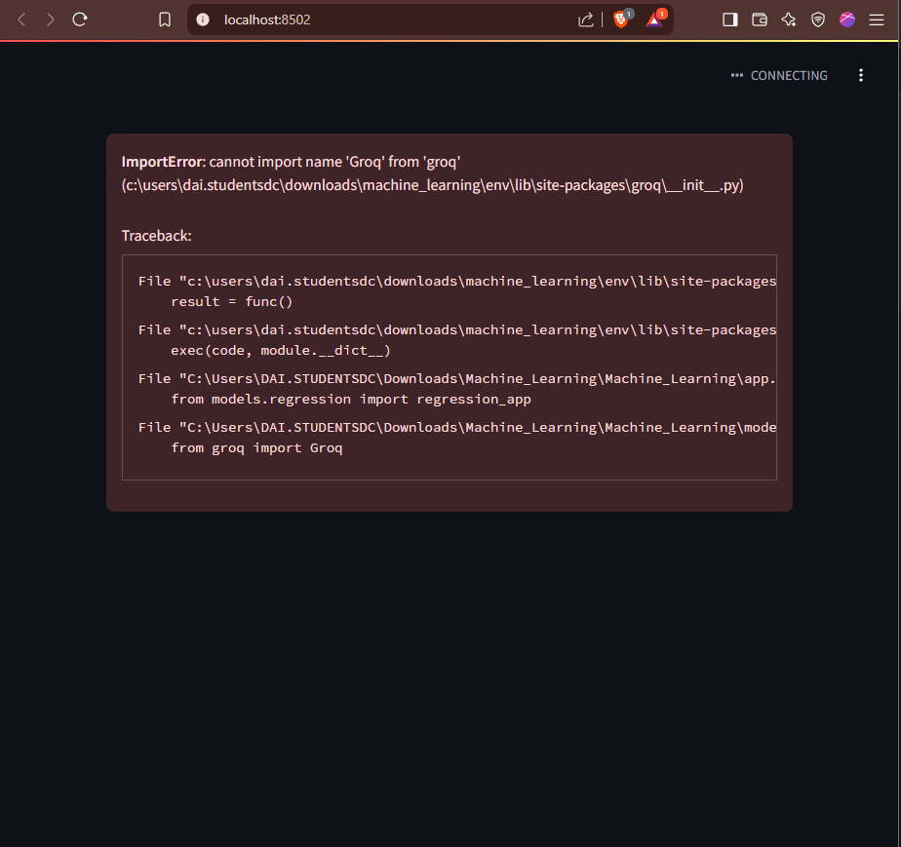
2024
PROBLEMS FACED
Challenges in handling image-based PDFs where OCR quality affected text extraction.
Initial performance issues due to limited and imbalanced training datasets.
Difficulty in optimizing the application for smooth performance with large AI models in Streamlit.
Page
06

Slide 8
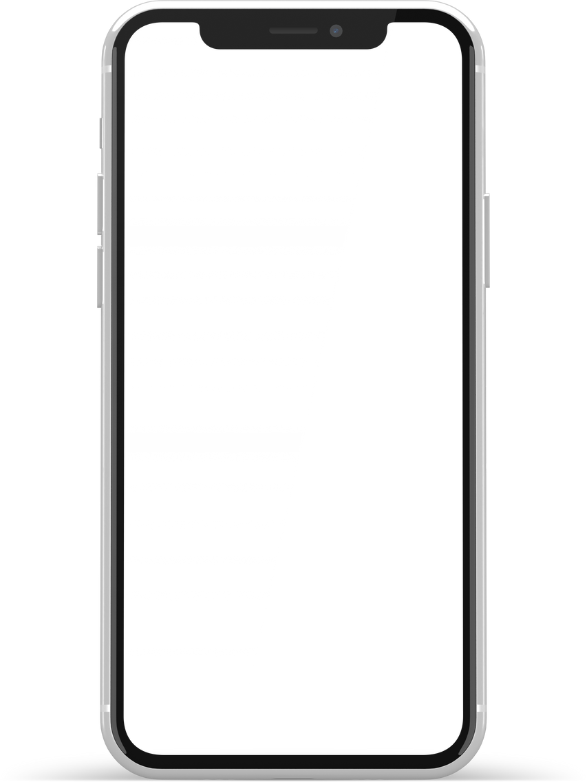
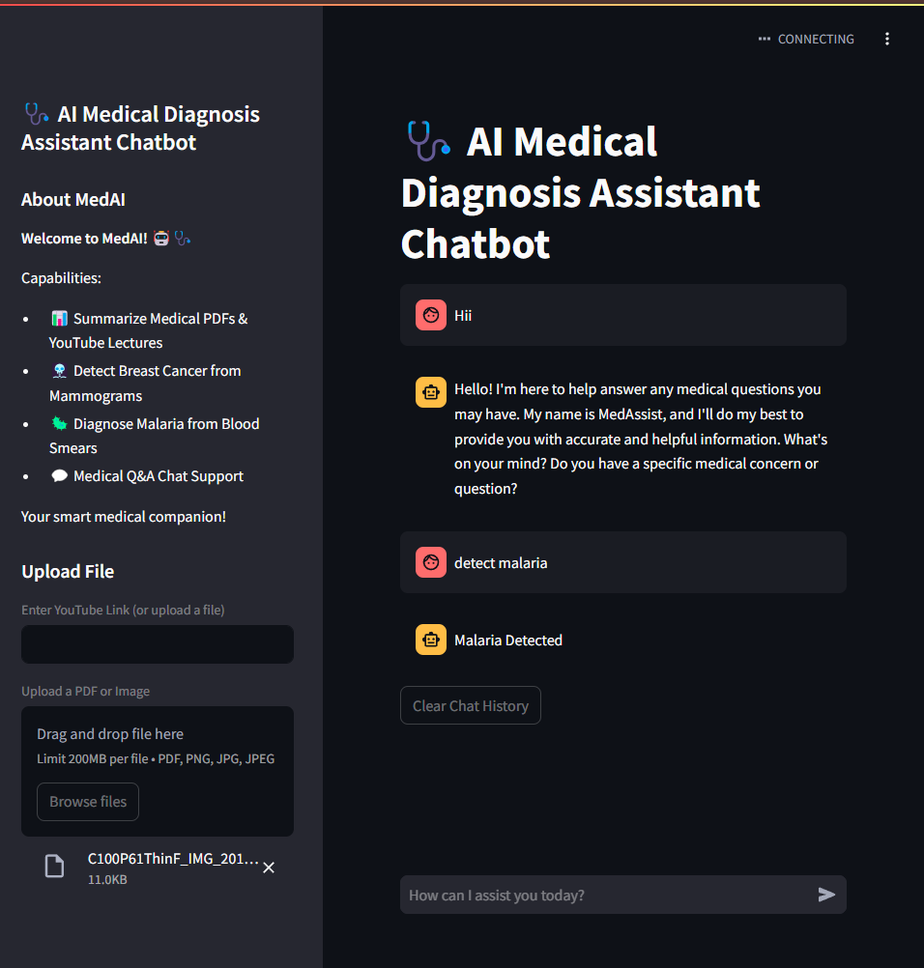
2024
TECHNICAL CHALLENGES
Integrating diverse AI models (for image processing and NLP) into a single cohesive application.
Real-time processing bottlenecks, especially with large PDFs and long YouTube videos.
Ensuring consistent model accuracy with varied image resolutions and data quality.
Page
07

Slide 9
2024
LIMITATIONS OF IMPLEMENTATION
Currently limited to detecting breast cancer and malaria; not designed for other diseases.
Reduced accuracy with low-resolution or poor-quality medical images.
Requires stable internet connectivity, especially for video-based summarization.
Page
08

Slide 10
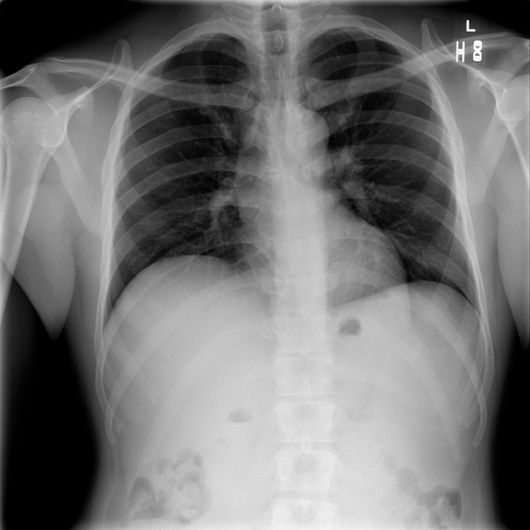
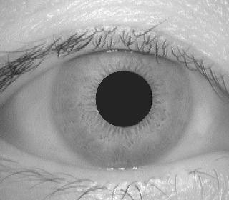
2024
FUTURE WORK
Expand the scope to detect additional diseases like pneumonia, diabetic retinopathy, etc.
Enhance OCR capabilities for better text extraction from scanned medical documents.
Develop an offline mode for use in resource-constrained or remote environments.
Introduce multilingual support to cater to a global audience.
Page
09

Slide 11
2024
CONCLUSION
Successfully created an AI-powered medical assistant that combines deep learning and NLP.
Demonstrated effective disease detection and document summarization capabilities.
Designed to support healthcare professionals with quick, accurate diagnostics.
Holds potential for broader applications in telemedicine, remote diagnostics, and healthcare automation.
Page
06

Slide 12
2024
REFERENCES
[1] Sharma, P.; Gaur, S.; Rathi, A.; Soni, P. "AI-Powered Malaria Detection from Microscopic Blood Smear Images Using Deep Learning Models
[2] John, P.; Kumar, S.; Choudhury, D. "Breast Cancer Detection Using Convolutional Neural Networks
[3] Vaswani, A.; Shazeer, N.; Parmar, N.; Uszkoreit, J.; Jones, L.; Gomez, A.; Kaiser, Ł.; Polosukhin, I. "Attention is All You Need,"
[4] Devlin, J.; Chang, M. W.; Lee, K.; Toutanova, K. "BART: Pre-training of Deep Bidirectional Transformers for Language Understanding,"
[5] Hinton, G.; Vinyals, O.; Dean, J. "Distilling the Knowledge in a Neural Network,"
Page
10

Slide 13
2024
Thank
You.
Get In Touch With Us
Page
10

