Slide 1
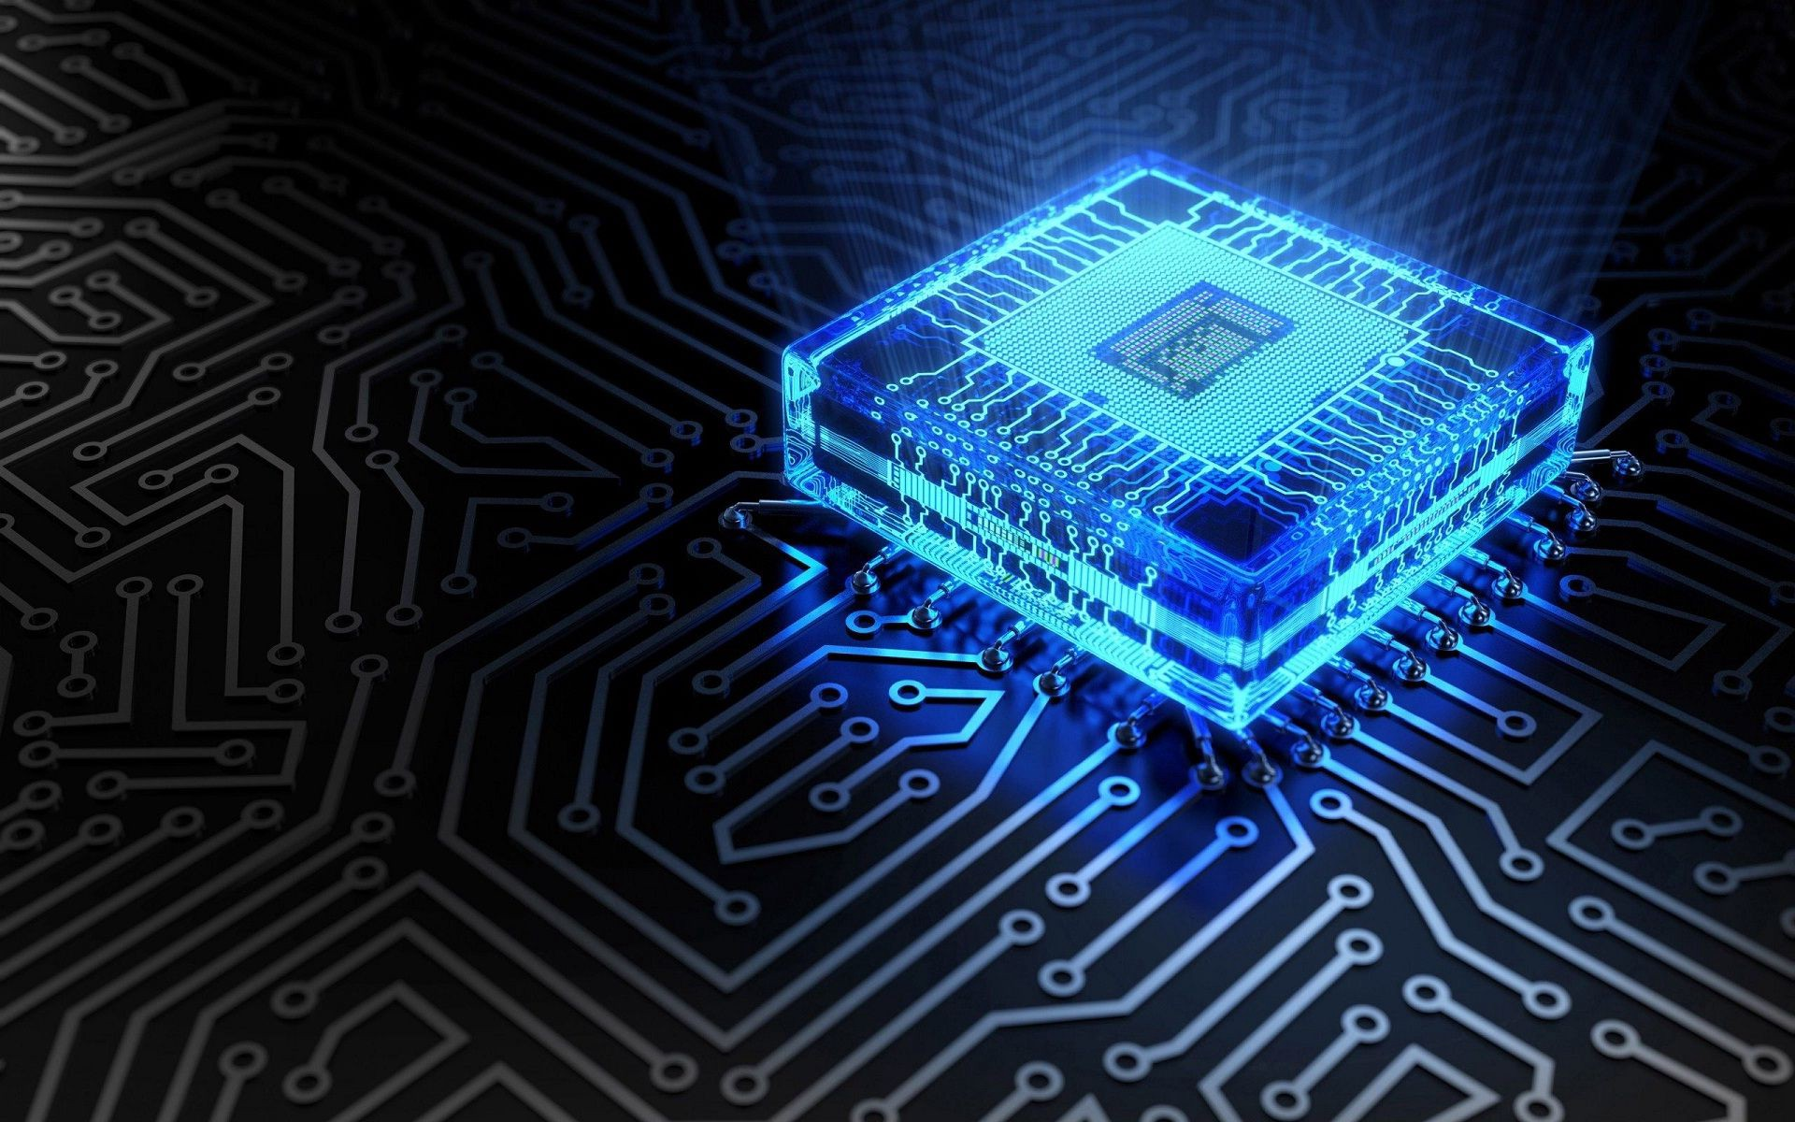
Error Detection:-

Slide 2
Q-munity HackQthon
Introduction
Aman Choudhari,
4th Year Mechanical Engineering Student
Harsh Kale,
4th year Integrated Mathematics Student

Slide 3
Q-munity HackQthon
Project Topic Introduction
There’s lot of research work going on in the Error Correction stretch of Quantum Computing.
What is the first step for doing Error Correction ?
Yes, It is Error Detection !!

Slide 4
Q-munity HackQthon
Project Topic
Error Detection :- 2-Qubit Checksum

Slide 5
Q-munity HackQthon
Why 2-Qubit Checksum??
During the data transmission errors can arise due to quantum noise and decoherence.
Signal Bit can get flip from ‘|0>’ to ‘|1>’.
Sign flip is another such error which arises due the inversion in sign.
It is the primary step in Error Correction to check whether error exist or not.
2-Qubit Checksum can easily detect such errors with less complexity.

Slide 6
Q-munity HackQthon
What is 2-Qubit Checksum ?
At sender side,
In 2-Qubit checksum , the data unit to be transmitted is divided into segments of 2 Qubits.
All the 2-Qubit segments are then added.
The result of the sum is then complemented using 1’s complement arithmetic.
The value so obtained is called as checksum.
The data along with the checksum value is transmitted to the receiver.

Slide 7
Q-munity HackQthon
The data along with the checksum value is transmitted to the receiver.
At receiver side,
In 2-Qubit checksum, the received data unit is again then divided into segments of
2-Qubits.
All the 2-Qubit segments are added along with the checksum value.
The value so obtained is complemented and the result is checked.

Slide 8
Q-munity HackQthon
Then, following two cases are possible-
Case-01: Result = 0
If the result is zero,
Receiver assumes that no error occurred in the data during the transmission.
Receiver accepts the data.
Case-02: Result ≠ 0
If the result is non-zero,
Receiver assumes that error occurred in the data during the transmission.
Receiver discards the data and asks the sender for retransmission.

Slide 9
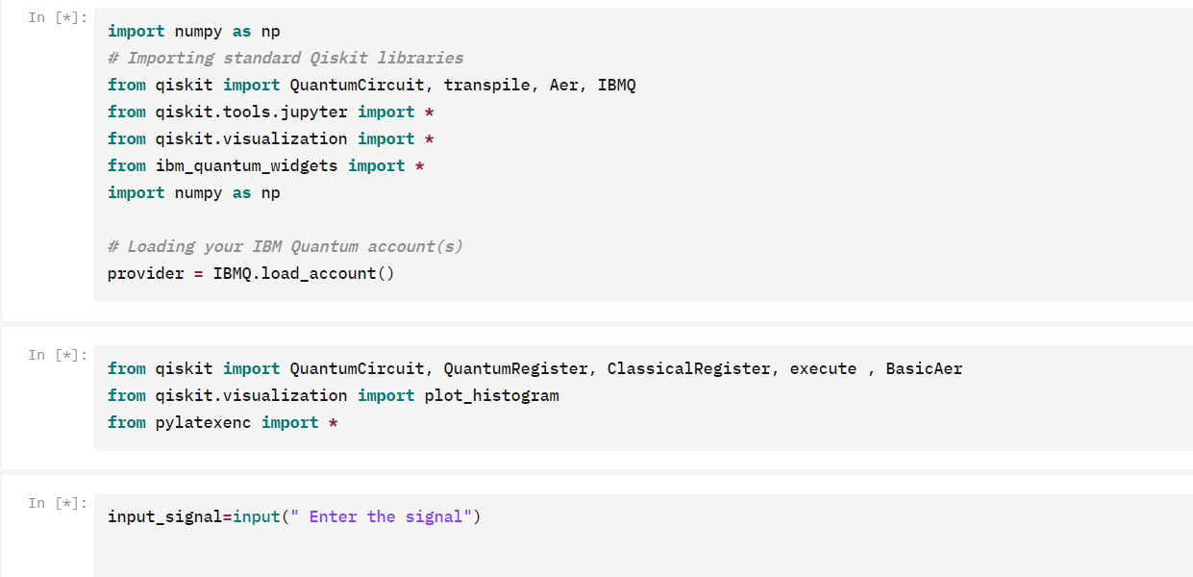
Q-munity HackQthon

Slide 10
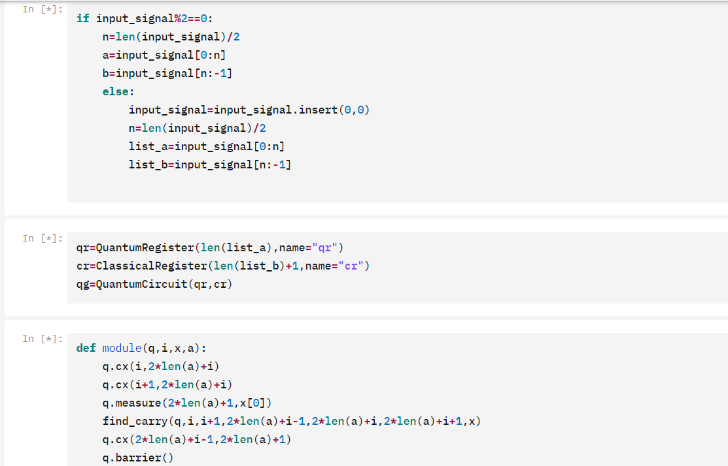
Q-munity HackQthon

Slide 11
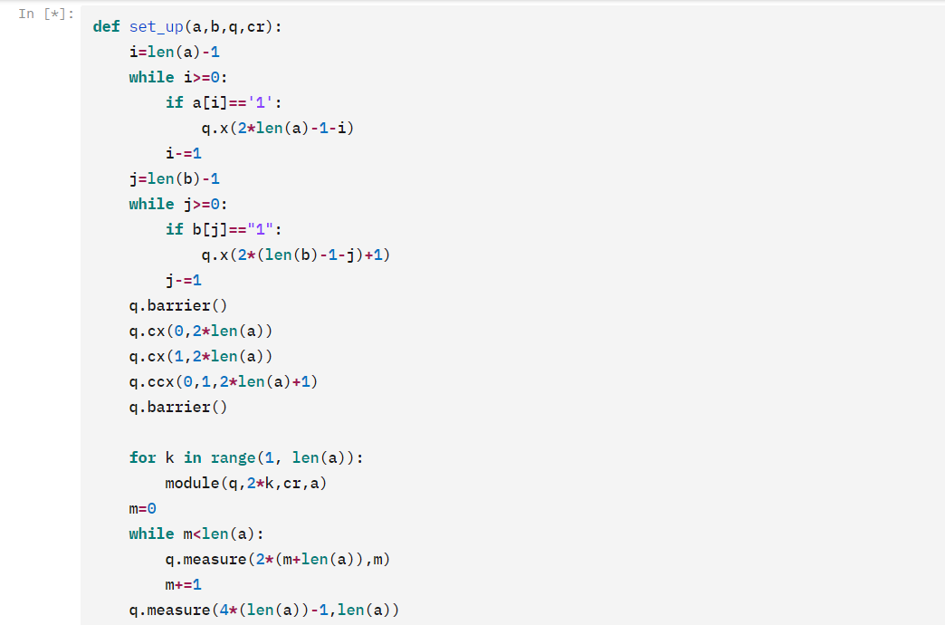
Q-munity HackQthon

Slide 12
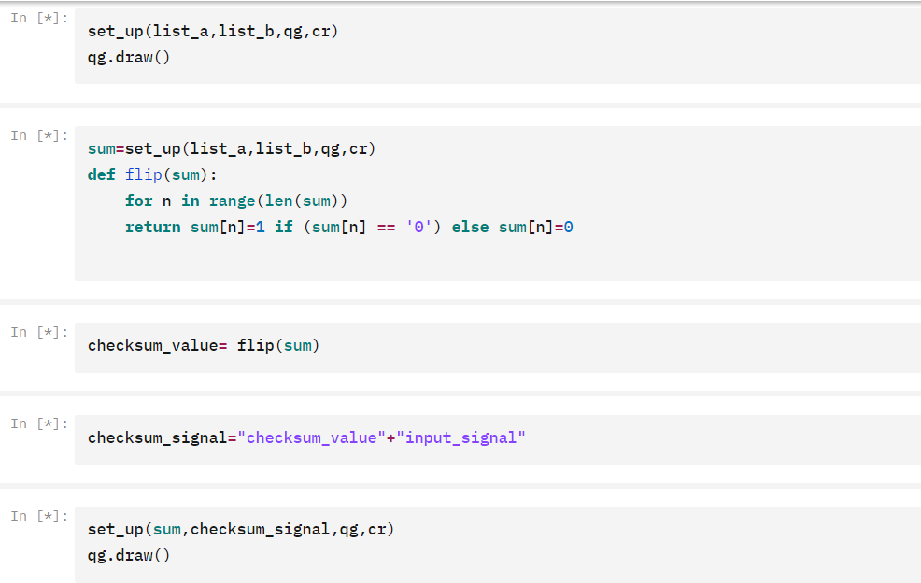
Q-munity HackQthon

Slide 13
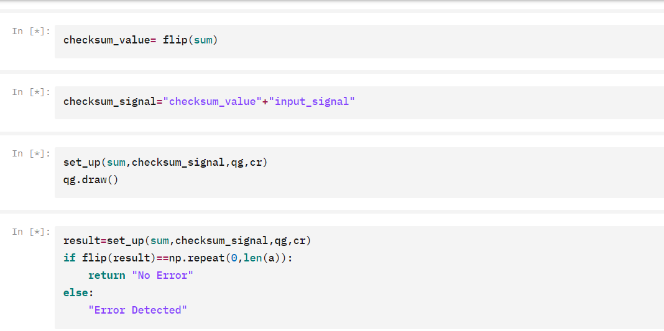
Q-munity HackQthon

Slide 14
Q-munity HackQthon
Thank You !!

