Slide 1
Homa
Data Center Transport Protocol
Presentation 2
Harsh Kapadia

Slide 2
Recap: Problems with TCP in the Data Center
Stream orientation
Connection orientation
Bandwidth sharing (Fair Scheduling)
Sender-driven Congestion Control
In-order packet delivery

Slide 3
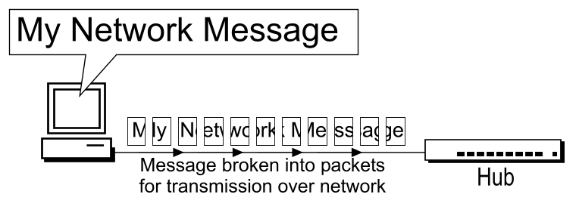
Recap: Message vs Packet

Slide 4
Recap: Homa Features
Message-oriented (RPCs)
Connectionless
Shortest Remaining Processing Time (SRPT) Scheduling
Receiver-driven Congestion Control
High out-of-order packet tolerance
No per-packet acknowledgements
At-least-once semantics

Slide 5
Recap: Sender vs Receiver
Client → Server
Sender: Client
Receiver: Server
Server → Receiver
Sender: Server
Receiver: Client

Slide 6
Homa Packet Types
DATA(rpc_id, data, offset, self_prio, m_len)
Sent by sender or receiver
Can ACK one RPC
GRANT(rpc_id, offset, exp_prio)
Sent by receiver
RESEND(rpc_id, offset, len, exp_prio)
Sent by receiver
UNKNOWN(rpc_id)
Sent by sender or receiver
BUSY(rpc_id)
Sent by sender
CUTOFFS(rpc_id, exp_unsched_prio)
Sent by receiver
ACK(rpc_id)
Sent by sender
Can ACK multiple RPCs
NEED_ACK(rpc_id)
Sent by receiver
FREEZE
BOGUS

Slide 7
Homa API
homa_send()
Send a request message to initiate a RPC.
homa_reply()
Send a response message for a RPC previously received.
homa_abort()
Terminate the execution of a RPC.

Slide 8
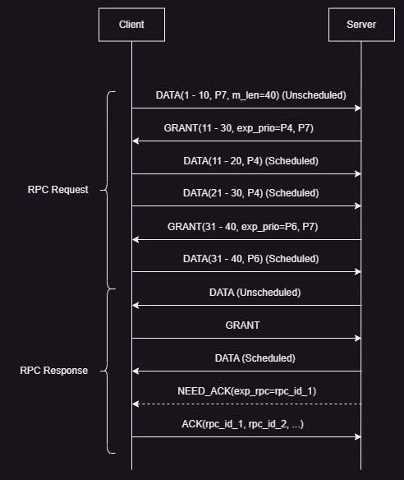
Homa Working
RPC Request, RPC Response
DATA, GRANT, ACK, NEED_ACK
Priority levels: P0 (lowest) to P7 (highest)

Slide 9
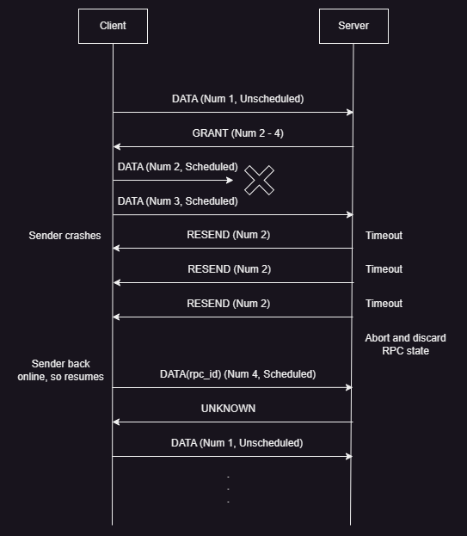
Homa Working
RPC Request
DATA, GRANT, RESEND, UNKNOWN

Slide 10
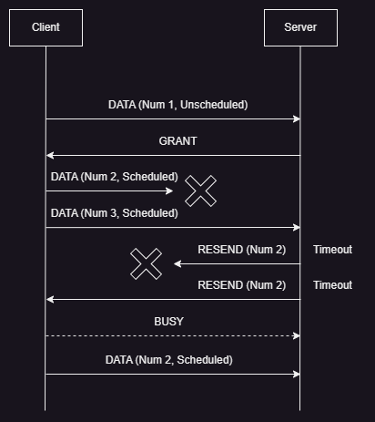
Homa Working
RPC Request
DATA, GRANT, RESEND, BUSY

Slide 11
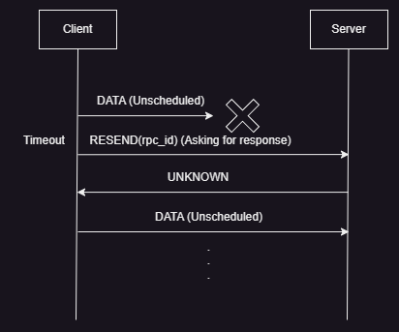
Homa Working
RPC Request
DATA, RESEND, UNKNOWN
Need to confirm this scenario

Slide 12
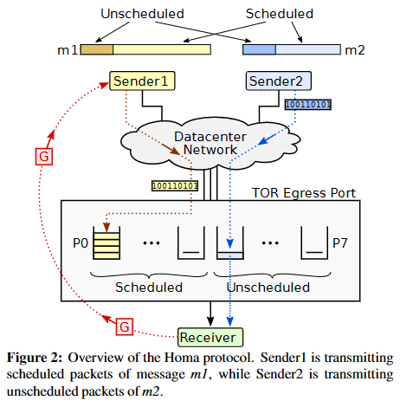
Recap: Homa Protocol Overview
On receiving message from top layer, sender blindly sends unscheduled portion
Sender can send further scheduled DATA packets only if receiver authorises through GRANT packet
GRANT usually requests for ‘RTT bytes’ worth outstanding data to keep transmission uninterrupted

Slide 13
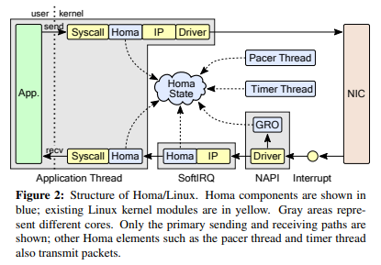
Homa Linux Architecture
Transmit (top): homa_send() → copy packets → TSO/GSO → Homa, IP layer → NIC
Receive (bottom): NIC (RSS) → Interrupt → NAPI (GRO, SoftIRQ core choosing) → SoftIRQ (network stack traversal) → copy packets → homa_recv()

Slide 14
Data Center TCP (DCTCP)
Makes use of Explicit Congestion Notification (ECN) to calculate how many bytes were affected and slows down based on that, rather than the fixed backoff that generic versions of TCP (Reno, CUBIC, etc.) have.

Slide 15
Experimentation Problems
I was not able to get GENI TCP throughput above 100 Mbps.
Need ~25 Gbps
CloudLab
I was not able to build the Homa module due to missing Linux kernel header files in Ubuntu 18.04 and 20.04 images on GENI.
Needs latest Ubuntu releases
Ubuntu 22.04 LTS image was not available on GENI
Broke multiple VMs trying to upgrade
Using CloudLab could solve problems

Slide 16
Tentative Future Plans
Set up CloudLab environment
Build Homa module
Understand Homa module experiments and scripts
Conduct Homa experiments
Wireshark analysis of Homa
Homa module code dive
Try to form algorithm
Try to make state machine

Slide 17
Resources
networking.harshkapadia.me/homa

Slide 18
Thank you!

