Slide 1
Homa
Data Center Transport Protocol
Presentation 3
Harsh Kapadia

Slide 2
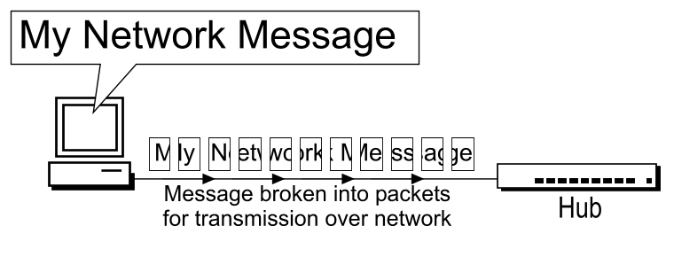
Recap: Message vs Packet

Slide 3
Recap: Homa Features
Message-oriented (RPCs)
Connectionless
Shortest Remaining Processing Time (SRPT) Scheduling
Receiver-driven Congestion Control
High out-of-order packet tolerance
No per-packet acknowledgements
At-least-once semantics

Slide 4
Recap: Sender vs Receiver
Client → Server
Sender: Client
Receiver: Server
Server → Receiver
Sender: Server
Receiver: Client

Slide 5
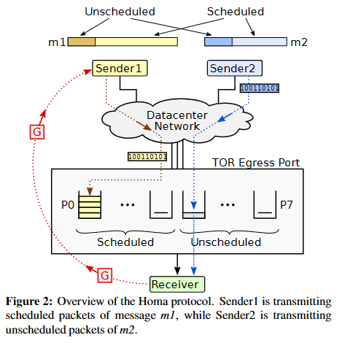
Recap: Homa Protocol Overview
On receiving message from top layer, sender blindly sends unscheduled portion
Sender can send further scheduled DATA packets only if receiver authorises through GRANT packet
GRANT usually requests for ‘RTT bytes’ worth outstanding data to keep transmission uninterrupted

Slide 6
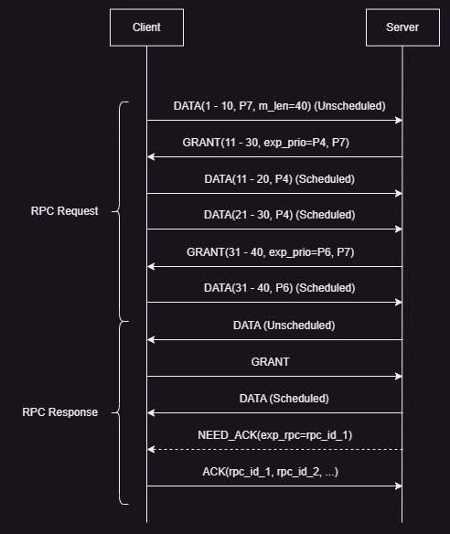
Recap: Homa Working
RPC Request, RPC Response
DATA, GRANT, ACK, NEED_ACK
Priority levels: P0 (lowest) to P7 (highest)

Slide 7
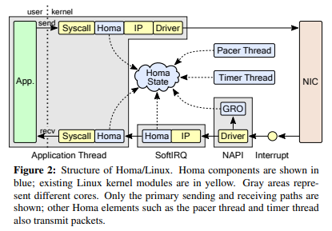
Recap: Homa Linux Architecture
Transmit (top): homa_send() → copy packets → TSO/GSO → Homa, IP layer → NIC
Receive (bottom): NIC (RSS) → Interrupt → NAPI (GRO, SoftIRQ core choosing) → SoftIRQ (network stack traversal) → copy packets → homa_recv()

Slide 8
Homa Algorithms
Sorting RPCs and Peers
Calculating Scheduled Priorities
Calculating Unscheduled Priorities
Calculating rtt_bytes
Calculating GRANT Offset
Calculating Unscheduled Bytes Offset

Slide 9
Homa Algorithms
Sorting RPCs and Peers
Calculating Scheduled Priorities
Calculating Unscheduled Priorities
Calculating rtt_bytes
Calculating GRANT Offset
Calculating Unscheduled Bytes Offset

Slide 10
Sorting RPCs and Peers
homa_state → grantable_peers
peer → grantable_rpcs
Sorting precedence for RPCs and peers
bytes_remaning
birth_time
bytes_remaining ↓ ⇒ priority ↑
birth_time ↓ (older) ⇒ priority ↑ (Tie-breaker mechanism)
Sorting order
RPCs
Peers

Slide 11
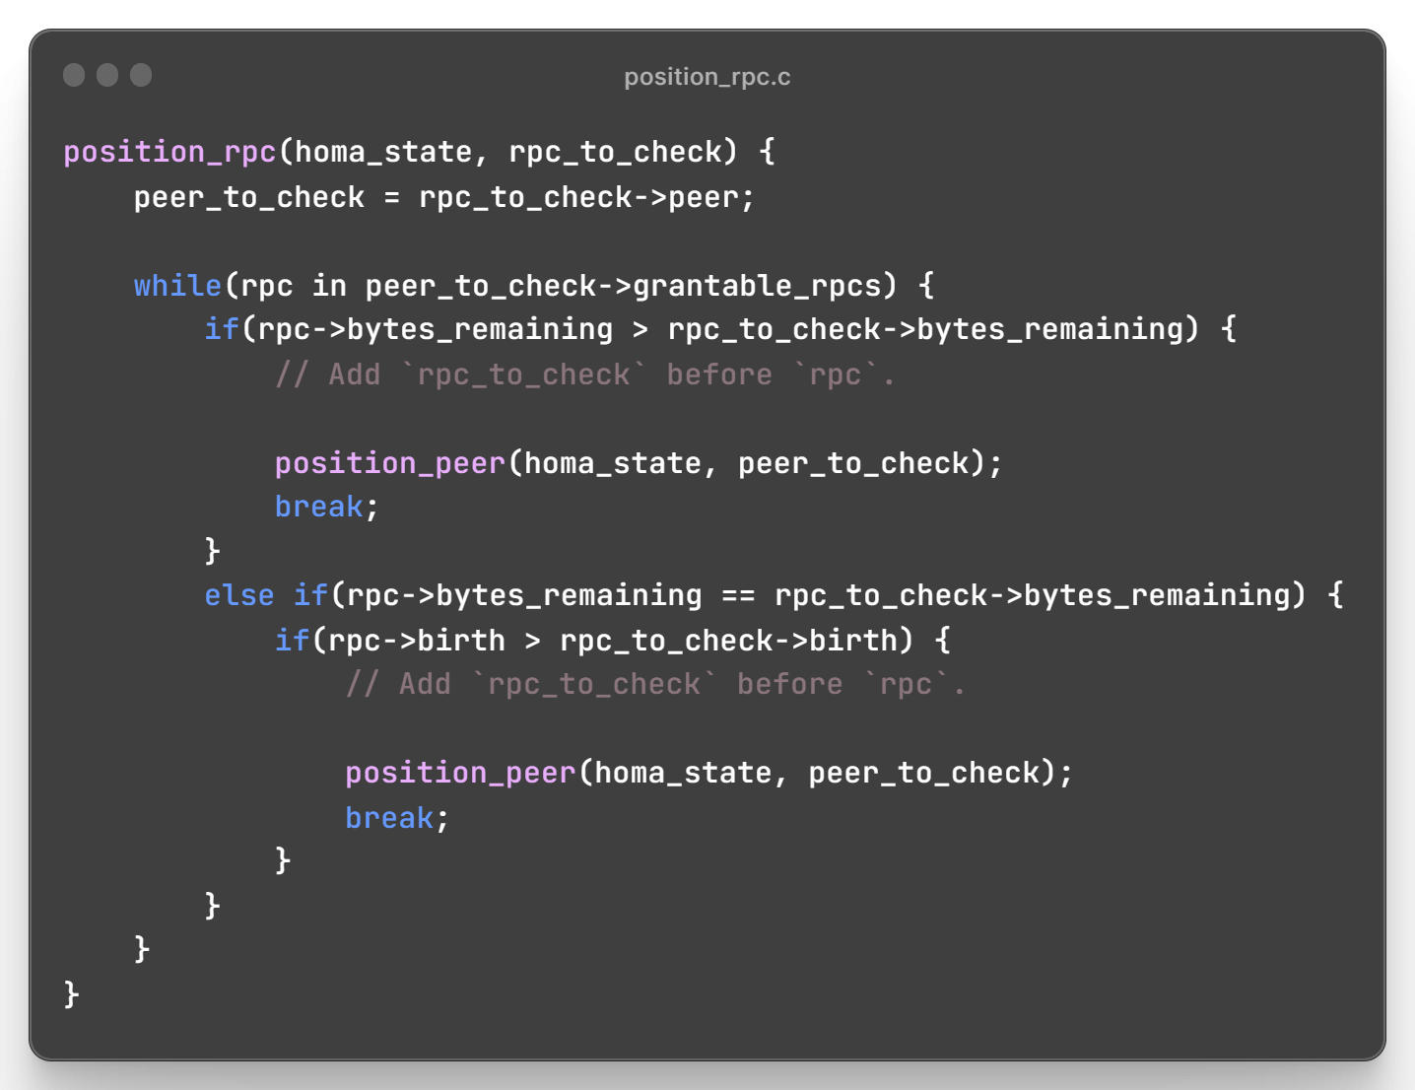

Slide 12
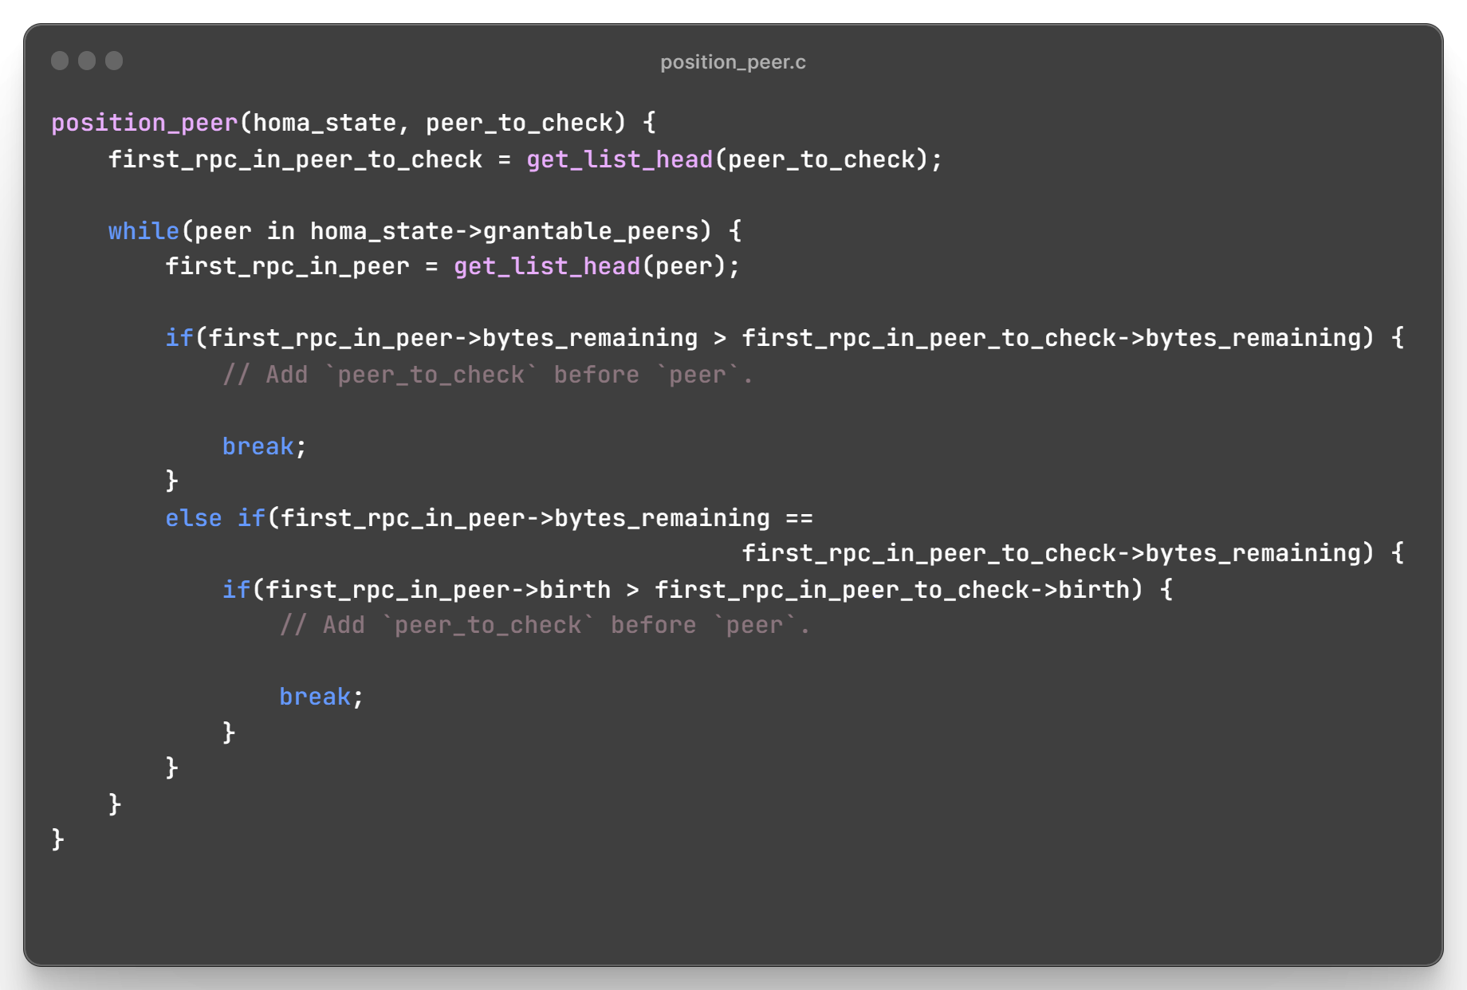

Slide 13
RPC and Peer Sorting Timing
homa_softirq()
homa_pkt_dispatch()
homa_data_pkt()
homa_check_grantable()
Contains sorting logic

Slide 14
Homa Algorithms
Sorting RPCs and Peers
Calculating Scheduled Priorities
Calculating Unscheduled Priorities
Calculating rtt_bytes
Calculating GRANT Offset
Calculating Unscheduled Bytes Offset

Slide 15
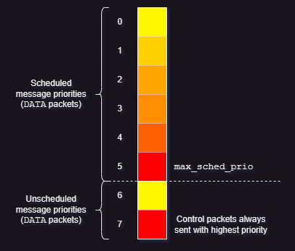
Calculating Scheduled Priorities
Eight default priority levels: 0 (lowest) to 7 (highest)
max_sched_prio splits levels between scheduled and unscheduled message (DATA packet) priorities
Message length ↓ ⇒ Priority ↑
Example:
Levels: 0 to 7
max_sched_prio = 5
⇒ Sched prio levels = 0 to 5 (both inclusive)
⇒ Unsched prio levels = 6 and 7
To accommodate higher priority messages for SRPT, Homa assigns lowest possible priority to each RPC
Calculated individually for first RPC of every grantable peer
Only first RPC of every grantable peer is granted

Slide 16
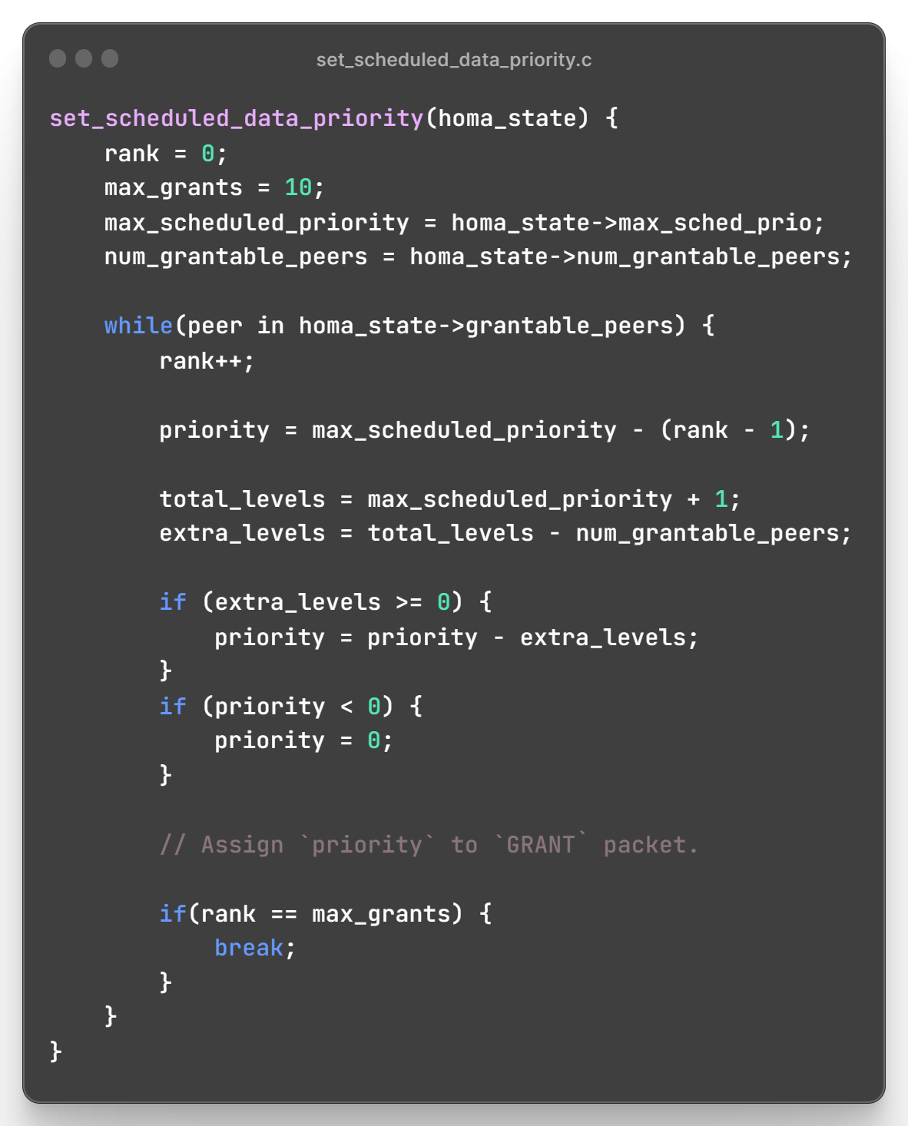

Slide 17
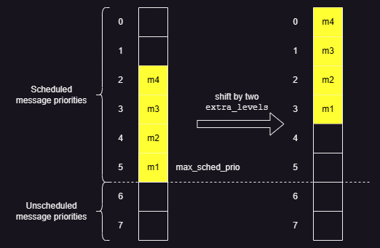
Lowest Priority Assignment

Slide 18
Scheduled Priority Calculation Timing
homa_rpc_free()
homa_rpc_abort()
Alt. title: ‘GRANT Packet Transmission Timing’
max_sched_prio set by unsched_cutoffs array
More info. in slides ahead
Same function call tree for GRANT offset calculation
More info. in slides ahead
homa_remove_from_grantable()
Contains sorting logic
homa_softirq()
homa_send_grants()
Contains scheduled priority calculation logic
(and GRANT offset calculation logic)

Slide 19
Homa Algorithms
Sorting RPCs and Peers
Calculating Scheduled Priorities
Calculating Unscheduled Priorities
Calculating rtt_bytes
Calculating GRANT Offset
Calculating Unscheduled Bytes Offset

Slide 20
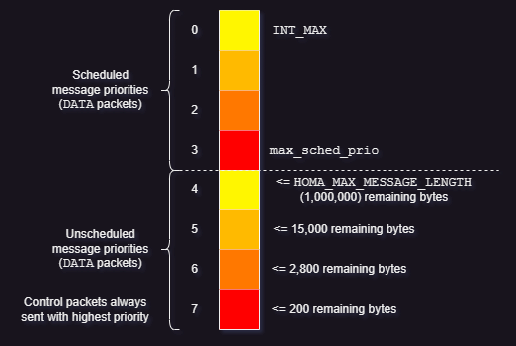
Calculating Unscheduled Priorities
Decided by unsched_cutoffs array
Statically defined values for unscheduled messages (DATA packets)
Control packets always sent at highest priority level
max_sched_prio = HOMA_MAX_MESSAGE_LENGTH - 1
unsched_cutoffs array initialization
cutoff_version = 1

Slide 21
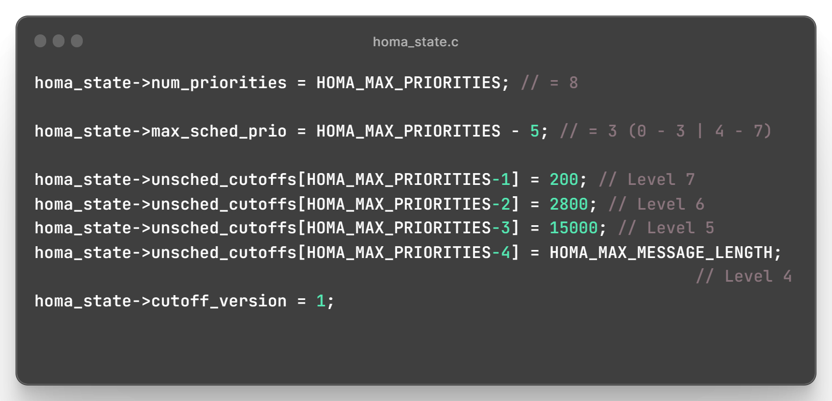
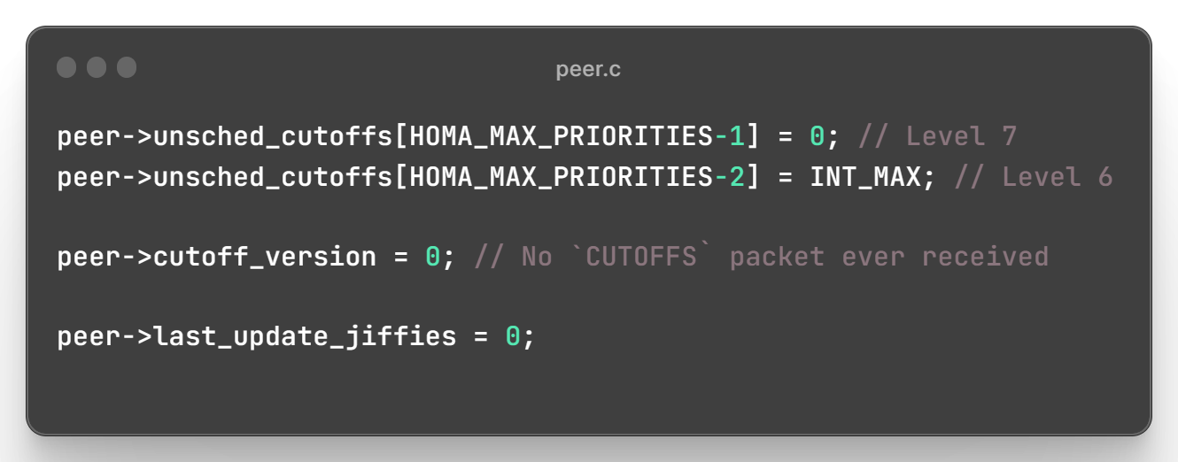
Cutoffs Initialization
Receiver: Incoming DATA packet cutoff_version is checked with homa_state->cutoff_version
Sender: Outgoing DATA packet cutoff_version is added from peer->cutoff_version
(Every receiver will have a different priority, so each peer structure on sender has to track its receiver data.)

Slide 22
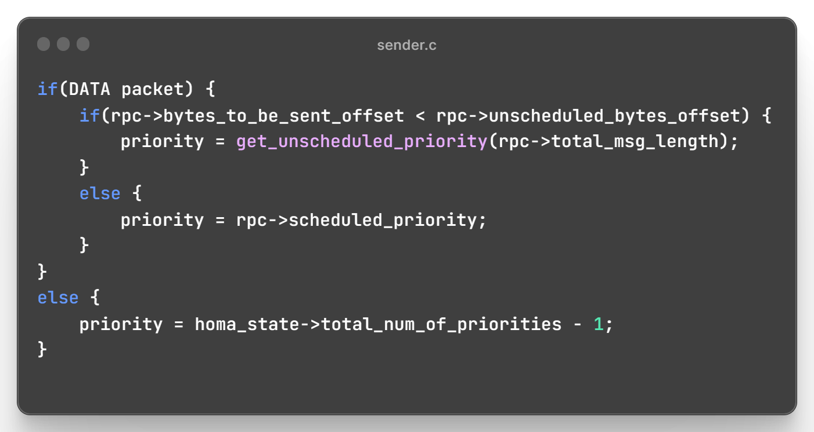
Sending DATA Packets
Initialized cutoff_version = 0 will cause a mismatch with receiver, which is initialized with cutoff_version = 1.
Version mismatch causes receiver to send CUTOFFS packet.
More info. on next slide.

Slide 23
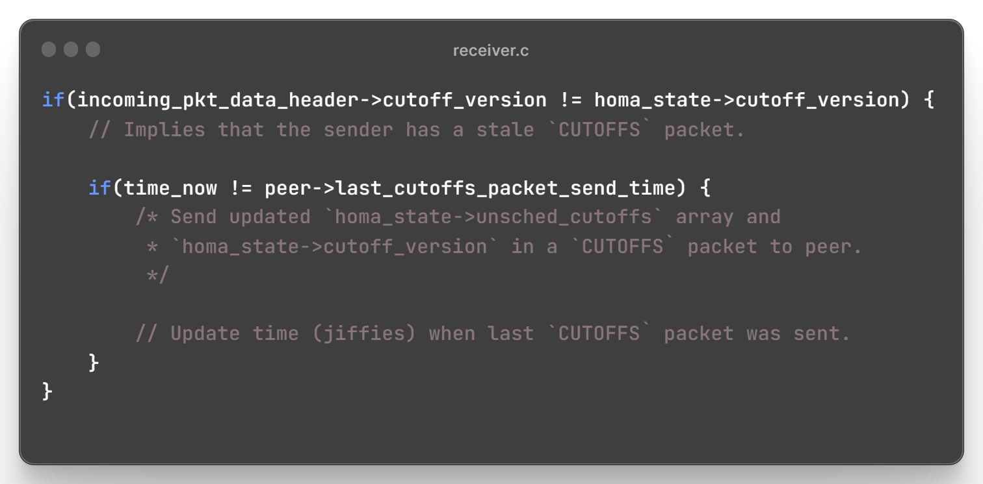
Receiving DATA Packets
Receiver will always have latest cutoff_version as it is the driver of communication and it updates priorities.
Time (unit: Jiffies) is checked to not send multiple CUTOFFS packets to same sender when packets are continuously arriving

Slide 24
Homa Algorithms
Sorting RPCs and Peers
Calculating Scheduled Priorities
Calculating Unscheduled Priorities
Calculating rtt_bytes
Calculating GRANT Offset
Calculating Unscheduled Bytes Offset

Slide 25
Calculating rtt_bytes
Helps in keeping link utilization ~100%
Unfortunately, currently a static config. parameter in receiver for all its peers
Should ideally be frequently dynamically calculated per peer by receiver

Slide 26
Homa Algorithms
Sorting RPCs and Peers
Calculating Scheduled Priorities
Calculating Unscheduled Priorities
Calculating rtt_bytes
Calculating GRANT Offset
Calculating Unscheduled Bytes Offset

Slide 27
Calculating GRANT Offset
Offset indicates permission to send bytes up to a particular bytes
offset ≤ total_msg_length
Optimal amount of newly granted data: rtt_bytes
Helps to keep link utilization ~100%
Example (At sender)
Total message length = 100
Sent data offset = 20
GRANT offset received = 45
⇒ Data sent = bytes 21 to 45 (should be ~rtt_bytes)

Slide 28
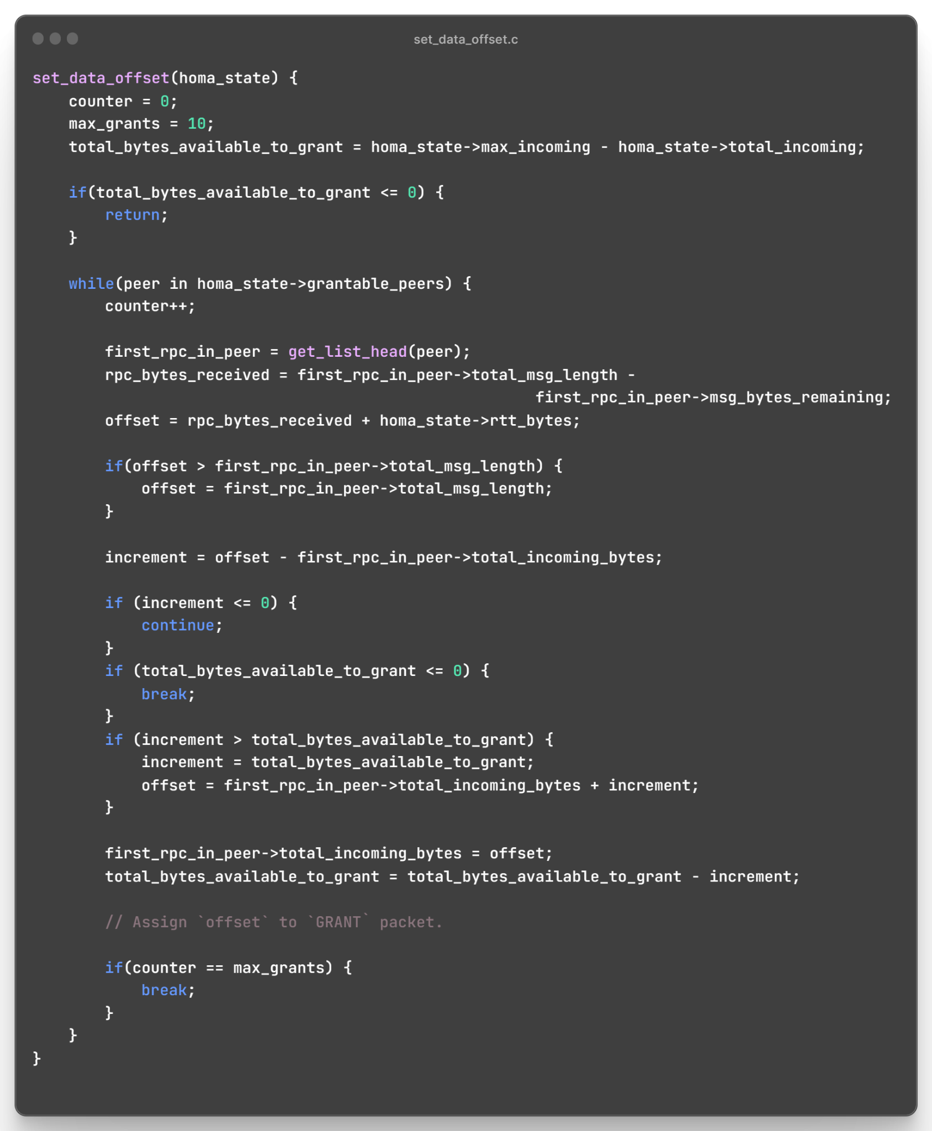
continued…

Slide 29
…continued

Slide 30
GRANT Offset Calculation Timing
homa_rpc_free()
homa_rpc_abort()
Alt. title: ‘GRANT Packet Transmission Timing’
max_sched_prio set by unsched_cutoffs array
More info. in slides ahead
Same function call tree for Scheduled Priority Calculation
As already seen in slides before
homa_remove_from_grantable()
Contains sorting logic
homa_softirq()
homa_send_grants()
Contains GRANT offset calculation logic
(and scheduled priority calculation logic)

Slide 31
Homa Algorithms
Sorting RPCs and Peers
Calculating Scheduled Priorities
Calculating Unscheduled Priorities
Calculating rtt_bytes
Calculating GRANT Offset
Calculating Unscheduled Bytes Offset

Slide 32
Calculating Unscheduled Bytes Offset
Calculated at sender
Example (At sender)
Total message length = 100
Calculated unschedules bytes offset = 20
⇒ Data sent = bytes 1 to 20 (should at least be ~rtt_bytes)
Rationale behind formula to decide unscheduled bytes offset not clear

Slide 33
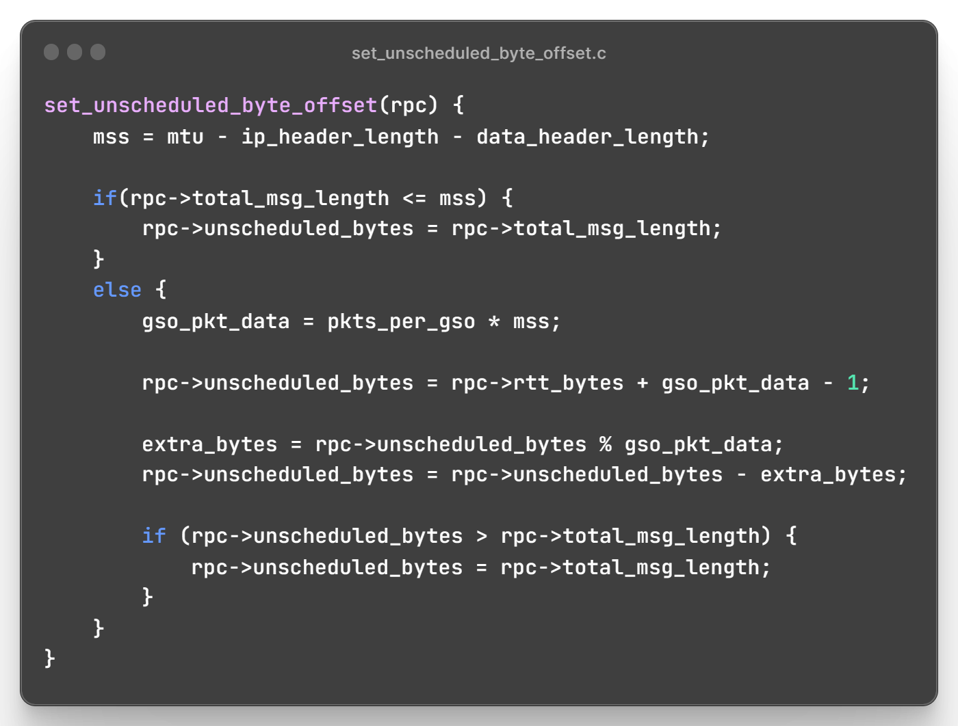

Slide 34
Unscheduled Bytes Offset Calculation Timing
homa_sendmsg()
Caller?
homa_message_out_init()
Contains unscheduled bytes offset calculation logic

Slide 35
Recap: Homa Algorithms
Sorting RPCs and Peers
Calculating Scheduled Priorities
Calculating Unscheduled Priorities
Calculating rtt_bytes
Calculating GRANT Offset
Calculating Unscheduled Bytes Offset

Slide 36
Things That Did Not Work Out
Building Homa module
Multiple errors that could not be debugged
Will have to ask Prof. Ousterhout for help
Setting up CloudLab environment
Sign in successful
Allocating exact infrastructure with Switch control tricky
HomaModule GitHub repo does not have sufficient instructions to set up environment

Slide 37
Tentative Future Plans
Ask Prof. Ousterhout for help
Set up CloudLab environment
Build Homa module
Conduct Homa experiments

Slide 38
Resources
Homa: networking.harshkapadia.me/homa
Code image generator: ray.so
Array diagrams: draw.io

Slide 39
Thank you!

