Slide 1
USED CAR PRICE PREDICTION
Garima Kakwani-2003078
Viren Kalra-2003079
Harsh Kasliwal-2003085
Supervisor: Prof. Manisha Dumbre

Slide 2
INTRODUCTION
The focus of this project is developing machine learning models that can accurately estimate the price of a used car based on its features, in order to make informed purchases.
A user interface has been developed that gets input from any user and will display the price of the car according to user inputs.
Depending on the various parameters we determine the price of the car.
Page 02 of 15

Slide 3
Objective:
To develop an efficient and effective model which predicts the price of a used car according to user’s inputs.
To achieve good accuracy.
To develop a User Interface (UI) that is user-friendly and takes input from the user and predicts the price.
Page 03 of 15

Slide 4
Literature Survey
YEAR | NAME OF THE PAPER | CONTENT
2014 | Predicting the price of used cars using machine learning techniques. | Different Techniques like multiple linear regression analysis, k-nearest neighbors, naive bayes and decision trees have been used to make the predictions. The predictions are then evaluated and compared in order to find those which provide the best performances.
2019 | Car price prediction using machine learning techniques | The car price is categorized into three groups: Cheap, moderate and expensive,. This done using SVM(Support Vector Machine) and Random Forest.
2017 | Price evaluation model in second hand car system | They used neural network model to predict the price of a second hand and used car
Page 04 of 15

Slide 5
Problem Statement
Making a web application that will predict the price of a used Car by taking its Company name, Model name, Year of Purchase, and other parameters.
Page 05 of 15

Slide 6
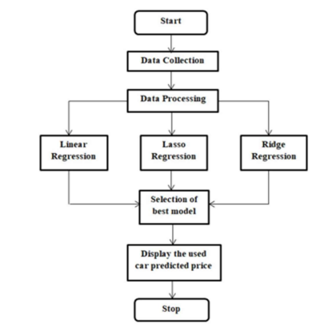
Proposed System Architecture
(Flow Chart)
Page 06 of 15

Slide 7
Algorithm Used
We will use two algorithms in our project which are Linear Regression and Lasso Regression, respectively. A detail explanation of the Algorithms which are used in this project is given below:
Page 07 of 15

Slide 8
Linear Regression:
Linear Regression is a statistical method that’s used for predictive analysis.
A simple Linear regression algorithm shows a linear relationship between a dependent (y) and one or more independent (x) variables, therefore called linear regression.
Since linear regression shows the linear relationship, which suggests it finds how the value of the dependent variable is changing with respect to the value of the independent variable.
The Formula for Simple Linear Regression is, y= a0+a1x+ ε

Slide 9
Lasso Regression:
Least Absolute and Selection Operator(Lasso) regression is another regularization technique to minimize the complexity of the model.
It’s almost like the Ridge Regression except that the penalty term contains only the absolute weights rather than the square of weights. Since it takes absolute values, hence, it can shrink the slope to 0. whereas Ridge Regression can only shrink it just about to 0.
The equation for the cost function of Lasso regression will be: 𝑖=1 𝑀 ∑ (𝑦𝑖 − 𝑦'𝑖) 2 = 𝑖=0 𝑀 ∑ (𝑦𝑖 − 𝑗=0 𝑛 ∑ β𝑗 * 𝑥𝑖𝑗) 2 + λ 𝑖=0 𝑛 ∑ |β𝑗|

Slide 10
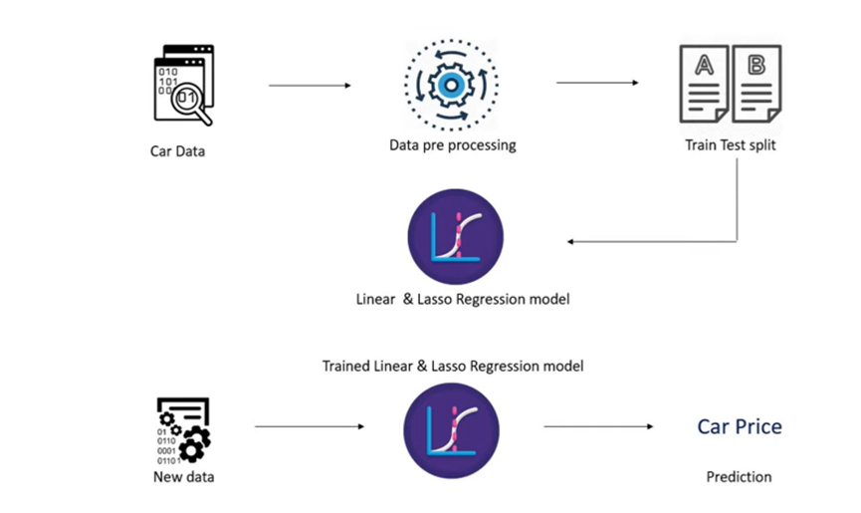
WORKFLOW

Slide 11
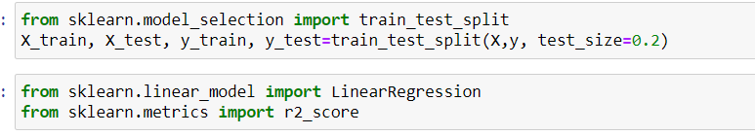
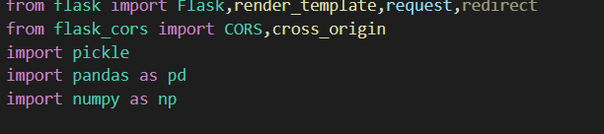
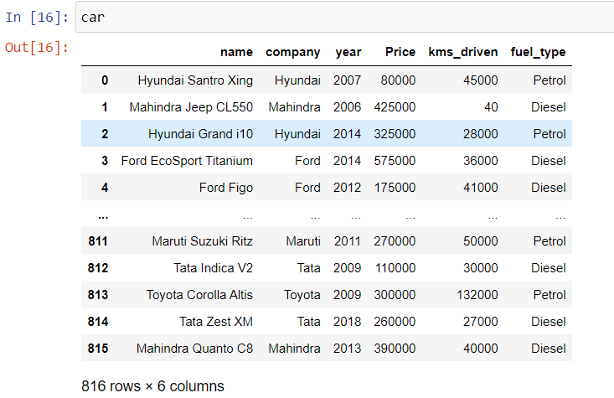
Implementation

Slide 12
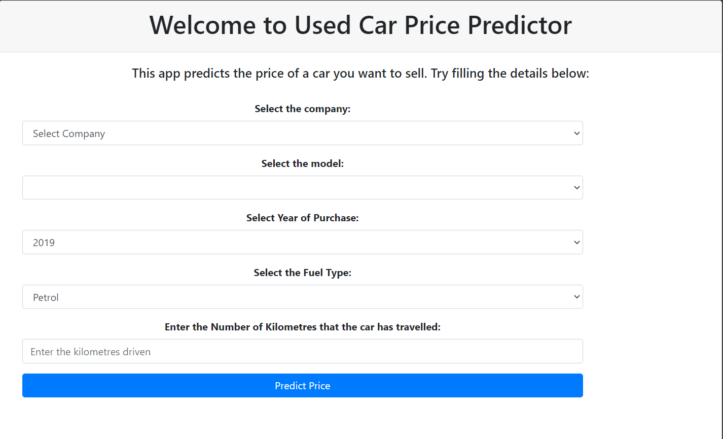

Slide 13
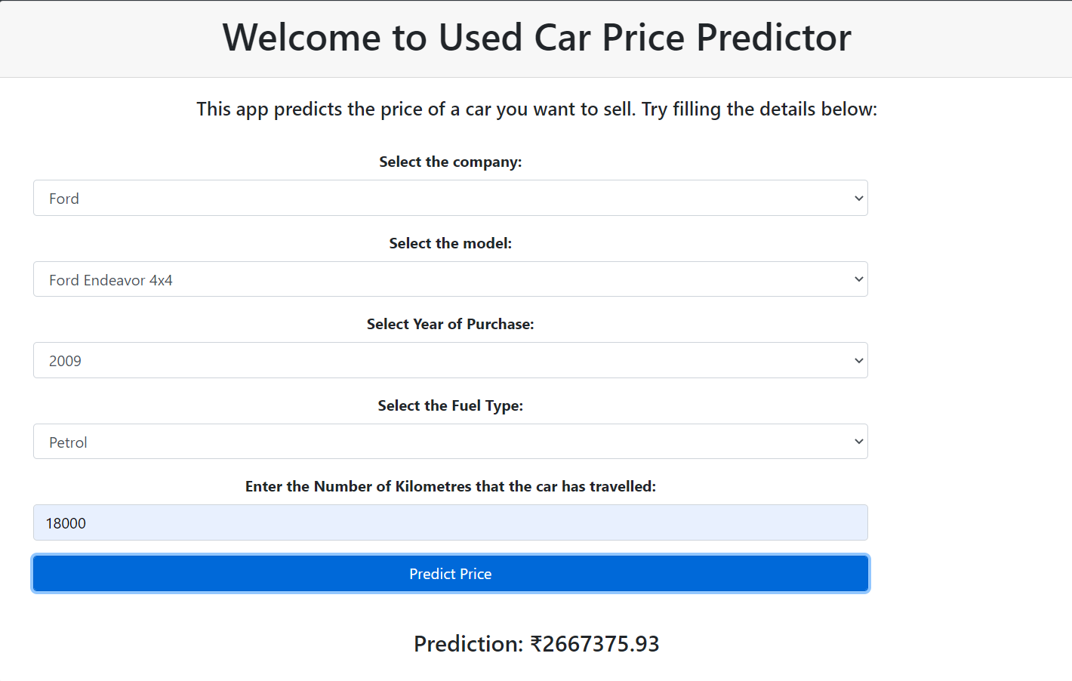

Slide 14
Reference
[1] Sameerchand Pudaruth, “Predicting the Price of Used Cars using Machine
Learning Techniques” ;(IJICT 2014) Accessed: Sep. 5, 2022 [Online] Available:
http://ripublication.com/irph/ijict_spl/ijictv4n7spl_17.pdf
[2] Enis gegic, Becir Isakovic, Dino Keco, Zerina Masetic, Jasmin Kevric, ”Car Price
Prediction Using Machine Learning”; (TEM Journal 2019) Accessed: Sep. 5, 2022
[Online].Available:https://www.temjournal.com/content/81/TEMJournalFebruary2019
_113_118.pdf
[3] Nitis Monburinon, Prajak Chertchom, Thongchai Kaewkiriya, Suwat Rungpheung,
Sabir Buya, Pitchayakit Boonpou, “Prediction of Prices for Used Car by using
Regression Models” (ICBIR 2018) Accessed: Sep. 21, 2022 [Online]. Available:
https://www.researchgate.net/publication/325910184_Prediction_of_prices_for_used_
car_by_using_regression_models

