Slide 1

SIP@SAIDE
Using Machine Learning for SARS-CoV-2 cure
Harsh Khandelwal
National Institute of Technology, Tiruchirappalli
Supervisor
Dr. Manish Aggarwal

Slide 2

Introduction
The whole world is facing a crisis, which is caused by a virus SARS-CoV-2. This virus is a member of SARS family. The viruses from this family can only be cured by blocking the active cites around their surface. In recent years there was a great development in Machine Learning and in Bio-Technology. We tried to use a famous Multi-Objective genetic algorithm named NSGA-II. We targeted to use this algorithm for drug discovery with a unique and effective modification in original algorithm with the help of Autoencoders for generation of more impactful cure.

Slide 3
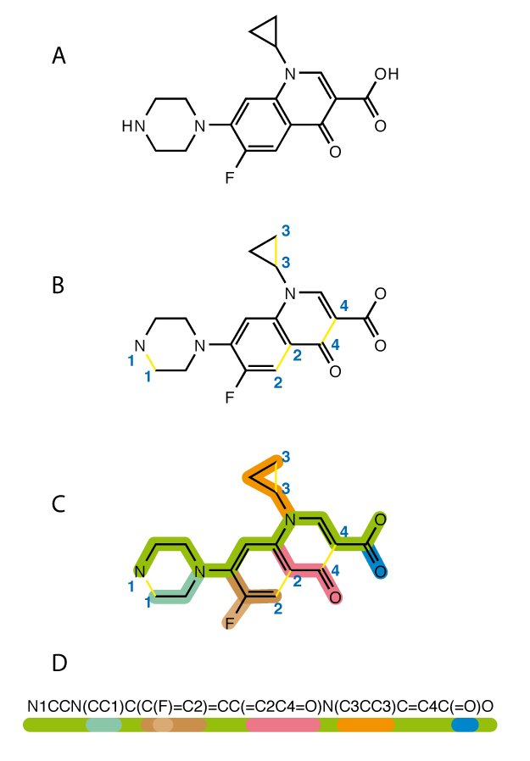
SMILES
SMILES (Simplified Molecular Input Line Entry System) is a type of chemical notation that allows a user to represent a chemical structure in a computer-readable format. SMILES is a flexible and easy-to-learn notation. SMILES is a string created by publishing the symbol nodes discovered in a chemical graph's depth-first tree traversal. To make a spanning tree, the chemical graph is first trimmed to remove hydrogen atoms and cycles are broken. Numeric suffix labels are added where cycles have been broken to indicate the related nodes. The tree's branching points are indicated by parentheses.

Slide 4
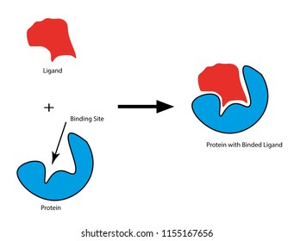
Protease Inhibition
It’s a process of blocking the active sites of a protease. The ligand will bind to the active site of the protease and preventing that active site to bind to other vital parts of our body. Which makes that protease harmless to us although its not destroyed but can't attack either. In order to make this possible we have to find a ligand which binds the site properly.

Slide 5
Objectives
Our objective here to find a drug or a ligand that could satisfy the conditions below:
Binding Affinity with SARS-CoV-2
Toxicity
Synthesis
Natural Product likeliness
Quantitative estimation of drug discovery

Slide 6
OBJECTIVES
Synthetic Accessibility: This scoring function allows us to get an estimate of the efforts required to synthesize the ligand. Since we want to mass produce the drug we will be able to decide which drug would be economically best fit for the nation.
Toxicity Estimation: We used the PAINS filter which is used to estimate the toxicity of the drug to human body.
Natural Product Likeness (NP): This scoring function tells how our drug is similar to the natural compounds which are produced naturally. In this way we can have a hold on the natural balance of our body. Since we are used to consume the products which are naturally available, therefore if the drug is having a good NP score implies that our body wouldn’t have a problem to consume it.
Quantitative Estimate of Drug-likeness: The QED is based on a method for multiparameter optimization known as ‘desirability functions’. This scoring function tells us whether a molecule can be used as drug. It uses Lipinski’s rule of five, which includes physiochemical properties of molecules such as size, how often its used, etc.

Slide 7
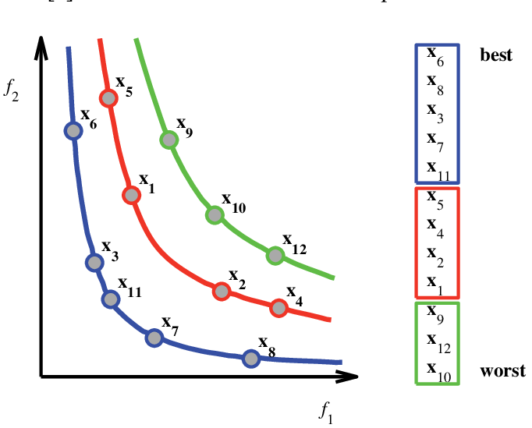
NON-Dominated sorting
This sorting technique tries to sort the values according to the score values. The datapoints more near to origin are considered the best as compared to the farthest points. A point ‘A’ dominates point ‘B’ if and only if all score values of ‘A’ are lesser than that of ‘B’. Hence point ‘A’ is considered better than ‘B’.

Slide 8
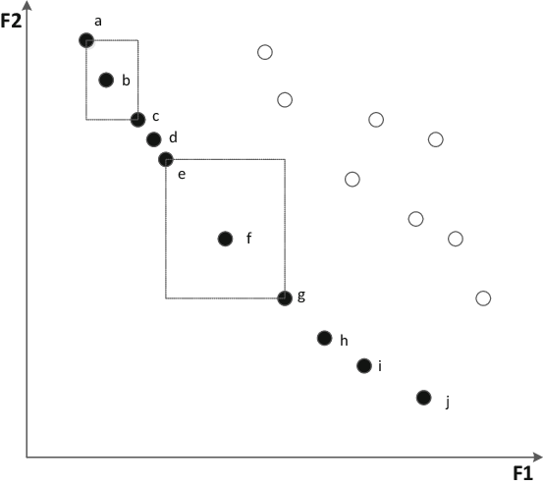
Crowding distance sorting
This sorting technique is used across the fronts created by non dominated sorting. We compute the crowding distance for each node which simply implies how spaced it is from others. Data points with less crowding distance are considered better than other points in the same front.

Slide 9
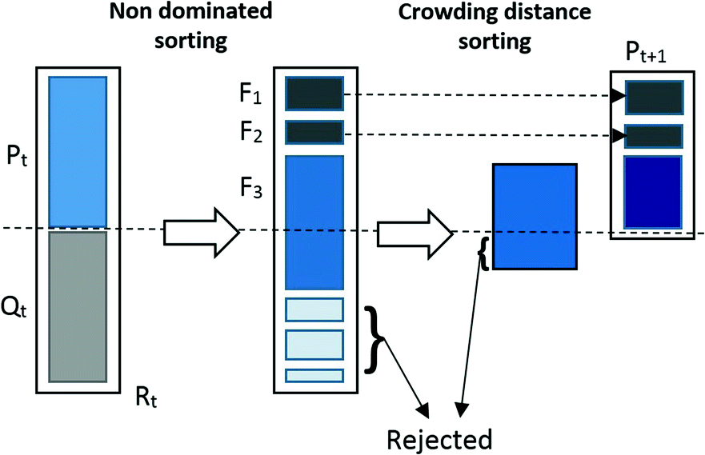
NSGA-II
NSGA-II is a Multi-Objective genetic algorithm, which is an advancement over NSGA. In this algorithm we try to find the best candidates who satisfy our conditions. This algorithm starts with initial space of candidates and sort them according to their score values with the help of NON-Domination sorting and Crowding distance sorting. After which we try to change the candidates in order to improve scores this step is called mutation. Once we have the new set of candidates, we append them with old candidates and sort them again, but this time we will discard the worst candidates according to our requirements. This step goes on repeatedly until we achieve our desired candidates.

Slide 10
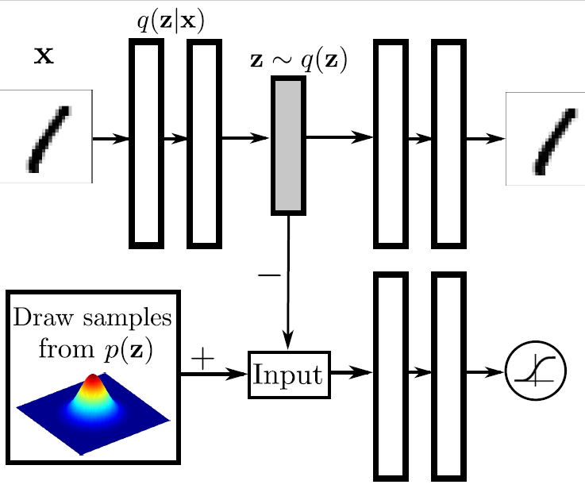
Adversarial Autoencoders
This is a probabilistic autoencoder that uses Generative adversarial networks (GANs) and Variational autoencoders (VAEs). In this we try to reconstruct the input as well as we try to make the learn the latent vector for the input values in such a way that the distribution of latent vector is as close as possible to the distribution P(z). So when we want to construct a new datapoint we can use the latent vector from that space directly.

Slide 11
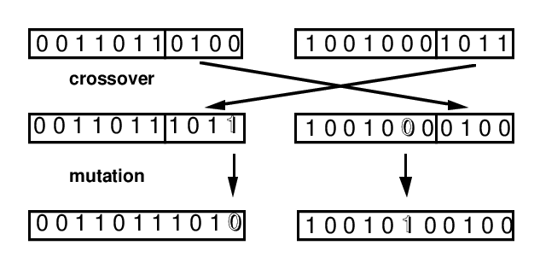
How adversarial autoencoder is useful in advancement of NSGA-II?
Traditionally NSGA-II uses one or two parents for generating new generation. But in case of molecules if we use one molecule and tried to change the structure of the molecule than we wouldn’t know weather the change will increase the quality of molecule, or even it is a valid molecule or not. So, to avoid this kind of uncertainty we instead used an Adversarial Auto Encoder. This Autoencoder will be trained on each generation with the score values. After training when we try to generate a new molecule than the model will try to generate samples with better scores than the previously generated samples. And in this way, we can have a track of the model improvements.

Slide 12
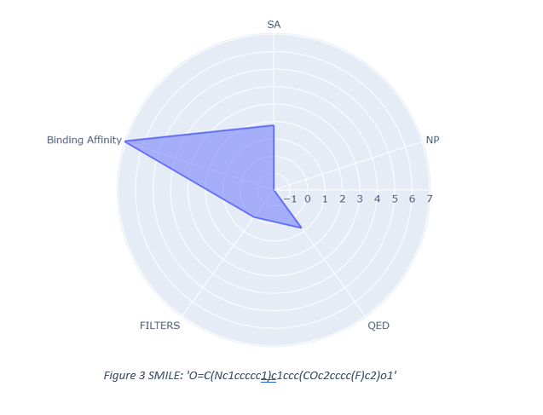
Some findings
The model was trained on a sample of MOSES dataset for around 2 generations, the process is time consuming and due to less hardware support, I was able to train this much. Most of the molecules at the top of the list were able to bind with target with around -7.3 Kcal/mol, SA = 3, NP= -1, QED= 1, Filters= 0.
I am sure that if the model would is trained on full mosses dataset and including other drug datasets for more generations than it would certainly improve and could provide new tools to fight crisis like these.

Slide 13
Future Modifications
This method can be applied to do drug discovery for such viruses just by changing the constraints of scoring functions and affinity scores which can be generated for every population at once using PyRx. I used ANNs but we can use a bunch of different generative networks such as Variational Autoencoder, etc.

