Slide 1
CUSTOMER ANALYTICS
Customer Shopping
Behavior Analysis
From raw transactions to decision-ready insight

Slide 2
EXECUTIVE READOUT
3,900 purchases reveal a measurable customer and revenue story
3,900
25
18
purchases
products
columns
DATASET
BUSINESS GOAL
3,900 purchases across 25 products, 4 categories, 50 locations, and 18 columns
Understand spending patterns, customer segments, product preferences, and subscription behavior
Interview lens: connect data preparation, SQL analysis, dashboarding, and business action
02

Slide 3




DECISION QUESTIONS
The analysis answers the questions a real retail organization needs
Revenue drivers
Product economics
Which customers and categories drive revenue?
Which products earn strong ratings or depend on discounts?
Loyalty signals
Business response
Do subscriptions and repeat purchases signal loyalty?
How should marketing, merchandising, and retention teams respond?
03

Slide 4
DATASET
3,900 purchases across 18 columns give a broad view of shopper behavior
AREA | KEY FIELDS | USED FOR
Customer demographics | Age, Gender, Location, Subscription Status | Segments and age groups
Purchase details | Item Purchased, Category, Purchase Amount (USD), Season, Size, Color | Revenue and product mix
Shopping behavior | Discount Applied, Promo Code Used, Previous Purchases, Frequency of Purchases, Review Rating, Shipping Type | Loyalty, discounts, and experience
Scope: 3,900 rows, 18 columns, 25 products, 4 categories, 50 locations. Review Rating has 37 missing values.
04
Notes:
Walk through the three field groups and why each one matters for the business questions.

Slide 5
ANALYTICAL WORKFLOW
The workflow moved from raw transactions to decision-ready insight
01
02
03
04
Profile
Prepare
Query
Communicate
Load and profile the data in Python using pandas
Clean missing values, standardize columns, and engineer age and purchase-frequency features
Load the cleaned DataFrame into PostgreSQL for business questions
Build an interactive Power BI dashboard for decision-makers
05

Slide 6
DATA QUALITY
Data quality work made the analysis more reliable
Missing data | 37 review ratings were missing and were imputed using the median rating for each product category
Feature engineering | Created age_group and purchase_frequency_days for more useful segmentation
Standardization | Renamed columns to snake case for readability and documentation
Consistency | Checked whether discount_applied and promo_code_used were redundant, then dropped promo_code_used
06

Slide 7
SQL ANALYSIS
SQL answered nine business questions across revenue, products, and segments
BUSINESS QUESTION | KEY RESULT
Revenue by gender | Female $75,191; Male $157,890
Subscribers vs. non-subscribers | Yes: 1,053 customers, $62,645 revenue; No: 2,847 customers, $170,436 revenue
High-spending discount users | 839 customers used discounts and spent above the average purchase amount
Top 5 products by rating | Gloves 3.86, Sandals 3.84, Boots 3.82, Hat 3.80, Skirt 3.78
Shipping type comparison | Standard $58.46 vs. Express $60.48 average purchase amount
Discount-dependent products | Hat 50.00%, Sneakers 49.66%, Coat 49.07%, Sweater 48.17%, Pants 47.37% discounted
Customer segmentation | Loyal 3,116; Returning 701; New 83
Repeat buyers and subscriptions | Repeat buyers by subscription status: Yes 958, No 2,518
Revenue by age group | Young Adult $62,143; Middle-aged $59,197; Adult $55,978; Senior $55,763
07
Notes:
Each SQL query answered one business question; the table is the answer set, not the query text.

Slide 8
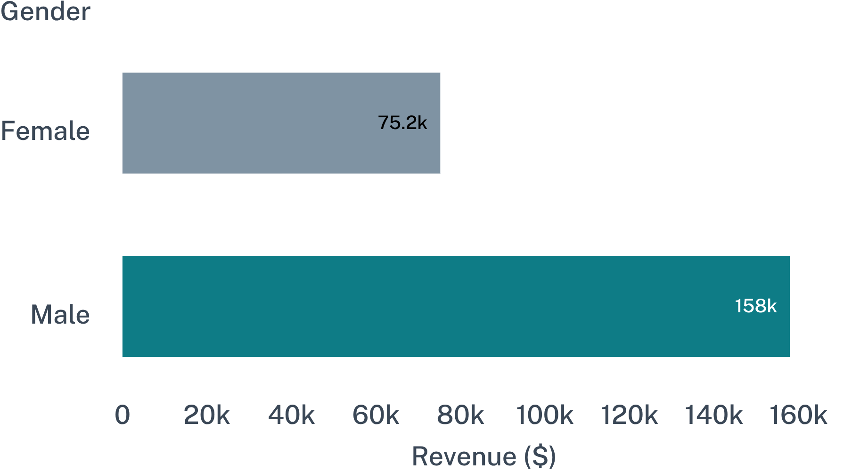
REVENUE CONCENTRATION
Revenue is concentrated in male customers and clothing
$157,890
Male customers
Clothing is the largest category by revenue and sales volume.
Category strategy and audience targeting should be grounded in observed revenue contribution.
08

Slide 9
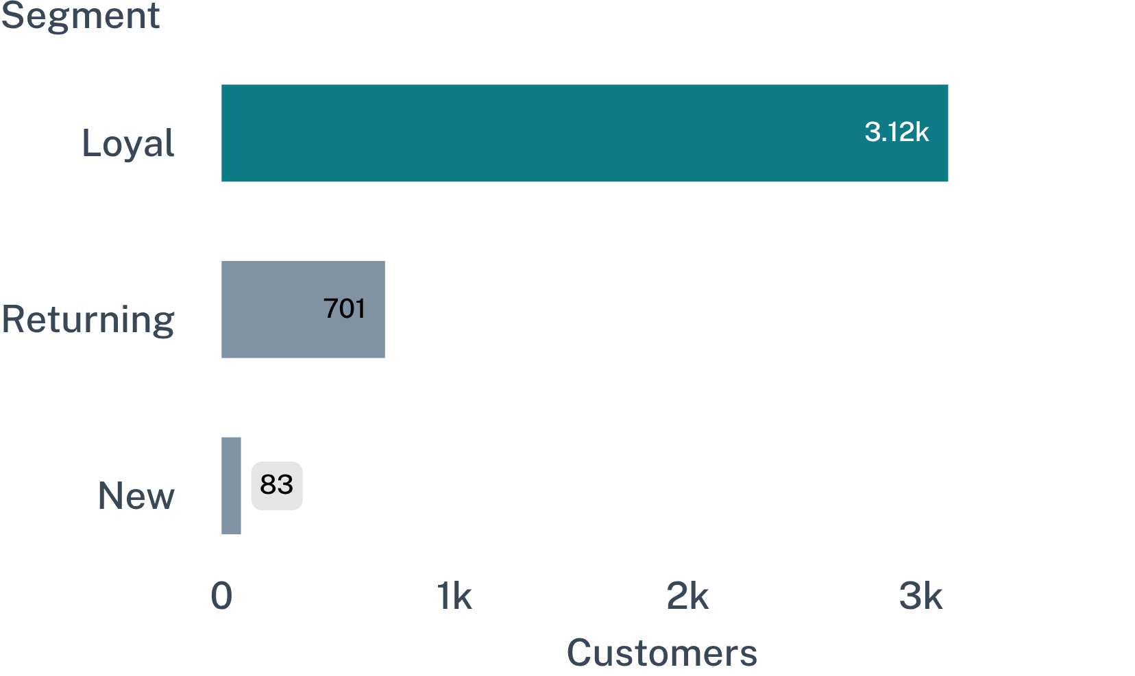
LOYALTY AND RETENTION
Loyal customers dominate the base, but subscriptions remain underdeveloped
1,053
2,847
subscribed
non-subscribers
Revenue: subscribers contributed $62,645 versus $170,436 from non-subscribers
Loyalty is strong, but subscription adoption is the clearest retention opportunity
09

Slide 10
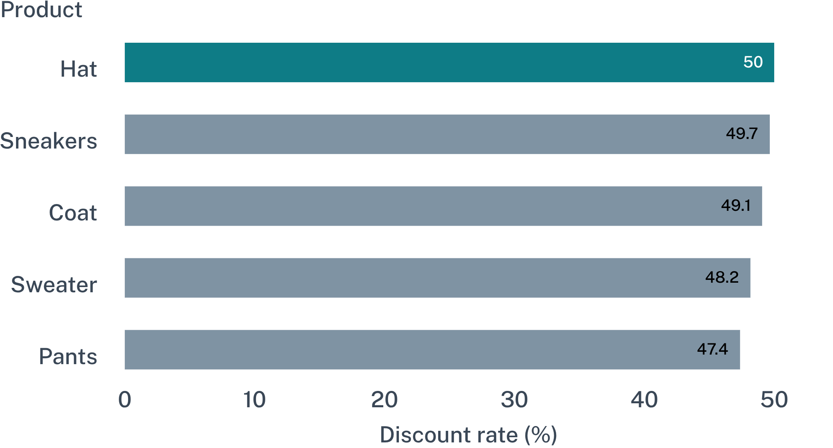
PROMOTION AND MARGIN
Discounts attract high spend, but some products may be margin-sensitive
839
customers used discounts while spending above the average purchase amount
Business question
Which promotions create incremental demand, and which simply reduce margin?
10

Slide 11
CUSTOMER EXPERIENCE SIGNALS
Product and fulfillment signals can sharpen the customer experience
TOP-RATED PRODUCTS
SHIPPING
AGE CONTRIBUTION
Gloves 3.86
$60.48
$62,143
Sandals 3.84 · Boots 3.82 · Hat 3.80 · Skirt 3.78
Average purchase amount with Express shipping
Young Adult customers generated the highest revenue; the other three age groups sit between $55.7K and $59.2K each
Standard shipping: $58.46
11

Slide 12
MANAGEMENT CONVERSATION
A Power BI dashboard turns the analysis into a management conversation
3.9K
$59.76
3.75
customers
average purchase amount
average review rating
VIEWS
FILTERS
Subscription status, revenue by category, sales by category, revenue by age group, and sales by age group
Gender, category, subscription status, and shipping type support focused exploration
12

Slide 13
BUSINESS RECOMMENDATIONS
Business Recommendations for Better Performance
Boost subscriptions with exclusive member benefits
Reward repeat buyers through loyalty programs
Review discount policy to protect margin
Feature top-rated and best-selling products to convert shoppers
Target high-revenue age groups and customers who value faster shipping
Track performance through: subscription adoption, repeat purchases, revenue by category and age group, discount rate, and average purchase amount.
13
Notes:
Close by linking each recommendation to a metric the team can monitor.

