Slide 1
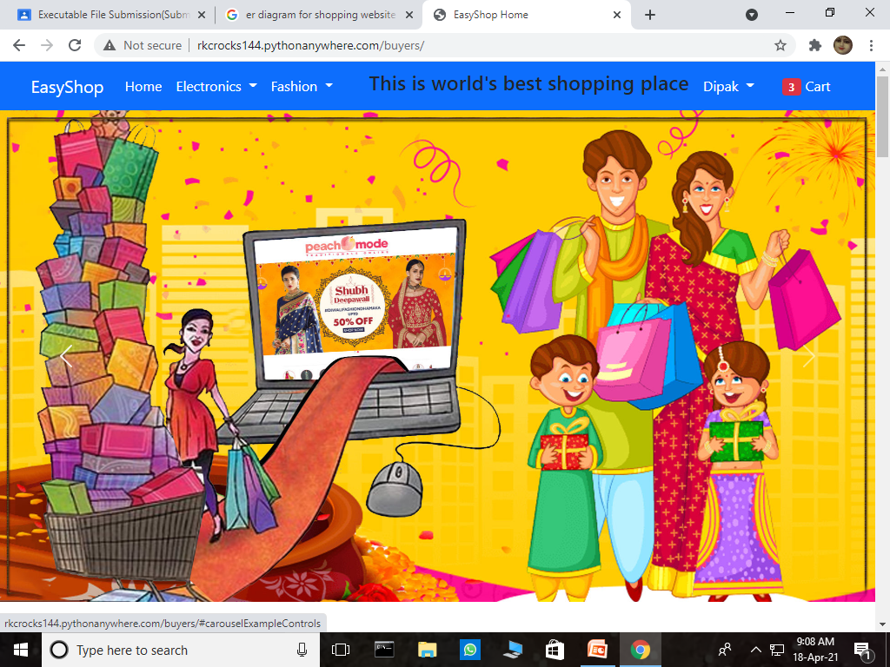
Easy Shop Website
Subtitles:
INTRODUCTION.
ER DIAGRAM.
SHEMAS.
WORKING.
Available At : https://rkcrocks144.pythonanywhere.com

Slide 2
INTRODUCTION
This is a shopping site integrated fully through backend and gateways along with normalized entities.
This site is made up using Django technology and for databases we are using SQLITE3 language.
This is hosted using python anywhere.
Main features of this site is that a user(buyer) can make purchase of items sold by other users(seller).
This site allows authentication, payments gateways, and registration also.
Django provides default site administration who can control all the databases and other information.
The redundancy of the tables are reduced very much and a normalization of 3NF is achieved, Although some entity sets are BCNF also.
Facility to update details in tables are also given to buyers and sellers. Also they can add or delete cart items.
The tables are minimized up to a large extent using minimization rules.
Rest of the recovery facilities and concurrency control is managed by django itself.

Slide 3
ADDRESS
ID STATE PINCODE ADD_PLACE
USER
ID PASSWORD USER_NAME
Delivery
addresses
CATEGORY
ID NAME
1
Delivery add.
BUYER
NAME EMAIL PHONE_NO ID
CAN_BE
SELLER
NAME EMAIL PHONE_NO ID
has
ORDERS_PLACED
STATUS DATE ID
purchases
Has
gender
1
GENDER
ID NAME
m
cart
seller
Item ordered
After purchase
Seller sold
Weak
Entity
Set.
ERD
PRODUCT
TITLE DESCRIPTION IMAGE SELLING_PRICE DISCOUNT_PRICE QUANTITY ID
CART items
QUANTITY ID
Cart is
Made of

Slide 4
KEY | USER | TYPE
PK | ID | INT
 | USER | CHAR
 | PASSWORD | CHAR
KEY | Category | Type
 | Name | Char
PK | ID | INT
SCHEMAS
KEY | seller | TYPE
FK | User | Char
 | Name | Char
 | E-mail | Char
FK | Gender | INT
 | Ph. No. | Char
PK | Id | INT
KEY | buyer | TYPE
FK | User | Char
 | Name | Char
 | E-mail | Char
FK | Gender | INT
 | Ph. No. | Char
PK | Id | INT
KEY | product | TYPE
 | Title | CHAR
 | Description | CHAR
 | Selling price | INT
 | Discount price | INT
 | Quantity | INT
FK | Category | CHAR
FK | Seller | INT
PK | id | INT
KEY | address | TYPE
PK | Id | INT
 | State | Char
 | address | Char
 | Pin code | Char
FK | User | INT
KEY | gender | TYPE
PK | ID | INT
 | NAME | CHAR

Slide 5
KEY | Orders placed | TYPE
FK | BUYER | INT
FK | DELIVERY_ADDRESS | INT
FK | PRODUCT | INT
 | QUANTITY | INT
 | DATE | INT
 | STATUS | CHAR
PK | ID | INT
Features of ERD and Schemas
Weak Entity sets:
Products (since two seller can sell same product).
Cart items(since two cart can be same but uniquely
Identified by buyer).
orders placed.
Total Participation and partial Participations:
There might be category for which we would
not have product.
Some buyers may don’t have items in cart at some time
SCHEMAS
These schemas are showing the minimized tables of extraneous relationships sets. Minimized using ER minimization rules.
.NORMALIZATIONS:
Gender and Category tables are separated from buyer and product tables to attain less redundancy and 2NF.
Address table is separated to reduce redundancy in state names.
Product table is separated from seller since we could have seller not selling any product(Quantity = 0). So this transitive dependency is removed and table attains 3NF.
some entity sets attains BCNF (category,user,gender).
KEY | Cart items | TYPE
FK | Buyer | INT
FK | Product | INT
 | Quantity | INT
PK | Id | INT
After making payments the Quantity
And other details of cart is sent to
orders table and cart is emptied.

Slide 6
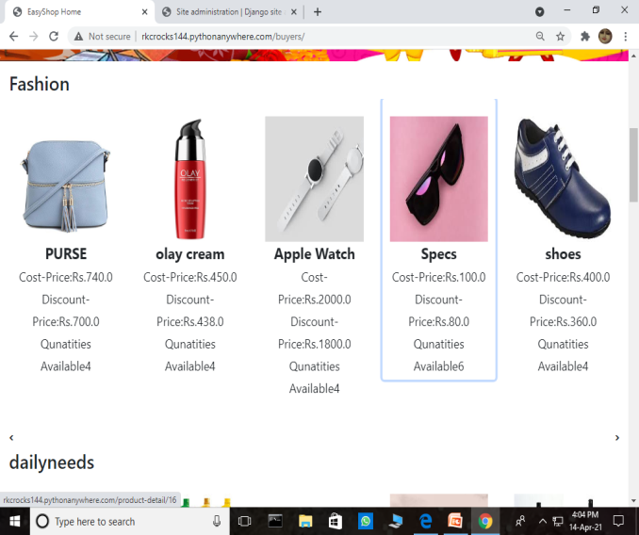
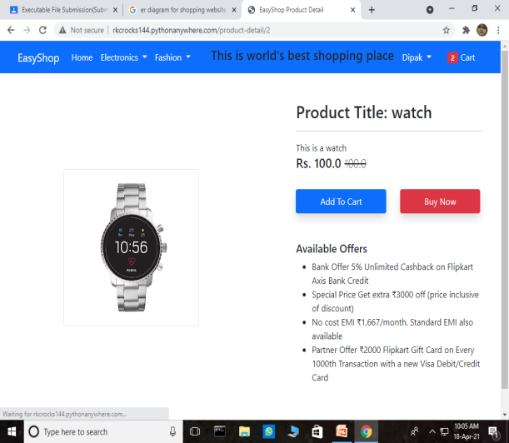
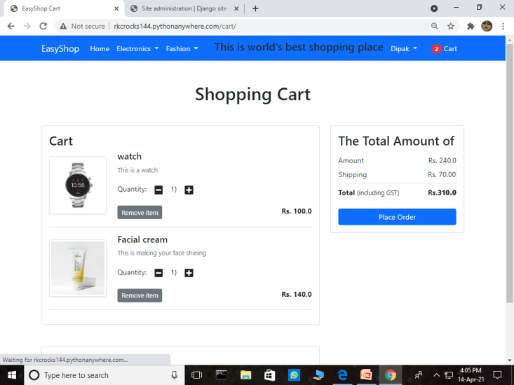
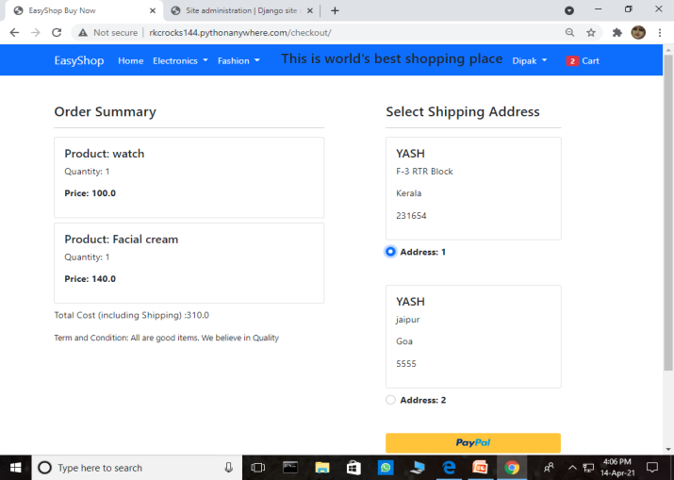
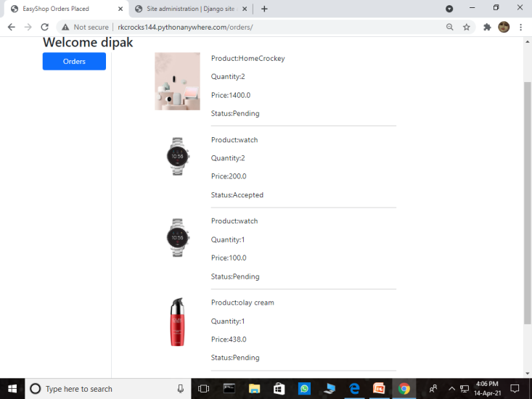
clicks
That product id is
than added to
cart table which
Contains that buyer
Id with default
Quantity 1.
These are displayed
form product table
And separated using
Category.
Then the user clicks on
place order and selects
the Delivery address
and makes payments.
After payments the
order summary is
displayed and all Orders
are added in orders table.
The cart table is emptied.
This slides shows how user can
Purchase items and by making
Payments how orders are placed.
The tables modification is done

Slide 7
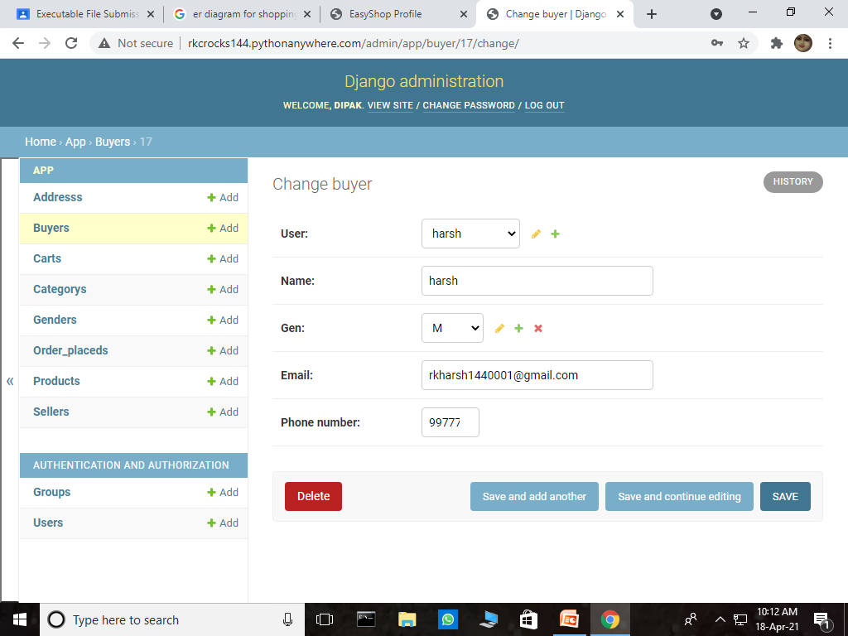
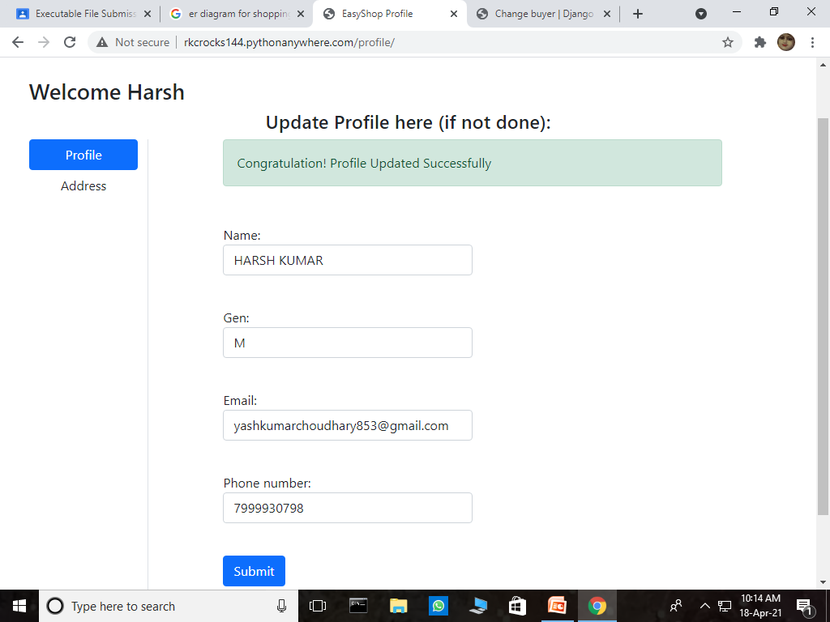

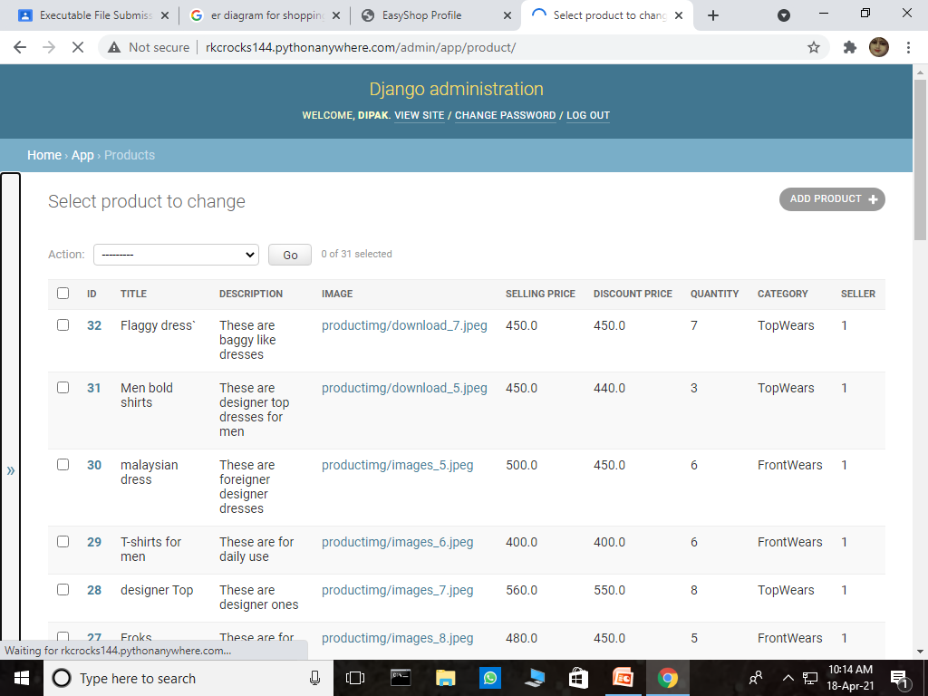
After updating the
details
they are also
updated in table.
Initially the details of the buyer
Are shown.
Products table

