Slide 1

TRAVELERS STAT-A-THON HOUSING CHALLENGE
CONNECTICUT HOUSING ANALYSIS
Harsh Madhyan, Senior Undergraduate, IIT Gandhinagar, India

Slide 2

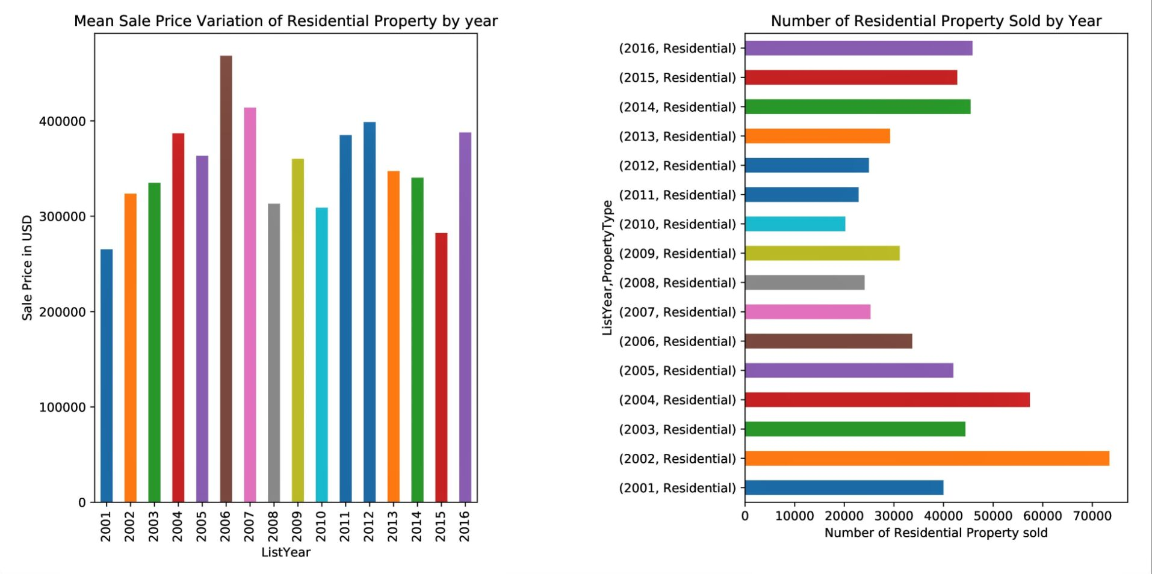
How did Sale Price affect demand for Housing?

Slide 3
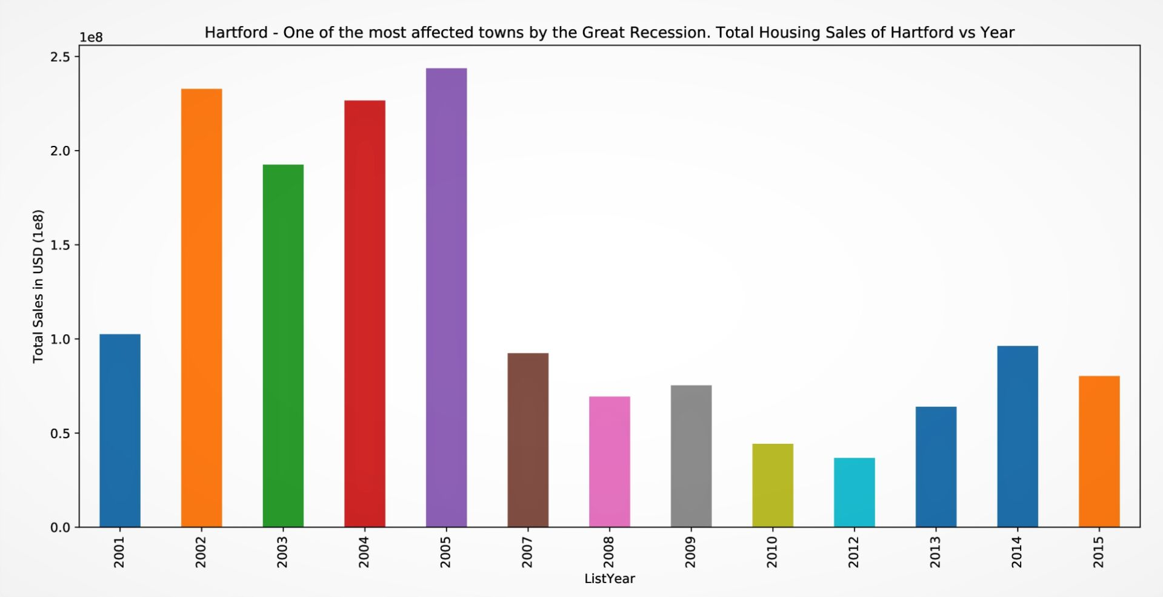

Slide 4
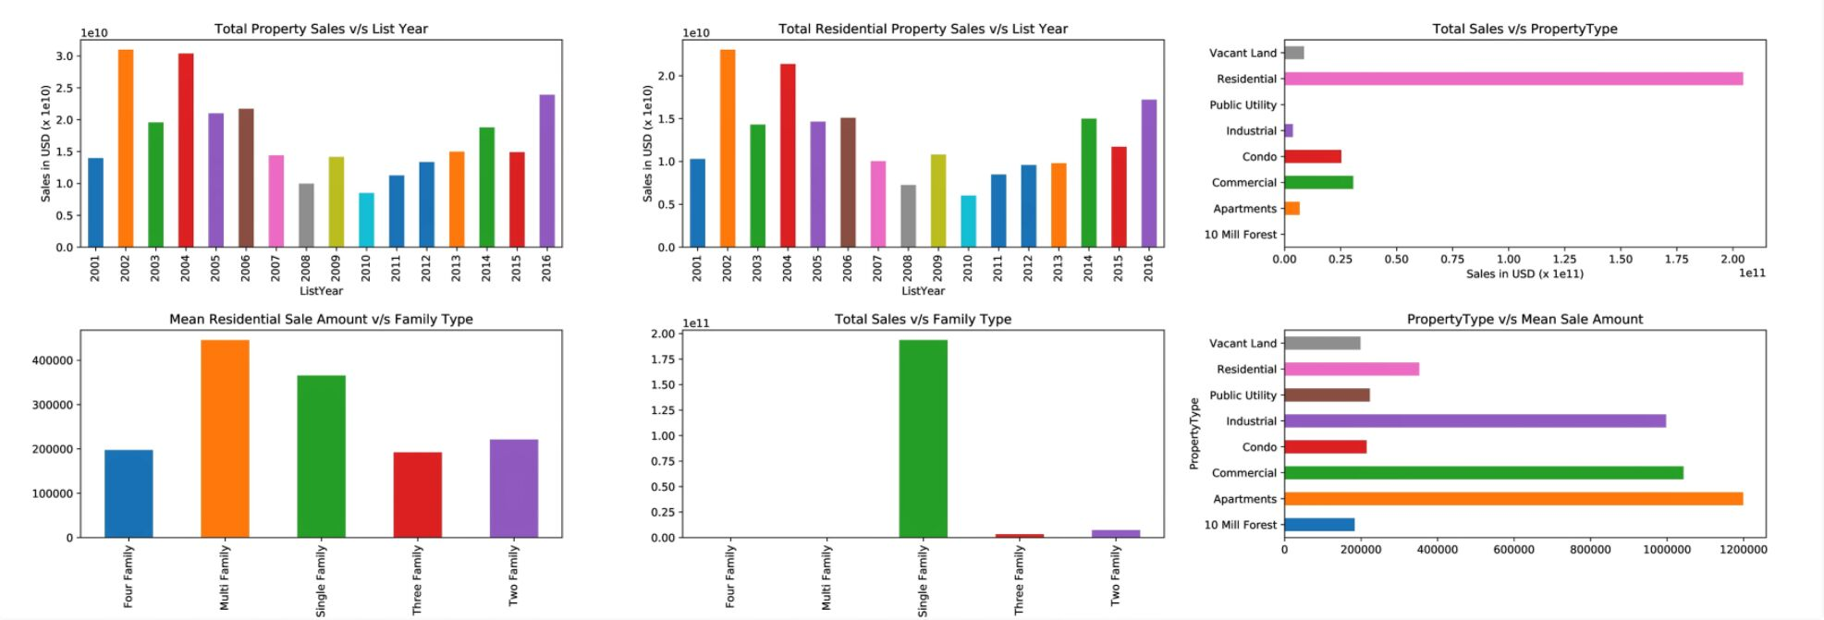
Going a step deeper...

Slide 5
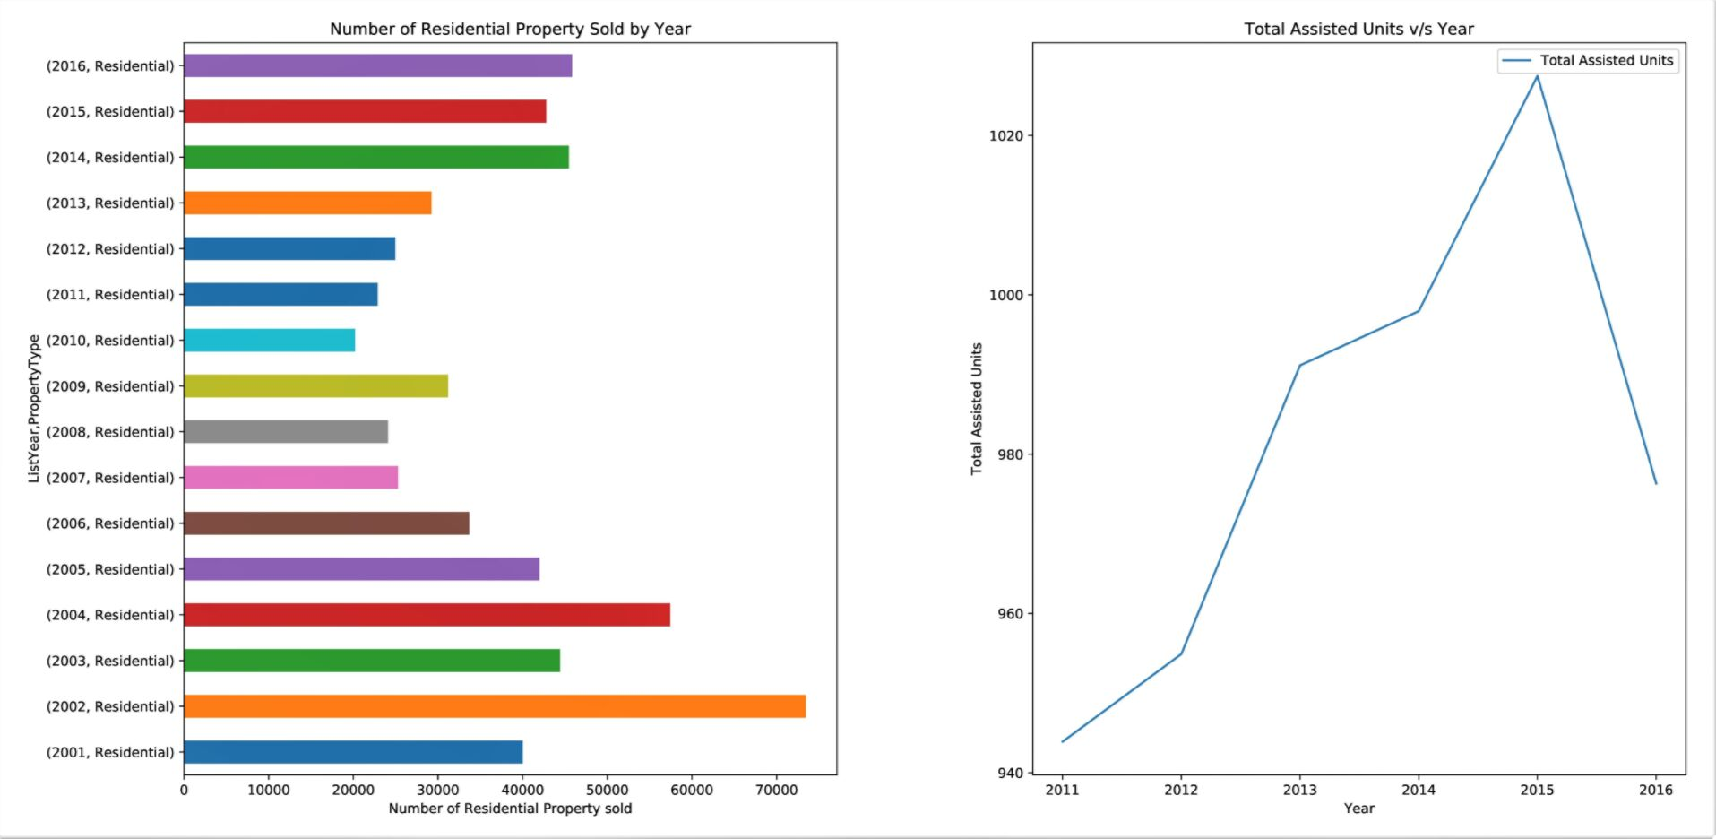
How did Assisted Units affect Housing Sales?

Slide 6
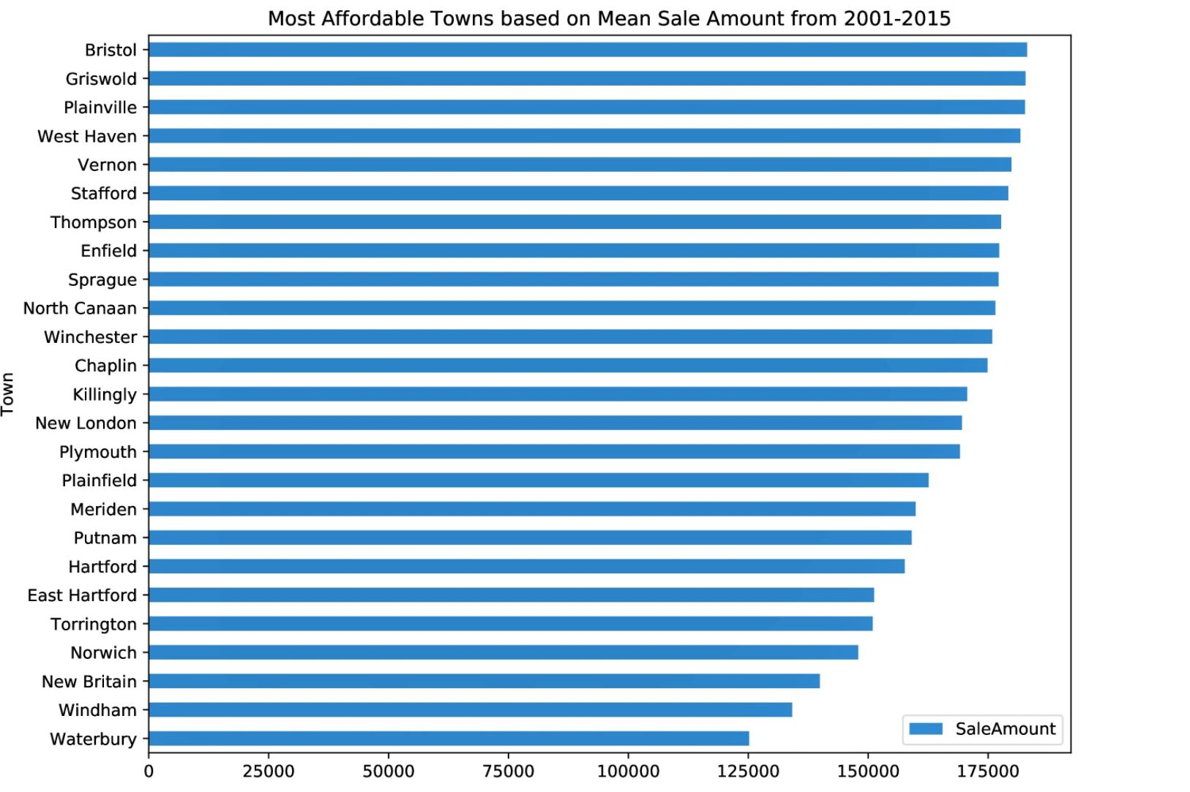

Slide 7
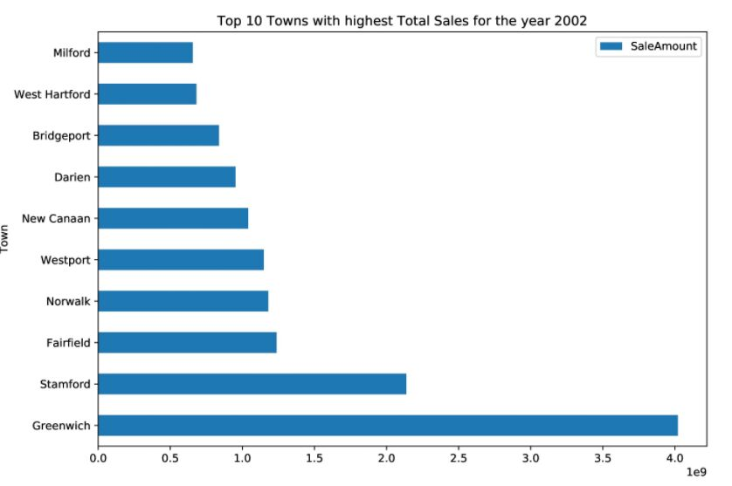
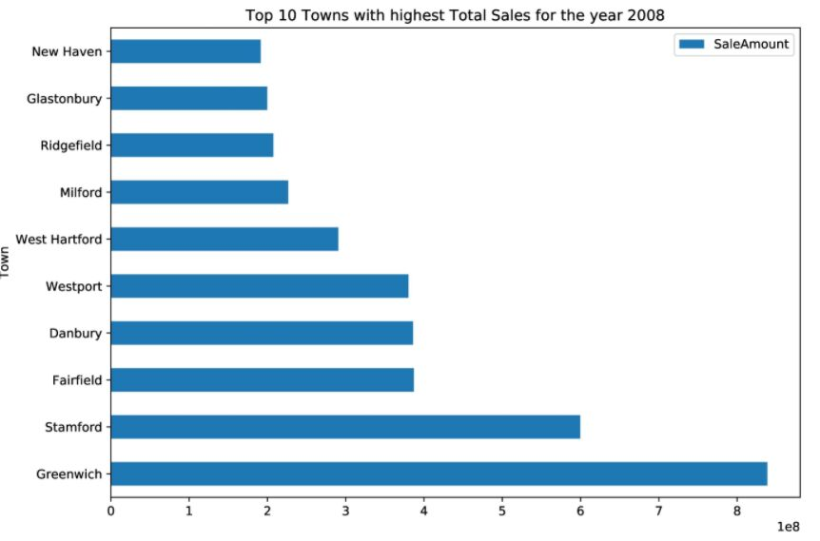
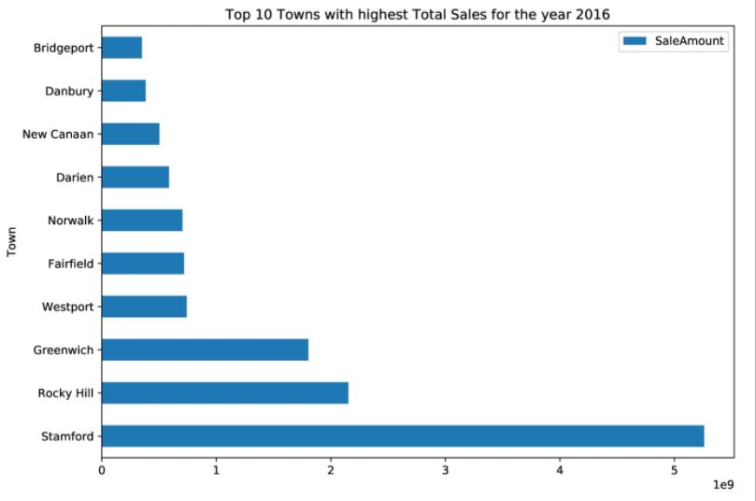

Slide 8
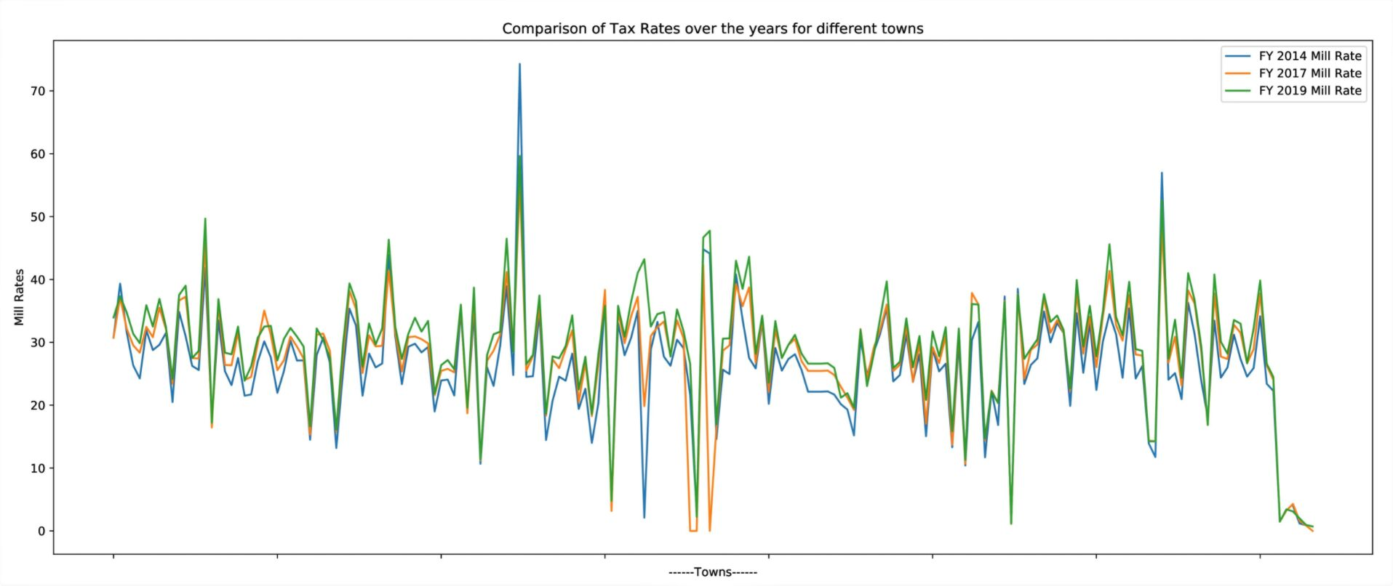
Increasing Tax Rate (FY 2014 < FY 2017 < FY 2019) and its implications

Slide 9
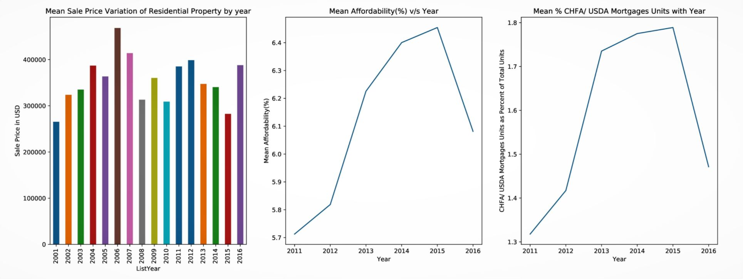
How did CHFA Mortgage and Sale Price Variation affect Affordability?

Slide 10
References (Links embedded):
1) Real estate sales (2001-16) by the State of Connecticut
2) Mill Rates (2014,'17,'18,'19) by the State of Connecticut
3) Affordable Housing by Town 2001-16 by the State of Connecticut
Codes & Data Analysis:
https://github.com/HarshMadhyan/Data-Visualization
Thank You

