Slide 1
IBM University Engagement Project Submission
“Exploring the Power of Agentic AI with IBM Granite and IBM Bob”

Slide 2
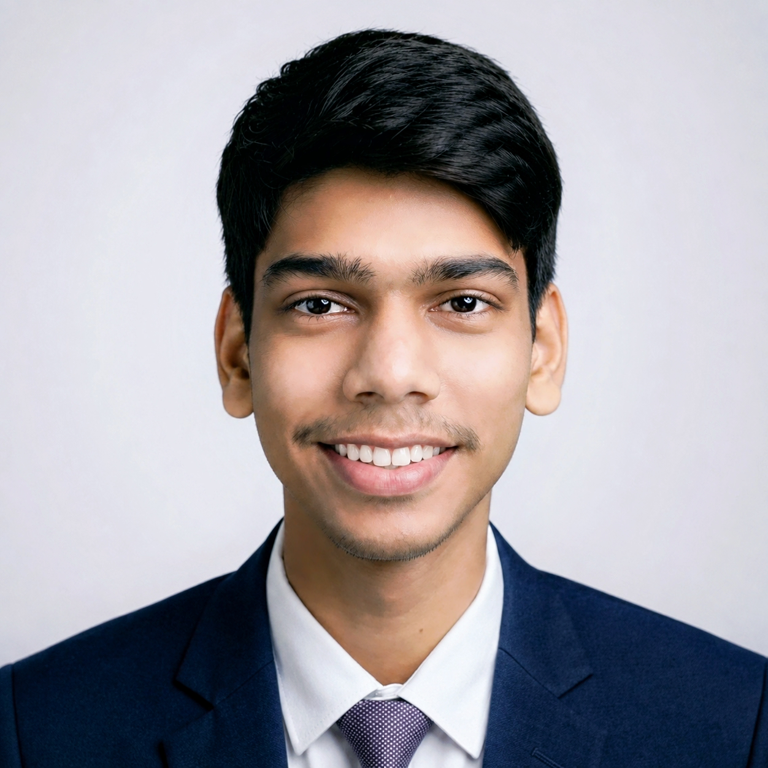
Project Tile : “KisanMitra AI” – AI Agent for Smart Farming Advice
Domain of Project : Agriculture🌾
Student Name | Recent Passport Photo | Email ID | Mobile number [WhatsApp]
Harsh Mahamalla
iamharshmahamalla31@gmail.com
9202118068

Slide 3
Problem Statement -
Problem Statement : AI Agent for Smart Farming Advice
The Challenge
Farmers often struggle with low crop yield, unpredictable weather, pest infestations, and limited access to timely expert advice. Traditional farming advisory services are fragmented, slow, and not personalized to the farmer’s specific land, crop, or climate conditions. With the rise of climate change, data-driven smart farming solutions are needed to empower farmers with actionable insights.
The Objective
Develop an AI-powered Smart Farming Agent that provides personalized, real-time, and sustainable agricultural advice. The solution should :
Agricultural Knowledge Retrieval (RAG) – Use Retrieval-Augmented Generation to fetch best practices, crop-specific guidelines, and government advisory updates.
Weather & Soil Insights – Integrate real-time weather forecasts, soil health data, and irrigation needs to optimize farm planning.
Pest & Disease Detection – Enable multimodal support where farmers upload crop images for early pest/disease identification and get instant recommendations.
Personalized Advisory Agent – Suggest seeds, fertilizers, irrigation schedules, and harvesting timelines based on farmer profile and land conditions.
Market & Cost Optimization – Forecast demand, suggest market prices, and recommend cost-efficient practices for better income.
Multi-Agent Collaboration –
↪ Crop Advisory Agent
↪ Weather & Irrigation Agent
↪ Pest/Disease Detection Agent
↪ Market Insights Agent

Slide 4
Proposed Solution -
Proposed Solution: KisanMitra AI
The proposed solution is a multi-agent AI-powered farming advisory platform built using IBM BOB, React, Flask and Groq - hosted LLMs to provide personalized, real-time agricultural guidance. The system addresses challenges in crop management, irrigation planning, pest control and market decision-making through an intelligent, modular architecture.
At its core, the solution uses an intent-classification and orchestration pipeline to route each farmer query to the relevant specialist agents. Live and simulated data - weather forecasts, soil parameters (NPK, pH, moisture) and mandi market prices - feeds into these agents, enabling the system to generate context-grounded, farm-specific recommendations rather than generic advice.
The system consists of four key agents :
Crop Advisory Agent recommends fertilizers, dosages and soil corrections with an organic-first approach.
Weather/Irrigation Agent decides whether to irrigate, delay or drain based on rainfall, soil moisture and forecast data.
Pest & Disease Agent diagnoses crop issues from images or text descriptions using a tiered Integrated Pest Management (IPM) strategy.
Market Advisory Agent advises whether to sell, hold, or diversify produce by comparing live mandi prices against MSP.
The solution includes a farmer-friendly dashboard (built with React) that visualizes a Farm Health Score, displays advisory results across tabs, shows a live animated weather scene and offers voice input/output and shareable advisory cards for easy communication.
An Orchestrator Agent coordinates all four specialist agents in parallel, then synthesizes their findings into a single, coherent, bilingual (English + Hindi) recommendation with clear reasoning, while the Groq LLM API powers reasoning, structured JSON generation and image-based pest analysis.
Overall, this solution delivers an end-to-end intelligent farming assistant that promotes better agricultural outcomes through personalized insights, real-time adaptation, and proactive decision support — acting as a trusted digital Kisan Mitra for every farmer.

Slide 5
Technology Used :
IBM Bob Platform – Used to design, orchestrate and code the complete multi-agent workflow of KisanMitra AI (agent creation, routing logic and end-to-end application development).
Groq LLM API (qwen/qwen3.8-27b) – Powers natural language understanding, reasoning and bilingual (English + Hindi) response generation for all four specialist agents.
React.js (Vite) – Frontend framework used to build the farmer-facing dashboard, chat interface, voice input and pest-scan UI.
Flask (Python) – Backend framework that handles API routing, agent orchestration, session/farmer-profile management and SSE-based streaming responses.
Multi-Agent Architecture – Four specialized agents (Crop Advisory, Weather/Irrigation, Pest & Disease, Market Advisory) coordinated by a central Orchestrator Agent, each returning structured JSON output.
Web Speech API – Enables voice input (speech-to-text) and voice output (text-to-speech) for accessibility.
Server-Sent Events (SSE) – Streams real-time, step-by-step advisory generation from backend to frontend.
Data Layer (Weather / Soil / Market Generators) – Supplies contextual, farm-specific data (rainfall, NPK, pH, mandi prices vs. MSP) that grounds each agent's recommendations.

Slide 6
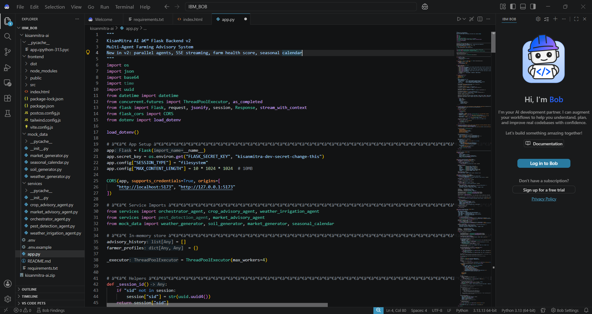
Required Files created using IBM bob -
App.py
Requirements.txt
.env
Index.html

Slide 7
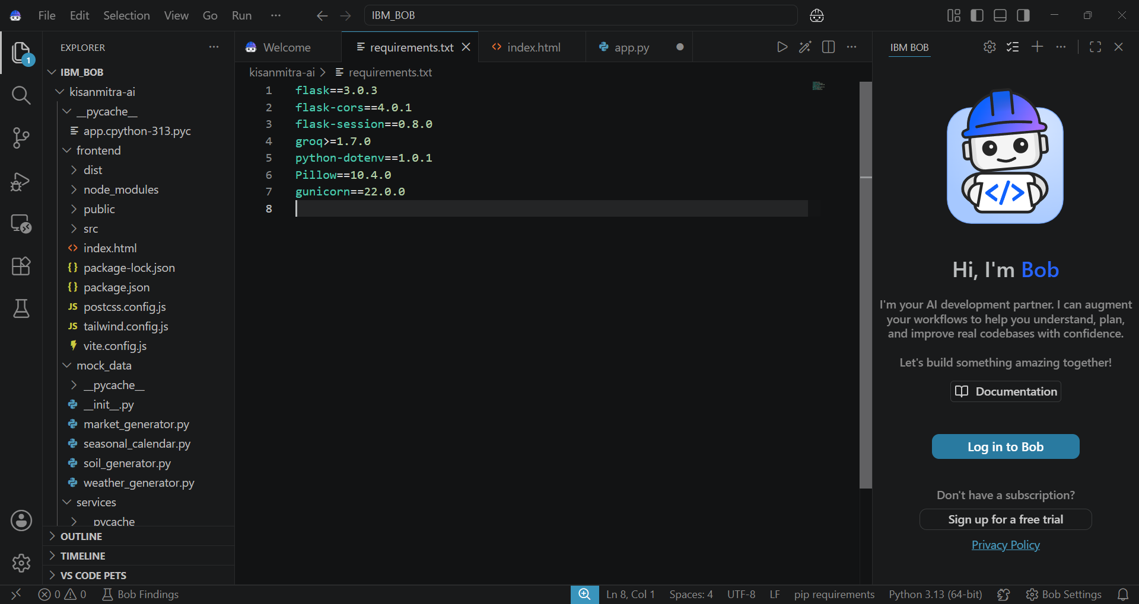
Required Files created using IBM bob -
App.py
Requirements.txt
.env
Index.html

Slide 8
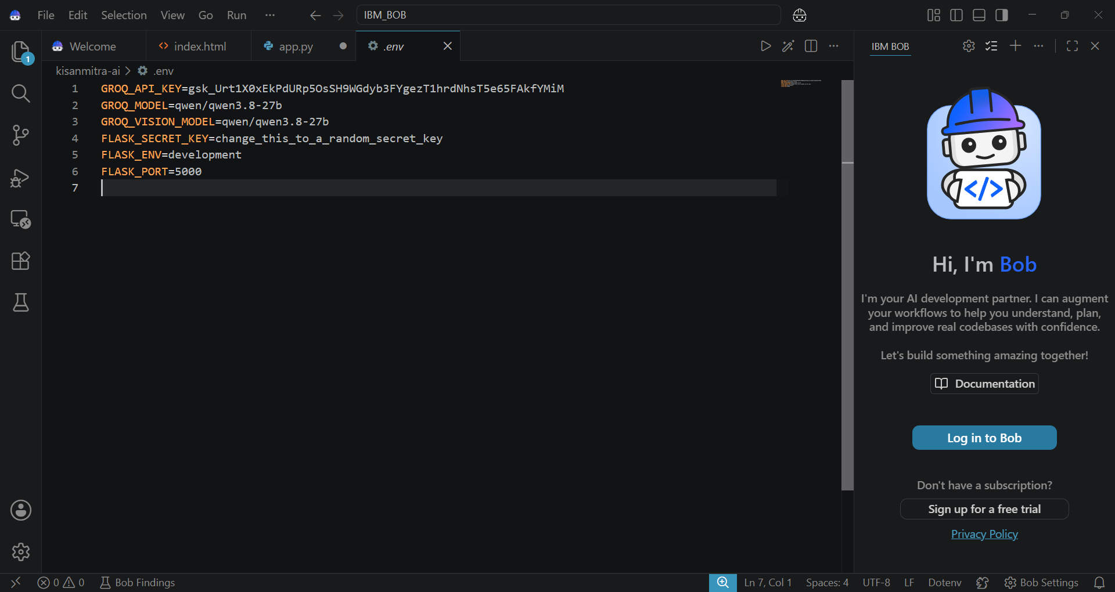
Required Files created using IBM bob -
App.py
Requirements.txt
.env
Index.html

Slide 9
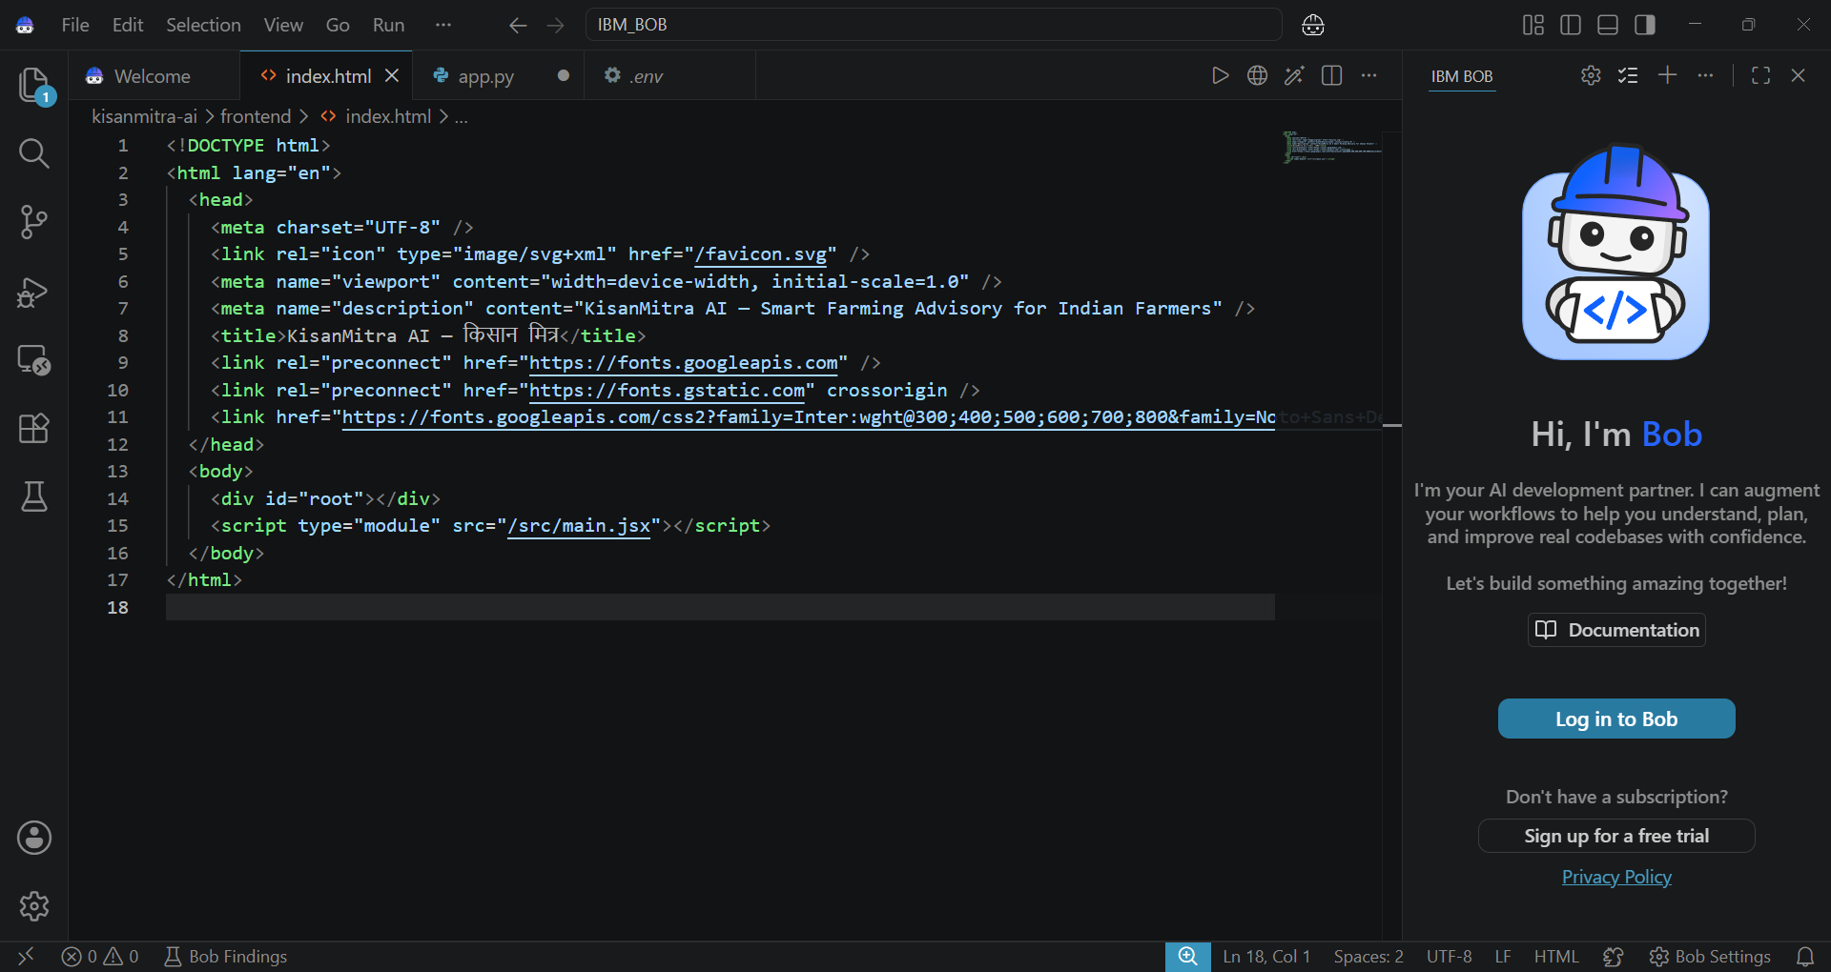
Required Files created using IBM bob -
App.py
Requirements.txt
.env
Index.html

Slide 10
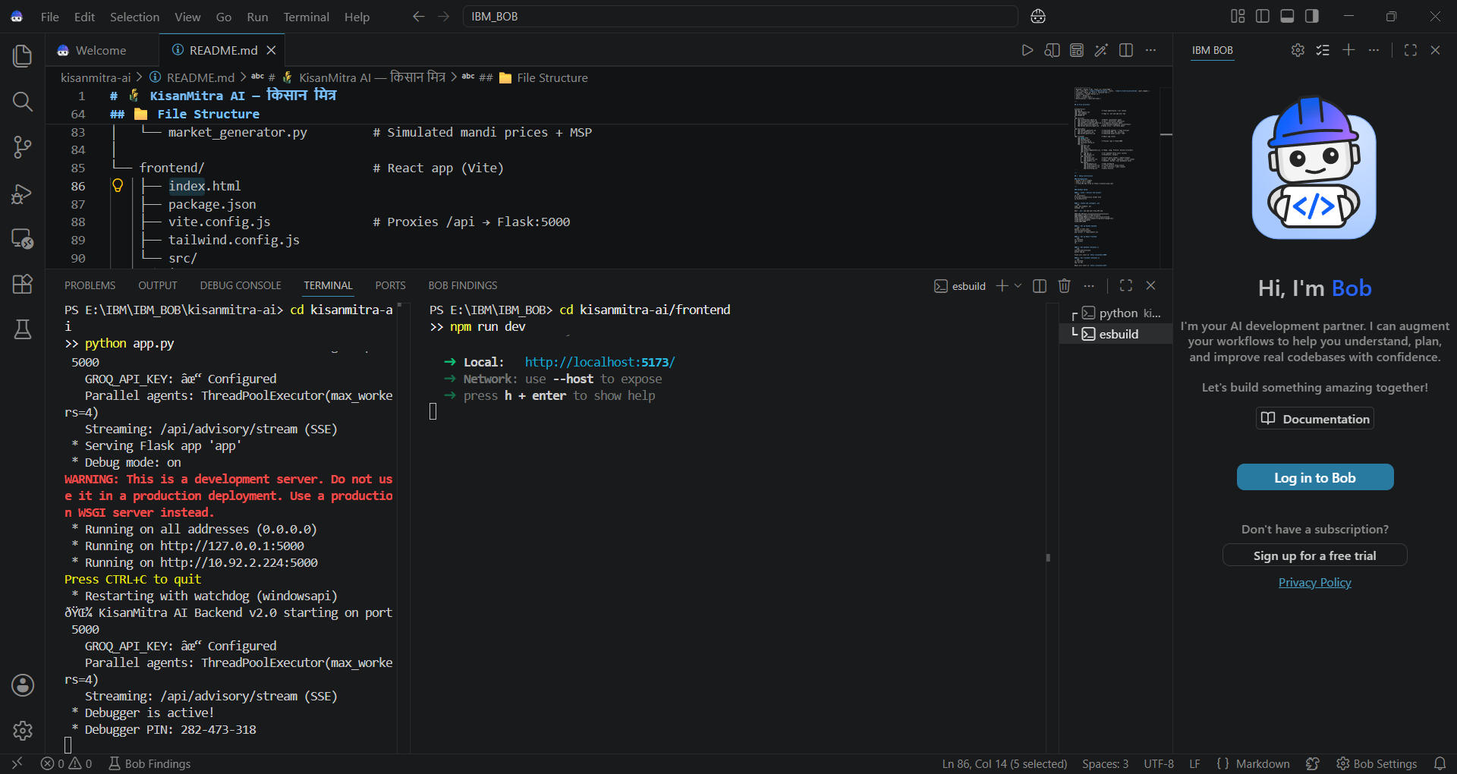
IBM Bob Screenshots :

Slide 11
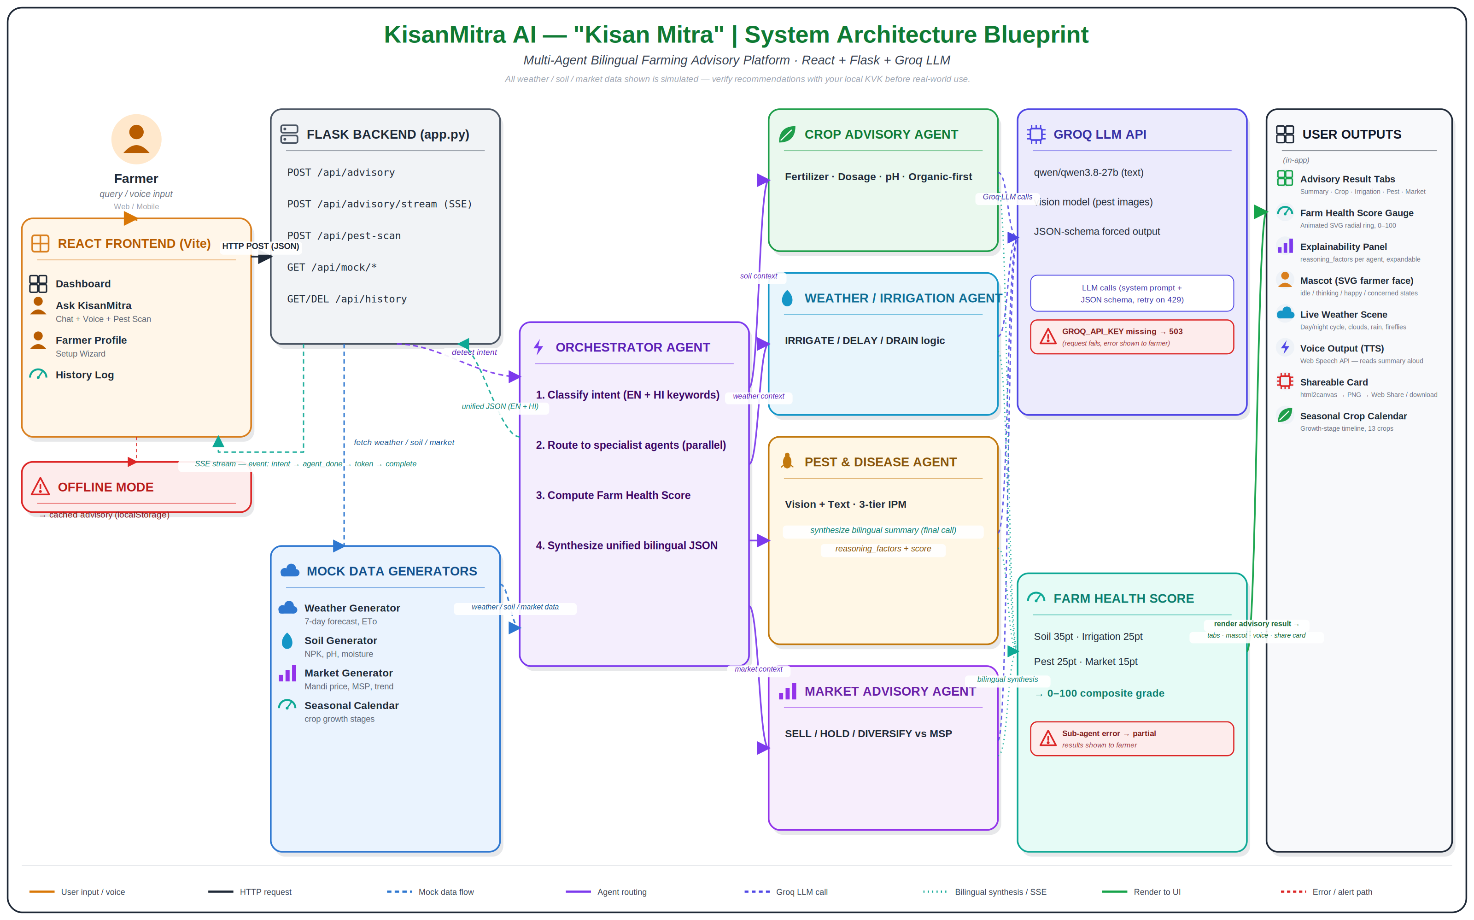
Architecture blueprint for IBM Bob:

Slide 12



Role of Agentic AI -
Role of Agentic AI in KisanMitra AI -
Agentic AI enables KisanMitra AI to function as an intelligent, autonomous farming advisor rather than a simple chatbot. Using an LLM-powered orchestration layer (Groq-hosted models), it coordinates multiple specialized agents to deliver personalized, real-time farming guidance.
Four specialist agents, one orchestrator — the Crop Advisory, Weather/Irrigation, Pest & Disease, and Market Advisory agents each own a distinct decision (fertilizer/soil fixes, irrigate/delay/drain, pest diagnosis via tiered IPM, sell/hold/diversify vs. MSP), coordinated by a central Orchestrator Agent.
Parallel execution — all four agents run simultaneously rather than one after another, making the multi-agent approach efficient without sacrificing accuracy.
Domain-specific accuracy — because each agent focuses narrowly on its own area, the results are more precise and reliable than a single general-purpose response.
Context-aware recommendations — the system factors in farm-specific details like location, soil type, current crop, and growth stage, so advice is tailored rather than generic.
Real-time adaptation — suggestions continuously update as live weather, soil, and market conditions change, keeping recommendations current rather than static.
Overall, the agents' findings flow back to the Orchestrator, which synthesizes them into one coherent, bilingual (English + Hindi) recommendation with a computed Farm Health Score and clear reasoning, making the system act like a smart digital Kisan Mitra that helps farmers make timely, informed decisions on crops, irrigation, pest control, and market timing.

Slide 13
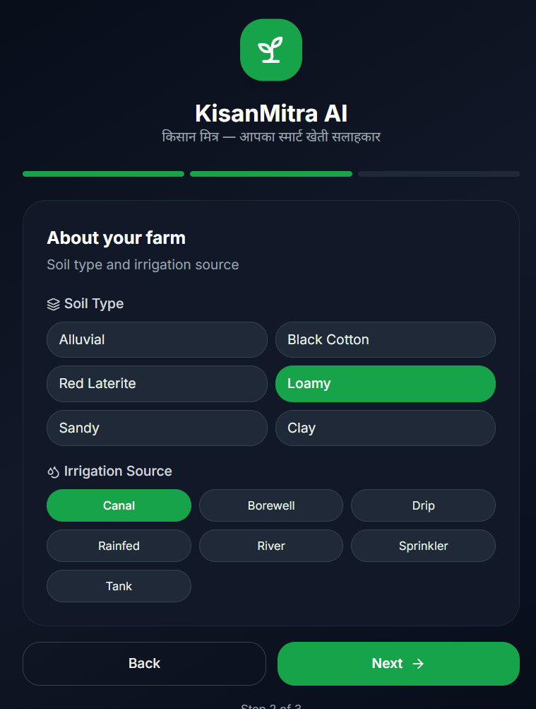
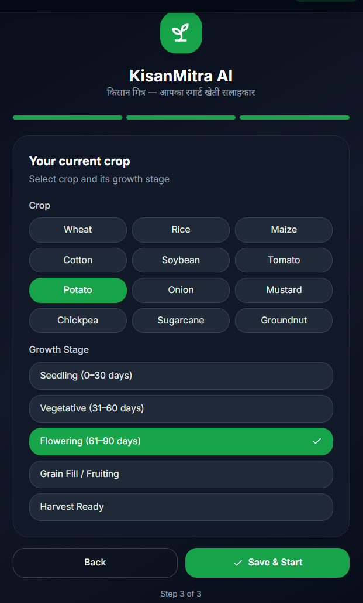
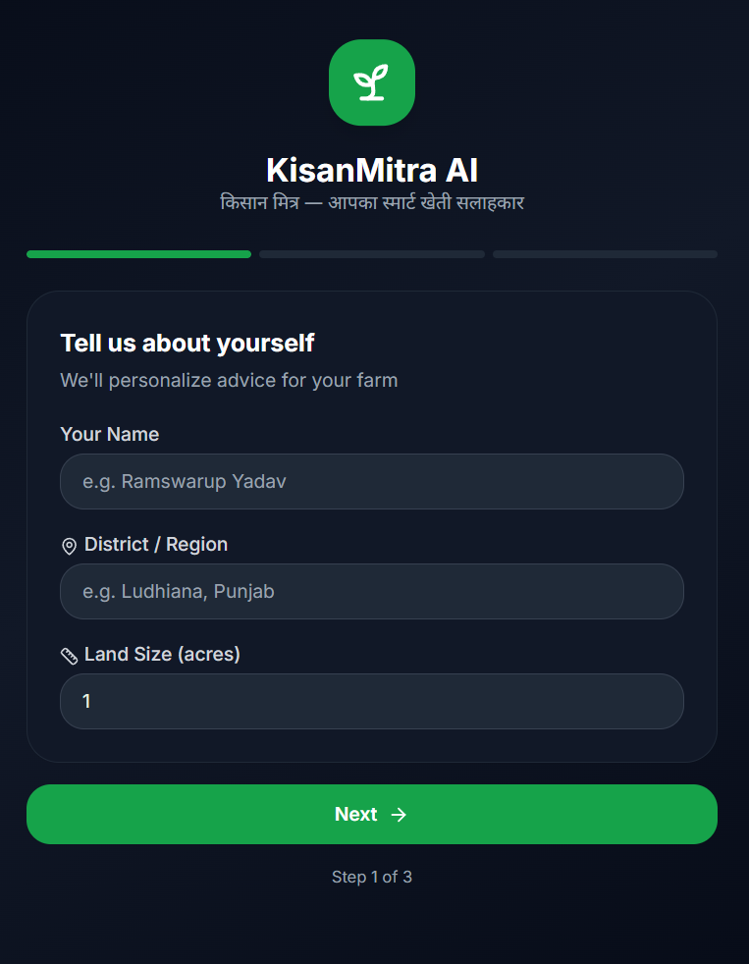
Project Output Screenshot :-

Slide 14
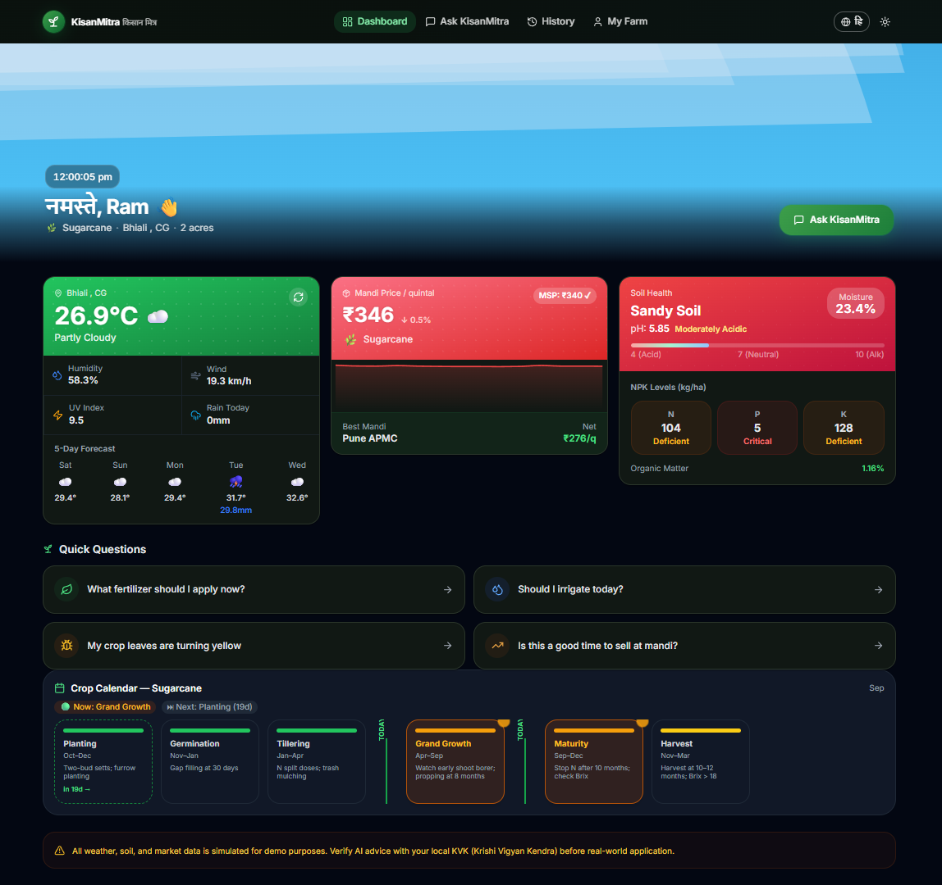
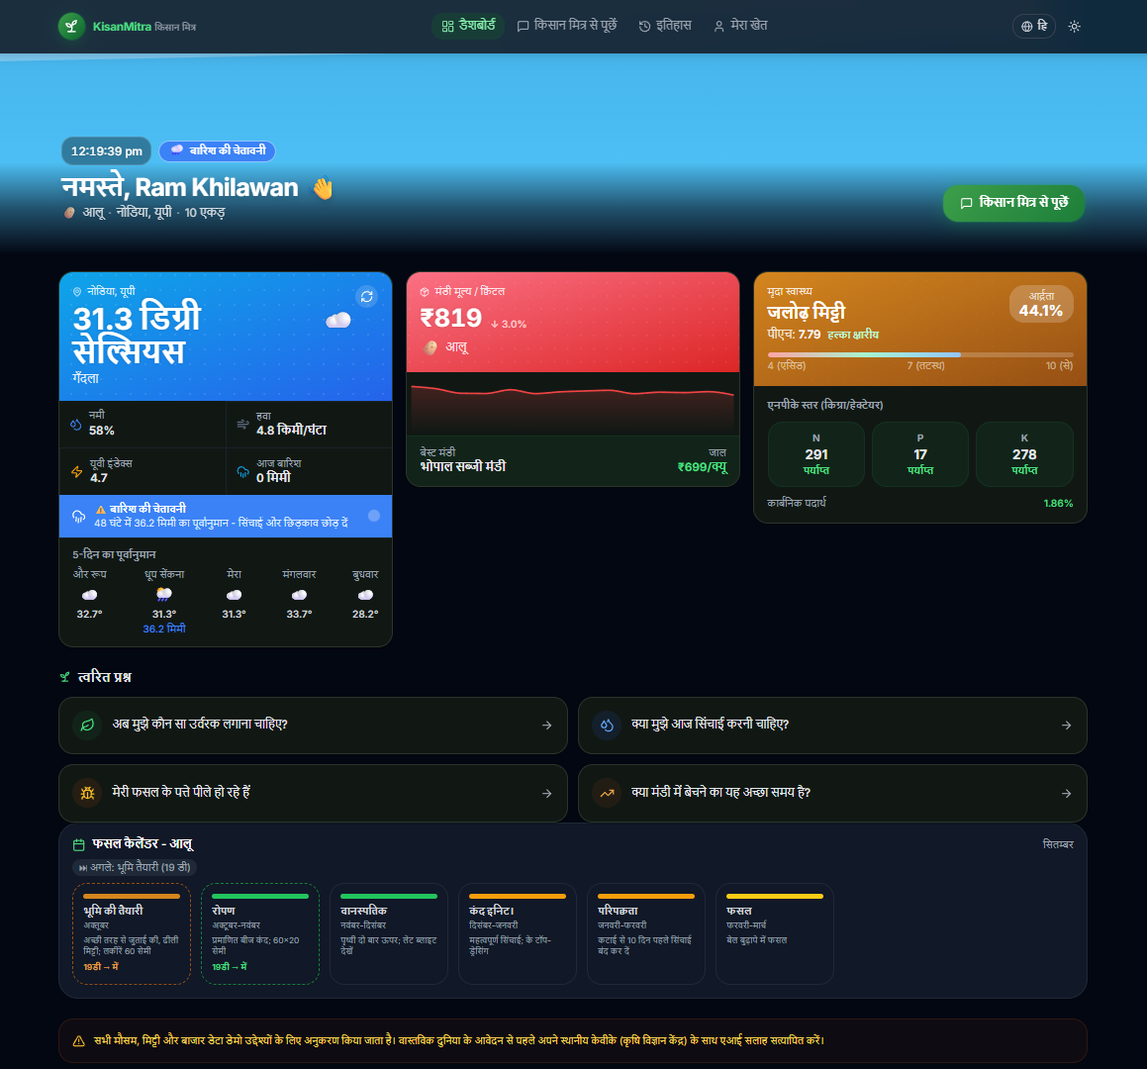
Project Output Screenshot :-
English
Hindi

Slide 15
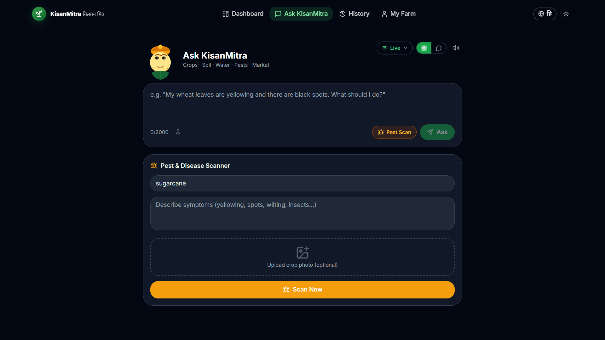
Project Output Screenshot
·
·
·

Slide 16
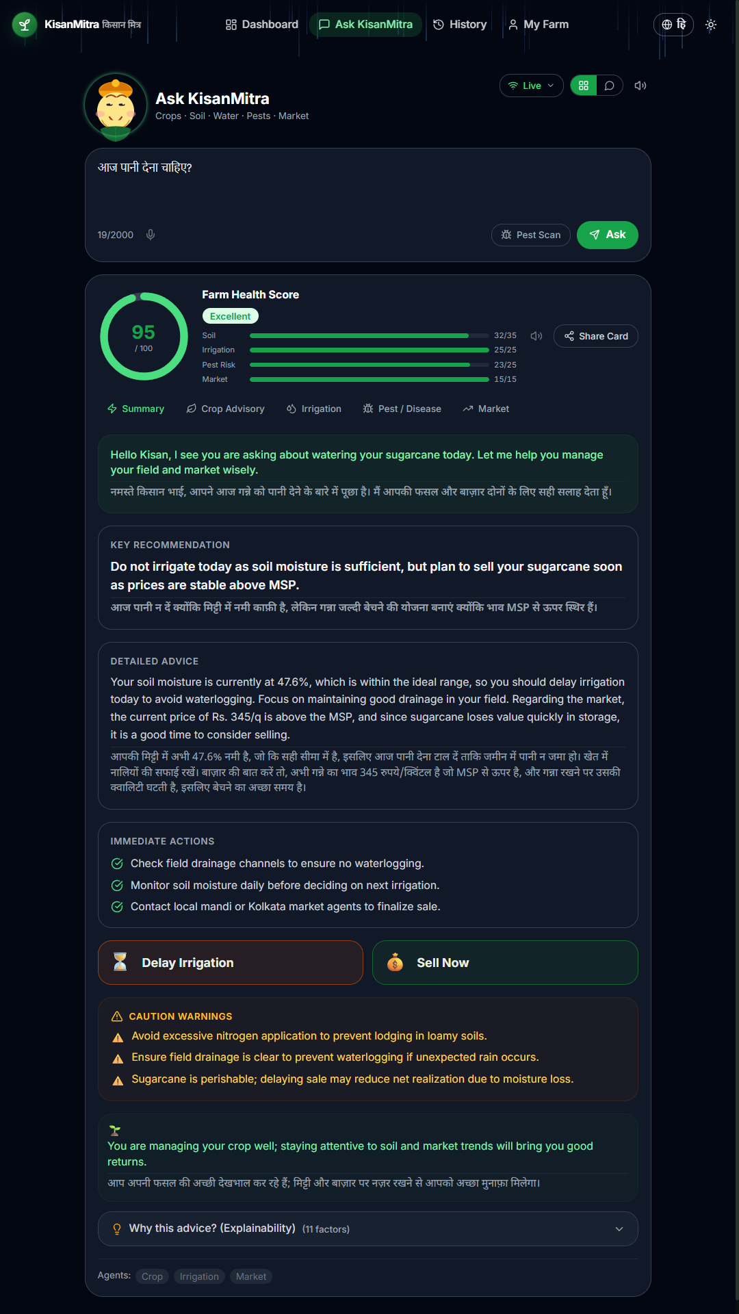
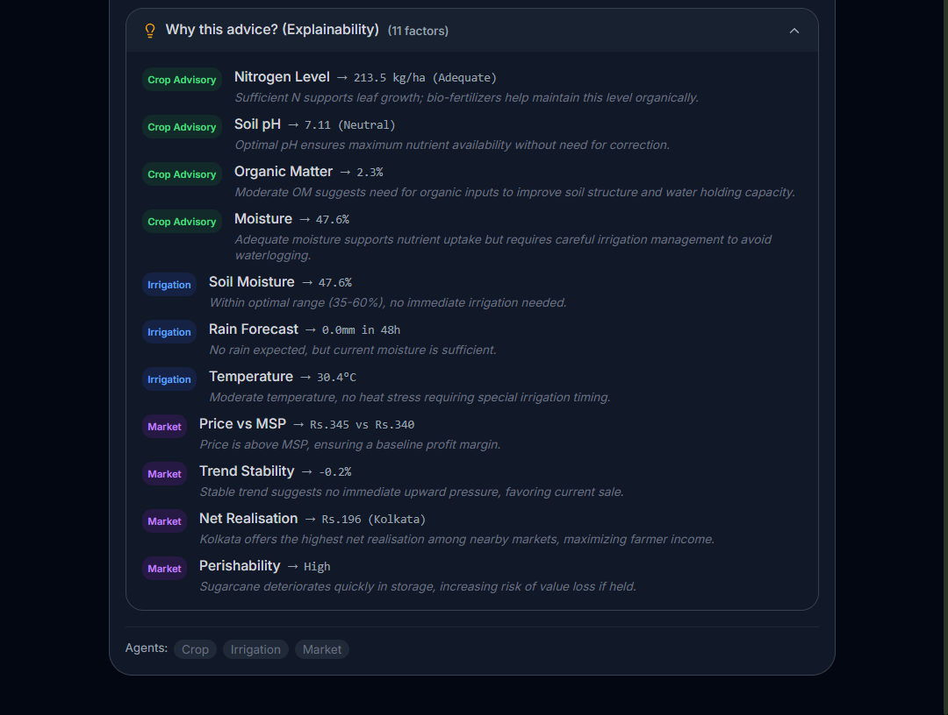
Project Output Screenshot :-
·
·
·

Slide 17
Novelty & Uniqueness :
The proposed KisanMitra AI stands out by combining Agentic AI, real-time contextual data, and farmer-centric design into a single intelligent system.
Multi-Agent Intelligence – Instead of a single chatbot, four specialized agents (Crop, Irrigation, Pest, Market) collaborate in parallel to deliver accurate, domain-specific farming guidance.
Real-Time Data Grounding – Every recommendation is grounded in live weather, soil and mandi price/MSP data rather than generic advice, reducing misinformation and improving trust.
Bilingual, Hyper-Local Personalization – Delivers guidance in both English and Hindi, tailored to the farmer's exact location, soil type, current crop and growth stage.
Real-Time Adaptive Feedback Loop – Continuously updates irrigation, pest and market advice as weather, soil and price conditions change.
Multi-Modal Input – Supports text, voice (speech-to-text and text-to-speech) and image-based pest/disease scanning for better usability among farmers with varying literacy levels.
Explainable & Transparent – Every recommendation is backed by a visible Farm Health Score and an Explainability Panel showing the reasoning behind each agent's decision, not a black-box answer.
Offline-Resilient Design – Detects poor or no connectivity and falls back to cached advisory, ensuring usability even in low-network rural areas.
Farmer-Friendly Experience – Uses a relatable mascot, live weather visualization, and shareable advisory cards to make AI guidance approachable rather than technical.
This makes the solution a smart, adaptive, and proactive digital Kisan Mitra, not just a static farming information tool.

Slide 18
Git Hub Links –
Profile – “HarshMahamalla (Harsh Mahamalla)”
Project – “HarshMahamalla/KisanMitra-AI”
Problem Statement File – “KisanMitra-AI/Problem_Statement_14.pdf at main · HarshMahamalla/KisanMitra-AI”
All Agent relevant folders :
Services –
“KisanMitra-AI/services at main · HarshMahamalla/KisanMitra-AI”
Data –
“KisanMitra-AI/mock_data at main · HarshMahamalla/KisanMitra-AI”
App.py –
“KisanMitra-AI/app.py at main · HarshMahamalla/KisanMitra-AI”
Requirements.txt –
“KisanMitra-AI/requirements.txt at main · HarshMahamalla/KisanMitra-AI”
Images –
“KisanMitra-AI/IMGs at main · HarshMahamalla/KisanMitra-AI”
·
·
·

Slide 19
Future Scope :
1. Integration with IoT Field Sensors & Satellite Data –
Replace mock data with real soil moisture sensors, weather stations and NDVI satellite imagery for farm-specific accuracy.
2. Expanded Regional Language & Voice Support –
Add more Indian regional languages (Marathi, Punjabi, Tamil, Telugu, etc.) for wider accessibility.
3. Government Scheme & Subsidy Integration –
Connect farmers to relevant crop insurance, MSP procurement and subsidy schemes based on their profile.
4. Community & Expert Connect –
Enable farmers to consult local Krishi Vigyan Kendra (KVK) experts or peer farmers directly within the app for complex cases.
5. Predictive Analytics for Yield & Disease Outbreaks –
Use historical data trends to forecast pest outbreaks or yield estimates before they occur, enabling proactive planning.
·
·
·

Slide 20
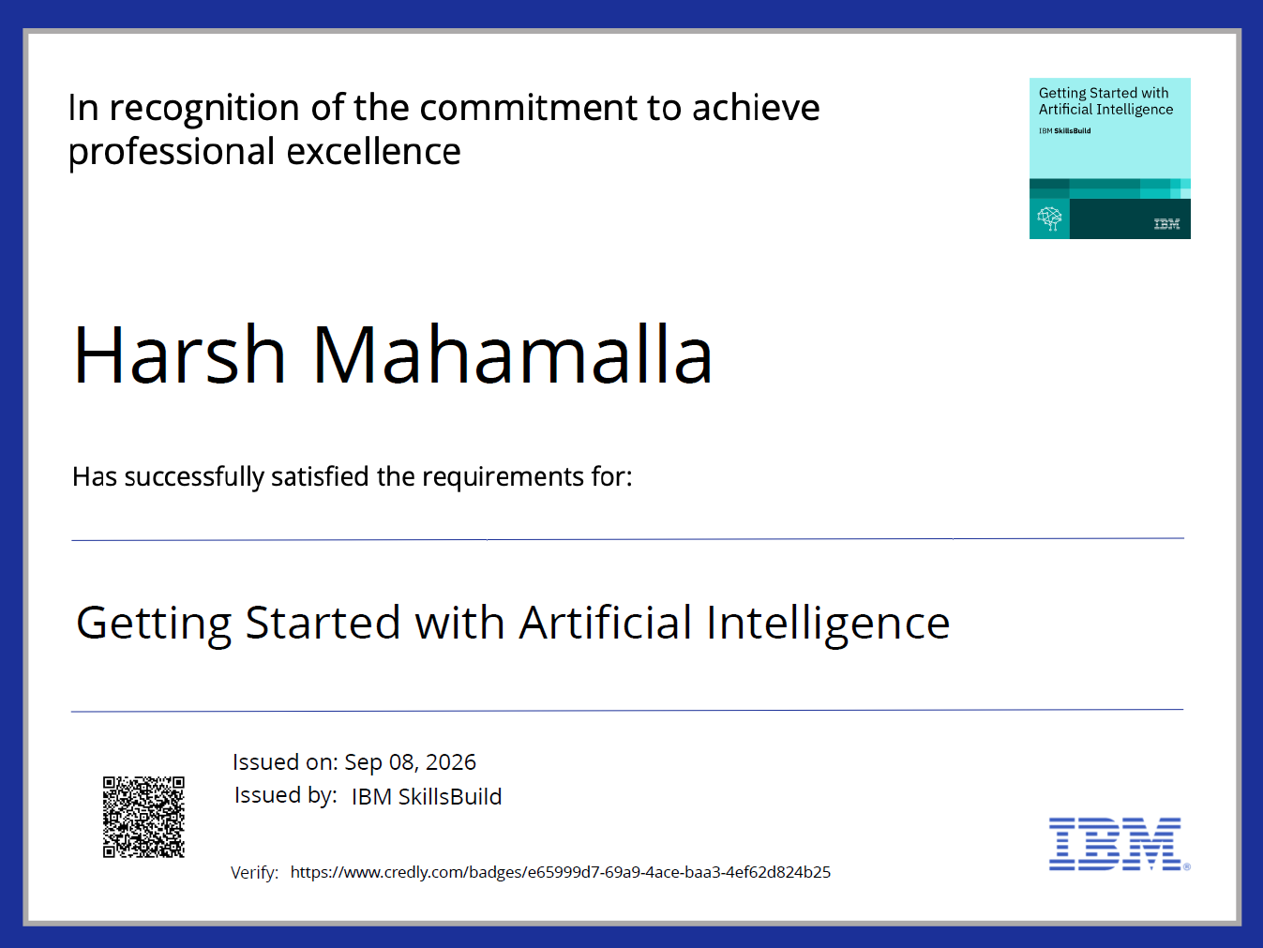
Certificates Earned :-
(Credly Certificates)
1. Getting Started with Artificial Intelligence

Slide 21
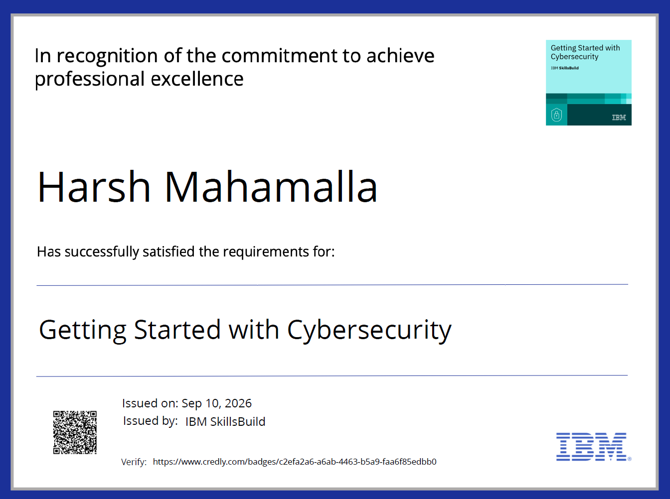
Certificates Earned :-
(Credly Certificates)
2. Getting Started with Cybersecurity

Slide 22
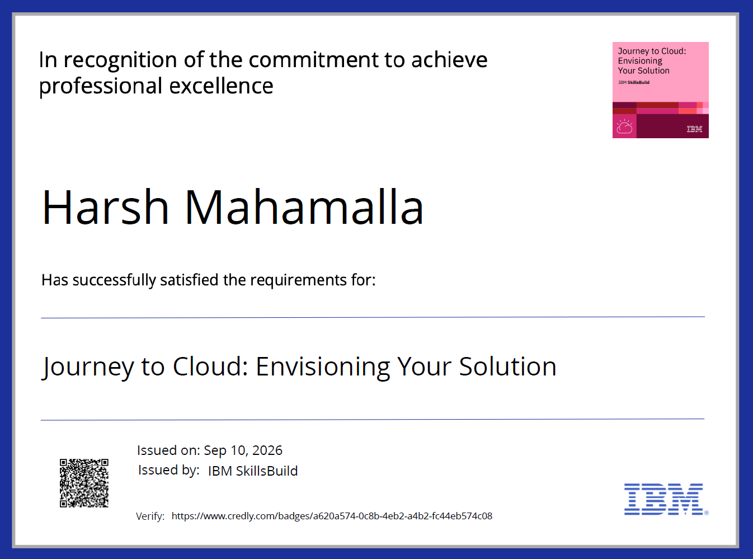
Certificates Earned :-
(Credly Certificates)
3. Journey to Cloud: Envisioning Your Solution

Slide 23
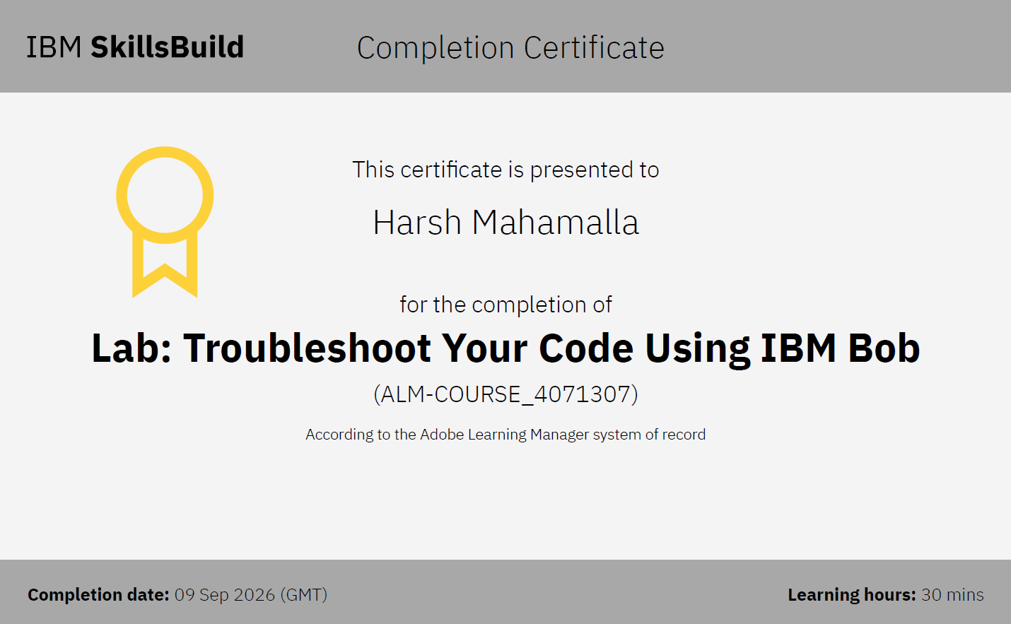
Certificates Earned :-
(IBM Certificates)
1. Lab: Troubleshoot Your Code Using IBM Bob

Slide 24

Certificates Earned :-
(IBM Certificates)
2. Level Up Cybersecurity with Generative AI

Slide 25

Certificates Earned :-
(IBM Certificates)
3. Responding to Live Cybersecurity Incidents Using Generative AI

Slide 26

Certificates Earned :-
(IBM Certificates)
4.Exploring Quantum Computing

Slide 27
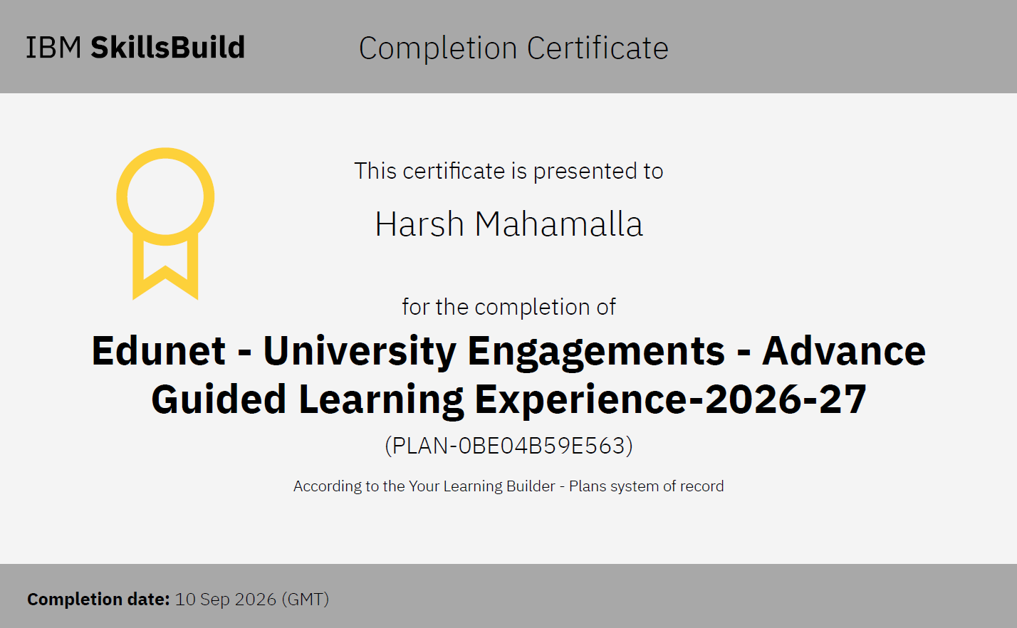
Certificates Earned :-
(IBM Certificates)
5. Edunet – University Engagements – Advance Guided Learning Experience – 2026-27

Slide 28


