Slide 1
Cloud-Native Data Architecture: Streamlining MSBA Financial Group’s Data Operations and Predicting Bankruptcy Risk By Harsh Mehta

Slide 2
Goal of the project : * Develop a cloud-native data architecture in AWS that centralizes and optimizes MSBA Financial Group's data operations. * Implement a scalable data lake using AWS S3 to efficiently store and manage diverse incoming data. * Design and execute ETL processes using AWS Glue to transform raw data into analysis-ready formats. * Create a centralized data warehouse cluster in AWS Redshift. * Leverage AWS SageMaker Canvas to perform exploratory data analysis and develop a machine learning model for bankruptcy prediction. * Generate actionable insights to guide investment decisions

Slide 3
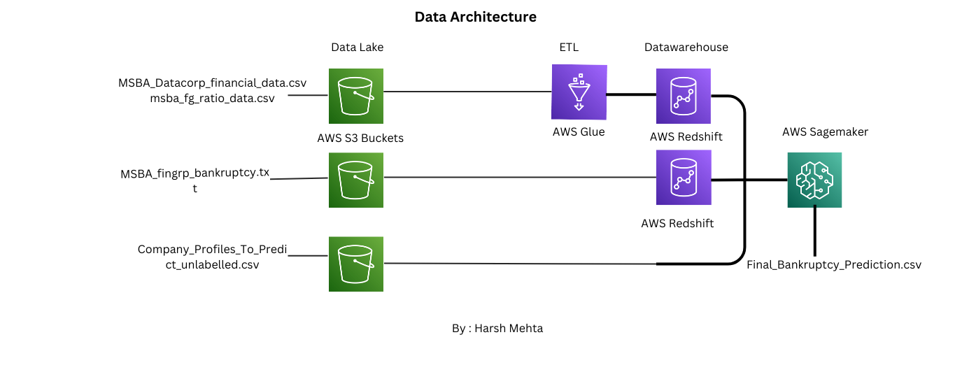

Slide 4
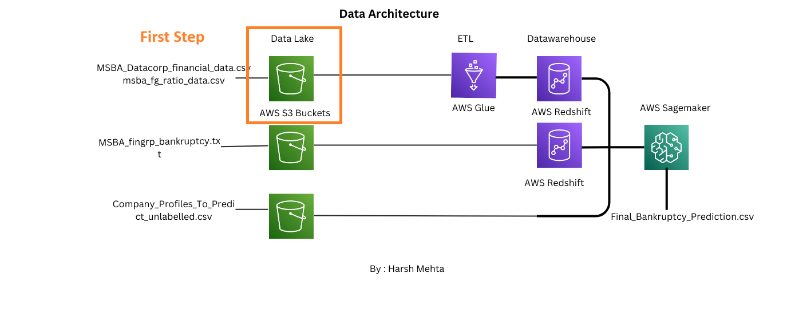

Slide 5
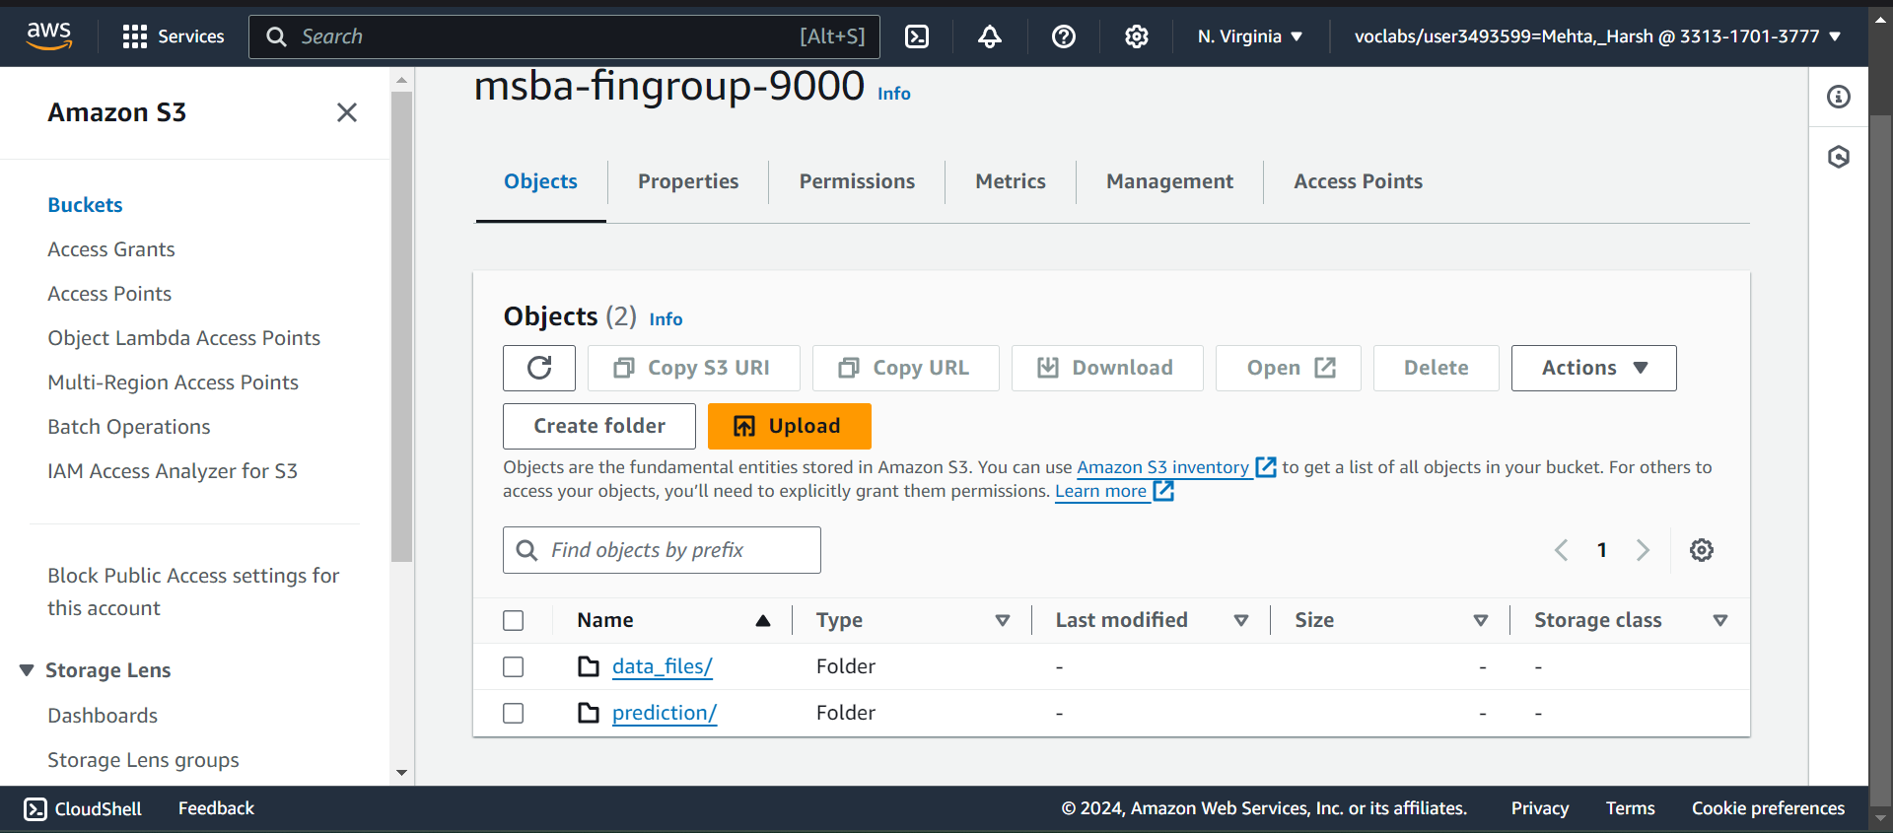

Slide 6
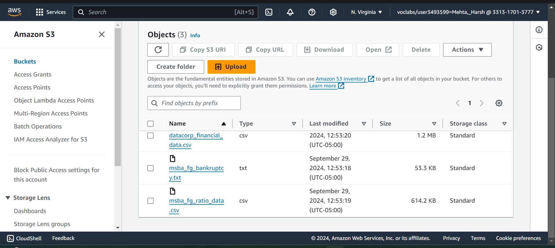

Slide 7
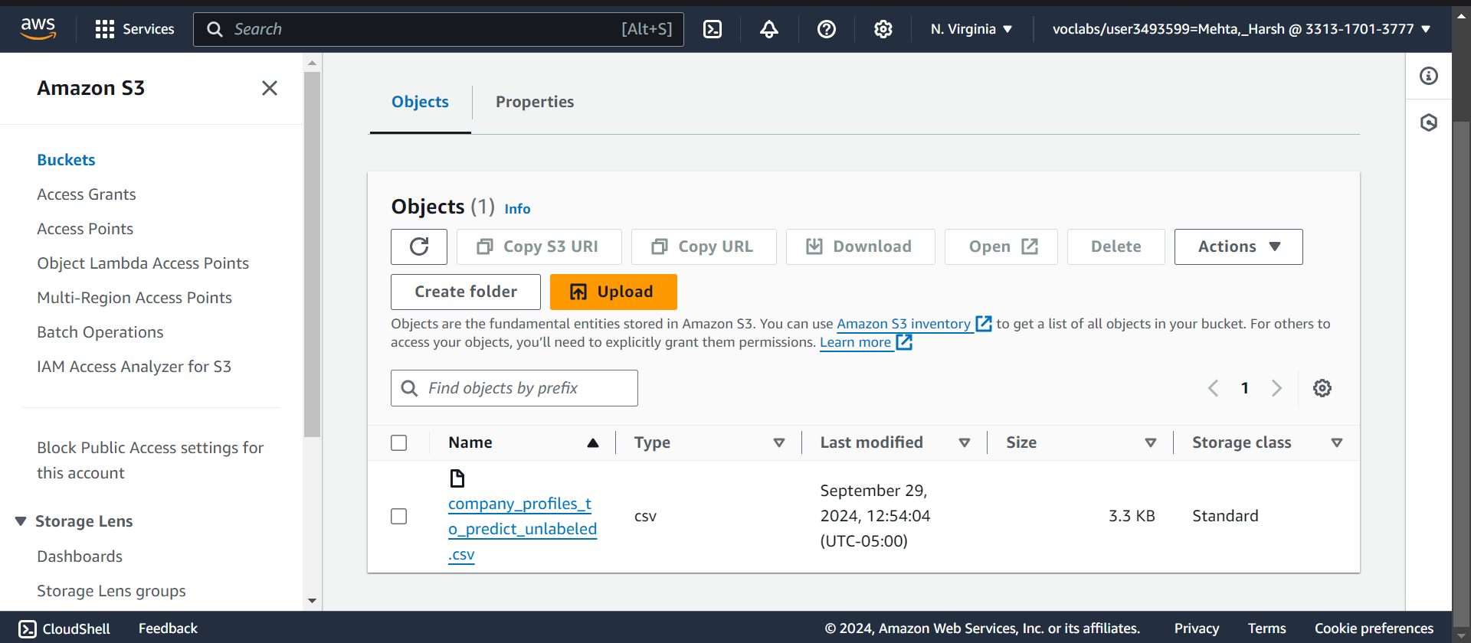

Slide 8
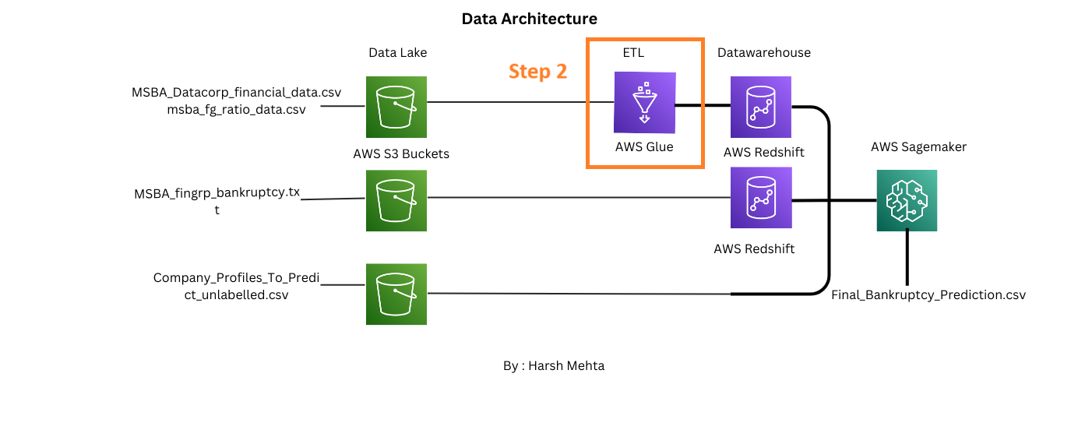

Slide 9
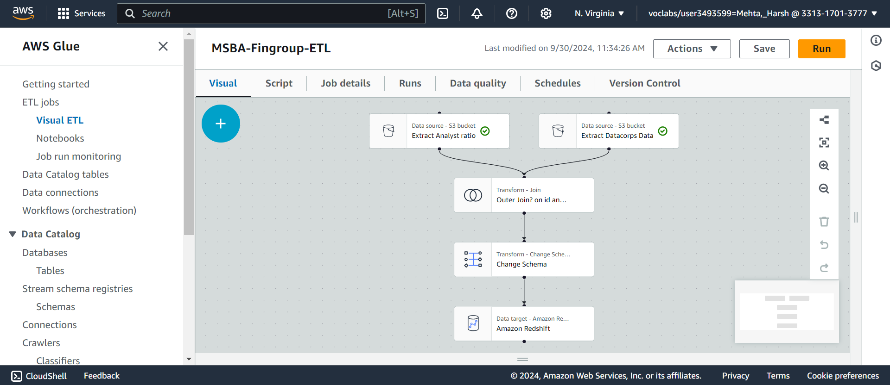

Slide 10
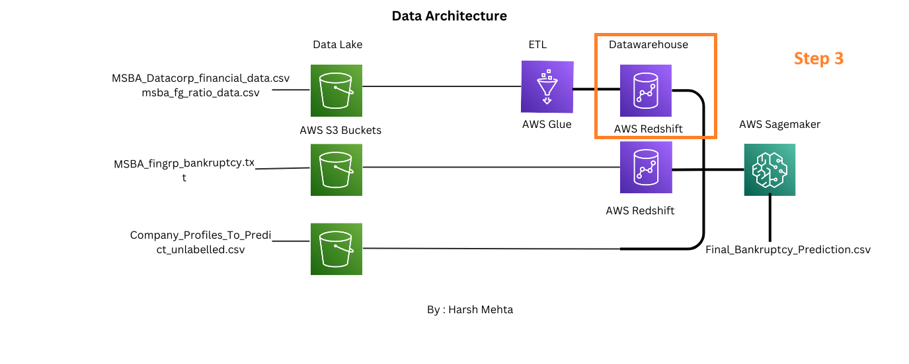

Slide 11
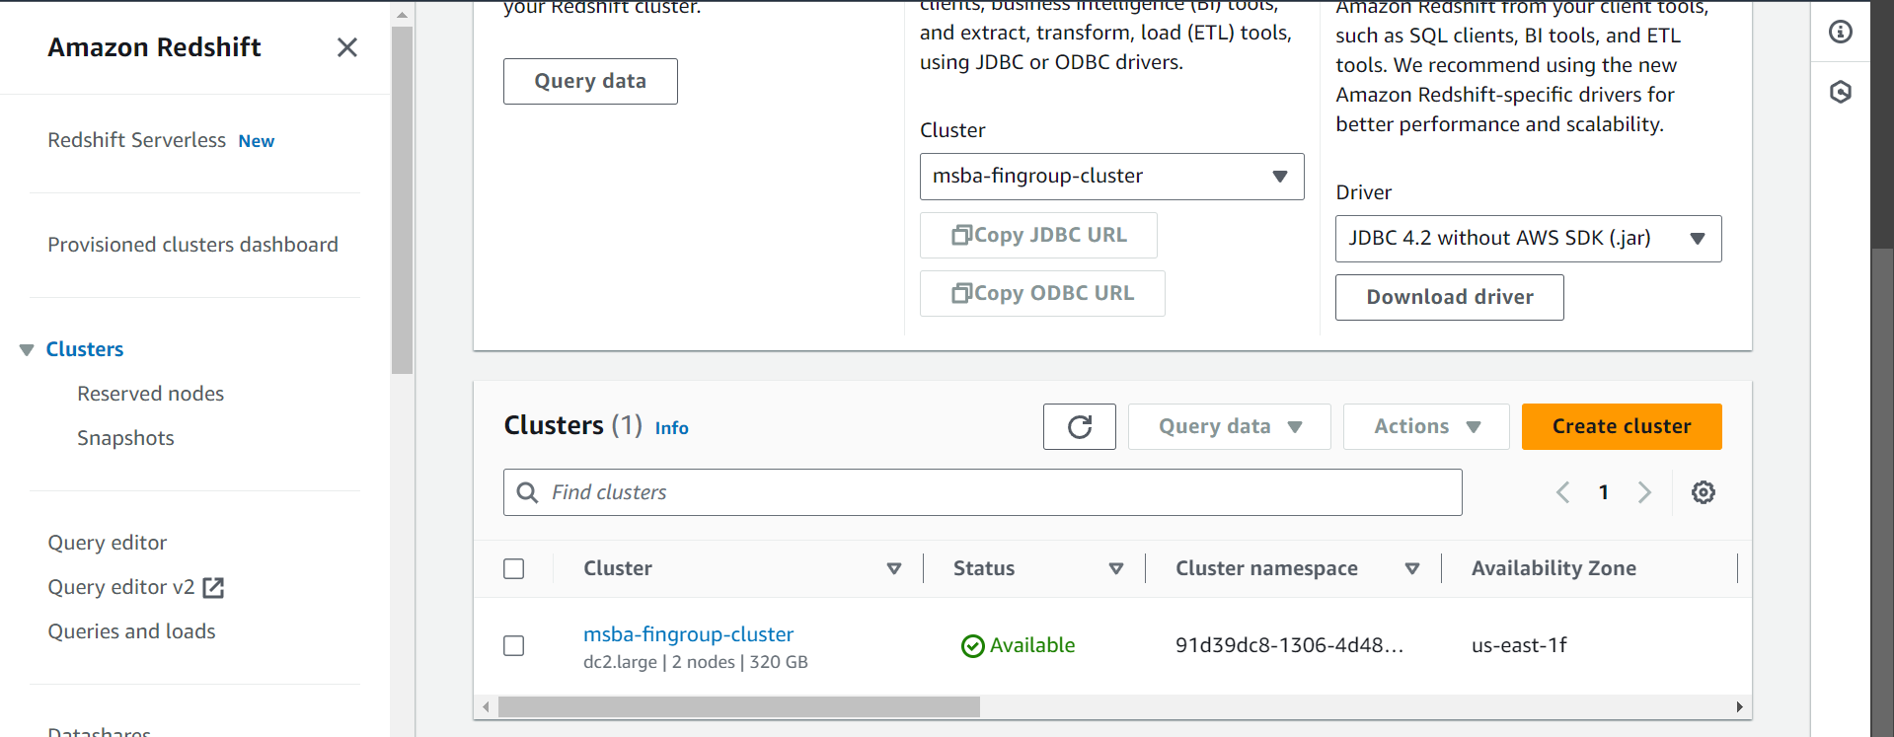

Slide 12
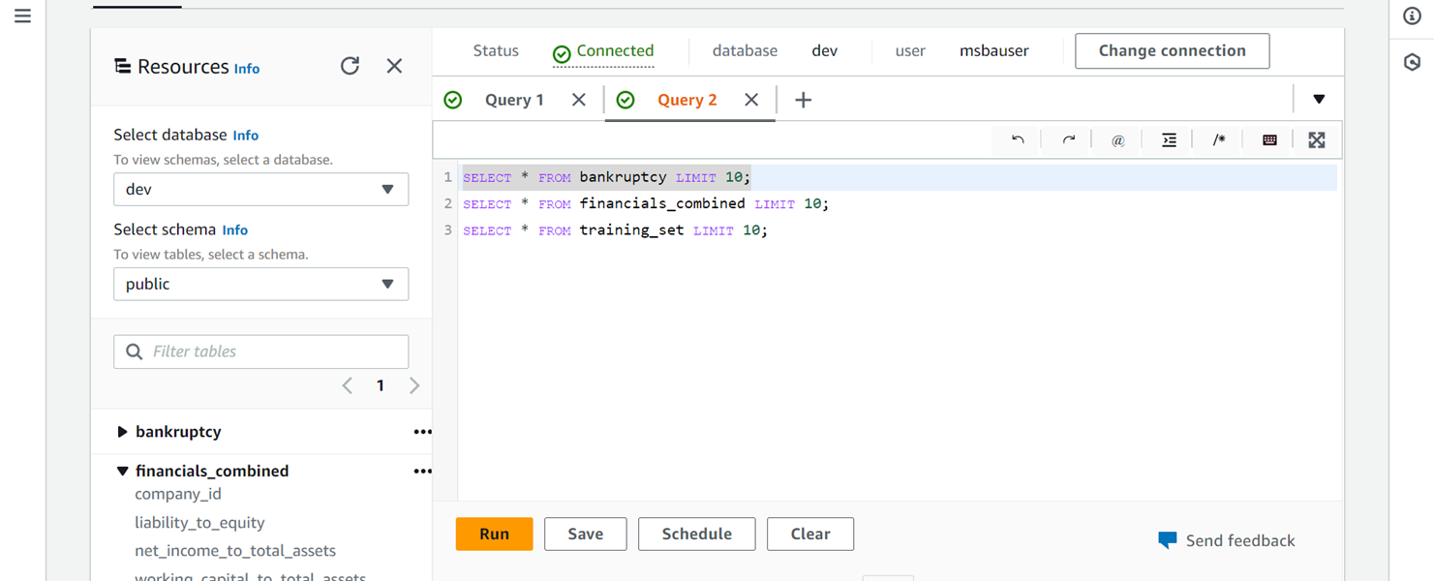

Slide 13
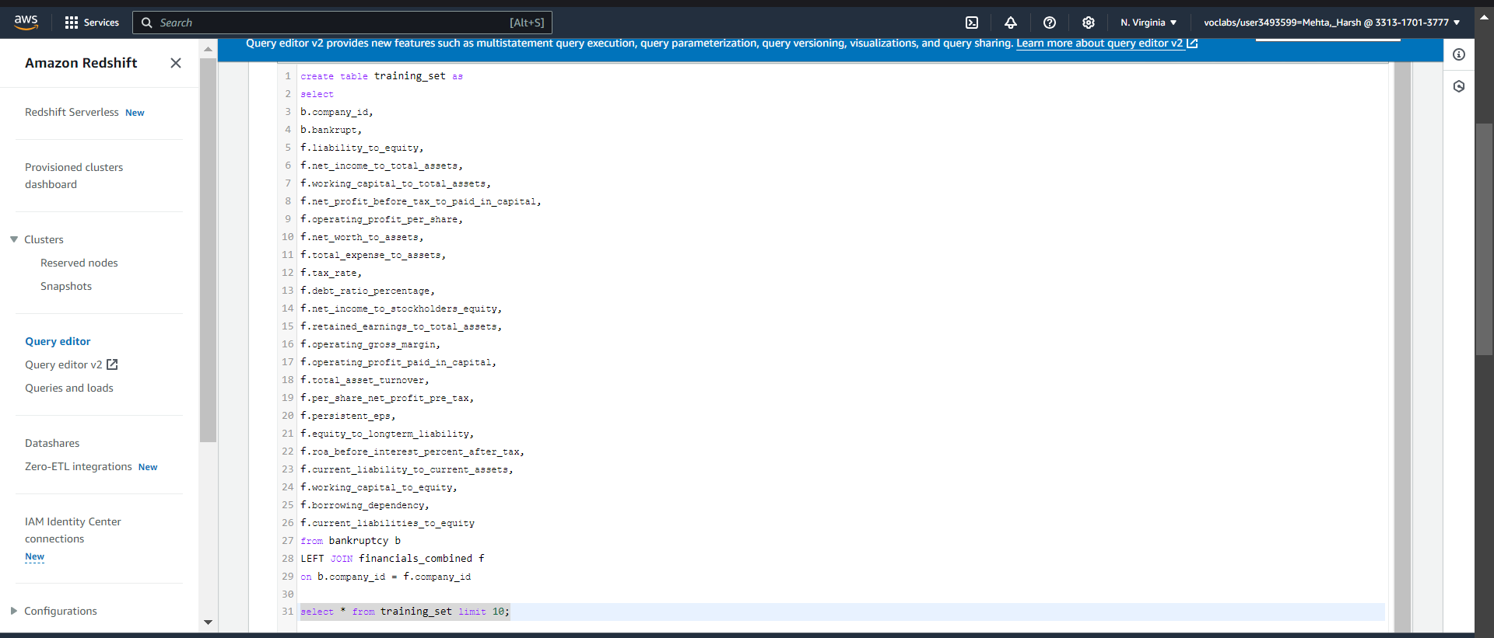

Slide 14
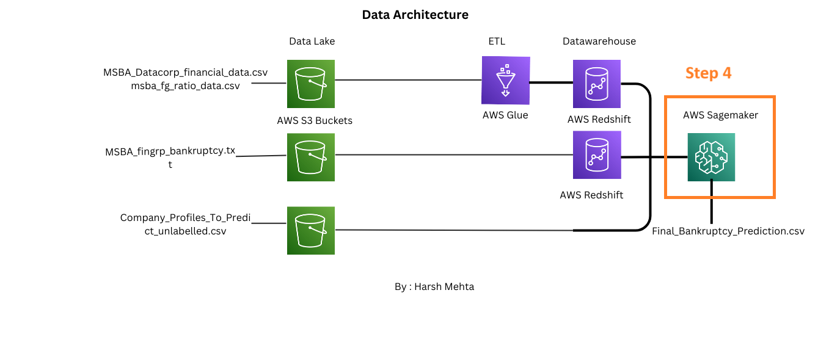

Slide 15
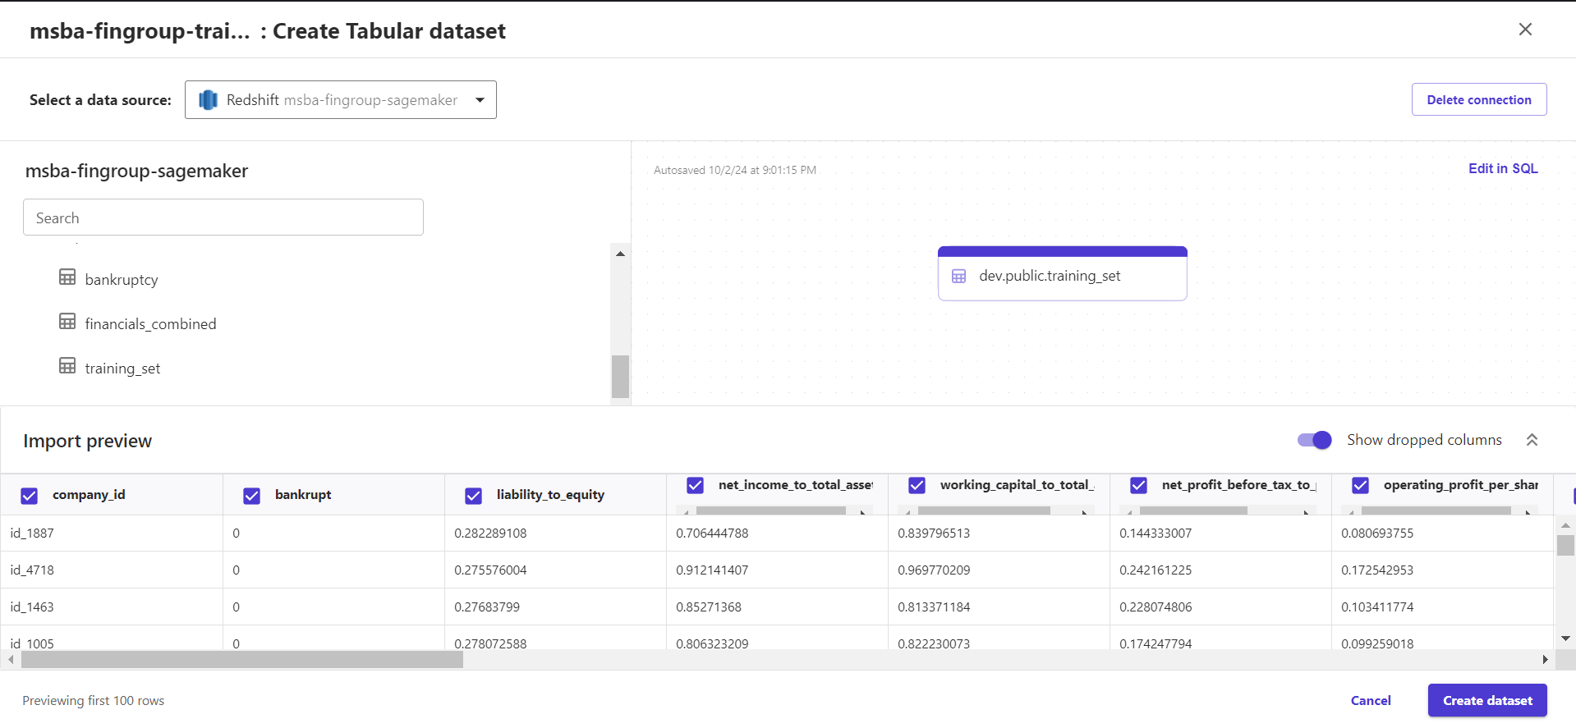

Slide 16
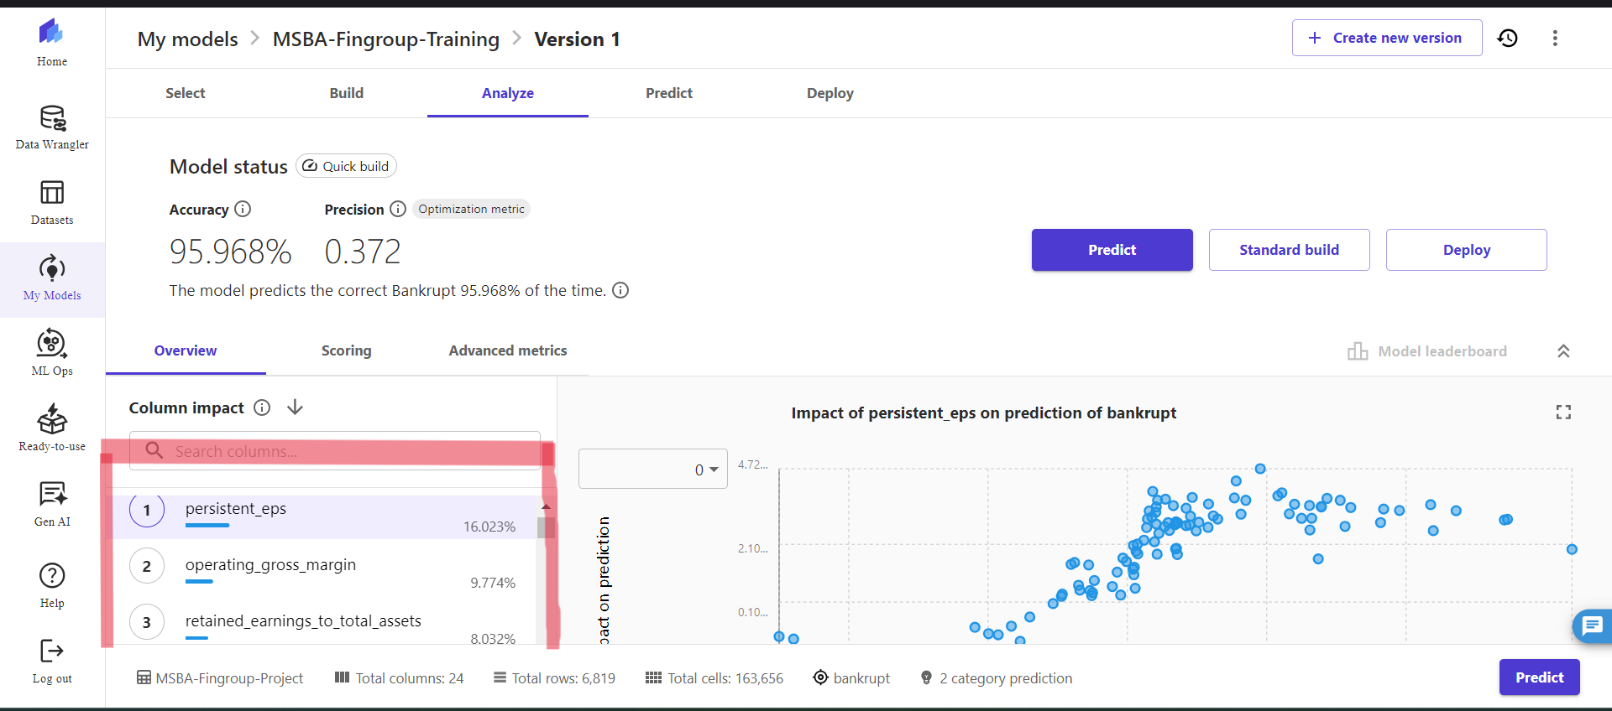
EDA Insights 1 :

Slide 17
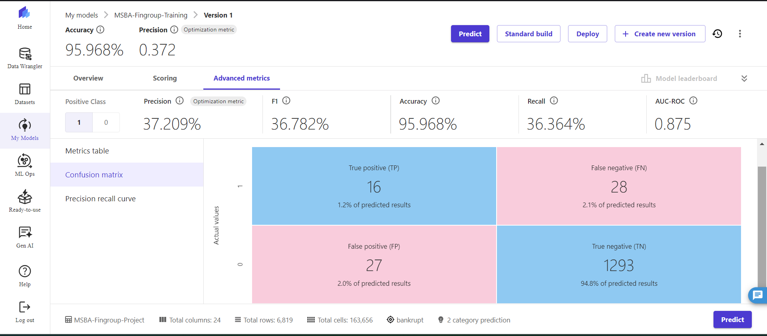
EDA Insights 2 :

Slide 18
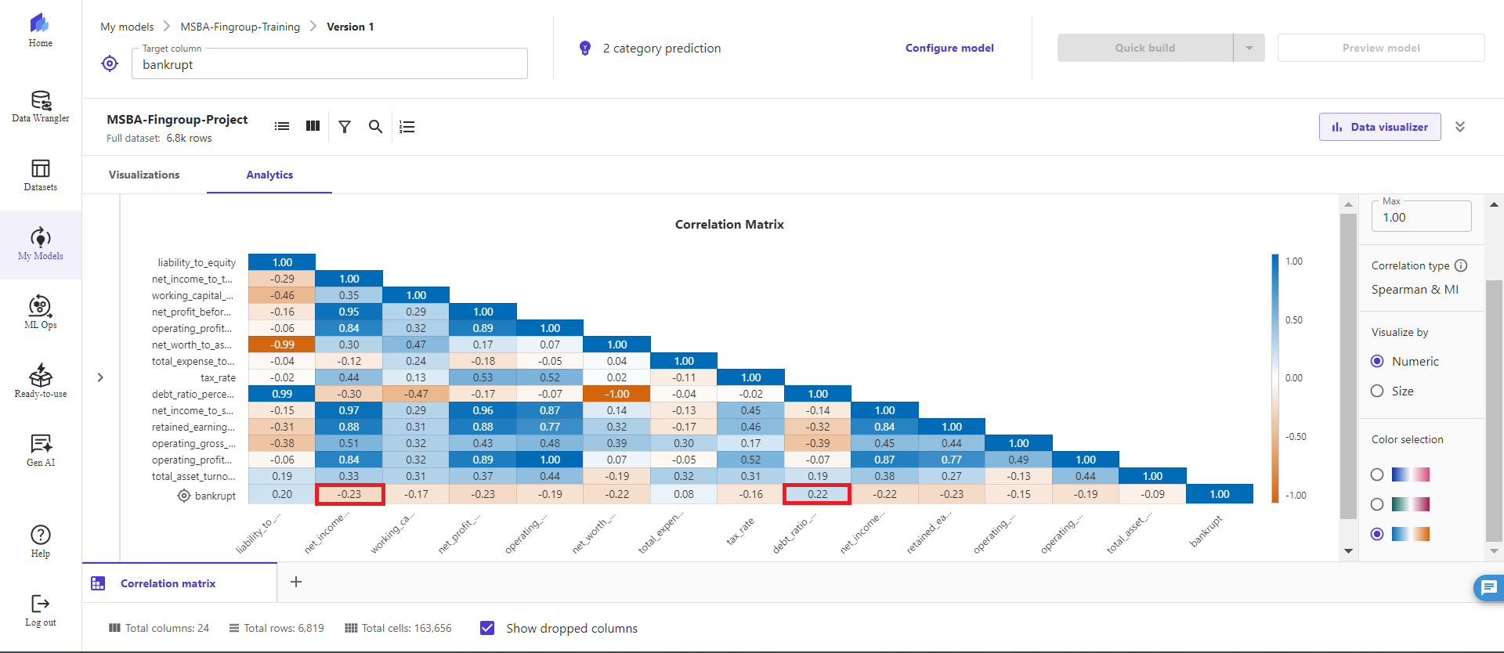
EDA Insights 3 :

Slide 19

Insights from ML Model

Slide 20
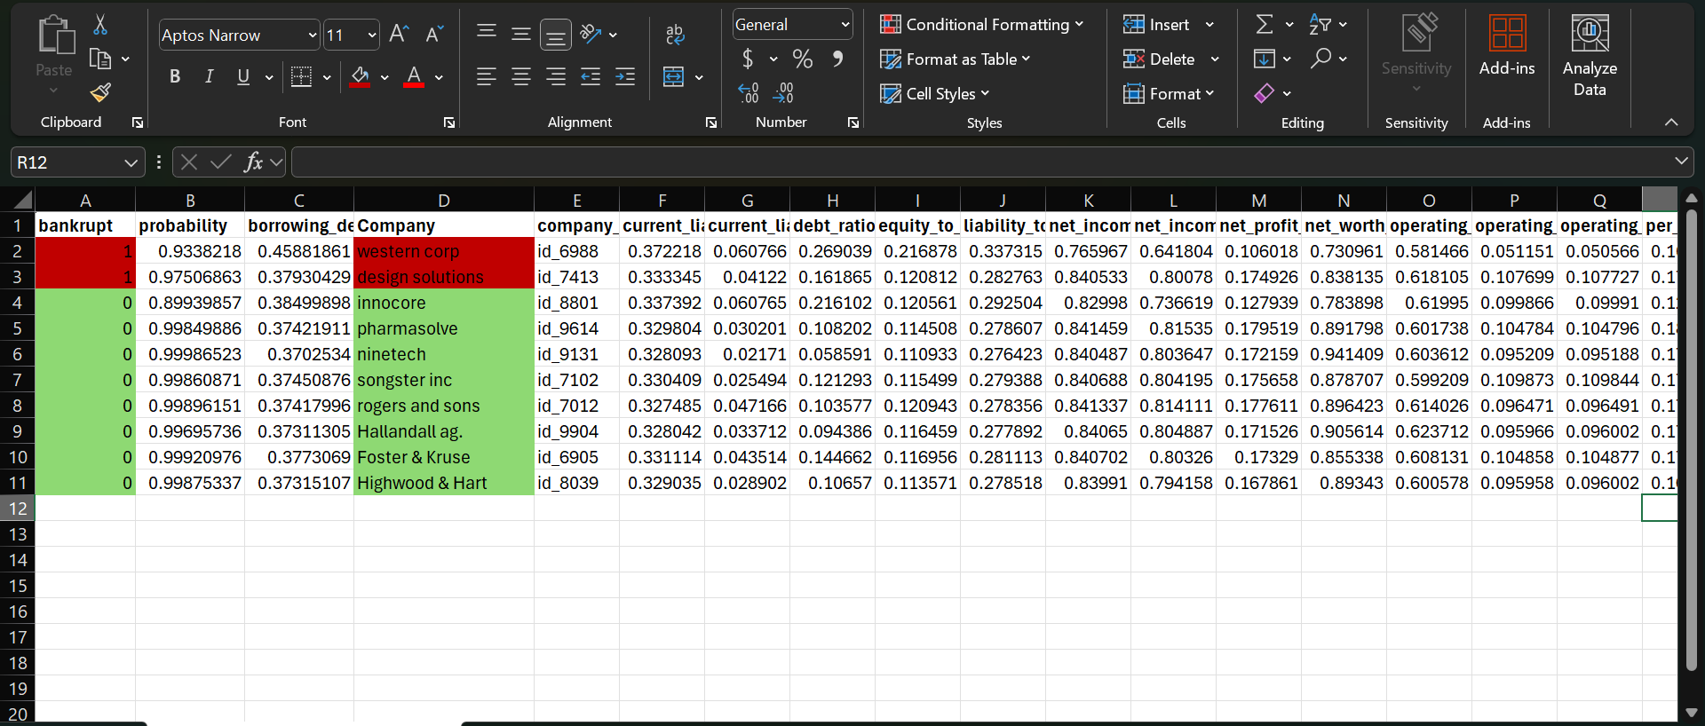
Insights from Prediction :

Slide 21
INVESTMENT INSIGHTS
High-Risk Alert:
Western Corp
Design Solutions ⚠️ These companies show elevated bankruptcy risk. Avoid for long-term investment.
Recommended Portfolio:
Innocore
Pharmasolve
Ninetech
Songster Inc
Rogers and Sons
Hallandall Ag.
Foster & Kruse
Highwood & Hart
Key Action: ✅ Focus on these 8 companies for a balanced, lower-risk investment strategy. 🔍 Continuously monitor financial health and market conditions.

Slide 22
Thank you
Presented by : Harsh Mehta

