Slide 1


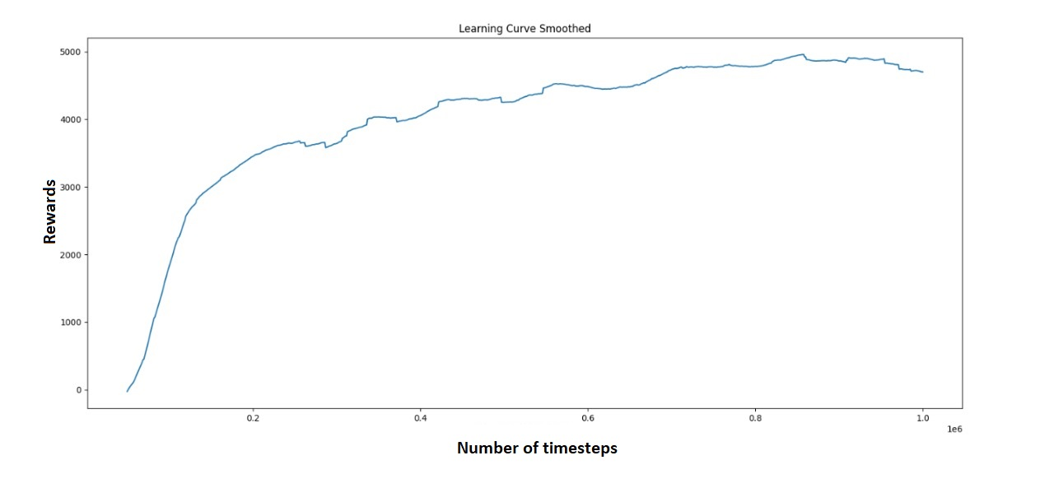
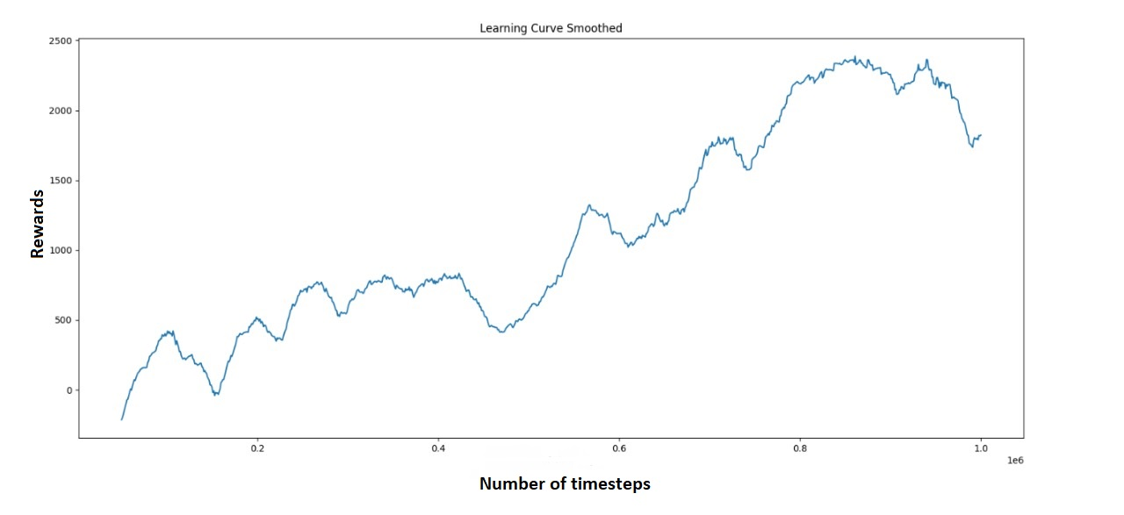
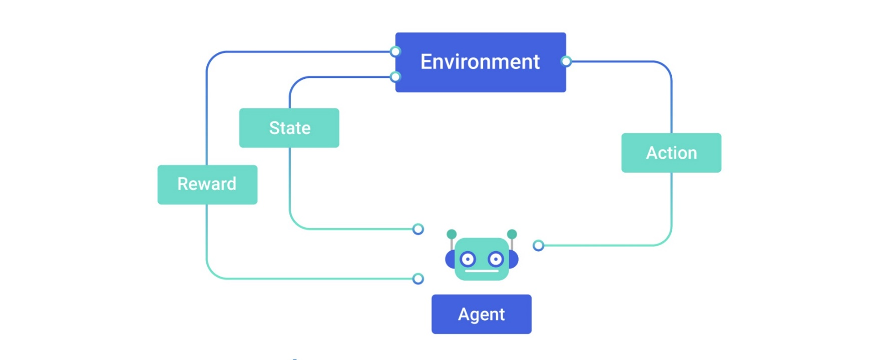
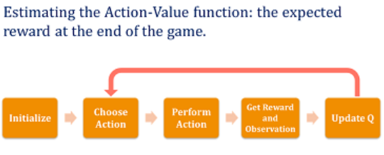
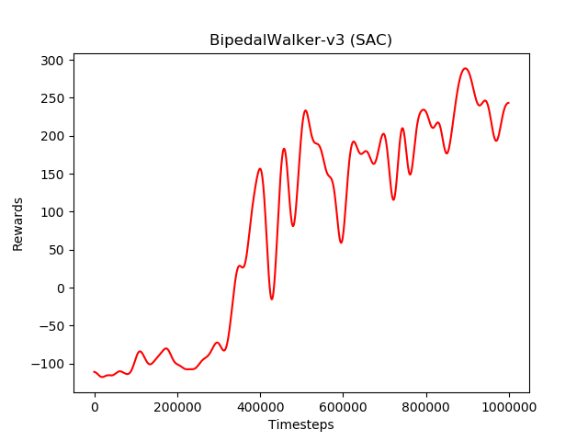
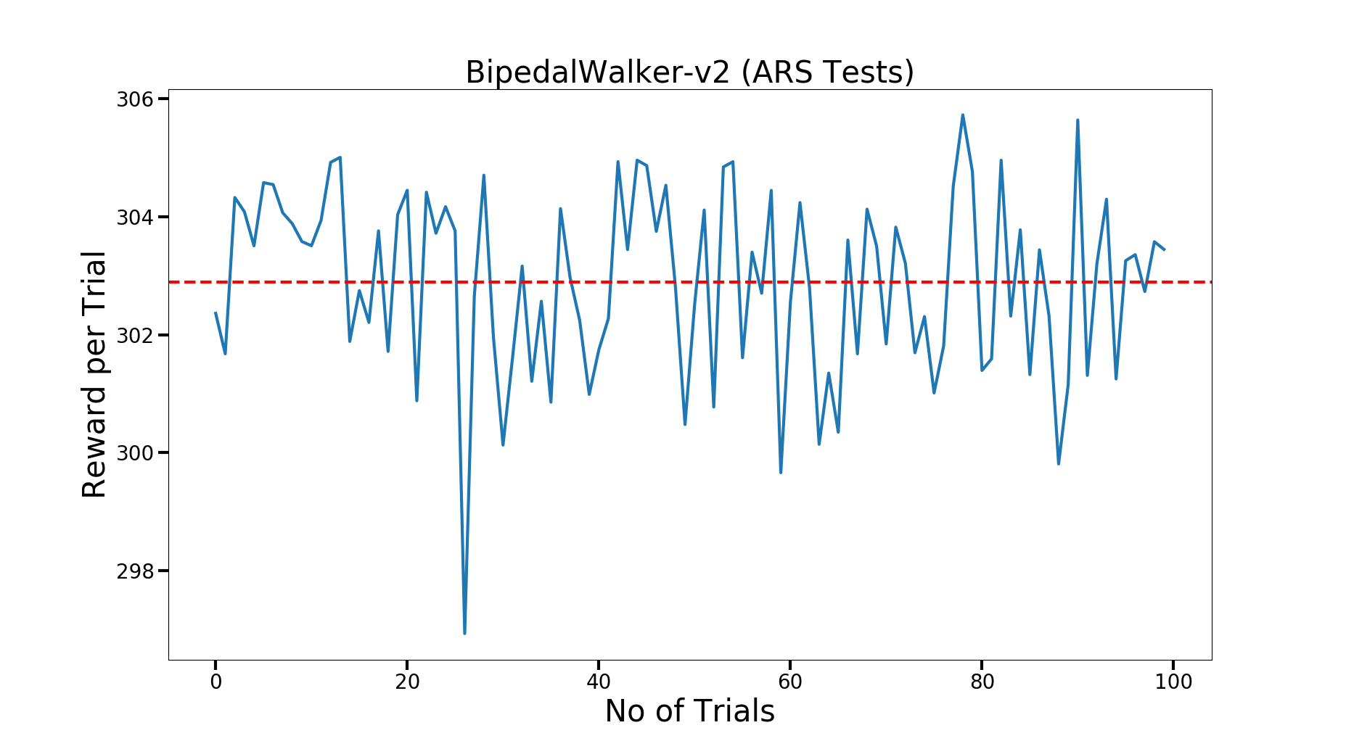
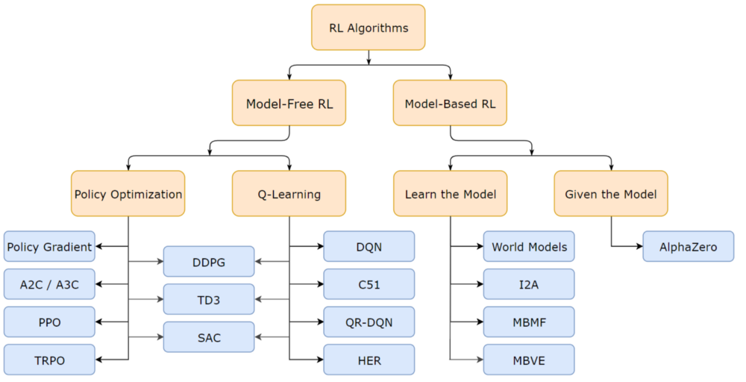
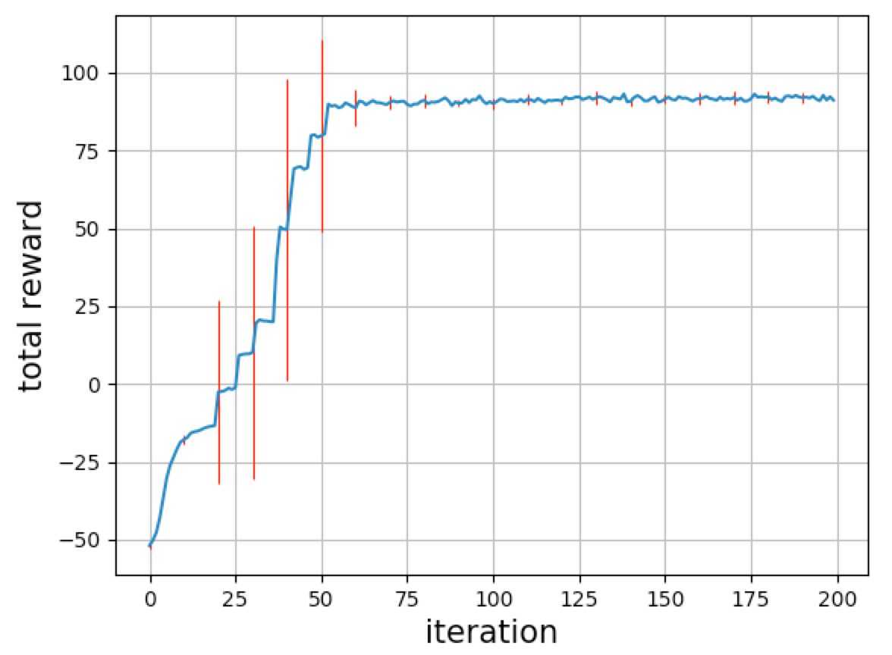
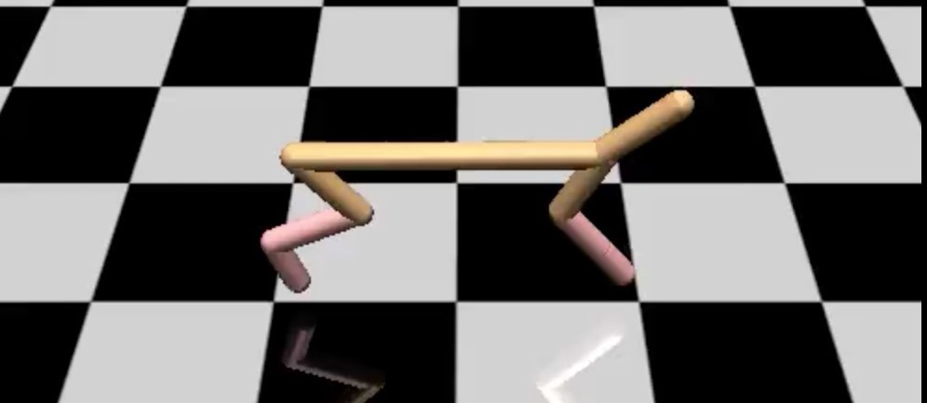
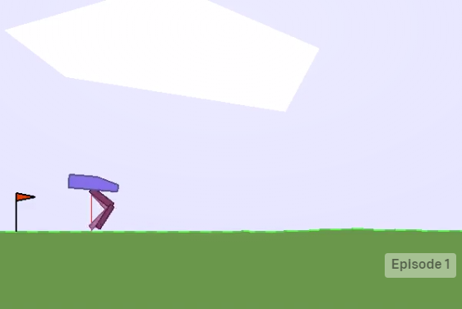
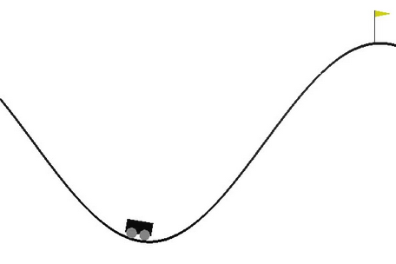
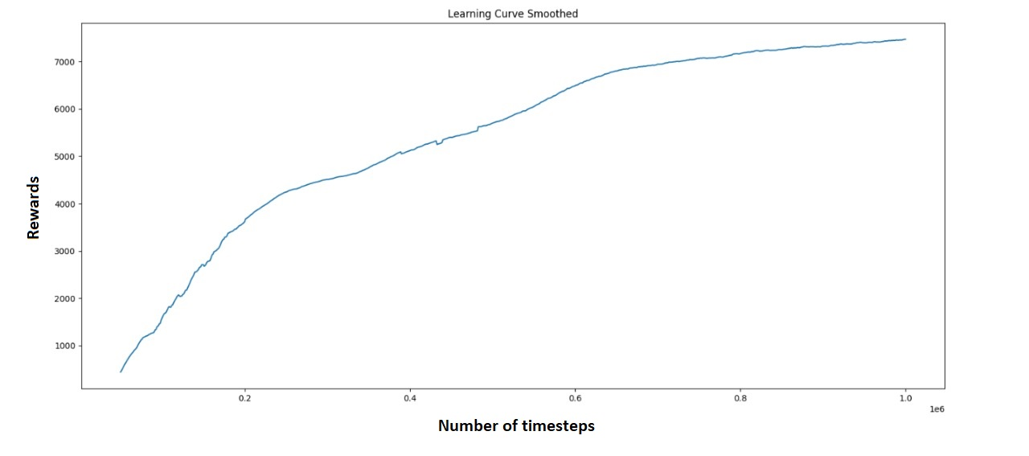

Topic: Deep Reinforcement Learning
To train
locomotion activity in Robots
By: Harsh Vyas
Prem Swarap
Manuel George
Balasurya M
Marlin Shah
Mentor: Ms. Surbhi Gupta
Abstract
In this project, we will train simulated robot that learn locomotion gaits automatically using Reinforcement learning algorithms.
SAC
Introduction
Reinforcement Learning: Learning to act through trial and error.
DDPG
Q Learning:
Bipedal Walker:
Reinforcement learning algorithms:
SAC
PPO2
Mountain Car:
PPO2
PPO2
State of the art model
The Models implemented are as follows:
All algorithms were successfully implemented on their desired models.
1. Half-Cheetah using TD3, DDPG and SAC
The graphs above are the comparison of rewards owned per timesteps. We can see that learnings vary from one model to another.
From graphs of :
1. Half Cheetah model we can say that TD3 performs better in comparison of DDPG and SAC.
2. Bipedal Walker model we can say that SAC performs better than PPO2..
2. Bipedal Walker using SAC and PPO2
Conclusions
We have done Deep Reinforcement Learning to train locomotion activity in Robots which is given to us by LeadingIndia. We have used various deep reinforcement learning algorithms for training the models. Out of which TD3 and SAC achieved highest accuracies.
3. Mountain walking car using PPO2
References
Experimental Results and Discussion
1. Playing Atari with Deep Reinforcement Learning, Mnih et al, 2013. Algorithm: DQN.
2. Deep Recurrent Q-Learning for Partially Observable MDPs, Hausknecht and Stone, 2015. Algorithm: Deep Recurrent Q-Learning.
3. Scott Fujimoto, Herke van Hoof, David Meger “Addressing Function Approximation Error in Actor-Critic Methods”,2018.
4. Soft actor-critic: Off-policy maximum entropy deep reinforcement learning with a stochastic actor- T Haarnoja, A Zhou, P Abbeel, S Levine
Half Cheetah:
TD3
Team No. - 8

