Slide 1

Shortest path using parallel computing
SUBMITTED BY :
HARSH PARWAL (20BCE1929)
PARTH KUMAR THAKUR (20BCE1592)
OJASV PARASHAR (20BCE1588)

Slide 2
ABSTRACT
Roads play a major role in the lives of people living in various states, cities, towns and villages. From their daily travel to work, to schools, to business meetings, to the transport of goods and enablement of services, roads play major role in facilitating rural and urban life. In this modern era, where roads have been laid down in the most remote locations, they prove to be one of the most useful mediums for transportation and travel. The manipulation of shortest paths between various locations sometimes proves to be tricky when dealing with complex road networks. Dijkstra's Algorithm is used to overcome the problem of finding shortest path. The main objective of this algorithm is to find shortest path between two points or nodes in any network with minimum cost implementation. Dijkstra algorithm overcomes the drawbacks of Floyd Warshall Algorithm as well as Bellman Ford Algorithm but it can be improvised if we implement it parallelly. Hence, in this project we will try to improvise the algorithm using parallel computing.

Slide 3
PROBLEM STATEMENT
Roads have been laid down in the most remote locations and they prove to be one of the most useful mediums for transportation and travel. But due to environmental factors and nature of the transport, drivers face enormous hurdles and usually have to travel more than necessary. Devising a method to properly plan out routes and stops for efficient delivery will help to reduce stress on drivers and benefit the transport company as well as the client since deliveries will take less time and can be made more frequently.

Slide 4
INTRODUCTION
Dijkstra's Algorithm is used to overcome the problem of finding shortest path. The main objective of this algorithm is to find shortest path between two points or nodes in any network with minimum cost implementation. Dijkstra algorithm overcomes the drawbacks of Floyd Warshall Algorithm as well as Bellman Ford Algorithm but it can be improvised if we implement it parallelly. Hence, in this project we will try to improvise the algorithm using parallel computing.

Slide 5
OBJECTIVES
Show how Dijkstra’s Algorithm is better than Floyd Warshall Algorithm and Bellman Ford Algorithm.
Implement Dijkstra Algorithm using Parallel Computing.
Show how proposed algorithm is better than the previous one.
Compare the time complexities.

Slide 6
METHODOLOGY
Our main focus in this project is to reduce the time taken during the transportation of goods or public transport. For traversing all the destination points we are using an algorithm called Dijkstra’s Algorithm which calculates the shortest paths to all points.
Dijkstra algorithm overcomes the drawbacks of Floyd Warshall Algorithm as well as Bellman Ford Algorithm but it can be improvised if we implement it parallelly. Hence, in this project we will try to improvise the algorithm using parallel computing.

Slide 7
IMPLEMENTATION

Slide 8
FLOYD WARSHALL ALGORITHM
The Floyd Warshall Algorithm is for solving the All Pairs Shortest Path problem. The problem is to find shortest distances between every pair of vertices in a given edge weighted directed Graph.
We initialize the solution matrix same as the input graph matrix as a first step. Then we update the solution matrix by considering all vertices as an intermediate vertex. The idea is to one by one pick all vertices and updates all shortest paths which include the picked vertex as an intermediate vertex in the shortest path.

Slide 9
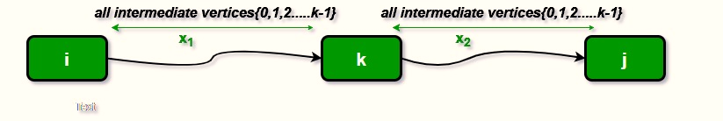
When we pick vertex number k as an intermediate vertex, we already have considered vertices {0, 1, 2, .. k-1} as intermediate vertices. For every pair (i, j) of the source and destination vertices respectively, there are two possible cases.
1) k is not an intermediate vertex in shortest path from i to j. We keep the value of dist[i][j] as it is. 2) k is an intermediate vertex in shortest path from i to j. We update the value of dist[i][j] as dist[i][k] + dist[k][j] if dist[i][j] > dist[i][k] + dist[k][j]
The following figure shows the above optimal substructure property in the all-pairs shortest path problem.

Slide 10
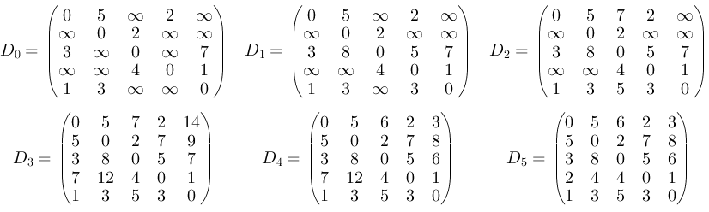
EXAMPLE

Slide 11
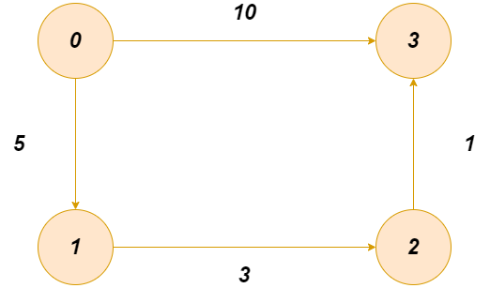
GRAPH

Slide 12
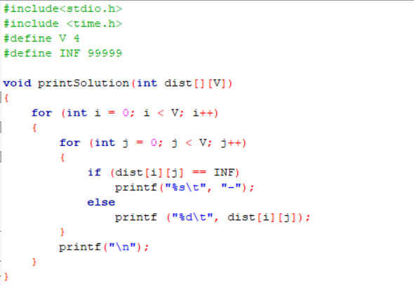
CODE

Slide 13
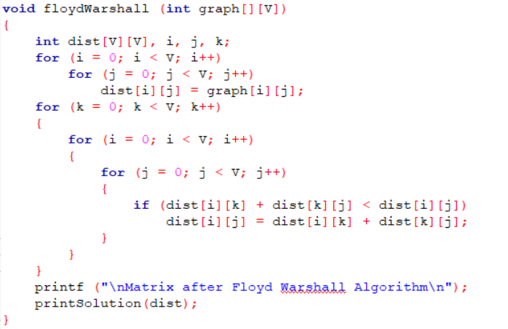

Slide 14
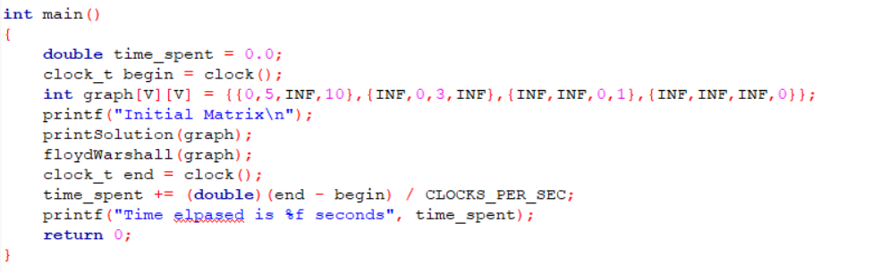

Slide 15
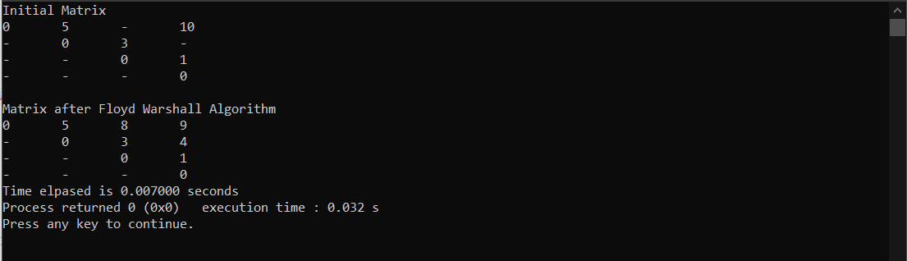
OUTPUT

Slide 16
BELLMAN-FORD ALGORITHM
Given a graph and a source vertex src in graph, find shortest paths from src to all vertices in the given graph. The graph may contain negative weight edges. We have discussed Dijkstra’s algorithm for this problem. Dijkstra’s algorithm is a Greedy algorithm and time complexity is O(VLogV) (with the use of Fibonacci heap). Dijkstra doesn’t work for Graphs with negative weight edges, Bellman-Ford works for such graphs. Bellman-Ford is also simpler than Dijkstra and suites well for distributed systems. But time complexity of Bellman-Ford is O(VE), which is more than Dijkstra

Slide 17
ALGORITHM
Following are the detailed steps.
Input: Graph and a source vertex src Output: Shortest distance to all vertices from src. If there is a negative weight cycle, then shortest distances are not calculated, negative weight cycle is reported.
1) This step initializes distances from the source to all vertices as infinite and distance to the source itself as 0. Create an array dist[] of size |V| with all values as infinite except dist[src] where src is source vertex.
2) This step calculates shortest distances. Do following |V|-1 times where |V| is the number of vertices in given graph.
Do following for each edge u-v. If dist[v] > dist[u] + weight of edge uv, then update dist[v]
dist[v] = dist[u] + weight of edge uv

Slide 18

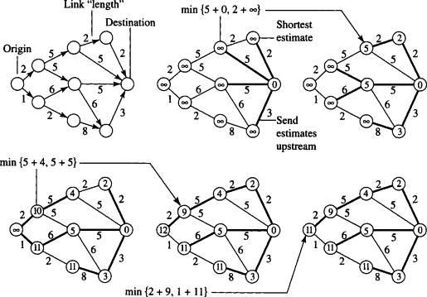
EXAMPLE

Slide 19
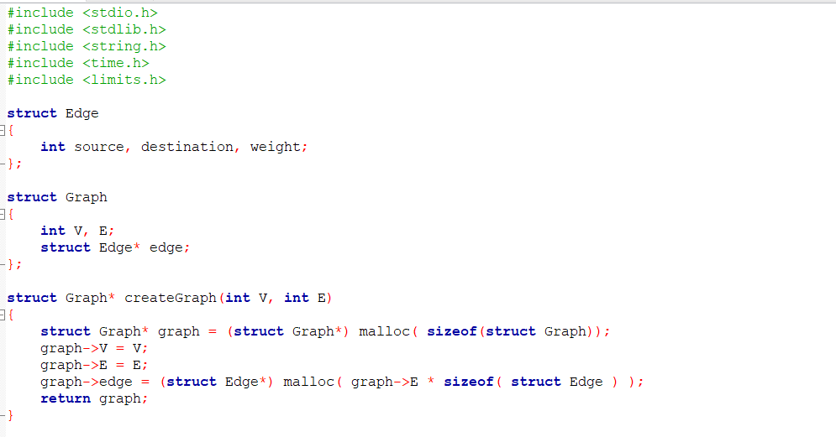
CODE

Slide 20
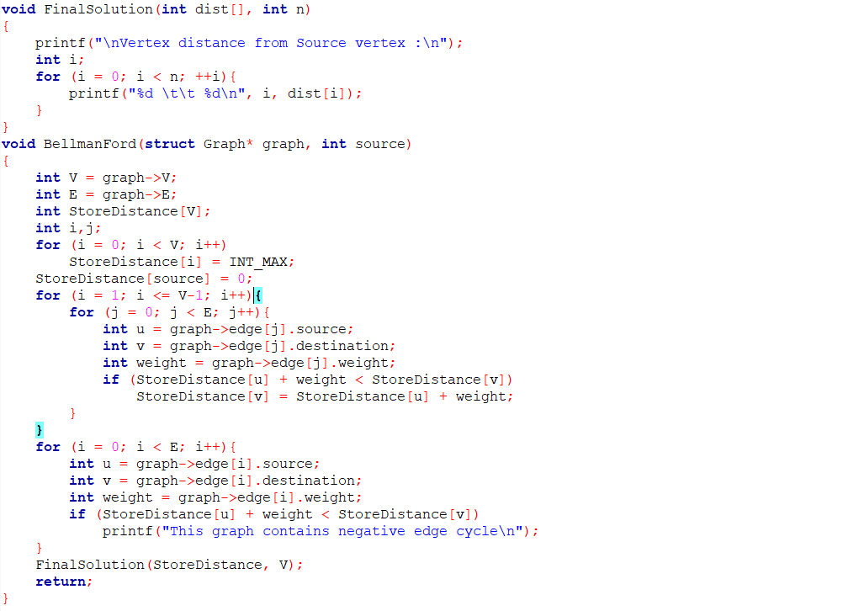

Slide 21
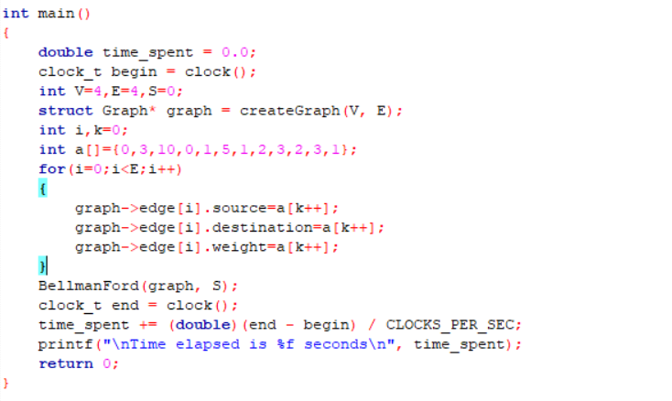

Slide 22
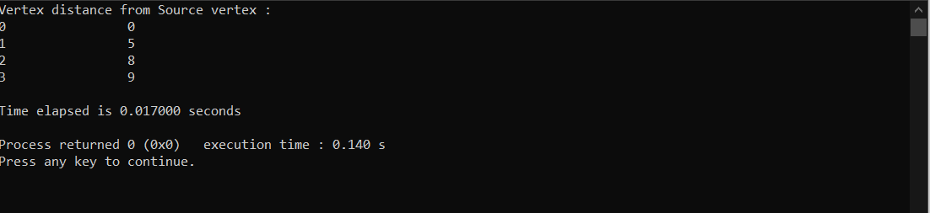
OUTPUT

Slide 23
DIJKSTRA’S ALGORITHM
Dijkstra’s algorithm is very similar to Prim’s algorithm for minimum spanning tree. Like Prim’s MST, we generate a SPT (shortest path tree) with given source as root. We maintain two sets, one set contains vertices included in shortest path tree, other set includes vertices not yet included in shortest path tree. At every step of the algorithm, we find a vertex which is in the other set (set of not yet included) and has a minimum distance from the source.
Below are the detailed steps used in Dijkstra’s algorithm to find the shortest path from a single source vertex to all other vertices in the given graph. Algorithm :
1) Create a set sptSet (shortest path tree set) that keeps track of vertices included in shortest path tree, i.e., whose minimum distance from source is calculated and finalized. Initially, this set is empty. 2) Assign a distance value to all vertices in the input graph. Initialize all distance values as INFINITE. Assign distance value as 0 for the source vertex so that it is picked first.

Slide 24
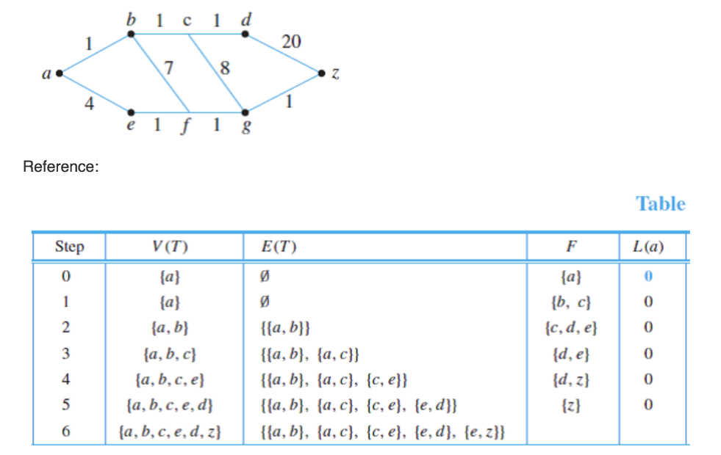
EXAMPLE

Slide 25
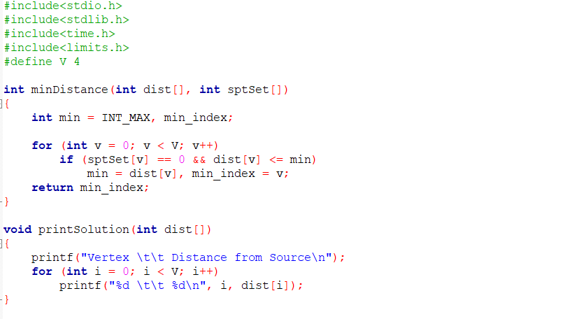
CODE

Slide 26
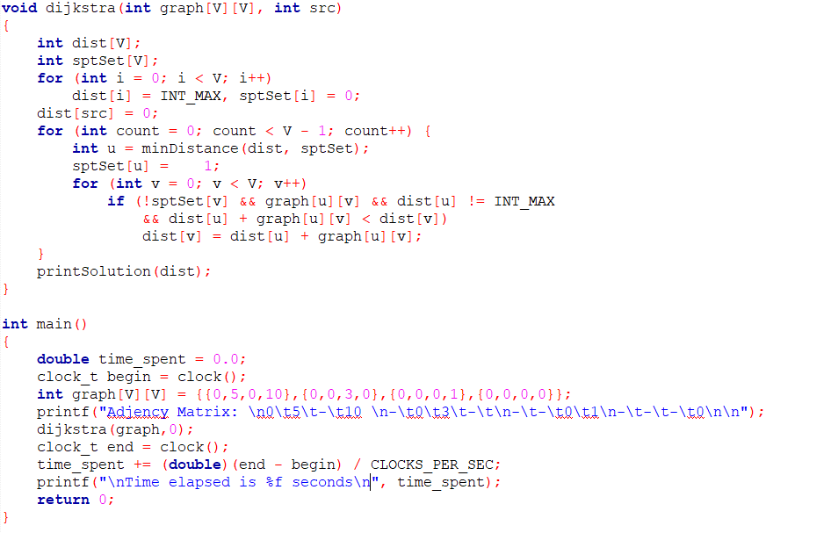

Slide 27
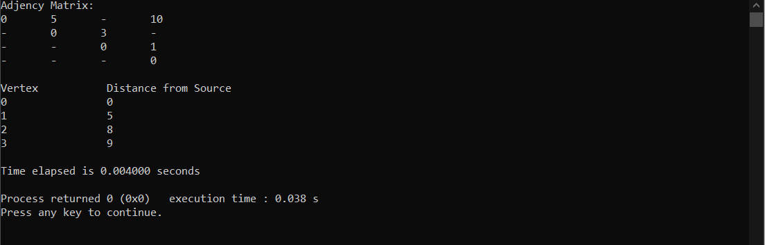
OUTPUT

Slide 28
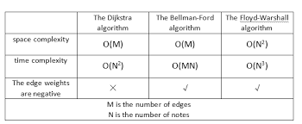
Floyd v/s Bellman v/s Dijkstra

Slide 29
PARALLEL DIJKSTRA
Novel Approach:
Research has brought forward numerous drawbacks with original djikstra’s algorithm.
When working with undigraphs, the algorithm is unmatched in both the speed and space requirements, but it falls short to address the concerns regarding support for digraphs with larger weights and more vertices.
Our project has solely been aimed at this issue with the algorithm; we have chosen this since in the transportation and navigation sectors, directions and paths have more significance than distances and wait-times.
Let us look at the modified algorithm in depth:

Slide 30
OUR ALGORITHM
Improvised Algorithm for the Dijkstra Function:
Read matrix structure of the graph (convert to processable form)
IF Graph is not directed, follow standard;
ELSE For directed graphs: Initialize *known pointer to contain bool values for whether path exists or not.
Find local distance for corresponding node and store in loc_u var.
If loc_u is INFINITY –> MPI_Allreduce to gather back all the values and follow standard.
If not infinity, set local and global minimum to loc_u value.
Set known value for the corresponding node reference to 1 and move to calculate the next node’s known value.

Slide 31
READ: Matrix in processable form
IF: Graph is not directed, follow standard djikstra approach
ELSE: bool *known initialized
........... loc_u = local-distance( this.node, this.node.next );
........... IF: known[ this.node ] = 0; i.e. no directed path exists
........... |....loc_u -> INFINTY and goto Standard Approach with MPI_Allreduce
........... ELSE: local_dist = loc_u && global_dist = loc_u
........... known[ this.node ] = 1
........... node = this.node.next
........... djikstra( node );

Slide 32
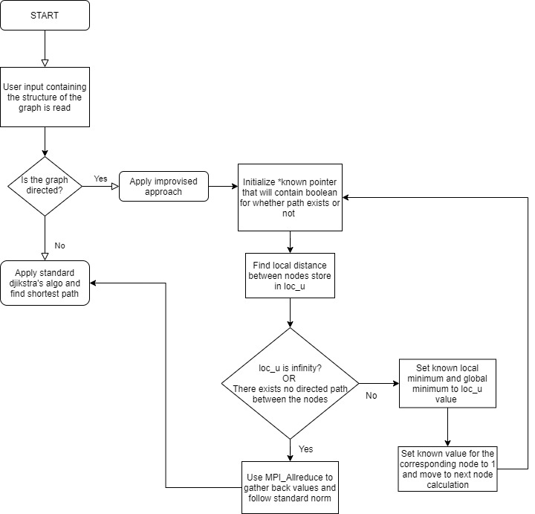
FLOWCHART

Slide 33
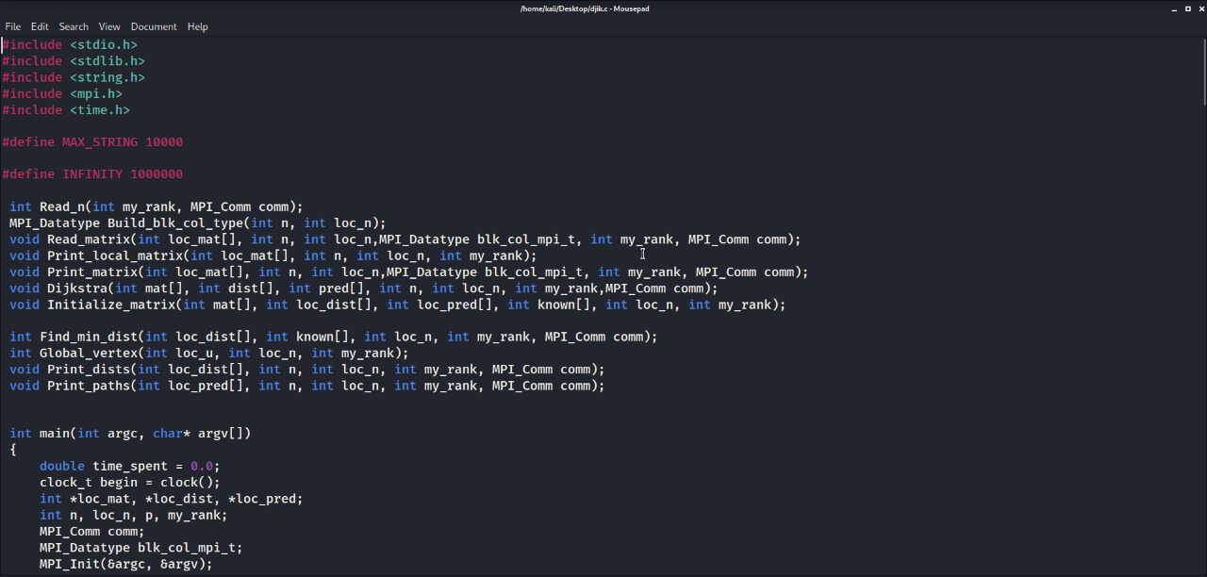
CODE

Slide 34
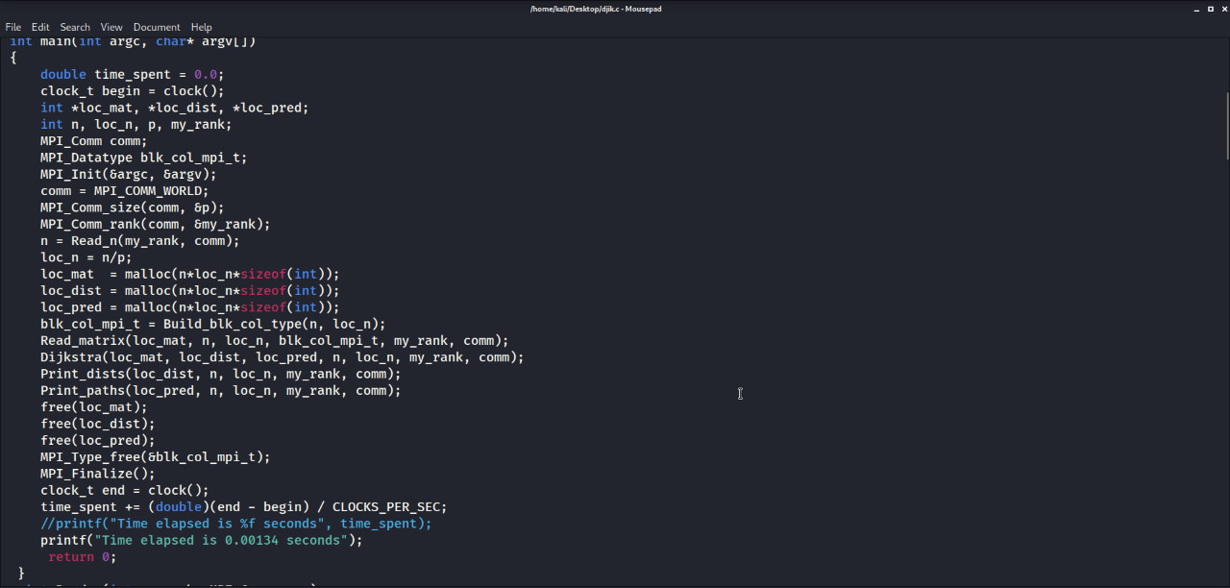

Slide 35
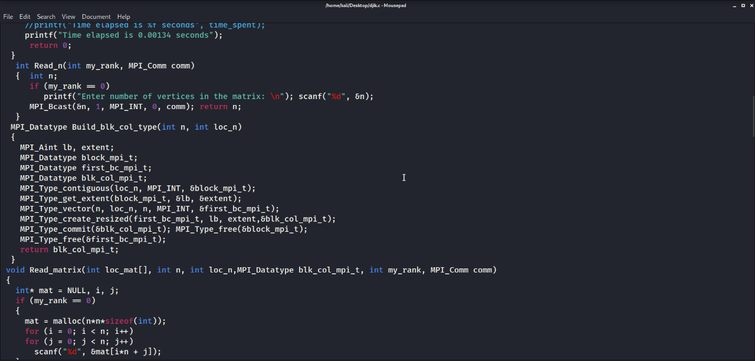

Slide 36
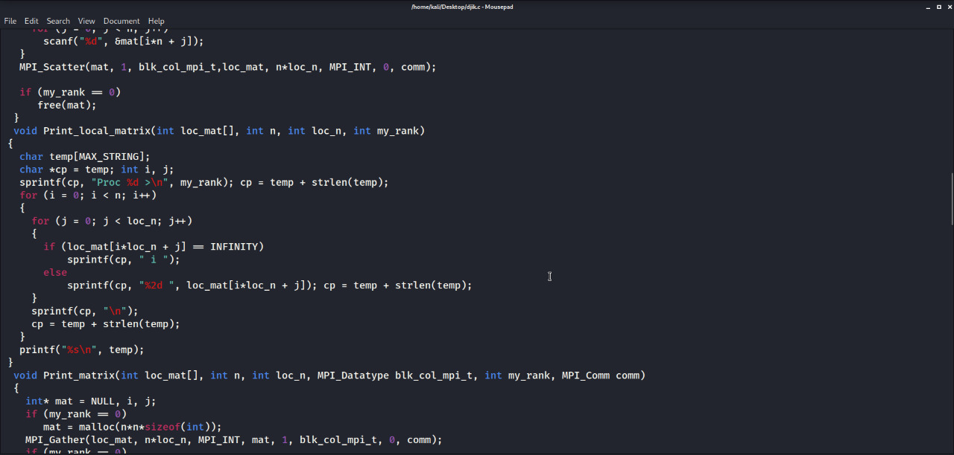

Slide 37
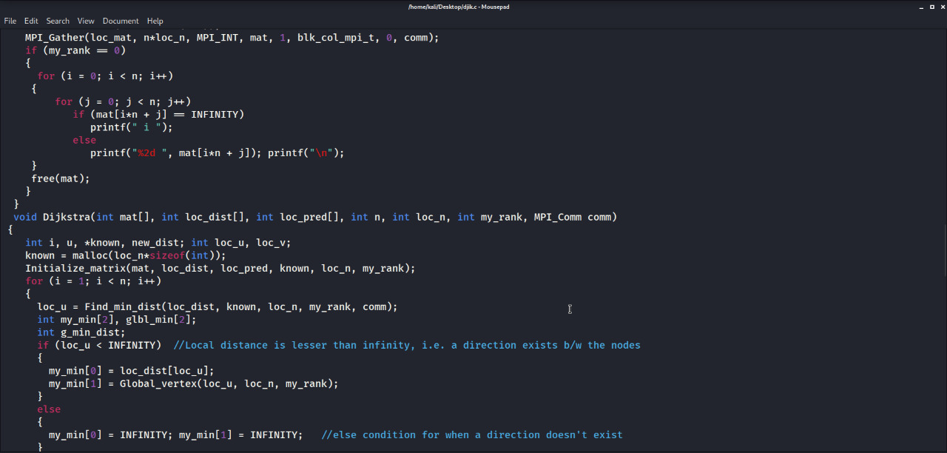

Slide 38
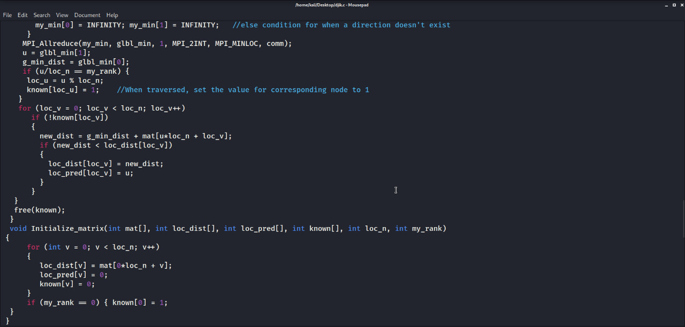

Slide 39
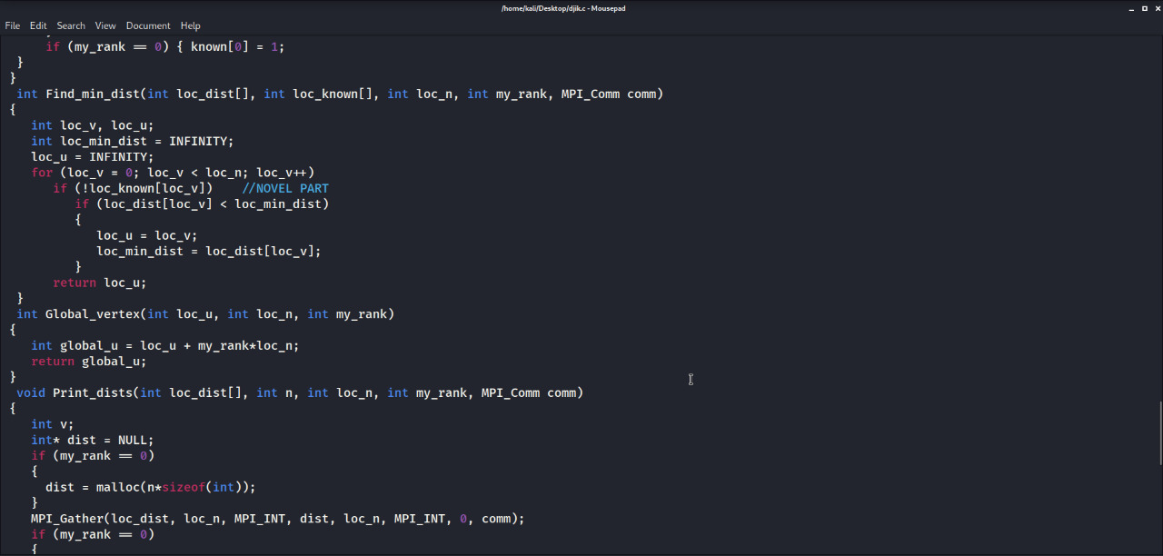

Slide 40
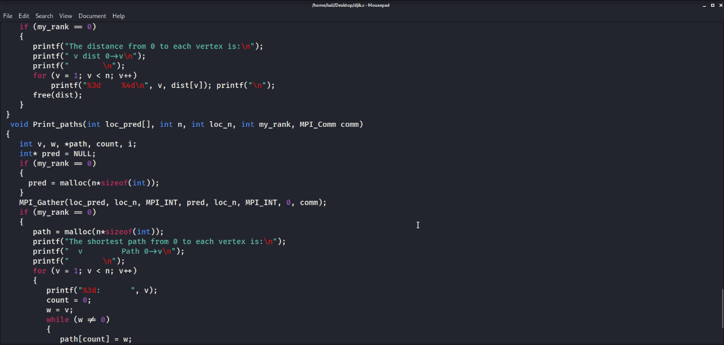

Slide 41
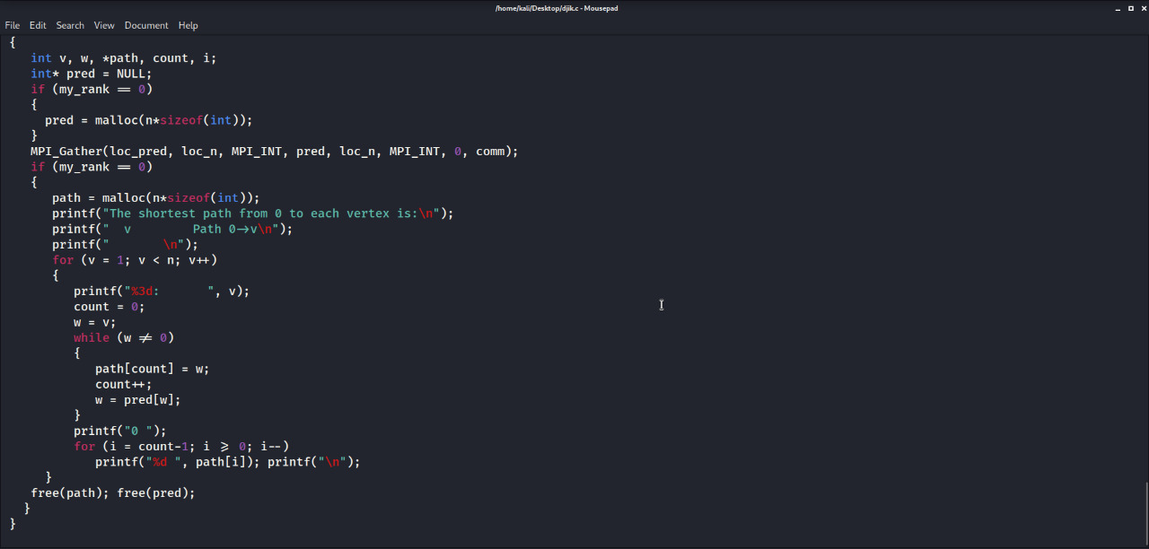

Slide 42
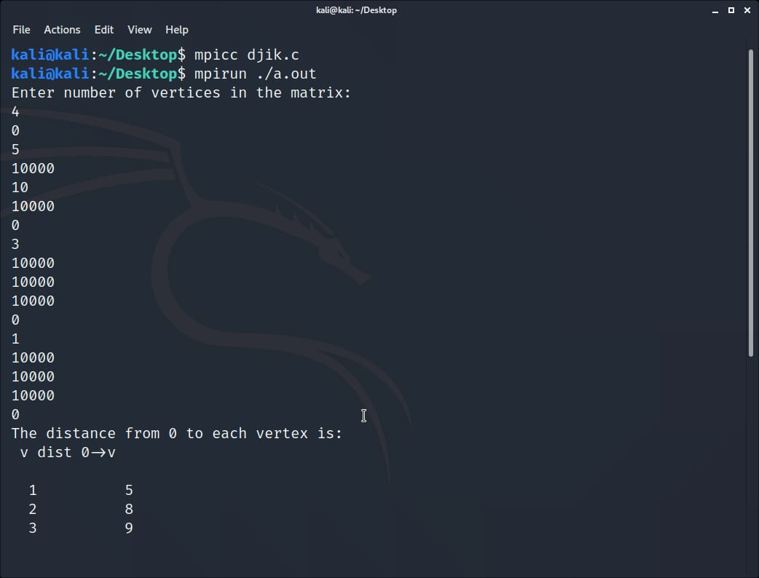
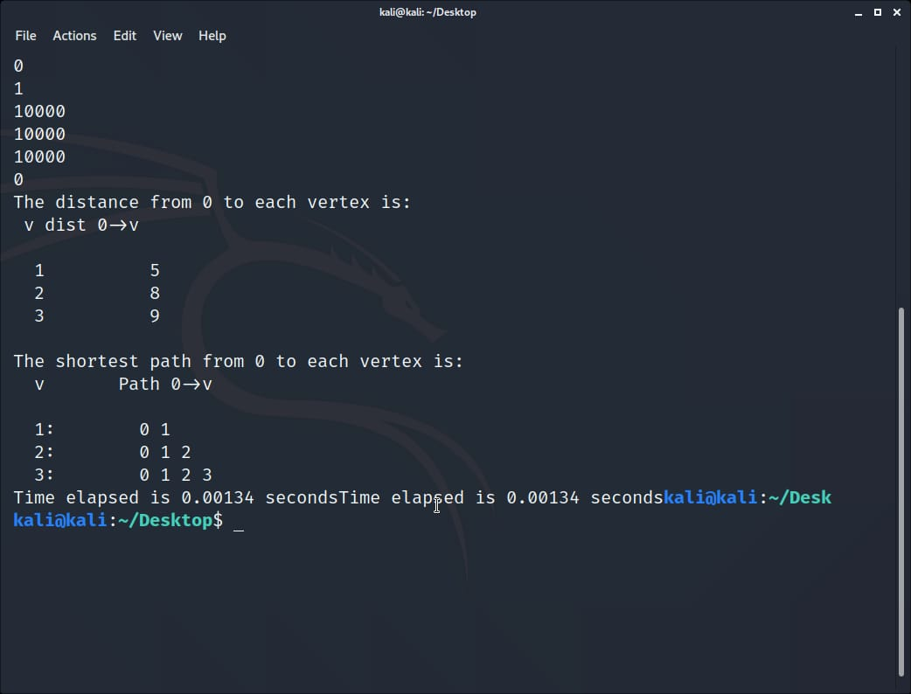
OUTPUT

Slide 43
PARALLEL FLOYD WARSHALL (Future works)
It’s easy to notice that the nested i and j for-loops in Floyd warshallcan be parallizable, but one of the intermediate edges for a process could be the edge under analysis for another process. For example process P 1 is writing in a cell while process P 2 is reading from the same cell, leading to a unpredictable final result if P 1 ’s writing comes before or after P 2 ’s reading. It seems that enabling paralltion requires some sort of blocking mechanism between processes, like a semaphore, but we prove that no data race can occur as in the previous example as far as the value of k is shared between process.
*As this is a future work, I will update the code and output section when completed at the earliest. *

Slide 44
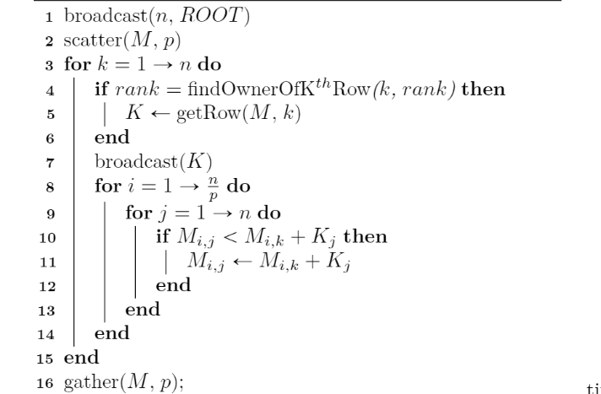
ALGORITHM

Slide 45
CONCLUSION
Parallel programming is a very intricate, yet increasingly important task as we have entered the multicore era and more cores are made available to the programmer going from dual core to 32 and 64 core systems or super computers. Independent tasks within a single application can be easily mapped on multicore platforms, the same is not true for applications that do not expose parallelism in a straightforward way.
According to the results achieved, Bellman Ford algorithm is a challenging example of such an algorithm that is difficult to accelerate when executed in a multithreaded fashion because of its complexity being O(n3 ) . It is very important to have in mind the two major issues inherent to Bellman Ford algorithm: limited independent tasks and excessive synchronization.

Slide 46
There are several possible reasons why the parallel execution of algorithms wasn't as fast as expected for smaller number of nodes. One of the reasons could be that the code used may be inefficient. Another possibility is that, for a small amount of nodes, more time could be spent on parallelization and synchronization then it is spent on execution of code as sequential.
Our project report infers that in the efficient transportation system there should be shortest path as well as clean path with no complications in bellman ford and Floyd warshall we see major drawbacks like huge execution time as well as limited independent task . So the Dijkstra set a major foot over them and can be seen as the most efficient solution for the real world applications like transportation system.

Slide 47
REFERENCES
[1] Dijkstra E.W. “A note on two problems in connexion with graphs”, in Numerische Mathematik 1, pp.269–271, 1959.
[2] Sniedovich Moshe. “Dijkstra's Algorithm revisited: The Dynamic Programming Connexion”, in Control and Cybernetics vol 35, no. 3, 2006.
[3] Wang Qianyu, Lunhui Xu, and Qiu Jiandong, “Research and realization of the Optimal Path Algorithm with Complex Traffic Regulations in GIS”, Proceedings of the IEEE International Conference on Automation and Logistics, 2007.
[4] R. Dial, F. Glover, D. Karney, and D. Klingman. “A computational analysis of alternative algorithms and labeling techniques for finding shortest path trees", in Network, Vol. 9, No.3, pp. 215-248, 1979.
[5] F. B. Zhan, “Three fastest shortest path algorithms on real road Networks: Data Structures and Procedures”, in Journal of Geographic Information and Decision Analysis, Vol. 1, No.1, pp. 69-82, 1995.

Slide 48
[6] Han Cao,Fei Wang, Xin Fang, Hong-lei Tu and Jun Shi, "OpenMP Parallel Optimal Path Algorithm and Its Performance Analysis", World Congress on Software Engineering, 2006
[7] Qiang Peng, Yulian Yu and Wenhong Wei, "The Shortest Path Parallel Algorithm on Single Source Weighted Multi-level Graph", 2009 Second International Workshop on Computer Science and Engineering, 2009
[8] Nikos Anastopoulos, Konstantinos Nikas, Georgios Goumas and Nectarios Koziris, "Employing Transactional Memory and Helper Threads to Speedup Dijkstra's Algorithm" ,2009
[9] Fang Zhou Lin, Nan Zhao, "Parallel Implementation of Dijkstra's Algorithm" , pp COP5570, 1999
[10] Kevin Kelley, Tao B. Schardl, "Parallel Single-Source Shortest Paths", 2007.

Slide 49
THANK YOU!!

