Slide 1
IE-406 Machine learning
Topic- Fake News Detection
Name-Harsh Patel
ID-202101183

Slide 2
Problem Statement
The proliferation of misinformation and fake news has become a significant challenge. With the rise of social media and online platforms, identifying and combatting fake news has become a critical issue for maintaining the integrity of information dissemination. The problem lies in the ability of fake news to spread rapidly and influence public opinion, leading to potentially harmful consequences such as political unrest, social division, and erosion of trust in media sources.
The objective of this project is to develop a robust machine learning model capable of detecting fake news articles with high accuracy. The model should be trained on a diverse dataset containing both genuine and fabricated news articles, encompassing various topics and writing styles. The primary aim is to leverage machine learning algorithms to discern patterns and features indicative of fake news, enabling the automatic identification of deceptive content.

Slide 3
Research Paper Survey
Title: Fake News detection Using Machine Learning
Authors:
Jasmine Shaikh
Rupali Patil
Publish: 2020 IEEE International Symposium on Sustainable Energy, Signal Processing and Cyber Security

Slide 4
Proposed Approach
Data Loading and Concatenation:
Load the fake and true news datasets.
Concatenate them into a single dataframe.
Data Preprocessing:
Convert text to lowercase for consistency.
Remove punctuation to clean the text.
Remove stopwords to eliminate noise.
Exploratory Data Analysis (EDA):
Visualize the distribution of news articles by subject and target (fake or true) using bar plots to understand the dataset's composition.

Slide 5
Word Frequency Analysis
Train-Test Split
Model Training and Evaluation:
Implement various machine learning models including Naive Bayes, Logistic Regression, Decision Tree, Random Forest, and SVM.
Use pipelines to create a consistent workflow of vectorization, TF-IDF transformation, and model training.
Evaluate each model's performance using accuracy scores and confusion matrices
Model Selection
-> This approach provides a structured framework for building and evaluating text classification models for distinguishing between fake and true news articles.

Slide 6
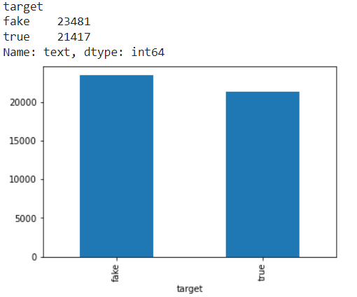
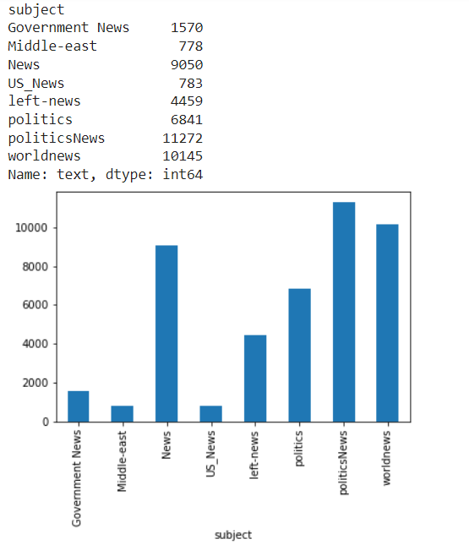
Output:

Slide 7
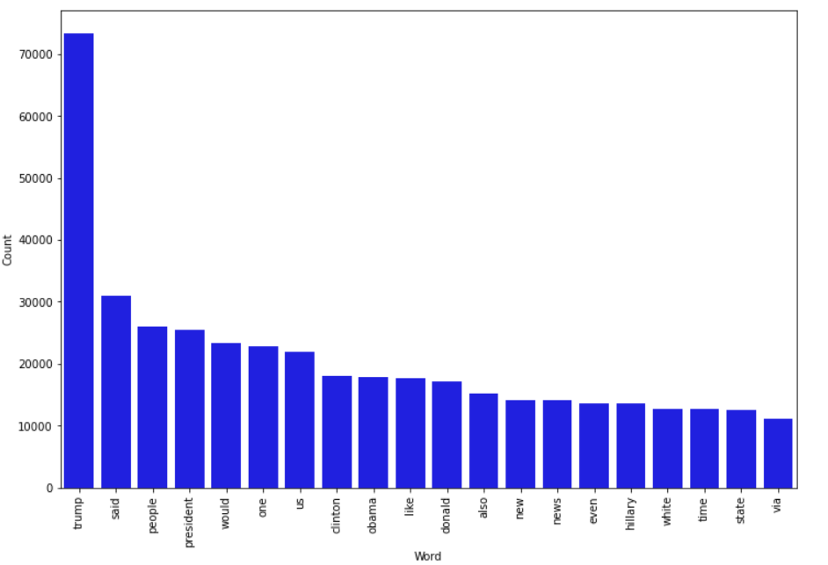
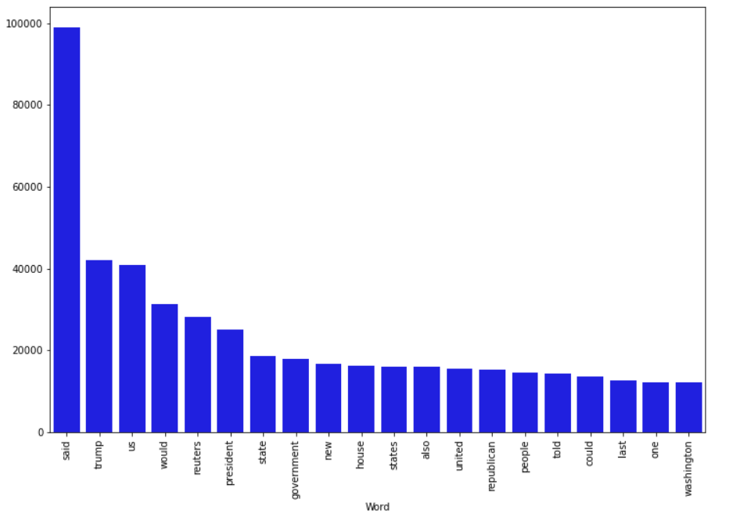
Word count for frequently occurring words

Slide 8
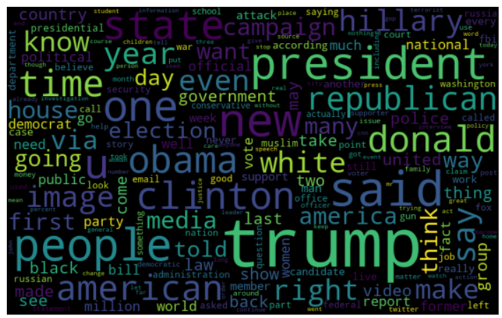
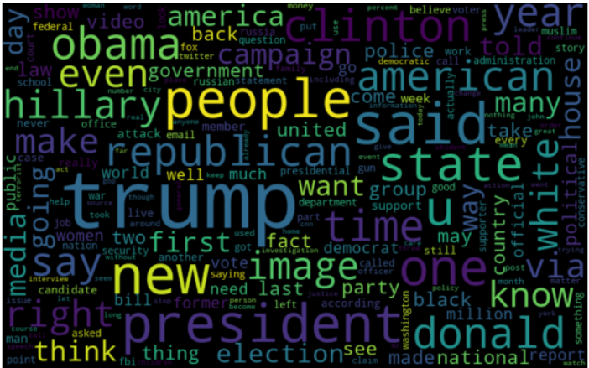
Word Clouds for Fake and True

Slide 9
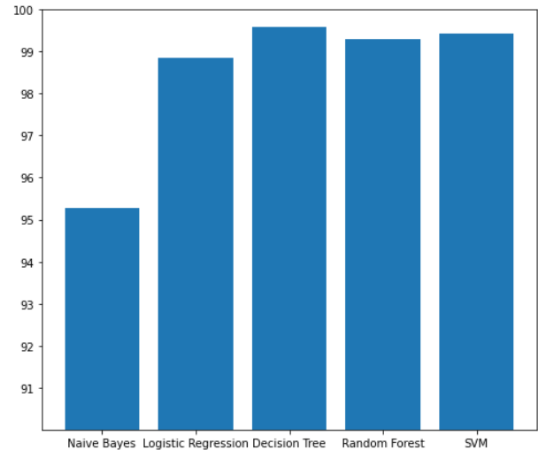
Accuracy of different models

Slide 10
Observations and Remarks
The decision tree and support vector machine (SVM) models emerge as the top performers, showcasing their pivotal role in achieving high accuracy.
Decision trees operate by recursively partitioning the feature space into smaller subsets based on the values of different features, effectively creating a tree-like structure where each internal node represents a feature and each leaf node represents a class label.
Support vector machines (SVMs) are powerful classifiers known for their ability to handle high-dimensional feature spaces and nonlinear decision boundaries. SVMs aim to find the optimal hyperplane that maximally separates data points belonging to different classes in the feature space.
To improve the performance of the code we can use method like gradient boosting or neural networks and Experiment with different text processing techniques, feature selection methods, and additional features to enhance the model's ability.

Slide 11
Conclusion
The project implements a robust pipeline for classifying news articles as fake or true. By leveraging various machine learning models such as Naive Bayes, Logistic Regression, Decision Tree, Random Forest, and Support Vector Machine (SVM), along with extensive data preprocessing techniques including text normalization, punctuation removal, and stopword elimination, the approach demonstrates a comprehensive understanding of text classification tasks.
Through exploratory data analysis, visualizations such as bar plots and word clouds offer valuable insights into the distribution of news articles and the most common words associated with fake and true news. The evaluation of model performance through accuracy scores and confusion matrices provides a clear understanding of each model's effectiveness.
Overall, this approach serves as a strong foundation for effectively identifying and combatting misinformation in news articles.

Slide 12
Thank You

