Slide 1
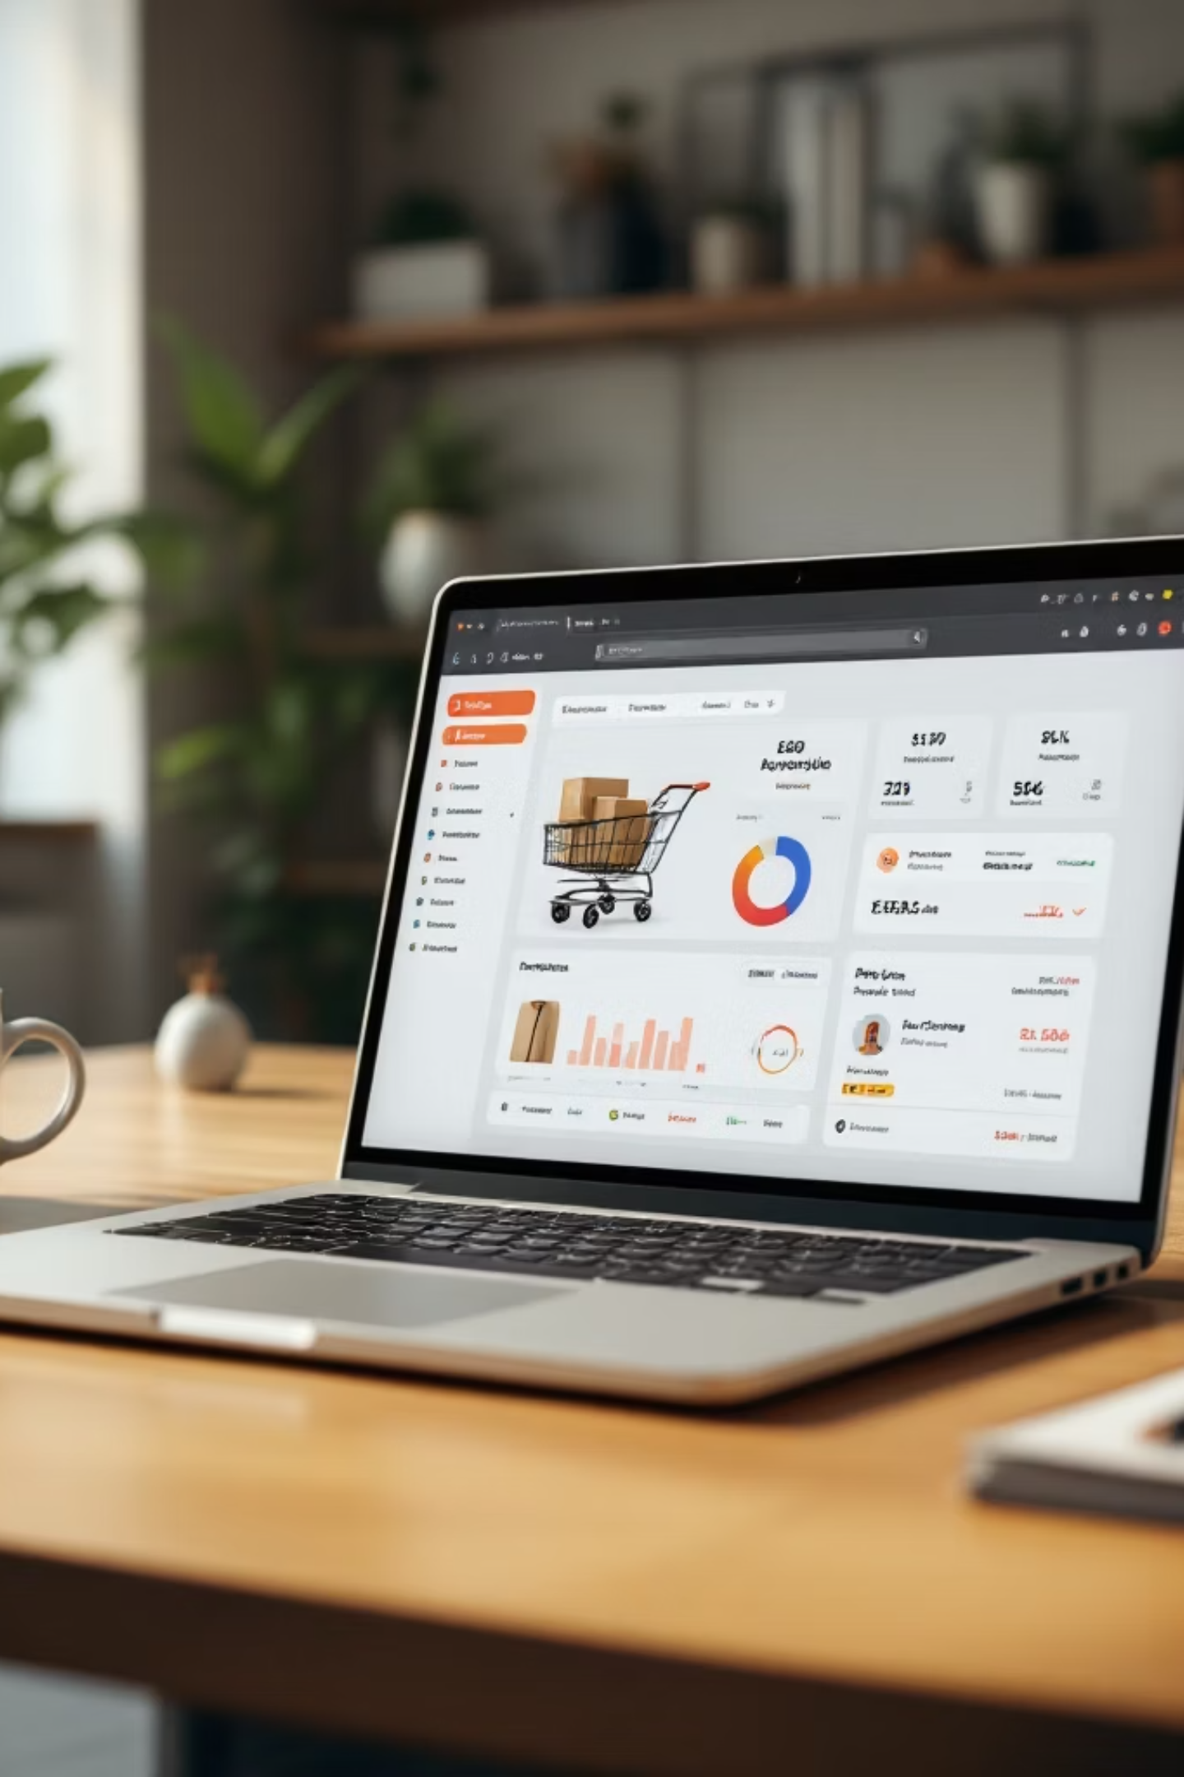
DukaanSetu – Multi-Vendor E-commerce Platform
Presented By :- Harsh Patel

Slide 2

Project Overview
DukaanSetu is a comprehensive multi-vendor e-commerce platform built using the MERN stack, designed to bridge the digital divide for local shopkeepers.
The application connects traditional brick-and-mortar businesses with online customers, creating new revenue streams while providing users with convenient access to a variety of local products.
The platform features three distinct user panels—Admin, Shopkeeper, and Customer—each with tailored functionalities to efficiently manage products, orders, and overall platform operations.

Slide 3

System Scope & Capabilities
Multi-Vendor Platform
Role-Based Access
Provides online presence for local shops with product listings and inventory management
Supports multiple user types with distinct permissions and dashboard views
Smart Search & Filter
Unified Cart System
Enables customers to browse and find products efficiently across vendors
Multi-vendor cart allows adding products from different shopkeepers in one checkout
Secure Authentication
Order Tracking
JWT-based security ensures protected user accounts and data privacy
Complete order lifecycle management with review and feedback system

Slide 4
System Architecture & Modules
The platform comprises five core modules working in harmony to deliver seamless e-commerce functionality:
01
02
03
Authentication Module
Customer Module
Shopkeeper Module
User registration and login with JWT-based security and role-based access control for secure platform access
Product search and filtering, multi-vendor cart management, order history tracking, and review submission capabilities
Product catalog management including adding, updating, and deleting items, along with order tracking and earnings analytics
04
05
Admin Module
Backend Module
Comprehensive platform oversight with user and category management, activity monitoring, and content moderation tools
RESTful APIs for data exchange, MongoDB database management, and server-side business logic implementation

Slide 5
Technology Stack
Frontend
Backend
React.js
Node.js
Component-based UI framework for dynamic, responsive user interface
Server runtime enabling JavaScript-based backend development
Express.js
Bootstrap 5
Web framework for building RESTful API endpoints efficiently
CSS framework ensuring consistent, mobile-first design across devices
Bcrypt.js
CSS3
Password hashing library ensuring secure credential storage
Styling language for custom animations and visual enhancements
Database
MongoDB
NoSQL database providing flexible schema design for storing user data, product catalogs, orders, and platform analytics. Offers scalability and efficient document-based data management.

Slide 6
Key Advantages
Empowers Local Businesses
Helps small shopkeepers establish digital presence and reach wider customer base without technical expertise
User-Friendly Interface
Intuitive design ensures easy navigation for all user types, reducing learning curve and improving adoption
Secure Authentication
JWT-based security with encrypted passwords protects sensitive user information and transaction data
Unified Shopping Experience
Multi-vendor cart system allows customers to purchase from multiple shopkeepers in single transaction
Time Efficiency
Reduces shopping time for customers whilst providing shopkeepers with automated inventory and order management
Centralized Management
Admin panel provides complete oversight of platform activity, users, and content moderation

Slide 7
Business Impact & Benefits
Economic Growth
Sales Growth
Digital Presence
Customer Convenience
Supports local economy by enabling small businesses to expand digital footprint and increase revenue potential
Increases sales opportunities for vendors by providing 24/7 online storefront accessible to wider audience
Transforms offline shops into digital businesses, ensuring competitiveness in modern marketplace
Enhances shopping experience with easy product discovery, secure transactions, and home delivery options
Trust Building
Platform Independence
Review and rating system establishes credibility and helps customers make informed purchasing decisions
Reduces dependency on large e-commerce platforms, giving shopkeepers control over their business

Slide 8
Future Enhancements
The platform can be extended with advanced features to further enhance functionality and user experience:
Payment Integration
Implement Razorpay or Stripe for secure online transactions, enabling seamless payment processing
Cloud Storage
Integrate AWS S3 or Cloudinary for scalable image hosting and faster content delivery
Multi-Language Support
Add language translation to reach diverse customer base and expand market reach
Real-Time Notifications
Implement email and SMS alerts for order updates, stock changes, and promotional messages
Chat System
Enable direct communication between customers and shopkeepers for queries and support
Advanced Analytics
Provide shopkeepers with detailed sales reports, customer insights, and performance metrics
Stock Alerts
Automated low-stock notifications help shopkeepers manage inventory levels proactively

Slide 9
Project Highlights
3
5
100%
User Panels
Core Modules
MERN Stack
Admin, Shopkeeper, and Customer dashboards
Complete system functionality
Full JavaScript ecosystem
Project Goal
Technical Approach
Key Features
Built to connect local shopkeepers with online customers through a multi-vendor platform, enabling small businesses to establish digital presence and reach wider audiences
Developed using MongoDB for flexible data storage, Express.js and Node.js for RESTful APIs, and React.js with Bootstrap 5 for responsive user interfaces
JWT-based authentication, multi-vendor shopping cart, role-based access control, product catalog management, order tracking system, and review functionality

Slide 10
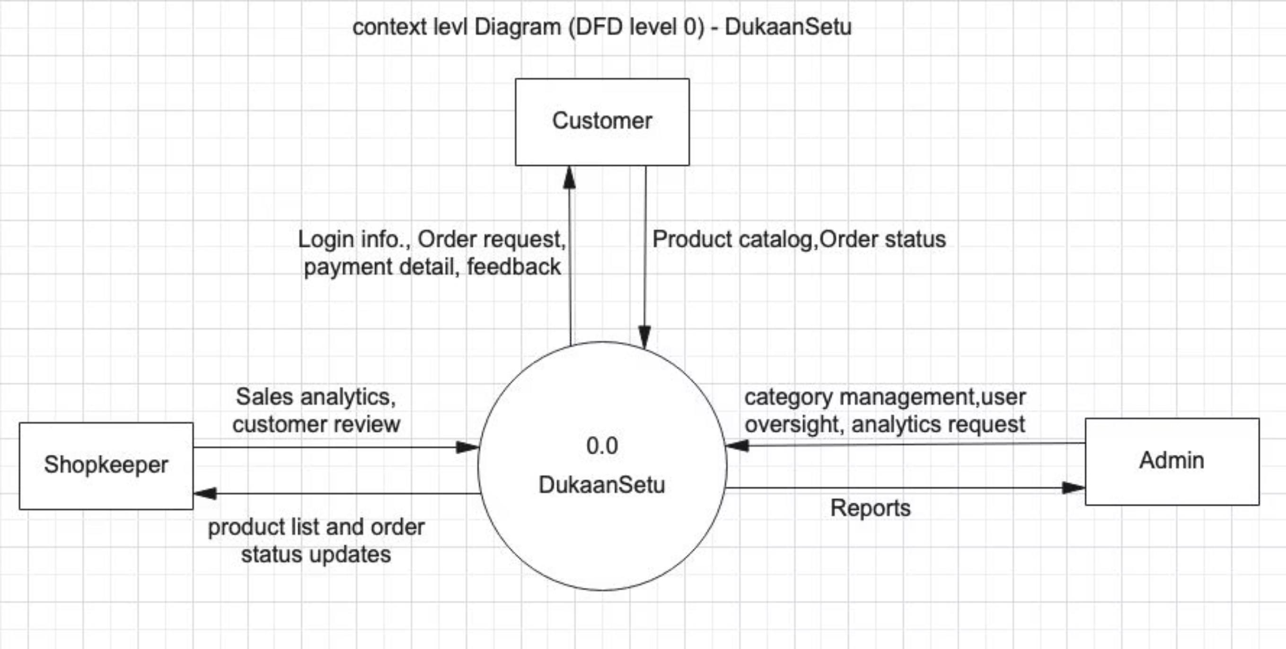
Context level Diagram

Slide 11
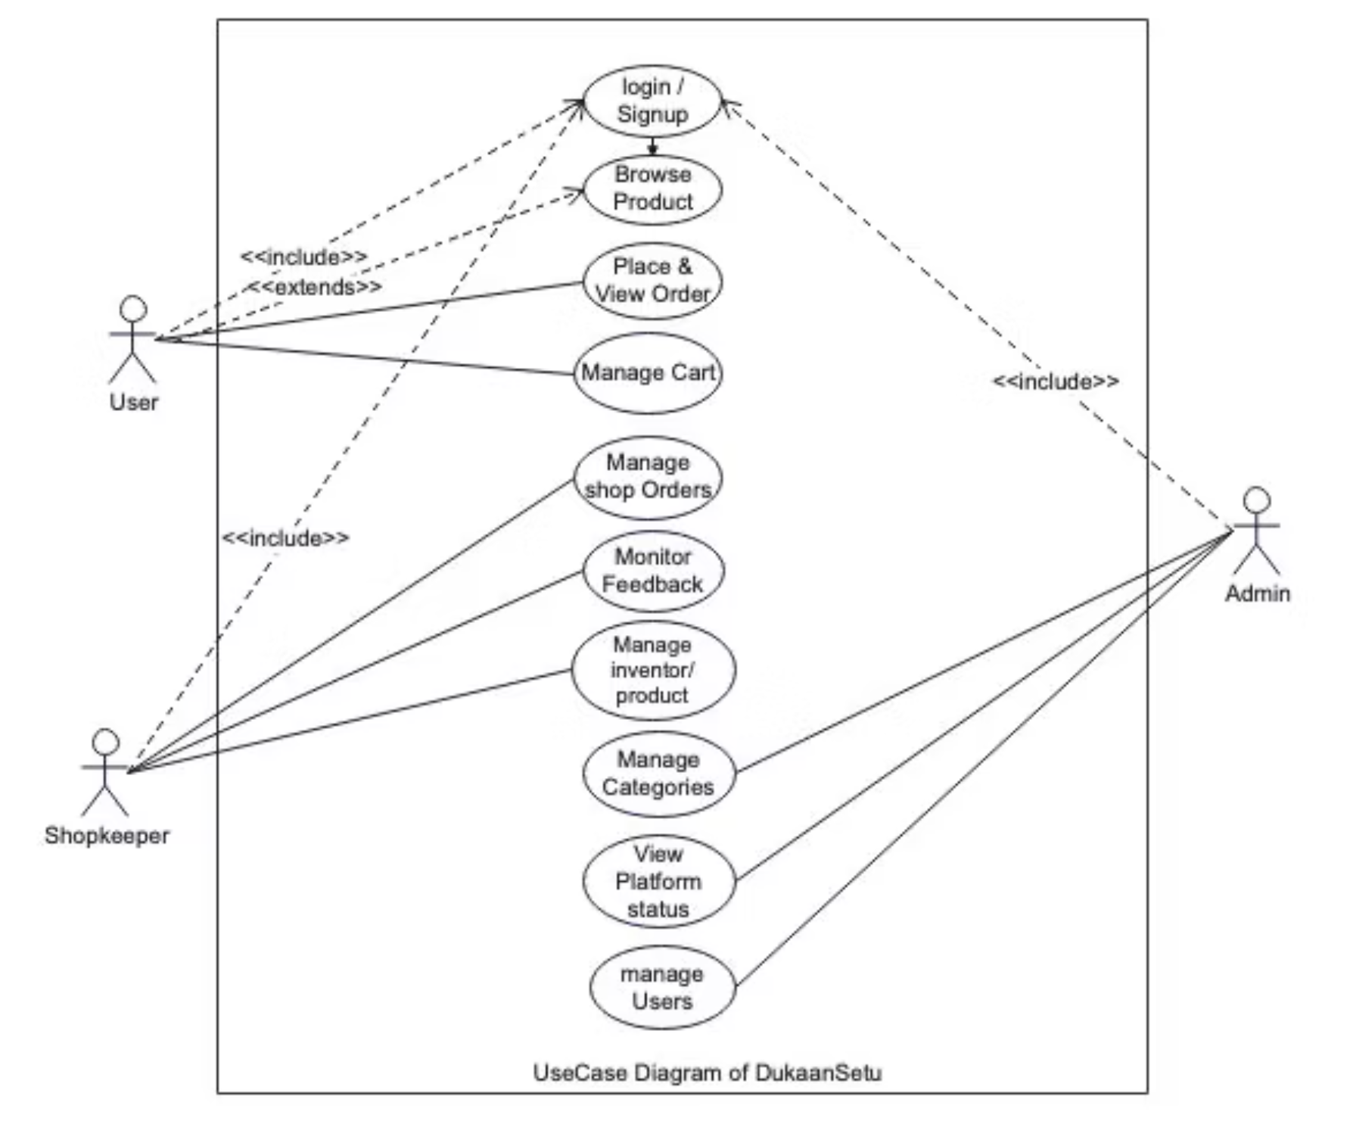
UseCase Diagram

Slide 12
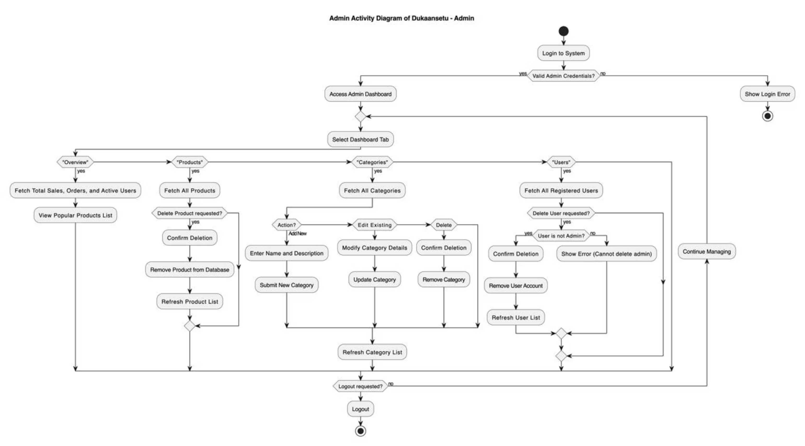
Activity Diagram

Slide 13
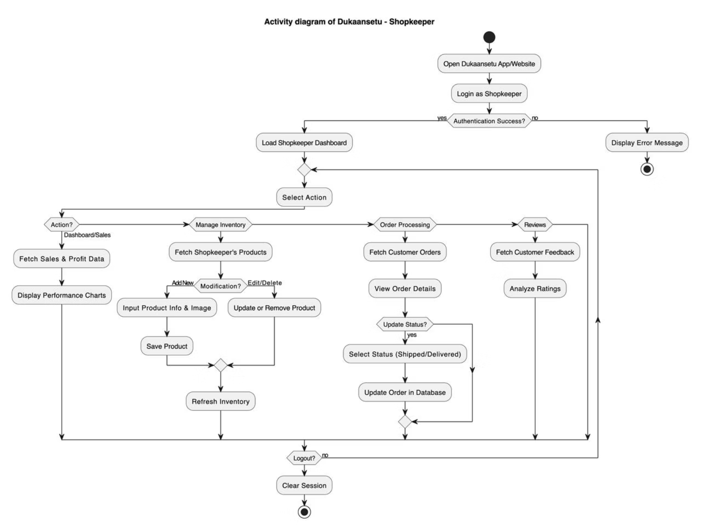
Activity Diagram

Slide 14
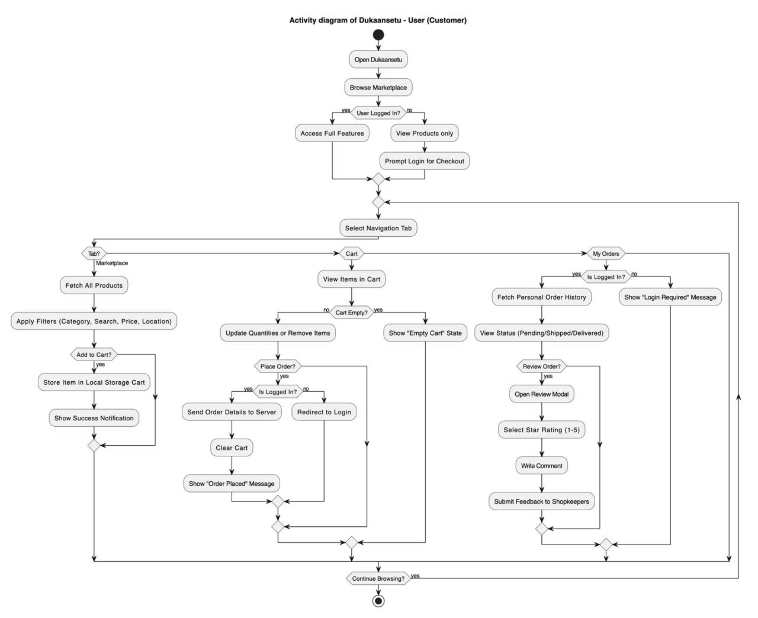
Activity Diagram

Slide 15
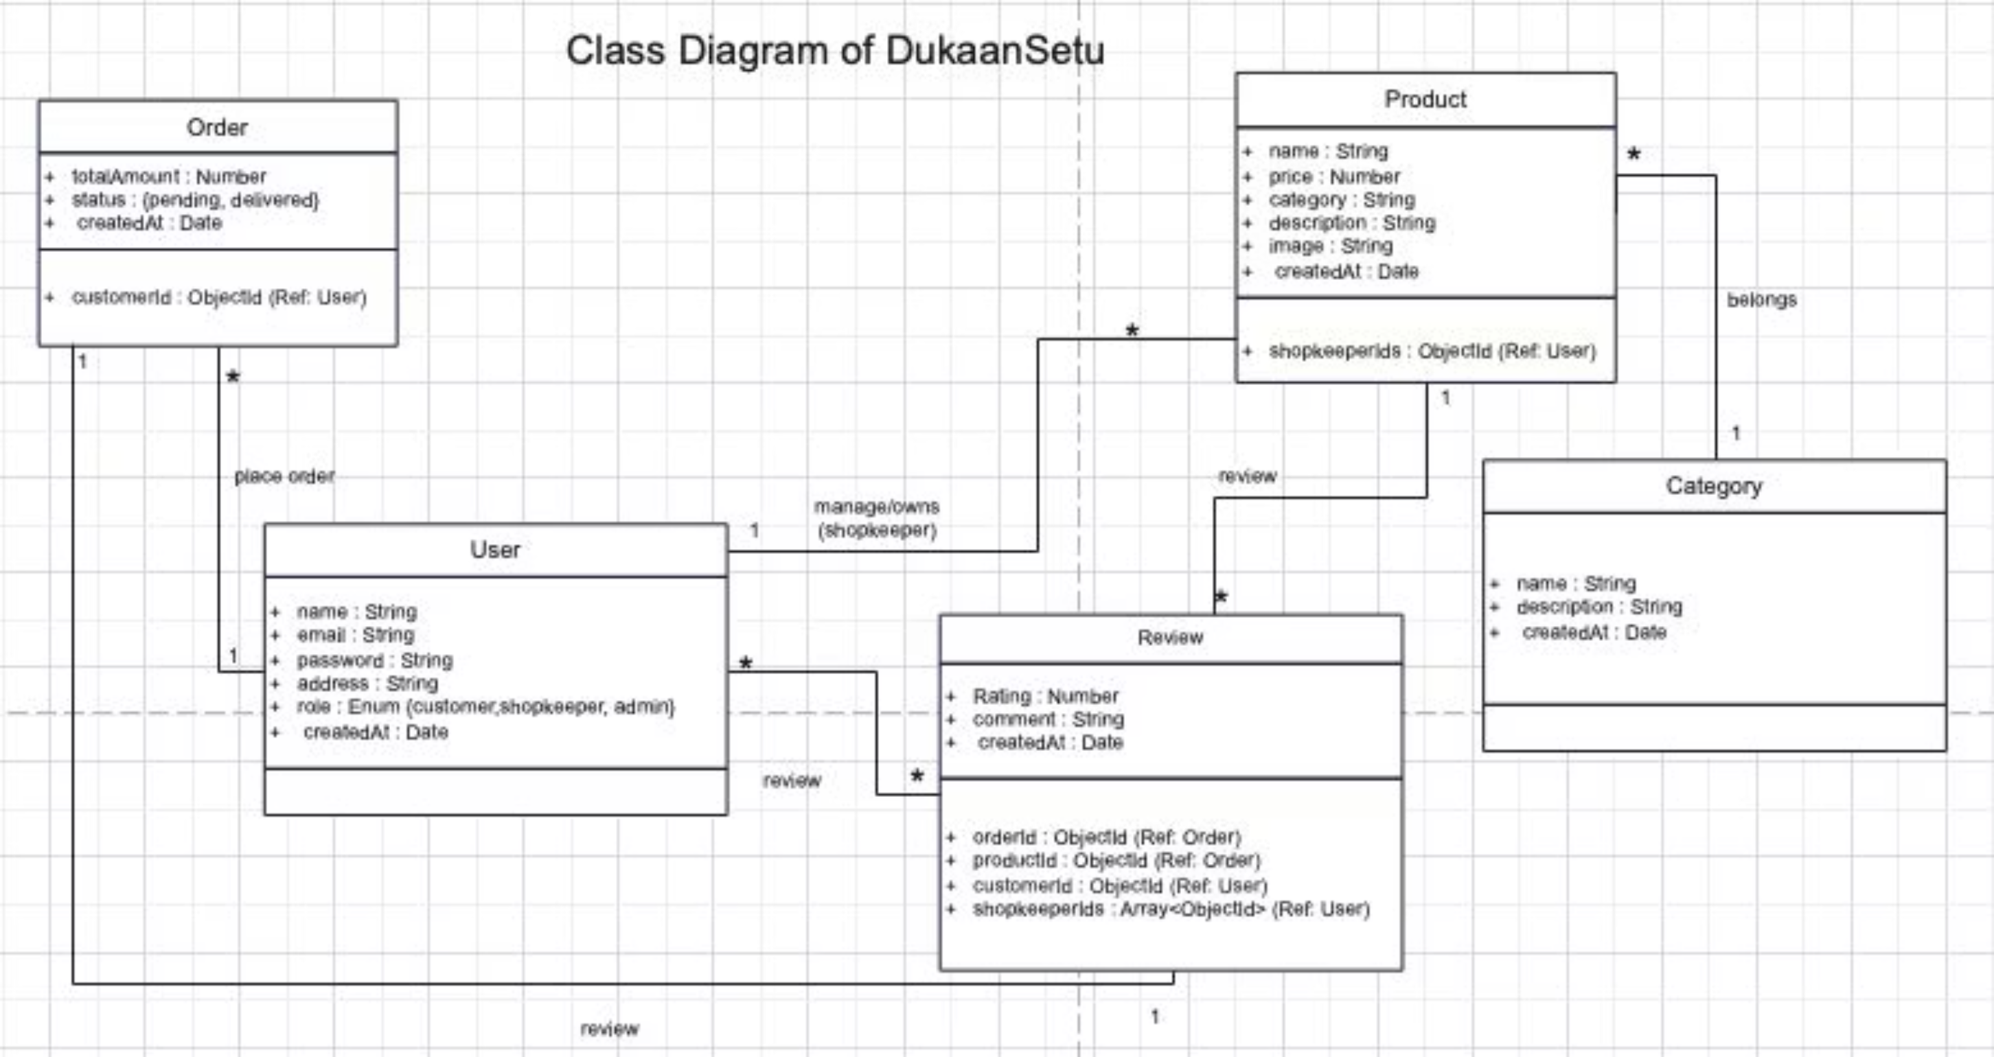
Class Diagram

Slide 16
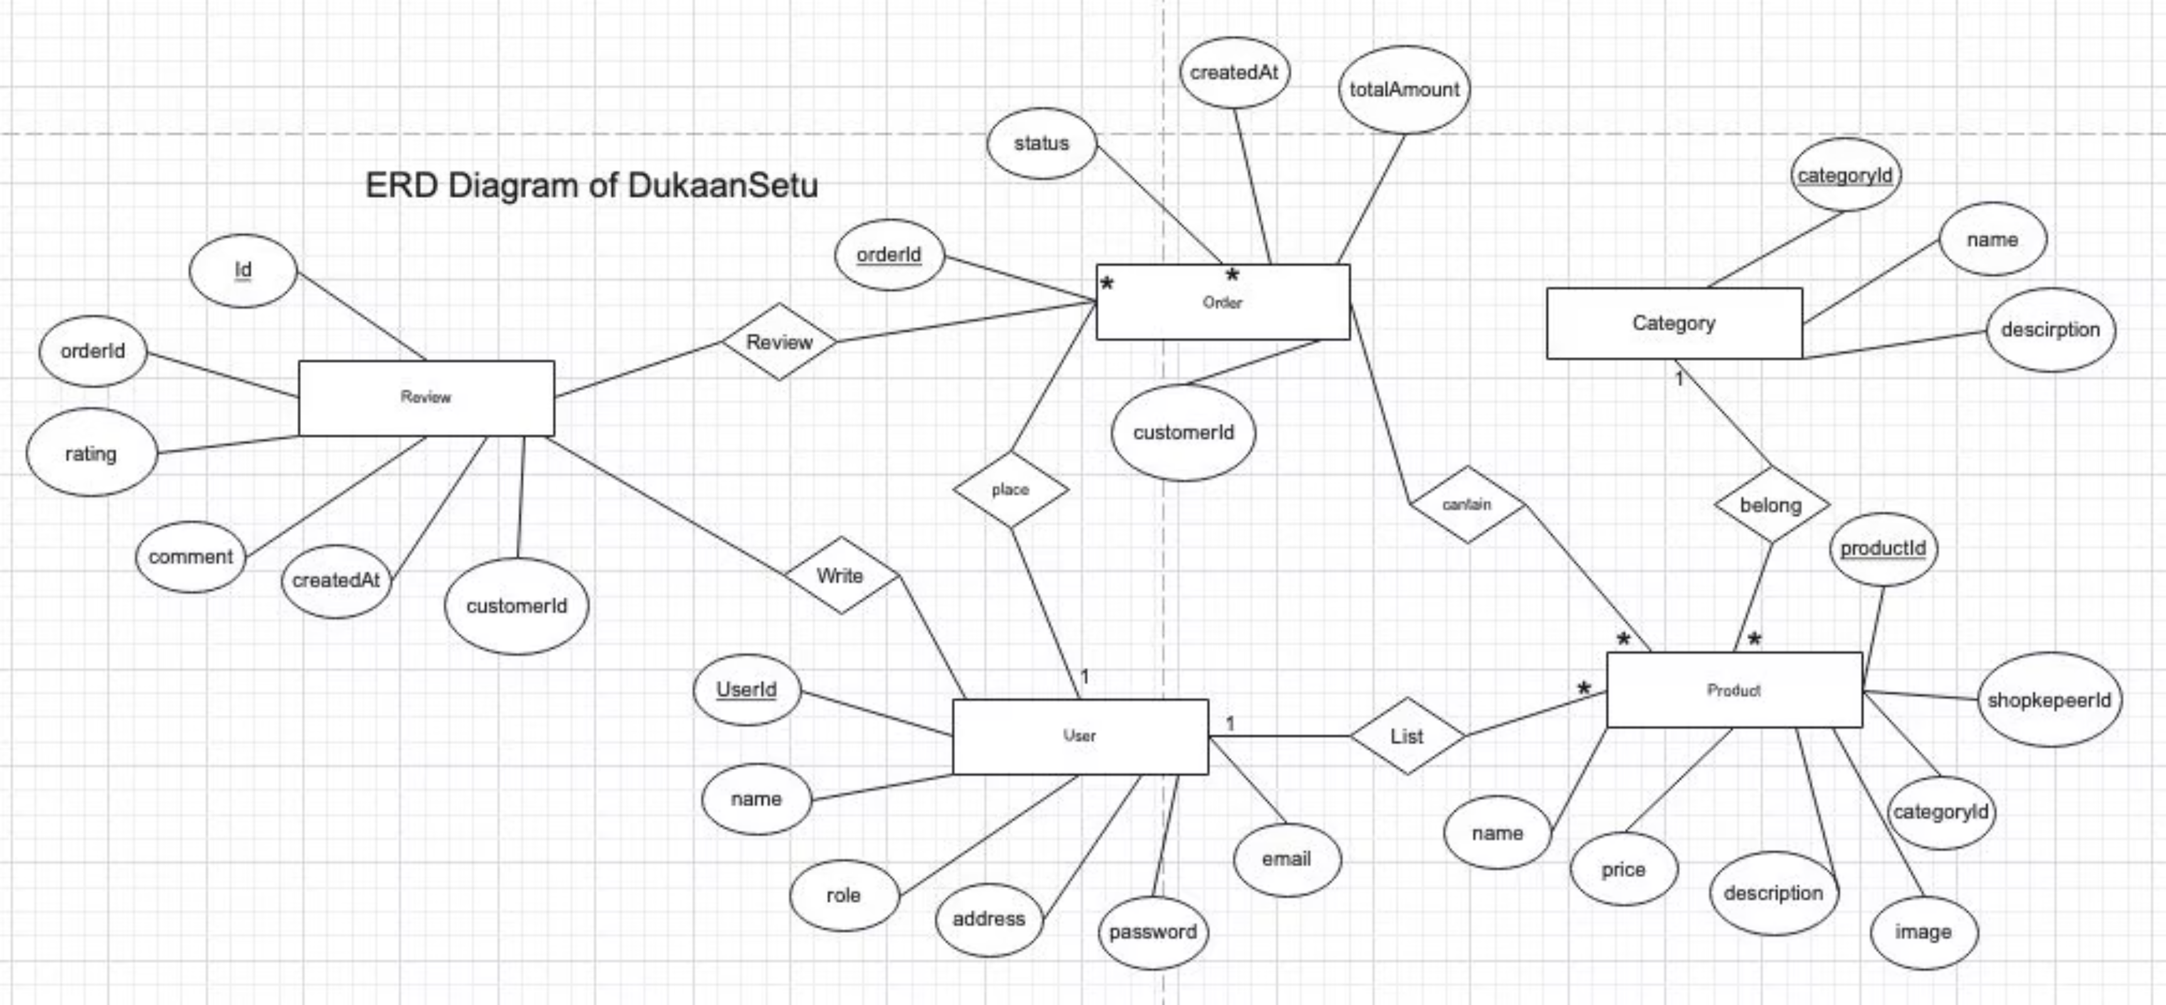
ERD Diagram

Slide 17
Thank You!
Presented By :- Harsh Patel

