Slide 1
InFANT INFORMANT
BY :- Harsh Patel(150770116043)

Slide 2
Introduction
INFANT INFORMANT can bring revolution in education system due to its various kind of features.
We can establish good connection between parents, faculties and principal by implementing this project in education sector.

Slide 3
Objectives
Education plays vital role in our life and this project is able to make education system more reliable and trustable.
Using this project we can save precious time and money of parents and faculties.

Slide 4
Related Background
This project will provide solutions according to our education system so it is suitable for all schools.
Further development in this project can extend the use of this application to higher secondary school.

Slide 5
Tools and Technology
The tools and technology which I will use are java and Android.
For admin access web portal is available which will made of java.
Parents and faculties can access it by using android application.
For data storage purpose DBMS will be used.

Slide 6
Methodology(MODULES)
Login:- Parents, Faculties and admin can login to gain access of portal.
Manage faculty:- Principal can manage information regarding faculties and students.
Leave:- Parents can make request for leave and faculties can grant it.
Attendance:- Attendance can be updated by faculties which is readable to parents.
Timetable:- Timetable is uploaded by admin.

Slide 7
Methodology(MODULES)
Event details:- Event detail updated by admin according to event and it can be viewable to parents.
Homework:- Homework is daily updated by faculties.
Query:- Parents can raise query and according to it faculties answer it.
Test result:- Result is uploaded by admins which is visible to parents.

Slide 8
Expected Outcome
Implementation of this concept can provide a portal which will become mile stone for every school because of it’s advantage.
Education system will become more convenient.
Our future generation can become much brilliant because of personal care.

Slide 9
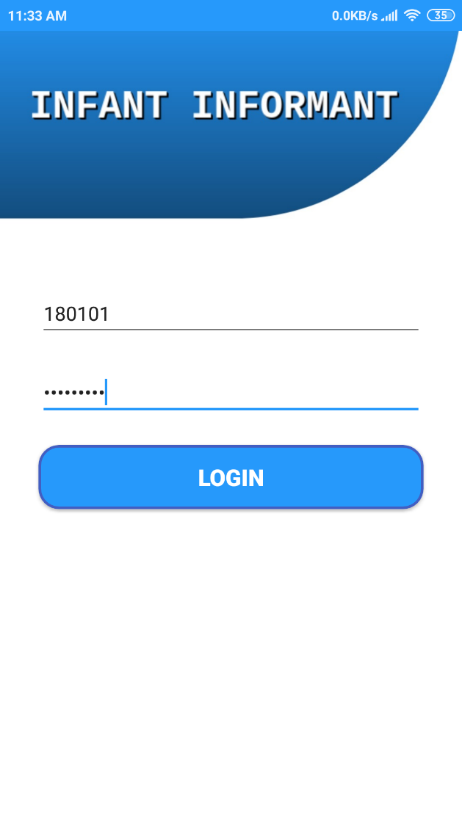
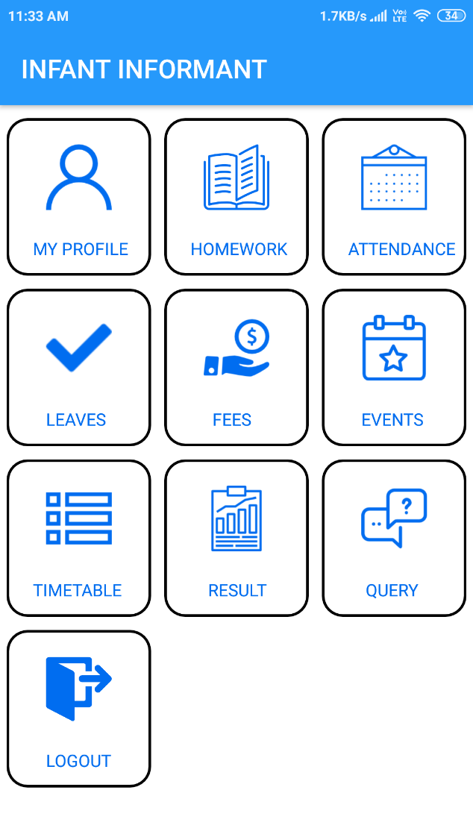
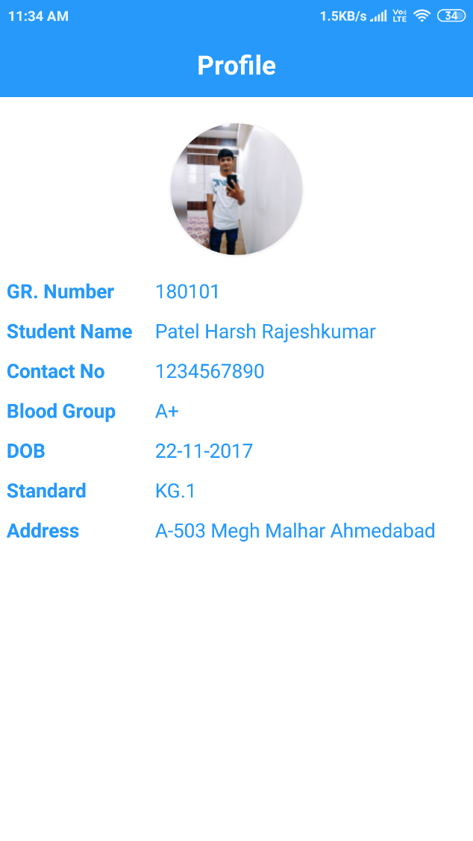
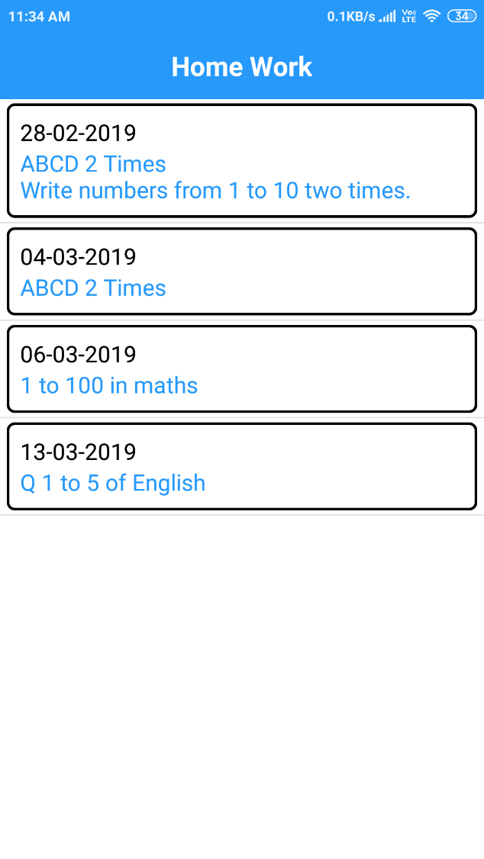
Prototype

Slide 10
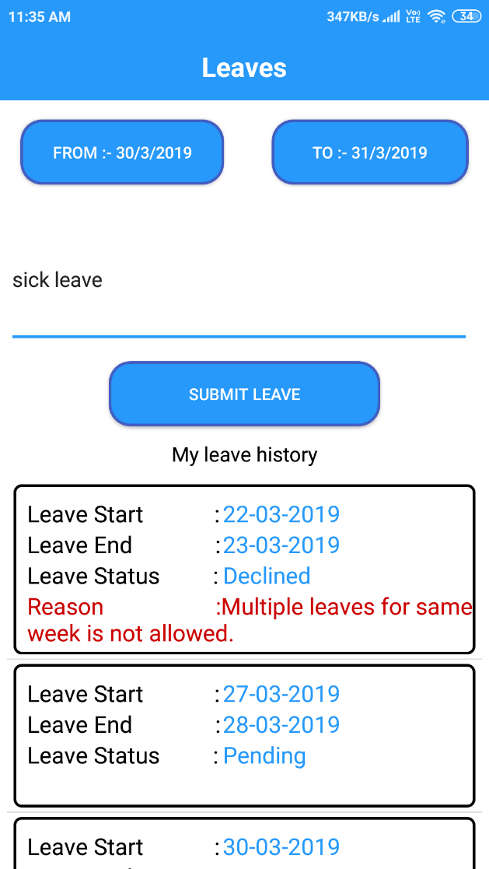
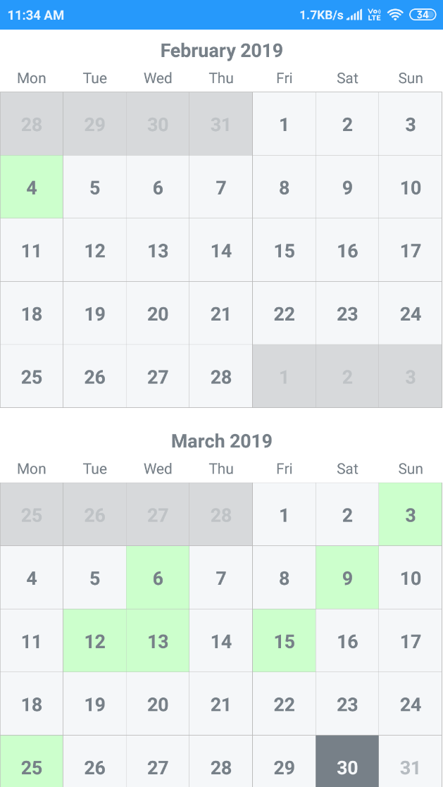

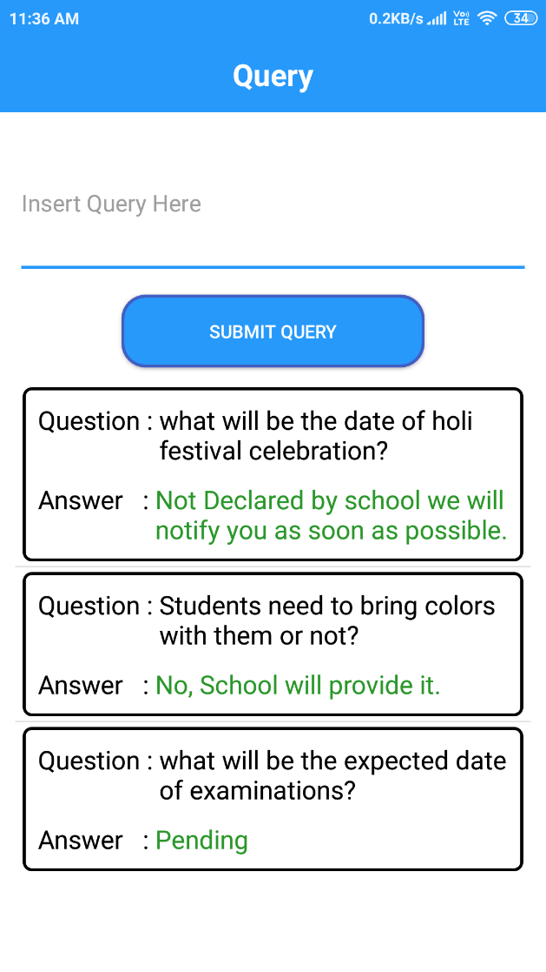
Prototype

Slide 11
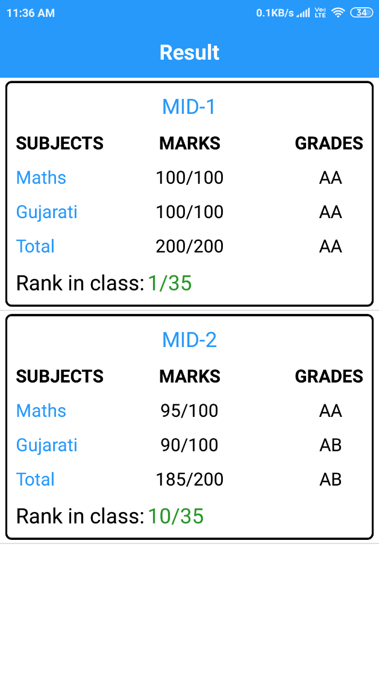
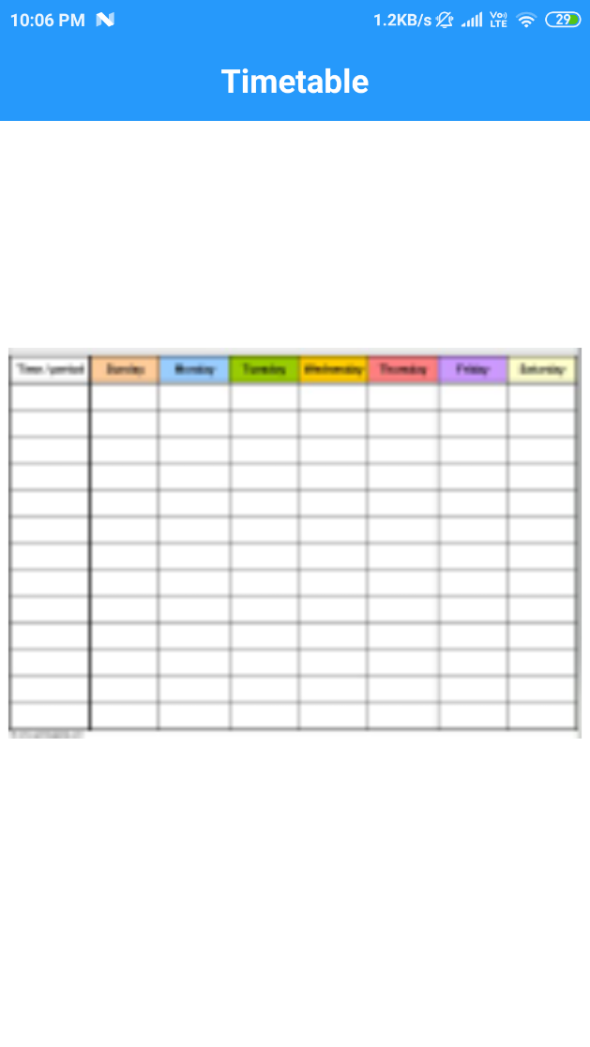
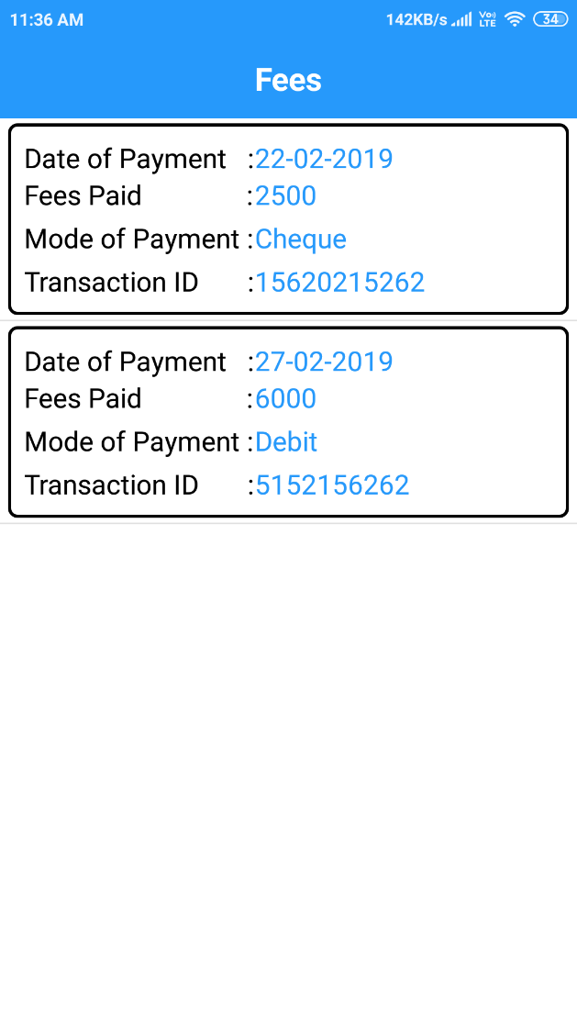
Prototype

Slide 12
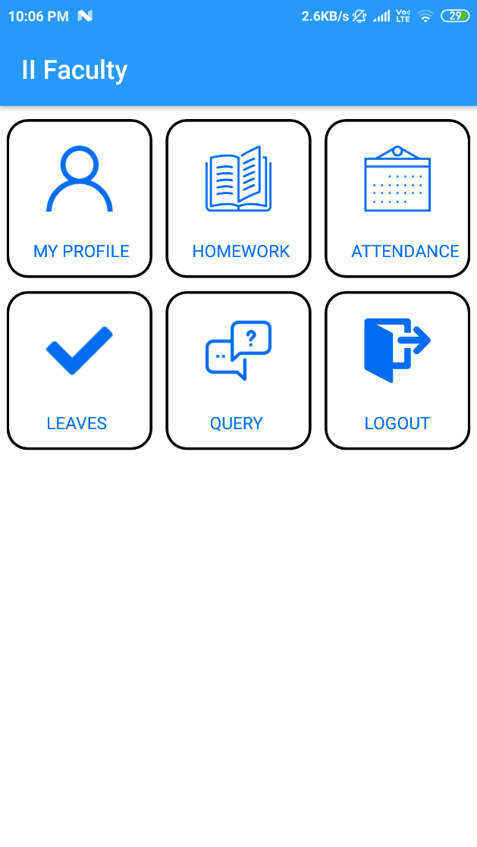
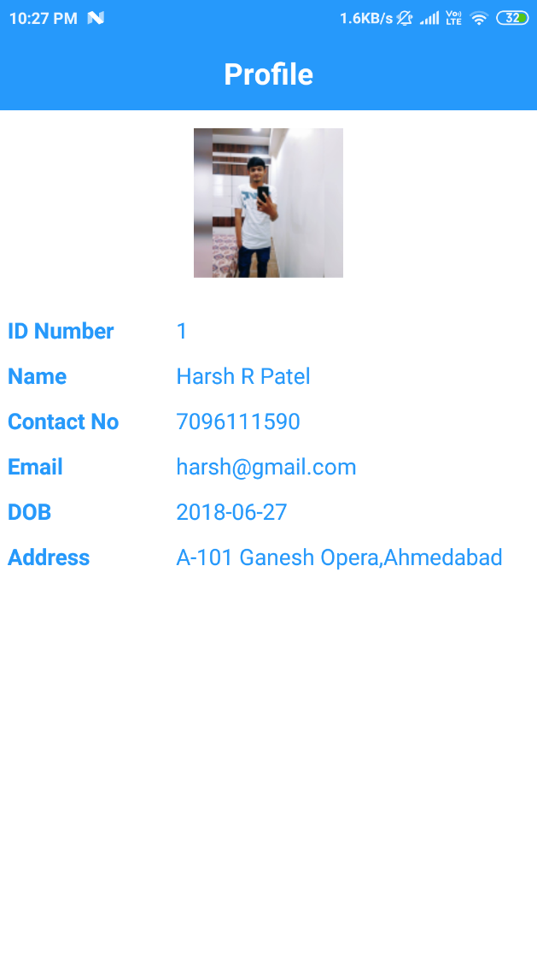
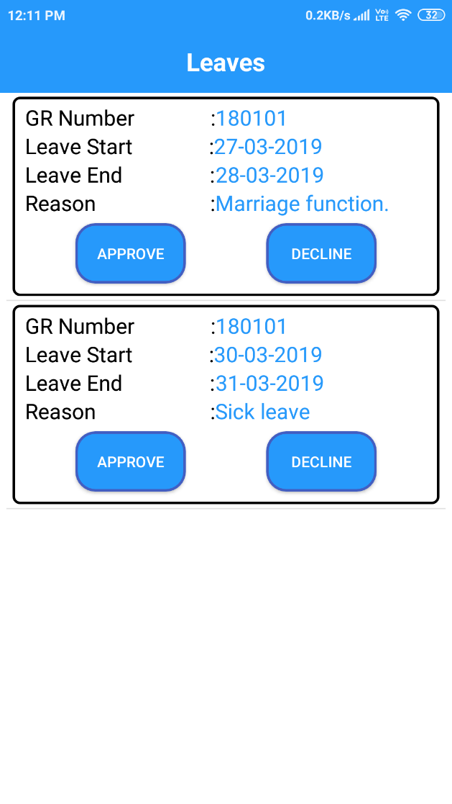
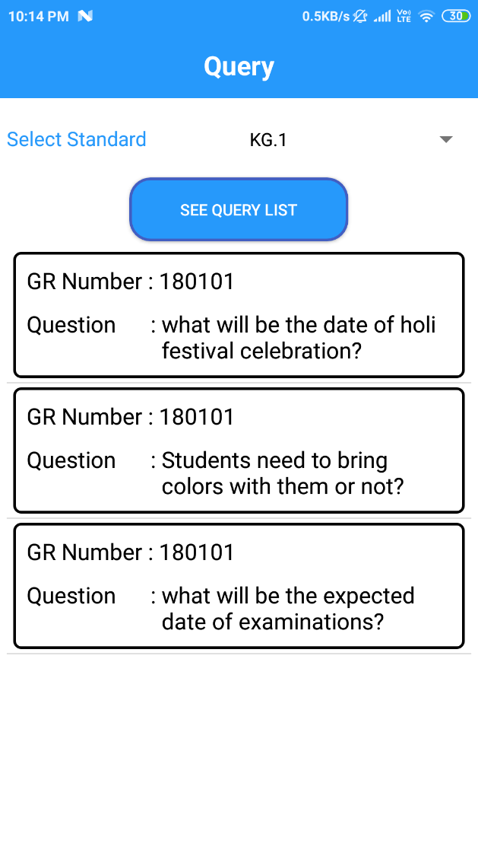
Prototype

Slide 13
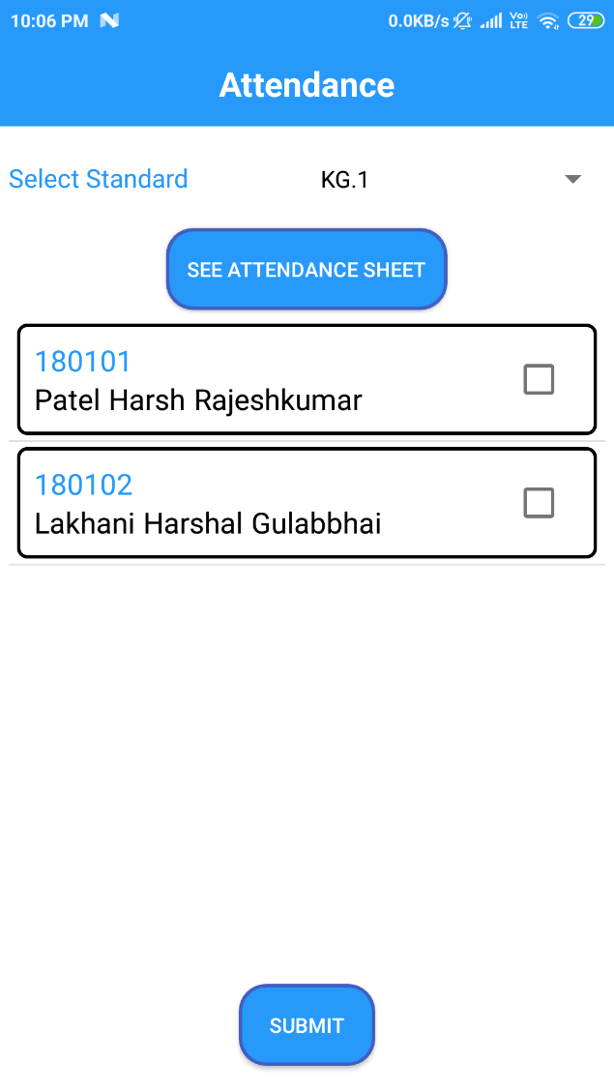
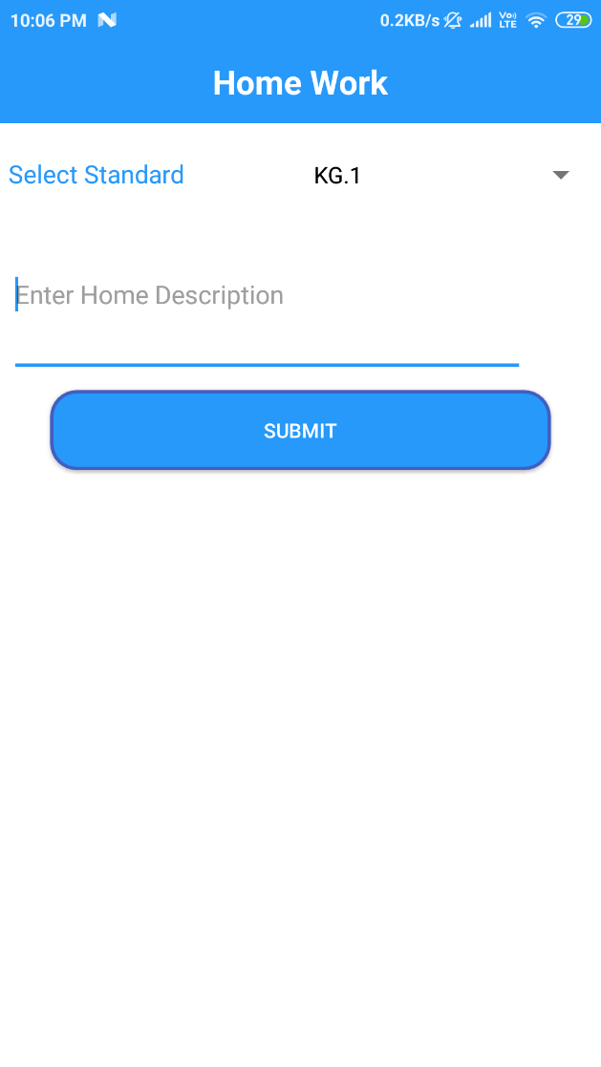
Prototype

Slide 14
Future Work
Implementation of online fees payment could be possible by use of payment gateway API.

Slide 15
List of References
https://developer.android.com/
https://stackoverflow.com/
https://github.com/
https://www.youtube.com/
https://www.w3schools.com/java/
https://www.tutorialspoint.com/

