Slide 1
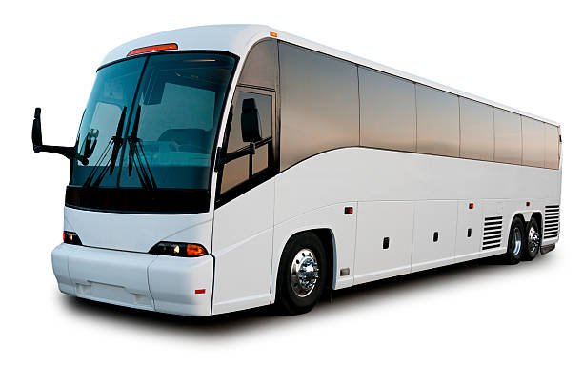
Online Bus Ticket
Reservation
System
MyTicket.com

Slide 2
Harsh Ponia
Team Members
Ayush Yadav
Deepak Kushwah
Prachi Chaudhary
Gautam Singh

Slide 3
Abstract
Introduction
Content
Project Design
Project Analysis
Alternative Solution Analysis
Project Progress Evaluation
Future Scope

Slide 4
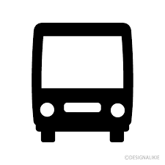

Abstract
The Online Bus Ticket Reservation System is a web-based application that allow
visitors check Bus ticket availability, book bus ticket.
This system is established for all the home/office users after gaining access
from the administrator.

Slide 5
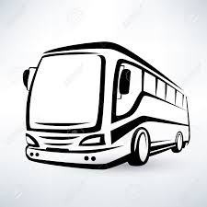
Introduction
Online Bus Reservation System is a Web based application that works on a centralized network . This system is basically for the reservation of confirm seats in the bus.
The main aim of this project is to resolve the problem which is faced by the user in their daily life , so this system will help the users to book their ticket in more efficient way .

Slide 6
Project Analysis
Objective:
Easy and Secure online Ticket Booking
Problem:
Customer have to book the tickets by standing in a row after multiple hours ,sometime they were not able to get the ticket after waiting for long time . This process leads to wastage of time.
Solution:
Work on an online Ticket Booking System which is fully secure.

Slide 7
Alternative Solution Analysis for Online Bus Reservation System
PROBLEM STATEMENT:
The System that is being used by the staff at the counter currently is an internal system and just used to sell the bus ticket at the counter.
Customer has to go to the counter to buy bus ticket or ask for bus schedule.
Futhermore , customers need to pay cash when the buy the bus ticket and sometimes needs to queue up long time to get the bus ticket. Besides that, customer also not allowed to buy ticket through telephone and the bus company’s has been always- busy line.

Slide 8
PROPOSED SOLUTION
The solution to this problem is to create an online portal for buying bus ticket system.
Customer can buy the bus ticket over the Internet, 24 hours a day,7days a week and the bus left behind.
In addition, the online system lets the customers check the availability of the bus ticket before they buy bus ticket.

Slide 9
OBJECTIVES
The main objectives of the online system include:
To provide a web-based bus ticket buying functions. Customer can buy bus ticket the Online system and no need to queue up to buy bus ticket at the counter.
To enable customer to check the availability of the us ticket online. Customer can check the time departure and arrival for every Transnational’s bus through the system.
To ease the bus ticket payment by online. Customer has to pay the bus ticket through credit/debit cards.
To reduce the number of staff at the point of sale. The number of staff at the counter can be reduced after the online buying bus ticket system launch.

Slide 10

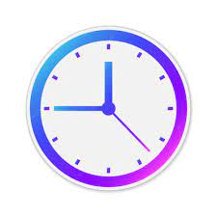

Analyzing the cost of the solution
Cost : No Cost the project is hosted on Github.
Time to Develop : 40 hours
Time to Delpoy : 5minutes

Slide 11
Project Design System Overview
Register
Confirm Payment
login
Print Ticket
Check Buses
Logout
User
Fill Information
Reserve Seat

Slide 12
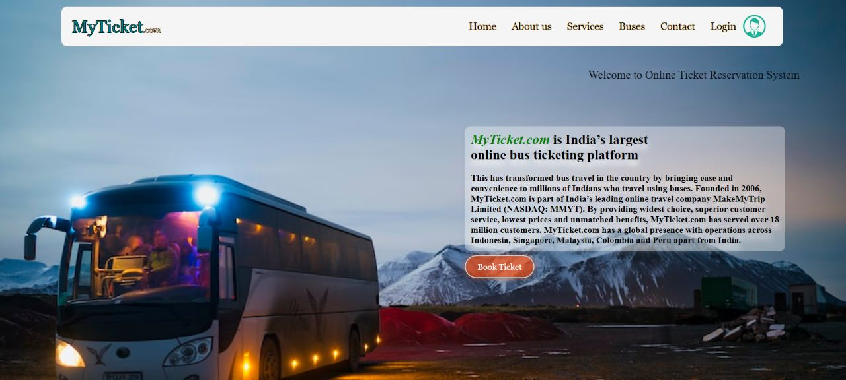
Home Page:

Slide 13
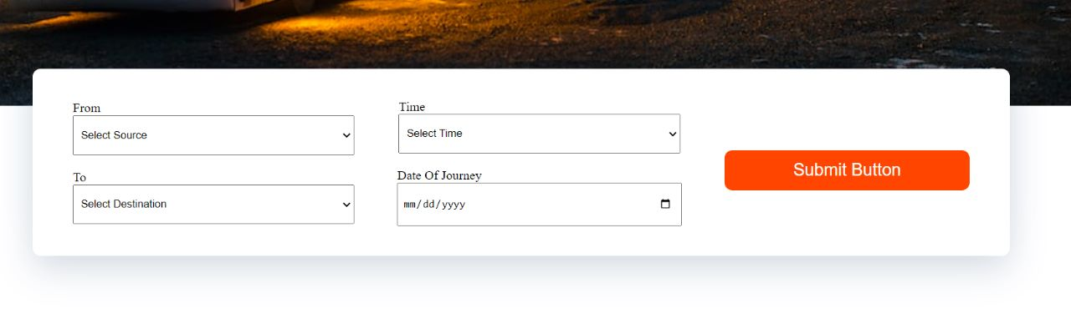
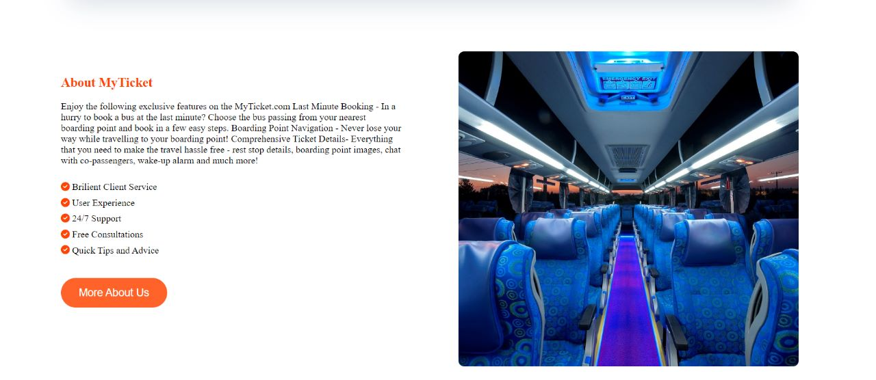

Slide 14
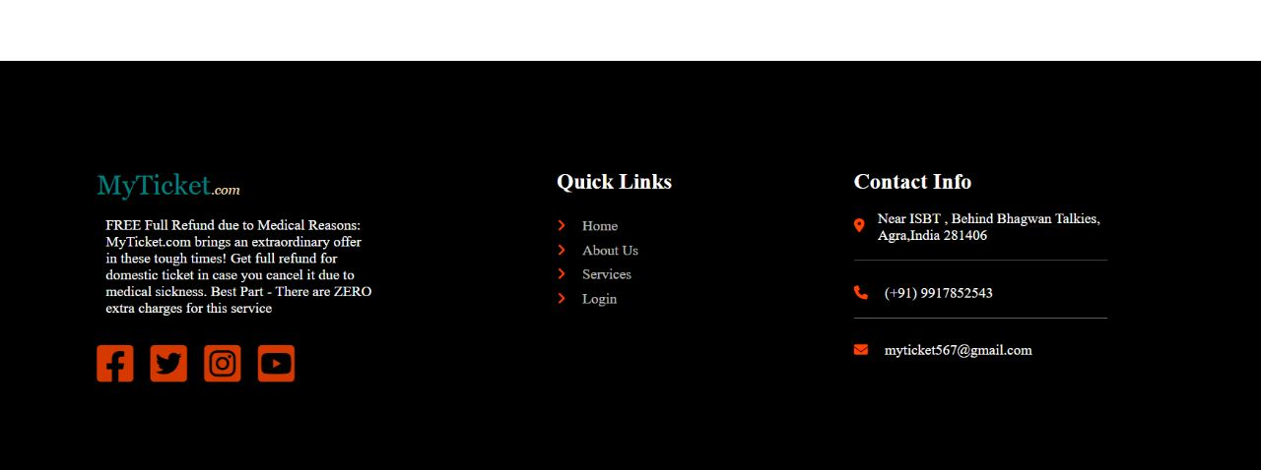

Slide 15
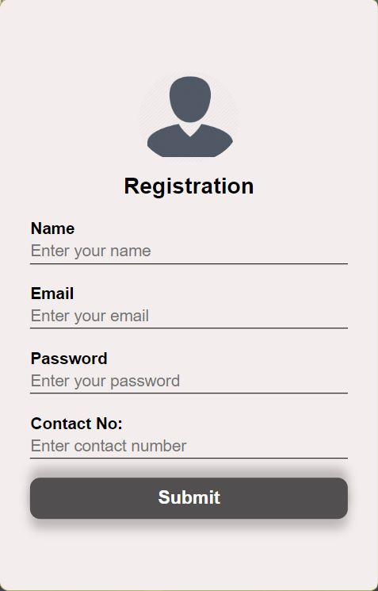
Online Bus Reservation Form
Any users can create an account by registering. The system will validate the user email and will reject them if they are missing or if the user email is already taken.
Customer fill all the details and clicks register.
System validates email and password fields.
System authorizes the user and create his account.
System confirms customer with email and phone authentication.
System sends confirming email to customer.

Slide 16
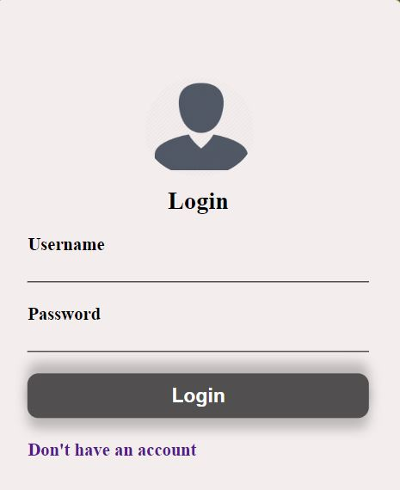
Login page
Login Page consist of username and password.
Customer have to give username and password to login.
System validates the details.

Slide 17
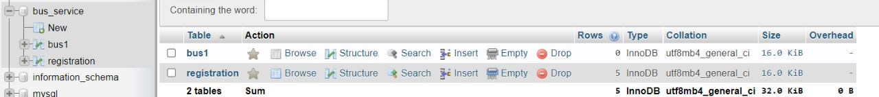
XAMPP Database

Slide 18
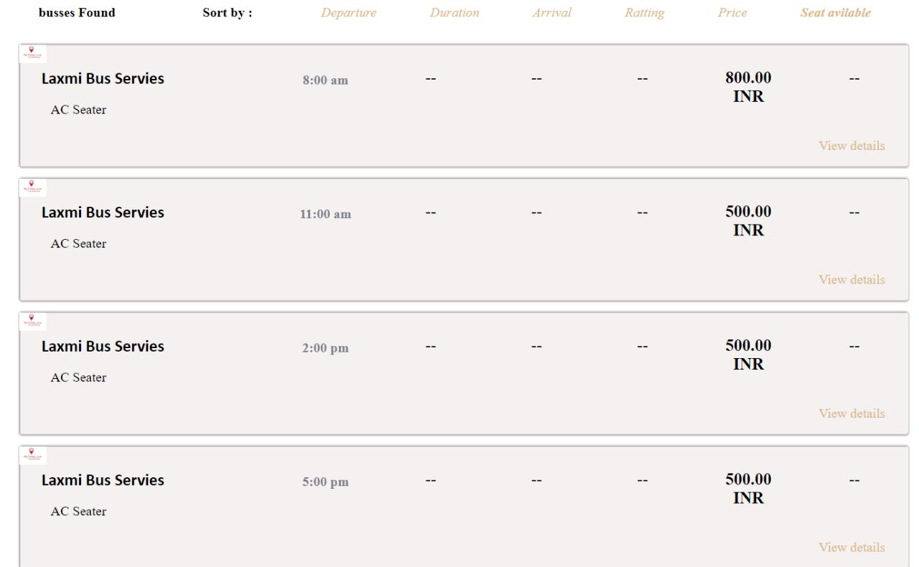
Bus Select:

Slide 19
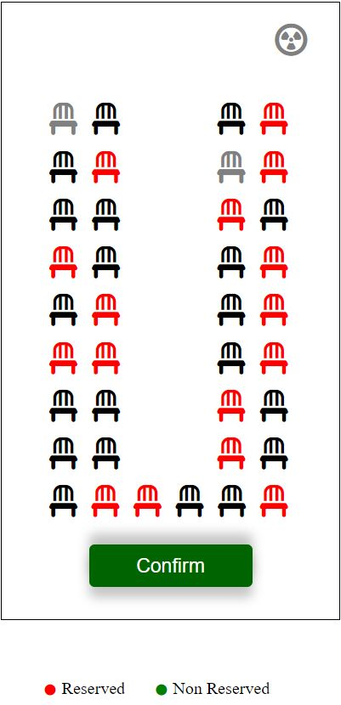
Availability of the Seats
As shows in figure there are

Slide 20
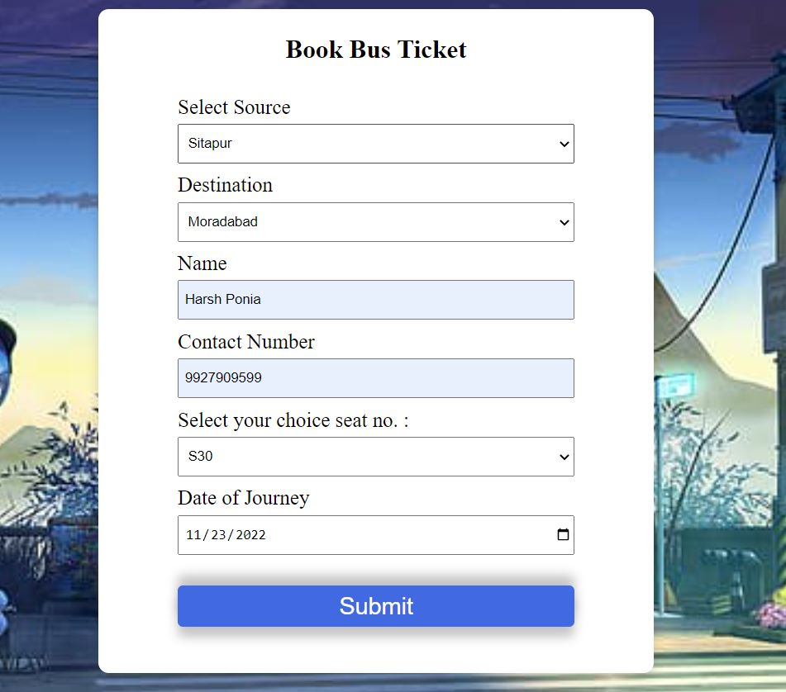
Information Form:

Slide 21
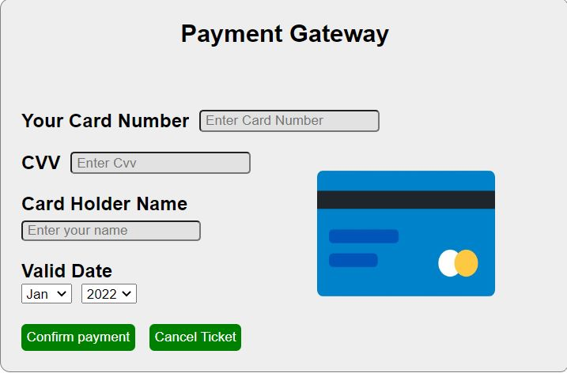
Payment and Cancel tickets

Slide 22
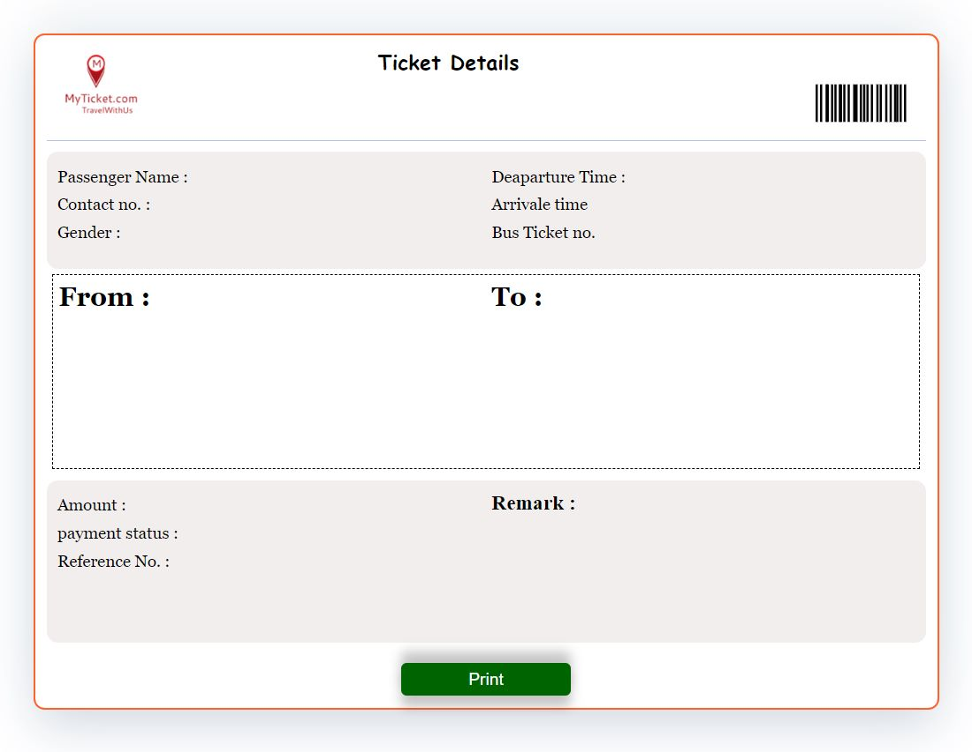
Ticket:

Slide 23
Programming Languages Used
Html5:Html stands for Hypertext Mark-up Language . It used for mainly to display text code as well as formatting these texts.
CSS: CSS stand for Cascading Style sheets. This is a very powerful language for formatting the web pages and has been of great help in my project.
Java scripts: Java scripts played a very crucial role in adding some functionalities to my system . These included sliding images, a features which is much clear in the system’s homepage.
PHP: is used for the backend .It is a powerful programming language as it can be used in web development as well as developing mobile device applications.
SQL: This an abbreviation which stands for Structured Query language .It used SQL as the language to connect the PHP code to the database as well as executing the various queries.

Slide 24
Future Plans
I would like to say that my system did not capture everything that would be required and would therefore recommend for future improvement on the following:
A features to allow the admin message the clients within the system.
Features to enable clients give their feedback and suggestions.
Integrating the system with Apple pay for customers to make payments using the system.
Implementation tracking system for the clients to track the bus.

Slide 25
Additional Future Plans
Projects gateway integration
Notification system
Chat functionality
Coupon management

Slide 26
Conclusion
It can be observed that computer application are very important in every field of human endevaour. Here all the information about customer that made reservation can be gotten just by clicking system are overcome.
It will also reduce the workload of the staff, reduce the time used for making reservation at the bus terminal and increase efficiency.

Slide 27
The application also can update records in various files automatically thereby relieving the company’s staff the stress of working from file security of data.
This project will give a new way in bus reservation and ticketing process. The automation and management of seats and reservation will be done online. However , this project does not limit the walk-in passengers that is passenger who visit the company’s counter because it also caters for them.
This also lessens the use of papers like in the traditional way of ticketing.

Slide 28
Thank You

