Slide 1
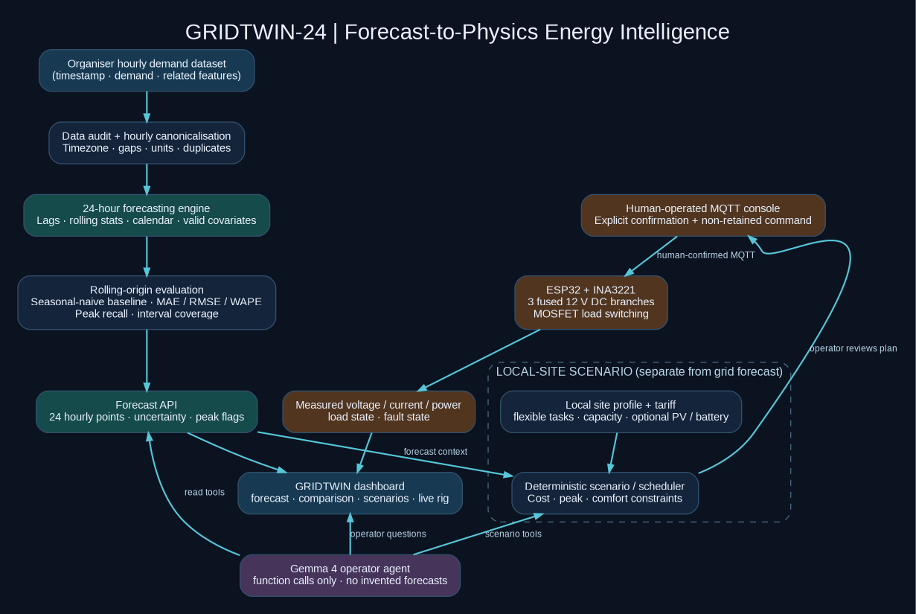
TOMORROW’S LOAD / TIME SERIES
GRIDTWIN-24
Forecast-to-Physics Energy Intelligence
Tomorrow’s demand. Today’s decisions.
24-hour forecast → PV / battery scenarios → 12 V DC bench validation path
Open-source • Gemma 4 operator • 12 V DC bench design
Working project name — trademark/domain check pending

Slide 2
01 / THE OFFICIAL PROBLEM
02
Tomorrow’s load is not just a chart
The organisers ask for the next 24 hourly demand values and a forecast-vs-actual view.
Forecast 24 hours
Evaluate honestly
Make it actionable
Predict one complete next-day hourly demand profile from past demand and related data.
Compare against actuals using time-respecting rolling-origin evaluation and a seasonal baseline.
Show peak windows, uncertainty where calibrated, and explain the operational implications.
Core rule
The provided dataset and the official 24-hour forecasting task remain the product’s source of truth. The hardware, scheduler and Gemma agent are extensions — never substitutes.
Source: official Hacktoberfest Hack Day Lucknow problem-statement PDF, page 3.

Slide 3
02 / PRODUCT VISION
03
Close the loop between prediction and action
Forecast → scenario → approval → measured response.
01
02
03
04
PREDICT
→
UNDERSTAND
→
SIMULATE
→
VALIDATE
24-hour demand curve and peak flags
Uncertainty, drivers and evidence
Tariff, capacity and flexible-load scenarios
Measure the response on a safe physical DC bench
The physical rig is a development testbed, not a real grid emulator or a mains controller.

Slide 4
03 / WHO BENEFITS
04
Energy affects everyone; sell first to someone who can act
Start with a facility manager, not “every consumer” as the first customer.
Hostels & campuses
Apartments & clinics
Small commercial
Multiple buildings, pumps, HVAC, kitchens and a facilities owner who can test a plan.
Shared loads, common-area energy, pumps and operating schedules.
Hotels, co-working, retail and workshops with repeated energy bills.
The product should answer
“What will our demand look like tomorrow, which hours need attention, and what can we safely move?”
Household edition comes later, once data access, meter integrations and the value proposition are validated.

Slide 5
04 / ARCHITECTURE
05
One system, three bounded layers
Forecasting, decision logic and language interface stay separate.

Slide 6
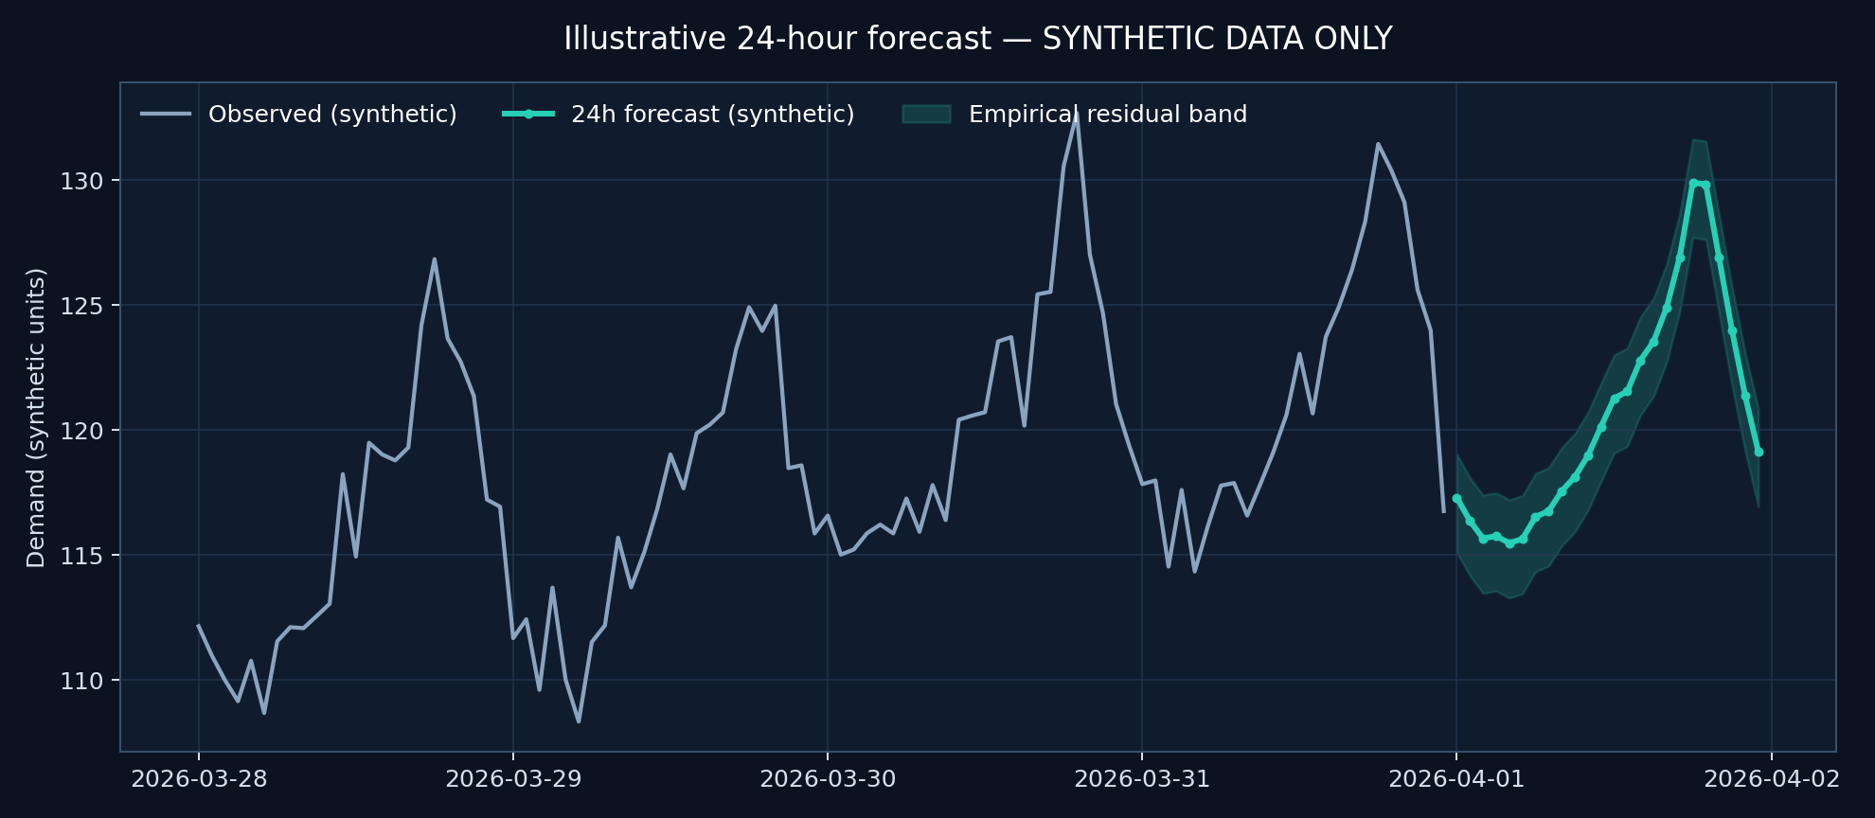
05 / SCIENTIFIC CREDIBILITY
06
A forecast only counts if it survives a fair test
No random row split. No future leakage. No interval without calibration.
Benchmark first
Seasonal-naive baseline; retain it if the ML model fails to beat it.
Rolling origin
Each test forecast sees only the history available at that forecast time.
Honest uncertainty
Show empirical bands only when calibration residuals support them.
Important: this plotted series is synthetic smoke-test data, not the organiser dataset or a claimed result.

Slide 7
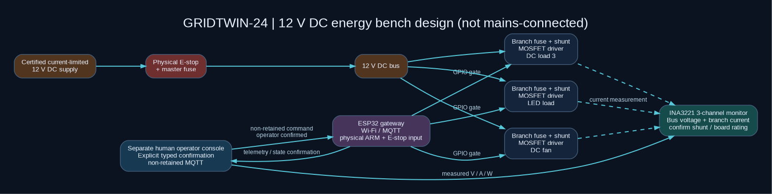
06 / PHYSICAL DEMONSTRATOR
07
A 12 V DC energy bench designed for safe measurement
12 V DC only • three loads • physical E-stop • local ARM interlock.
Controller
ESP32 DevKit + Wi-Fi / MQTT telemetry.
Measurement
INA3221: 3-channel voltage/current monitoring; check exact shunt limits.
Actuation
Fused DC branches + logic MOSFET drivers + physical E-stop and ARM switch.
No AC mains. No building wiring. Commercial control requires certified devices and qualified installation.

Slide 8
07 / GEMMA 4
08
The agent operates tools; it does not invent the physics
Native function calling turns an operator question into a verifiable workflow.
Ask in natural language
Call deterministic tools
Return grounded answer
“Why is tomorrow’s peak at 19:00? Move the demo pump without crossing the capacity limit.”
get_forecast()
explain_peak()
run_load_shift_scenario()
get_live_telemetry()
Numbers come from Python. Tool outputs are logged. Hardware changes require confirmation and interlocks.
Gemma 4 supports image / multimodal inputs and function calling; the application must validate and execute tool calls safely.
Model reference: official Google AI for Developers Gemma 4 model card and function-calling guide.

Slide 9
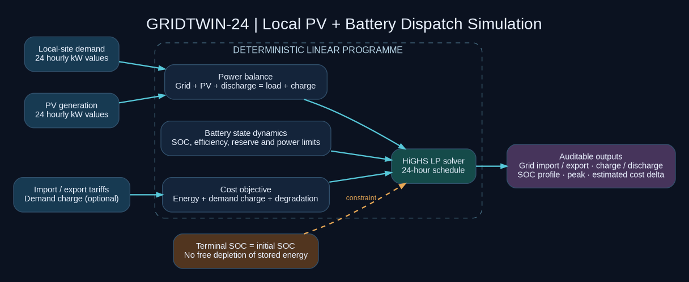
08 / ENERGY DECISION ENGINE
09
Optimise the energy system, not just the next-day curve
A constrained LP models energy balance, battery SOC and real operating limits.
Physical constraints
Charge / discharge power, SOC reserve, efficiencies and grid import cap.
Economic objective
Import / export tariff, battery degradation and optional peak-demand charge.
No free energy
Terminal battery SOC is forced back to its starting level in the 24-hour simulation.
Simulation only: does not control a real battery and does not claim measured savings.

Slide 10
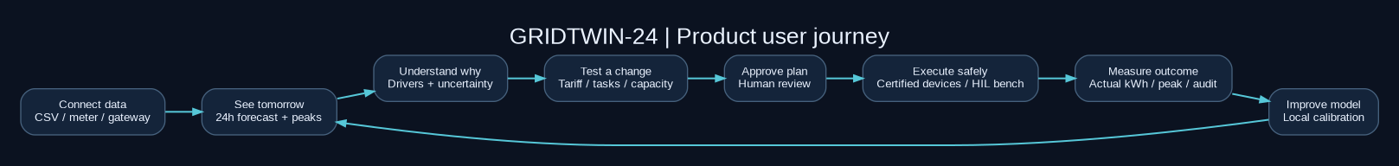
09 / USER JOURNEY
09
From “what happens tomorrow?” to measured action
A product loop customers can use every day.
Read-only first
Automation later
Upload bill / interval data; receive forecast, peak report and scenario.
Only after paid pilot, approved meter access and certified control equipment.

Slide 11
10 / BUSINESS MODEL
10
Start narrow, prove ROI, then expand
Software-first B2B beats selling hardware before product-market fit.
Pilot buyer
Recurring value
Revenue path
Campus / hostel / apartment operator with interval data and a facilities owner.
Peak forecasts, weekly reports, scenario decisions and multi-site comparisons.
Per-site SaaS → paid commissioning → gateway / integrations → multi-site contracts.
The ROI test
Baseline meter data → agreed intervention → measured kWh / peak / cost → operational impact check.
No savings percentage should be claimed before a real site pilot.

Slide 12
11 / COMPETITIVE REALITY
11
Energy dashboards already exist. We must be more specific.
Do not claim that forecasting, digital twins or HIL are globally unprecedented.
Existing landscape
Our wedge to test
What becomes defensible
Home Assistant, commercial building-energy platforms and microgrid digital-twin research already cover adjacent capabilities.
Vendor-neutral, low-cost forecasting + constrained scenarios + measured low-voltage validation for smaller multi-building sites.
Real site integrations, forecast calibration, workflow adoption, measured outcomes and trusted deployment.
If a customer cannot share data or identify a recurring decision, do not build a custom hardware product for them.

Slide 13
12 / RED-TEAM REVIEW
12
The project is ambitious, but its claims must stay bounded
These are the conditions that prevent a good demo from becoming a bad product.
Data mismatch
Leakage
Audit timestamp, unit, cadence and timezone.
Rolling-origin 24-hour evaluation; no random split.
False intervals
Grid/site mismatch
Calibrate and report coverage, or withhold them.
Keep challenge grid series separate from local site profile.
Unsafe control
No market proof
12 V DC bench, fuse, E-stop, physical ARM, fail OFF.
Paid read-only pilot before field hardware.

Slide 14
13 / EXECUTION
13
Build the forecast first. Hardware is the final act.
A disciplined order keeps the required problem statement complete.
P0
DATA + MODEL
Dataset audit, baseline, rolling evaluation, 24 outputs
P1
DASHBOARD
Forecast vs actual, peak windows, explanation and interval
P2
AGENT
Gemma 4 tool calling over tested functions
P3
HIL
ESP32 + INA3221 + 12 V fused DC energy bench

Slide 15
GRIDTWIN-24
Forecast → Decide → Measure
We are not building another energy dashboard. We are building a testable path from tomorrow’s demand forecast to a safer, more informed operating decision.
NEXT STEP
Run on the real organiser dataset. Then secure one read-only campus / hostel pilot.
GRIDTWIN-24 • working name

Slide 16
APPENDIX / REFERENCES
16
Technical sources and limitations
Use these to ground architecture choices; re-check model and component docs before build.
Official problem statement: Hacktoberfest Hack Day Lucknow PDF, page 3 — Tomorrow’s Load.
Gemma 4 model card: ai.google.dev/gemma/docs/core/model_card_4
Gemma 4 function calling: ai.google.dev/gemma/docs/capabilities/text/function-calling-gemma4
TI INA3221: ti.com/product/INA3221 — 0–26 V, 3-channel monitor; current depends on shunts.
Adafruit INA3221 Arduino library: github.com/adafruit/Adafruit_INA3221
Energy digital-twin context: Computers and Electrical Engineering, June 2026, DOI 10.1016/j.compeleceng.2026.111100
Home Assistant energy docs: home-assistant.io/docs/energy/; Schneider EcoStruxure Building Energy Management.
Synthetic demo data is not organiser data. No measured savings or real-grid control claims are made.

