Slide 1

Problem Statement Title: Develop an automated platform that monitors nirf ranking changes and recommendations for improvement based on comparative analysis Team Name: BotBrigade Team Leader: Abhishek Sharma Team Member: Gurudayal Maurya Team Member: Harsh Chauhan Team Member: Anurag Kumar
Basic Details of the Team and Problem Statement

Slide 2
Idea Explanation
Our task is to predict and suggest how NIRF ranking of institutions can be improved so for this we first discovered about the factors on which it depends that are Teaching Learning and Resources , Research and publications , Graduation outcomes , Outreach and inceptibilities and Perception.so we decide to make machin learning models for the predictions and suggestions and then make a web platform with good user interface for the application of model.

Slide 3
Solution
Our solution consist of the following steps:
Make two models one for predictions and one for suggestions using ml algorithms which i have done using random forest
Then for suggestions our model gives us value of TLR , RP , GO , OI , PERCEPTION after that we made some json files using content based filtering which contains practical description of quantitative values of these factors .
And after that we have displayed the description of these factors for suggestions according to the values predicted by our model for a required rank.

Slide 4
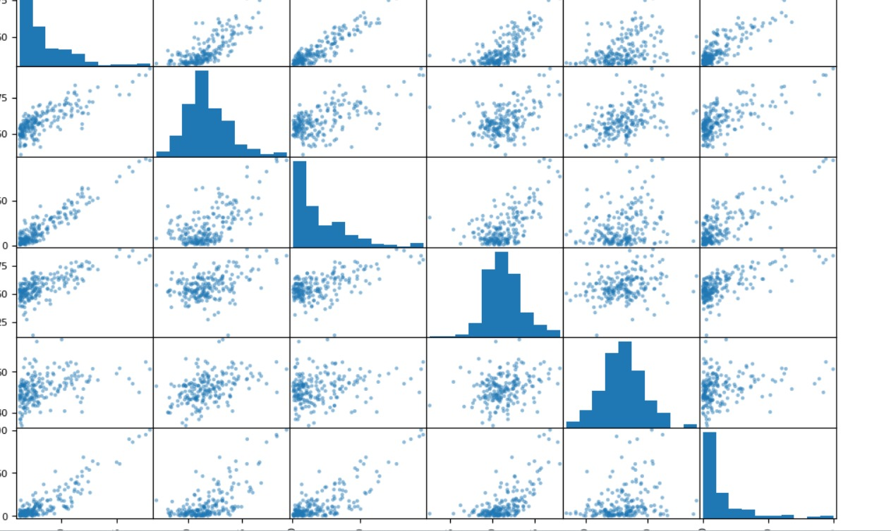
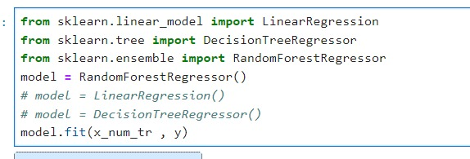
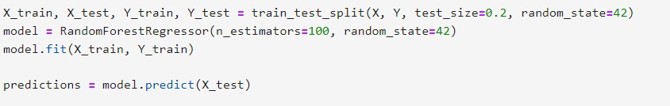
Graph & Model

Slide 5
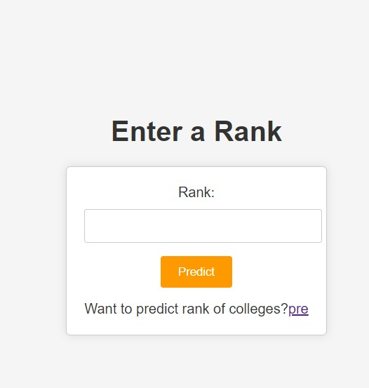
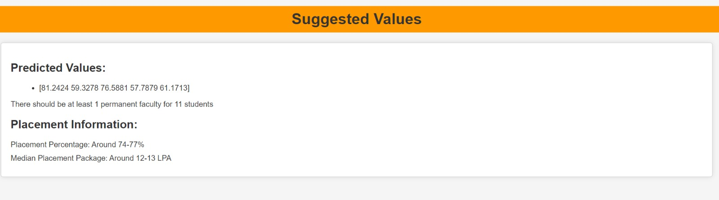
Conclusion
Finally after all the implementations our project predicts the factor's values and suggest institution on the basis of the values.These are some screenshots of our project.
.

Slide 6
Thank You

